Slide 1
Medical domain (ICPS)
Asunción Gómez Pérez
asun@fi.upm.es
ETSI Informaticos
Universidad Politécnica de Madrid
Campus de Montegancedo s/n
28660 Boadilla del Monte, Madrid, Spain
Participants: María Poveda Villalón, Elena Montiel Ponsoda, Mari Carmen Suárez de Figueroa Baonza

Slide 2
Collaboration with World Health Organization
ICPS: International Classification for Patient Safety
To transform the ICPS into an ontology network
From ontology specification to implementation
Specific domains:
Falls
Pressure ulcer
Reuse:
Ontological resources
Non-Ontological resources
No public results

Slide 3
Domains and resources analysis

Slide 4
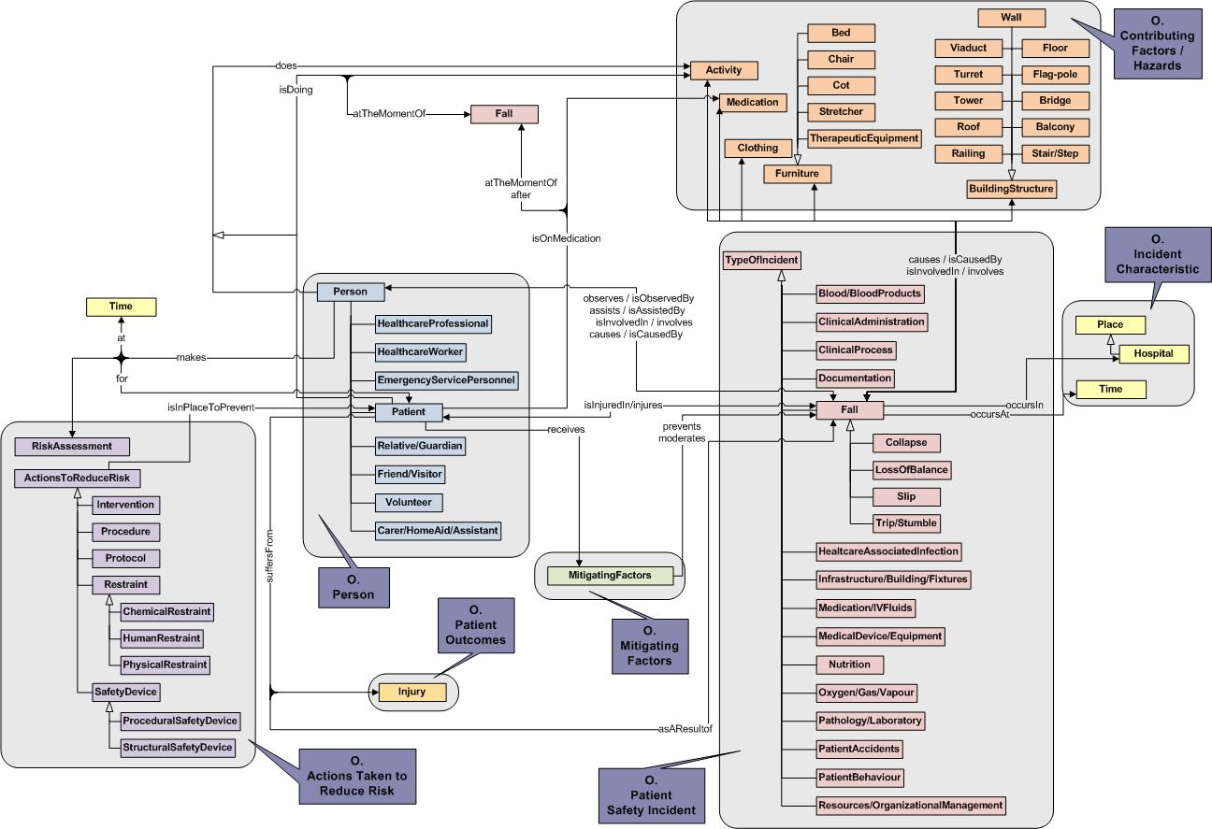
High level conceptual model

