Slide 1
Semantic Licensing
Víctor Rodríguez-Doncel
Subset of ¿?
Ontology Engineering Group
Universidad Politécnica de Madrid

Slide 2

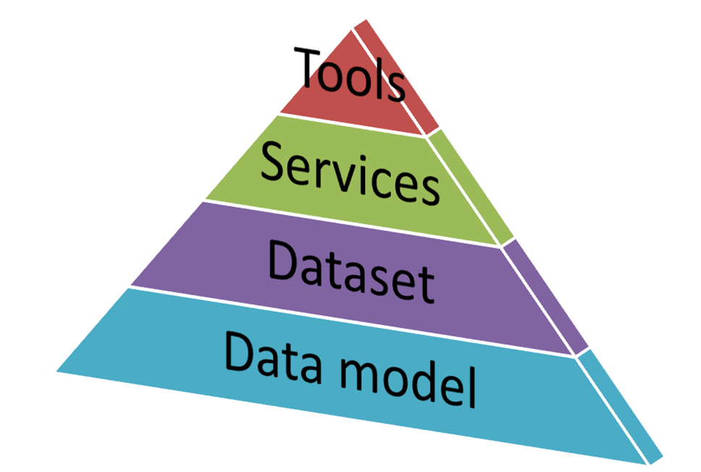

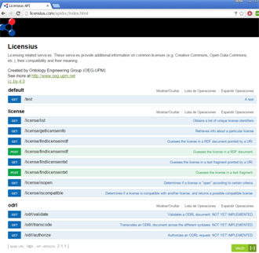
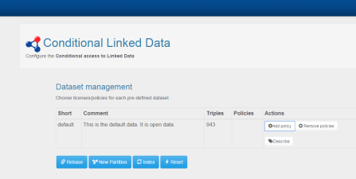

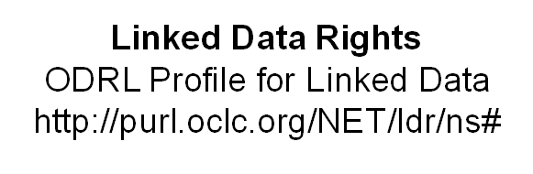

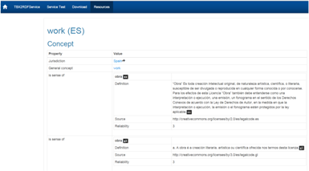
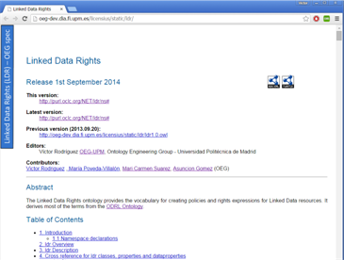
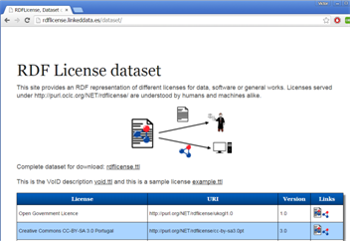
Support for licensing with semantic technologies
http://www.licensius.com

Slide 3


Projects
Juan de la Cierva research grant (2012-2015)
Juan de la Cierva research grant (2016-2018)
Activity transversal to other projects

Slide 4


Results
Edition of W3C Specifications
Editor of the ODRL 2.1 Ontology. W3C ODRL Community Group spec)
Editor of the W3C Recommendation on ODRL Vocabulary & Expression (WD)
Edition of ISO/IEC Standards
ISO/IEC 21000-20, Information Technology - Multimedia framework - Part 20: Contract Expression Language (2013 spec)

