Slide 1
MONNET
Multilingual Ontologies for Networked Knowledge
Small or medium-scale focused research project (STREP) ICT Call 4 (FP7-ICT-2009-4)
Starting date: March 1st, 2010
PARTICIPANTS
1. National University of Ireland, Galway NUIG Ireland
2. DFKI, Germany
3. Universität Bielefeld, Germany
4. Universidad Politécnica de Madrid, Spain
5. SAP AG, Germany
6. XBRL Europe, Belgium
7. Be Informed, the Netherlands
Speaker: Elena Montiel-Ponsoda
Date: January 12th, 2010

Slide 2
Main Objective
The Monnet project will provide a semantics-based solution for integrated information access across language barriers.
A key solution to this problem is to deal with information at the semantic level, allowing for more advanced and uniform:
  i) integration,
  ii) aggregation,
  iii) querying, and
  iv) presentation of information across languages
<<EVERIS, January 12th, 2010>>

Slide 3
Solution Building Blocks
An integrated Ontology-Lexicon Model that allows for associating linguistic information with ontologies to permit flexibly moving back and forth between languages in information extraction, integration and presentation.
Multilingual Ontology Localisation services that allow for the automatic localisation of an ontology
Cross-lingual Ontology-based Information Extraction techniques for the extraction of information from documents and (semi-)structured data across languages, including semantic-level integration and representation in the ontology
Multilingual Knowledge Access and Visualisation techniques based on structured information presentation (rather than full text generation), quickly customizable to different languages
<<EVERIS, January 12th, 2010>>

Slide 4
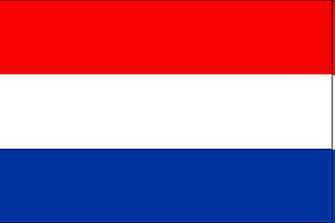


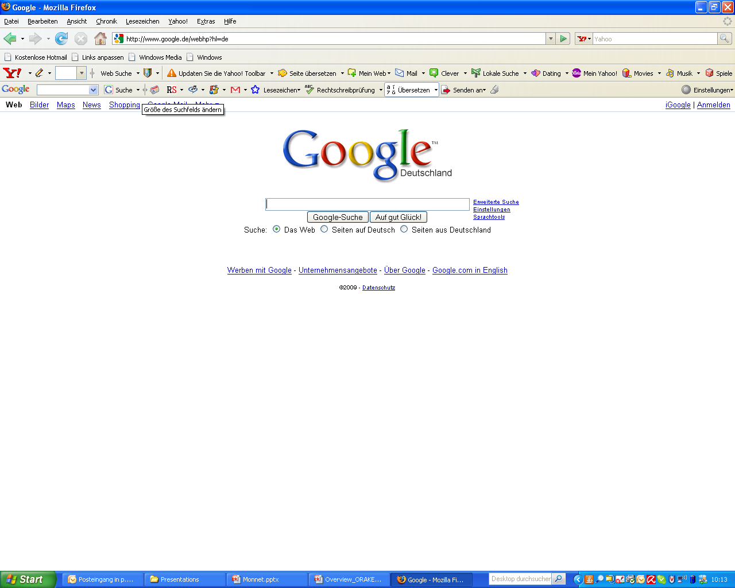


High-level Overview of Monnet Architecture
Multilingual Knowledge
Access & Visualization
Ontology
Localization
1
3
DB
Knowledge Base
Cross-language
Ontology- based Information
Extraction
Web
2
Legend:
Input
Output
<<EVERIS, January 12th, 2010>>

