Slide 1

Ontology Localization
Mauricio Espinoza, Elena Montiel-Ponsoda,
Guadalupe Aguado de Cea, and Asunción Gómez-Pérez
Ontology Engineering Group – Dpto. de Inteligencia Artificial
Facultad de Informática
Universidad Politécnica de Madrid
Campus de Montegancedo s/n
28660 Boadilla del Monte, Madrid, Spain
http://www.oeg-upm.net
{jespinoza, emontiel, lupe, asun}@fi.upm.es
Phone: 34.91.3363670
Fax: 34.91.3524819
Speaker: Elena Montiel-Ponsoda
Date: January 12th, 2010

Slide 2
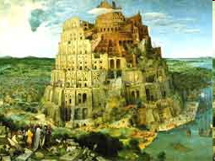
The need for multilingual ontologies
Most of the ontologies build so far have English or another natural language as the basis
Multilinguality is nowadays demanded by international organizations that have to manage information in several natural languages
Ontology-based systems have to be build for different multilingual applications, such as: indexing, information retrieval, question answering, knowledge management…
HOWEVER, multilingual ontology building is time consuming and cost intensive
NEED FOR METHODS AND TOOLS TO LOCALIZE ONTOLOGIES!!
<<EVERIS, January 12th, 2010>>

Slide 3
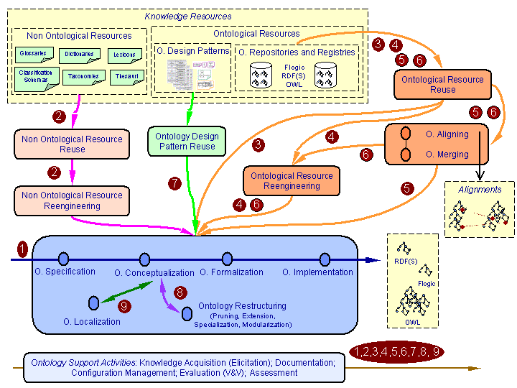

How to address the need?
Ontology Localization: activity in the NeOn Methodology* for building ontology networks defined as “the adaptation of an ontology to a particular language and culture” (inspired by Software Localization).
Express ontology labels
in a natural language
different from the one in
which the ontology has
been conceived
*NeOn Project. Deliverable 5.4.1 (2008). In http://www.neon-project.org
<<EVERIS, January 12th, 2010>>

Slide 4
Characterization of the Ontology Localization Problem
Ontology
Localization
Problem
Translation Problem
Multilinguality Representation Problem
<<EVERIS, January 12th, 2010>>

Slide 5
Translation Problem
Translation Problem
Existence of an exact equivalent
Existence of several context-dependent equivalents
Existence of a conceptualization mismatch
watercourse
curso de agua
swimming pool
piscina
alberca
Spain
Mexico
river
rivière
fleuve
<<EVERIS, January 12th, 2010>>

Slide 6
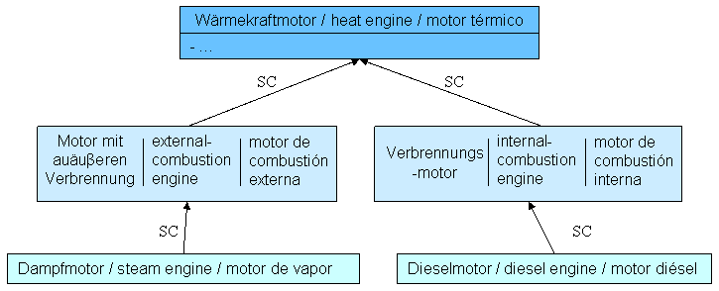
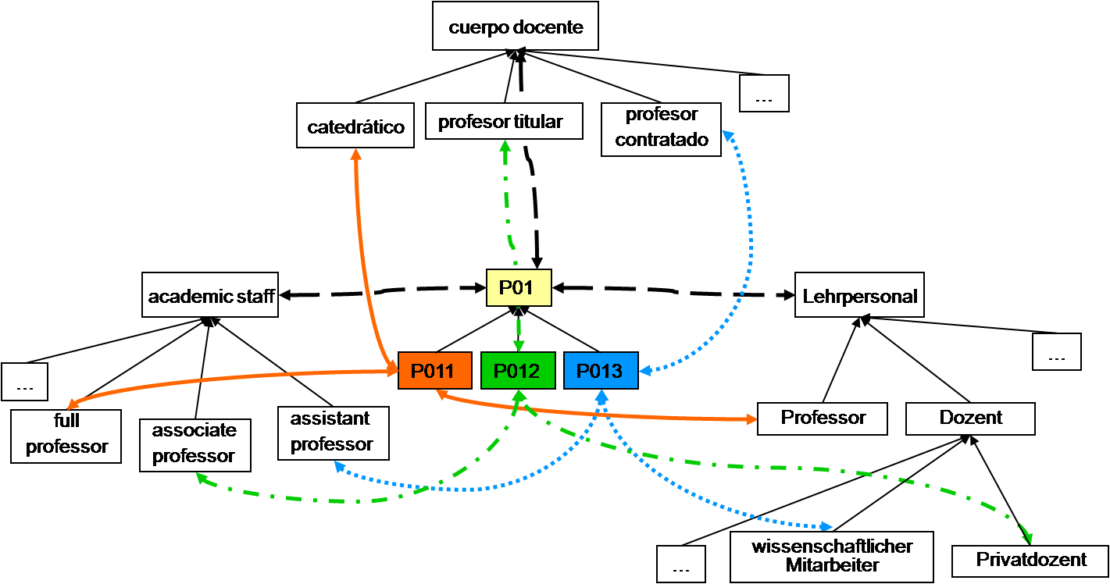
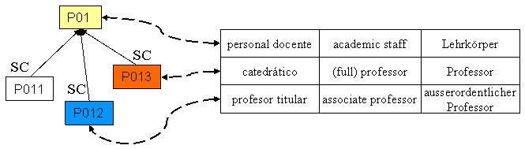
Multilingual Representation Problem
Multilinguality Representation Problem
Inclusion of multilingual information in the ontology (rdfs:label and rdfs:comment properties) – Model 1
One conceptualization per culture and language involved, and mappings establishment among conceptualizations – Model 2
Association of external multilingual model to the ontology – Model 3
<<EVERIS, January 12th, 2010>>

Slide 7
Choosing a multilinguality representation model
Multilinguality representation models
Type of domain of knowledge
Amount of linguistic information
Consensual domain
Culturally-dependant domain
Labels
Definitions Morpho-syntactic info
<<EVERIS, January 12th, 2010>>

Slide 8
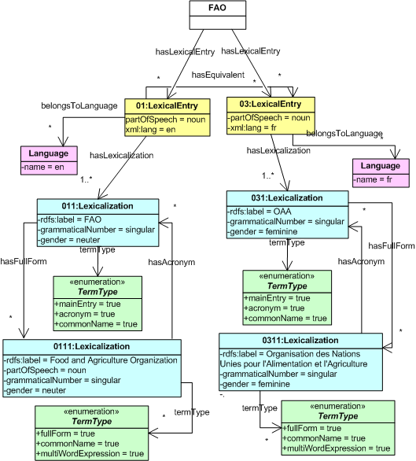
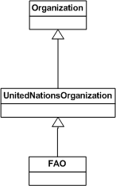
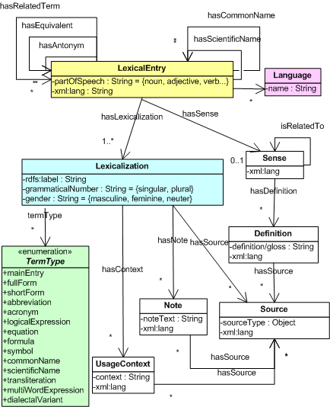
LIR Instantiation
LIR instantiation for
ontology class FAO
Ontology
LIR model
EN
FR
<<EVERIS, January 12th, 2010>>

Slide 9
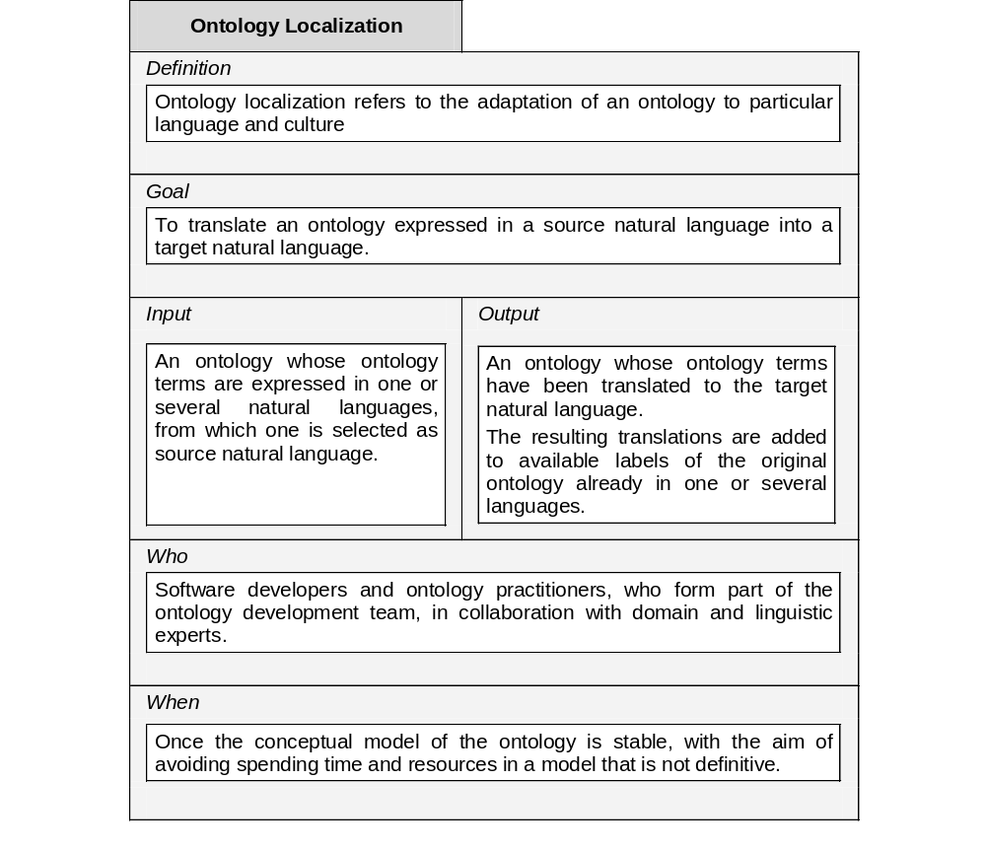
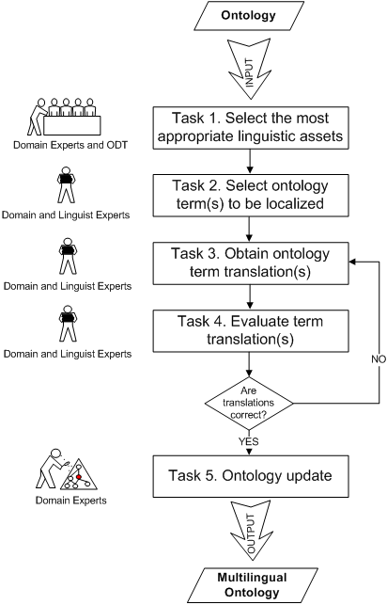
Proposed Guidelines for Ontology Localization
Suárez-Figueroa, M.C., et al. D5.4.2. Revision and Extension of the NeOn Methodology for Building Contextualized Ontology Networks. NeOn Project. 2009.
<<EVERIS, January 12th, 2010>>

Slide 10
Ontology Localization with LabelTranslator
Task 1: multilingual linguistic resources (EWN, Wiktionary, IATE) and translation web services (GoogleTranslate, BabelFish)
Task 2: selection can be manual or automatic (per default, all ontology labels are selected)
  The local context (direct hypernyms, hyponyms, siblings) of each ontology label is retrieved
Task 3: techniques used by LabelTranslator
  Cross-language term extraction accessing resources to discover translation equivalents
  Sense discovery technique accessing Watson and EWN (of selected and context labels)
  Word sense disambiguation
Task 4: in the current version, manually performed by the user
Task 5: resulting label translators stored in the LIR
<<EVERIS, January 12th, 2010>>

Slide 11
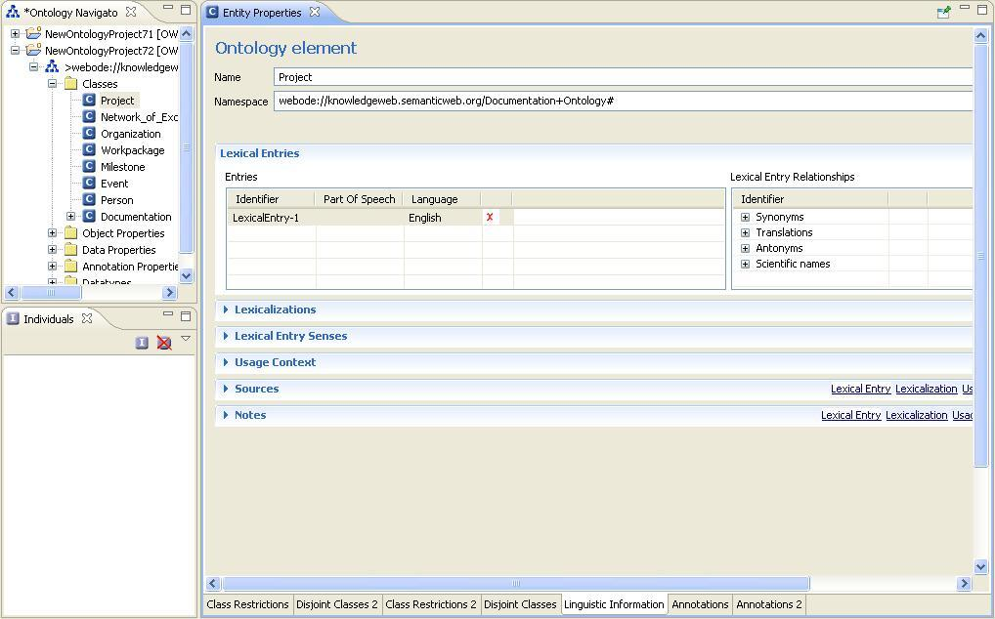
LabelTranslator NeOn plugin
<<EVERIS, January 12th, 2010>>

