Slide 1
ODESeW
Plataforma de desarrollo de aplicaciones con ontologías.
Aplicación: Gestión de proyectos Europeos

Slide 2
ODESeW
Index
ODESeW platform
Application ecReport

Slide 3
ODESeW
General Functionalities
  Ontology-based application that automatically generates and manages knowledge portals for intranets and extranets:
    Semantic Driven
    Permission-based
    User Oriented
    Interoperate
    Synchronization with the ontologies

Slide 4










ODESeW Layers
Semantic Driven
Portal Administrators
Ontologies and Software
Permission-based
User Oriented
search
OWL
RDF(S)
FEED
view
view
search
edit
permission
permission
permission
O₂
O₁
O_{i}
O_{j}
Extranet Users
Internal Users
Agents
External resources

Slide 5
ODESeW
Index
ODESeW platform
Application ecReport

Slide 6
EC R&D Project Reporting
European R&D Projects must report progress periodicaly.
Person involed:
  Managing Director
  One person per partner
  Editor
From the begining of the reporting period to the end, documents may change.

Slide 7



Reporting Workflow
Partners
3-10 PDay
Diss.
WP
Efforts
3-10 PDay
WP
1 PMonth
Efforts
Diss.
Diss.
3-10 PDay
3-10 PDay
Efforts
WP
Diss.
Editor
Managing Director
Efforts
3-10 PDay
WP

Slide 8
ecReport
A web application supported by 6 ontologies:
Documentation Ontology
Organization Ontology
Person Ontology
Project Ontology
Event Ontology
Project Management Ontology
A collaborative tool for editing the periodic reports
  Workpackage Progress Report
  Effort Report
  Dissemination Report
  E-Mail notification on starting periods or for delays
  Monitorization of the Reporting Period
  Compilation of partial reports into a complete report in MSWord format.

Slide 9
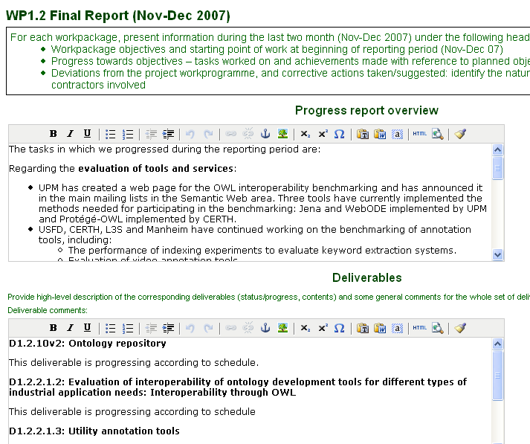
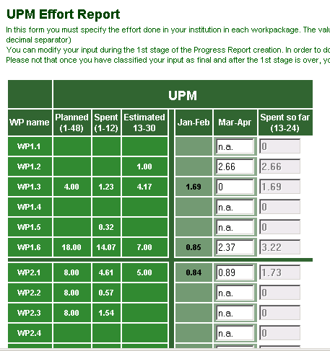
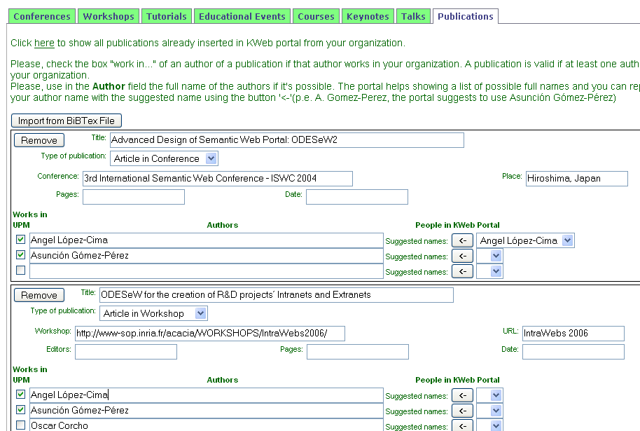
ecReport
Bimonthly Progress Report:
Partner Reporting
Progress Report
Effort Report
Dissemination Report

Slide 10

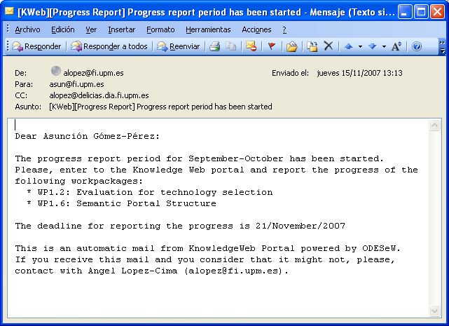
ecReport: E-Mail Notification
Starting notification of the reporting period
ecReport
The reporting period starts
WP Leaders
Partner
Current staus of WP reports: delays
WP Leaders
Manager Director
ecReport
A new stages of the reporting starts
Current staus of effort reports: delays
ecReport
A new stages of the reporting starts
Partner
Manager Director

Slide 11
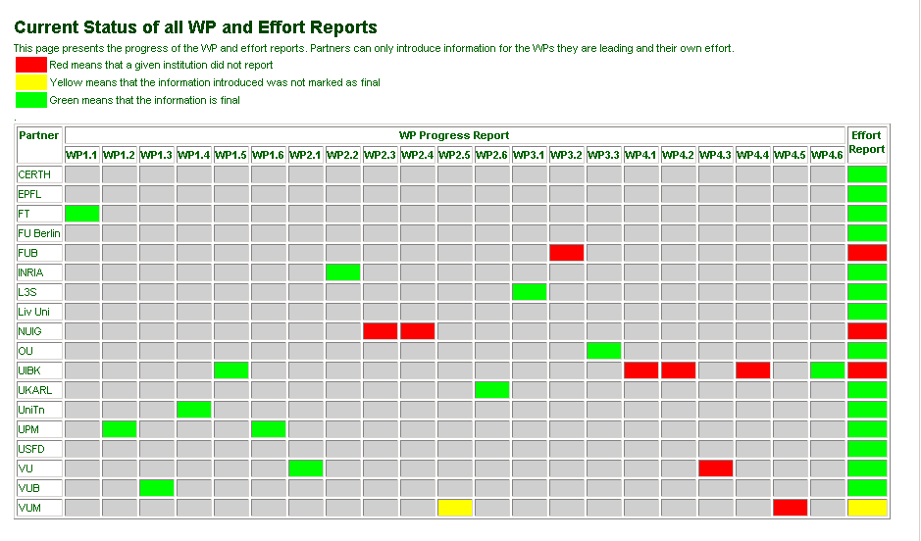
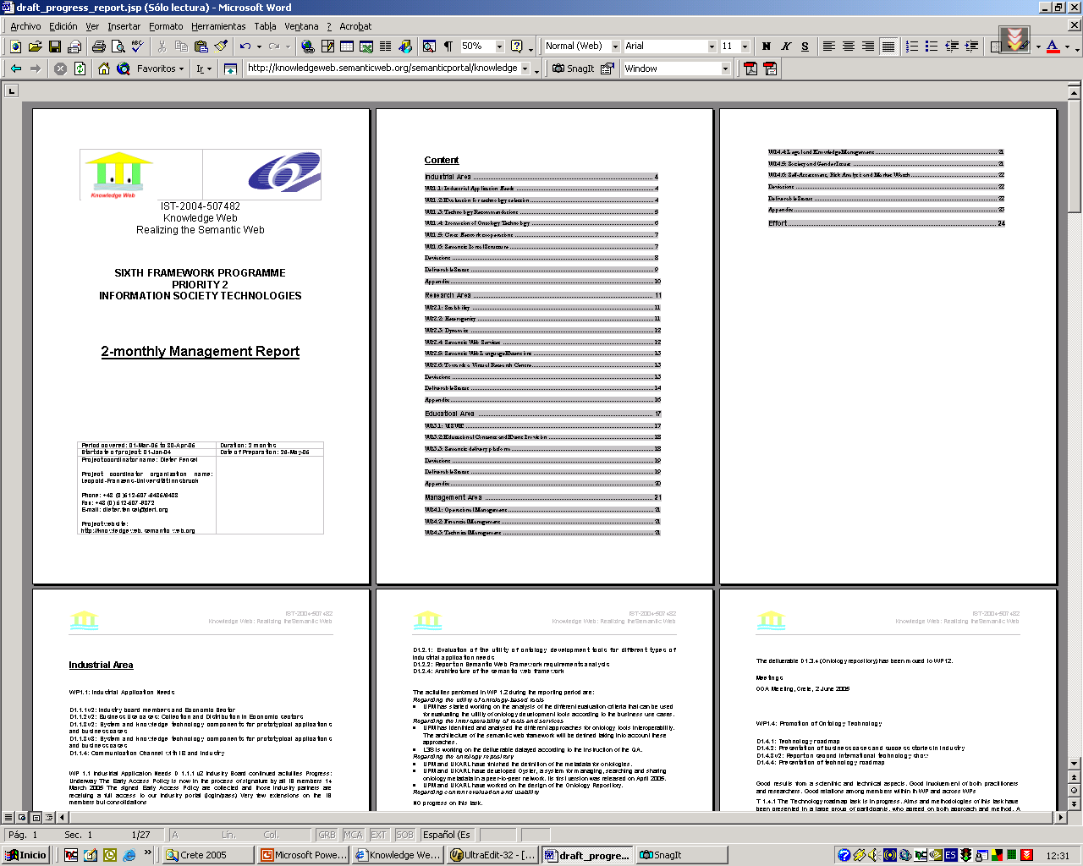
ecReport : Monitorization & Compilation

Slide 12
ecReport : document compilation
Draft version periodic report
in MSWord

