Slide 1

Summary
May 2016

Slide 2














Who we are
Managers UPM & ISBAN
Asunción Gómez
Javier Soriano
Óscar Corcho
Rubén de Dios
Fernando Serena
Miguel
Esteban
Carlos Blanco
Andrés
García
Alejandro Fernández
Alejandro Vera
Ignacio Molina
María Poveda
Developers UPM

Slide 3
Objectives
Smart Developer Hub (SDH) provides insights about the performance of software development teams by
Generating quantitative and qualitative metrics based on data gathered from ALM tools that are used in the organization's development process
Offering configurable role-based dashboards
Leveraging semantic technologies
The SDH platform has been designed with extensibility and interoperability in mind in order to facilitate the integration of heterogeneous ALM tools and the provision of tool-independent metrics.

Slide 4






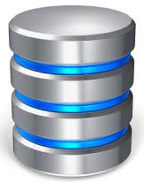
Generating ALM metrics using a traditional data integration approach
M1
M2
M3
What if…
we need to migrate from GitLab to GitHub?
we need to partition the load between different Jenkins instances?
we need more metrics?
the exposed data is not complete, valid or consistent?
Interoperability
issues
Distribution
issues
Extensibility
issues
Consistency
issues

Slide 5

Generating ALM metrics using our approach
Dashboard
Dashboard
Dashboard
Dashboard
GUI
SDH Web Framework
SDH API
API
Metrics Services
& Data Views
Graph-based
Query System
SDH Core Services
Organization
Position
Repository
Role
Build
Vocabularies
(RDF, OWL,
OSLC, …)
Committer
Project
Person
Execution
Commit
Branch
State
Result
Master
dev
COM
Completed
Linked Data
(LDP)
0220
0411
A1
0102101
SDH
01
001
0221
Fail
0102111
Passed
HARVESTERS
DATA
SOURCES

Slide 6
Metric : Calculate the number of passed executions triggered by commits of a given employee
Search Plan Execution
Query:
where ( ?e a Execution . ?e result ?r .
…
filter (r=“Passed”)
)
Search Plan: Start <http://org/organizations/COM>
dereference all org:member
filter org:id = “001” …
SDH Core Services
Organization
Position
Repository
Role
Build
Vocabularies
(RDF, OWL,
OSLC, …)
Committer
Project
Person
Execution
Commit
Branch
State
Result
Master
dev
COM
Completed
Linked Data
(LDP)
0220
0411
A1
0102101
SDH
01
001
0221
0102111
Failed
Passed
HARVESTERS
DATA
SOURCES

Slide 7
Benefits of our approach
Reduced interoperability issues, thanks to
Standardized semantic data model (W3C OWL-based vocabularies)
Vocabulary reuse: well-known vocabularies (i.e., FOAF, DoaP) and enterprise-driven standardization initiatives (i.e., OASIS OSLC)
Standardized exchange data format (i.e., W3C RDF)
Standardized data access mechanism (i.e., W3C LDP)
Designed with distribution in mind
Leverage the Web as a platform
Simple information consumption mechanism
Reusable core services
Notes:
To facilitate the consumption of the data provided by heterogeneous ALM tools, the Smart Developer Hub platform (a.k.a. SDH platform) standardizes the data access mechanism as well as the data model (a.k.a. SDH vocabulary) and format used for the exchange of the data within the platform, using the web as a platform and leveraging standards such as the LDP, RDF, and OWL W3C recommendations and the OSLC initiative from OASIS.

Slide 8
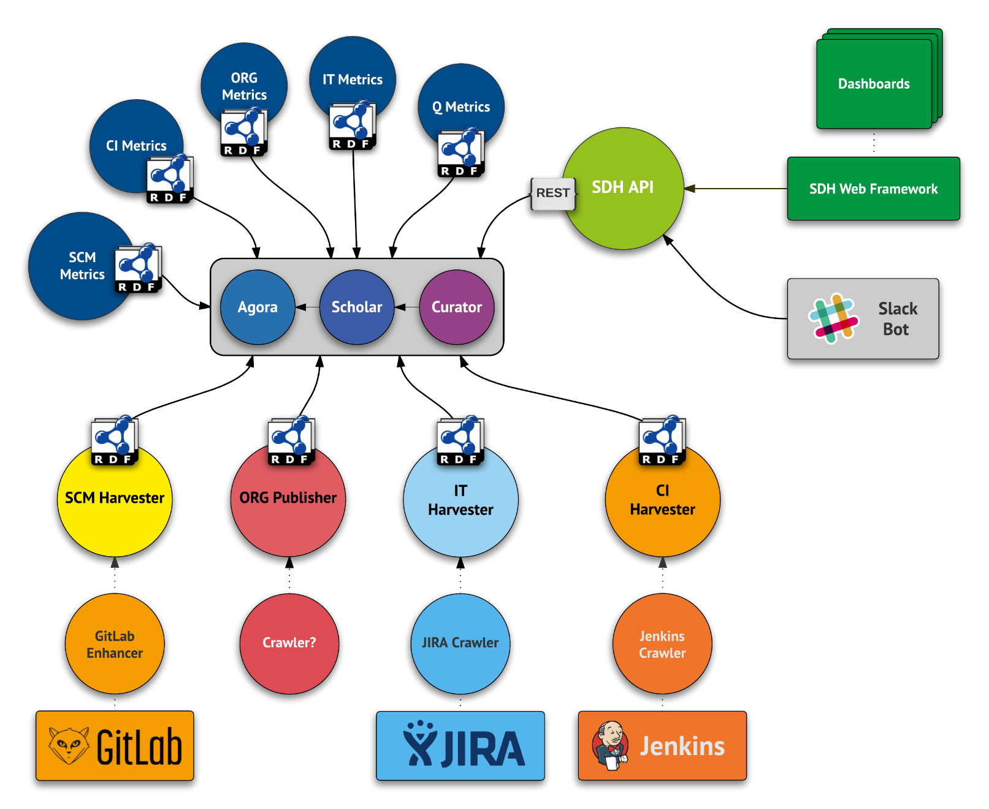
SDH Platform Architecture

