Slide 1


SEEMP
Single European Employment Market-Place
Boris Villazón-Terrazas, Asunción Gómez-Pérez
{bvillazon,asun}@fi.upm.es
Ontology Engineering Group. Laboratorio de Inteligencia Artificial
Departamento de Inteligencia Artificial
Facultad de Informática
Universidad Politécnica de Madrid
Date: 03/01/2010

Slide 2




Motivation: helping Job Seekers on their way
EURES
ES (Int)
Local
Matching
algorithm
o
ES
n
ES
p
ES
m
ES
Local
Matching
algorithm
q
ES
Catalonia
ES (Es)
l
ES
r
ES
Lombard
ES (It)
European
Employment
Mediators
Marketplace
i
ES
a
ES
h
ES
LEGENDA
Private
ES (Int)
Local
Matching
algorithm
Requester ES
b
ES
g
ES
Responding ES
Local
Matching
algorithm
ES not involved
c
ES
f
ES
Wallonia
ES (Be)
Job Seeker’s Candidacy
d
ES
e
ES
Employer Job Vacancy

Slide 3
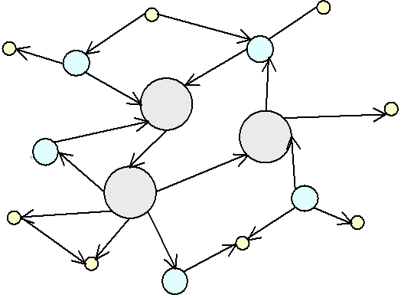
Architecture
1. Reference Ontology
2. Local Ontologies
3. Mappings Local Ontologies - ES Data Sources
4. Mappings Reference Ontology - Local Ontologies
ES
Data Sources
Data Sources
ES
M
ES
M
M
M
Data Sources
M
M
Reference
Ontology
Data Sources
M
M
M
M
ES
ES
M
M
Data Sources
M
M
Data Sources
ES
Data Sources
ES

Slide 4

Reference Ontology
EURES
CEF
ISCO-88 COM
ONET
ISO 6392
Language
Ontology
Skill
Ontology
EURES
Occupation
Ontology
LE FOREM + BLL + EURES
EURES
has job category /
ISO 3166
has contract type /
is associated to
is associated with
Geography
Ontology
Labour
Regulatory
Ontology
subClass-Of
has language proficiency /
belongs to
has job category /
Is associated with
has mother tongue / is mother tongue of
has job category /
is associated with
has work condition / is associated to
speaks / is spoken by
has contract type / is associated with
has work condition /
is associated with
Job Offer
Ontology
Job Seeker
Ontology
has location / is associated with
Competence
Ontology
is located in /
has nationality from / is nation of
DAML Time
Ontology
is associated with
requires competence /
is associated with
resides in / is residence of
has salary /
Time
Ontology
is associated to
has date of birth
/ is date of birth of
has salary / is associated with
has education /
is education of
ISO 4217
Compensation
Ontology
has begin date /
is begin date of
has competence /
is competence of
subClass-Of
has activity sector /
is associated with
FOET
has activity sector /
is associated with
Education
Ontology
ISCED97
requires education /
is associated with
Driving
License
Ontology
Economic
Activity
Ontology
has activity sector /
is associated with
European Legislation
Ad hoc wrapper
External Sources
NACE Rev. 1.1
http://droz.dia.fi.upm.es/hrmontology/

Slide 5
Local Ontologies
  Option 1 for Job Seeker and Job Offer Ontologies
they can be derived from the RO, because they represent a widely accepted structure.
  Option 2 for Occupation, Education, etc.
they must be derived from specific ES taxonomies.
Reference
Ontology
Job Seeker
Ontology
Occupation
Ontology
Reverse
Engineering
ES Occupation
Taxonomy
Integrate
Local Ontology

Slide 6
SEEMP
Single European Employment Market-Place
Boris Villazón-Terrazas, Asunción Gómez-Pérez
{bvillazon,asun}@fi.upm.es
Ontology Engineering Group. Laboratorio de Inteligencia Artificial
Departamento de Inteligencia Artificial
Facultad de Informática
Universidad Politécnica de Madrid
Date: 03/01/2010

Slide 7

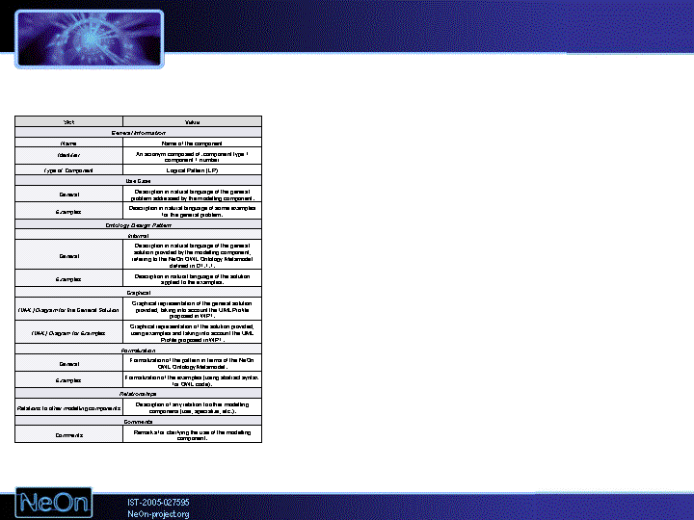
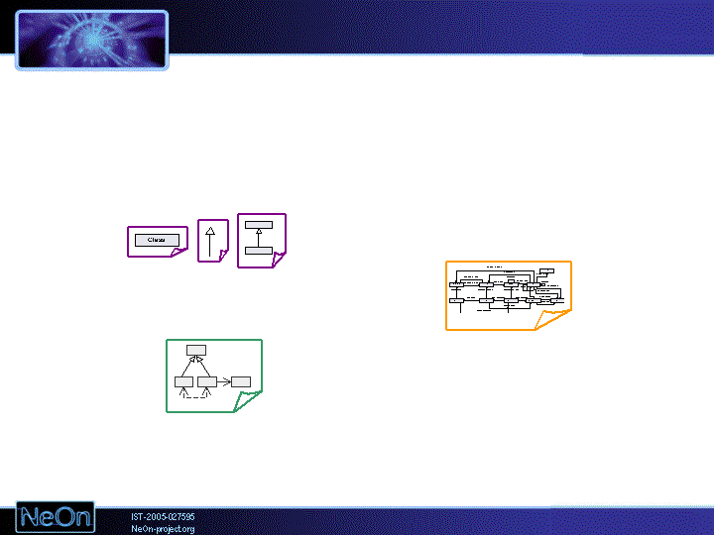
Building the Reference Ontology II
Knowledge Resources
Non-Ontological Resources
Ontological Resources
Glossaries
Dictionaries
Lexicons
O. Design Patterns
O. Repositories and Registries
Classification
Schemas
Flogic
RDF(S)
OWL
Taxonomies
Thesauri
Ontological Resource
Reuse
2
Non-Ontological Resource
Reuse
Ontology Design
Pattern Reuse
O. Aligning
O. Merging
Ontological Resource
Reengineering
Non-Ontological Resource
Re-engineering
Alignments
RDF(S)
O. Specification
O. Conceptualization
O. Formalization
O. Implementation
Flogic
Ontology Restructuring
(Pruning, Extension,
Specialization, Modularization)
O. Localization
OWL
Ontology Support Activities: Knowledge Acquisition (Elicitation); Documentation;
Configuration Management; Evaluation (V&V); Assessment

Slide 8







Building the Reference Ontology
Mappings
L.O. - ES
Data Sources
ES Data
Sources
Repositories & libraries
Building
Mappings
L.O. - ES
Data Sources
ISCO-88 (COM),
ONET,
EURES taxonomy,
FOET, ISCED97,
NACE, ISO 4217,
ISO 3166, ISO 6392,
HR-XML, …
RDF(S) OWL
Local
Ontologies
Building
Reference
Ontology
Building
Local
Ontologies
Reference
Ontology
Mappings
R.O. - L.O.
Building
Mappings
R.O. - L.O.

