Slide 1

Olga Giraldo
Supervisors
Oscar Corcho, PhD
Alexander Garcia, PhD

Slide 2










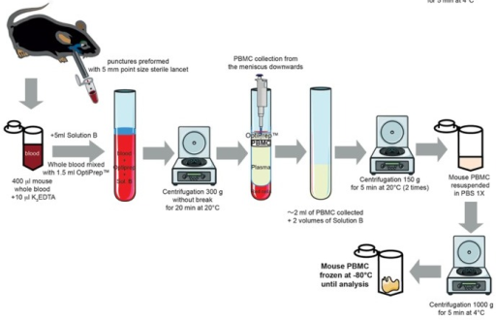
Improving the reproducibility
Resources for reporting guidelines or Minimum Information standards
Bio-ontologies
OBI, EXPO, EXACT, BAO, IAO, ERO…
For reproducibility purposes, if the data must be available, so does the experimental protocol detailing the methodology followed to derive the data.
Data repository for making data available
few efforts focus on representing and standardizing experimental protocols.

Slide 3

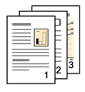
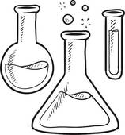
How to accurately document and retrieve meaningful information from experimental protocols
Goal
leaf tissue
Sample
Instrument
Mortar and pestle
Reagent
Triton X-100
Sample
DNA
Grind
Cell
disruption
Action
Grind the leaf tissue
using a mortar and pestle
Precipitation reaction
Precipitate the DNA with
0.6 mL of 2-propanol.
Notes:
Our goal is to extract meaningful information from experimental protocols. for instance, instructions in the workflow, objectives, and other parts that describe the protocol.

Slide 4
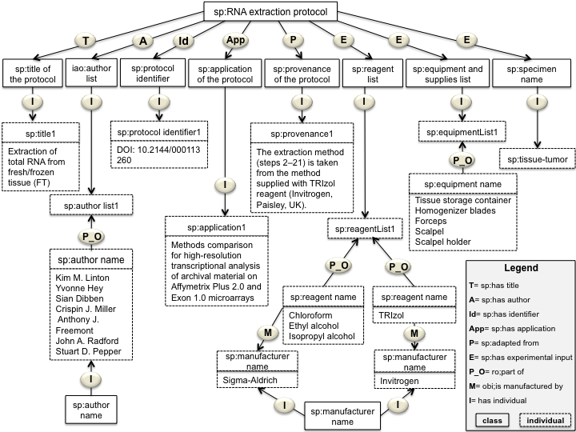
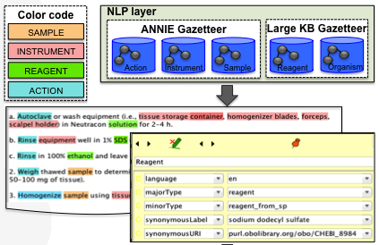
Design and reuse of ontologies:
SMART Protocols ontology
Documentation is available at:
http://vocab.linkeddata.es/SMARTProtocols/
Design of grammar rules
Facilitate the annotation of instructions
Design of semantic Gazetteers
Facilitate the annotation of instances related to:
Experimental actions
Instruments
Samples/ organisms
Reagents
SMART Protocols platform under construction
Each protocol includes a score of completeness.
Automatic annotation of SIRO elements in the content of the document.
de novo protocols are to be born semantics. We are using the SP ontology as a template.

