Slide 1
Project on TIC vigilance
Asunción Gómez Pérez
asun@fi.upm.es
ETSI Informaticos
Universidad Politécnica de Madrid
Campus de Montegancedo s/n
28660 Boadilla del Monte, Madrid, Spain
Participants: María Poveda Villalón, Socorro Bernardos

Slide 2
Pilot project on ontologies for TIC vigilance
Collaboration with the Secretary of State for Telecommunications and Information Society
Problem:
  Different organizations and locations use different schemes (CPV, UNSPSC, ad-hoc…) and classification for products and services.
  Heterogeneity through dataset annotated with different schemes
  Need for query translation (when using another schema)
Reuse:
  Ontological resources
    foaf, org, GoodRelations, SKOS…
  Non-Ontological resources
    propietary database
    csv files

Slide 3

Generation of relations between companies and 3 classifications
Plataformas de contratación
(formalized inSKOS)
Company
(gr:BusinessEntity)
Solutions
(gr:ProductOrService)
gr:hasManufacturer
tieneConsultor
tieneMayorista
CPV codes
(reused)
11
gr:category
1, 2
3, 4
Categories and sub-categories INTECO (ad-hoc)
(formalized in SKOS)
7, 8
Product classifications
(formalized in SKOS)
9, 10
UNSPSC
Create INTECO categories and subcategories (manual)
Generate RDF for the INTECO categories
Manual mappings INTECO-CPV (csv)
Generate mappings INTECO-CPV in RDF
Subset of UNSPSC products selection (csv)
RDF generation of UNSPSC products subset
Manual mappings UNSPSC-CPV
Generate mappings UNSPSC-CPV in RDF
Manual mappings UNSPSC-INTECO (csv)
Generate mappings UNSPSC-INTECO in RDF
Transform companies and solutions from INTECTO database to in RDF
5, 6

Slide 4
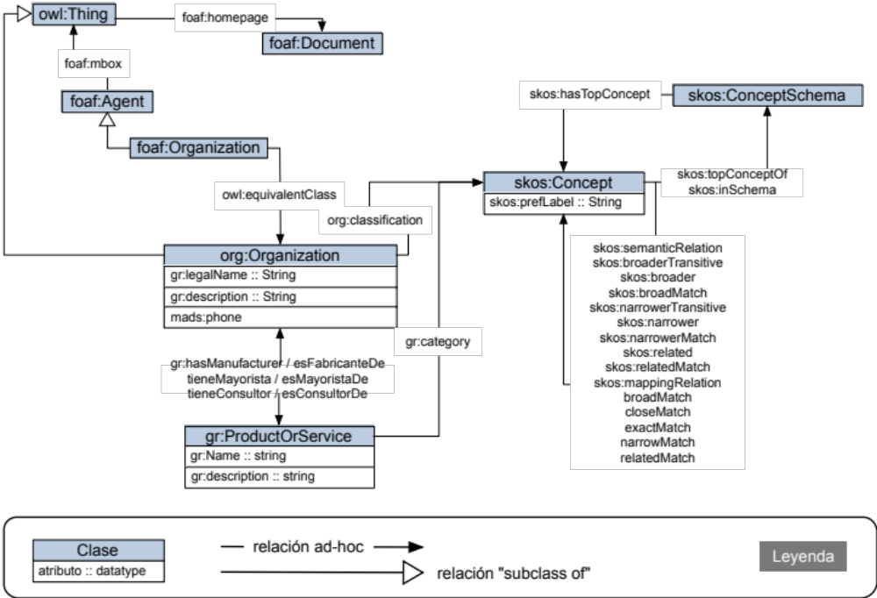
Conceptual model

Slide 5
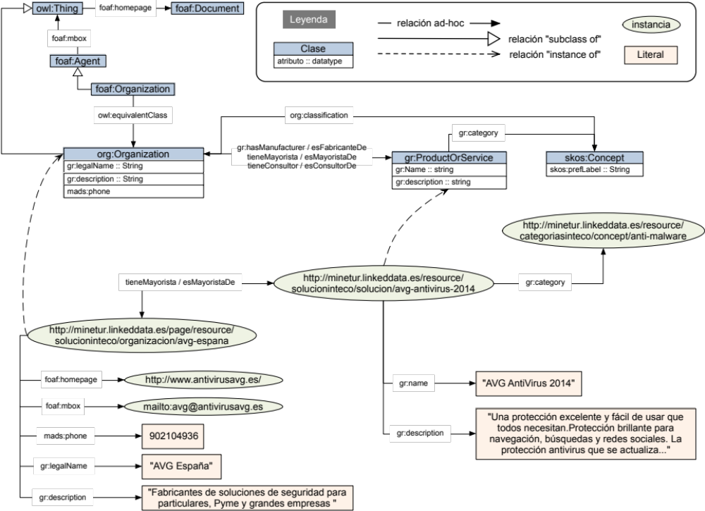
Population example

Slide 6
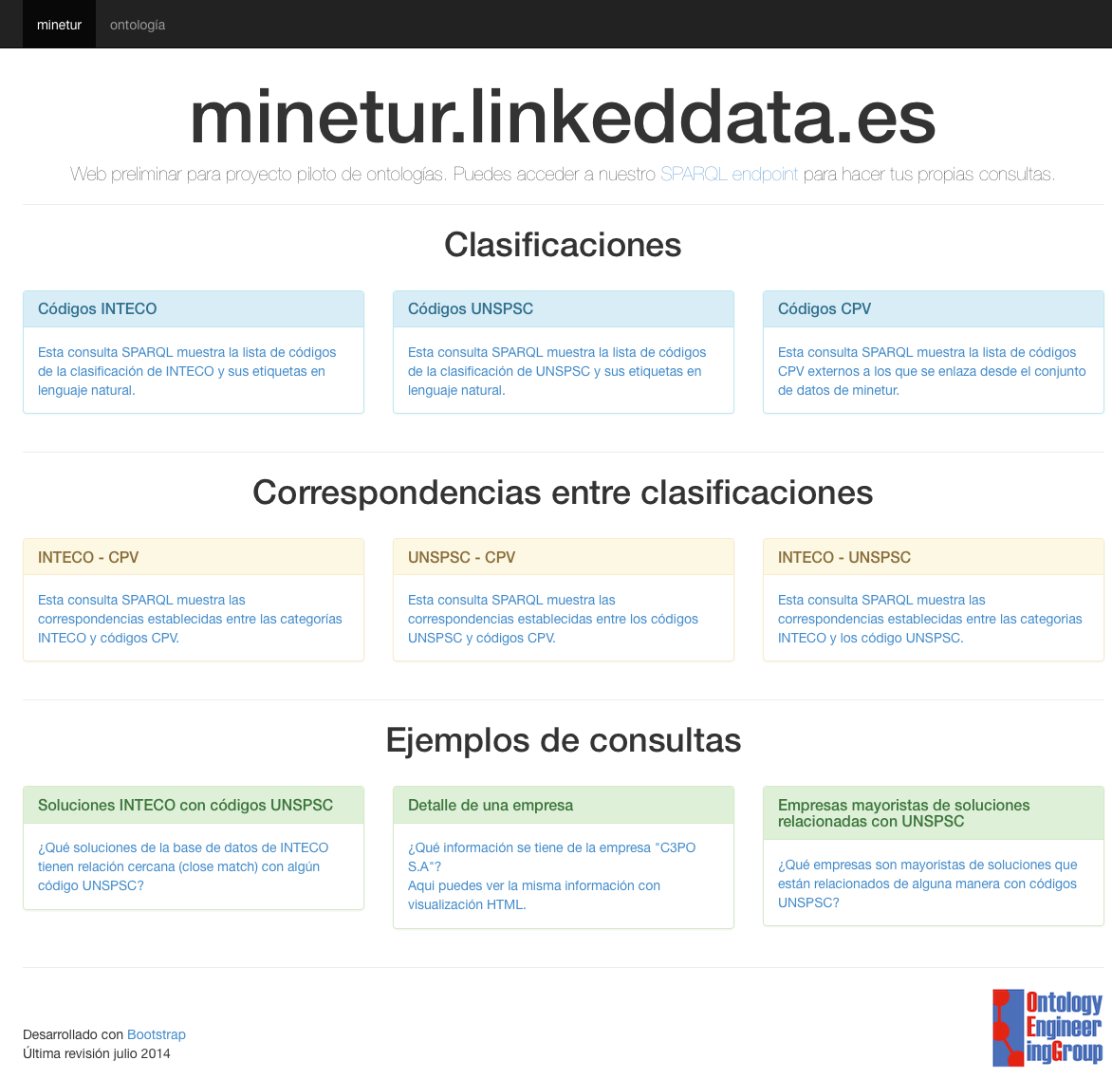
Website
This question couldn’t be answered before linking the 3 classifications.
Which solutions from the proprietary database (ad-hoc classification) has relation to any UNSPSC code?

Slide 7
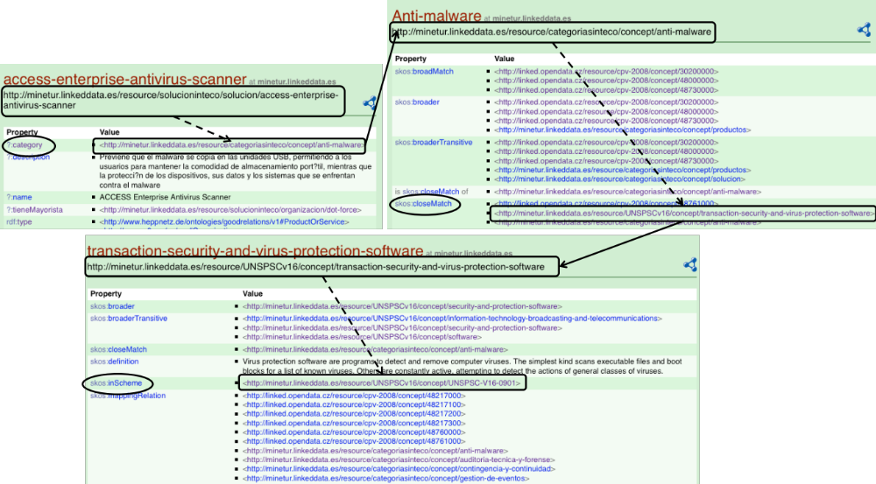
Navigation example

