Slide 1
GeoBuddies: Anotación semántica colaborativa con dispositivos móviles en el Camino de Santiago
WP2

Slide 2
Index
WP2 Overview
Starting point: Knowledge bases and proposed solution
Step 1: Authomatic ontology building
Step 2: Mapping Definition
Step 3: Mapping Discovery
Step 4: Mapping Interpretation
Step 5: Integration all Sources Information
Step 6: Mapping Composition
Step 7: Multilinguality
Work to be done to December 2008

Slide 3
WP.2 Ontology-based multilingual information integration
Objective 3. semantic accessibility to IGN resources and other data available in the Web
  harmonised views of IGN databases → OntoBCN
  Multilingual content (Spanish, Galician and Basque)
  Information integration techniques
Main Steps and results
  Domain Ontology
  Onto-BD mapping definition (R₂0 is not enough)
  Onto-BD mapping discovery algorithm
  Mapping execution (ODEMapster is not enough)
  Information integration with external data
  Composition procedural and declarative mappings
  Multilinguality
Strong cooperation IGN-UPM (2007,2008)

Slide 4
Starting point
Monolingual Knowledge bases of IGN (spanish): NC (Nomenclátor Conciso), NGN (Nomenclátor Geográfico Nacional), BCN200 (Base Cartográfica Nacional escala 1:200.000), BCN25 (Base Cartográfica Nacional escala 1:25.000)
Monolingual Knowledge bases of CC.AA. (spanish, basque, galician): Castilla y León, Cataluña, Euskadi, Extremadura, Galicia, La Rioja, Madrid, Murcia, Navarra.
Creation of an ontology mapped with knowledge bases

Slide 5
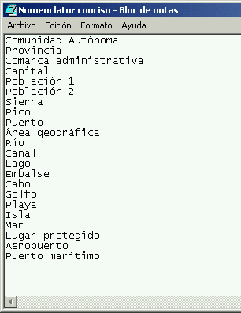
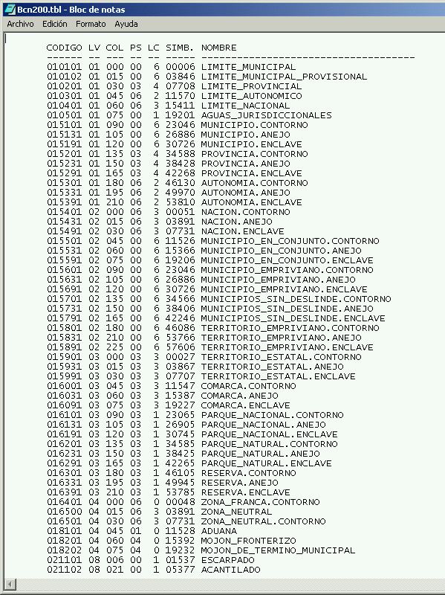
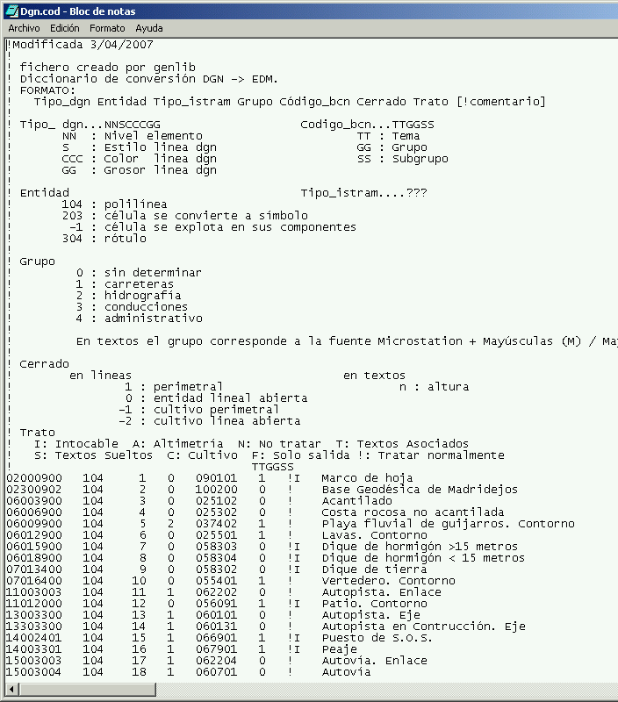
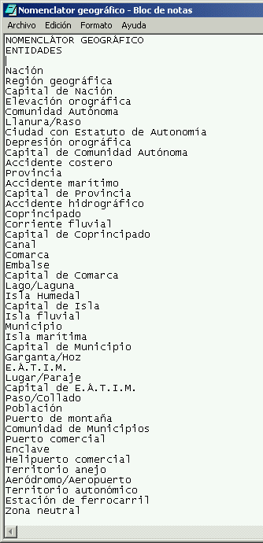
Knowledge Bases
Nomenclátor Conciso (NC)
Base Cartográfica N. (BCN200)
N. Geográfico Nacional (NGN)
Base Cartográfica N. (BCN25)

Slide 6
Initial Knowledge Bases (IGN)
NC (22)
NGN (52)
- Río
- Corriente fluvial
BCN200 (224)
BCN25 (421)
- Ríos, arroyos 3º y 4º, ramblas. Lagunas medianas
- Ríos y rías medianos de 2º orden. Lagunas > 100 Ha
- Ríos y rías principales 1º orden
- Ríos, arroyos, 5º y 6º, lagunas y charcas pequenas,
fuentes, manantiales, pozos, etc.
- 4 Knowledge Bases: NC, NGN, BCN200, BCN25
- Heterogeneity and granularity example
- Vocabulary differences: “Autovia”, “Autovías”, “AUTOVIA.”

Slide 7
Proposed Solution
NGN
NC
PhenomenOntology
BCN200
BCN25

Slide 8
Step 1: Authomatic Ontology Building: PhenomenOntology
Generación automática de la ontología a partir de BCN25 (ontobcn)
→ criterios de depuración de niveles.
BCN25
OntoBCN:
PhenomenOntology
DEMO
Detección automática de diferencias lingüísticas (linsearch): plurales, tildes, diéresis, signos de puntuación, mayúsculas.
Evaluándose en el IGN

Slide 9
Step 2: Onto-BD Mapping (R₂O)
R₂O is a language for expliciting procedural mappings between relational models and ontologies. (model – model)
ODEMapster is a compiler that cans execute mappings for:
  carrying out ontology population (DB → ontology)
  responsing queries to ontology with DB information
  (ontology → DB → ontology)
conceptmap-def
name Cliente
identified-by Usuarios.ID
uri-as
<transformation>
applies-if
<cond-expr>
joins-via
<cond-expr>
documentation ”Correspondence description”
column4 ∪ column5

Slide 10
Step 2: Onto-BD Mapping (IGN case)
Ontology concepts are expressed as instances of relational model. (model – individuals)
Mappings does not express procedural relation (actions condicionated to events), express declarative relation (facts with certainty).
≡
(0.8)

Slide 11
Step 2: Mapping Model Definition
Model of declarative mappings and XML example
Alignment
<Mapping>
<MappingId>BCN1_Fenomenos.Phenomens.030701-Phenomtology.Castillo</MappingId>
<Certainty>1.0</Certainty>
<Reference>Manual Mapping by JARG</Reference>
<MappingRelation>
<Name>Igualdad</Name>
<Description>All elements are semantically equivalents.</Description>
<Formalization>A=B=C=...</Formalization>
<ResolutionFile>--None--</ResolutionFile>
<Reference>OEG Mapping Relations</Reference>
</MappingRelation>
<ConceptualizationElement>
<KR>DB</KR>
<Id>BCN1_Fenomenos.Phenomens.030701</Id>
</ConceptualizationElement>
<ConceptualizationElement>
<KR>Ontology</KR>
<Id>Phenomtology.Castillo</Id>
</ConceptualizationElement>
</Mapping>
- AlignmentId
- OriginalAuthor
- LastModificationAuthor
- CreationDate
- LastModificationDate
1
*
Mapping
- MappingId
- Reference
- Reference
*
*
MappingRelation
*
1
ConceptualizationElement
- Name
- Description
- Formalization
- ResolutionFile
- Reference
- KR
- Id
Storage Systems
  - XML file (XSD defined yet)
  - WebODE now
  - To be decided new storage system

Slide 12
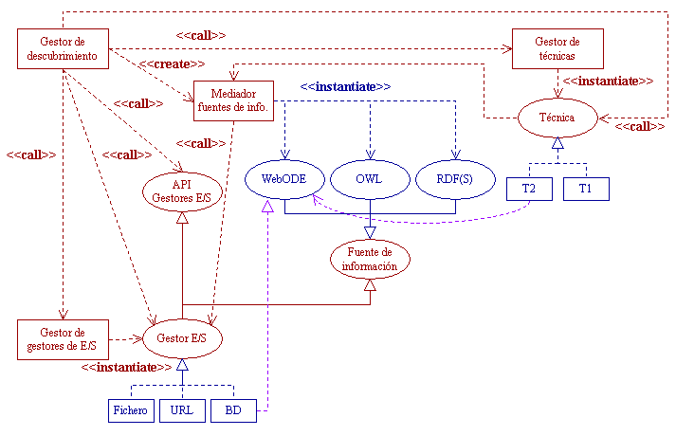
Step 3: Mapping discovery (in progress)

Slide 13
Step 4: Onto –BD Mapping interpretation
(in progress)
Query: ¿ ?
Mapping interpreter permits response queries using DB information transparently through declarative mappings
≡
(0.8)
Response:

Slide 14
First Prototype (in progress)
NGN
NC
Query:
¿Edif. Religioso?
Construcción Rel.
BCN200
BCN25
Edif. Religioso
Catedral
Response:
Edif. Religioso
Construcción Rel.
Ermita
Catedral
Ermita

Slide 15
Step 5: Integration of IGN+CCAA+European
Query:
¿Edif. Religioso?
NGN
NC
Galicia
EuroGeoNames
Cataluña
País Vasco
BCN200
BCN25
Response:
Edif. Religioso
Construcción Rel.
Ermita
Catedral
Cathedral

Slide 16
Step 6: Composition with R₂0 mappings
NGN
Cated.
NC
Query:
¿Edif. Religioso
de Soria?
Construcción Rel.
Soria
BCN200
BCN25
Cated.
Edif. Religioso
NS Nieves
Catedral
Cated.
Response:
Catedral Soria
Ig. Sto. Tomás
Catedral Soria
Ermita N.S. Nieves
Catedral Soria
Ig. Sto.
Ermita
Soria
Soria

Slide 17
Step 7: Multilinguality
¿Quién va a interactuar con la ontología?
  Un programa -> la multilingualidad no es necesaria
  Un usuario -> interesa que la ontología sea multilingüe
Si interesa que sea multilingüe aunque no hay necesidad,
  ¿Cómo se va a proporcionar?
  ¿En qué nivel ha de estar la multilingualidad?

Slide 18
Posible solutions
Solution 1
  NeonMultilingual Model
  Label Translator
Solution 2
  Neon Multilingual Meta-model
    Add linguistic information → elements are part of an ontology
      classes, properties or relations
  LabelTranslator plugin
    Used sources
      EWN databases
      Web Translation resources
    Linguistic information
      Translated labels
      Gloss or definition
    Supported languages
      English, German and Spanish

Slide 19
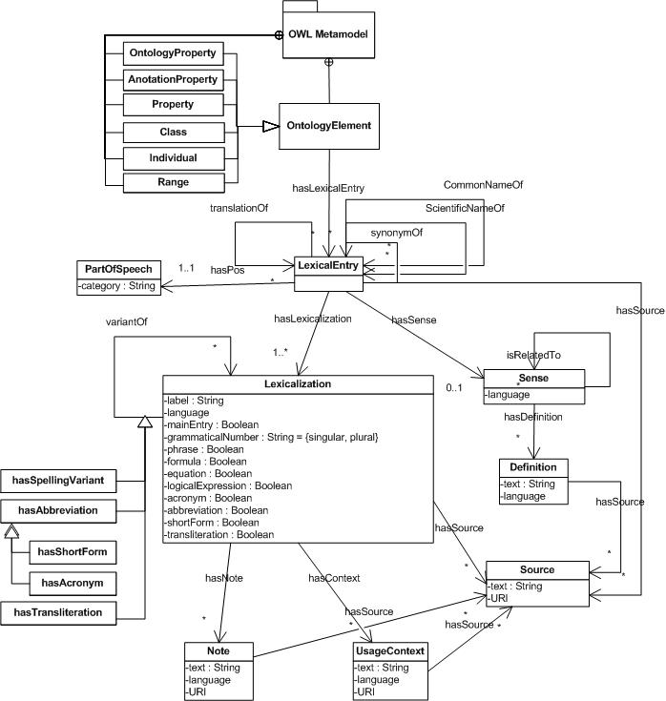
NeonMultilingual Model

Slide 20
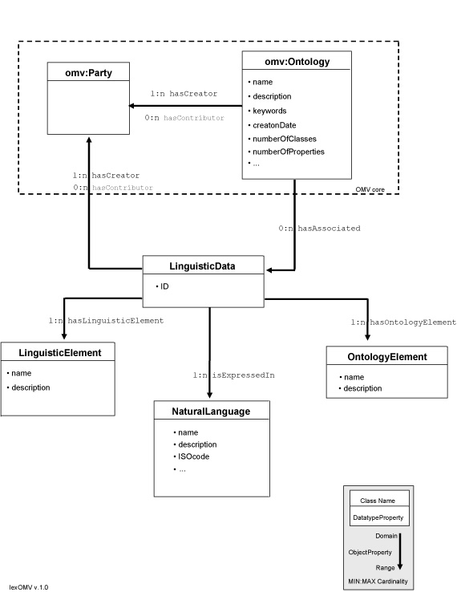
Extension of the OMV

Slide 21
Work to be done until Dec. 08
- OntoBCN
- Mapping Model def.
Mapping
discovery
(2nd prototype
debugged)
Mapping
discovery
(1st prototype
debugged)
Mapping
discovery
(1st prototype)
Mapping
discovery
(2nd prototype)
Mapping
interpretation
Composition
with R₂0
done 3 6 9 12 15

