Slide 1
Visual Analytics with Linked Open Data and Social Media for e-Governance
Vitaveska Lanfranchi
Suvodeep Mazumdar
Tomi Kauppinen
Anna Lisa Gentile
Updated material will be available at http://linkedscience.org/events/vislod2014/
#VISLOD_ESWC2014

Slide 2
Outline
Agenda
Introductions
Overview
What is Visual Analytics?
What is Social Media?
How is it used for e-Governance?
Social Media Access and Processing
Visual Analytics Techniques
Wrap up and questions

Slide 3
The Information Space
The size of the ‘digital universe’ in 2010 surpassed one ZB
About 70% of this information is generated by individuals
Ubiquitous Computing
Smartphones
Tablets
24/7 Connectivity
This trend has driven, and been driven by, the dramatic rise of content sharing and social media platforms

Slide 4
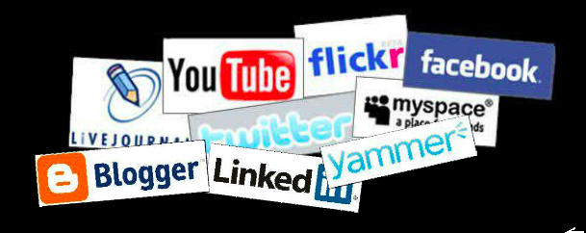
Social Media

Slide 5
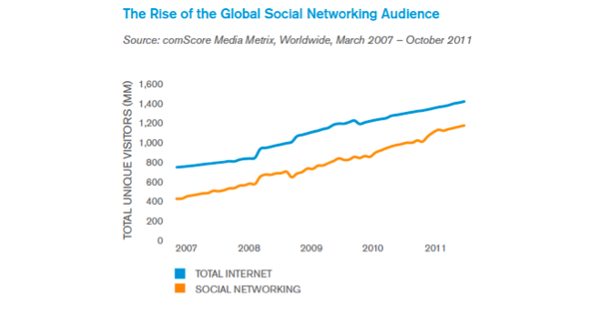
The rise of Social Network

Slide 6

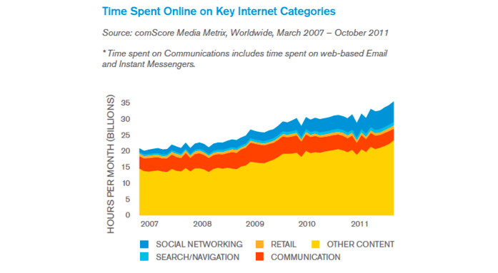
Online Activities
1 out of 5 online minutes are spent on social networks

Slide 7

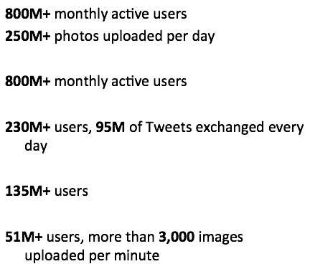




The Social Media Universe

Slide 8
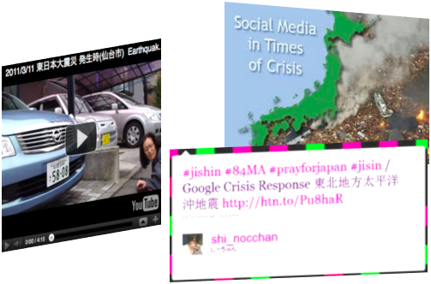
Situational Awareness

Slide 9
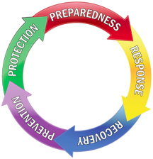
How can Social Media help?
Real-time communication between citizens
Alerting friends, relatives
Alerting authorities
Providing advice, help, support
Real-time communication from authorities
Alerting population
Contacting people
Providing advice, help, support
Constant monitoring of social media to spot and follow emerging situations
Supporting all the phases of an emergency

Slide 10
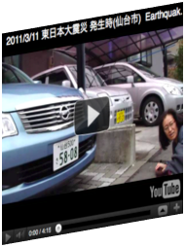
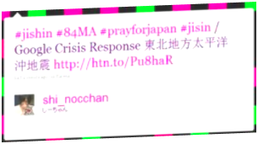
A few examples
In 2011 Japan and US earthquakes
more than 40K related tweets were sent within the first minute peaking at about 5,500 tweets per second
During the East Coast US earthquake the first tweet after 24 seconds

Slide 11
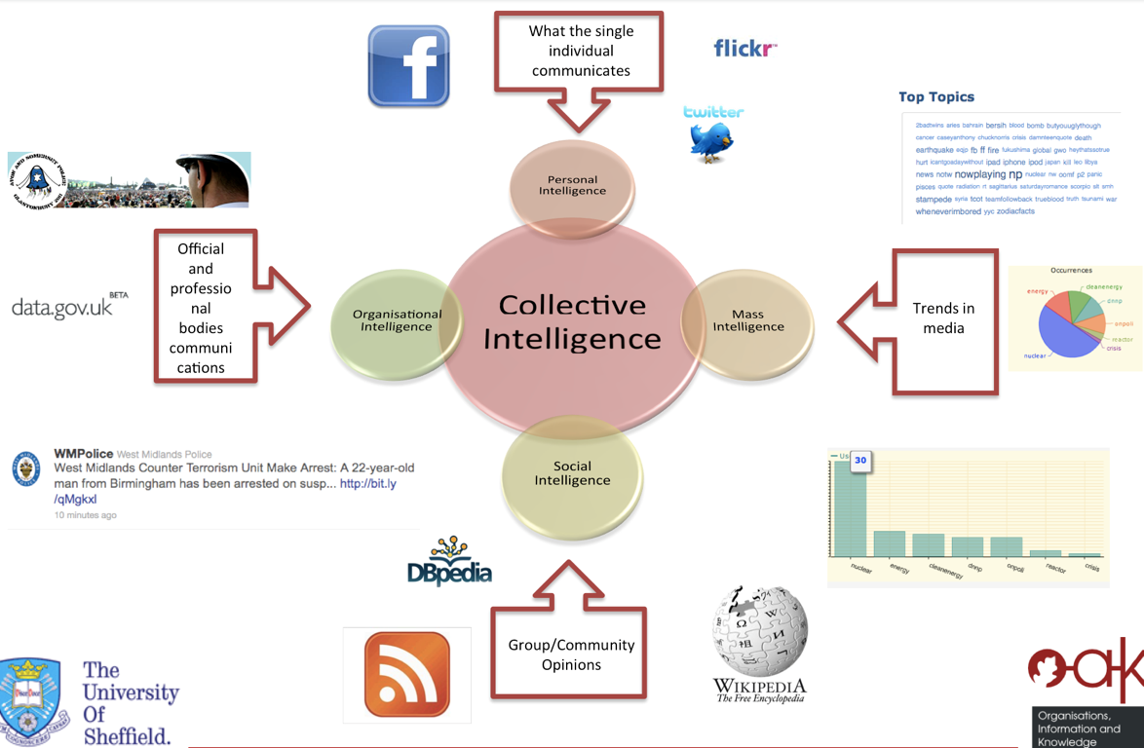

Slide 12
Social Media Data - Key Features
Massive, real-time data
Numerous and Diverse Data Source
High noise to signal ratio
Semantic Underspecification
High multimediality
30% of Twitter posts contain images or links

Slide 13
WHAT IS VISUAL ANALYTICS

Slide 14
Some Definitions
“Visual Analytics is the science of analytical reasoning facilitated by interactive visual interfaces” [Thomas and Cook, 2005]
“Visual analytics is more than just visualization and can rather be seen as an integrated approach combining visualization, human factors and data analysis” [Keim et al, 2006]
“Visual analytics is the formation of abstract visual metaphors in combination with a human information discourse (usually some form of interaction) that enables detection of the expected and discovery of the unexpected within massive, dynamically changing information spaces” [Cook, 2007]

Slide 15
Challenges for e-Governance
Information Overload
Scalability:
Information availability
Visual display
Multimodality
Information manipulation
Focus without loss

Slide 16
Aims
facilitate analytical reasoning:
data → information → knowledge →explanation
detect the expected and discover the unexpected
provide understandable assessments
communicate assessments
effectively
Information, knowledge, and reasoning
must be made explicit

Slide 17
What is needed
Knowledge Capture
Knowledge Representation
Knowledge Integration

Slide 18
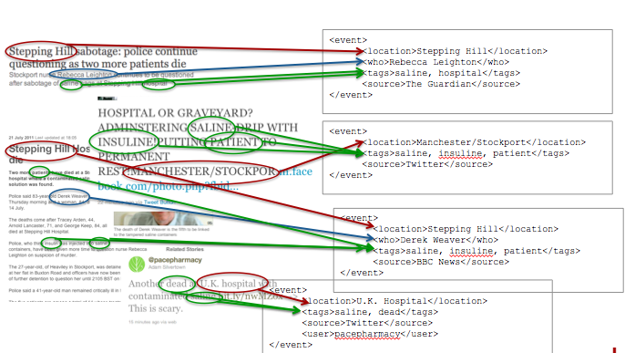
Knowledge Capture and Representation

Slide 19
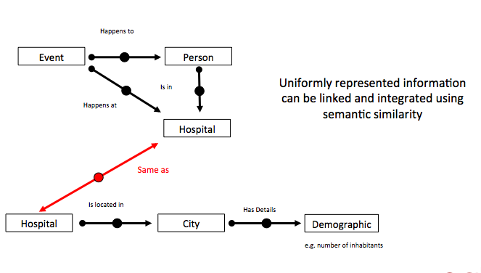
Knowledge Integration

Slide 20
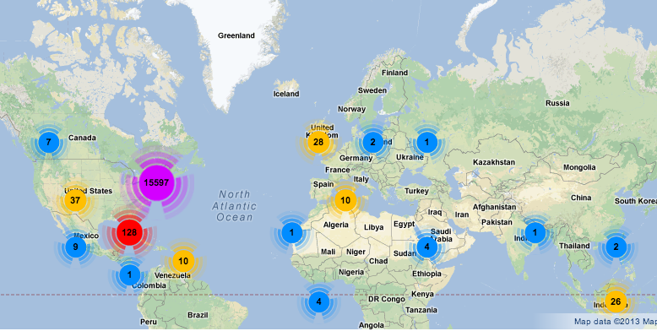

VA - Multidimensional displays
Different colors and size circles display different data dimensions

Slide 21
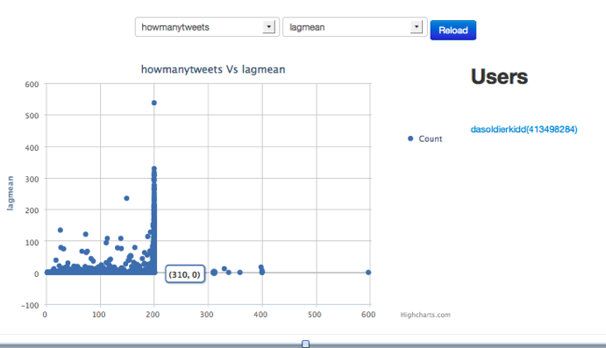
VA - Interactive displays
Users can interact and manipulate data

Slide 22
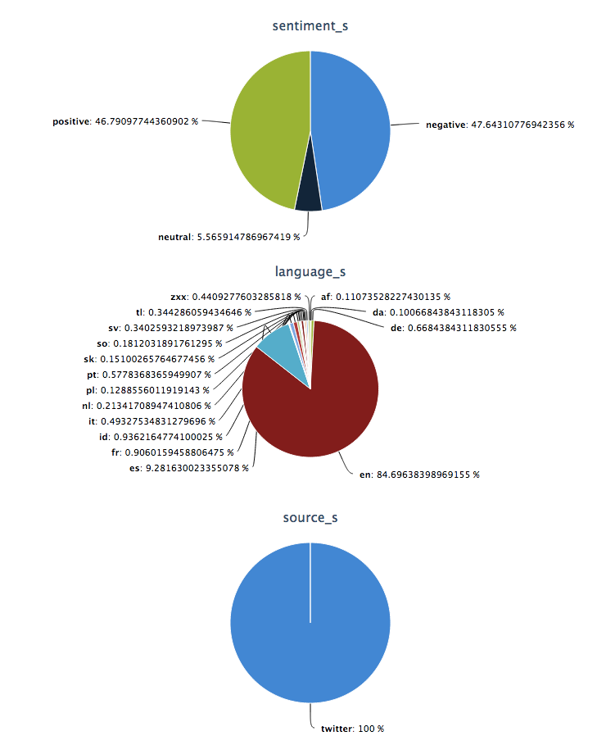
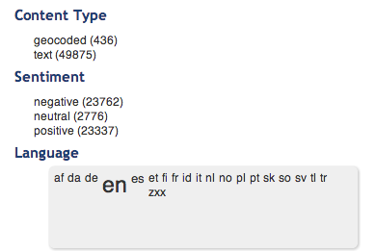
VA - Comparative Complementary displays

