Slide 1

How to Analyse Social Media Content
Vitaveska Lanfranchi
Suvodeep Mazumdar
Tomi Kauppinen
Anna Lisa Gentile
Updated material will be available at http://linkedscience.org/events/vislod2014/

Slide 2


Challenges
Massive, real-time data
Numerous and Diverse Data Sources
High noise to signal ratio
Unstructured content
Semantic Underspecification
High multimediality
30% of Twitter posts contain images or links
© Fabio Ciravegna, University of Sheffield

Slide 3
What is needed
Knowledge Capture
Knowledge Representation
Knowledge Integration
© Fabio Ciravegna, University of Sheffield

Slide 4
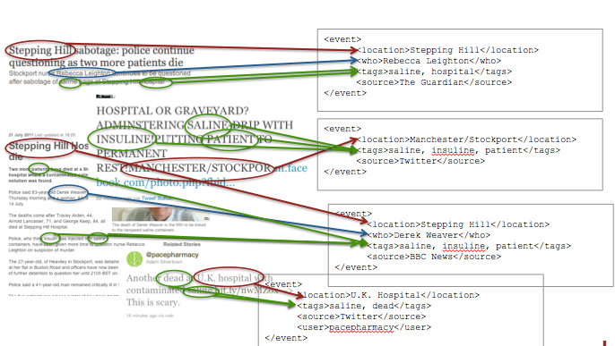
Knowledge Capture and Representation
© Fabio Ciravegna, University of Sheffield

Slide 5
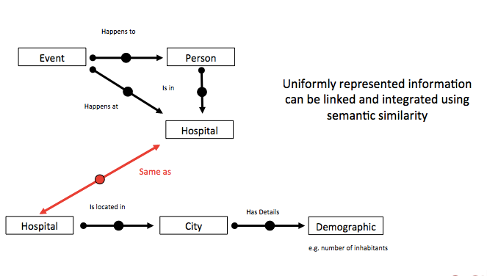
Knowledge Integration
© Fabio Ciravegna, University of Sheffield

Slide 6

Case study: Twitter
Faculty
Of
Engineering.

Slide 7
What is Twitter
Online social network
Microblogging service
Messages up to 140 characters
Accessible through websites, mobile apps, desktop apps, SMS etc.
© Fabio Ciravegna, University of Sheffield

Slide 8
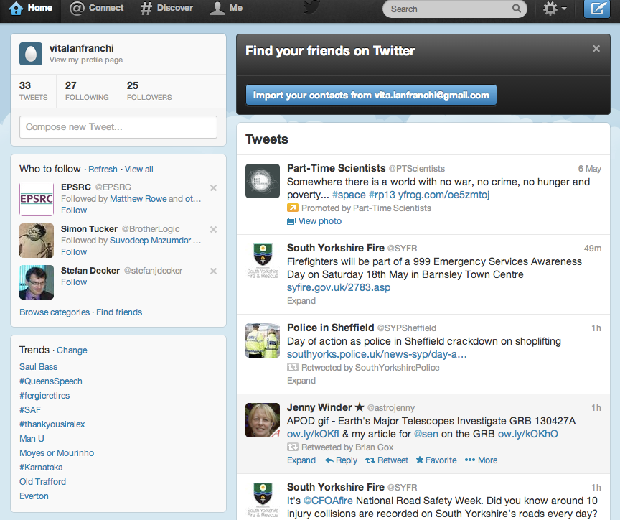

Slide 9
Information about users
Twitter provides a user profile containing:
name
location
biography
photo
© Fabio Ciravegna, University of Sheffield

Slide 10
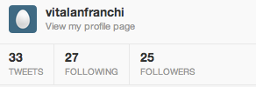
Information about users’ networks
As part of the user profile, twitter provides data about:
n. of followers
following
linked
lists
© Fabio Ciravegna, University of Sheffield

Slide 11
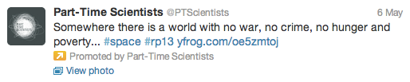
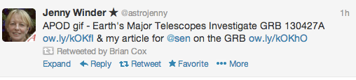
Information about the message itself
Message tags
Links
Timestamp
Device/App used to post the message
User mentions
© Fabio Ciravegna, University of Sheffield

Slide 12
Why is it useful for research
Statistics about usage
User Profiling
Community Identification
Sentiment analysis
Topic analysis
Trend detection
© Fabio Ciravegna, University of Sheffield

Slide 13
State of The Art
Faculty
Of
Engineering.

Slide 14
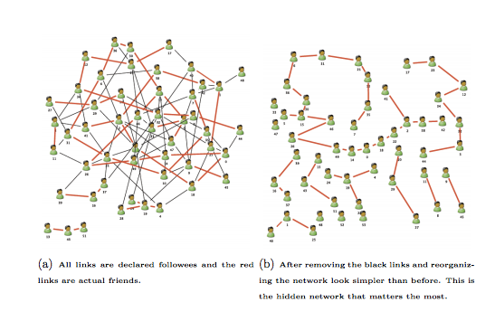
Huberman et al, 2008
Identifies followers vs. people mentioned to discover “hidden friends”
© Fabio Ciravegna, University of Sheffield

Slide 15
Wanichayapong et al, 2011
Identifies traffic information
(traffic congestion, incidents, weather reports)
in microblogs in Thailand
Simple keyword-based filtering approach
looks at Road names, and other traffic information
classify the tweets into point (a car crash at a crossroad) and line categories (traffic jam between 2 squares)
© Fabio Ciravegna, University of Sheffield

Slide 16
Temnikova et al (2013)
Finding tweets related to
Haiti Earthquake, Wildfires iN Chile, Asian Disaster Preparedness Centre
Filtering tweets related to ER based on keywords and hashtags (#disaster)
Tweets, WordNet for extracting keywords synonyms (e.g. Earthquake → “earthquake”, “quake”, “temblor” and “seism”)
© Fabio Ciravegna, University of Sheffield

Slide 17
Cano et al (2013)
Classifying tweets as being related to crime/disaster/war
Binary classification using SVM classifiers
Knowedge sources
Dbpedia and Freebase)
Tweets
© Fabio Ciravegna, University of Sheffield

Slide 18
Axel et al (2013)
Real-time identification of small scale incidents
Car crash: e.g. “Motor Vehicle Accident”, “Motor Vechicle Accident Freeway”, “Car Fire”, “Care Fire Freeway”
Binary classification (are the tweets related or not related to incidents?) using SVM
Sources
Linked Open Government data (data.settle.gov)
real time fire 911 calls dataset;
Wordnet for hyponyms
© Fabio Ciravegna, University of Sheffield

Slide 19
Vieweg et al (2010)
Red River floods in April 2009 and 2010
Haitian earthquake,
Oklahoma grass fire in april 2009
Using IE techniques to extract/find useful/relevant information during emergencies
the extracted info contains of geo-location, location referencing information, “situation update”
© Fabio Ciravegna, University of Sheffield

Slide 20
Gupta (2013)
Finding fake images about Hurricane sandy in 2012
Built supervised (naive bayes, decision tree) classifiers to detect fake images
© Fabio Ciravegna, University of Sheffield

Slide 21
Kumar (2013)
Arab Spring movement
Identifies whom to follow during crises
by taking into account people’s location before, during and after the crises
as well the topic they are describing
© Fabio Ciravegna, University of Sheffield

Slide 22
Sakaki et al (2011)
Earthquake monitoring using Tweets
Following the Japan Earthquake
Classifies tweets that are positively or negatively related to earthquake
Geolocates tweets to build a map of the earthquake
© Fabio Ciravegna, University of Sheffield

Slide 23
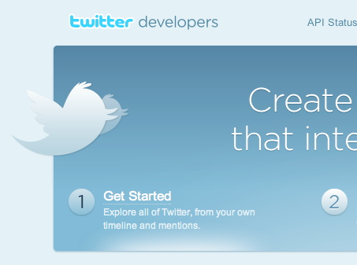
How to access Twitter
© Fabio Ciravegna, University of Sheffield

Slide 24
Twitter API
http://net.tutsplus.com/tutorials/other/diving-into-the-twitter-api/
There are three separate Twitter APIs
The normal REST based API
methods constitute the core of the Twitter API, and are written by Twitter itself. It allows other developers to access and manipulate all of Twitter’s main data.
You’d use this API to do all the usual stuff you’d want to do with Twitter including retrieving statuses, updating statuses, showing a user’s timeline, sending direct messages and so on.
The Search API
Lets you look beyond you and your followers. You need this API if you are looking to view trending topics and so on.
The Stream API
lets developers sample huge amounts of real time data.
© Fabio Ciravegna, University of Sheffield

Slide 25
The API (ctd)
http://dev.twitter.com/pages/every_developer
There are limits to how many calls and changes you can make in a day
API usage is rate limited with additional fair use limits to protect Twitter from abuse.
The API is entirely HTTP-based
Methods to retrieve data from the Twitter API require a GET request. Methods that submit, change, or destroy data require a POST.
API Methods that require a particular HTTP method will return an error if you do not make your request with the correct one.
HTTP Response Codes can help you
The API presently supports the following data formats: XML, JSON, and the RSS and Atom syndication formats, with some methods only accepting a subset of these formats.
http://dev.twitter.com/pages/rate-limiting
© Fabio Ciravegna, University of Sheffield

Slide 26
REST API Methods
https://dev.twitter.com/docs/api/1.1
Timeline Methods
statuses/public_timeline
statuses/home_timeline
statuses/friends_timeline
statuses/user_timeline
statuses/mentions
statuses/retweeted_by_me
statuses/retweeted_to_me
statuses/retweets_of_me
And several others!!!!
© Fabio Ciravegna, University of Sheffield

Slide 27
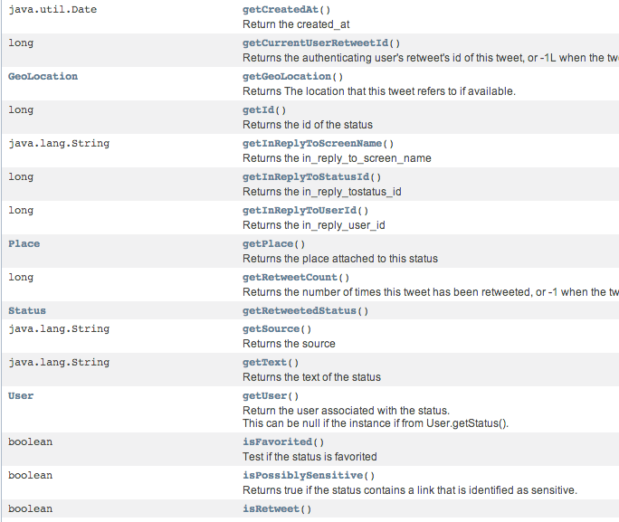
Main Classes: Status
It represents a tweet
© Fabio Ciravegna, University of Sheffield

Slide 28
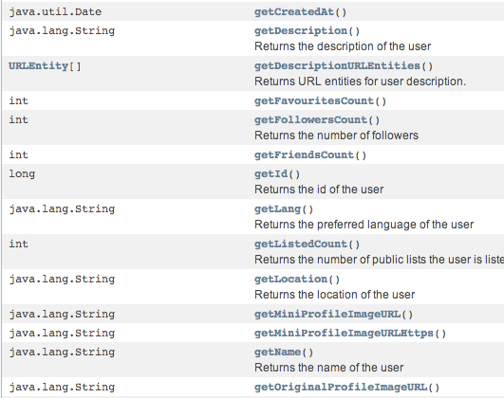
Main Classes: User
It represents a user
© Fabio Ciravegna, University of Sheffield

Slide 29
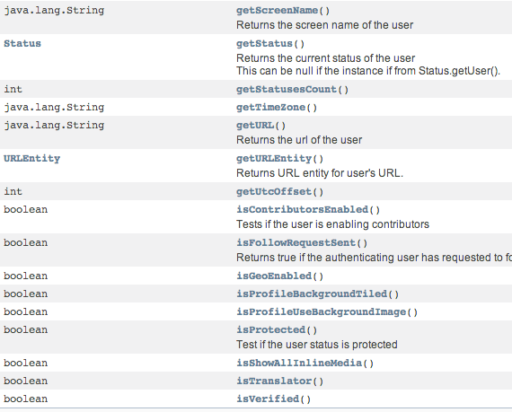
User (2)
© Fabio Ciravegna, University of Sheffield

Slide 30
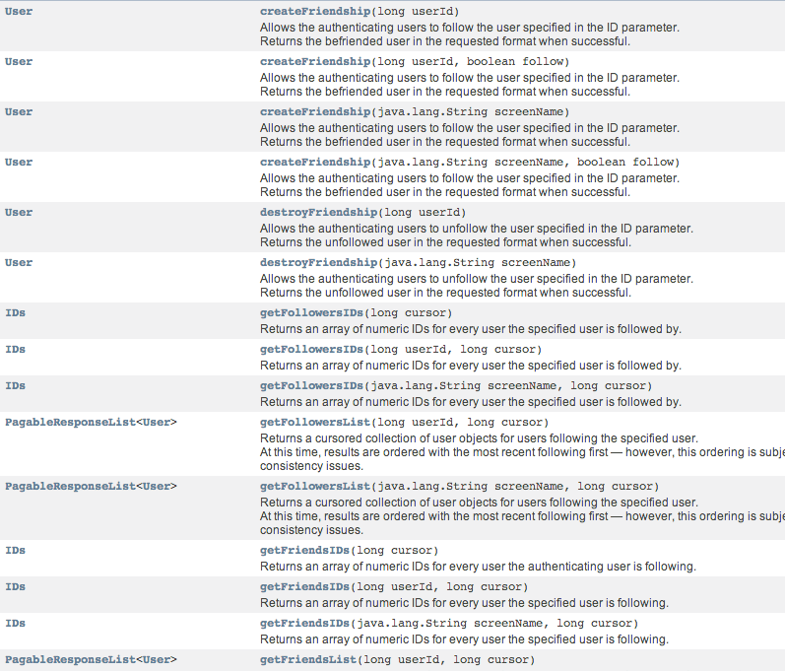
Main Classes: Twitter
Main Classes: Twitter
© Fabio Ciravegna, University of Sheffield

Slide 31
Twitter API details
Each OAuth key has 300 queries per hour allowed
You always must check the code returned by each call
If asked to desist you must stop and wait
Most calls will tell you when you can query again
Sometimes they do not -> wait for an hour, then
Using multiple keys is forbidden
© Fabio Ciravegna, University of Sheffield

Slide 32
Practical Session:
Accessing Twitter
Faculty
Of
Engineering.

Slide 33
Interacting with Twitter in Java
http://twitter4j.org
Twitter4J is an unofficial Java library for the Twitter API.
You can easily integrate Java application with the Twitter service
Twitter4J is featuring:
100% Pure Java - works on any Java Platform version 1.4.2 or later
Android platform and Google APP Engine ready
Zero dependency : No additional jars required
Built-in OAuth support
Out-of-the-box gzip support
Just download and add its jar file to the application classpath.
© Fabio Ciravegna, University of Sheffield

Slide 34
Authentication for Twitter API
https://dev.twitter.com/docs/auth/obtaining-access-tokens
In order to make authorized calls to Twitter's APIs
Your application must first obtain an OAuth access token
On behalf of a Twitter user
The dev.twitter.com application control panel offers the ability to generate an OAuth access token for the owner of the application.
This is useful if:
Your application only needs to make requests on behalf of a single user (for example, establishing a connection to the Streaming API)
© Fabio Ciravegna, University of Sheffield

Slide 35
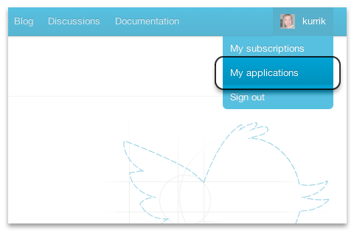
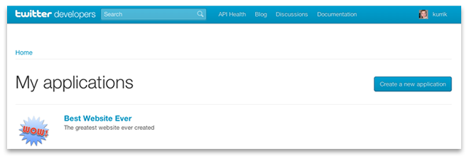
Generating a Token
Visit dev.twitter.com "My applications" page, either by
navigating to dev.twitter.com/apps,
or hovering over your profile image in the top right hand corner of the site and selecting "My applications"
Click on my applications --> Create new applications
© Fabio Ciravegna, University of Sheffield

Slide 36
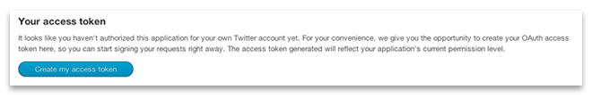
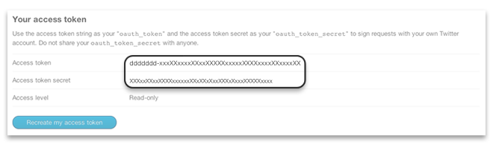
Access Token
At the bottom of the next page, you will see a section labeled "your access token":
Click on the "Create my access token" button
© Fabio Ciravegna, University of Sheffield

Slide 37
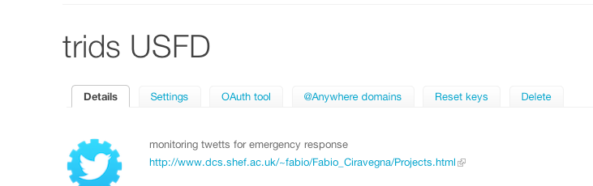
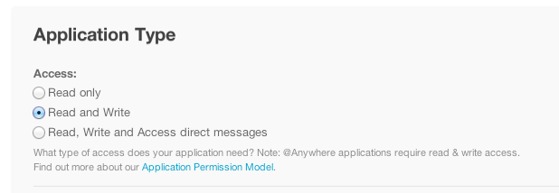
Changing access level
For most application the default access level (read-only) is fine
In some cases you will need writing permissions
My Application Name
© Fabio Ciravegna, University of Sheffield
Click settings

Slide 38
Set Import
import java.io.FileInputStream;
import java.io.IOException;
import java.net.URLEncoder;
import java.text.SimpleDateFormat;
import java.util.ArrayList;
import java.util.Date;
import java.util.HashMap;
import java.util.List;
import java.util.Properties;
import java.util.logging.Level;
import java.util.logging.Logger;
import java.util.regex.Matcher;
import java.util.regex.Pattern;
import twitter4j.User;
import twitter4j.conf.ConfigurationBuilder;
import twitter4j.json.DataObjectFactory;
© Fabio Ciravegna, University of Sheffield

Slide 39
Set Import
import org.apache.solr.client.solrj.SolrServer;
import org.apache.solr.client.solrj.SolrServerException;
import org.apache.solr.client.solrj.impl.HttpSolrServer;
import org.apache.solr.client.solrj.request.UpdateRequest;
import org.apache.solr.client.solrj.response.UpdateResponse;
import org.apache.solr.common.SolrInputDocument;
import twitter4j.GeoLocation;
import twitter4j.Query;
import twitter4j.QueryResult;
import twitter4j.Status;
import twitter4j.Twitter;
import twitter4j.TwitterException;
import twitter4j.TwitterFactory;
© Fabio Ciravegna, University of Sheffield

Slide 40
OAuth access
public TweetExtractor(){
//sets server
server = new HttpSolrServer("http://localhost:8983/solr/tweets");
// builds authentication
cb = new ConfigurationBuilder();
cb.setJSONStoreEnabled(true);
ConfigurationBuilder setOAuthAccessTokenSecret;
setOAuthAccessTokenSecret = cb.setDebugEnabled(true)
.setOAuthConsumerKey("")
.setOAuthConsumerSecret("")
.setOAuthAccessToken("")
.setOAuthAccessTokenSecret("");
TwitterFactory tf = new TwitterFactory(cb.build());
twitter= tf.getInstance();
}
© Fabio Ciravegna, University of Sheffield

Slide 41
Perform Twitter Search
public String[] search(String keyword,int num){
String[] tweetsToReturn=new String[num];
Query query = new Query(keyword).lang("en");
query.setCount(1);
QueryResult result = null;
int cnt=0;
do {
try {
Thread.sleep(1000);
} catch (InterruptedException ex) {
ex.printStackTrace();
}
try{
result = twitter.search(query);
List<Status> tweets = result.getTweets();
for (Status tweet : tweets) {
addTweetToDB(tweet);
}
}
catch(Exception ex){
ex.printStackTrace();
}
} while (cnt<num&&(query = result.nextQuery()) != null);
return tweetsToReturn;
}
© Fabio Ciravegna, University of Sheffield

Slide 42
Main method
public static void main(String[] args) {
TweetExtractor te = new TweetExtractor();
System.out.println("*****emergency");
te.search("Emergency",1);
try{
Thread.sleep(20*1000*60);
}
catch(Exception e){};
}
© Fabio Ciravegna, University of Sheffield

Slide 43
Retrieve Geolocated Tweets
Get tweets from people in Sheffield about Sheffield
People in Sheffield == geolocated in Sheffield
About Sheffield == using #Sheffield
A number of examples at https://github.com/yusuke/twitter4j/tree/master/twitter4j-examples/src/main/java/twitter4j/examples
© Fabio Ciravegna, University of Sheffield

Slide 44
GeoSearch
public String getSimpleTimeLine(){
String resultString= "";
try{
Query query= new Query("#sheffield");
query.setGeoCode(new GeoLocation(53.383, -1.483), 2,Query.KILOMETERS);
QueryResult result = twitter.search(query);
List<Status> tweets = result.getTweets();
for (Status tweet : tweets) {
User user = tweet.getUser();
Status status= (user.isGeoEnabled())?user.getStatus():null;
if (status==null)
resultString+="@" + tweet.getText() + " ("
+ user.getLocation()
+ ") - " + tweet.getText() + "\n";
else resultString+="@" + tweet.getText()
+ " (" + ((status!=null&&status.getGeoLocation()!=null)?
status.getGeoLocation().getLatitude()
+","+status.getGeoLocation().getLongitude():user.getLocation())
+ ") - " + tweet.getText() + "\n";
}
}catch (Exception te){
te.printStackTrace();
System.out.println("Failed to search tweets:" + te.getMessage());
System.exit(-1);
}
return resultString;
}
© Fabio Ciravegna, University of Sheffield

Slide 45
Main (geosearch)
public static void main(String[] args)
{
TweetExtractor te = new TweetExtractor();
System.out.println(te.getSimpleTimeLine());
}
© Fabio Ciravegna, University of Sheffield

Slide 46
Output
@eatSheffield (Sheffield) - RT @barandgrillshef: #Sheffield if you had to order a cocktail what would it be, or would you just like a cup from
@YorkshireTea ?@barandgrillshef (Leopold Square, Sheffield) - #Sheffield if you had to order a cocktail what would it be, or would you just like a cup from @YorkshireTea ?
@CFMDsFMKX (Sheffield Hallam University) - We're teaching today at #sheffieldhallam #sheffield on our UG programme in #facilitiesmanagement on Managing Premises & The Work Environment
@Map_Game (-12.5743, 131.102) - Where is Sheffield on the map? Play the game at http://www.map-game.com/sheffield #Sheffield
@Map_Game (-12.5743, 131.102) - Where is Sheffield on the map? Play the game at http://www.map-game.com/sheffield #Sheffield
@barandgrillshef (Leopold Square, Sheffield) - Fancy relaxing on the beach #sheffield http://www.youtube.com/watch?v=Dax5Sbt20sA we'll see you there
@barandgrillshef (Leopold Square, Sheffield) - #Sheffield #Cloudy according to the BBC http://news.bbc.co.uk/weather/forecast/353 hows your day?
@barandgrillshef (Leopold Square, Sheffield) - #mothersday april 3 any plans #sheffield ? why not book a table now http://www.barandgrillsheffield.co.uk/mothers-day/]
@Kineets (sheffield) - @shefgossip what's all the factor lot doing here @katiewaissel24 checked in #sheffield an hour ago?
@aryayuyutsu (53.382419,-1.478586) - RT @SheffieldStar 400 workers lose job as firm closes down in #Chesterfield http://bit.ly/hpX8NK (#Sheffield)
@Map_Game (-12.5743, 131.102) - Where is Sheffield on the map? Play the game at http://www.map-game.com/sheffield #Sheffield
@Map_Game (-12.5743, 131.102) - Where is Sheffield on the map? Play the game at http://www.map-game.com/sheffield #Sheffield
@Map_Game (-12.5743, 131.102) - Where is Sheffield on the map? Play the game at http://www.map-game.com/sheffield #Sheffield
@aryayuyutsu (53.382419,-1.478586) - Off for the final night of a most ROTFL-ing and LOL-ing and LMAO-ing #ComedyFestival 2011. I voted for the amazing #Thünderbards! #Sheffield
@Map_Game (-12.5743, 131.102) - Where is Sheffield on the map? Play the game at http://www.map-game.com/sheffield #Sheffield
© Fabio Ciravegna, University of Sheffield

Slide 47
Retrieving Friends (or Followers)
long[] tempFriendArray = new long[0];
try {
long[] friendArray= twitter.getFriendsIDs(userId, -1).getIDs();
// followers: long[] followerArray= twitter.getFollowersIDs(userId, -1).getIDs();
Long[] myIds= new long[100]
For (int ix=0; ix<100; ix++) myIds[ix]= friendArray[ix];
ResponseList<twitter4j.User> userList = twitter.lookupUsers(myIds);
for (User us : ll) {
/* do whatever necessary with the user */
}
} catch (TwitterException e) {
e.printStackTrace();
}
It gets 5000 IDs at a time
© Fabio Ciravegna, University of Sheffield
It looks up up to 100 ids for one call

Slide 48
Processing Social media Content
Faculty
Of
Engineering.

Slide 49
Information Extraction
Automatic methodologies for identifying important information in a piece of text
Is a fundamental method for knowledge capture from structured and unstructured text
Allows to recognise terms, hashtags, dates
If couple with semantic technologies (i.e. ontologies) allows linking instances to concepts
increased structure
allows linkages, inferences etc.
This tutorial is not about methodologies for IE so we will just look into easy to use technologies, not into the algorithms behind them
© Fabio Ciravegna, University of Sheffield

Slide 50
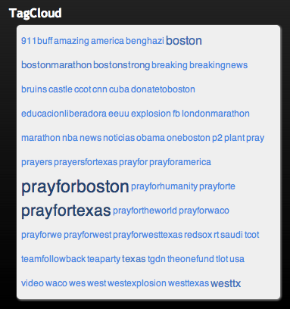
Term recognition
Recognises words from a pre-defined dictionary
does not classify them
can recognise synonyms
very useful to recognise
hashtags
topics most talked
forms the basis for tagcloud
Give your backing to Sheffield venues in running for top awards:
#Tramlines Shef is encouraging everyone to get behind... http://bit.ly/VfBrM4
© Fabio Ciravegna, University of Sheffield

Slide 51
Entity recognition
Classification of text into pre-defined classes
belonging to a schema, a dictionary or an ontology
<User>The Star</User>
<Date>20/09/2012</Date>
<City>Sheffield</City>
<Tweet>
Give your backing to <City>Sheffield</City>
venues in running for top awards:
#Tramlines Shef is encouraging everyone to get behind... http://bit.ly/VfBrM4
</Tweet>
© Fabio Ciravegna, University of Sheffield

Slide 52
Sentiment Detection
Uses complex algorithms to associate opinions and feelings to tweets or topics
Simple versions may just consider emoticons and provide positive/negative/neutral feedback
Advanced version will look at
emotional states
emotions for specific subsets of a concept
grades of emotions
© Fabio Ciravegna, University of Sheffield

Slide 53
More complicated IE
Information Integration
similar instances are integrated as they refer to the same concept
Relation Extraction
text is interpreted to relate entities
<band>Rolling Stones</band> are playing<festival>Glastonbury</festival>
© Fabio Ciravegna, University of Sheffield
Subject
Predicate
Object

Slide 54
Why is IE for Tweets difficult?
Tweets (and in general social media content) are characterised by
short text
often ungrammatical
containing abbreviations, slang, misspelling
concerning the short time period
Moreover there is a trade off between in depth IE and real-time analysis
© Fabio Ciravegna, University of Sheffield

Slide 55
Existing technologies
Stanford NLP Tools (www-nlp.stanford.edu/software/CRF-NER.shtml)
JAVA
entity recognition and complex NLP
Gate (gate.ac.uk/ie/)
JAVA
term recognition
entity recognition
NLP
© Fabio Ciravegna, University of Sheffield

Slide 56
Existing technologies
Alchemy API (http://www.alchemyapi.com/)
sentiment analysis
Entity Extraction
Keyword Extraction
Concept Tagging
Relation Extraction
Multi-language support (English, Spanish, German, Russian, Italian)
you need to register for an API key
© Fabio Ciravegna, University of Sheffield

Slide 57
Existing technologies
Zemanta (http://developer.zemanta.com/)
for any given text returns
entities
related images
articles
hyperlinks
tags
you need to register for an API key
© Fabio Ciravegna, University of Sheffield

Slide 58
Practical Session:
extracting hashtags and UserIDs
Faculty
Of
Engineering.

Slide 59
Term recognition
In order to recognise terms we will use regular expressions
A specific pattern that provides concise and flexible means to "match" (specify and recognize) strings of text, such as particular characters, words, or patterns of characters
Regular expressions can be applied to any text
Fast processing
Very precise results
© Fabio Ciravegna, University of Sheffield

Slide 60
Hashtag Recognition
Pattern pHashTags = Pattern.compile("(#\\w+)");
// hashtags
Matcher matchTags = pHashTags.matcher(tweet.getText());
String hashtags="";
while(matchTags.find()){
hashtags+=matchTags.group(1)+" ";
}
© Fabio Ciravegna, University of Sheffield

Slide 61
UserID recognition
Pattern pMentions = Pattern.compile("(@\\w+)");
Matcher matchMention = pMentions.matcher(tweet.getText());
String mentions="";
while(matchMention.find()){
mentions+=matchMention.group(1)+" ";
}
© Fabio Ciravegna, University of Sheffield

Slide 62
Sentiment Analysis (Alchemy)
import com.alchemyapi.api.AlchemyAPI;
import com.alchemyapi.api.AlchemyAPI_NamedEntityParams;
import java.io.IOException;
import java.io.StringWriter;
import java.util.logging.Level;
import java.util.logging.Logger;
import javax.xml.parsers.ParserConfigurationException;
import javax.xml.transform.Transformer;
import javax.xml.transform.TransformerException;
import javax.xml.transform.TransformerFactory;
import javax.xml.transform.dom.DOMSource;
import javax.xml.transform.stream.StreamResult;
import javax.xml.xpath.XPathExpressionException;
import org.w3c.dom.Document;
import org.xml.sax.SAXException;
© Fabio Ciravegna, University of Sheffield

Slide 63
Authentication
public class Analysis {
AlchemyAPI alchemyObj;
public Analysis(){
alchemyObj= AlchemyAPI.GetInstanceFromString("");
}
© Fabio Ciravegna, University of Sheffield

Slide 64
Analysis
public float analyse(String analysethis){
try {
AlchemyAPI_NamedEntityParams entityParams = new AlchemyAPI_NamedEntityParams();
entityParams.setSentiment(true);
Document doc = alchemyObj.TextGetTextSentiment(analysethis);
String xmlresp = getStringFromDocument(doc);
System.out.println(xmlresp);
System.out.println(alchemyObj.TextGetRankedNamedEntities("Person"));
return Float.parseFloat(xmlresp.split("<score>")[1].split("</score>")[0]);
} catch (Exception ex) {
// ex.printStackTrace();
return -99;
}
}
© Fabio Ciravegna, University of Sheffield

Slide 65
Main
public static void main(String[] args) {
Analysis an = new Analysis();
System.out.println(an.analyse(" I am so blown away by the police officers and all 1st responders in Boston. Awesome bravery. I salute you! #BostonStrong")); }
© Fabio Ciravegna, University of Sheffield

Slide 66
Keywords Extraction
Document doc2 = alchemyObj.TextGetRankedKeywords(analysethis);
System.out.println(getStringFromDocument(doc2));
© Fabio Ciravegna, University of Sheffield

Slide 67
Concept Extraction
Document doc2 = alchemyObj.TextGetRankedConcept(analysethis);
System.out.println(getStringFromDocument(doc2));
© Fabio Ciravegna, University of Sheffield

Slide 68
Entity Extraction
Document doc2 = alchemyObj.TextGetRankedNamedEntities(analysethis);
System.out.println(getStringFromDocument(doc2));
© Fabio Ciravegna, University of Sheffield

