Slide 1
Rapid evaluation of multispecies connectivity (Reconnect)
R-tool to efficiently compute multiple connectivity indicators for multiple species needs and across large regions of interest
by
Jacqueline Oehri

Slide 2
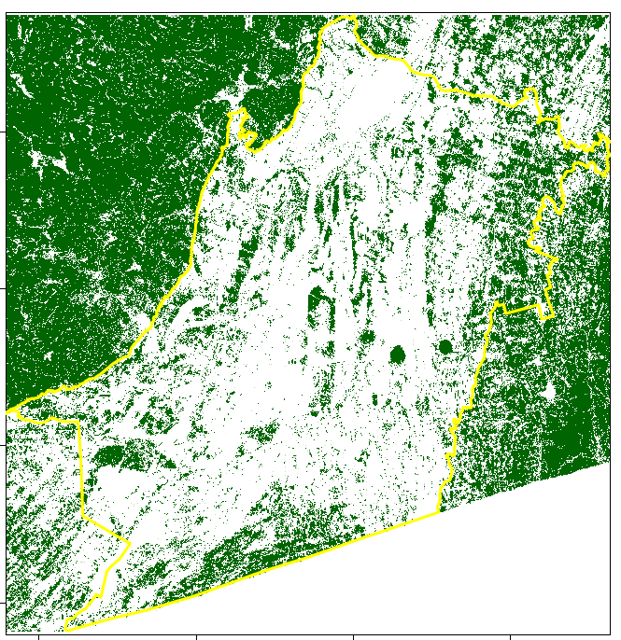
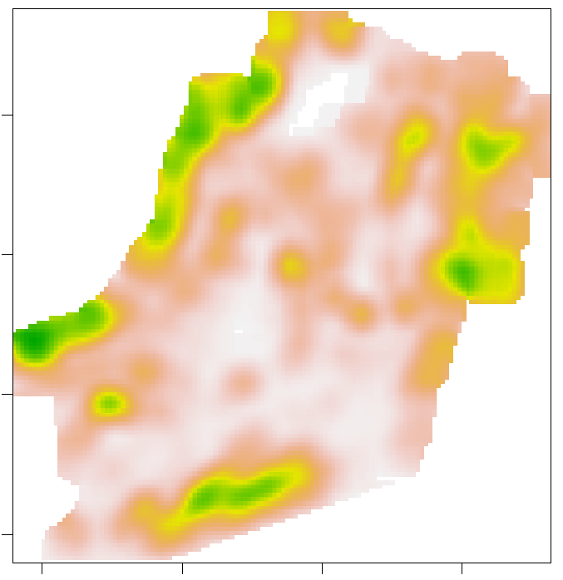

Rapid evaluation of multispecies connectivity (Reconnect)
Habitat map
species specific minimum patch size
2) Multilayer networks
species specific dispersal capacity
3) Connectivity maps
4) Multispecies persistence in region of interest
Species 1
Species 2
Conservation target
Species 3
Connectivity indicator X
Scalable moving windows: size dependent on species dispersal capacity
Species rank

Slide 3
Reconnect R-tool core functions
1 ) Reconnect_wrap()
Implement moving windows, scales and resolution of interest
Read inifile (a), apply connectivity functions in moving windows using Reconnect_core (b)
2) Reconnect_summary()
Summarize moving window outputs into seamless maps
At pixel, patch and landscape-level
1a) Reconnect_inifile.xlsx
define connectivity functions
define species needs (habitat, dispersal)
1b) Reconnect_core()
Apply connectivity functions in moving windows

Slide 4
Connectivity indicator – functions
Metapopulation capacity (MPC)
2. Equivalent Connected Area (ECA)
3. Fraction of connected habitat (ECA_{AP}, ECA_{AL})
4. Betweenness centrality (BC), node degree (ND)
5. Inverse cumulative resistance (invCR)
«Barrier»
Highlights:potential long-term species persistence.
Metapopulation carrying capacity, based on area and connectance of habitat (Hanski & Ovaskainen 2000, Schnell et al. 2013).
Highlights: size (area) of connected habitat.
The size of a single habitat patch providing the same probability of connectivity than the actual habitat pattern in the landscape (Saura et al. 2011).
Highlights: underused connectivity potential.
Fraction of habitat that is connected: ECA divided by the total habitat area (AP) or landscape area (AL; cf. ProtConn index, Saura et al. 2017).
Highlights: stepping stones.
BC (Brandes 2001): nr. of shortest paths between pairs of habitat patches passing through a focal patch.
ND (Minor & Urban 2008): nr. of habitat patches connected to a focal patch.
Highlights: ease of landscape traversability. Omnidirectional inverse cumulative resistance (Albert et al. 2017).
Notes:
We also selected these indicators because of their alignment with latest scientific criteria for Essential Biodiversity Variables^{20,21} (i.e. feasibility, scalability, sensitivity to temporal change, and relevance for biodiversity conservation targets)²¹.

Slide 5
Connectivity indicator – functions
Metapopulation capacity (MPC)
Equivalent Connected Area (ECA)
Fraction of connected habitat (ECA_{AP}, ECA_{AL})
Betweenness centrality (BC), node degree (ND)
Inverse cumulative resistance (invCR)
«Barrier»
Highlights potential long-term species persistence.
Highlights size (area) of connected habitat.
Highlights underused connectivity potential.
Highlights stepping stones.
Highlights: ease of landscape traversability.
Notes:
We also selected these indicators because of their alignment with latest scientific criteria for Essential Biodiversity Variables^{20,21} (i.e. feasibility, scalability, sensitivity to temporal change, and relevance for biodiversity conservation targets)²¹.

Slide 6



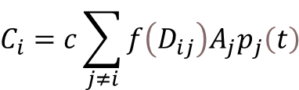

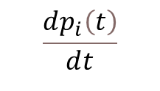








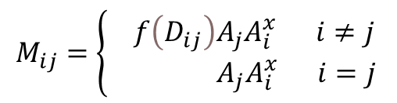








Metapopulation capacity indicator – based functions
$$A_{3}$$
Occupancy-based, spatially explicit
metapopulation model (SEM)
$$D_{i3}$$
$$A_{4}$$
$$\frac{ⅆp_{i}\left(t\right)}{ⅆt}=C_{i}\left[1−p_{i}\left(t\right)\right]−E_{i}p_{i}\left(t\right)$$
$$A_{2}$$
$$A_{5}$$
$$D_{i4}$$
$$C_{i}=c\sum_{j≠i}{f\left(D_{ij}\right)A_{j}p_{j}\left(t\right)}$$
$$D_{i5}$$
$$D_{i2}$$
$$\frac{ⅆp_{i}\left(t\right)}{ⅆt}$$
$$D_{ij}$$
$$E_{i}=\frac{ⅇ}{A_{i}^{x}}$$
$$A_{6}$$
$$A_{j}$$
$$D_{i6}$$
$$\frac{ⅇ}{A_{i}^{x}}$$
Metapopulation capacity (MPC) as leading eigenvalue of ‘landscape matrix’ (M)
$$D_{i7}$$
$$A_{7}$$
$$D_{i8}$$
$$M_{ij}=\left\{\begin{aligned} f\left(D_{ij}\right)A_{j}A_{i}^{x} i≠j \\ { A}_{j}A_{i}^{x} i=j\end{aligned}\right.$$
$$A_{8}$$
$$MPC={λ }_{M}$$

Slide 7
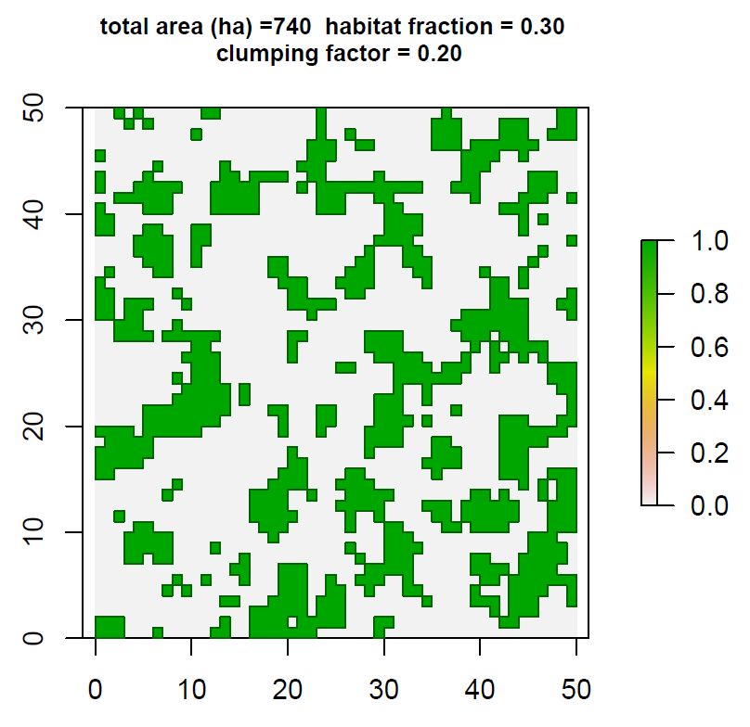
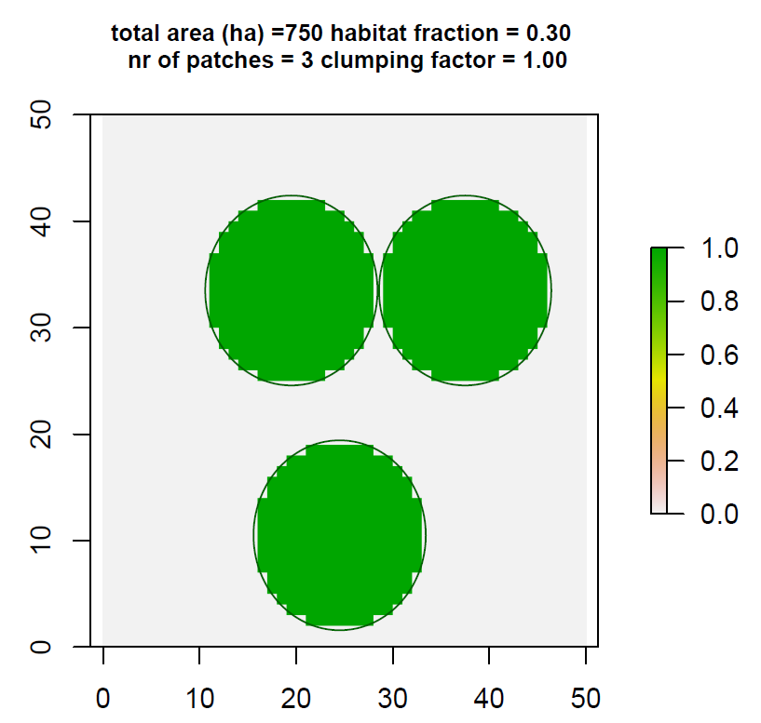
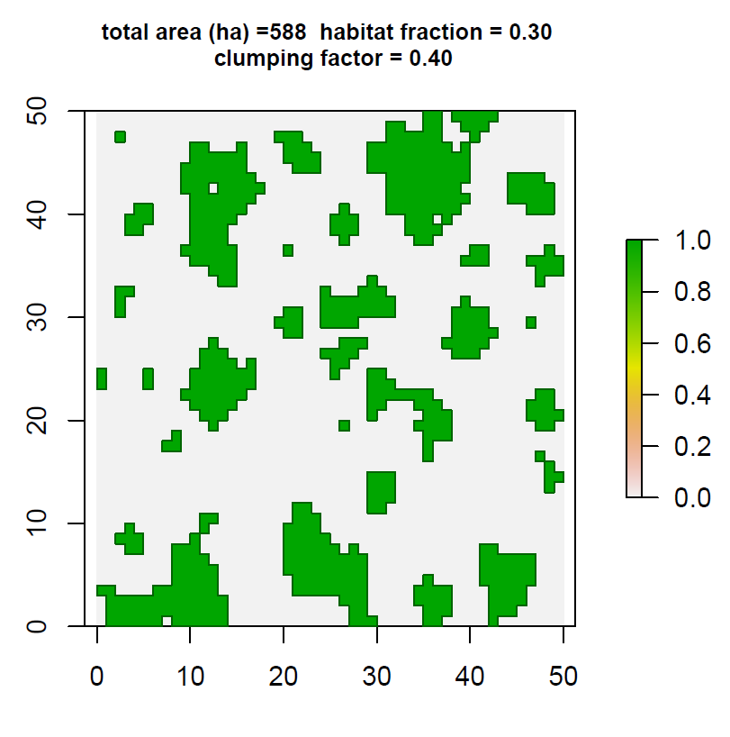
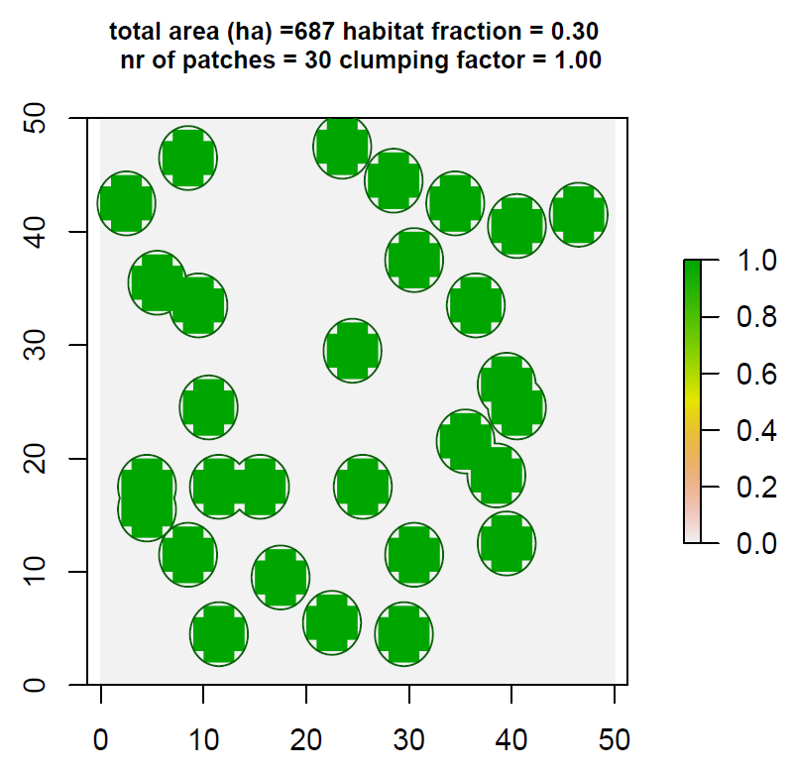
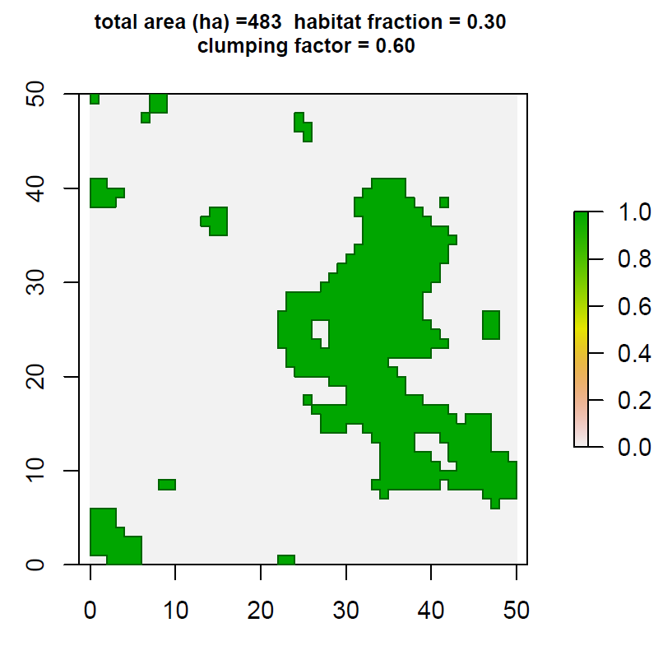
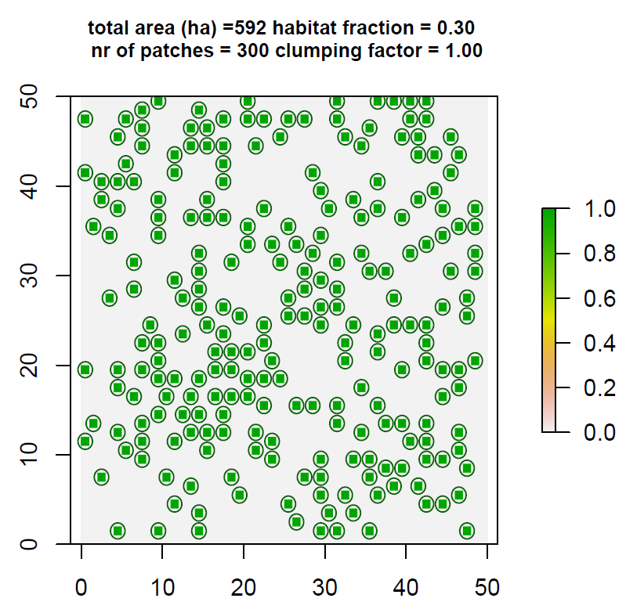
Neutral landscape models
Generate simulated landscapes «libraries» covering a gradient in habitat amount & fragmentation (clumping)
Functions for two types available:
Random cluster
Based on the algorithm by Saura & Martínez-Millán 2000. and the NLMR R-package (Sciaini et al. 2018)
Simple-circle
Simple indication of habitat amount and number of patches.

Slide 8
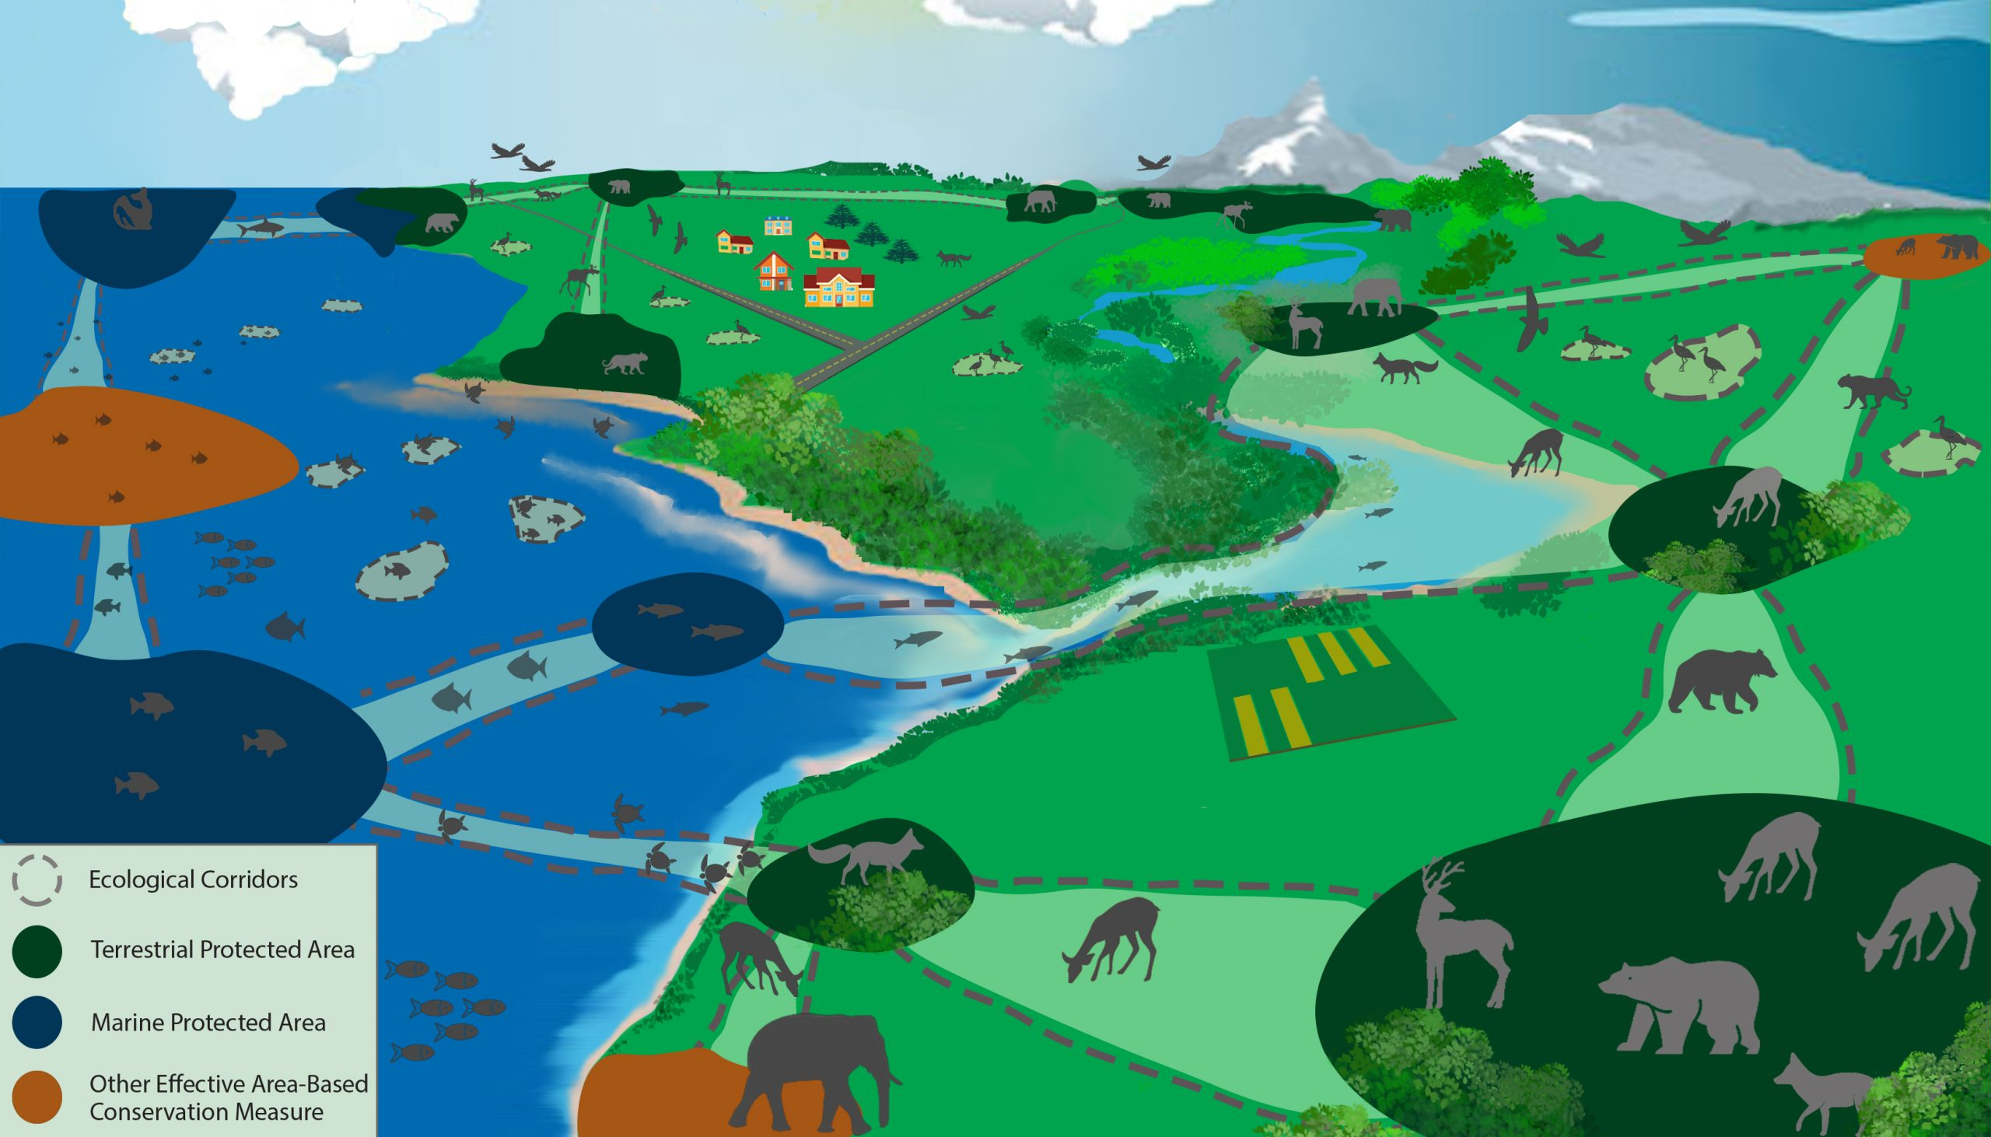

Introduction
Ecological connectivity:
The ‘unimpeded movement of species and the flow of natural processes that sustain life on Earth’
(Convention on Migratory Species, UN, 2019)
Important for
Persistence of biodiversity
Landscape ecosystem functioning & resilience
Access to Nature’s Contributions to People
Central to
the targets of the Kunming-Montreal Global Biodiversity Framework
Kendra Hoff, CLLC
Notes:
Ecological connectivity, however, the ‘unimpeded movement of species and the flow of natural processes that sustain life on Earth’, is essential for biodiversity and human well-being.
For example, dispersal and migration enable many species to access vital resources and complete their lifecycles, maintain geneflow, as well as track their climate niches. Likewise, connectivity is important for landscape ecosystem functioning and resilience, as well as access to Nature’s contributions to people from many people.
Hence, it is not surprising that restoring connectivity is one of the central targets in the Post 2020 strategy of the Convention on Biological Diversity (CBD).

Slide 9
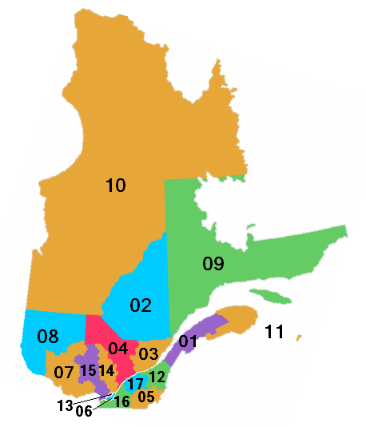
Motivation
Safeguarding connectivity for biodiversity (many species!)
Conservation targets
Connectivity for biodiversity
Status or trend in connectivity
0
time
species
2010
2020
2030
Spatial planning for connectivity
Need for tools that enable monitoring of multiple aspects of connectivity for multiple species that are efficient, scalable, validated & that allow evaluation regarding conservation targets!
Notes:
Therefore, to safeguard connectivity for biodiversity, we need an iterative workflow where
We set conservation targets, such as to bend the curve of connectivity loss for biodiversity,
We then monitor e.g. the temporal trend in connectivity for many species in any region of interest
By comparing actual values (blue) with target values (green or orange) we can adjust spatial planning for connectivity and enter a new loop of monitoring.
Therefore, we need a method allowing the rapid evaluation of species connectivity over large areas of interest to support spatial planning for connectivity. This means that the method should be simple, scalable, generalizable and validated; and at the same time be able to account for multiple dimensions of species traits and habitat needs.

Slide 10
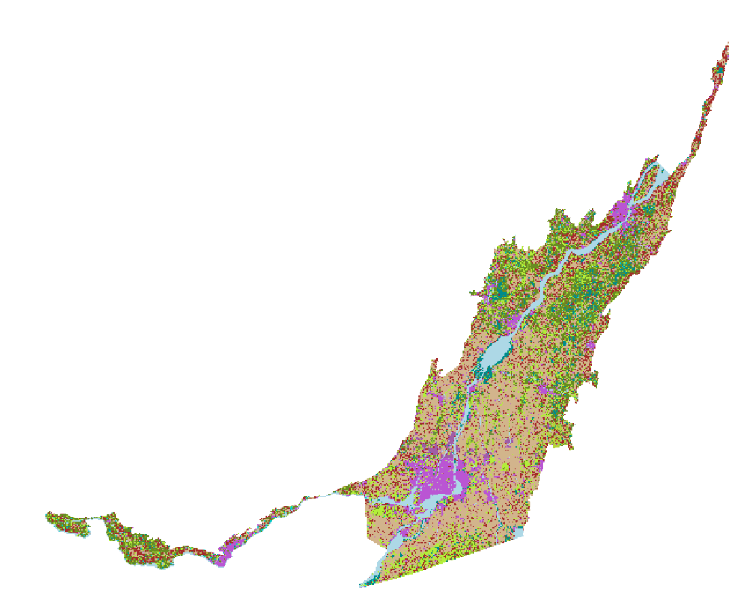
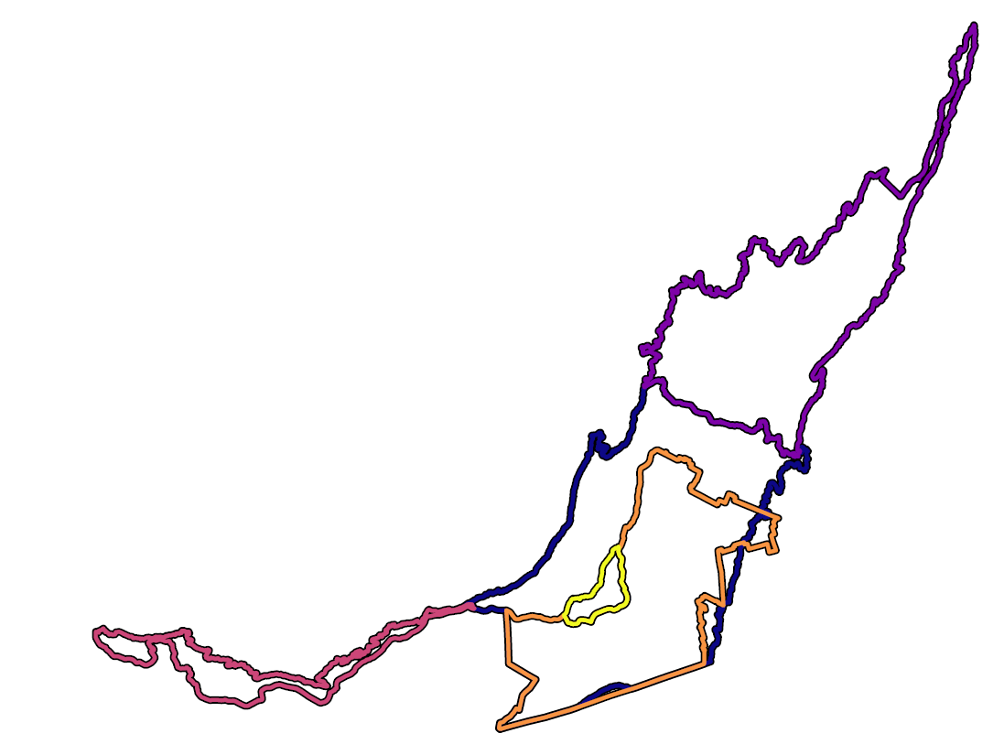
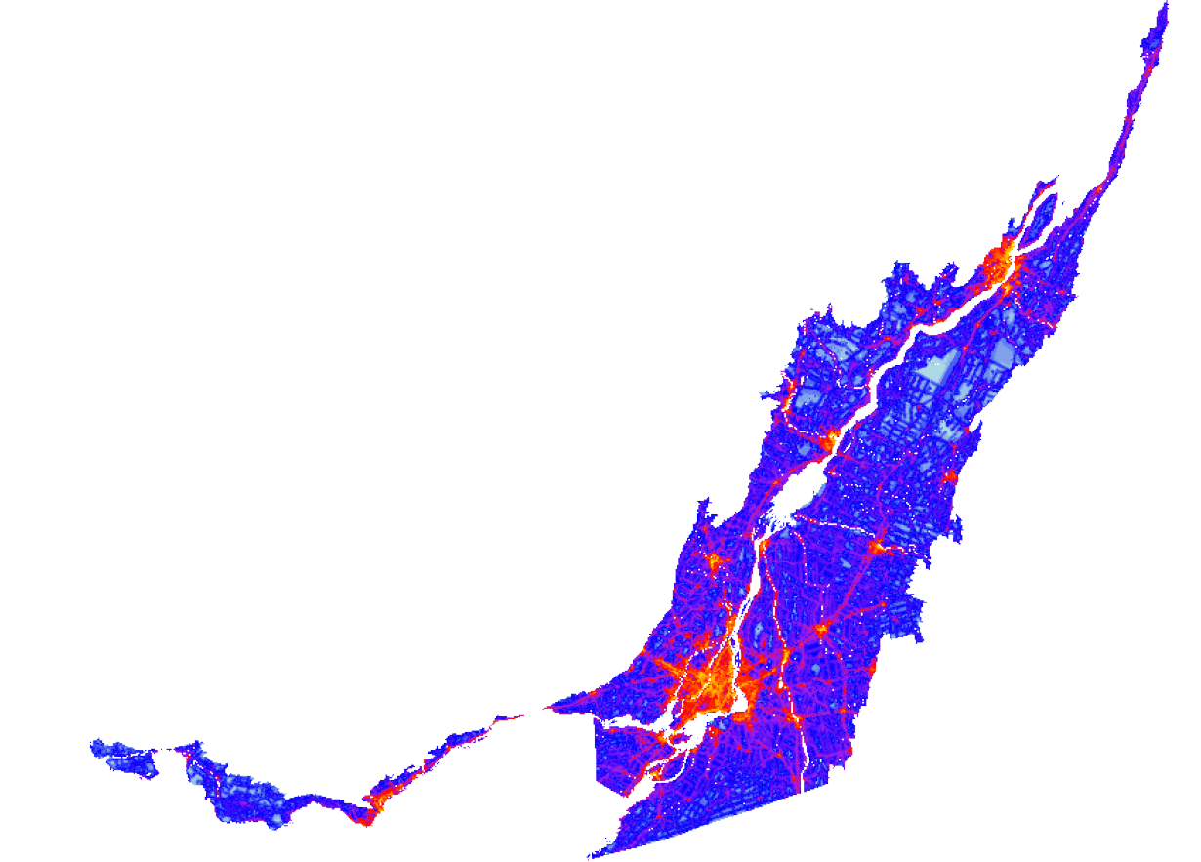
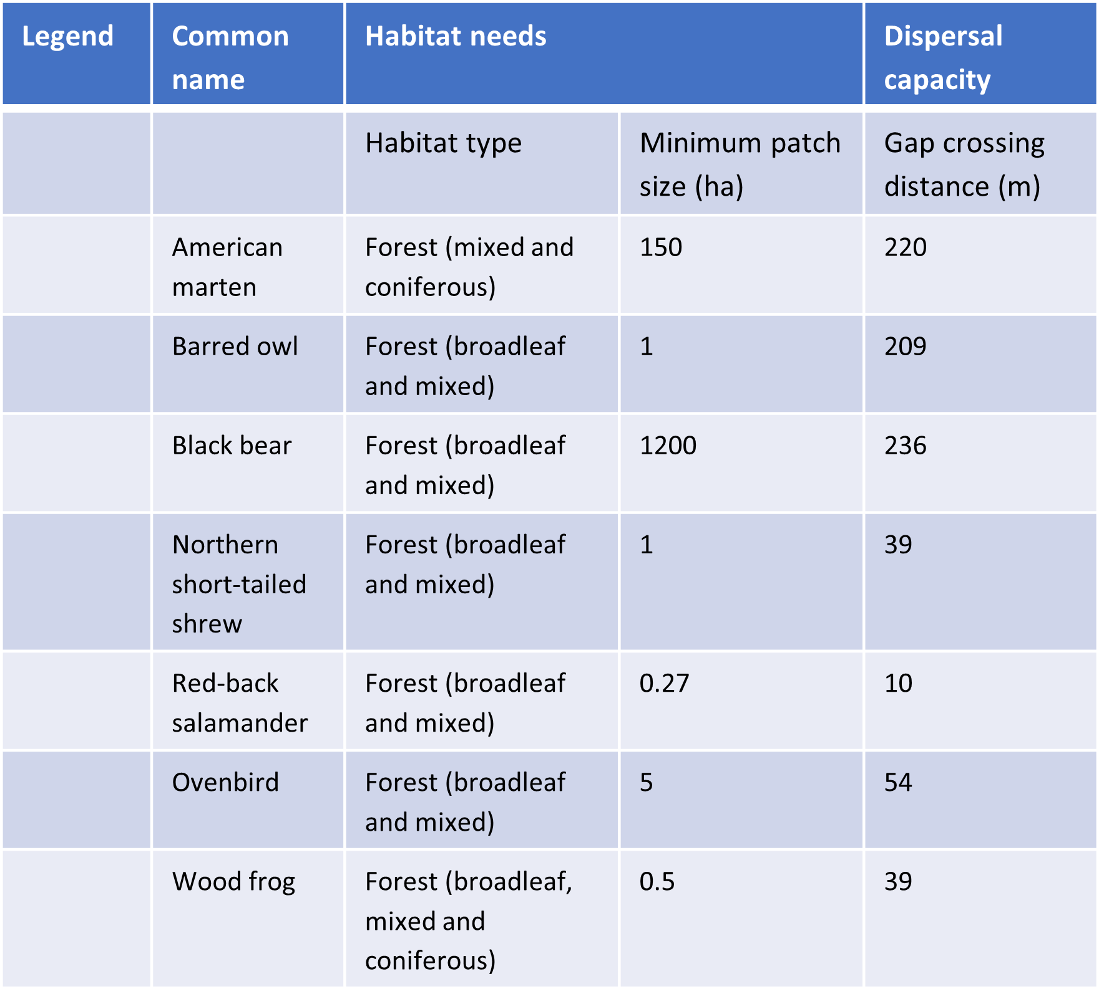
Rapid assessment of multiple connectivity indicators for multiple species and large regions of interest
Reconnect data input
Reconnect settings
Land cover map
Species habitat needs and dispersal capacity
Region of interest (optional)
Resistance map (optional)
Moving window size
Spatial overlap
Connectivity functions
Landscape, patch and/or pixel level?
Runtime dependent on..
Resolution & extent of Data input
Number of species
Moving window size and overlap
Number and complexity of connectivity functions…

Slide 12
Rapid evaluation of multispecies connectivity (Reconnect)
Habitat map
species specific minimum patch size
2) Multilayer networks
species specific dispersal capacity
3) Connectivity maps
4) Multispecies persistence in region of interest
Species 1
Species 2
Conservation target
Species 3
Connectivity indicator X
Scalable moving windows: size dependent on species dispersal capacity
Species rank

Slide 13
Reconnect R-tool core functions
1 a) Reconnect_wrap
make moving windows
2) Reconnect_core
Apply connectivity functions in moving windows
3) Reconnect_summary
Summarize outputs from moving windows
1 b) inifile.xls
define functions*
define species needs (habitat, dispersal)
*Any function applicable to raster or shapefiles!

