Slide 1
Fazit
DOAG OCI Kickstart Workshop

Slide 4
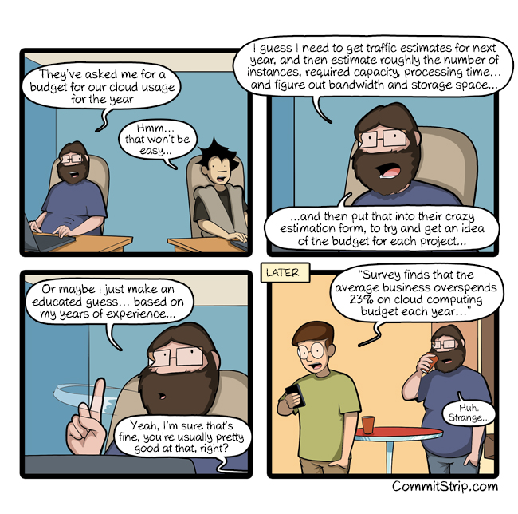

Slide 5
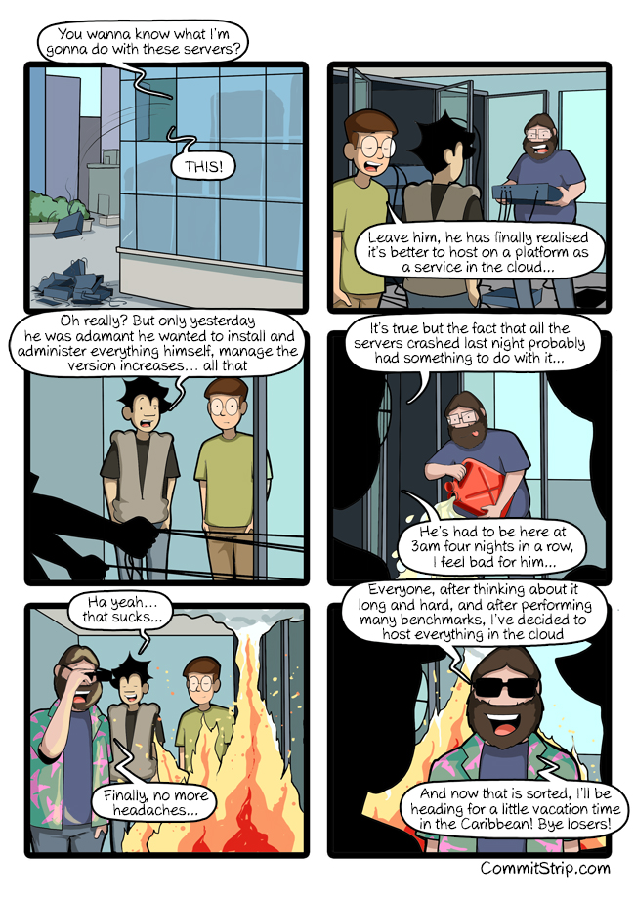

Slide 6
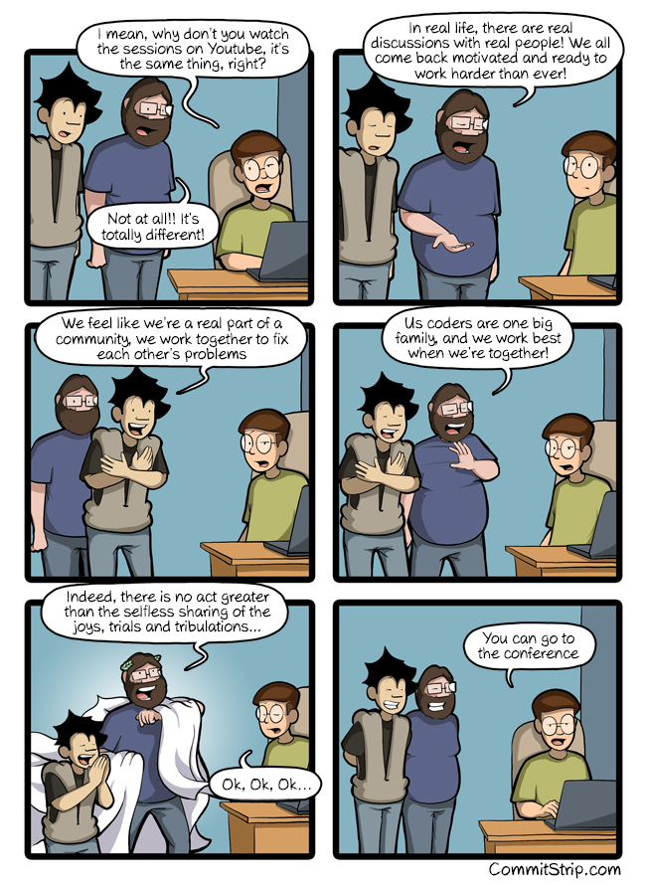

Slide 7
