Slide 1
Oracle Cloud Infrastructure Security
Security Zones
Martin Berger
Stefan Oehrli

Slide 2
Security Zones
1
Security Zones
2
Web Application Firewall
Security for free.
3
Hands-On Labs

Slide 3
Security Zones
1
Security for free.

Slide 4
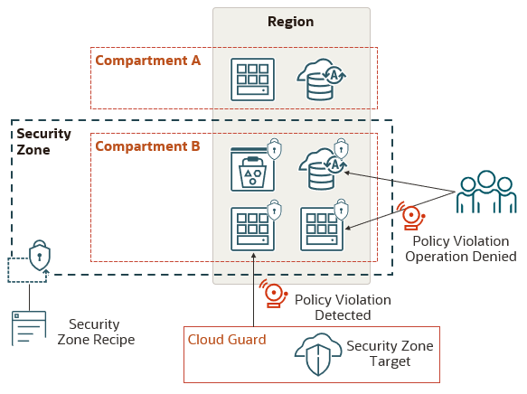
Concept
Deny Public Access
Ensure Data Security
Avoid Resource Movement
No unattached Volumes
…
Source: oracle.com

Slide 5
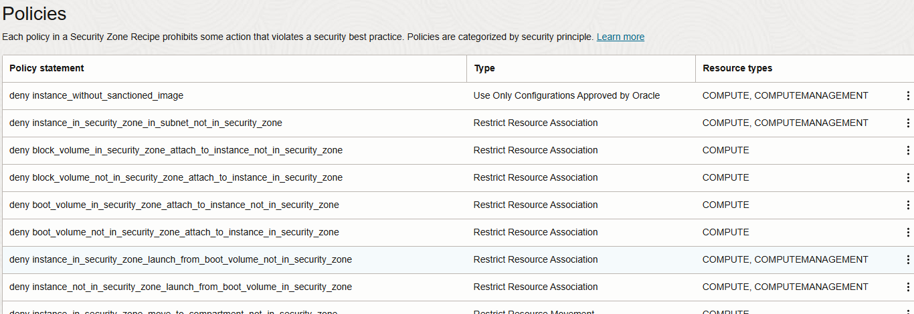
Maximum Security Recipe - 20200914

Slide 6
Components
Proactive enforcement of security policies in a compartment.
Policy Compliance:
Security Zones ensure that resources like Compute, Networking, Object Storage, Block Volume, and Database comply with security policies.
Validation and Enforcement:
OCI validates and enforces security policies when creating or updating resources in a Security Zone, denying operations that violate policies.
Predefined and Custom Recipes:
Use the Maximum Security Recipe provided by Oracle, or create custom recipes to meet specific security needs.
Oracle Cloud Guard Integration:
Enable Cloud Guard to detect policy violations in existing resources before creating Security Zones.

Slide 7
Principles
Resources in a security zone can't be moved to a compartment outside of the security zone because it might be less secure.
All the required components for a resource in a security zone must also be located in the same security zone.
Example, an instance (Compute) in a security zone can't use a boot volume that is not in the same security zone.
Resources in a security zone must not be accessible from the public internet.
Resources in a security zone must be encrypted using customer-managed keys.
Resources in a security zone must be regularly and automatically backed up.
Data in a security zone is considered privileged and can't be copied outside of the security zone because it might be less secure.
Resources in a security zone must use only configurations and templates approved by Oracle.

Slide 8
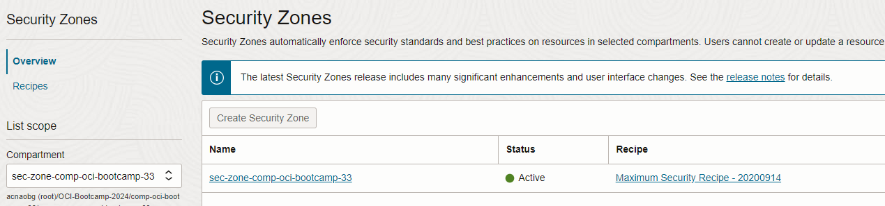
Create a new Security Zone
You can create your own recipes for a zone based on a template,
Any pre-defined Cloud Goard target settings are replaced by Oracle recipes if there is an existing detector configuration.
Rules are immediately active.

Slide 9
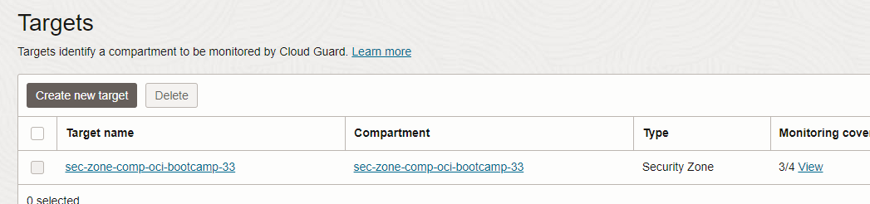
Security Zones and Cloud Guard
Compartment and Security Zone Integration:
Security Zones enforce policies on resource operations within compartments, including existing resources created before the zone.
Cloud Guard Integration:
Security Zones work with Cloud Guard to identify and address policy violations in existing resources.
Centralized Monitoring:
Cloud Guard provides a dashboard to monitor and manage security weaknesses across cloud resources, offering suggestions and corrective actions.

Slide 10
Web Application Firewall
2
Security for free.

Slide 11
Web Application Firewall WAF
Comprehensive Protection:
WAF shields applications from malicious internet traffic and enforces consistent security rules across all applications.
Advanced Threat Management:
Create and manage rules to defend against threats like XSS, SQL Injection, and other OWASP-defined vulnerabilities; access rules can limit traffic by geography or request signature.
Regional and Edge Solutions:
WAF policies are regional and act as load balancer plug-ins, while edge policies provide global protection; allowlist Oracle nodes for edge enforcement.

Slide 12
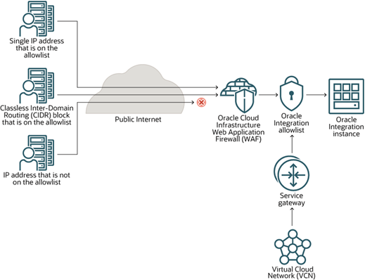
Web Application Firewall WAF Architecture

Slide 13
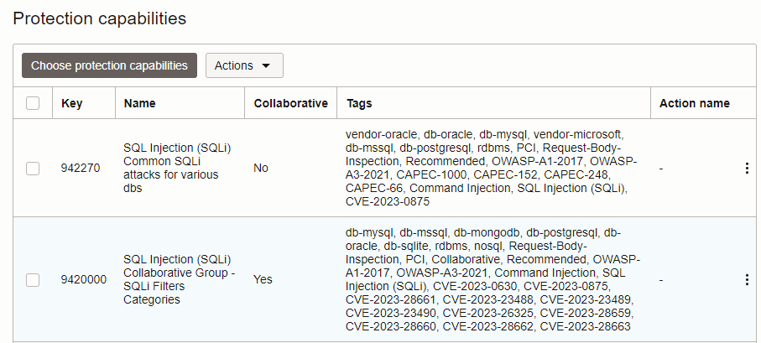
Load Balancer and WAF
A WAF – Layer 7 - can be configured in front of a load balancer to enforce security
You can define policies like regions, verify for XSS injections, rate limitations etc.
Response can be another check or a 401 error

Slide 14
Hands-On Labs
3
What about the Database Security?

Slide 15
Hands-On Labs
List of Hands-On Labs
Security Zones – Configure Security Zones to enforce compliance and security policies.
Web Application Firewall (WAF) – Set up and test the Web Application Firewall to protect applications from threats.

