Slide 1
Wrap-Up
5
Key Takeaways, Resources, and Next Steps

Slide 2
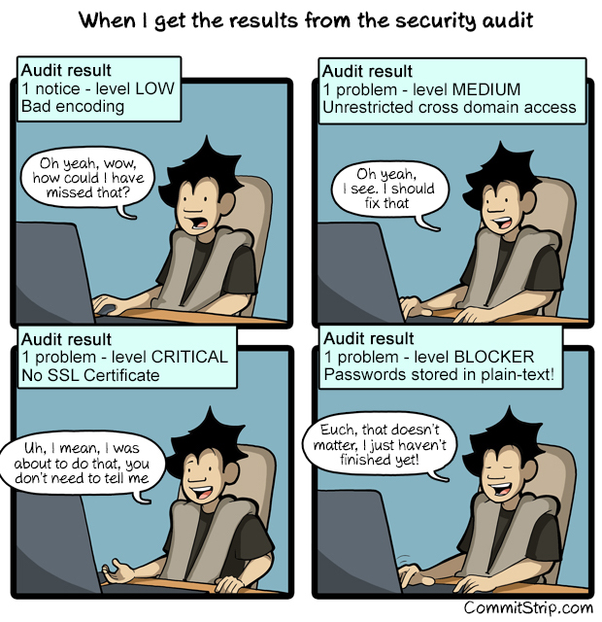
Basics of OCI Security
Foundational Security Features
Key Management
Centralized control over encryption keys to protect data at rest and in transit.
OS Management
Simplifies OS updates and patching for enhanced security.
Vulnerability Scanning
Automated detection of system vulnerabilities to proactively manage risks.
Shielded Instances
Ensures uncompromised boot security with Secure Boot, Measured Boot, and Trusted Platform Module (TPM).

Slide 3
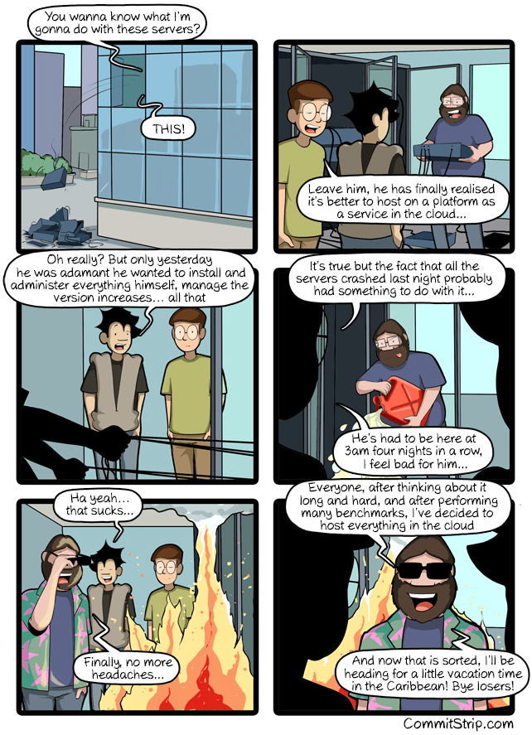
Cloud Guard Overview
Proactive Threat Monitoring
Key Features
Detect misconfigurations, vulnerabilities, and anomalous activities.
Responder recipes for automated remediation of identified risks.
Centralized monitoring and scoring for better risk management.
Use Case
Monitor resources like Object Storage, Compute Instances, and Networking.

Slide 4
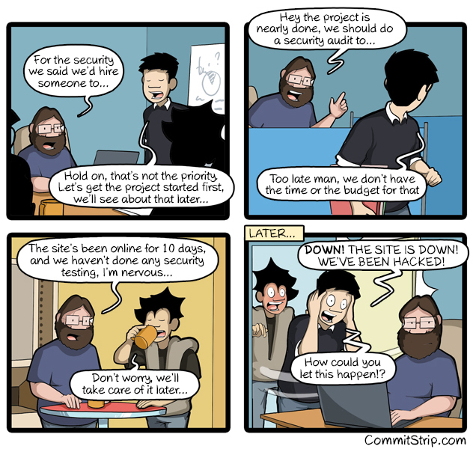
Enhancing Database Security with Data Safe
Centralized Database Security Management
Core Capabilities
Security Assessment: Analyze configurations for compliance.
User Assessment: Monitor high-risk users and their actions.
Audit Activity: Comprehensive logs for user actions and compliance.
Sensitive Data Discovery: Locate and classify sensitive data for protection.
Advanced Feature
SQL Firewall for real-time SQL execution monitoring and restriction.

Slide 5
Security Zones and Wrap-Up
Enforcing and Consolidating Security Policies
Security Zones:
Enforce strict compliance for OCI resources.
Block public access, mandate encryption, and ensure regular backups.
Seamlessly integrate with Cloud Guard for enhanced monitoring.
Overall Takeaways:
Built-in OCI features simplify complex security challenges.
Proactive tools like Cloud Guard and Data Safe mitigate risks effectively.
Security Zones ensure consistent policy enforcement across resources.
Next Steps: Explore hands-on labs to apply these concepts.

Slide 6

OCI Access Information
Resources and Cloud Environment Details
The course materials and exercises are available via the GitHub repository/website:
OCI Walkthrough: https://code.oradba.ch/oci-sec-ws
PDFs and Course Materials: https://code.oradba.ch/oci-sec-ws/others

Slide 7
Thank You

