Slide 1
Oracle Cloud Infrastructure Security
Basics
Martin Berger
Stefan Oehrli

Slide 2
Basics
1
Key Management
2
OS Management
Security for free.
3
Vulnerability Scanning
4
Shielded Instances
5
Hands-On Labs

Slide 3
Key Management
1
Security for free.

Slide 4

Encryption Basics
Plain Text
+
Algorithm
Cipher Text
ENCRYPTION
Transform plain text into cipher text.
Cipher Text
+
Algorithm
Plain Text
DECRYPTION
Transform cipher text into plain text.

Slide 5
Encryption Basics
Encryption at rest
Encryption in transit
in-transit encryption
Client
Server
Protect stored, static data
Protect data moving from one location to the other, through a private network.
Purpose
Keeps data encrypted until a person or system provides a decryption key to access to the data
Encrypts messages before transmission and decrypts upon arrival at the destination
How does it work

Slide 6
Key Management Service
The Oracle Cloud Infrastructure (OCI) Key Management Service (KMS) is a cloud-based service that provides centralized management and control of encryption keys for data stored in OCI. It simplifies key management by centrally storing and managing encryption keys, protecting data at rest and in transit by supporting various encryption key types, including symmetric and asymmetric keys.
OCI KMS addresses security and compliance requirements by giving you more control over your encryption keys. You can bring your own keys (BYOK) to OCI, create them within OCI, or hold your own keys (HYOK) externally. Additionally, you can use FIPS 140-2 Level 3-certified hardware security modules (HSMs) to store and protect your encryption keys.
Example Use Case: Block Volume Encryption
Key Vault
KMS Keys
Block Volume

Slide 7
Key and Secret Management Concepts
OCI Vault
A customer-managed encryption service that enables you to control the keys that are hosted in Oracle Cloud Infrastructure (OCI) hardware security modules (HSMs) while Oracle administers the Hardware Security Module HSM.
OCI Dedicated KMS
A single-tenant HSM partition as a service that provides a fully isolated environment for storing and managing encryption keys. You can control and claim ownership of the HSM partitions and use standard interfaces, such as PKCS#11, to perform cryptographic operations.
OCI External KMS
Enables you to use your own third-party key management system to protect data in OCI services. You control the keys and HSMs outside OCI, and you’re responsible for the administration and manageability of those HSMs.
HSM: The OCI Vault Hardware Security Module (HSM) provides secure key management and cryptographic operations by using dedicated hardware devices to protect sensitive data and encryption keys.

Slide 8
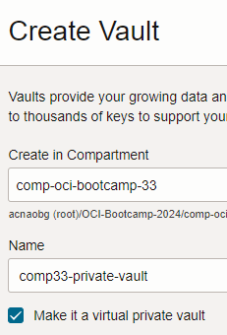
Vault
A managed service in Oracle Cloud Infrastructure that provides secure key management
There are two different types available: Virtual private vault and Vault in a shared Partition.
Virtual private vault:
creates the vault as a dedicated partition on the HSM
pricing based on the maximum usage against key limits
isolated cryptographic resources and enhanced security controls
greater performance
Vault in a shared partition:
free for use
cryptographic resources are shared among multiple tenants

Slide 9
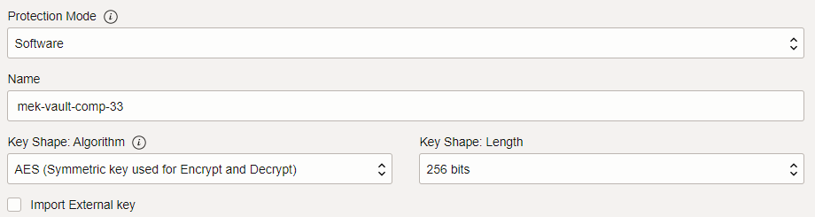
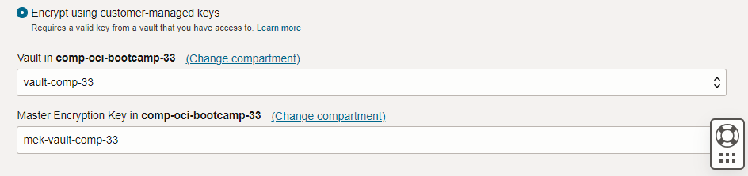
Master Encryption Key
The Master Encryption Key in OCI Vault is the primary key used to encrypt and protect other keys and secrets, ensuring their secure management and storage within Oracle Cloud Infrastructure.
This key is used as example for Object Storage encryption
You can choose between Software and HSM protection mode, with different costs.

Slide 10
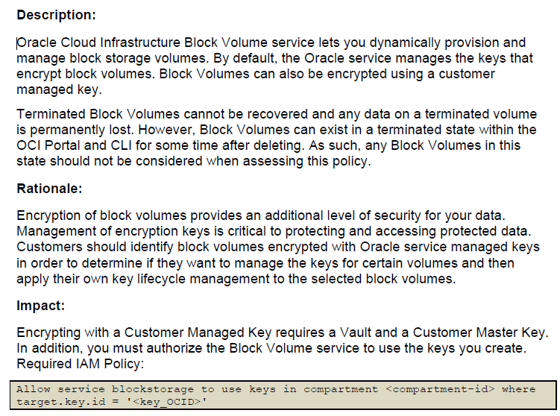
CIS – Center of Internet Security OCI Benchmark
5.2.1 Ensure Block Volumes are encrypted with Customer Managed Keys (CMK). (Automated)
Notes:
for region in `oci iam region list | jq -r '.data[] | .name'`; do for compid in `oci iam compartment list --compartment-id-in-subtree TRUE 2>/dev/null | jq -r '.data[] | .id'`; do for bvid in `oci bv volume list --compartment-id $compid --region $region 2>/dev/null | jq -r '.data[] | select(."kms-key-id" == null).id'`; do output=`oci bv volume get --volume-id $bvid --region $region --query=data.{"name:\"display-name\","id:id""} --output table 2>/dev/null` if [ ! -z "$output" ]; then echo $output; fi done done done

Slide 11
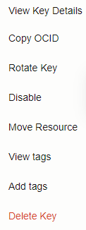
Can I rotate my keys?
Yes. You can regularly rotate your keys in alignment with your security governance and regulatory compliance needs or do it ad hoc in case of a security incident.
Regularly rotating your keys (for example, every 90 days) by using the console, API, or CLI, limits the amount of data protected by a single key.
Note: Rotating a key does not automatically re-encrypt data that was
previously encrypted with the old key version; this data is re-encrypted
the next time it’s modified by the customer.
If you suspect that a key has been compromised, you should
re-encrypt all data protected by that key and disable the prior key version.

Slide 12
Backup and Replicate Vault and Keys
Backup:
Backing up a private vault ensures that cryptographic keys and sensitive data can be restored in case of accidental deletion, corruption, or system failure.
Regular backups help meet regulatory requirements for data protection and enable thorough audits of key management practices.
Maintaining backups supports uninterrupted operations by allowing quick recovery of essential cryptographic resources, minimizing downtime in the event of an incident.
Replication:
Replicate virtual private vaults across regions to meet compliance requirements or improve latency.
Cross-region replication automatically syncs creation, deletion, updates, or moves of keys and key versions between source and destination vaults.
The originating vault is called the source vault, and the receiving vault in the destination region is known as the vault replica.
Minimum Level: Private Vault

Slide 13
Secrets
OCI Vault Secrets provides a secure location to store sensitive information such as passwords, API keys, and confidential data.
It ensures that secrets are accessible only to authorized applications and users through fine-grained access policies.
It facilitates automated secret management, including versioning and rotation, to enhance security and compliance.
Example: Store the database credentials as a secret in OCI Vault. The application can securely retrieve these credentials at runtime, ensuring that sensitive information is not exposed in the codebase or configuration files.
curl -s -X GET \
-H "Authorization: Bearer <your_auth_token>" \
-H "Content-Type: application/json" \
"https://<region>.secrets.vaults.<domain>/20190301/secretBundles/<secret_ocid>" | jq -r '.secret-bundle-content.content' | base64 --decode

Slide 14
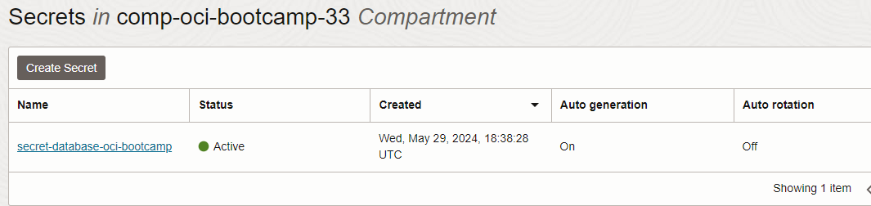
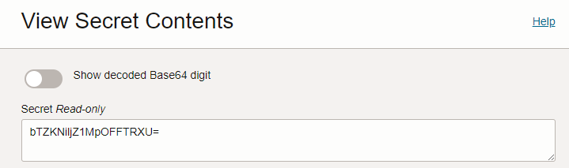
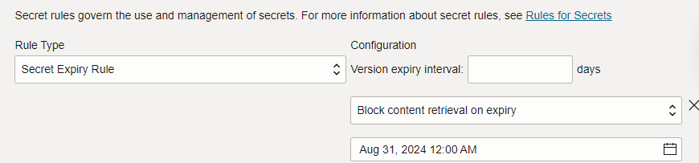
Secret Creation
Based on Master Encryption Key
Different secret types like passphrase, SSH key etc.
Auto-generation or manual input

Slide 15
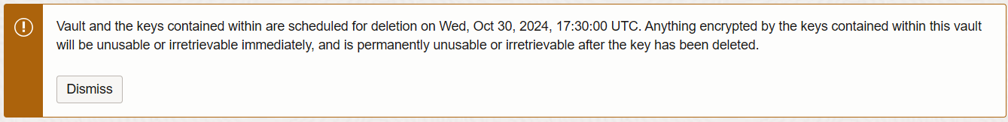
Deleting a Vault
When you delete a vault, the vault and all its associated keys go into a pending deletion state until the waiting period expires.
By default, the waiting period is set to 30 days, but it can be adjusted from a minimum of 7 days to a maximum of 30 days.
When a vault is deleted, all its associated keys are also deleted.
If replication is configured, deleting a vault in the source region also deletes the vault and any keys in the vault in the destination region.

Slide 16
OS Management
2
Security for free.

Slide 17
OS Management Hub
Next generation of OS management functionality
OS Management Hub uses an agent plugin for managing and applying updates.
Simplified OS Management:
Oracle OS Management Hub streamlines the management and monitoring of OS updates across on-premises, OCI, and supported third-party clouds.
Inclusive Service:
OS Management Hub is included with Oracle Linux Support and OCI Compute subscriptions, providing comprehensive OS management at no additional cost.
Auto-Patch capable:
Keep your OS up to date

Slide 18
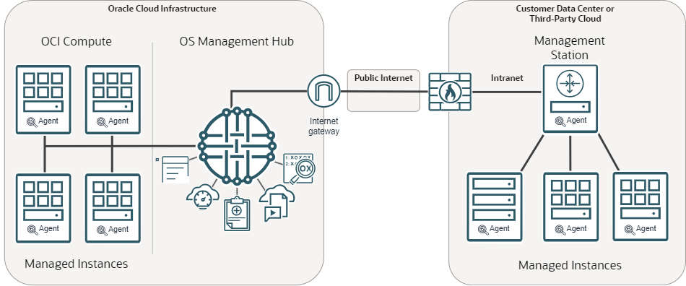
OS Management Hub Architecture
Source: oracle.com

Slide 19
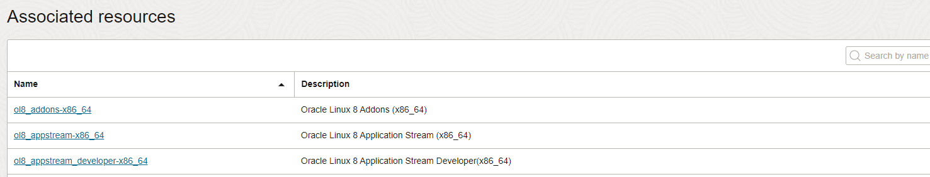
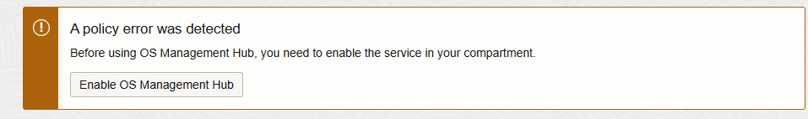

OS Management Workflow 1/2
Adding Vendor Software Sources (create in root compartment first for later usage)
Create custom Software Source on compartment level
Create Service Profile
Verify OS Management Hub plugin is running on target instances

Slide 20
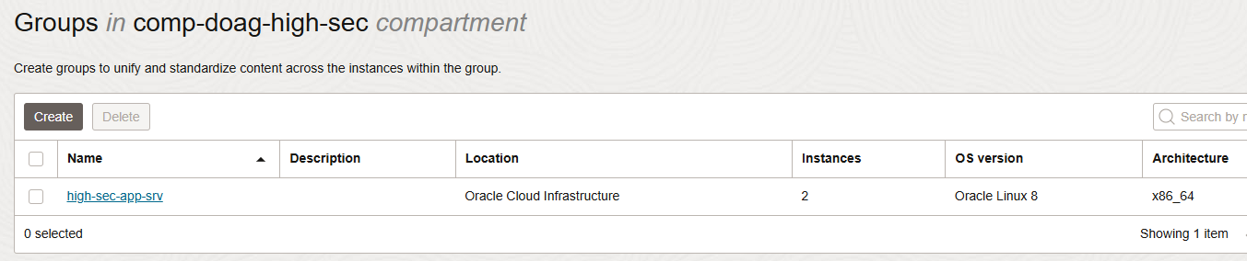
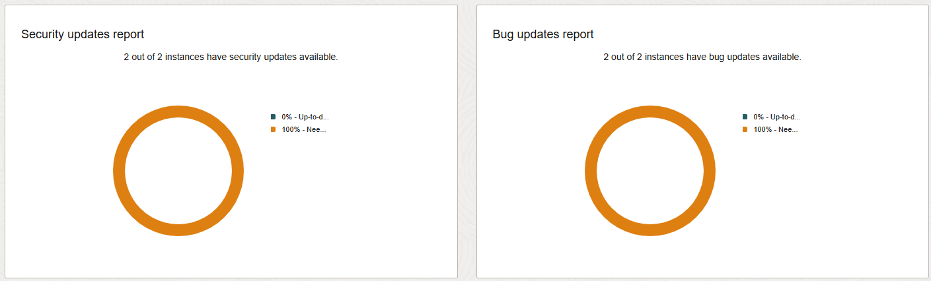
OS Management Workflow 2/2
Wait 10 mins..
(optional) create group with custom software source, attach instances
Verify Dashboard and Reports

Slide 21
Verify OS Management & Categories
On target hosts, any DNF/YUM command shows the enabled service
[opc@compute-high-sec-public ~]$ sudo dnf update
This system is receiving updates from OSMH.
Last metadata expiration check: 0:01:54 ago on Thu 17 Oct 2024 07:25:37 AM GMT.
Dependencies resolved.
OS Management Hub Category | Description
Security | An update that addresses security vulnerabilities found during development, testing, or reported by users. Security fixes usually have one or more associated CVE (Common Vulnerabilities and Exposure) names to identify the vulnerabilities.
Ksplice | An update used by Ksplice for installing zero-downtime security patches. The update job can include only Ksplice kernel updates, only Ksplice userspace updates, or both. See Using Ksplice for Oracle Linux for how to configure an instance to receive Ksplice updates.
Bug Fix | An update that fixes issues reported by users or discovered during development or testing.
Enhancement | An update that introduces new features, improved functionality, or enhanced performance in the package's software.
Other | An update that's not associated with any errata.

Slide 22
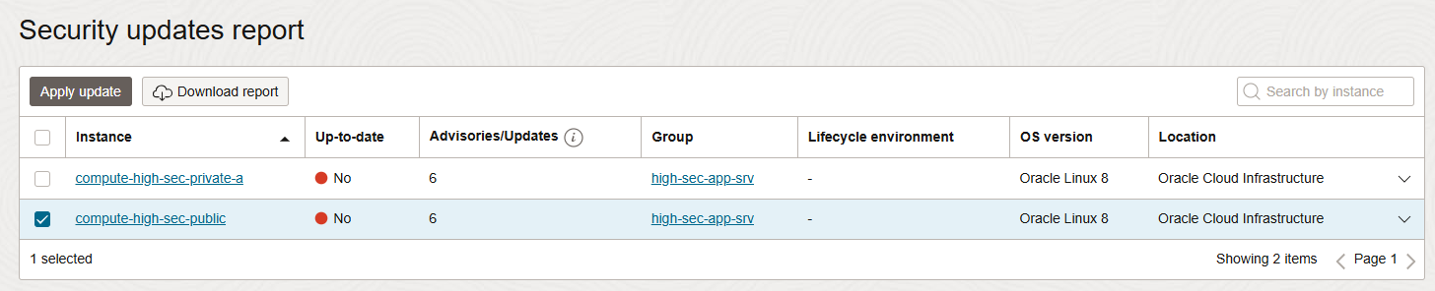
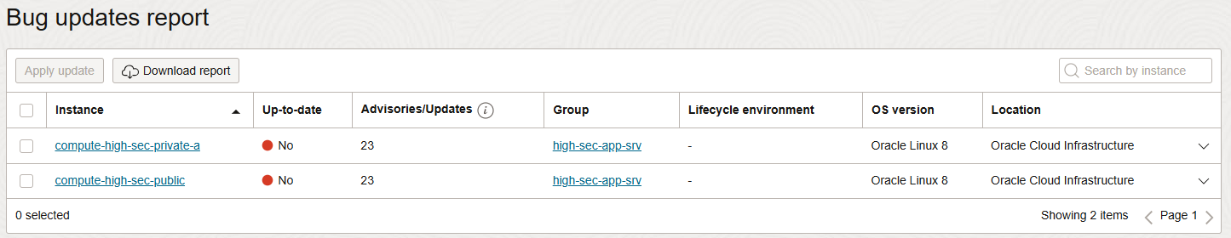
Reports
You can apply the patches, fixes automatically or manually

Slide 23
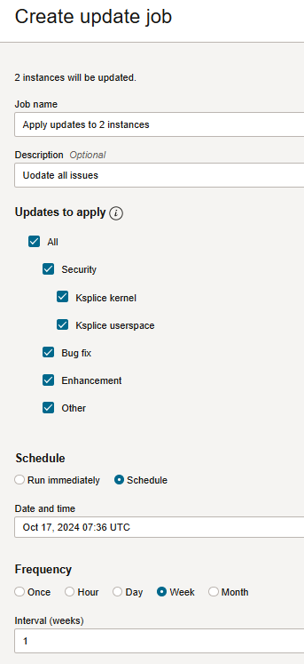
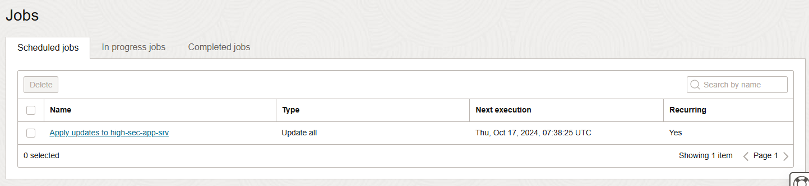
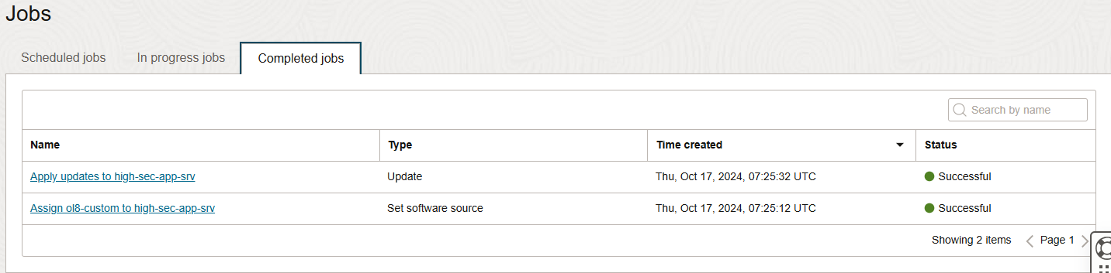
Update Schedule
If you want to apply the patches and fixes automated and recurring, a job is required.
Can run once
Or scheduled, as example every Monday
Scheduled
Completed

Slide 24
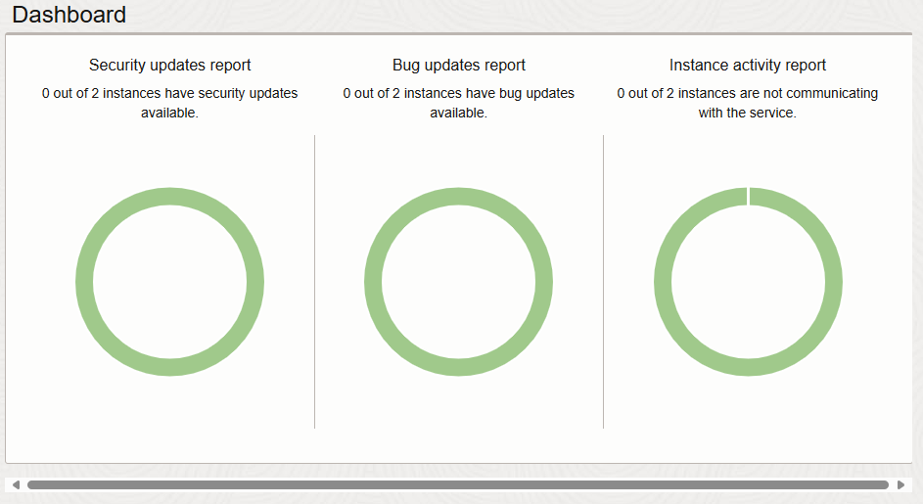
Finally

Slide 25
Vulnerability Scanning
3
Security for free.

Slide 26
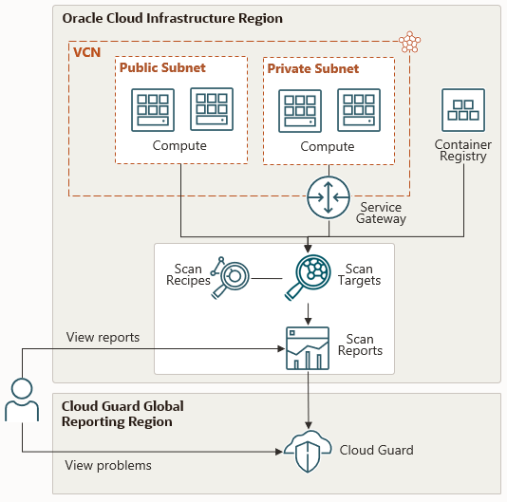
Vulnerability Scanning Service
Source: oracle.com

Slide 27
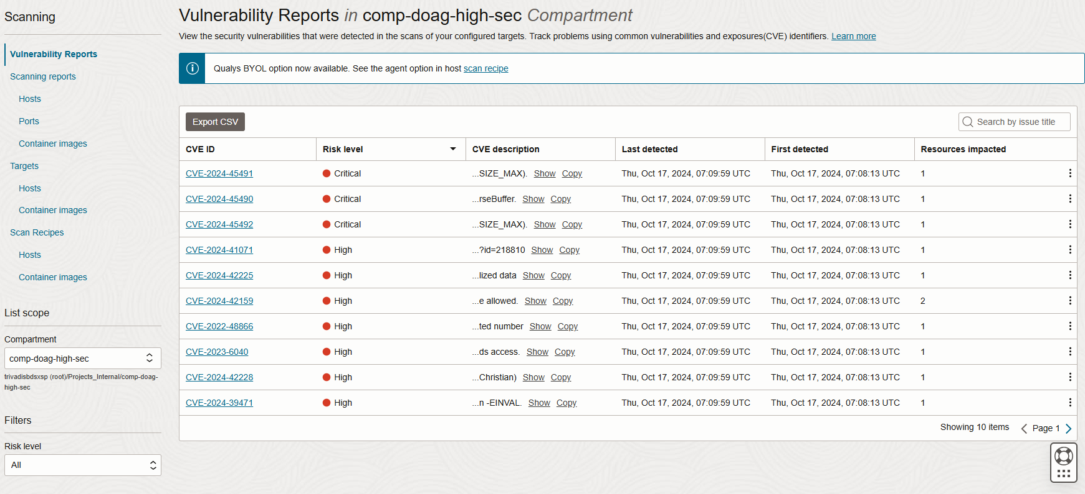
Reports

Slide 28
Vulnrability Sources
The Vulnerability Scanning service detects vulnerabilities in the following platforms and using the following vulnerability sources.
Targets: Compute Instances and images with a Container Registry repository
Platform | National Vulnerability Database (NVD) | Open Vulnerability and Assessment Language (OVAL) | Center for Internet Security (CIS)
Oracle Linux | Yes | Yes | Yes
CentOS | Yes | Yes | Yes
Ubuntu | Yes | Yes | Yes
Windows | Yes | No | No

Slide 29
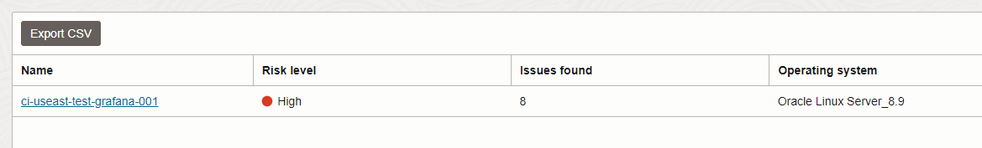
Vulnerability Scanning
Free or BYOL by Qualys
Based on targets according Cloud Guard
Pre-defined or adapted recipes
Cloud Guard integration

Slide 30
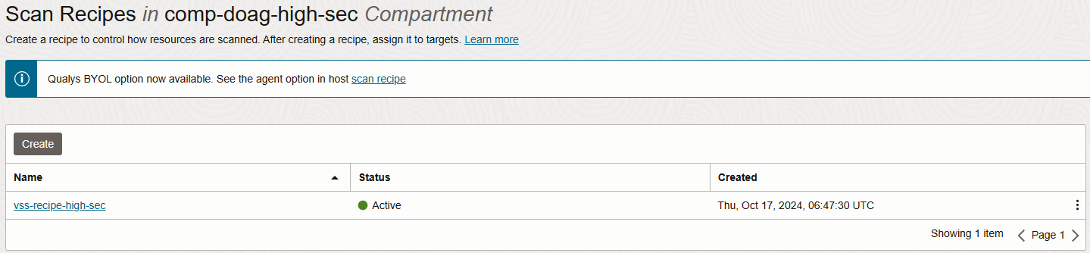
Recipes
A CIS benchmark profile and OS folders can be selected
Linux and Windows

Slide 31
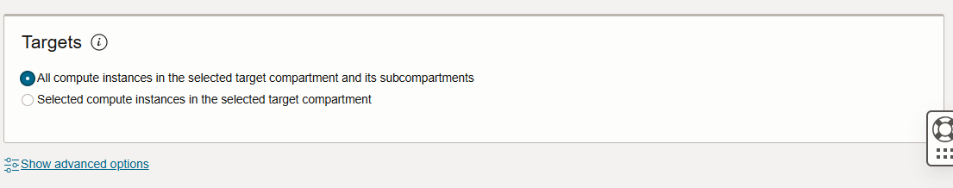
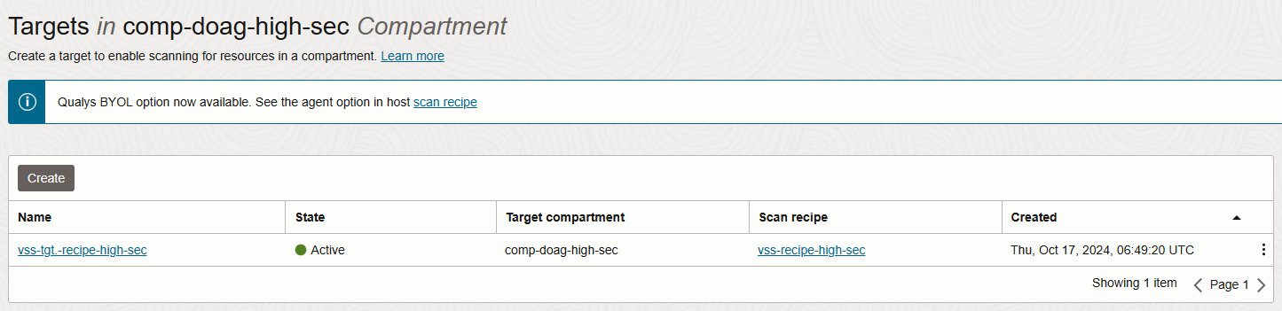
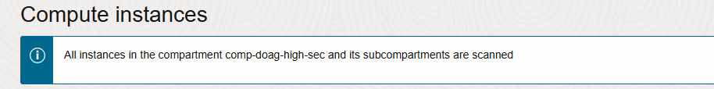
Targets
Select all or defined Compute Instances only

Slide 32
Shielded Instances
4
Security for free.

Slide 33
A combination of Secure Boot, Measured Boot, and the Trusted Platform Module
Functions:
Enhanced Security: Oracle Shielded Instances provide an additional layer of security by protecting against unauthorized access and tampering.
Secure Boot: Ensures that only trusted software is loaded during the boot process, preventing malicious code from running.
Trusted Platform Module (TPM): Utilizes TPM to securely store cryptographic keys and other sensitive data, enhancing overall security.
Benefits:
Protection Against Ransomware: Shielded Instances help protect against ransomware attacks by preventing unauthorized changes to system configurations and data.
Compliance and Regulatory Standards: Meet compliance requirements and regulatory standards with enhanced security features provided by Shielded Instances.
Integration with OCI Services: Seamlessly integrate with other OCI services such as monitoring, notifications, and identity management for comprehensive security managemen

Slide 34
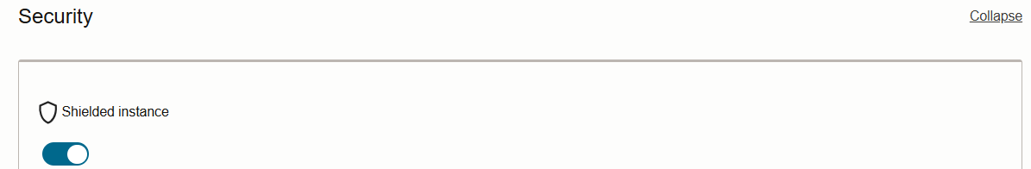
Components
Shielded Instances
Harden the firmware security on bare metal hosts and virtual machines (VMs) to defend against malicious boot level software.
Secure Boot
Unified Extensible Firmware Interface (UEFI) feature that prevents unauthorized boot loaders and operating systems from booting.
Measured Boot
Measured Boot enhances boot security by taking and storing measurements of boot components, such as bootloaders, drivers, and operating systems. Bare metal instances do not support Measured Boot.
Trusted Platform Module
The Trusted Platform Module (TPM) is used to securely store boot measurements.

Slide 35

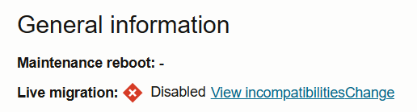
Uncompromised Boot Security
No live migration or reboot migration support.
If you enable the hardware TPM on a bare metal instance, the instance cannot be migrated, because the hardware TPM is not migratable.
Custom images are not supported.
Confidential computing is not supported.

Slide 36
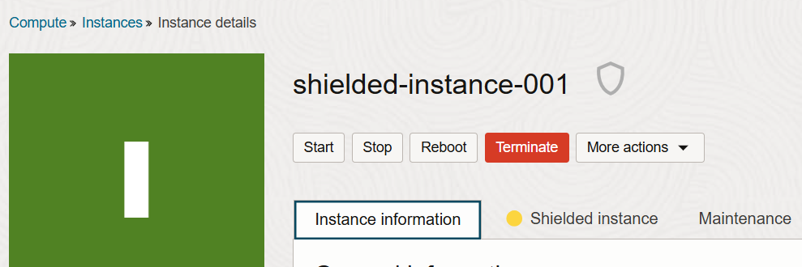
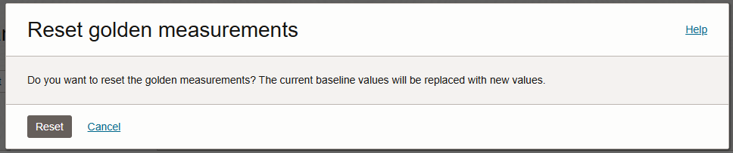
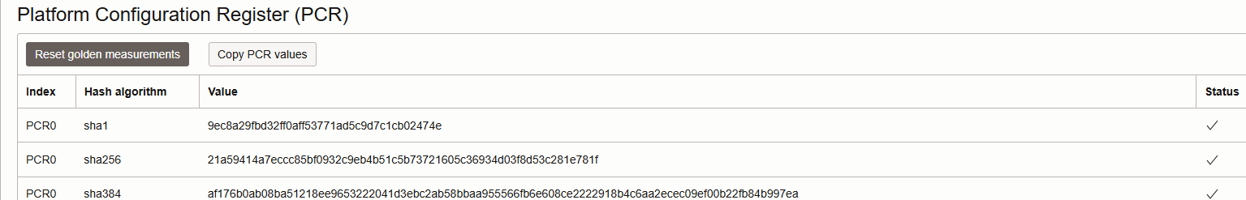
Platform Configuration Register
A PCR is an internal memory slot within a Trusted Platform Module (TPM) that attests to the current system configuration or any alterations thereof. PCRs are used to store measurements of software and hardware states, which can then be used to verify the integrity of the system. This ensures that the system has not been tampered with and is running trusted software.

Slide 37
Confidential Computing - AMD EPYC™ Processors
Real-time Encryption: OCI Confidential Computing provides real-time CPU encryption, ensuring that data is encrypted while it is being processed. This helps protect sensitive information from unauthorized access1.
Secure Key Management: The encryption keys used in OCI Confidential Computing reside only in the AMD Secure Processor, making them inaccessible to any user, including administrators1.
Enhanced Data Privacy: By encrypting data in use, OCI Confidential Computing enhances data privacy and security, making it suitable for workloads that require high levels of confidentiality
Virtual Machine Compute Shapes (on Oracle Linux 7.x or 8.x platform images) | Bare Metal Instance Compute Shapes (on any platform image)
VM.Standard.E4.Flex | BM.DenseIO.E4.128
VM.Standard.E3.Flex | BM.Standard.E4.128
 | BM.Standard.E3.128

Slide 38
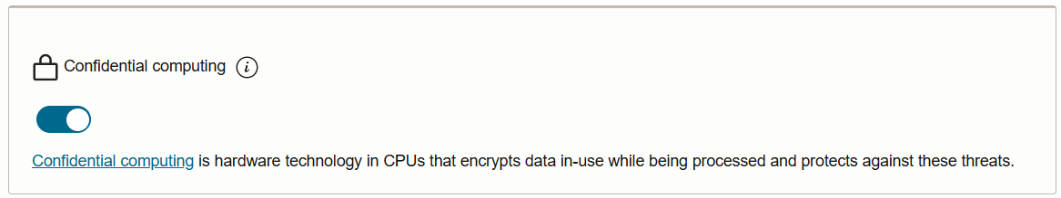
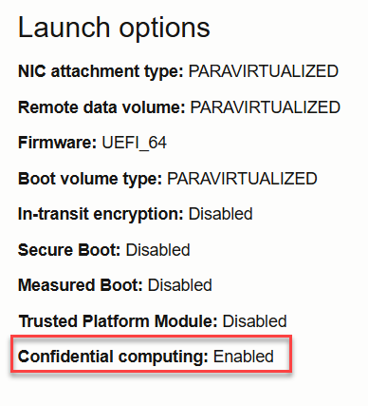
Create Instance
Create instance, enable confidential computing without addional costs.
Select shape – watch for shield icon
Instance with confidential computing enabled can be live migrated. No code change and a minimal performance impact.

Slide 39
Hands-On Labs
5
What about the Database Security?

Slide 40
Lab
List of Labs here…..

Slide 41
Thank You

Slide 42
WAF
2
Security for free.

Slide 43
Web Application Firewall WAF
Comprehensive Protection:
WAF shields applications from malicious internet traffic and enforces consistent security rules across all applications.
Advanced Threat Management:
Create and manage rules to defend against threats like XSS, SQL Injection, and other OWASP-defined vulnerabilities; access rules can limit traffic by geography or request signature.
Regional and Edge Solutions:
WAF policies are regional and act as load balancer plug-ins, while edge policies provide global protection; allowlist Oracle nodes for edge enforcement.

Slide 44
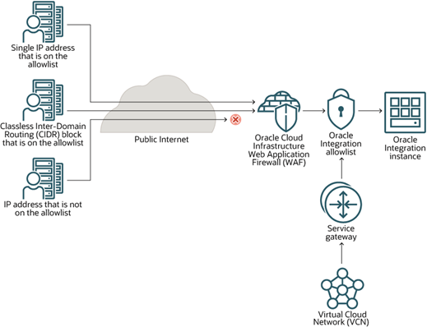
Web Application Firewall WAF Architecture

Slide 45
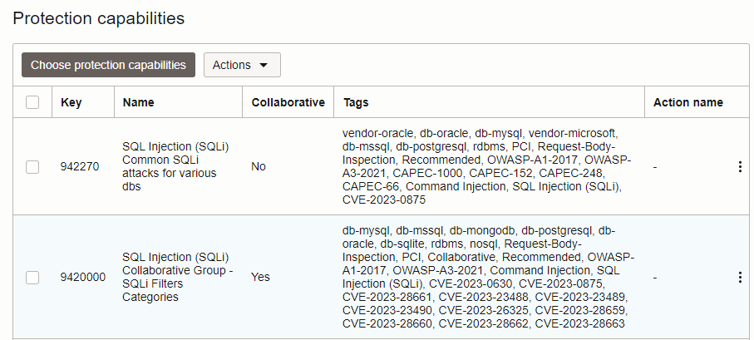
Load Balancer and WAF
A WAF – Layer 7 - can be configured in front of a load balancer to enforce security
You can define policies like regions, verify for XSS injections, rate limitations etc.
Response can be another check or a 401 error

