Slide 1
Oracle Cloud Infrastructure Security
Cloud Guard
Martin Berger
Stefan Oehrli

Slide 2
Cloud Guard
1
Introduction
2
SQL Firewall
Security for free.
3
CLI Management
4
GUI Management
5
Reporting, Audit and Alerts
6
Licensing
7
Challanges
8
Conclusion

Slide 3
Understanding Cloud Guard
1
Security for free.

Slide 4
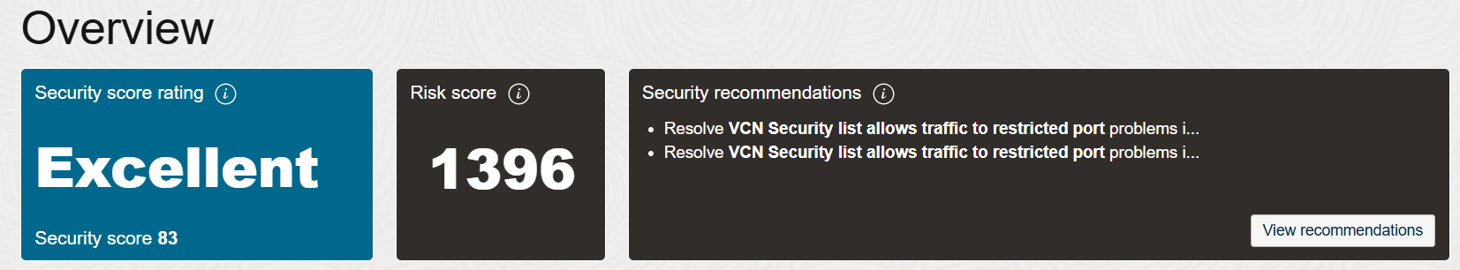
What is Cloud Guard?
Oracle Cloud Guard is a cloud-native service designed to help customers monitor, identify, and maintain a strong security posture on Oracle Cloud Infrastructure. It continuously examines OCI resources for security weaknesses related to configuration and user activities
Real-Time Threat Detection
Automated Risk Assessment
Customizable Security Policies
Cloud Guard provides real-time monitoring and threat detection by continuously scanning OCI resources for misconfigurations, vulnerabilities, and anomalous activities. This ensures that potential security issues are identified and addressed promptly
Cloud Guard automatically assesses security risks based on predefined security policies and industry standards, such as the CIS Benchmark. It offers actionable recommendations for addressing detected risks, allowing for quick remediation and enhancing overall security
Users can configure custom policies and rules to align monitoring with their specific security requirements. Cloud Guard integrates seamlessly with other OCI tools, providing a comprehensive and flexible security solution.

Slide 5
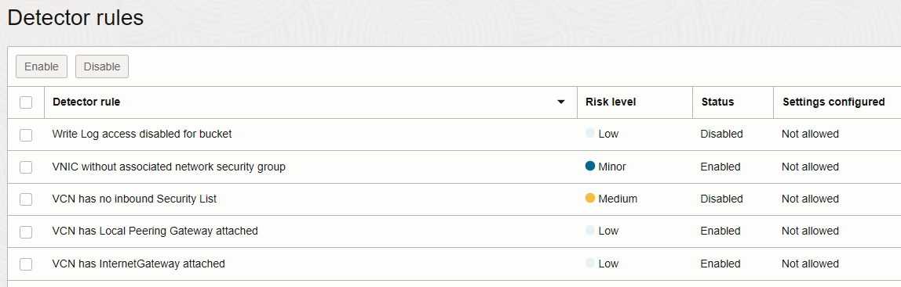
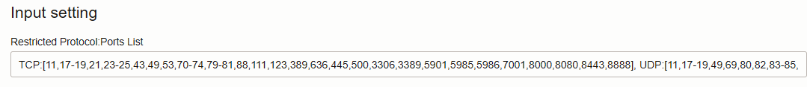
The Concept
Detector Rules provide a class of resources with specific actions or cinfiugurations that can cause a detector to report a problem.
Detector Receipes provide the baselines for examining the resources and activities in the target.

Slide 6
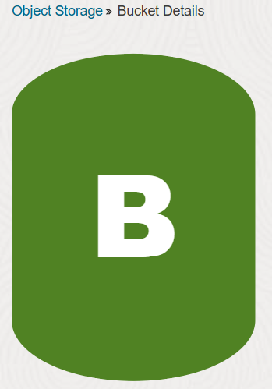
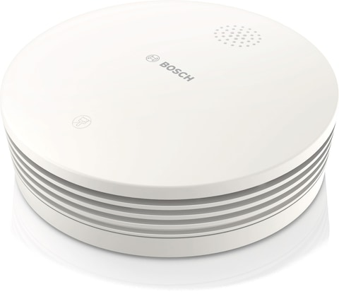


Key Components of Cloud Guard
Targets
Targets define the scope of what Cloud Guard is to check. This scope is tied to the compartment where the target is defined and all the child compartments from that point until another target is encountered. Compute Instances, Object Storage etc.
Detectors
Detectors perform checks and identify potential security problems based on their type and configuration.
Responder Recipes
These provide the baselines for examining the resources and activities in the target. Oracle-managed detector recipes allow setting only the scope of resources for which a rule triggers a problem, while user-managed detector recipes allow more customization.
Detector Recipes
Responder recipes define the actions to be taken when a problem is detected. They can be configured to automatically remediate security issues or to notify administrators for manual intervention.

Slide 7


How Cloud Guard works
Target
Detectors
Problems
Responder
Object Storage Bucket
Visibility Public
Mail Notification
Change Visibility
Security List
0.0.0.0/0
Stream Information
Remove Rule
Compute Instance
Public IP
Slack Channel
Shutdown
Data Collection and Analysis
Alert
Remediation

Slide 8
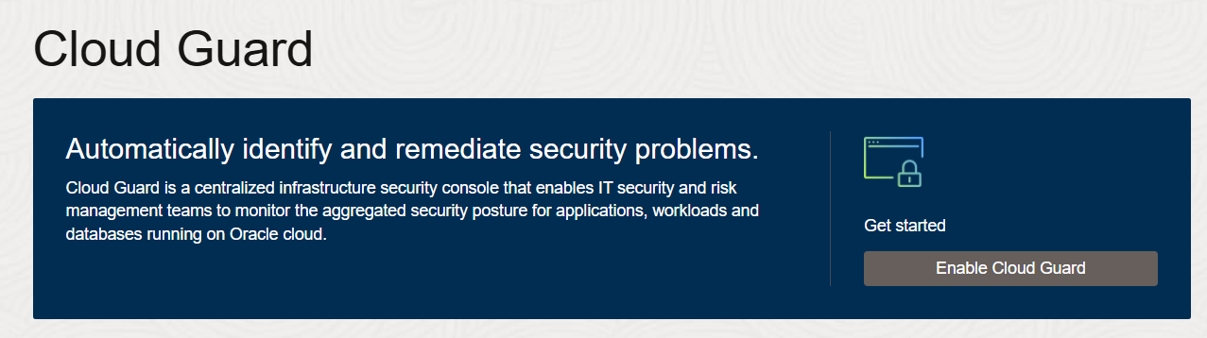
Enable Cloud Guard
The prerequisites for enabling Oracle Cloud Guard:
Having a paid Oracle Cloud Infrastructure tenancy, as Cloud Guard is not available for free tenancies.
Users must create a user group with administrator privileges to work with Cloud Guard, and this group should be restricted to a limited audience.
Additionally, specific policy statements must be added to enable the Cloud Guard users group to manage Cloud Guard resources.

Slide 9
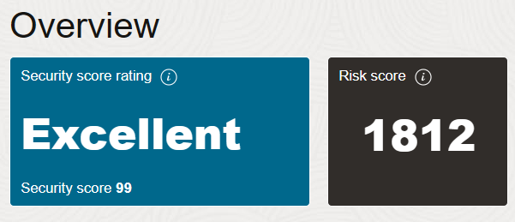
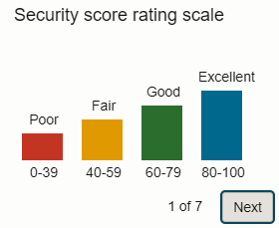
Scores
Security Score: A higher security score is better. A security score of 100 would mean that no problems were detected for any resources. Reflects monitoring for past 30 days.
Risk Score: Related to the number and severity of problems. In general, organizations with many more resources are likely to have more problems, and thus a higher risk score. The risk score is closely related to the "potential surface area" of risk. Updated every 15 Minutes.

Slide 10
About Compartments – Important Notes
All compartments of a target inherit that target's configuration.
Detector and responder rule settings for a target apply to:
The top-level compartment assigned to that target.
Any subordinate compartments below it in the hierarchy.
Target defined within an existing target overrides inherited configuration.
If you want to exclude some compartments from monitoring, create targets below the root level and do not include the root compartment in any target.

Slide 11
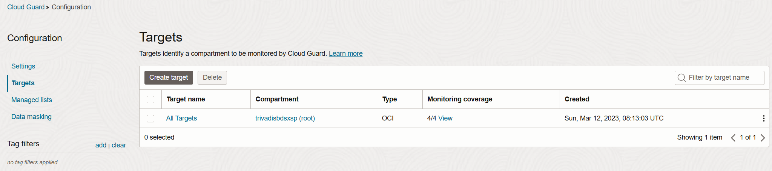
Setting Up Cloud Guard Targets
Defines the resources where Cloud Guard is enabled.
Setting up more targets allows more specific monitoring
OCI Cloud Guard service targets are logical objects inspected by Cloud like Compute Instance, Object Storage Bucket, Security Lists etc.
Rules to detect and resolve issues are applied to targets.

Slide 12
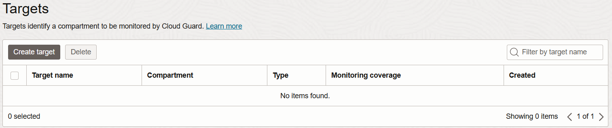
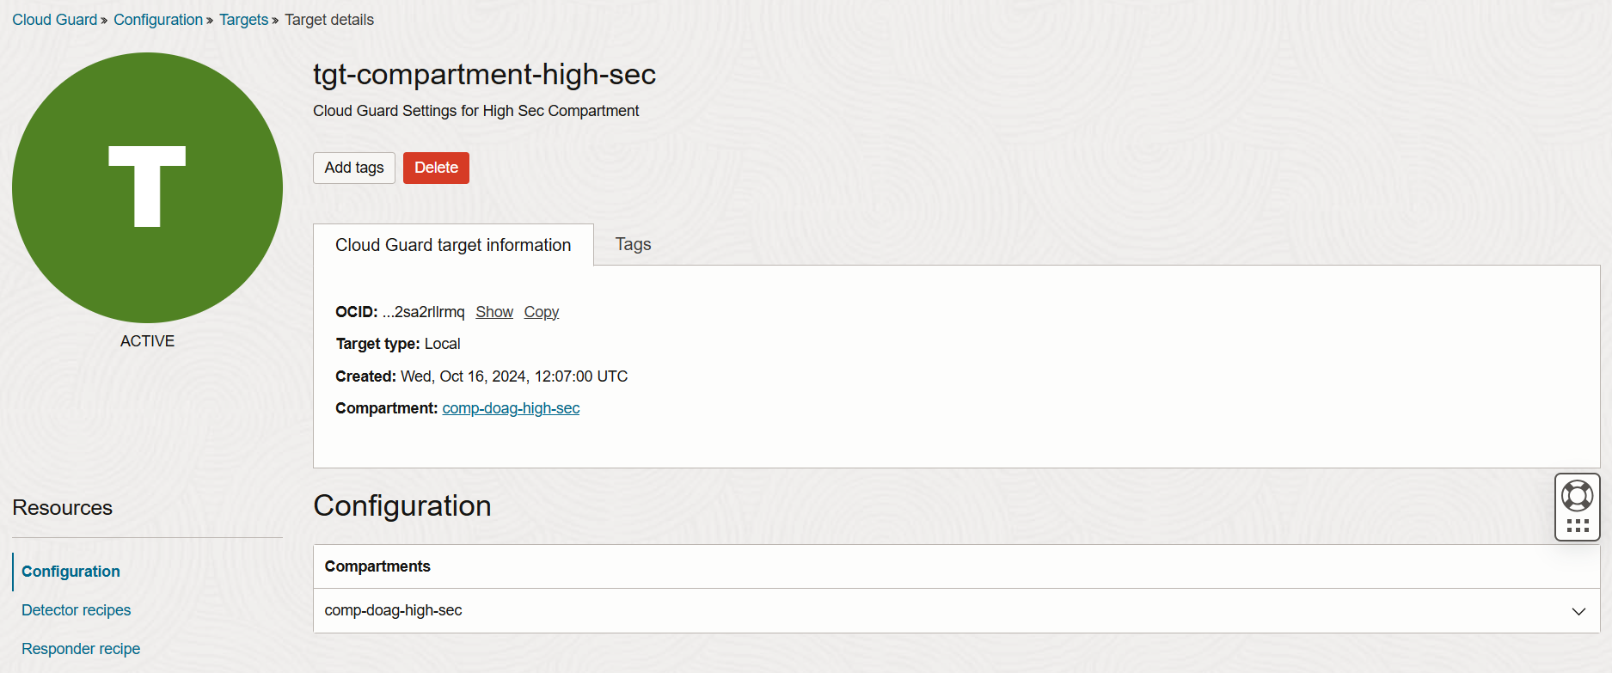
Targets Inside
You don’t see the new created target for a compartment in the configuration list? Search it via Tenacy Explorer or Search Bar.

Slide 13
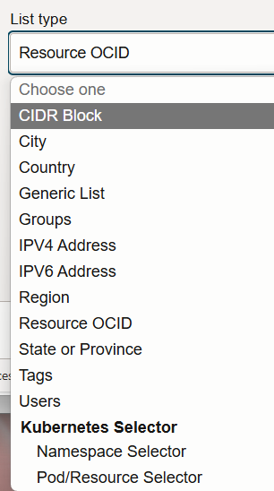
Managed Lists
A managed list is a reusable set of target parameters that simplifies setting the scope for detector and responder rules. It can be used to apply specific configurations to detectors.
For example, a predefined "Trusted Oracle IP address space" list includes all Oracle IP addresses you want to consider trusted when defining rules for detectors and responders.
Cloud Guard also allows you to create your own managed lists as needed, such as lists of states or provinces, zip or postal codes, OCIDs, or any other criteria you require.
Here are some specific use cases for custom managed lists:
Trusted IP addresses: Exempt listed IP addresses from triggering alerts that should only be triggered by untrusted IP addresses.
Resources that should be public: Exempt listed resources from all detectors related to identifying public configurations.

Slide 14
Detection or Responding
Detector Recipes
These recipes are used to identify potential security issues by continuously monitoring resources for misconfigurations, vulnerabilities, and anomalous activities.
Detector recipes contain rules that define what constitutes a problem. When these rules are triggered, Cloud Guard creates a problem.
Responder Recipes
These recipes define the actions to be taken when a problem is detected by a detector recipe.
Responder recipes contain rules that specify the actions to remediate, resolve, or dismiss the identified problems.
Oracle provides a set of recipes (3+1) – you can clone then for adaption according your security needs.

Slide 15
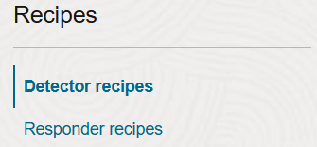
Detector Recipes
OCI Configuration Detector Recipe
Designed to detect resource configuration settings that could pose a security problem.
Helps identify misconfigured resources to ensure compliance with security policies.
OCI Instance Security Recipe
Monitors compute hosts for suspicious activity, providing runtime security for workloads in Compute virtual and bare metal hosts.
Collects important security information such as security alerts, vulnerabilities, and open ports to provide actionable guidance for detection and prevention.
OCI Activity Detector Recipe
Detects actions on resources that could pose a security problem.
Monitors activities to identify potential security issues based on resource actions.
OCI Threat Detector Recipe
Designed to detect subtle patterns of activity that could be building up to pose a security problem.
Continuously monitors OCI audit events for malicious activity using machine learning-based behavioral attack models.

Slide 16
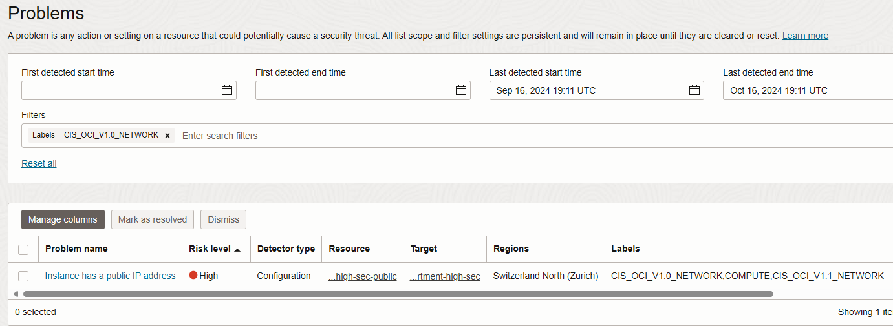
OCI Configuration Detector Recipe – Center of Internet Security
The Configuration Detector recipe follows the CIS – Center of Internet Security – guidelines in version 1.0 ,1.1 or 2.0.

Slide 17
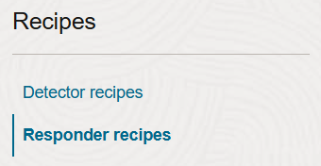
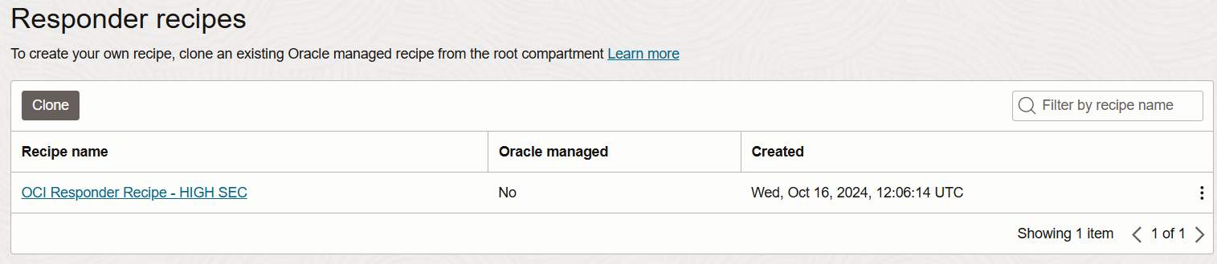
Responder Recipes
Define actions to be taken when a problem is detected by a detector recipe.
Can be configured for automatic remediation or to notify administrators for manual intervention.
Contain multiple responder rules specifying actions to address identified problems.
Can use Oracle-managed recipes with default rules or customized user-managed recipes.

Slide 18
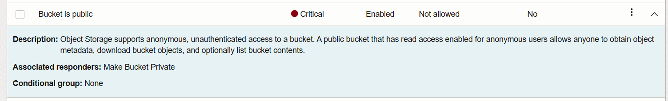
Auto-Resolve
This is configured on level targets according the Responder rules.
Requires an IAM policy to allow Cloud Guard the action.
The Detector and Responder rule must be enabled.
Allow service cloudguard to manage buckets in compartment
comp-doag-high-sec

Slide 19
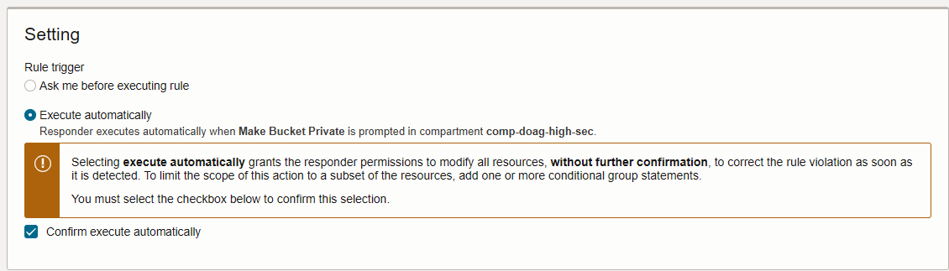
How to enable Auto-Resolve
Search Cloud Guard Target Group
Select Responder Recipe - Responder Rule – click on three dots / edit
Change Setting and enable checkbox for confirmation

Slide 20
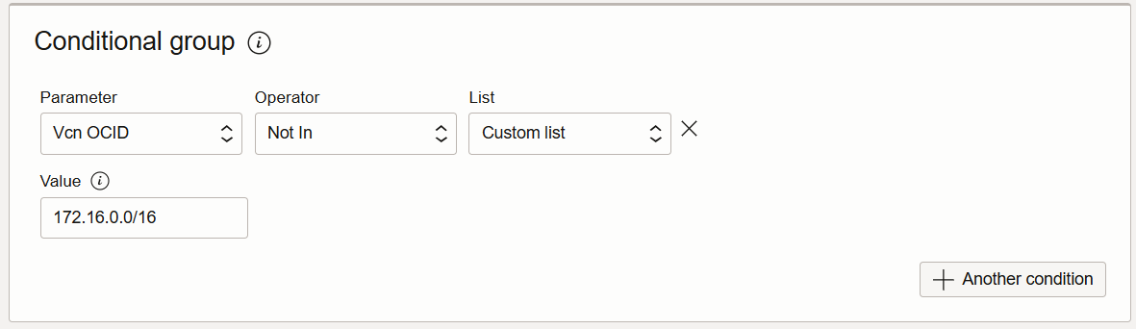
Conditional Execution
Key points about the conditional execution of a responder recipe:
Specify conditions under which a responder rule will be executed.
Define conditional groups with parameters like region, resource type, or tags.
The rule is enforced only if all conditions in the group are met.
Helps create precise, context-aware security responses, reducing unnecessary actions.

Slide 21

Problem solving
Remediate: When you click the "Remediate" button, you are instructing Cloud Guard to take action to fix the identified problem. This typically involves executing a responder rule that addresses the issue, such as changing a configuration setting or applying a security patch. The goal is to resolve the problem so that it does not occur again.
Mark As Resolved: Used to indicate that a problem has been addressed and resolved. When you mark a problem as resolved, you are telling Cloud Guard that the issue was indeed a problem, but you have taken the necessary actions to handle it.
Dismiss: Clicking the "Dismiss" button indicates that you have reviewed the alert and decided that no action is necessary. This could be because the alert is a false positive, or the issue is not relevant or critical. Dismissing an alert will close it without taking any corrective action.

Slide 22
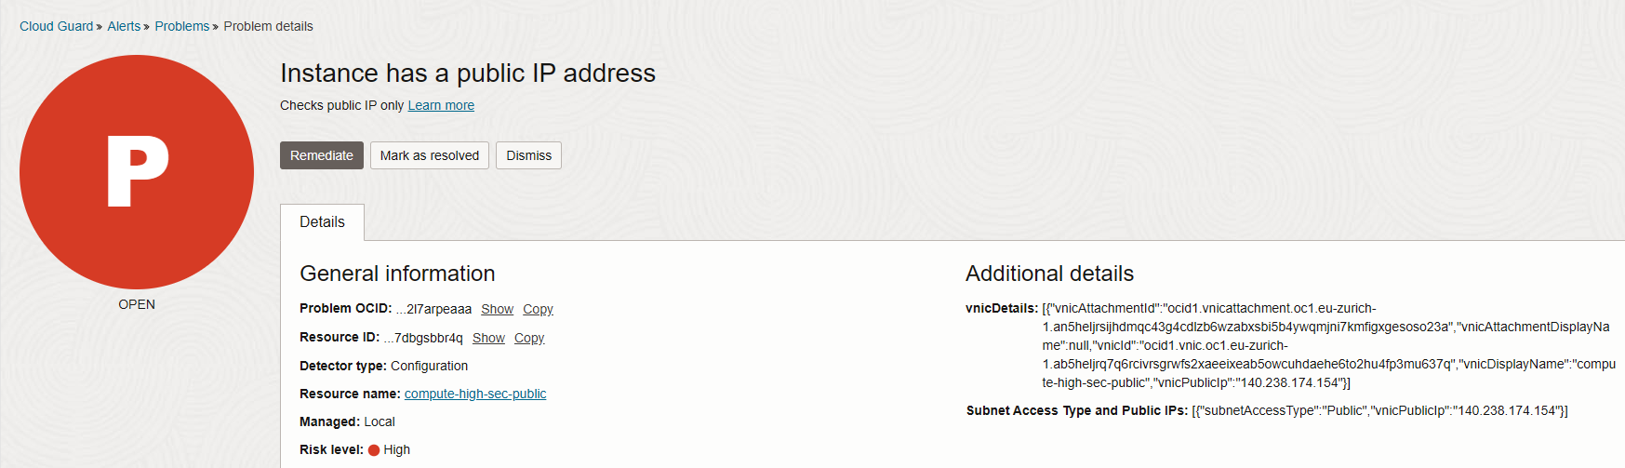
Processing Problems
If not auto-resolved, see what you have to do for remediation.
Remediated: Fixed by Cloud Guard Responder
Resolved: Fixed by other processes
Dismissed: Ignored / closed

Slide 23
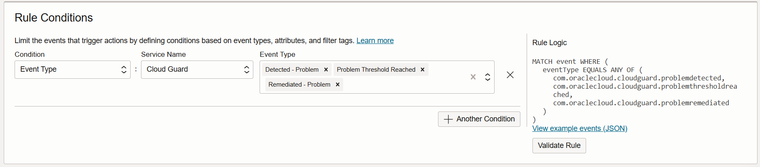
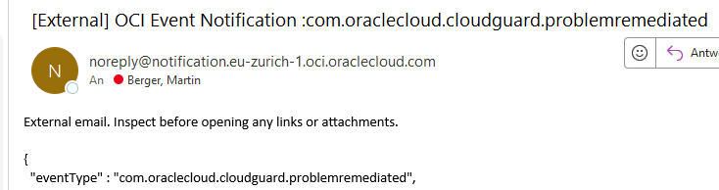
Notification
Be informed whenever Cloud Guard has detected or auto-resolved the problem by definig Rules.

Slide 24
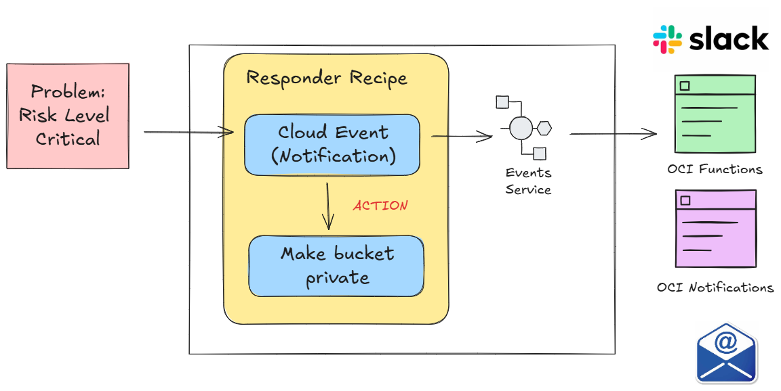
Notification

Slide 25
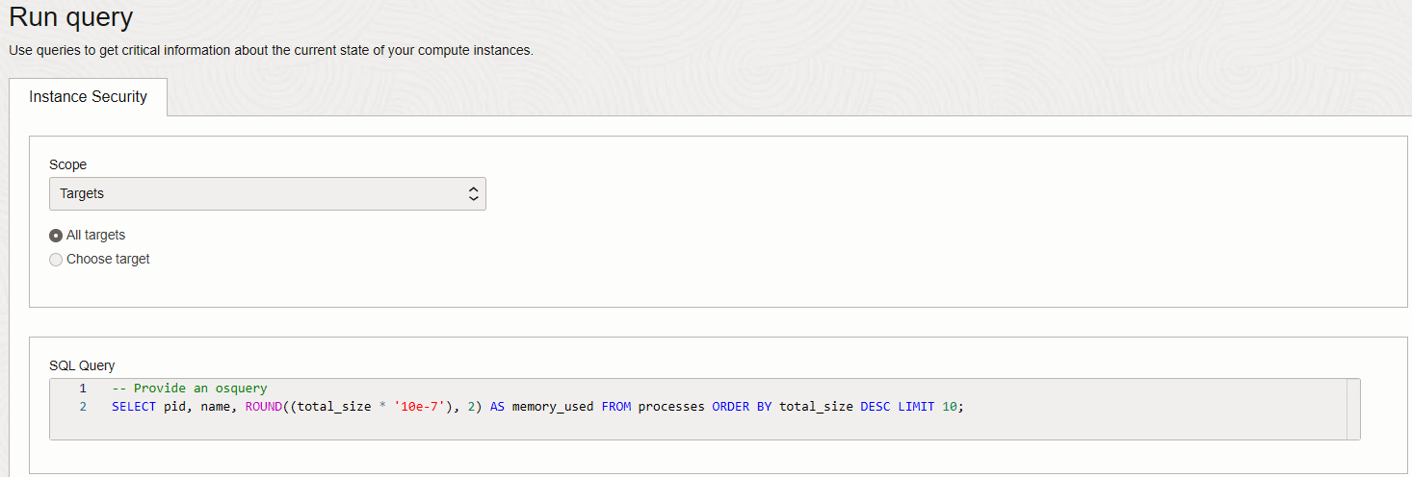

Queries – Verify Instances
Use queries to get critical information about the current state of your compute instances via OS Agent plugin.
Instance Security uses Osquery, which leverages a relational data model to describe an instance.
A little bit tricky to configure (IAM & Firewall)
Notes:
Agent Logs – Linux:
/var/log/oracle-cloud-agent/plugins/oci-wlp
Egress Rule:
>> before
2024/10/16 17:35:44.044464 base_client.go:87: fetched metadata from http://169.254.169.254/opc/v2/instance/ , status 200 OK
2024/10/16 17:38:45.231486 agent.go:381: failed to create object storage client
2024/10/16 17:38:45.231542 agent.go:96: cannot connect to object storage provider: failed creating ObjectClient: can not create client, bad configuration: failed to get security token: failed to renew security token: failed to get security token: failed to call: Post "https://auth.eu-zurich-1.oraclecloud.com/v1/x509": dial tcp 140.204.16.230:443: i/o timeout
Instance principals authentication can only be used on OCI compute instances. Please confirm this code is running on an OCI compute instance and you have set up the policy properly.
See https://docs.oracle.com/en-us/iaas/Content/Identity/Tasks/callingservicesfrominstances.htm for more info
>> after
2024/10/16 18:02:12.959099 ensure_boringfips.go:179: FIPS compliance check successful: boringcrypto build of golang used and fips only crypto imported
2024/10/16 18:02:12.959139 plugin.go:56: start wlp as plugin
2024/10/16 18:02:12.960783 agent.go:74: Attempting to start oci-wlp plugin
2024/10/16 18:02:12.960806 agent.go:91: Starting oci-wlp plugin
2024/10/16 18:02:12.960811 agent.go:92: current oci-wlp version 1.43.2-12607
2024/10/16 18:02:12.965114 base_client.go:87: fetched metadata from http://169.254.169.254/opc/v2/instance/ , sta
Egress Rule
2024/10/16 18:03:14.179848 breaker.go:87: [DEBUG] the error is neither server error or resource principal error.
2024/10/16 18:03:45.181206 breaker.go:87: [DEBUG] the error is neither server error or resource principal error.
2024/10/16 18:03:45.181278 wlp_dp_client_wrapper.go:173: [ERROR] failed to call getResourcePrincipalToken, Post "https://dp.workloadprotection.eu-zurich-1.oci.oraclecloud.com/20230505/resourceprincipaltoken": giving up after 2 attempt(s): dial tcp 192.29.182.44:443: i/o timeout
2024/10/16 18:03:45.181303 wlp_run.go:189: [ERROR] failed to get agent id due to error: Post "https://dp.workloadprotection.eu-zurich-1.oci.oraclecloud.com/20230505/resourceprincipaltoken": giving up after 2 attempt(s): dial tcp 192.29.182.44:443: i/o timeout
2024/10/16 18:03:45.181310 agent.go:252: Error setting DP client [WLPExecutor] in [env]: prod err: Post "https://dp.workloadprotection.eu-zurich-1.oci.oraclecloud.com/20230505/resourceprincipaltoken": giving up after 2 attempt(s): dial tcp 192.29.182.44:443: i/o timeout
2024/10/16 18:03:45.181330 agent.go:281: no 4xx, resetting 4xx timer
SELECT pid, name, ROUND((total_size * '10e-7'), 2) AS memory_used FROM processes ORDER BY total_size DESC LIMIT 10;

Slide 26
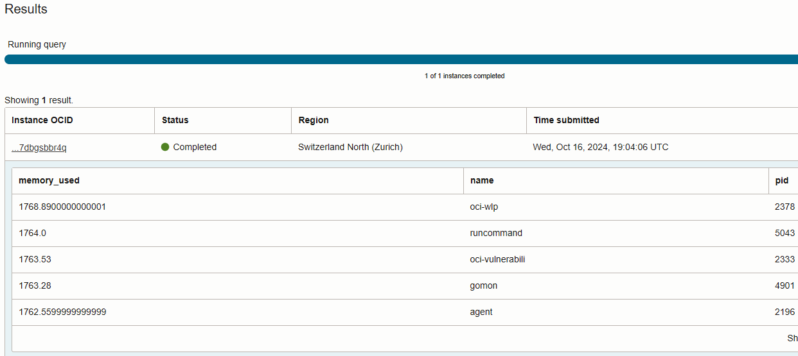
Queries – Results
Notes:
Agent Logs – Linux:
/var/log/oracle-cloud-agent/plugins/oci-wlp
Egress Rule:
>> before
2024/10/16 17:35:44.044464 base_client.go:87: fetched metadata from http://169.254.169.254/opc/v2/instance/ , status 200 OK
2024/10/16 17:38:45.231486 agent.go:381: failed to create object storage client
2024/10/16 17:38:45.231542 agent.go:96: cannot connect to object storage provider: failed creating ObjectClient: can not create client, bad configuration: failed to get security token: failed to renew security token: failed to get security token: failed to call: Post "https://auth.eu-zurich-1.oraclecloud.com/v1/x509": dial tcp 140.204.16.230:443: i/o timeout
Instance principals authentication can only be used on OCI compute instances. Please confirm this code is running on an OCI compute instance and you have set up the policy properly.
See https://docs.oracle.com/en-us/iaas/Content/Identity/Tasks/callingservicesfrominstances.htm for more info
>> after
2024/10/16 18:02:12.959099 ensure_boringfips.go:179: FIPS compliance check successful: boringcrypto build of golang used and fips only crypto imported
2024/10/16 18:02:12.959139 plugin.go:56: start wlp as plugin
2024/10/16 18:02:12.960783 agent.go:74: Attempting to start oci-wlp plugin
2024/10/16 18:02:12.960806 agent.go:91: Starting oci-wlp plugin
2024/10/16 18:02:12.960811 agent.go:92: current oci-wlp version 1.43.2-12607
2024/10/16 18:02:12.965114 base_client.go:87: fetched metadata from http://169.254.169.254/opc/v2/instance/ , sta
Egress Rule
2024/10/16 18:03:14.179848 breaker.go:87: [DEBUG] the error is neither server error or resource principal error.
2024/10/16 18:03:45.181206 breaker.go:87: [DEBUG] the error is neither server error or resource principal error.
2024/10/16 18:03:45.181278 wlp_dp_client_wrapper.go:173: [ERROR] failed to call getResourcePrincipalToken, Post "https://dp.workloadprotection.eu-zurich-1.oci.oraclecloud.com/20230505/resourceprincipaltoken": giving up after 2 attempt(s): dial tcp 192.29.182.44:443: i/o timeout
2024/10/16 18:03:45.181303 wlp_run.go:189: [ERROR] failed to get agent id due to error: Post "https://dp.workloadprotection.eu-zurich-1.oci.oraclecloud.com/20230505/resourceprincipaltoken": giving up after 2 attempt(s): dial tcp 192.29.182.44:443: i/o timeout
2024/10/16 18:03:45.181310 agent.go:252: Error setting DP client [WLPExecutor] in [env]: prod err: Post "https://dp.workloadprotection.eu-zurich-1.oci.oraclecloud.com/20230505/resourceprincipaltoken": giving up after 2 attempt(s): dial tcp 192.29.182.44:443: i/o timeout
2024/10/16 18:03:45.181330 agent.go:281: no 4xx, resetting 4xx timer
SELECT pid, name, ROUND((total_size * '10e-7'), 2) AS memory_used FROM processes ORDER BY total_size DESC LIMIT 10;

Slide 27
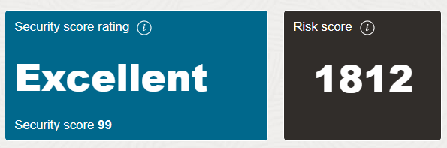
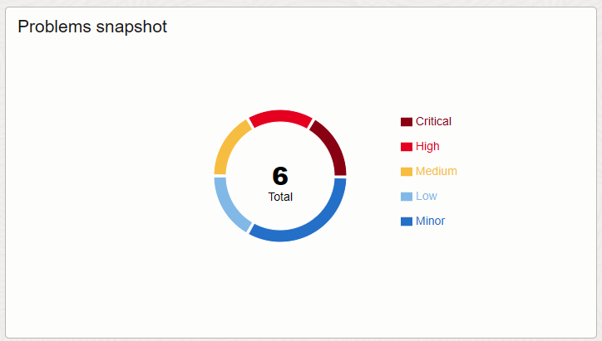
Best Practices for Using OCI Cloud Guard
Enable
Enable it, it is for free
Define
Define own recipes and rules
Stay
Stay informed
Force
Force users to remediate issues
Create
Create guidelines for creating OCI ressources

Slide 28
Hands-On Labs
4
What about the Database Security?

Slide 29
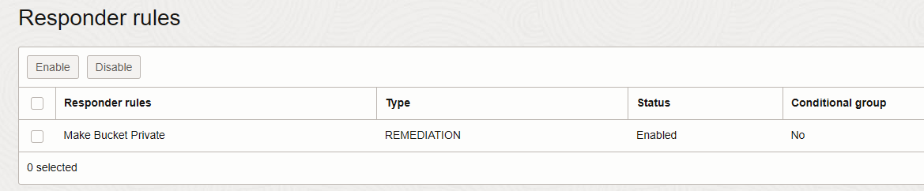
Lab 1: Creating and Customizing Detector Recipes
Clone the existing Oracle detector and responder recipes.
Enable in cloned responder recipe the rule: Change a Public Bucket automated to Private.
Create a private Object Storage bucket, change visibility to public and verify the visibility status after 2mins again.

Slide 30
Lab 3: Creating and Customizing Responder Recipes

Slide 31
Lab 4: Monitoring and Managing Security Posture

Slide 32
Conclusion
5
What about the Database Security?

Slide 33
Summary and Key Takeaways

Slide 34
Resources
Cloud Guard Quick Start Guide | Oracle

Slide 35
Thank You

