Slide 1
Wrap-Up
5
Key Takeaways, Resources, and Next Steps

Slide 2
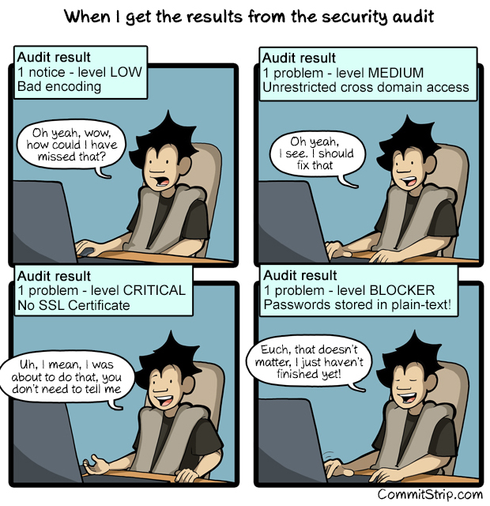

Slide 3
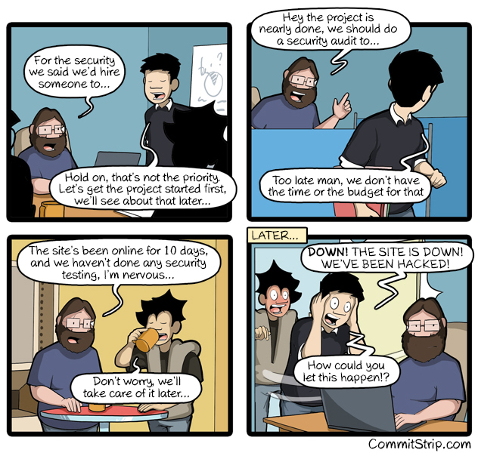

Slide 4
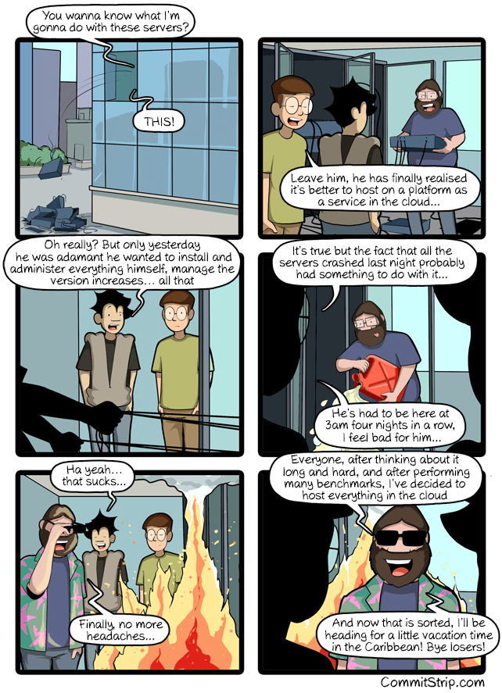

Slide 5
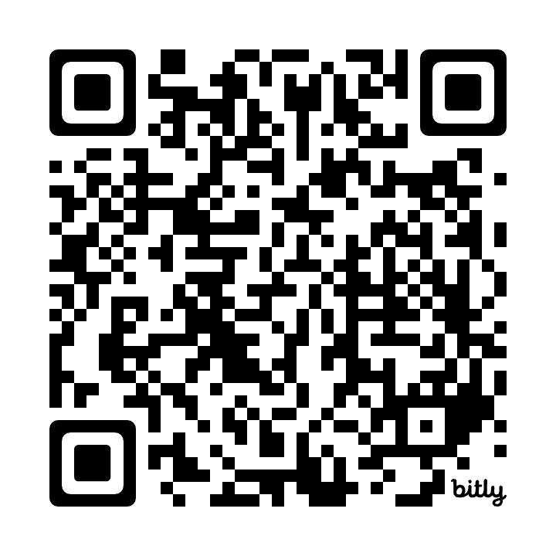
OCI Access Information
Resources and Cloud Environment Details
The course materials and exercises are available via the GitHub repository/website:
OCI Walkthrough: https://code.oradba.ch/oci-sec-ws
PDFs and Course Materials: https://code.oradba.ch/oci-sec-ws/others

Slide 6
Thank You

