Slide 1
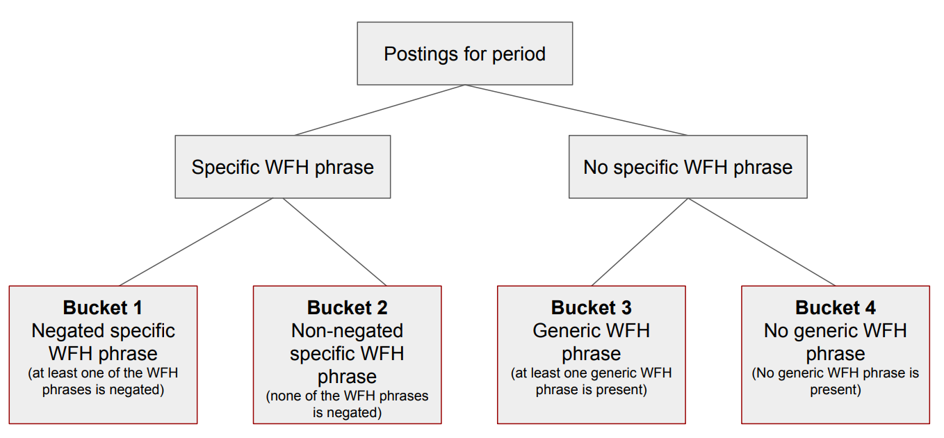
Bucket 1
Negated specific phrases and words that negate Work from Home, like ‘presencial’

Slide 2
Bucket 2
Includes disponibilidadnombre = Teletrabajo, for non-negated specific
Bucket 3
Generic WFH count if every Word of the dic phrase is on the string target regardless the words order, this way we count different ways to build the generic phrases.
Each bucket dictionary contains the original phrase, the phrase without capital letters, the phrase with each Word with initial capital letter and all caps, also a copy with accent and without accent and with ‘ñ’ and without.

Slide 3
Buckets

Slide 4
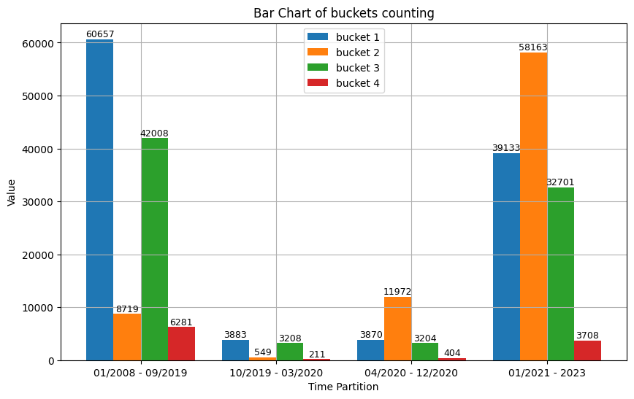

Slide 5
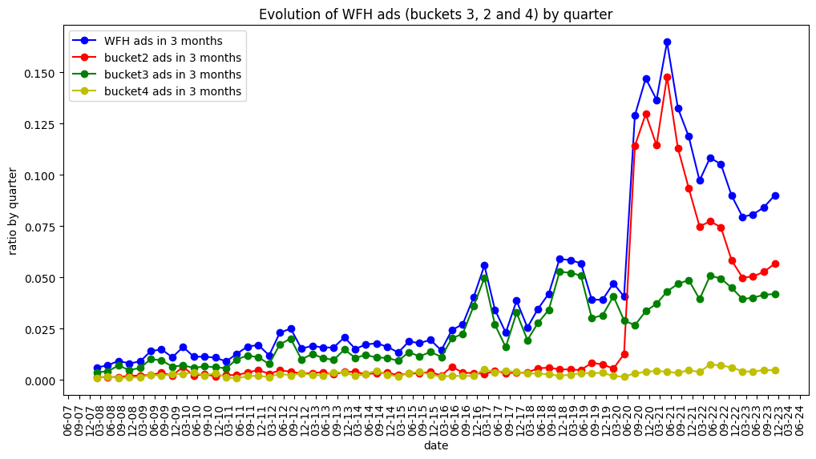

Slide 6
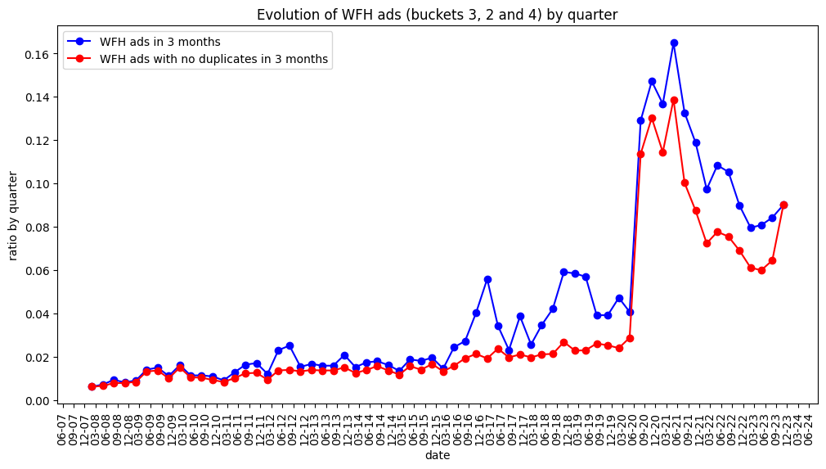

Slide 7
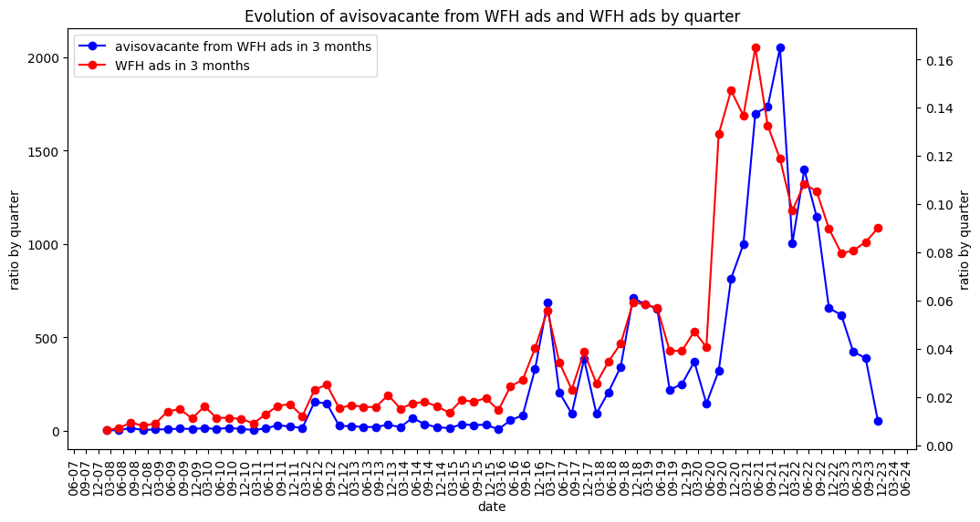

Slide 8
By database field
Avisocuerpo, avisocargo, avisorequisitos, disponibilidadnombre

Slide 9
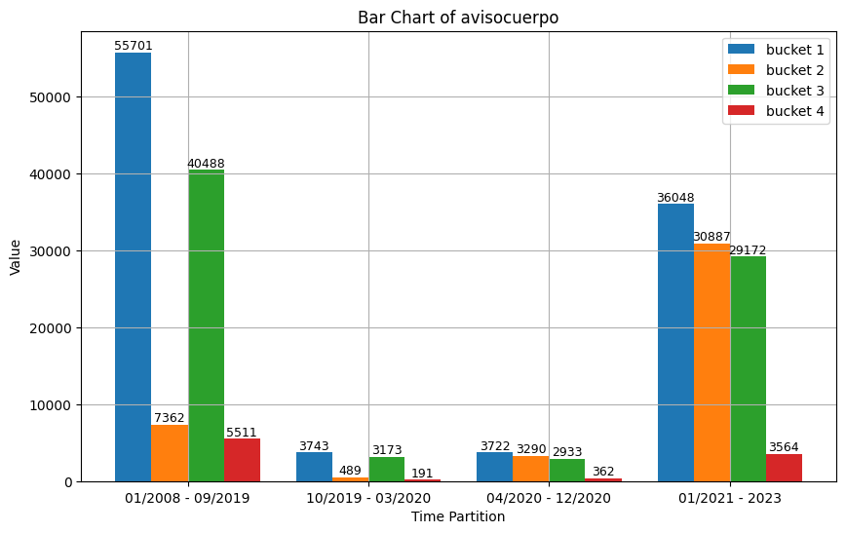

Slide 10
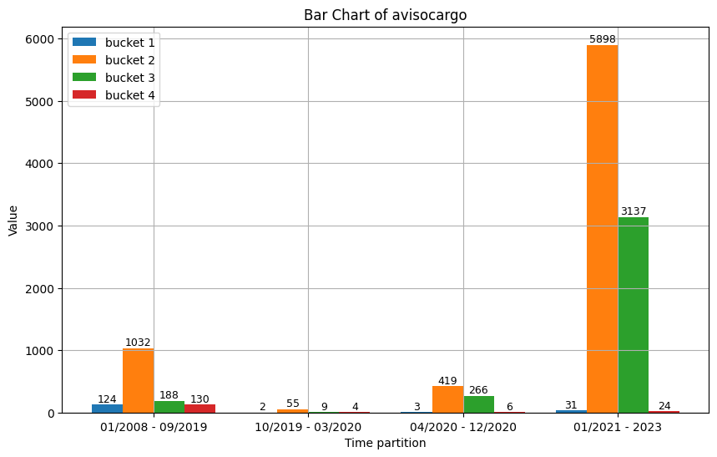

Slide 11
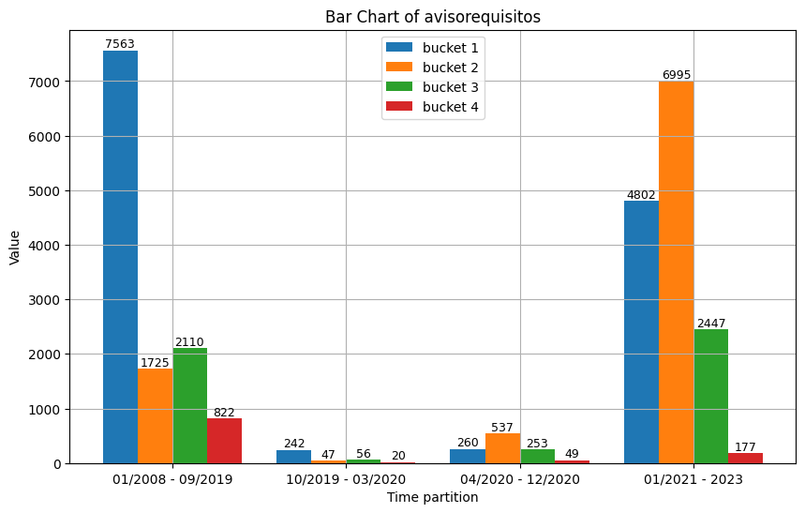

Slide 12
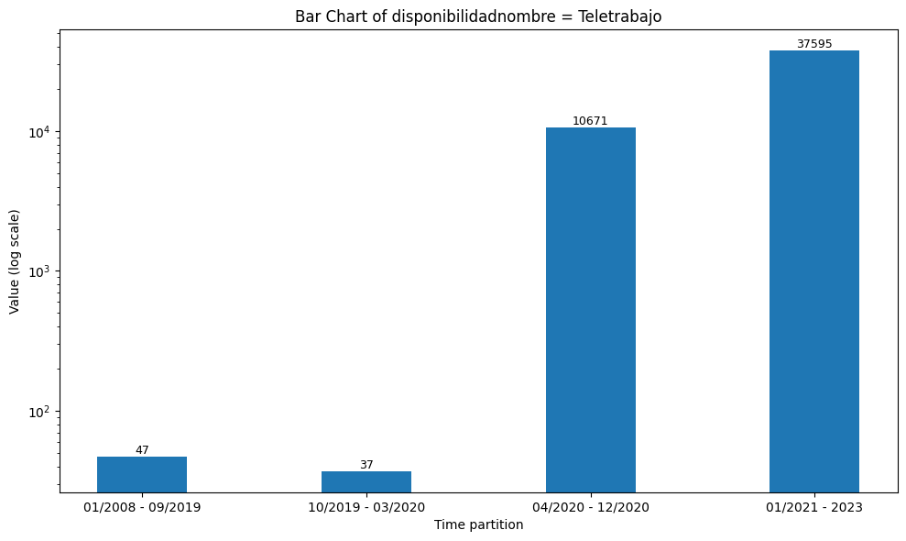

Slide 13
Field composition by bucket

Slide 14
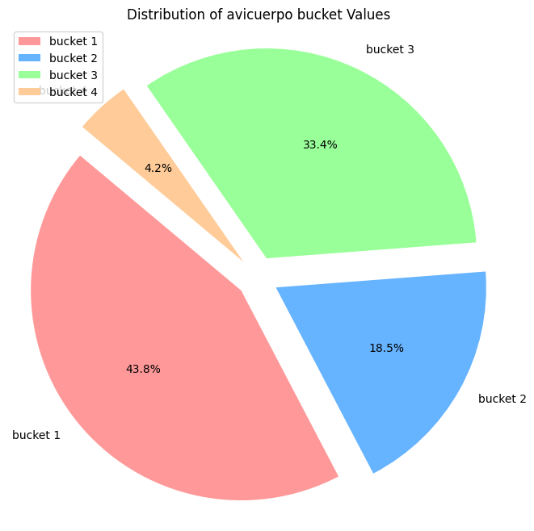
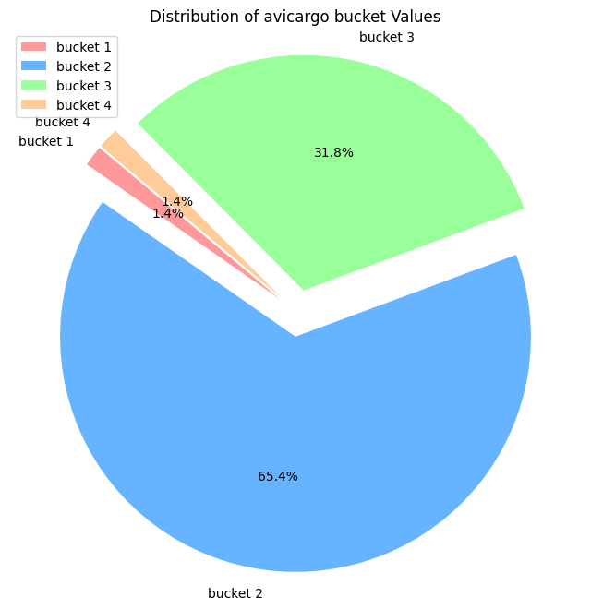

Slide 15
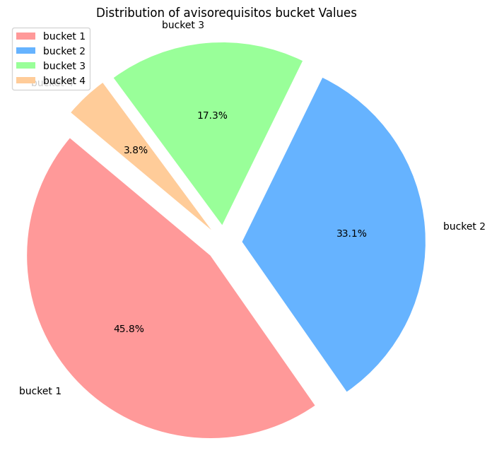

Slide 16
Duplicates
Duplicates are defined as True or False in each ad that is duplicated for empresaid avisolugartrabajo and avisocuerpo
For example avisocargo duplicates will be the ads whit the same empresaid, avisolugartrabajo, avisocuerpo and avisocargo
Sueldoestimado duplicates will be the ads whit the same empresaid, avisolugartrabajo, avisocuerpo and sueldoestimado
Avisocuerpo duplicates will be the ads whit the same empresaid, avisolugartrabajo and avisocuerpo

Slide 17
Avisocuerpo

Slide 18
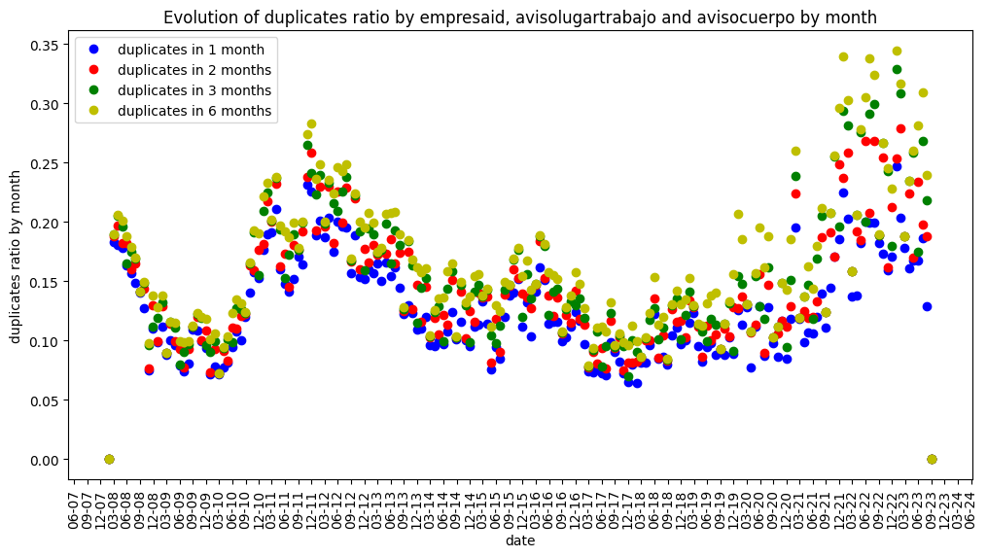

Slide 19
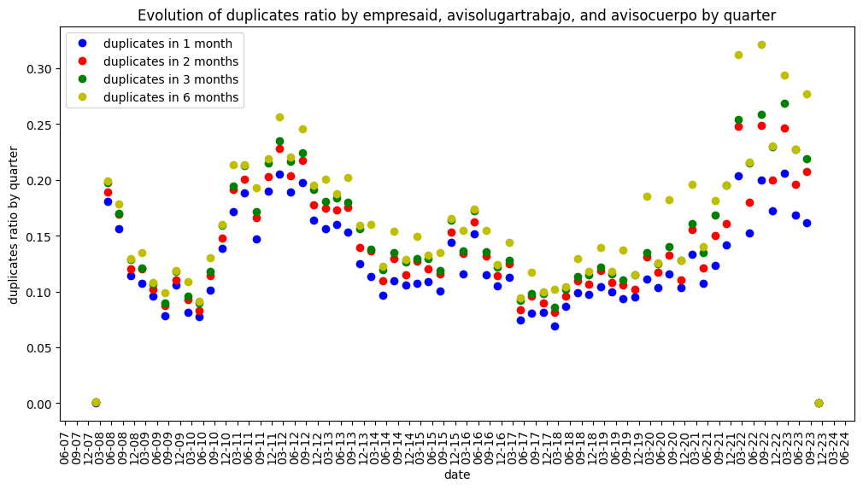

Slide 20
Avisocargo

Slide 21
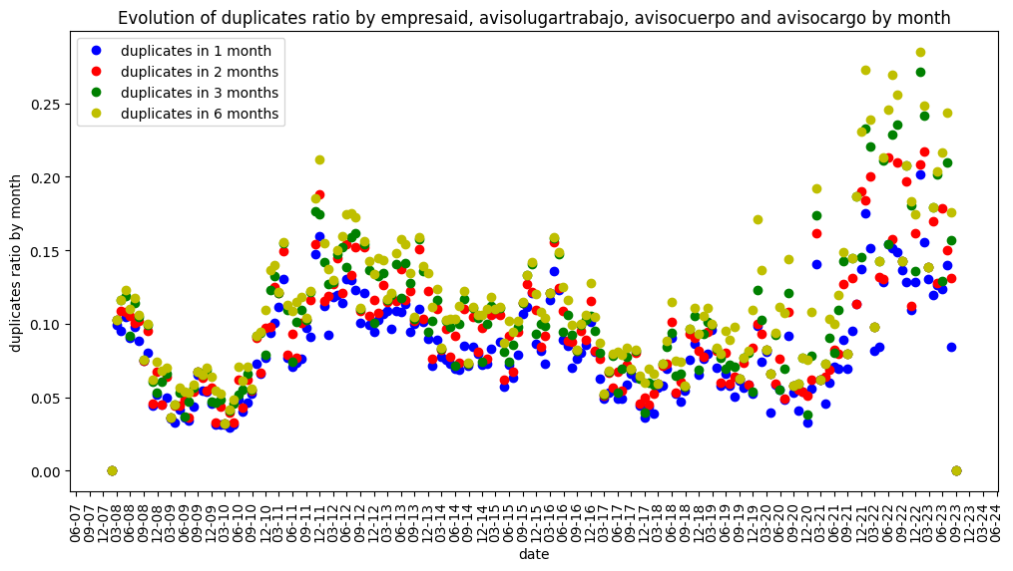

Slide 22
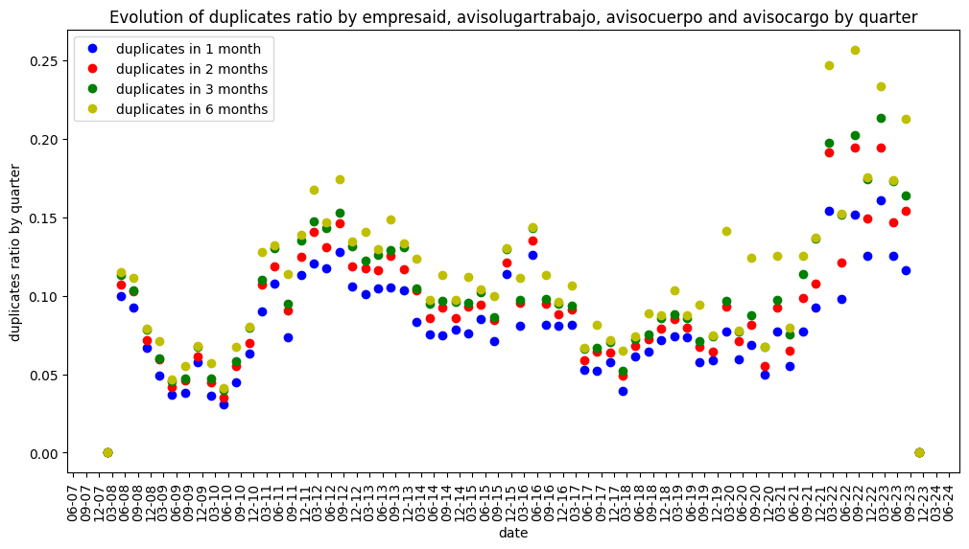

Slide 23
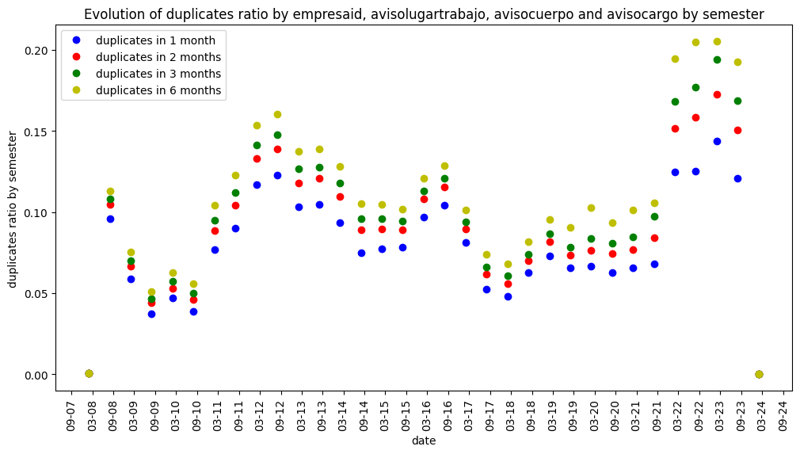

Slide 24
sueldoestimado

Slide 25
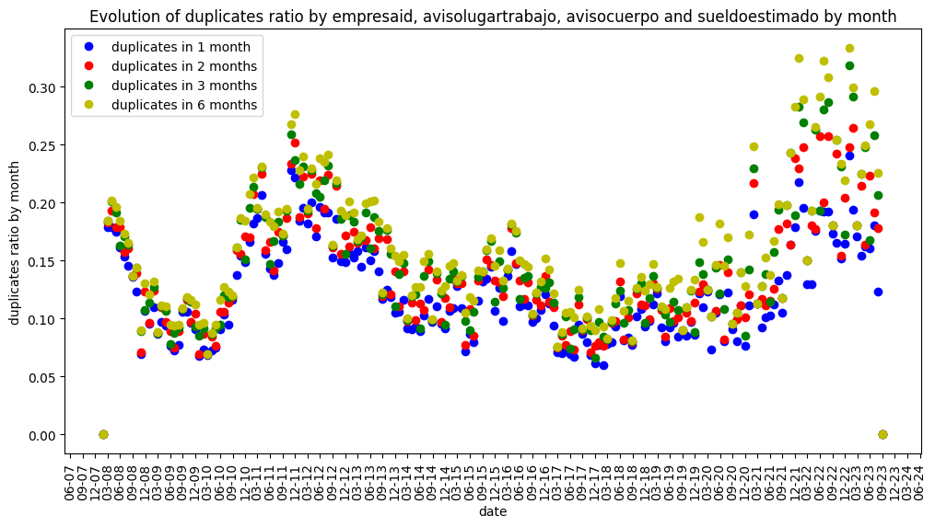

Slide 26
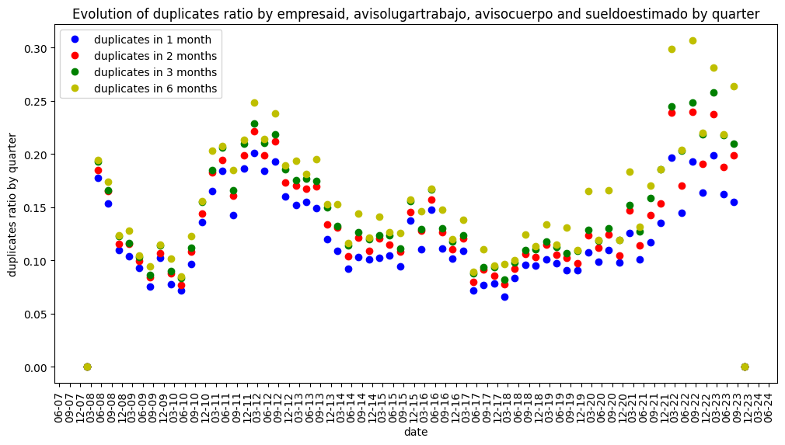

Slide 27
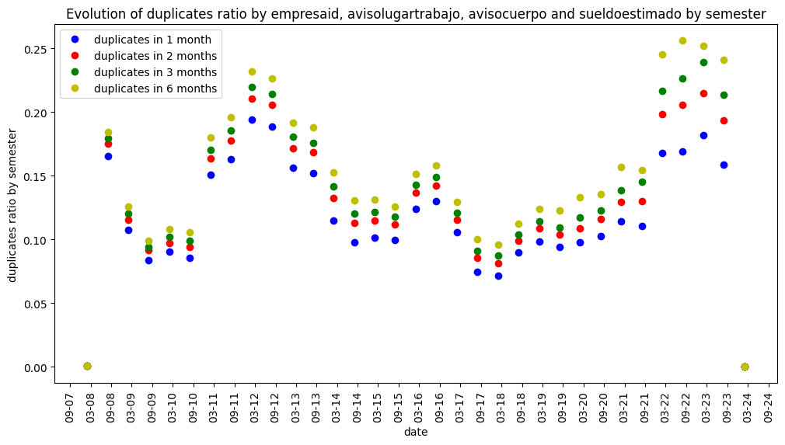

Slide 28
Duplicates differences

Slide 29
