Slide 1
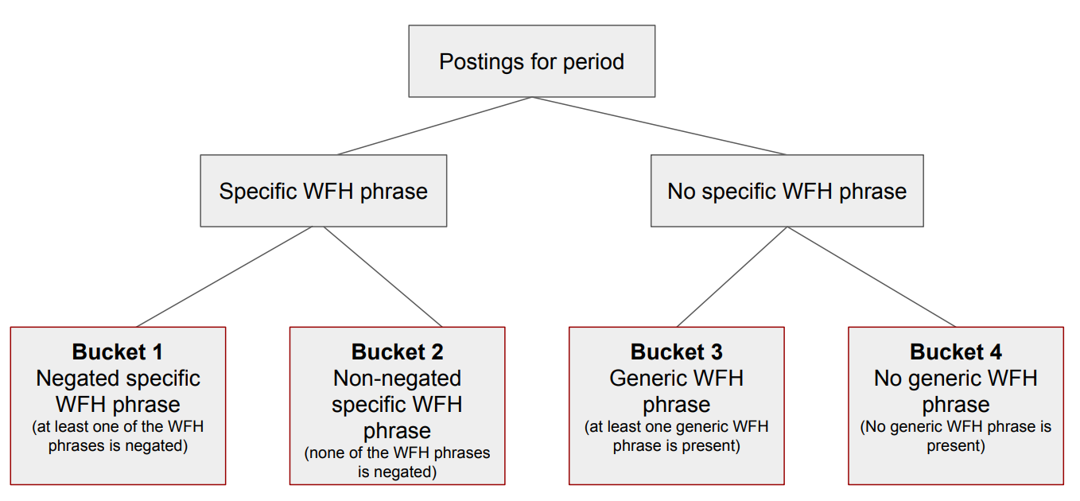
Bucket 1
Negated specific phrases and words that negate Work from Home, like ‘presencial’

Slide 2
Bucket 2
Includes disponibilidadnombre = Teletrabajo, for non-negated specific
Bucket 3
Generic WFH count if every Word of the dic phrase is on the string target regardless the words order, this way we count different ways to build the generic phrases.
Each bucket dictionary contains the original phrase, the phrase without capital letters, the phrase with each Word with initial capital letter and all caps, also a copy with accent and without accent and with ‘ñ’ and without.

Slide 3
Mensual, trimestral, avisos, comparado, relativos, contar WFH relativos
Eliminar duplicados, weighting vacantes y similares

Slide 4
Buckets

Slide 5
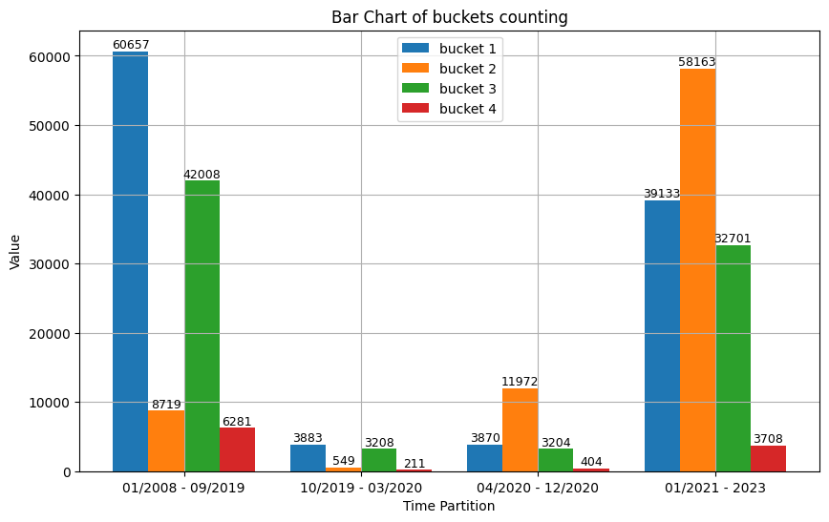

Slide 6
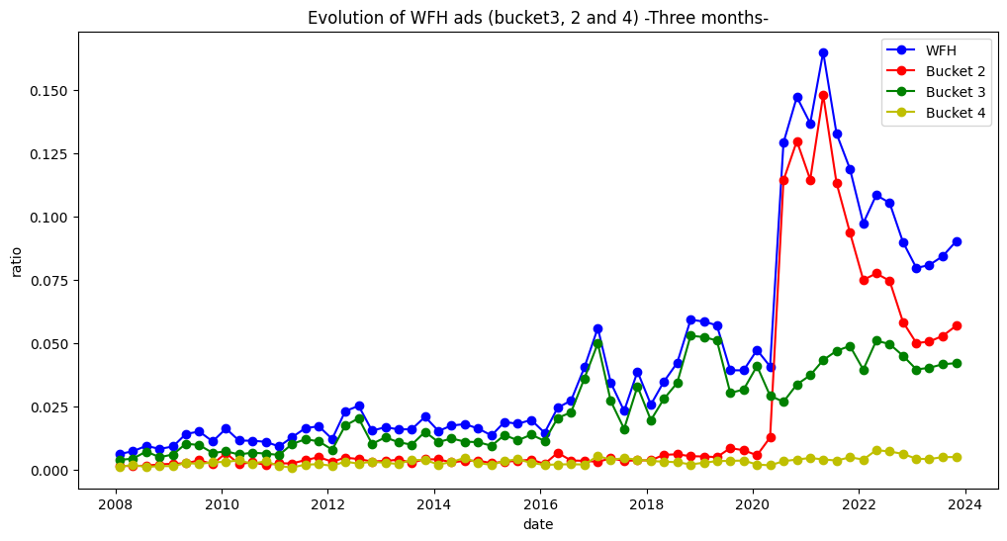

Slide 7
By database field
Avisocuerpo, avisocargo, avisorequisitos, disponibilidadnombre

Slide 8
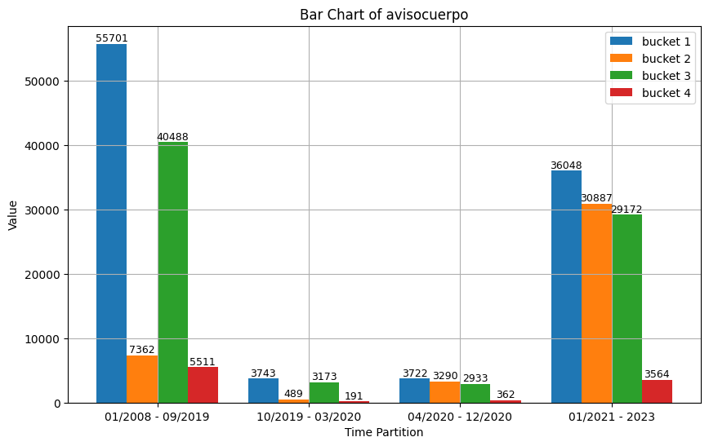

Slide 9
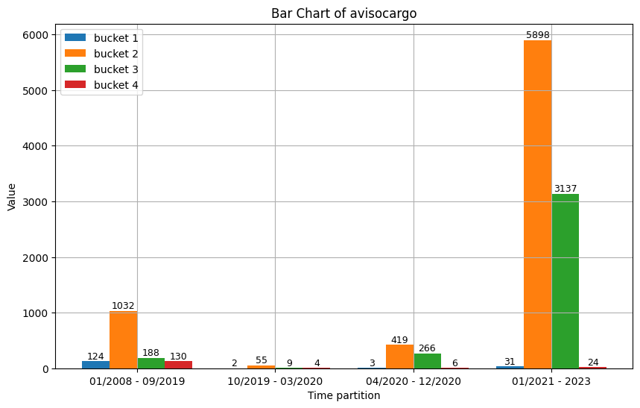

Slide 10
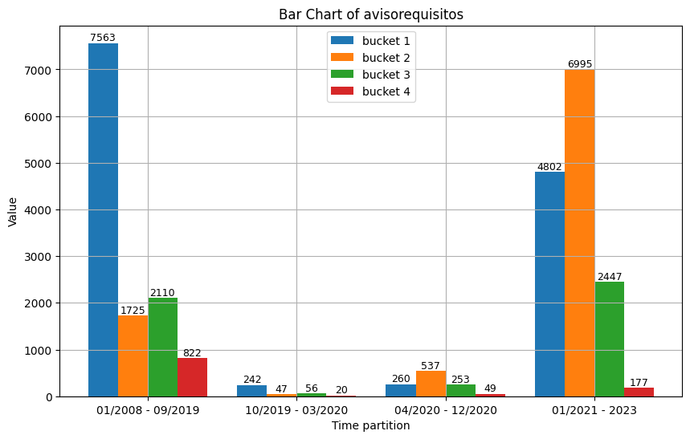

Slide 11
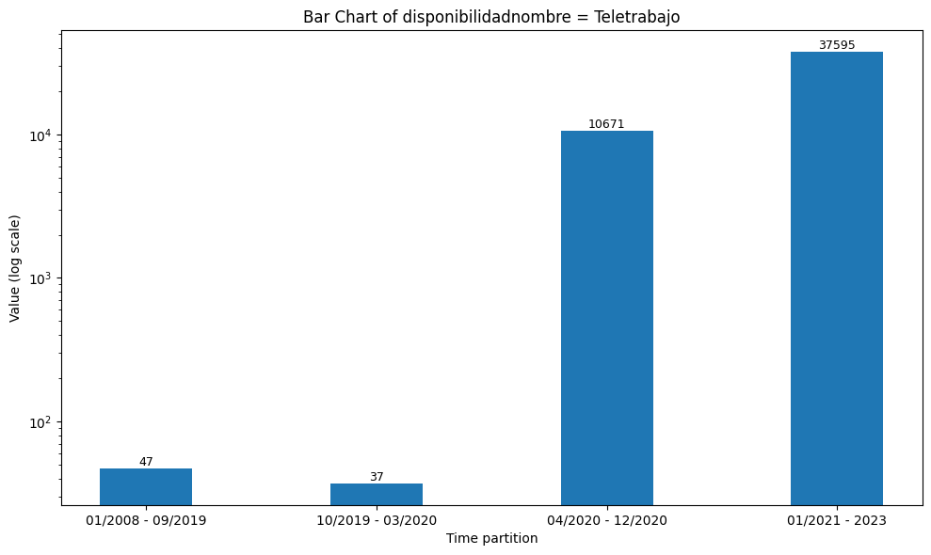

Slide 12
Field composition by bucket

Slide 13
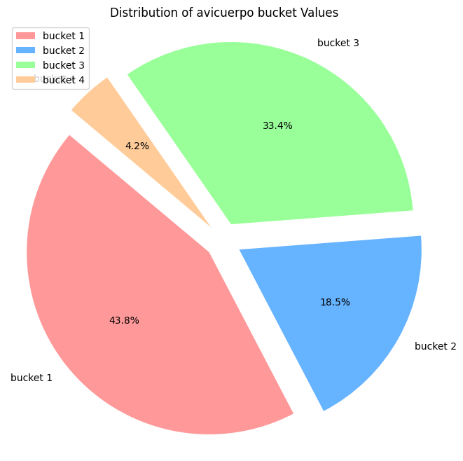
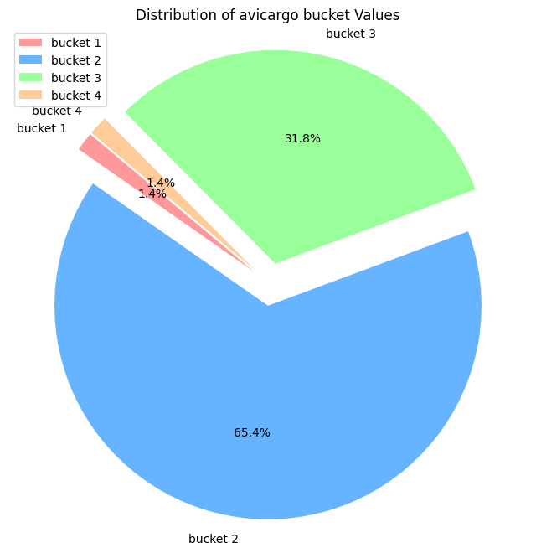

Slide 14
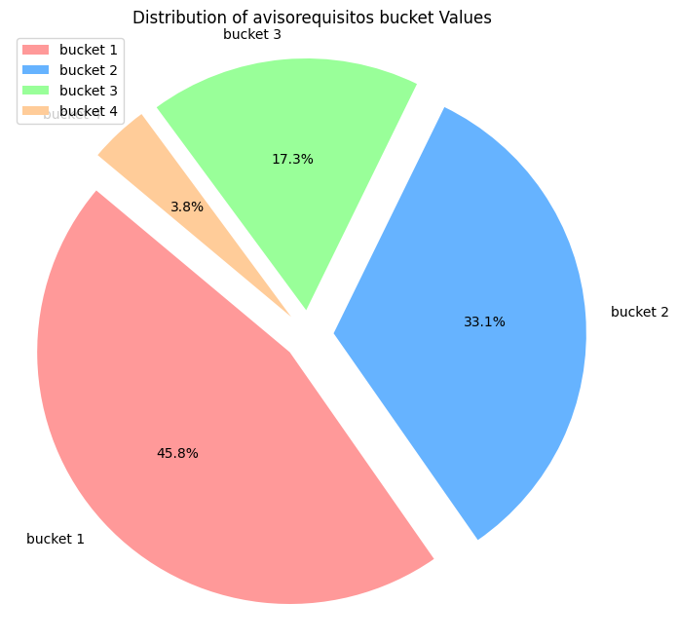

Slide 15
Duplicates

Slide 16
