Slide 1
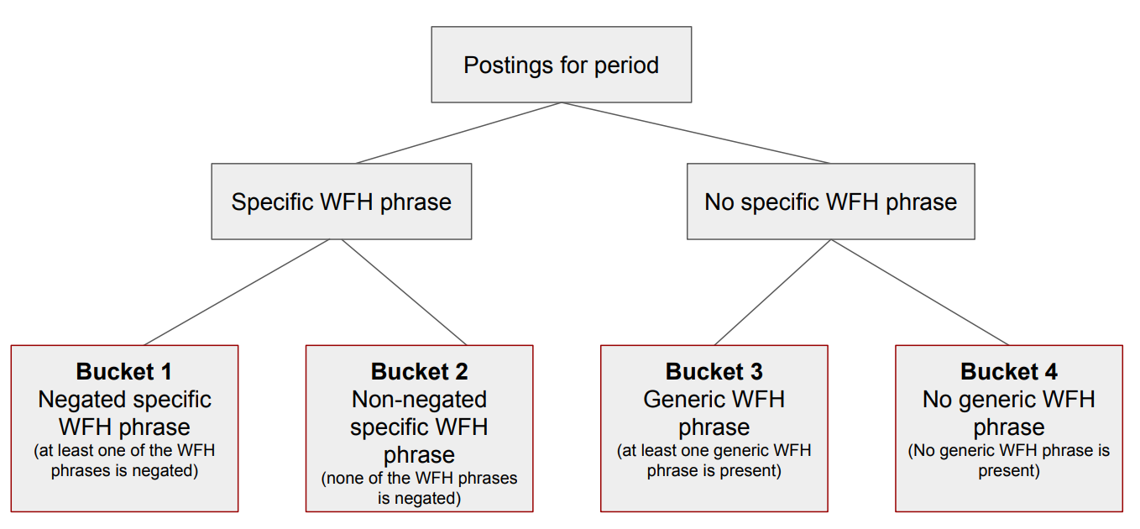

Slide 2
Bucket 1
Negated specific phrases and words that negate Woek from Home, like ‘presencial’
Bucket 3
Generic WFH count if every Word of the dic phrase is on the string target regardless the words order, this way we count different ways to build the generic phrases.
Each bucket dictionary contains the original phrase, the phrase without capital letters, the phrase with each Word with initial capital letter and all caps, also a copy with accent and without accent and with ‘ñ’ and without.

Slide 3
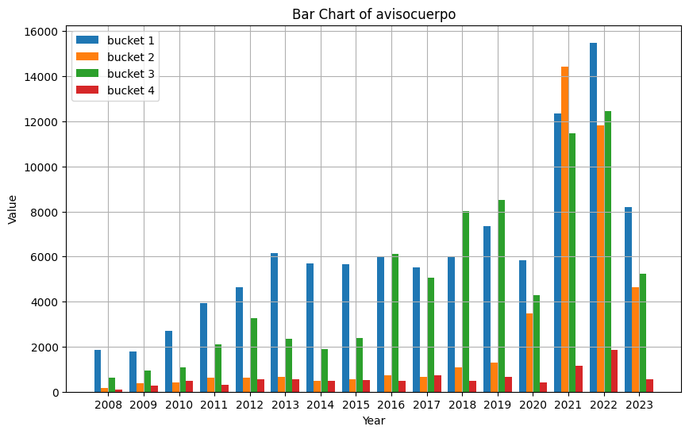
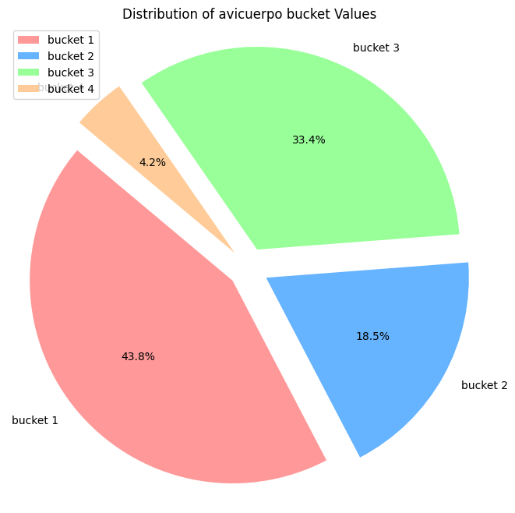
avisocuerpo

Slide 4
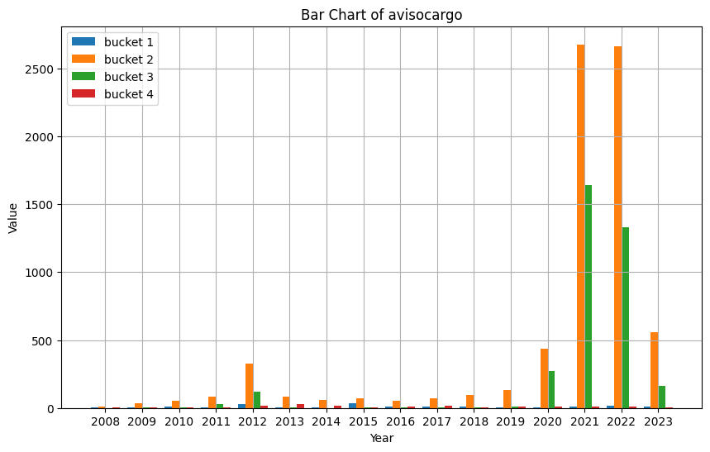
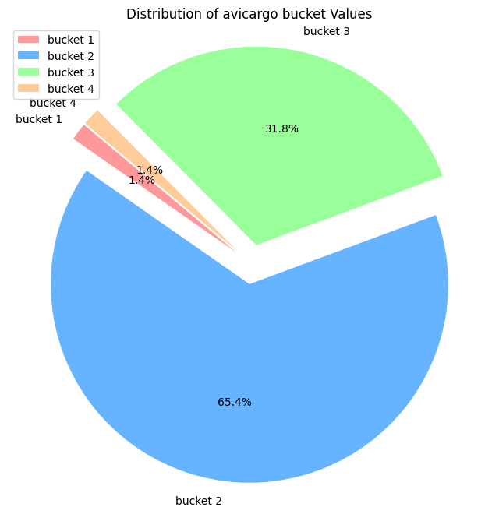
avisocargo

Slide 5
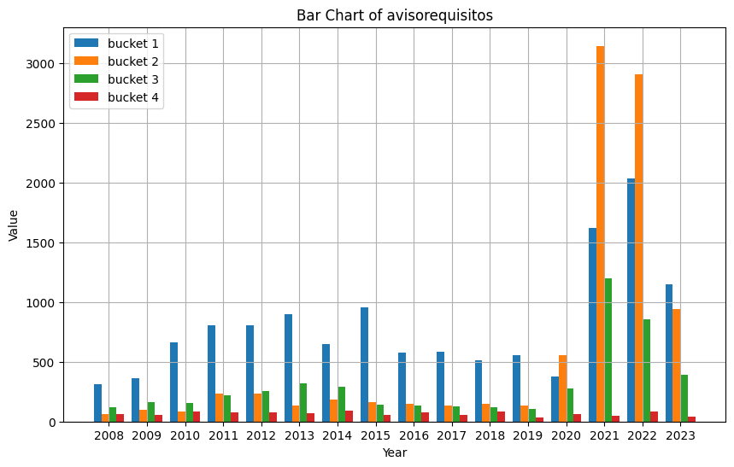
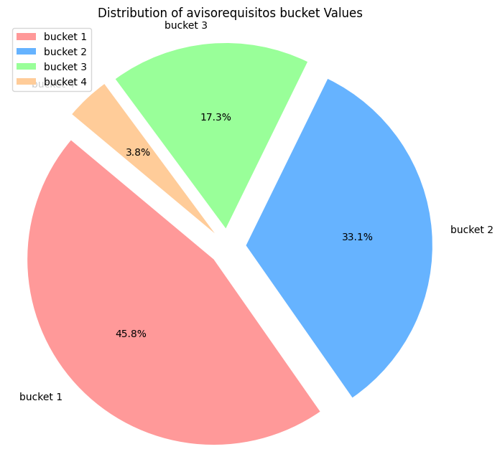
avisorequisitos

