Slide 1
TLA+ Part V (TLA 도구 사용)
정형기법 연구실
박사과정 4학기 김영미
2017년 3월 15일(수)

Slide 2
TLA+ Toolbox
TLA+ Toolbox(IDE for the TLA+ tools)
TLA+ parser
TLC
TLATEX
TLAPS
TLA Proof Manager
“backend” verifiers
Pdflatex 프로그램 필요
설치 프로그램 별도로 제공

Slide 3
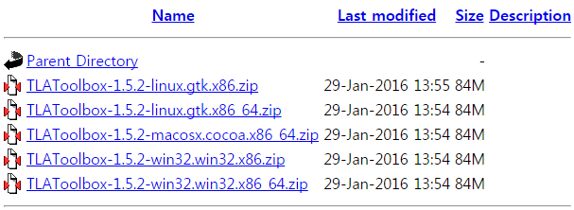
TLA+ Toolbox 설치
TLA+ Tools
환경
Java runtime 1.8
Windows, Linux 지원
다운로드
http://research.microsoft.com/en-us/um/people/lamport/tla/toolbox.html#downloading
https://tla.msr-inria.inria.fr/tlatoolbox/products/

Slide 4
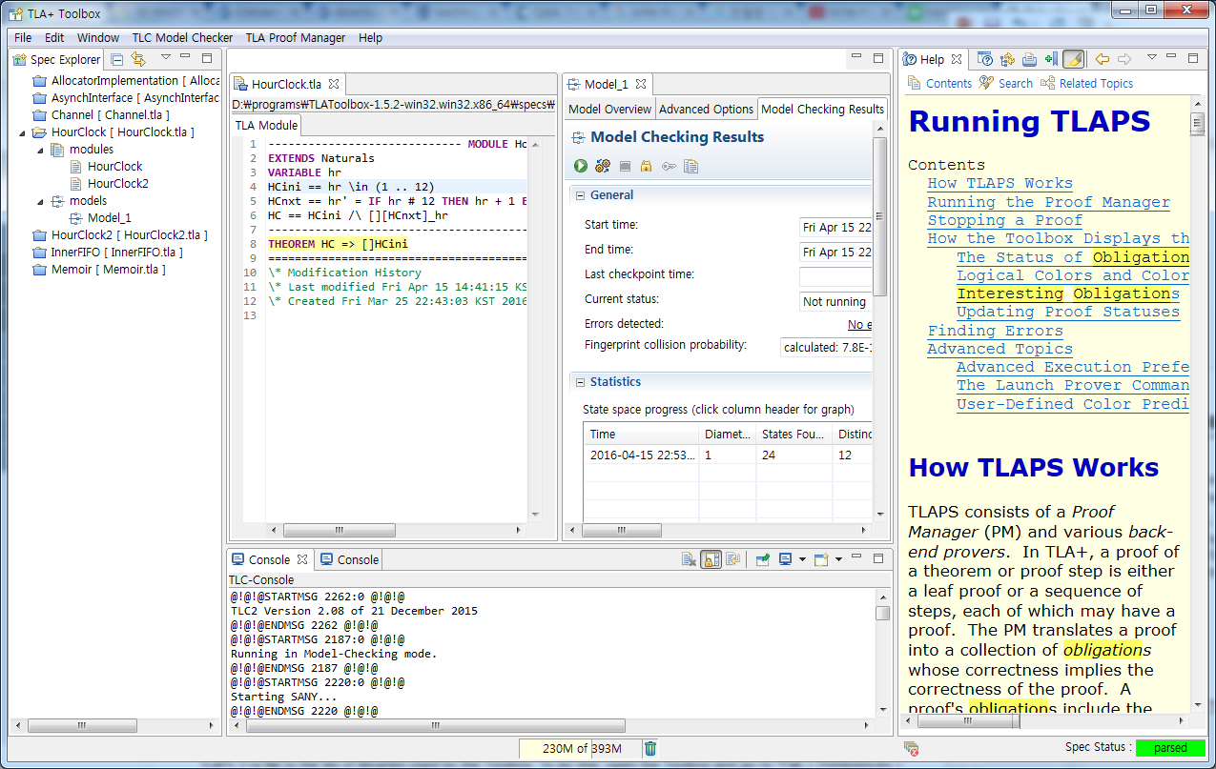
TLA+ Tools

Slide 5
Specifying Systems
Specify a system by specifying a set of possible behaviors
Behavior
A sequence of states
State
An assignment of values to variables

Slide 6
TLA+ - Overview
4 parts to a specification
Initial predicate
Possible “Next” states
Safety Properties
Liveness Properties

Slide 7
TLA+ - Overview
Most TLA system specifications are of the form
Init ∧ □[Next]_{v} ∧ L
Init : state formula describing the initial state(s)
Next : action formula formalizing the transition relation
usually a disjunction A₁ ∨...∨ A_{n} of possible actions (events) Ai
L : temporal formula asserting liveness conditions
usually a conjunction WF_{v}(A_{i}) ∧...∧ SF_{v}(A_{j}) of fairness conditions
* Ref: Modeling and Developing Systems Using TLA+(ppt, by Stephan Merz)

Slide 8
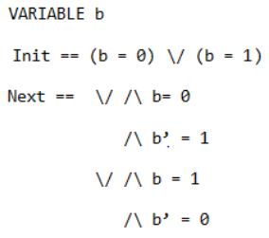
Alternating One-bit Clock
Initial Predicate
(b = 0) ∨ (b = 1)
Next States
((b = 0) ∧ (b’ = 1)) ∨ ((b = 1) ∧ (b’ = 0))

Slide 9
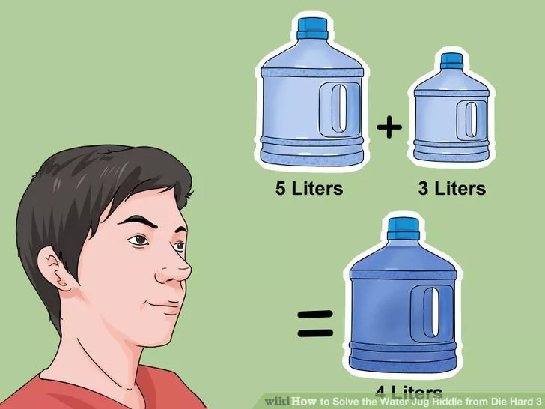
Die Hard Problem
In the movie Die Hard 3, the heroes must solve the problem of obtaining exactly 4 gallons of water using a 5 gallon jug, a 3 gallon jug, and a water faucet.
https://www.youtube.com/watch?v=BVtQNK_ZUJg
*Image source:http://www.wikihow.com/Solve-the-Water-Jug-Riddle-from-Die-Hard-3

Slide 10


Die Hard Problem
The initial predicate
The next possible actions on the system
*Ref: http://www.ebpml.org/blog15/2015/01/tla-the-die-hard-problem/

Slide 11
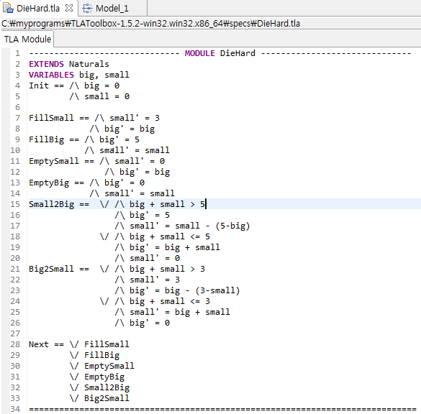
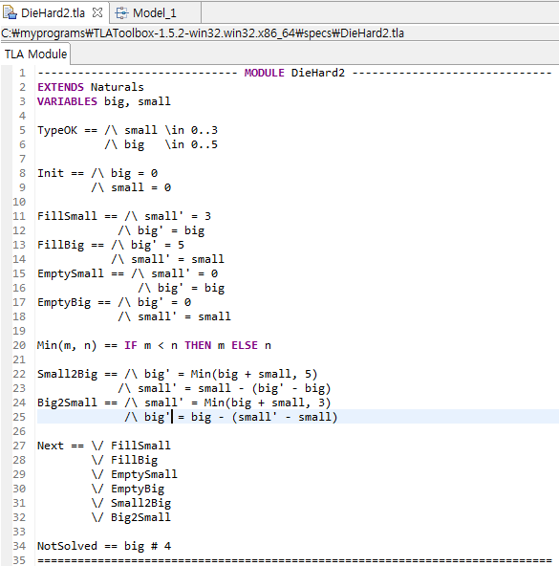
Die Hard Problem

Slide 12
A Verification Method of SDN Firewall Applications
SDN(Software-Defined Networking)
* Ref: Miyoung KANG et al, “A Verification Method of SDN Firewall Application”, IECE TRANS. COMMUN., July 2016

Slide 13
Verification Framework

Slide 14
Translation of Firewall Rules to pACSR

Slide 15
Translation of Switch’s OpenFlow Tables to pACSR
k

Slide 16
Example of Firewall Rules and OpenFlow tables

Slide 17
Translation of Firewall rules

Slide 18
Translation of Switch’s OpenFlow tables

Slide 19
Q & A

