Slide 1
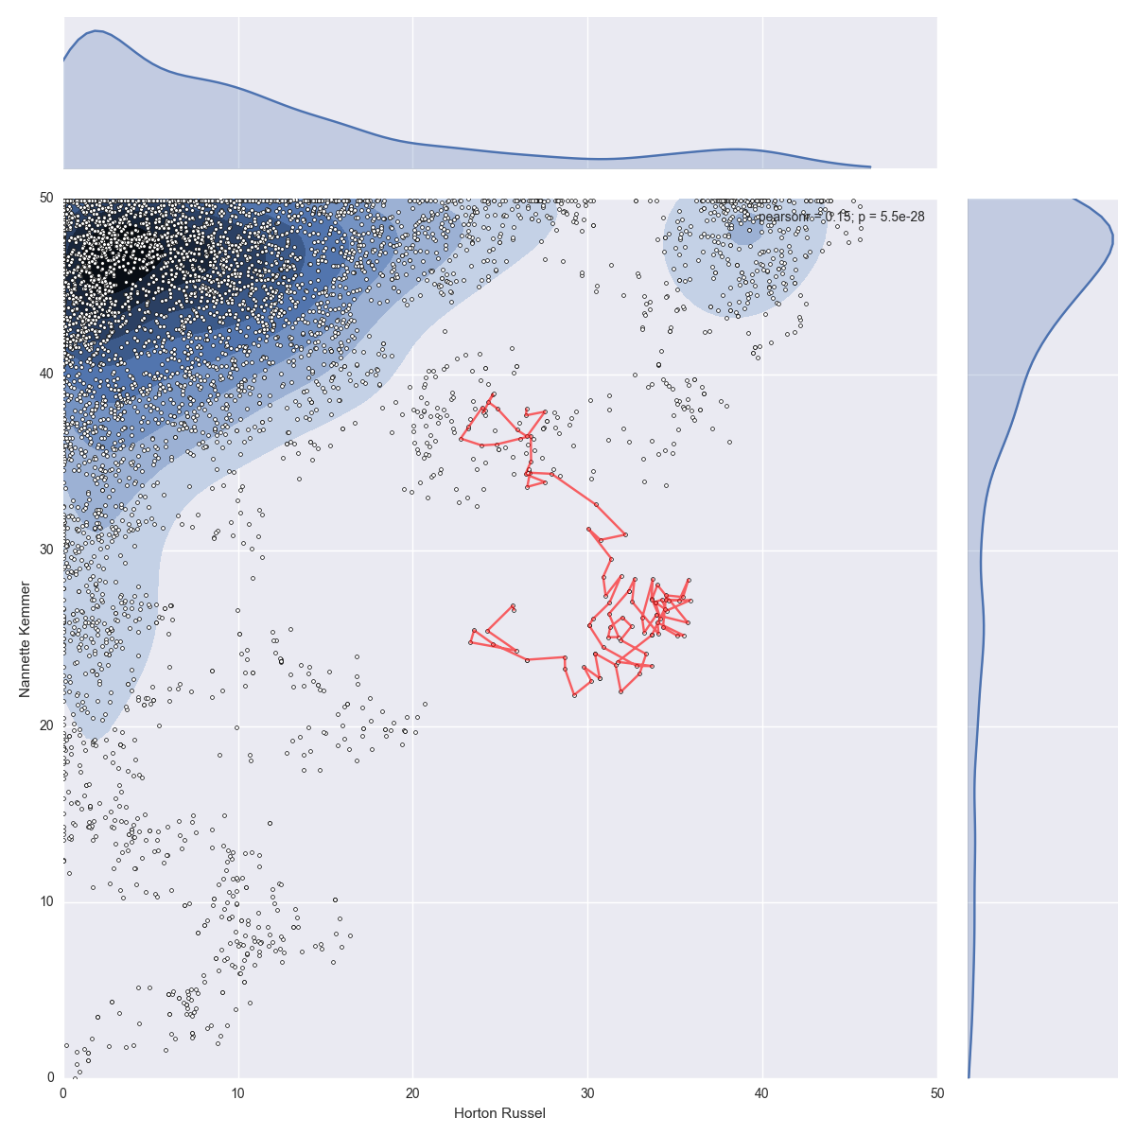
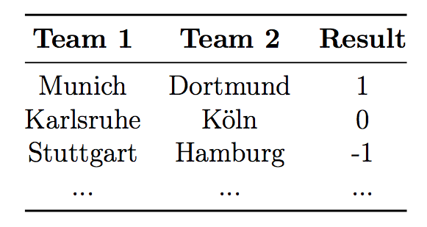
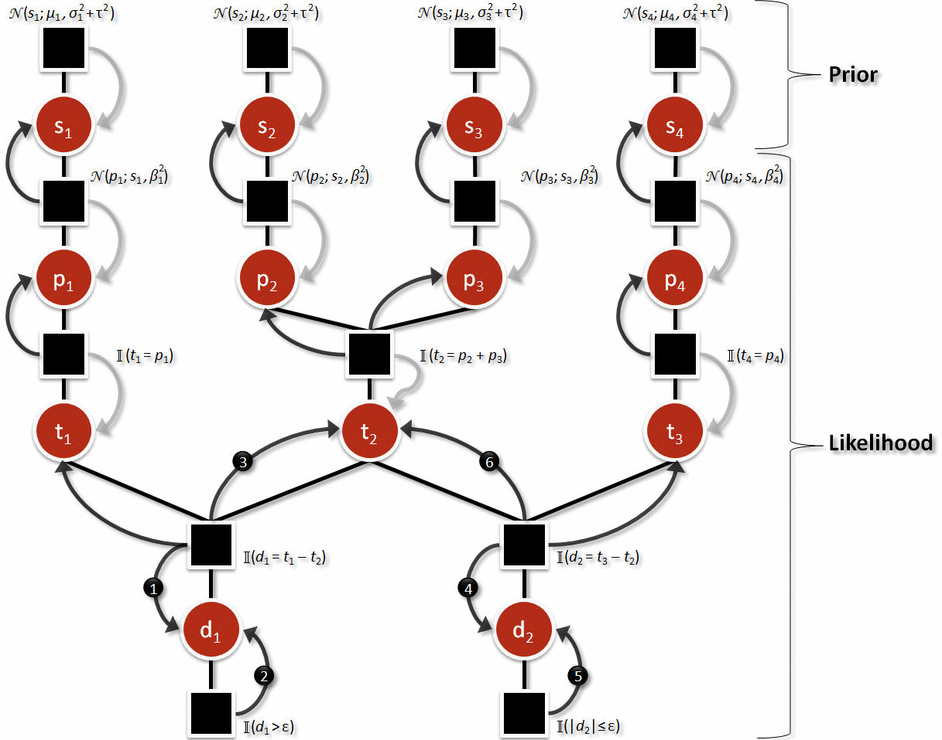
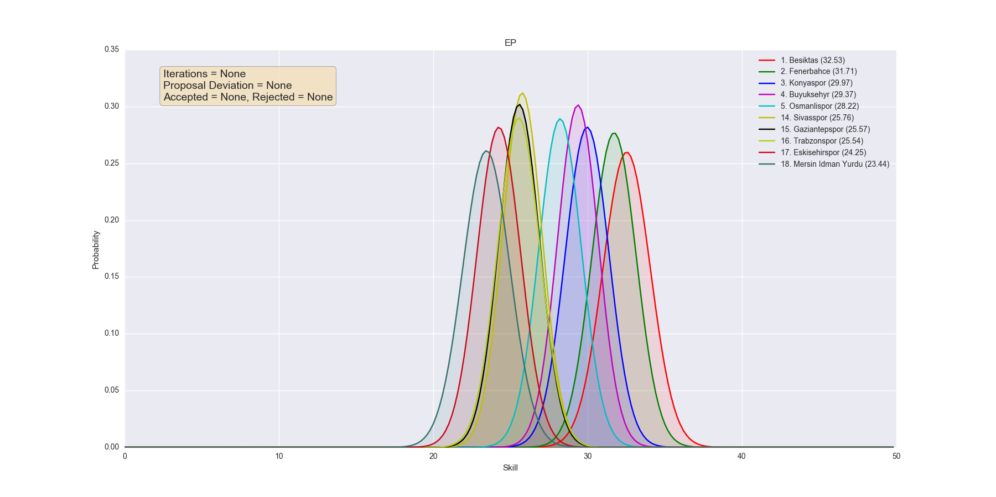
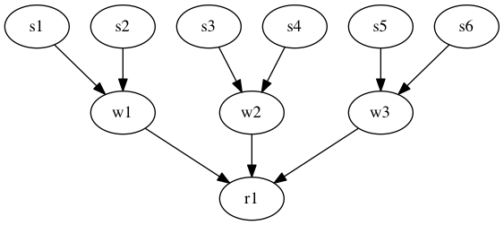
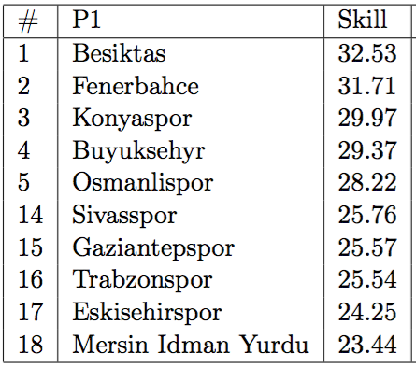
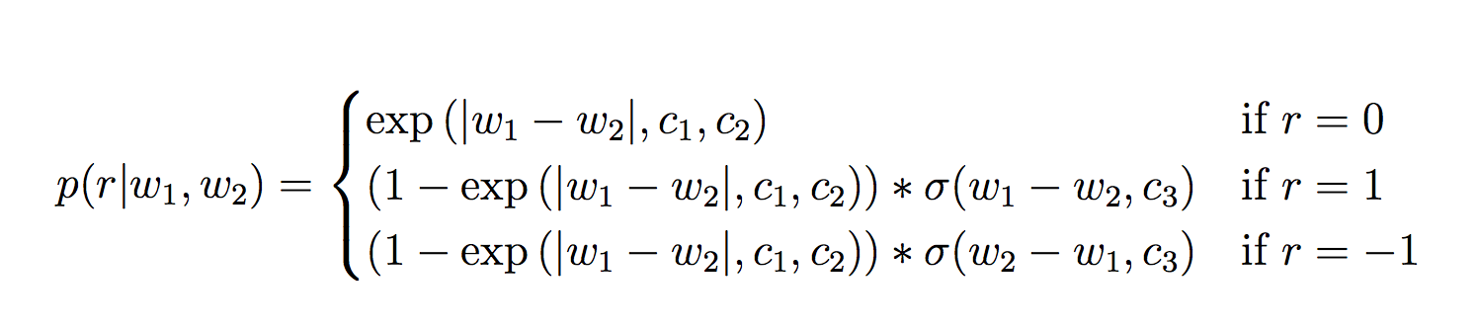
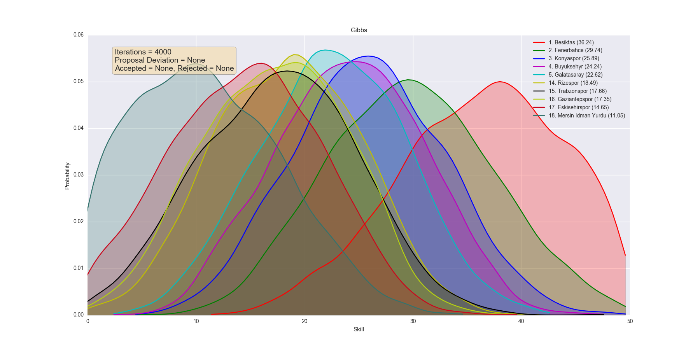
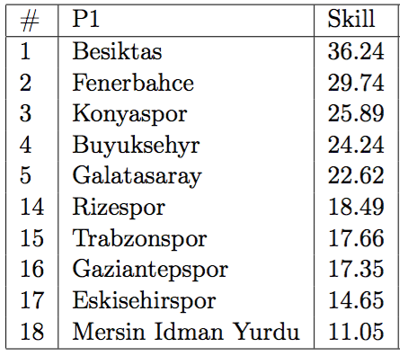
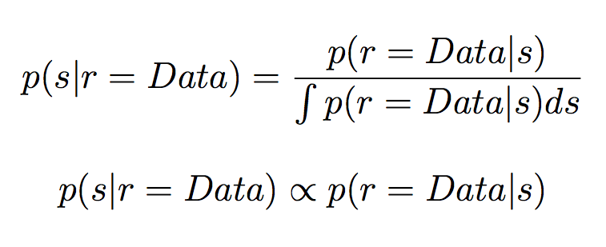
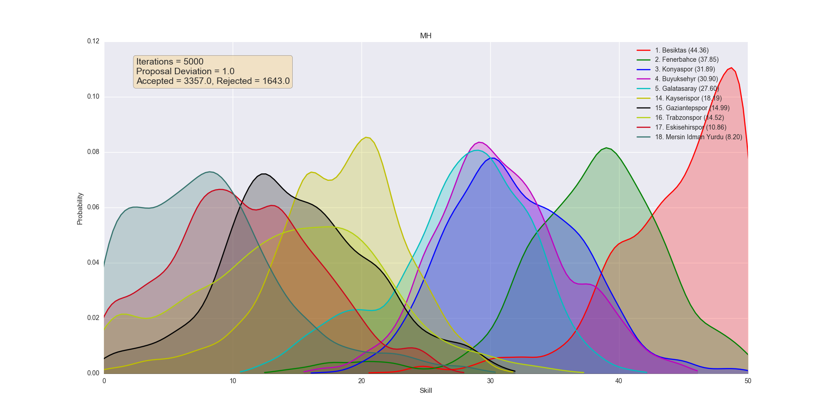
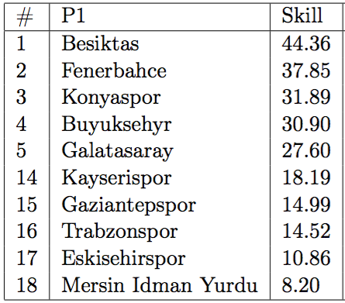
Player Rating Estimation via Bayesian Inference
Mustafa Onur Eken
Advisor: Ali Taylan Cemgil
Motivation
Data
Player rating systems are essential to games in situated in all different contexts (video games, sports etc).
If we can devise a model which captures real-life dynamics of match-making and fit players of the game in that model, then we can:
1. Estimate outcomes of future matches
2. Arrange matches that are more likely to be exciting
3. Rank players of the game
Synthetic Data: We generated synthetic data with various configurations assuming the model described for MCMC methods to solve.
Real-World Data: We collected match results of
Tennis Grand Slams in 2013
German, Spanish, Turkish, English primary national football leagues of 2015-2016 season
NBA 2015-2016 season
Preprocessed data has the following form:
Method I: MCMC
Assume a model where a skill value is associated with each player and skill values regulate the probabilities for different outcomes of matches.
Assume players form teams (which might contain a single member as well) that eventually compete in matches.
Method II: Expectation Propagation
Results
EP
Gibbs
Assume a similar and slighly more complex model where:
Players produce a performance each match based on their skill
We use a Gaussian distibution to represent a skill whose variance stands for the uncertainty.
Approach III: Use an online Bayesian inference algorithm Expectation Propagation to update prior distributions of skills.
Model is defined such that upsetting results cause a greater decay in uncertainty and a greater shift in mean
Approach I: Sample from the posterior distribution with Metropolis-Hasting algorithm
Approach II: Since we can calculate the conditional and can sample from it, we can sample from the target posterior distribution using Gibbs sampler
Compute mean of samples to be the point estimate of actual skill of the player.
MH

