Slide 1

Player Rating Estimation via Bayesian Inference
Mustafa Onur Eken
Advised by Ali Taylan Cemgil
Submitted to the Department of Computer Engineering in partial fulfillment of the requirements for the degree of Bachelor of Science
Boğaziçi University, Spring 2016

Slide 2
Motivation & Introduction
Player rating systems are essential to games in situated in all different contexts (video games, sports etc). Often people would like to:
Rank players of the game
Arrange matches that are interesting (Not dominated by a particular competitor)
Estimate outcomes of future matches
In this project, we specify two different models to explain real-life dynamics of match-making.
Then, we find parameters of the model via performing approximate Bayesian inference.

Slide 3
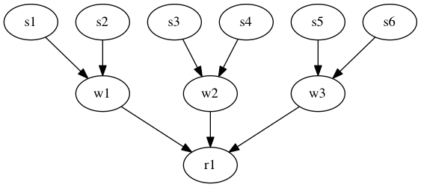
Our Generative Model
A way to represent dependencies
Model assumes that each players has a fixed, unknown skill value
First layer (s) represents the skills of involved players
Second layer (w) represent the skills associated with teams. They depend on (s)
Third layer (r) represents the match results

Slide 4
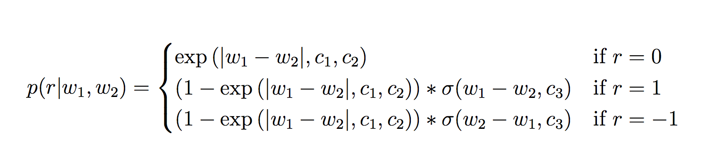
More Assumptions!
Assume that the following dynamic generates the match results
This is the most crucial assumption of our model
For instance say c1 = 0.33, c2 = 0.05, c3 = 0.06, then:
P(r = 1 | w1 = 25, w2 = 10) = 0.51
P(r = -1 | w1 = 25, w2 = 10) = 0.29
P(r = 0 | w1 = 25, w2 = 10) = 0.20

Slide 5
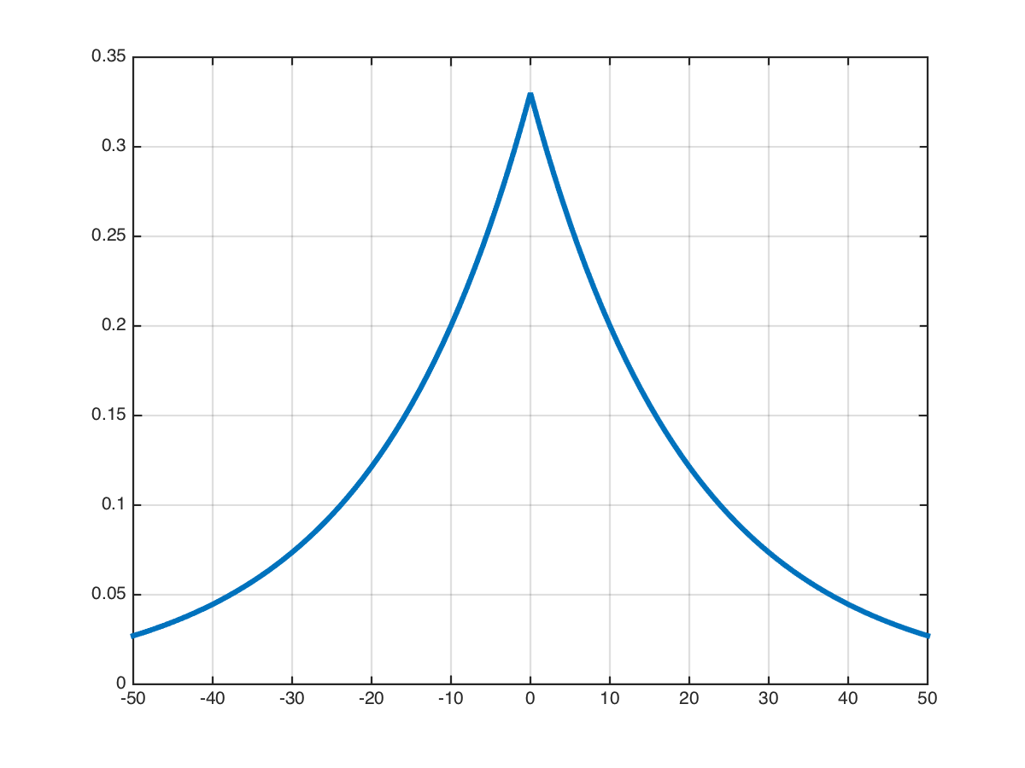
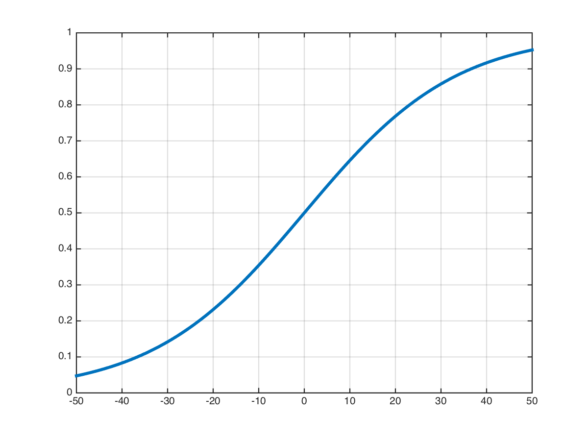


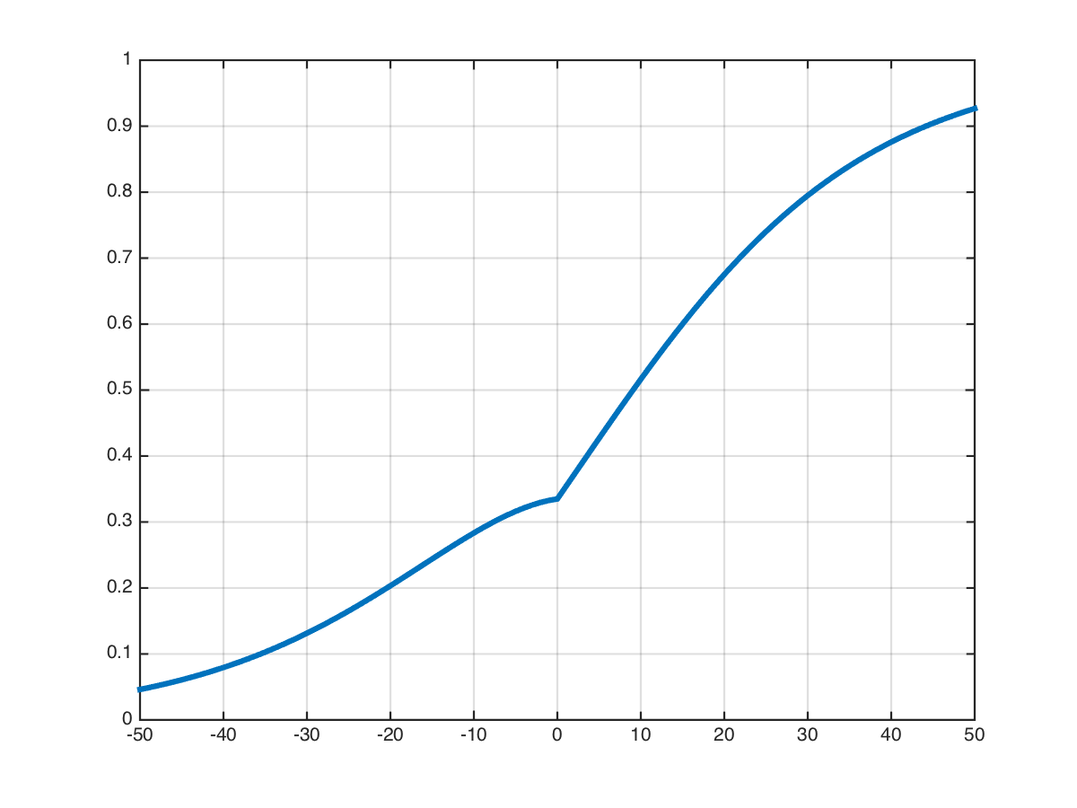
C1, C2, C3 ?
c1: the y-intercept
c2: how fast it decays
c3: Steepness of the function

Slide 6
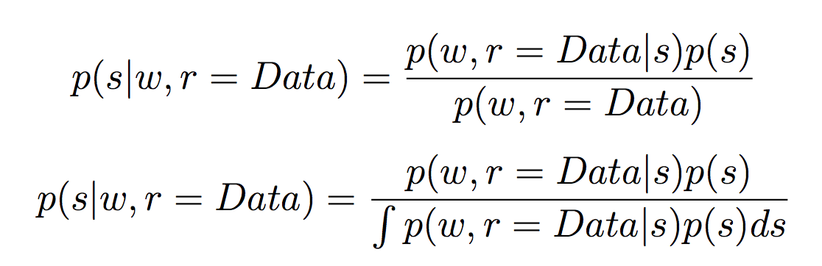
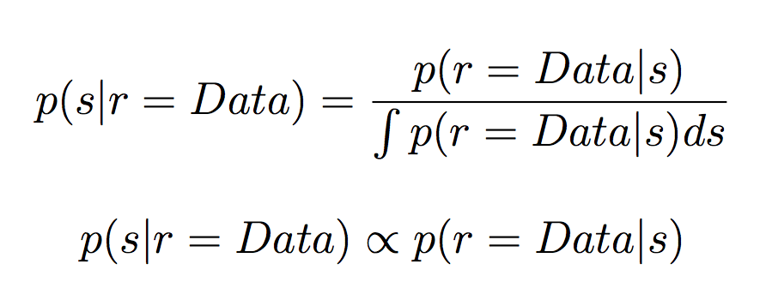
What about the priors?
We have these two let’s apply Bayes rule
Assume uniform prior p(s)
Assume sum of s yields w

Slide 7
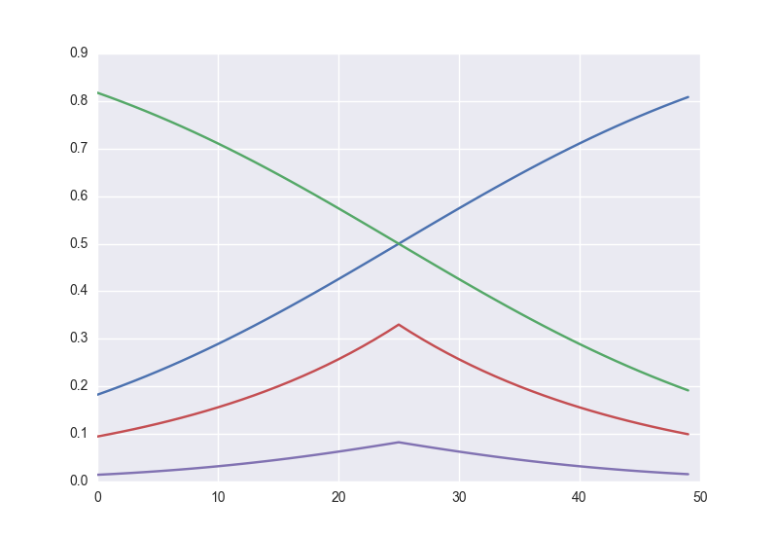
How to infer the posterior?
1. Use Metropolis-Hastings algorithm to sample from the posterior
2. We can use Gibbs sampler thanks to the fact that computation of individuals skills conditioned on other skills & results is tractable.
Blue: Distribution of one skill variable (say s1) conditioned on a match result and skill value of another player
Red: Distribution of the same skill variable in blue (i.e. s1) but conditioned on another a match result and skill value of another player
Purple: Multiplication of blue and green. Complete distribution of skill variable s1 conditioned on all other variables
Toy Example: computing conditional distribution of s1

Slide 8
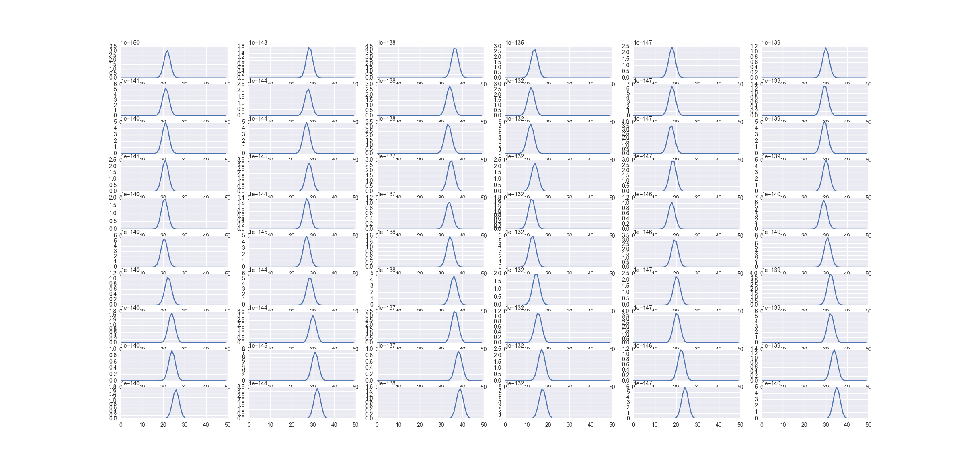
Example: conditionals of skills over time
Variables (s1, s2, s3, s4, s5, s6)
Iteration

Slide 9
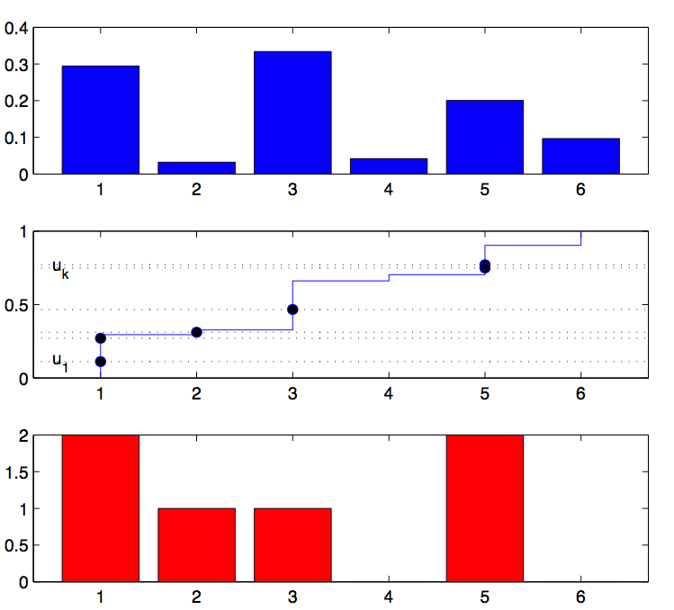
How to sample from conditional?
IDEA:
Compute the function at various points
Compute the cumulative version of it by summing
Use multinomial resampling method to generate samples

Slide 10
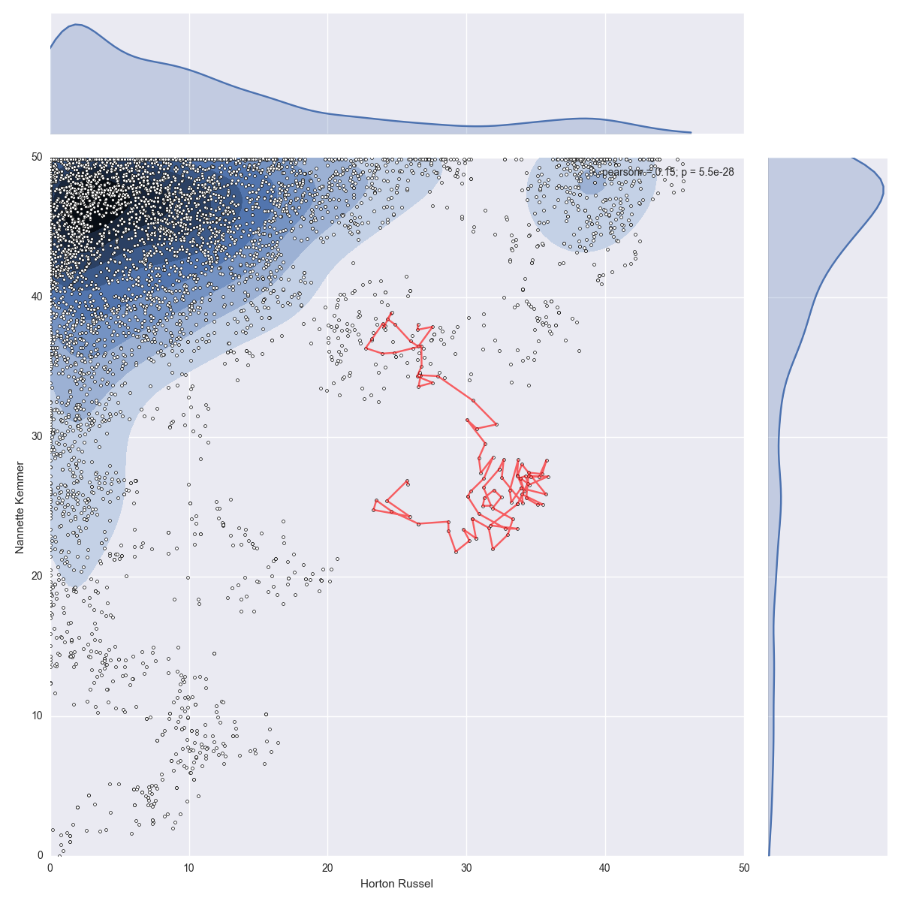
MH: How do samples look like?
Projections on axes: approximate distribution is visualized using Gaussian kernel density estimator
Axis of player 2
Red lines indicate the first 100 samples visited
Axis of player 1

Slide 11
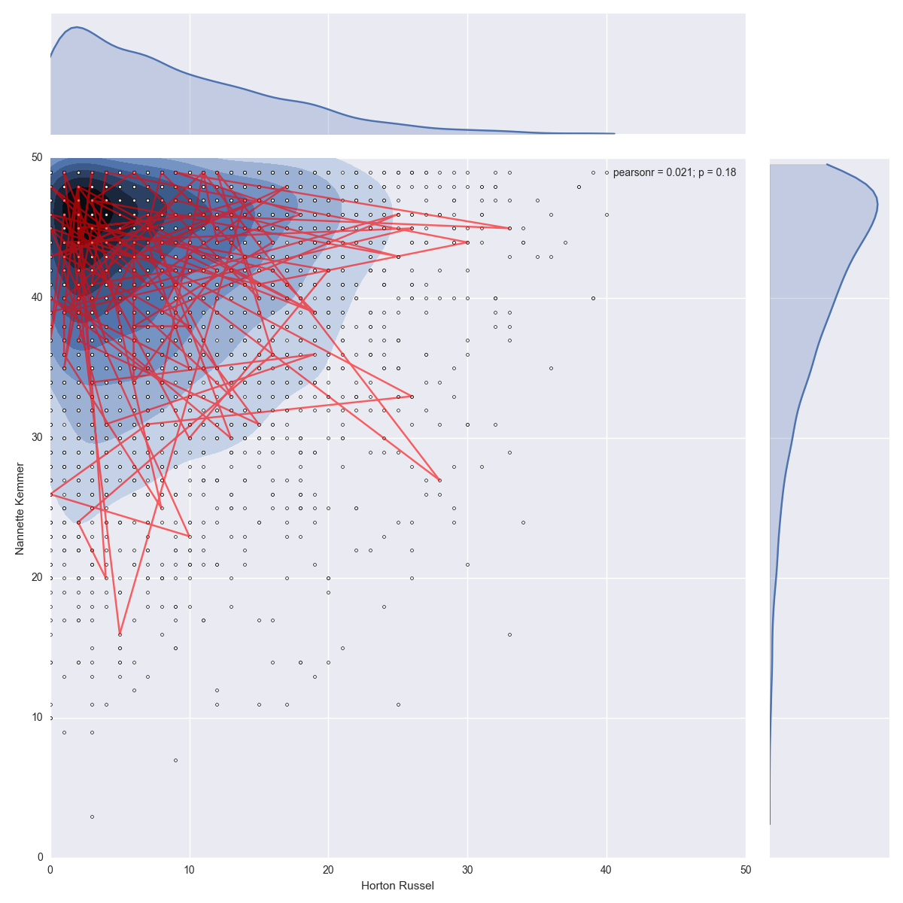
Gibbs: How do samples look like?
Projections on axes: approximate distribution is visualized using Gaussian kernel density estimator
Axis of player 2
Red lines indicate the first 100 samples visited
Axis of player 1

Slide 12
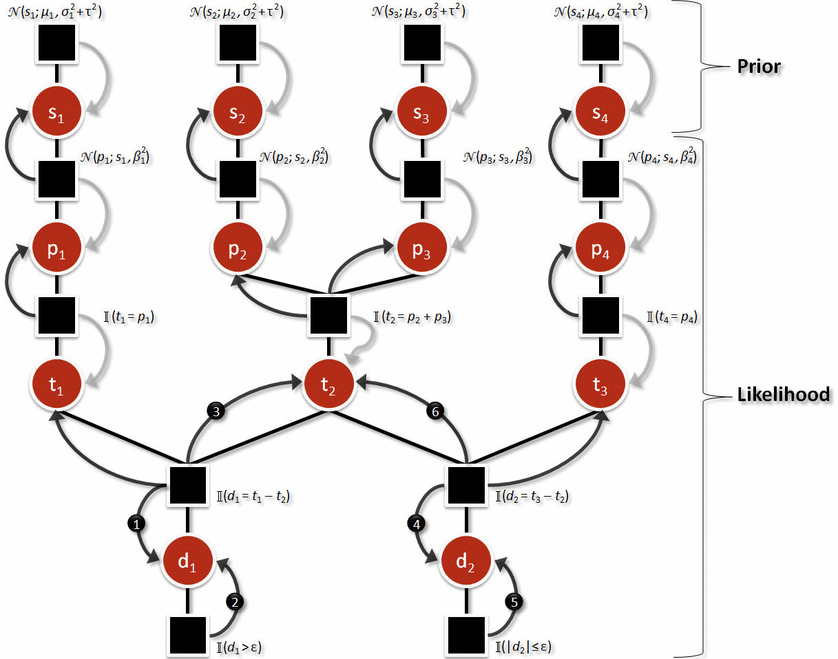
How about Expectation Propagation?
Thirdly, we used EP algorithm to perform Bayesian inference on the model assumed by TrueSkill™ that is factor graph. Like the one below
To approximate the non-Gaussian message by a Gaussian message to ease inference of skill variables, follow the path shown and apply EP refinement.
All Gaussian messages!
Not Gaussian 😪

Slide 13
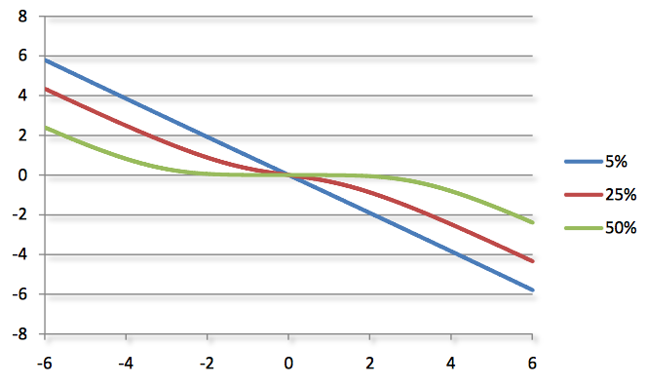
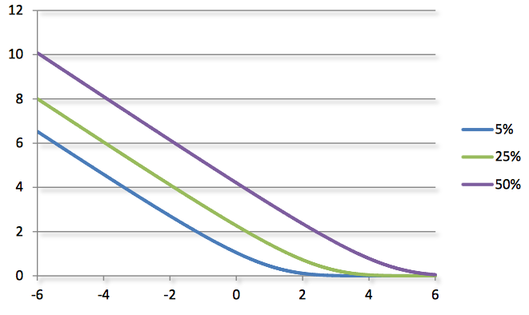
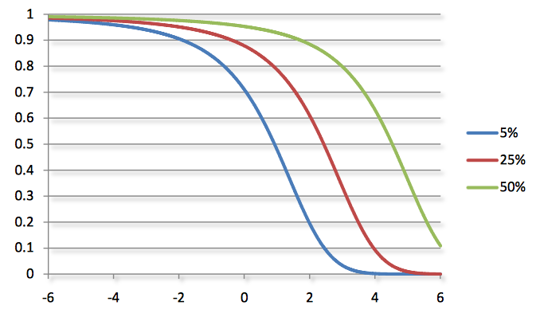
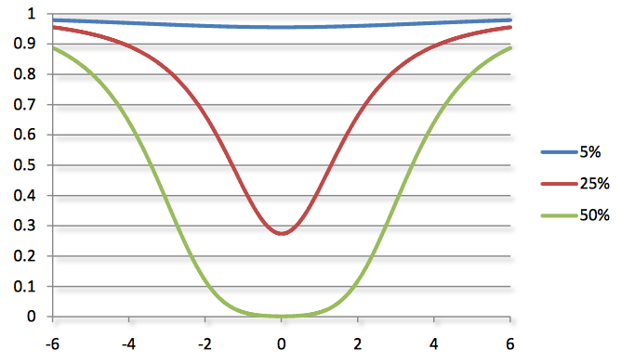
Expectation Propagation (contd.)
EP is an online learning algorithm in contrast of MCMC methods we described previously. It updates estimate of skills and uncertainties on skills after observation of a single instance of data
Outcome: win
Updated parameter: mean
Outcome: draw
Updated parameter: mean
Outcome: win
Updated parameter: uncertainty
Outcome: draw
Updated parameter: uncertainty

Slide 14
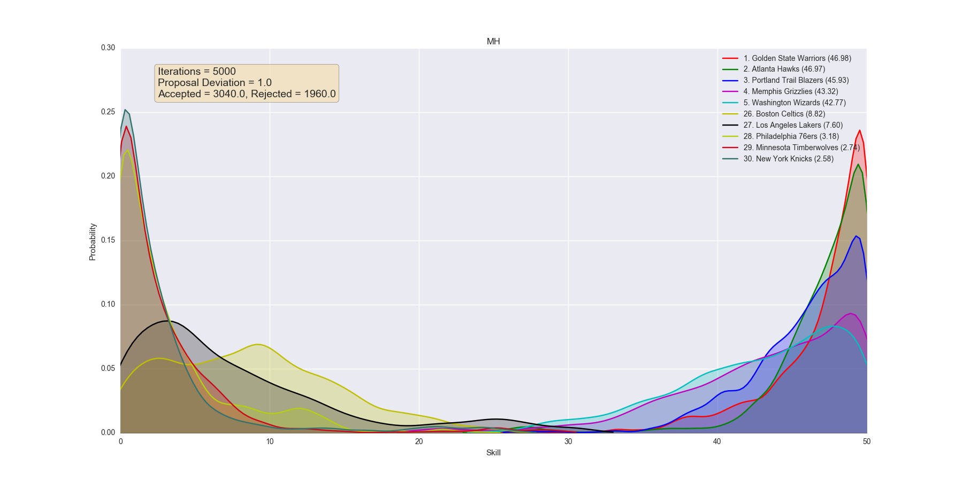
Example result: MH

Slide 15
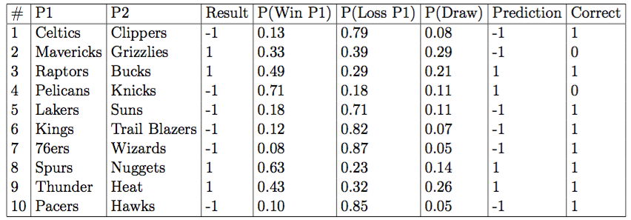
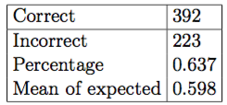
Example result: MH

Slide 16
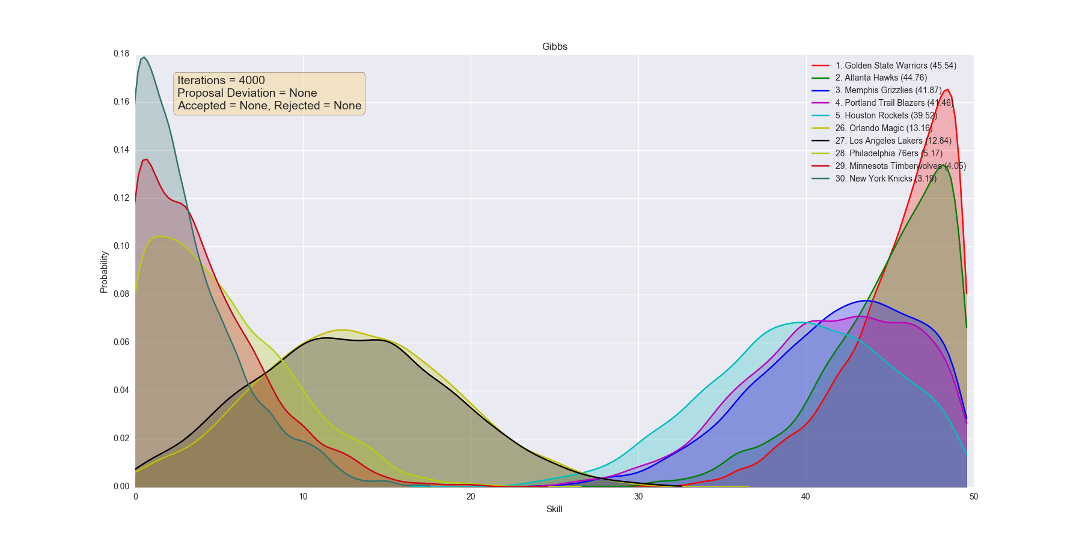
Example result: Gibbs

Slide 17
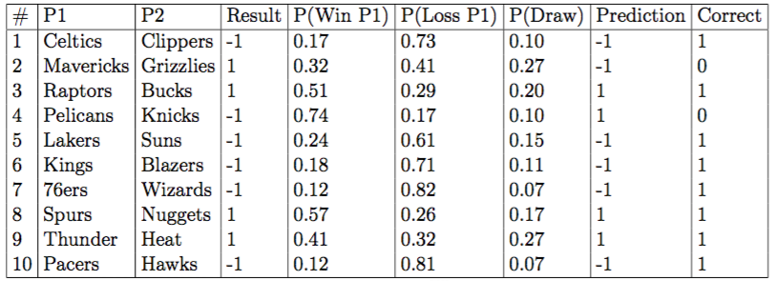
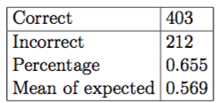
Example result: Gibbs

Slide 18
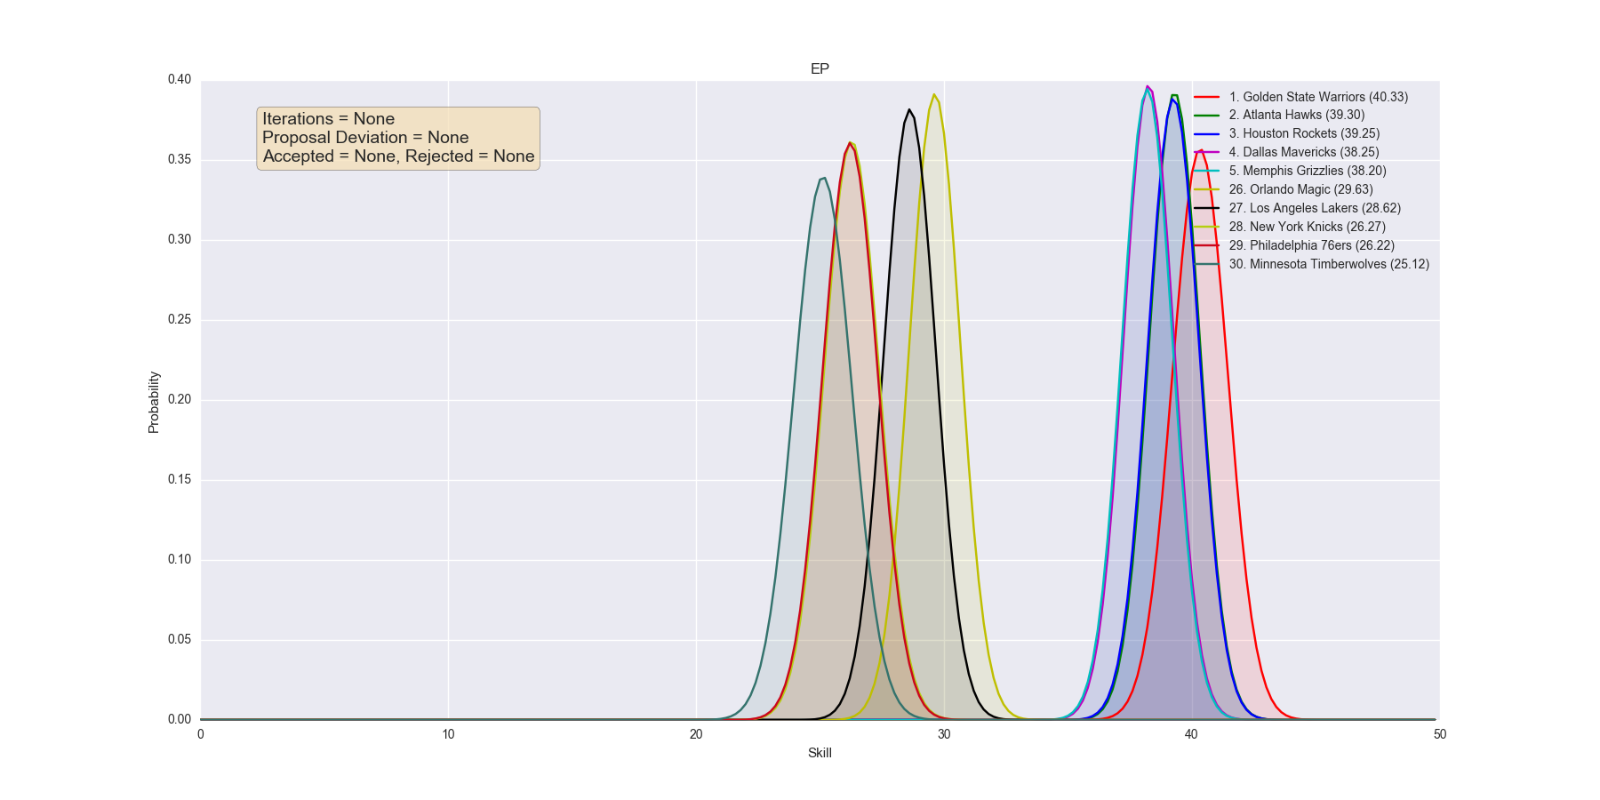
Example result: EP

Slide 19
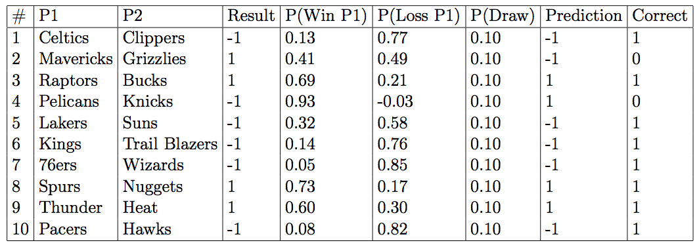
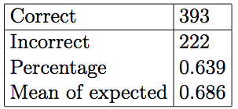
Example result: EP

