Slide 1
When investment costs of peak unit differ across zones
Previously: (:n1, :n2, 2000.0),
Previously, All zones had same investment costs
const BRANCHES = [
(:n1, :n2, 500.0), # ℓ₁₂ (A–A)
(:n2, :n4, 3000.0), # ℓ₂₄ (A–C)
(:n4, :n3, 3000.0), # ℓ₄₃ (C–B)
(:n3, :n1, 3000.0) # ℓ₃₁ (B–A)
]
Zone A: 60k€/MW
Zone B: 70k€/MW
Zone C: 80k€/MW

Slide 2
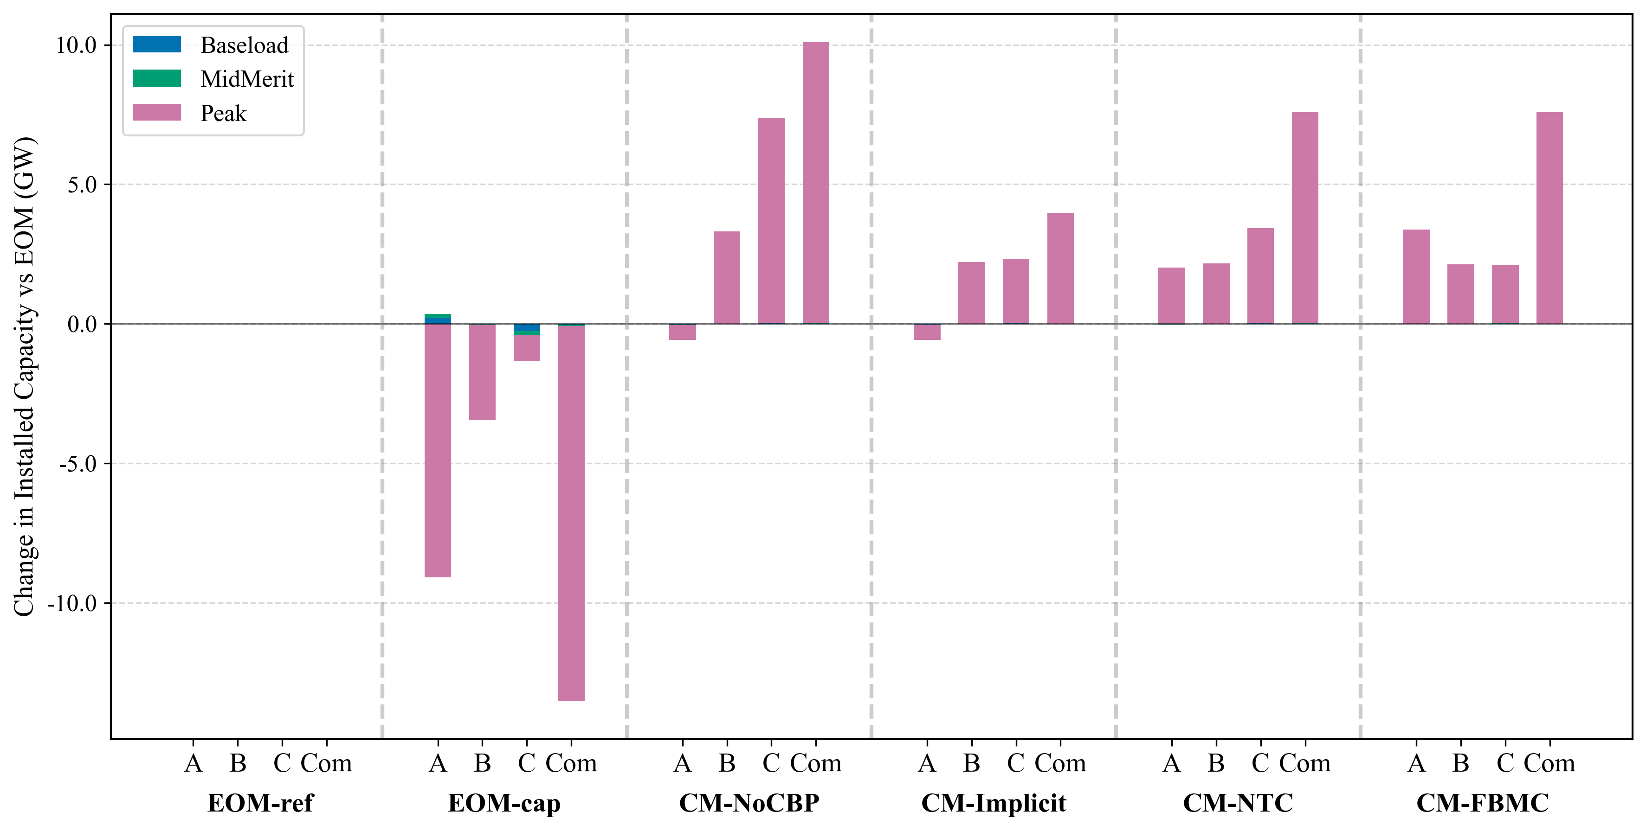
Installed capacity: capacity mix differs across both NTC & FBMC designs. FBMC directs investments toward the cheaper zone A.
Notes:
Assess peak demand served
Does the locational difference in investment impact the demand served?

Slide 3
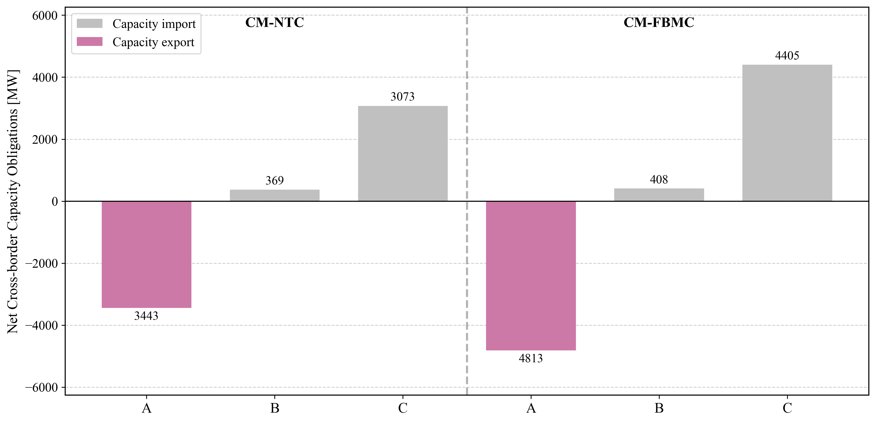
Trade of cross-border capacity obligations: FBMC unlocks more trade

Slide 4
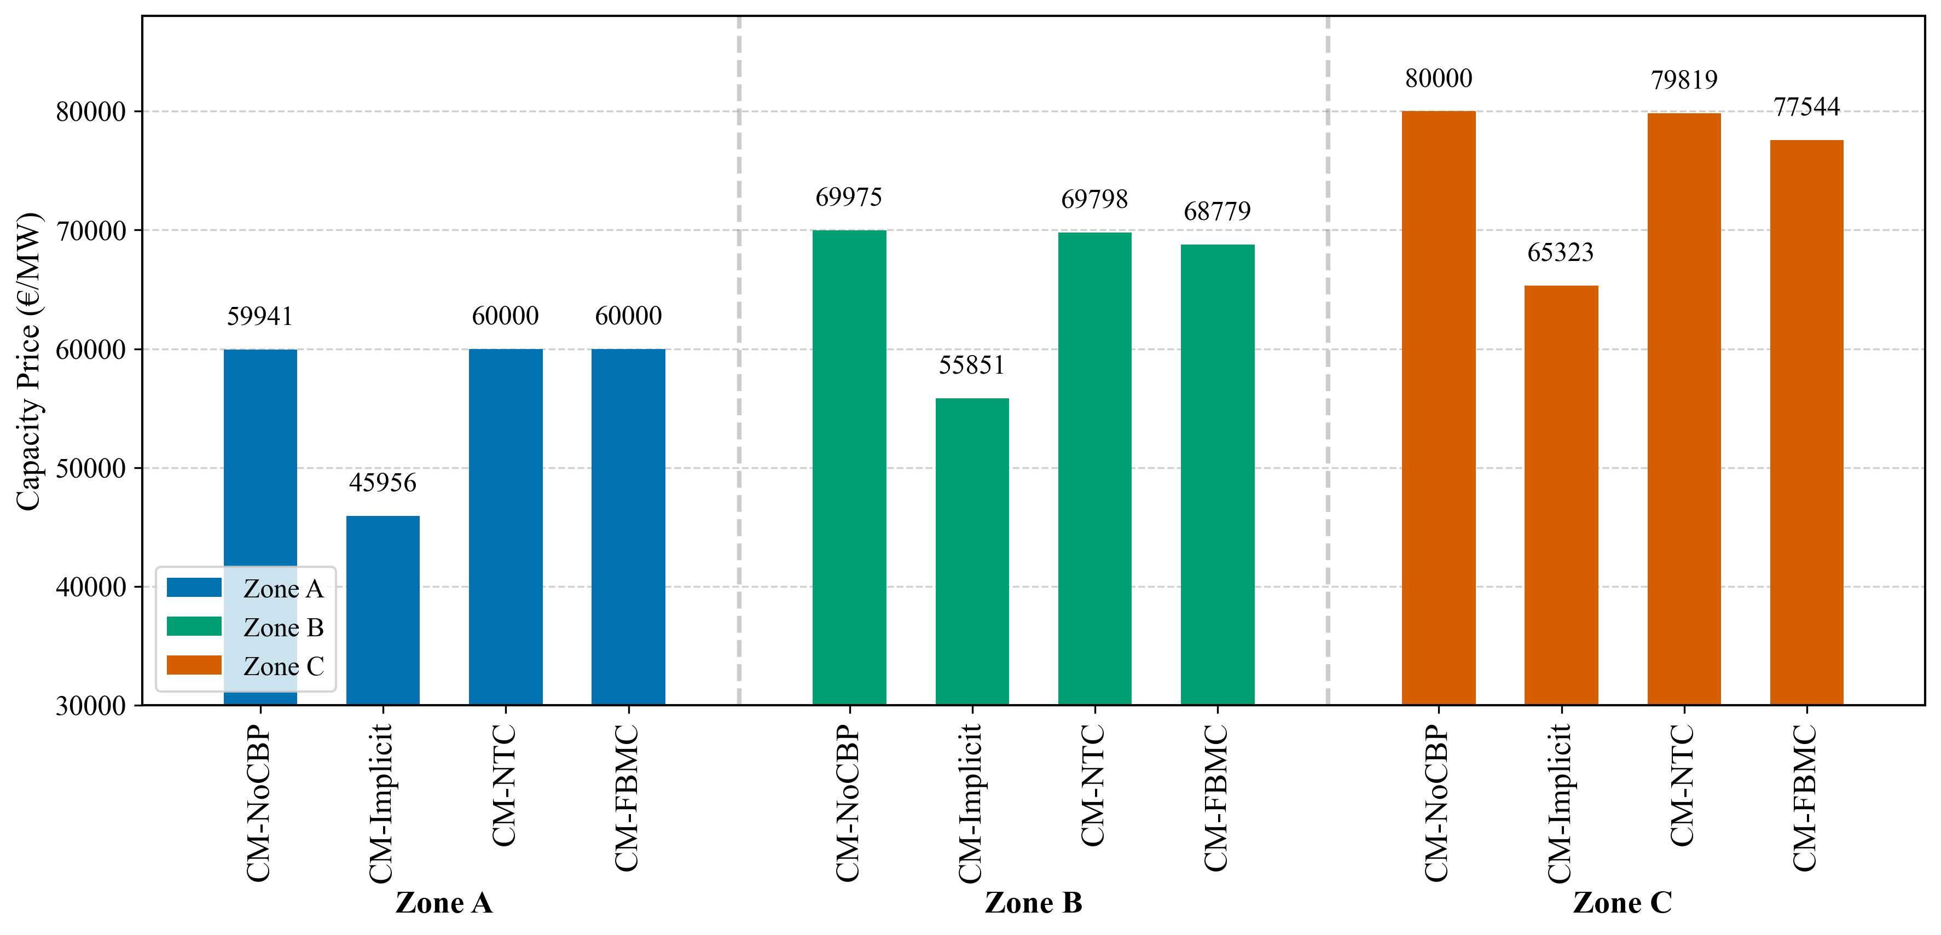
The overall capacity price is lower in FBMC than in NTC due to greater cross-border capacity trade.

Slide 5
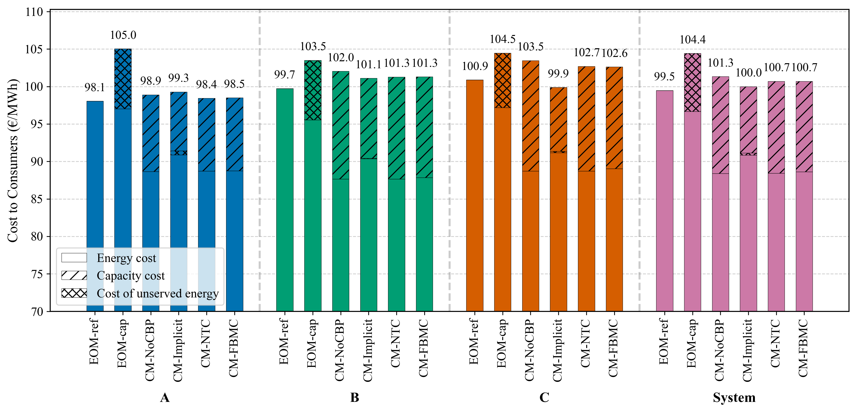
Cost to consumers: costs remain the same across FBMC and NTC.

Slide 6
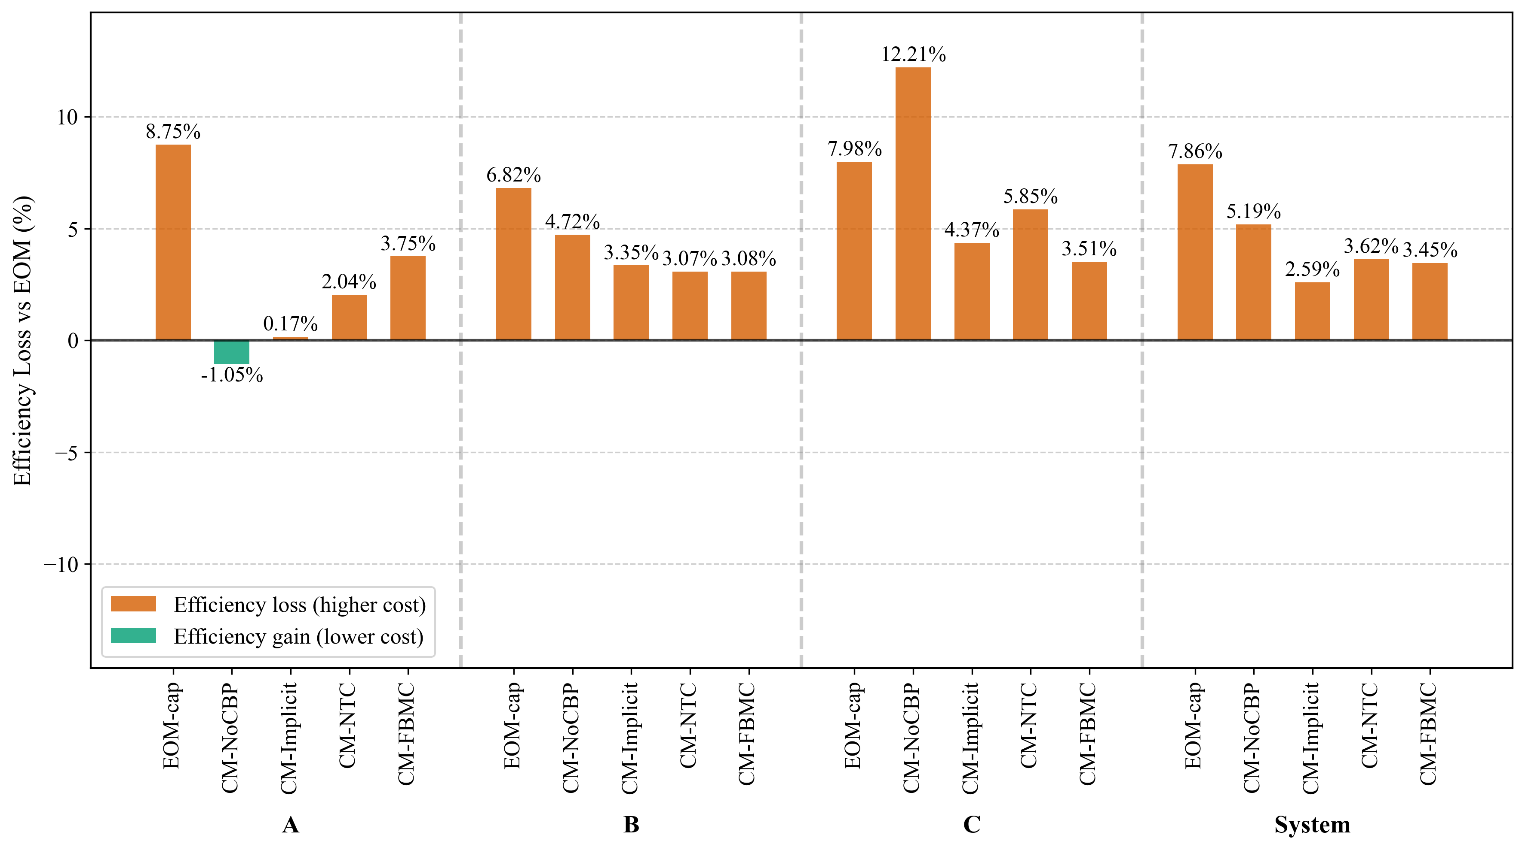
System costs: Slightly higher system costs for NTC w.r.t FBMC

Slide 7
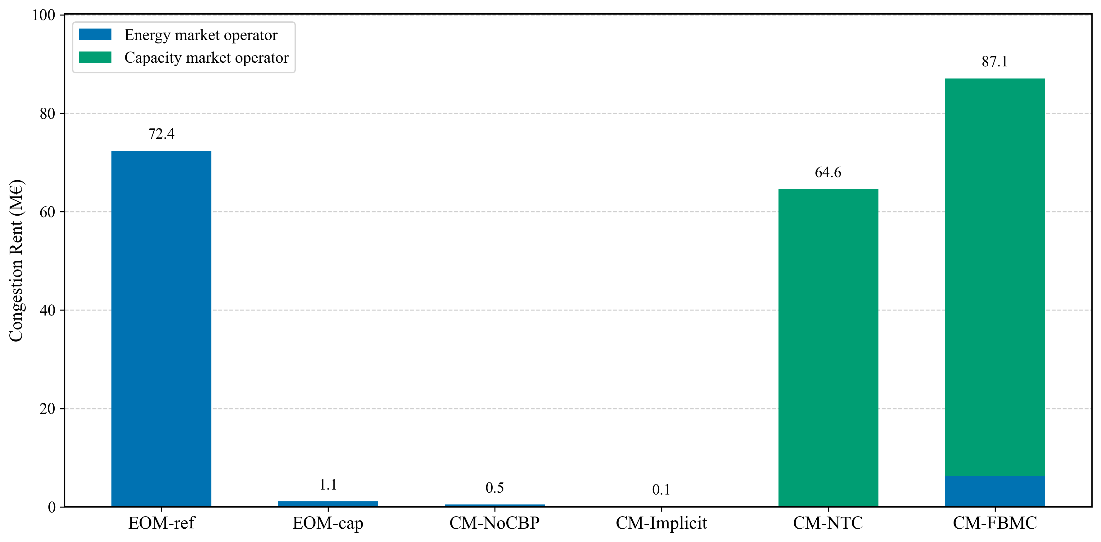
Greater congestion rent captured in cm-fbmc. The welfare gain does not transfer to consumers but is captured by the network operator, who can then redistribute as they choose.
Notes:
Convert to euros/MWh
Price differentials and flow component

Slide 8
Installed capacity differs across zones, with FBMC capturing more trade. The cost implications are small because imports remain a small fraction of total investments.

Slide 9
When investment costs of peak unit differ across zones
Using EOM as baseline
Zone A: 60k€/MW
Zone B: 70k€/MW
Zone C: 80k€/MW

