Slide 1
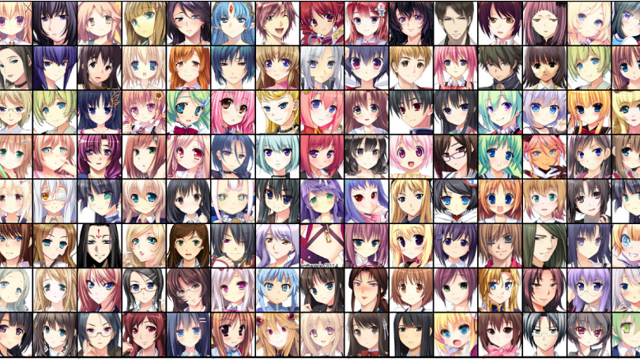
Generative Models for Anime Face Generation
ADNAN KEREM AKSOY - 2081392
ÖMER CEM TABAR - 2081169

Slide 2
































Purpose of the Project
Data augmentation on the dataset 'Anime Faces' dataset for the purpose of generating real-like synthetic data.
Implementing optimized versions of Deep Convolutional Generative Adversarial Network(DCGAN) and Adversarial Auto-Encoder(AAE)
Validating & Evaluating Performance of models by Inception Score(IS) and Frechet Inception Distance (FID) score

Slide 3
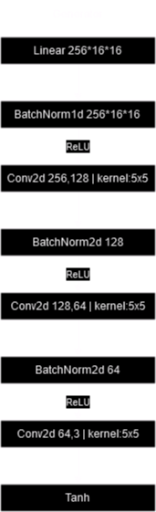
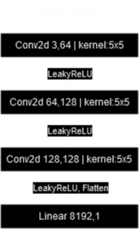
Deep Convolutional Generative Adversarial Network (DCGAN) Implementation

Slide 4
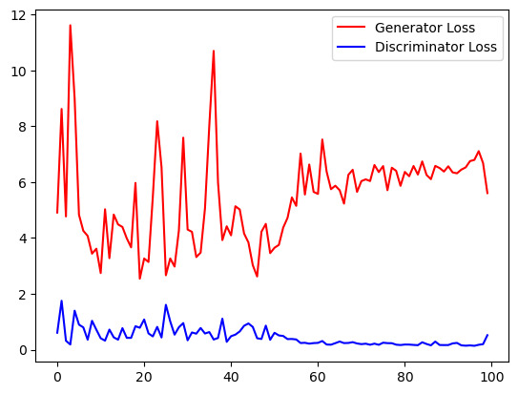
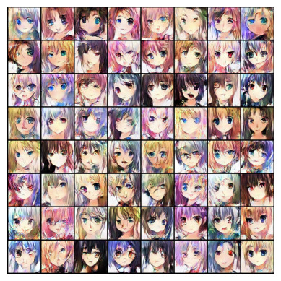
Output & Convergence

Slide 5
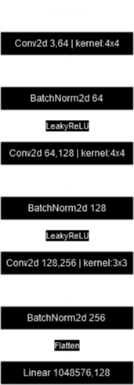
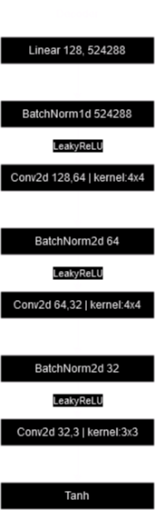
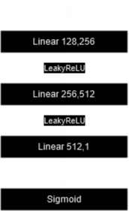
Adversarial Auto-Encoder (AAE) Implementation

Slide 6
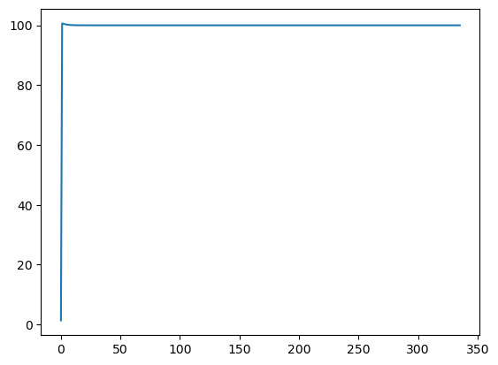
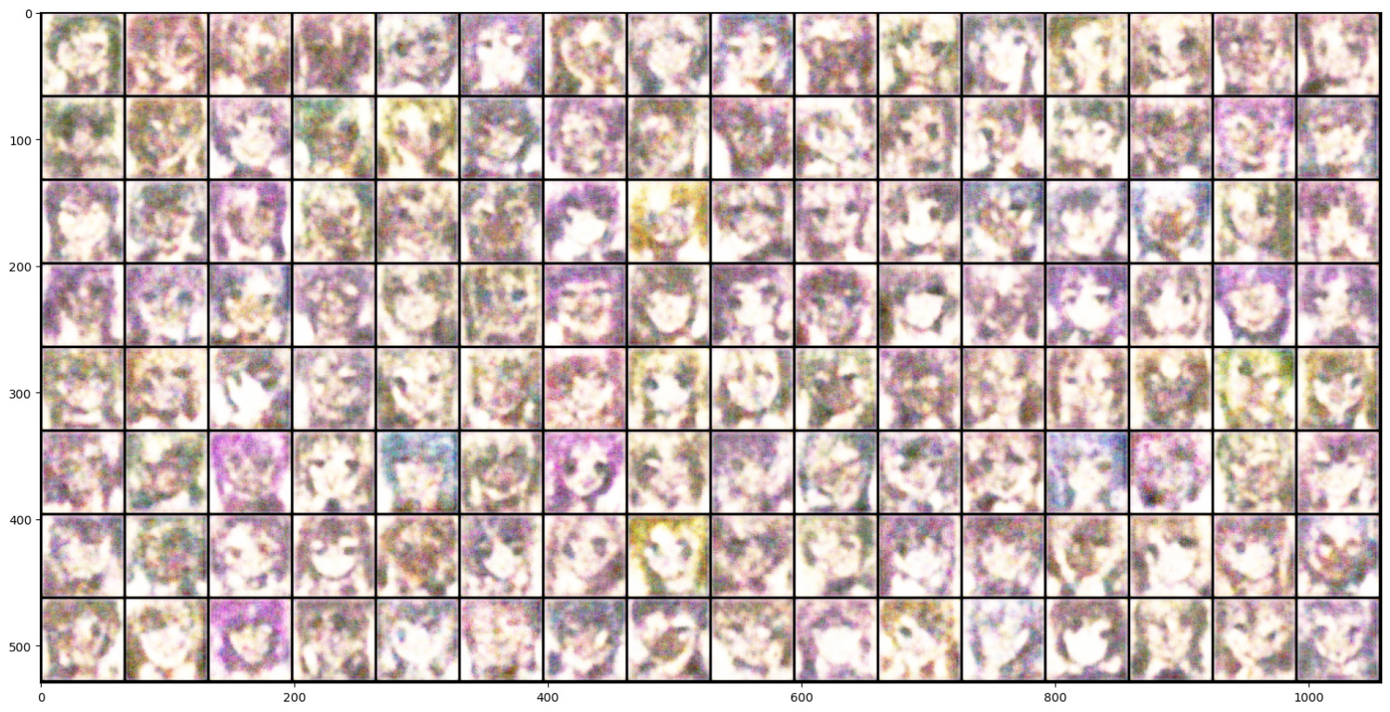
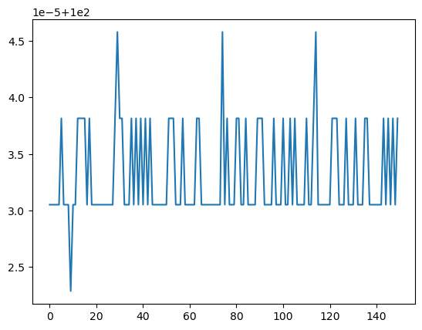
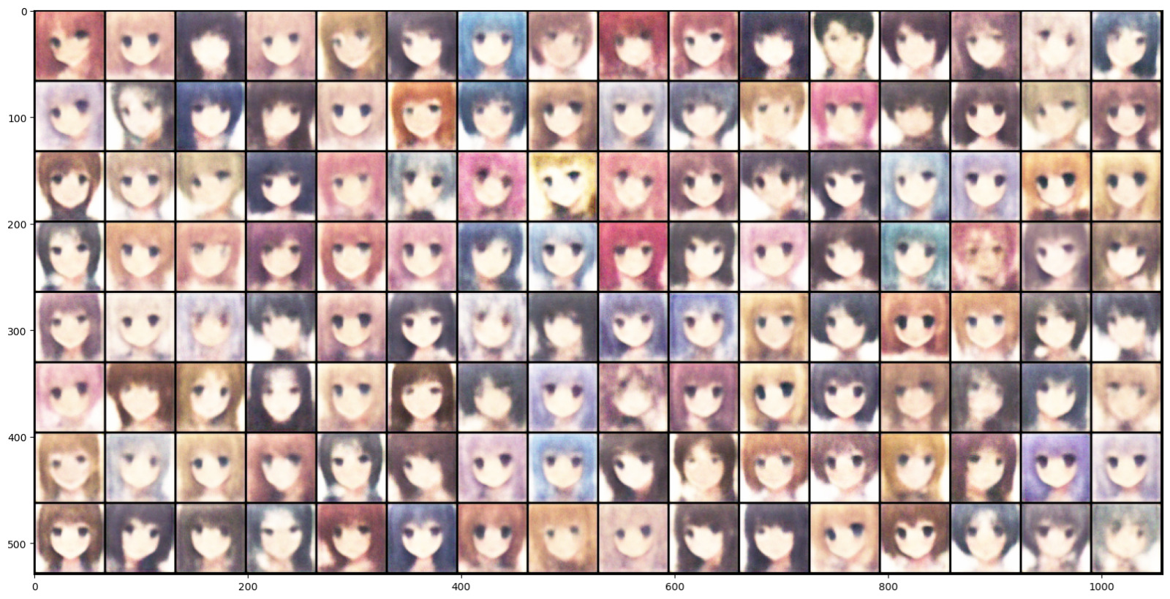
Output & Convergence

Slide 7
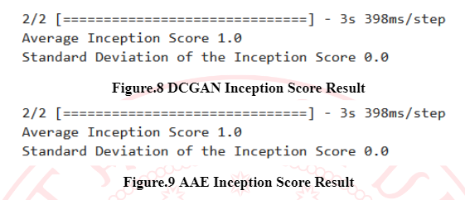
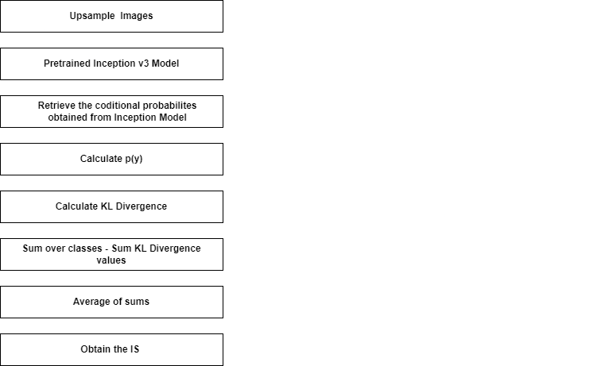
Performance Evaluation – Inception Score(IS)
!!! Not a reliable metric !!!
#No relation between real and generated data

Slide 8
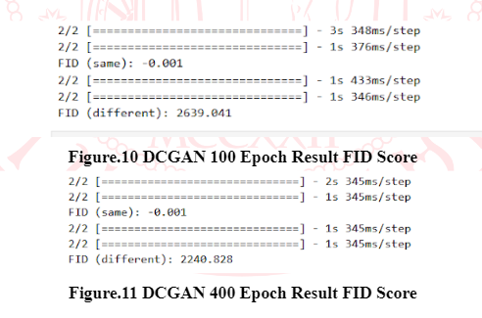
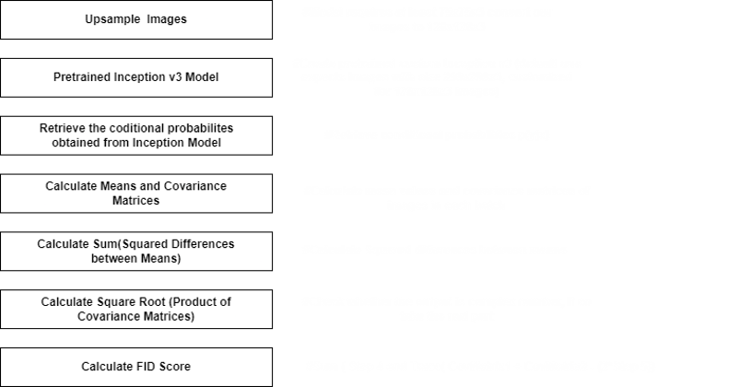
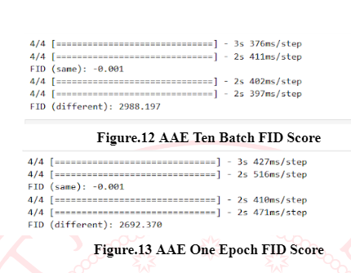
Performance Evaluation – Fréchet Inception Distance (FID) Score
!!! Good metric for evaluation !!!
Evaluate similarities btw real and fake images

