Slide 1
Deep Learning for Image Super-Resolution
Zhetao Zhuang
Department of Engineering, University College London

Slide 2
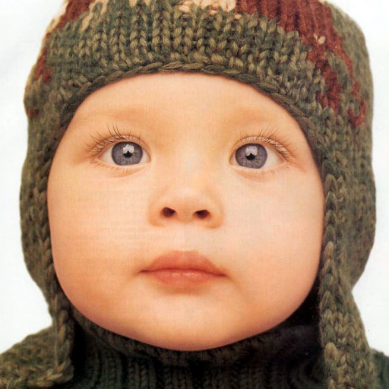

1.1 Breif Introduction to Image Super Resolution
Low resolution image
High resolution image
Big&Sharp!
Mapping(A+,SC,SRCNN,VDSR,etc)
Notes:
Single image super-resolution (SISR) is a classical problem in computer vision. It is widely used in applications such as object detection, security and medical imaging where more image details are required on demand.

Slide 3
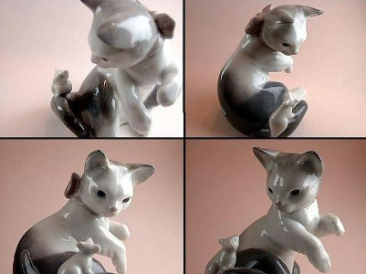
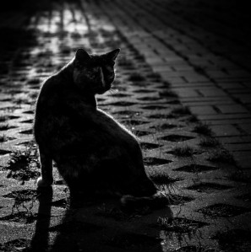

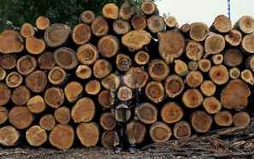
1.2 Challenges in Computer Vision
There are some key roadblocks in computer vision which may make it difficult for object detecting and recognizing:
1.Variations in
Viewpoint
2. Difference
in Illumination
3.Hidden parts
of images
4. Background
Clutter
Notes:
traditional methods such as SC can not cope well with these problems, however, CNN does

Slide 4
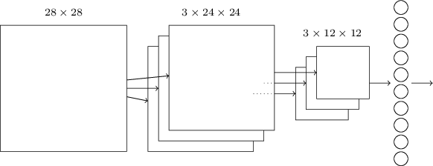
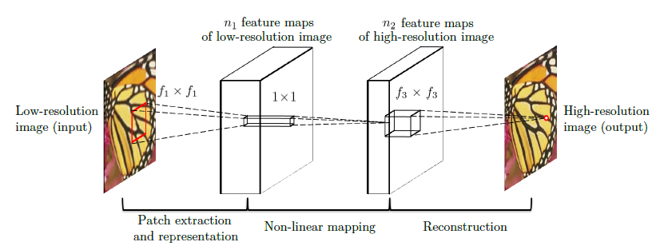
1.3 Convolutional Nerual Networks (CNN) and Image Super-Resolution Using Deep Convolutional Networks(SRCNN)
Basic structure of CNN
Convolution
Pooling
Fully Connected
A practical use of CNN：SRCNN
Notes:
CNN has been widely implemented in computer vision for its better performance. This is an efficient architecture for image super-resolution which learns an end-to-end mapping from low-resolution to high-resolution. It jointly optimizes all the layers rather than handle each component separately which achieves state-of-the-art results on images restoration

Slide 5
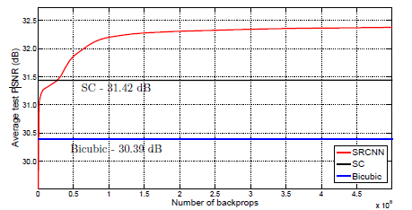
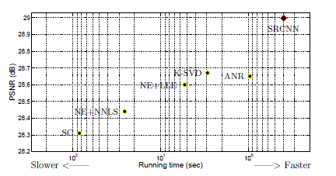
2.2 Sparse Coding vs SRCNN
Fig.1[1]
Fig.2[1]
1. Provides superior accuracy comparing with state-of-the-art example-based methods.
2 Faster than a series of example-based methods
3. Restoration quality can be further imporved with larger model or more data
Notes:
a low resolution dictionary is used to encode the patches. Then high-resolution patches are reconstructed through the sparse coefficient which are passed into a high resolution dictionary.

Slide 6
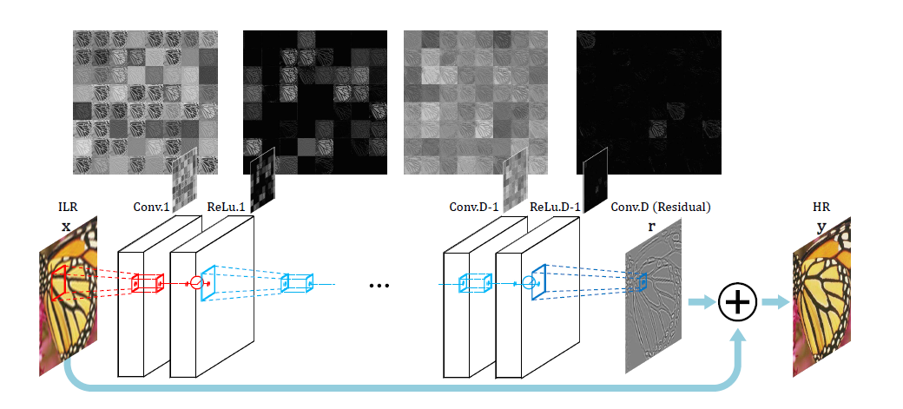
2.3 Accurate Image Super-Resolution Using Very Deep Convolutional Networks(VDSR)
1.Contextual information spread over
very large image regions
2.Residual-learning and extremely high learning rates.
3.Multi-scale factor super-resolution
Larger image regions
Residual-learning
Notes:
The network predicts a residual image and the addition of low resolution images and the residual gives the desired output. 64 filters are used for each convolutional layer and some sample feature maps are drawn for visualization. Most features after applying rectified linear units (ReLu) are zero.

Slide 7
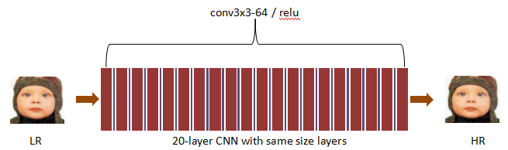
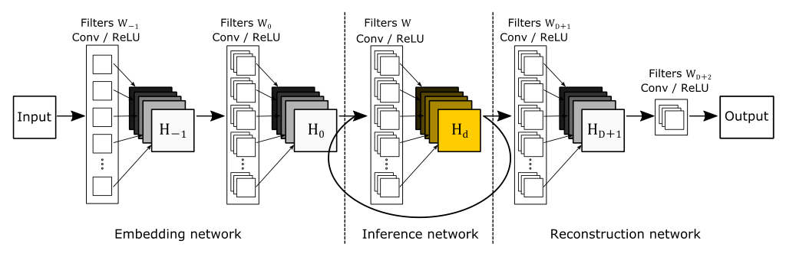
2.4 Deeply-Recursive Convolutional Network(DRCN)
Same weight used for inference network so better performance with reduced parameters.
Hard to train!
layers added recursively

Slide 8
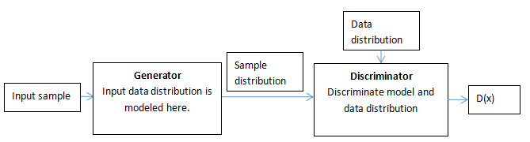

2.5 Deep Convolutional Generative Adversarial Networks(DCGAN)
widely used in SR
player 1
player 2
Player 1 and Player 2 compete with each other until an equilibrium is reached,both G and D optimized, with value function :
Notes:
The generator part G captures the sample distribution and the discriminator part D estimate the probability that the sample came from the real data rather than G.More specifically, we are training G so that if we input a sample to G and feed the output of G ,namely the sample distribution,to D, D can not tell whether the sample is from model distribution or data distribution,i.e D(x)=1/2,D(x) represents the probability that x came from the data rather than G. Here is the object function:

Slide 9
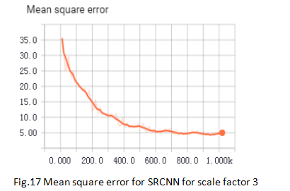
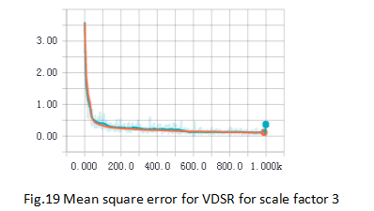
3.1 SRCNN and VDSR
Training data: 91 images Testing data: Set5 Scale factor: 3
Converge quicker and more accurate
Training iterations
Training iterations
Notes:
For SRCNN,the training set consists of 91 images and the Set5[1] is used evaluate the performance of upscaling factors 2,3,4. For VDSR, 291 training images as in [2] and Set5 are used for benchmark with other methods. In the training phase,the ground truth are prepared as 33×33 and 41×41 sub images randomly cropped from training images for SRCNN and VDSR respectively.The output in SRCNN after each layer decreases due to the convolution.However,in VDSR, the output after each layer remain the same due to zero padding in each layer,so the resulting output for the former one is 21×21 and the latter one is 41×41. MSE loss is evaluated between the corresponding output and labels.

Slide 10
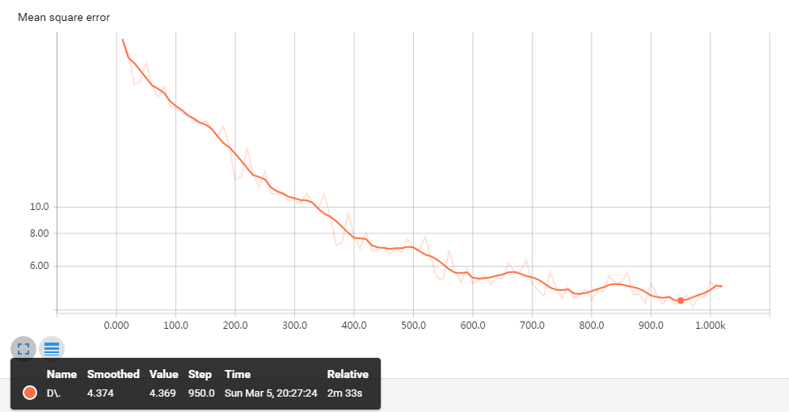
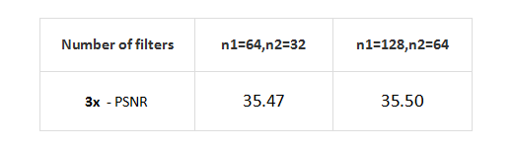
3.2 More number of filters and larger filter size
Double number of filters,higher PSNR
Training iterations
Larger filter size,lower minimum of MSE,4.37

Slide 11
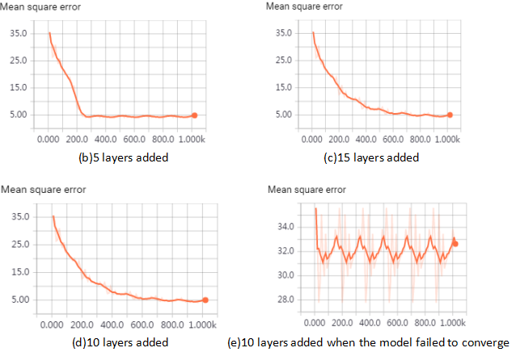
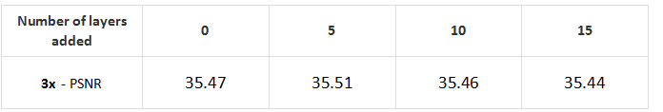
More layers
MSE is not improved
Even worse PSNR

Slide 12

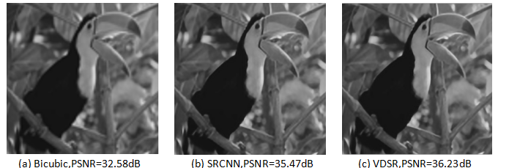
Some result for SRCNN and VDSR

Slide 13
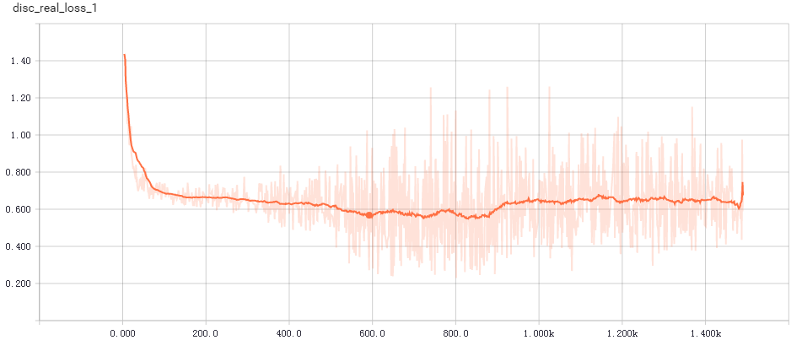
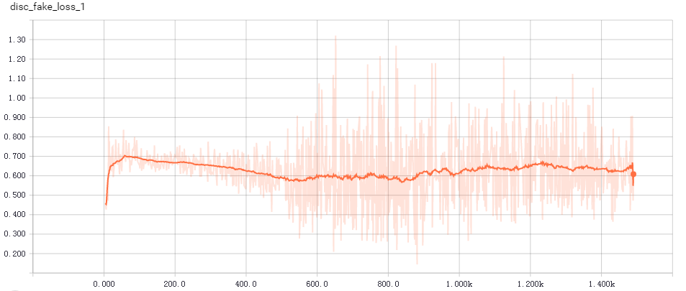
3.4 Image super-resolution using DCGAN
The loss for discriminator from real data decreases to around at 0.6 and remains at that level.
Loss of discriminator from real data
Training iterations
Equilibrium reached ！
The loss for discriminator from fake data increases to around at 0.6 and remains at that level.
Loss of discriminator from fake data
Training iterations
Notes:
For image super resolution, the proposed model is inspired by DCGAN and Residual Network.It is basically the combination of methods depicted before with the structure of generator and discriminator model.The input images are randomly cropped from original image with some preprocessing such as flip and saturation and finally resized to 16×16. Then the input images are upscaled by a factor 4. The resulting 64x64 images display sharp features that are plausible based on the dataset that was used to train the neural net. The label images are of size 64×64.The datasets used for proposed model is the Large-scale CelebFaces Attributes (CelebA) Dataset with the Align&Cropped Images version.

Slide 14
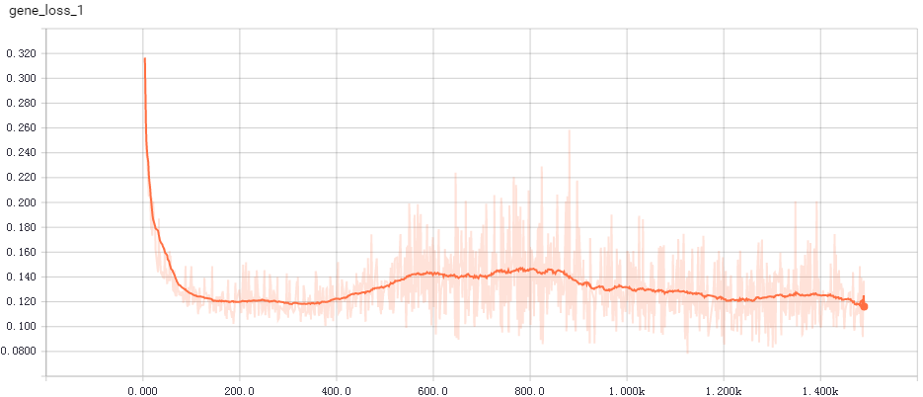
Loss for generator
L1 term :sample input minus generator output,
very similar to residual learning！
Loss of generator from sample input
Training iterations

Slide 15
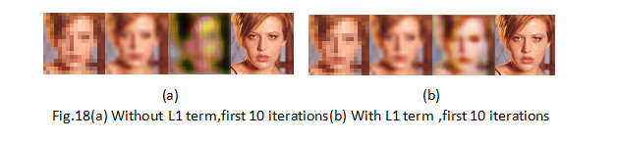
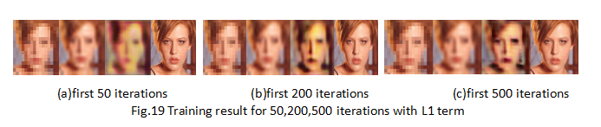
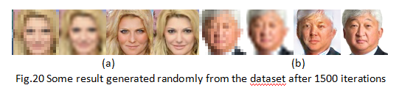
Some Result for DCGAN
Better result for model with L1 term added.
More details and shaper feature
Notes:
The final result for some examples are shown in Fig.20 after 15,00 iterations. As we can see from the result in Fig.20,a plausible reconstruction of the original face can be produced from the network. However, the reconstruction can be poor if the picture is not well illuminated or face at an angle,for example, Fig20(b). This may due to the fact that most of the faces in the dataset are well illuminated or looking straight ahead.

Slide 16
4 Conclusion
1.Deep learning models can be well applied to image super resolution tasks and can generate some state-of-the-art result.
2. Can be applied to other image restoration problems easily.
3.The performance may yet to be further gained by trying different combinations of layer, filters or new structures.
Notes:
Other methods like Accelerating the Super-Resolution Convolutional Neural Network and Image Restoration Using Convolutional Auto-encoders also achieves good results.

Slide 17
THANK YOU

Slide 18
5 APPENDIX
[1]Learning a Deep Convolutional Network for Image Super-Resolution
[2]Accurate Image Super-Resolution Using Very Deep Convolutional Networks
[3]Generative Adversarial Nets

