Slide 1
Welcome to the History and Computing workshop
DNA - Setting up VSCodium
Step 1: Make sure you are signed in to the local Google Drive
Press the Windows Key (start) on the keyboard and type Google Drive in the search box.
Click on the Google Drive icon.
Click on getting started and sign in.
Step 2: Now launch VSCodium
Click on Windows Key (start) on the keyboard and type VSCodium in the search box.
Click on the VSCodium icon and wait for it to open.
Step 3: Add the workshop folder to VSCodium Explorer
While in VSCodium, on the top left, look for the explorer sign and click on it or (Ctrl + Shift + E). Press the ‘Open Folder’ button.
Navigate to your Google Drive folder and find the folder ‘history_and_computing_workshop’
‘Select Folder’ to add the ‘history_and_computing_workshop’ folder to the VSCodium Explorer.

Slide 2
History and Computing workshop
Lesson objectives - to be able to:
record observations as structured data in a digital catalogue
edit catalogue mark-up templates to reflect objects studied
encode personal stories about museum objects as text with presentational mark-up
use Quire to include catalogue data and marked-up text within a digital book
explain how marked-up text and catalogue data enable Quire to automate book creation

Slide 3
Structured data for museum objects
Museums keep structured data about their objects in catalogues (a specialist database)
Can you suggest some examples of the data that a museum may wish to store? What values would this data have?
Key
Example of value
Title
Anti-slavery Medallion
Creator
Genius of Universal Emancipation Newspaper
Type
Metal
Year
1830
Notes:
Add rumble example

Slide 4
Sharing structured data between computers
We use standard formats to move structured data from one computer system to another.
When a computer receives a file, it can follow rules - because the format is standardised - to process the data into that computer’s internal representation.
Linked Art is one format for moving structured museum data between museums
…YAML is an alternative format
Notes:
Example is moving data from one institution to another e.g. if a picture goes on loan from the Ashmolean to the Royal Portrait Gallery, or from a museum in China to the UK

Slide 5
Sharing structured data between computers
Linked Art example
{
"@context": "https://linked.art/ns/v1/linked-art.json",
"id": "http://dhoxss.linkedmusic.org/AN1896-1908.AE.10.json",
"identified_by": [
{
"type": "Name",
"content": "Replica gold cup from Vapheio"
}
],
"classified_as": [
{
"id": "http://vocab.getty.edu/aat/300197197",
"type": "Type",
"_label": "Containers",
}
],
"referred_to_by": [
{
"type": "LinguisticObject",
"content": "h 7.9 cm dia 10.2 cm",
"classified_as": [
{
"id": "http://vocab.getty.edu/aat/300435430",
"type": "Type",
"_label": "Dimension Statement",
…
YAML example
- id: 1-ashmolean
title: Replica gold cup from Vapheio
type: Containers
dimensions: h 7.9 cm dia 10.2 cm
creator: Émile Gilliéron, designer
year: late 19th - early 20th century
accession: AN1896-1908.AE.10
What other rules does a computer need to know and use?
Notes:
Linked Art is more detailed that YAML. The Linked Art on the left (and more!) is equivalent to just the first title and creator lines in the YAML.
What other rules does a computer need to know and use? Syntax e.g. where there’s a : or a - or a list item
What could be encoded in this structured data? Is there a limit? What types of values? Everything the museum knows? Draw out examples

Slide 6
Sharing structured data between computers
YAML is a simpler format than Linked Art, more easily understood by people / grandmas / school children!
What would you need to go from one format to the other?
Can YAML describe everything that is in Linked Art?
Why do we use YAML then?
What happens to “lost data”?
Can we make Linked Art data from YAML data?
YAML example
- id: 1-ashmolean
title: Replica gold cup from Vapheio
type: Containers
dimensions: h 7.9 cm dia 10.2 cm
creator: Émile Gilliéron, designer
year: late 19th - early 20th century
accession: AN1896-1908.AE.10
Notes:
What would you need to go from one format to the other? Rules for both formats, a program which can translate, some data to translate
Can YAML describe everything that is in LinkedArt? No
Why do we use YAML then? Simpler for us to understand, rather than computers
What happens to “lost data”? Still in the LinkedArt file, not in the ether
Can we make LinkedArt data from YAML data? Yes and No. It will have the correct format, but big gaps

Slide 7
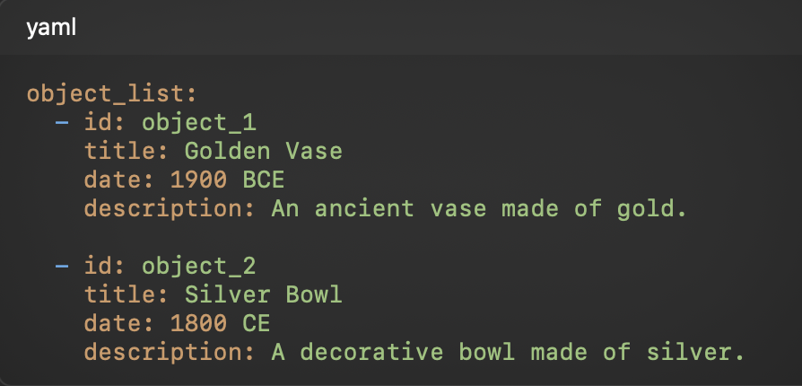
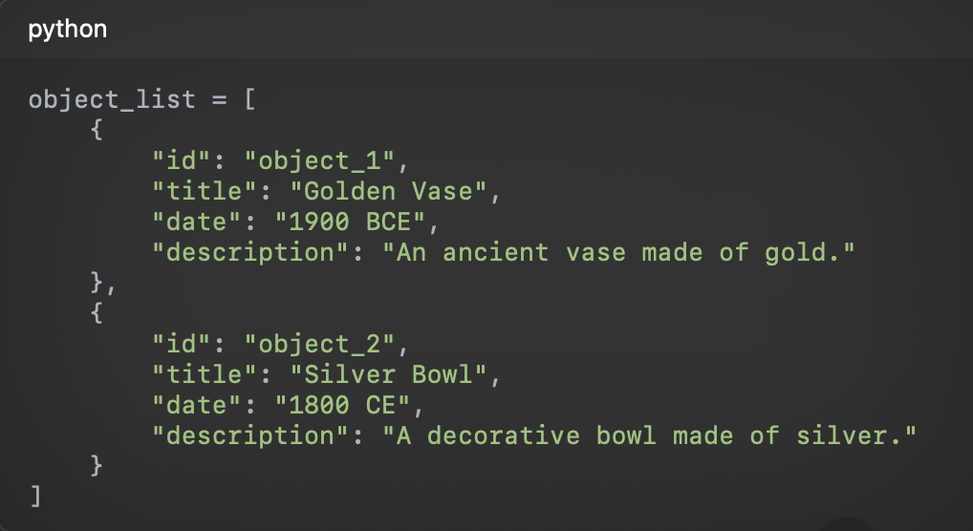
The Concept of Key-Value Encapsulation
Definition: A method to store data using pairs of keys and values
Efficiency: Allows for quick data retrieval and reference
Usage: Common in databases, APIs, and data serialization formats
Examples: YAML and dictionaries in Python illustrate this concept
YAML example:
Python example:
Notes:
Key-value encapsulation is a fundamental concept in computer science, used to store and access data efficiently. It involves associating specific pieces of data, known as values, with identifiers called keys. This structure enables quick retrieval and reference of data.
In the examples on the slide, we see how key-value pairs can be organized in different formats. In the YAML example, we define an object_list containing multiple cultural heritage objects. Each object has a unique identifier, such as id, along with keys for properties like title, date, and description.
Similarly, in the Python dictionary example, we use a list of dictionaries to represent the same data. Each dictionary corresponds to an object and contains the same key-value pairs as the YAML format. The structured approach allows us to efficiently manage and reference the data, whether we are working with YAML or Python.

Slide 8
Structured Data to describe our book
We’re going to edit some YAML together, using key-value pairs to describe some basic properties of our book, then see what effect this has when we publish the book.
DEMO TIME!

Slide 9
Automated conversion of Linked Art to YAML and images
Ashmolean
Quire
Linked Art
YAML
Images
The Quire software has already been used to convert Linked Art for Ashmolean and Rumble Museum objects into YAML for you - the video you’re about to see shows this. It has also downloaded images associated with that Linked Art. This is used to make the digital book.

Slide 10
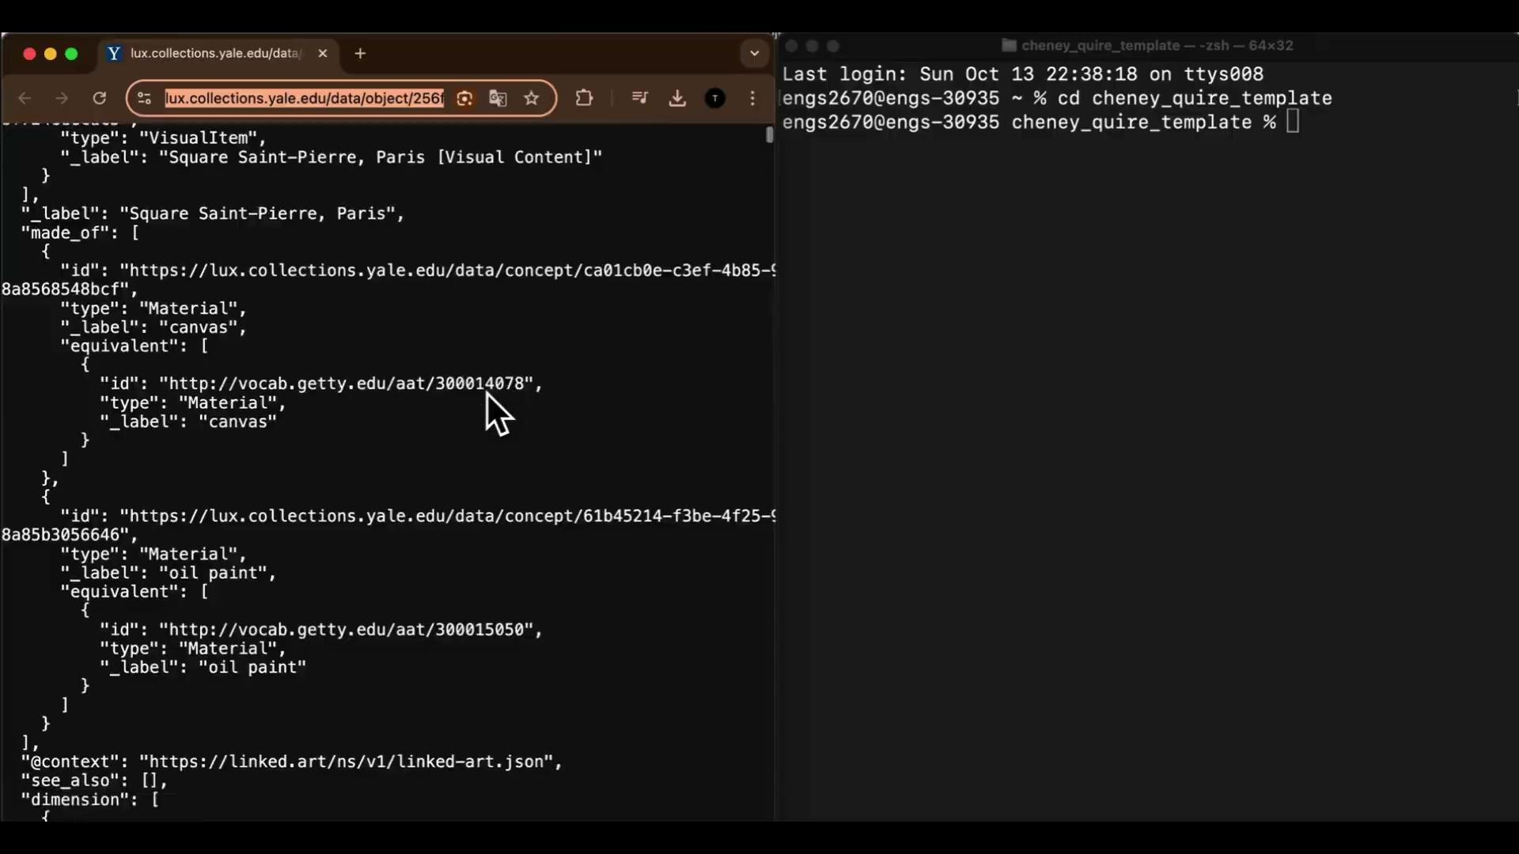
Quire converting Linked Art to YAML
Notes:
Narration to video: the left-hand side shows Linked Art JSON-LD on a website at Yale University. The identifier for Yale’s Linked Art JSON-LD is copied and given as the argument to the Quire software, which you can see on the right-hand side.
The Quire software is told to add any objects found in the Linked Art JSON-LD to the objects.yaml file used by Quire, and at the same time download any pictures available from the Yale web service.

Slide 11
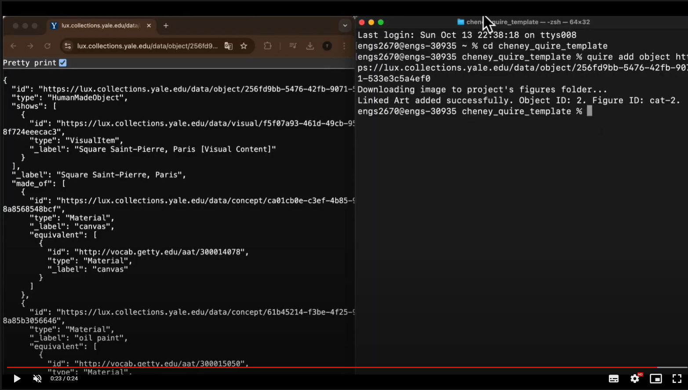

Slide 12
Referring to an object using an identifier
YAML example
- id: 1-ashmolean
title: Replica gold cup from Vapheio
type: Containers
dimensions: h 7.9 cm dia 10.2 cm
creator: Émile Gilliéron, designer
year: late 19th - early 20th century
accession: AN1896-1908.AE.10
identifier
What is the advantage of wrapping the object data in an identifier?
Saves time - no need to restate the keys and values
Reduces mistakes and errors
Can contain masses of information (in other examples)

Slide 13
Adding your own structured object data in YAML
You now have 12 minutes to complete the following steps on your worksheet:
Step 4. Find your group’s Ashmolean object in objects.yaml
Step 5. Enter any data you recorded during the Ashmolean visit that are missing from the YAML for the object

Slide 14
Presentational markup in Markdown
Mark-up using Markdown syntax | Corresponding mark-up using HTML | How it’s presented in a browser
# Header 1 ## Header 2 ### Header 3 And so on… Paragraphs are separated by a blank line. Text attributes: *italic*, **bold**, ***bold and italic***, `monospace`. | <h1>Header 1</h1> <h2>Header 2</h2> <h3> Header 3</h3> And so on… <p>Paragraphs are separated by a blank line.</p> <p>Text attributes: <em>italic</em>, <strong>bold</strong>, <em><strong>bold and italic</strong></em>, <code>monospace</code></p> | Header 1 Header 2 Header 3 Paragraphs are separated by a blank line. Text attributes: italic, bold, bold and italic, monospace.
These are processing instructions for the computer to display your text

Slide 15
Presentational markup in Markdown
Mark-up using Markdown syntax | Corresponding mark-up using HTML | How it’s presented in a browser
Bullet lists nested within numbered list: 1. fruits * apple * banana 2. vegetables - carrot - broccoli | <p>Bullet lists nested within numbered list:</p> <ol> <li>fruits <ul> <li>apple</li> <li>banana</li> </ul></li> <li>vegetables <ul> <li>carrot</li> <li>broccoli</li> </ul></li> </ol> | Bullet lists nested within numbered list: fruits apple banana vegetables carrot broccoli
Markdown files have a .md extension

Slide 16
Presentational mark-up to introduce our book
We’re going to edit some Markdown together, which will be processed by Quire to create the cover page of our book.
DEMO TIME!

Slide 17
Adding our stories
The video showed how Quire can convert Linked Art into YAML and image files, to automatically include object data in our book. We then added our own observations to YAML.
What other things might we wish to show or say in our book about our objects?
What might we want the computer to do with our written stories and interpretations?
Ashmolean
We wish to include:
Our photos
Our stories
Our text formatting e.g. bolds and italics
Quire
Linked Art
YAML
Images
Notes:
Make a connection to the interpretations they wrote in the Rumble Workshop

Slide 18
Combining our stories with the structured (Linked Art) data
Student Notes
Ashmolean
Quire
Linked Art
Markdown
Photos
YAML
Images
Quire
epub
PDF
website
Notes:
We see how the computer can automatically include object data in our book (from the video)
What else do we want to include - our photos, our stories
Draw on the board in the room around the left hand half of the image

Slide 19
Combining information using Quire
Quire uses two types of information processing to build our book
Using the identifier allows the story (in Markdown) to reference the structured data (in YAML)
structured data objects
in YAML
stories
in Markdown
Why do we want to use an identifier? How unique does the identifier need to be?
How could the identifier help with data at scale?
Notes:
Identifiers remove the need for cut and paste
Unique to the dataset
Labour saving
Important if you have 100s and 10000s of objects

Slide 20
Combining our stories with the structured (Linked Art) data
Student Notes
Ashmolean
Quire
Linked Art
Markdown
Photos
YAML
Images
Markdown
Photos
Markdown
Photos
Markdown
Photos
Quire
epub
PDF
website
Notes:
We see how the computer can automatically include object data in our book (from the video)
What else do we want to include - our photos, our stories
Draw on the board in the room around the left hand half of the image

Slide 21
Building the Quire Book
We’re going to run three commands in Quire then check the output matches our expectations:
Run quire preview and see the preview in a web browser
Run quire build
Run quire pdf and you will check the output document
DEMO TIME!

Slide 22
Checking the Quire book
Whilst you have been at lunch we have been checking the Quire output…
Return to your worksheet for today’s session, starting from Step 9.
Open the shared folder ‘cheney_book’. Inside this folder look for the file pagedjs.pdf - this is the PDF created by Quire using our book data.
Page through the PDF until you find the page for your group’s Ashmolean object.
Does it include your observations as a table? Can you see how these have been derived from the key-value pairs you entered?
Is there a picture of the object automatically included from the Ashmolean object record?
Is your story present and correct? Is your story formatted and styled as you expect?
If any of these are missing or incorrect, let your teacher know - we may need to debug your data to uncover and correct any problems.

Slide 23
Final thoughts…
When you go home tonight and tell your parent about what you did today, what will you say? Can you use the diagram to help you? Write a short paragraph in a new document in the shared ‘student_summaries’ folder
Student Notes
Ashmolean
Quire
Linked Art
Markdown
Photos
YAML
Images
Quire
epub
PDF
website

Slide 24
Title?
Student Notes
Ashmolean
Quire
LinkedArt
Markdown
Photos
YAML
Images
Quire
epub
PDF
website

