Slide 1








Enriching Exhibition Stories with Quire
Digital Humanities at Oxford Summer School 2024
Funded by the UK Arts and Humanities Research Council (AH/Y006011/1)

Slide 2
Welcome
First session (today)
Introduction to Quire, Linked Art, and our project.
What can Quire produce? Into the Labyrinth exemplar.
How to use Quire and Linked Art.
How to install Quire and the Linked Art extension.
Questions and next steps.
Before the second session preparation using provided instructions; in-person help available.
Second session
Hands on: creating your own digital exhibition using Quire and Linked Art.

Slide 3
Enriching Exhibition Stories (EES2) project team
University of Oxford e-Research Centre Kevin Page - EES2 Principal Investigator Tyler Bonnet - Postdoctoral research assistant Erin Canning - DPhil candidate
University of Edinburgh Clare Llewellyn - UK Principal Investigator of Enriching Exhibition Scholarship project (EES1)
Yale University Rob Sanderson - Senior Director for Digital Cultural Heritage Kelly Davis - Cultural Heritage Data Engineer
Ashmolean Museum, University of Oxford Andrew Shapland - Sir Arthur Evans Curator of Bronze Age and Classical Greece Aruna Bhaugeerutty - Head of Digital Collections
Emmanuelle Delmas-Glass - Head of Collections Information Access at YCBA Kayla Shipp - UK Principal Investigator of Enriching Exhibition Scholarship project
https://linked.art/community/projects/ees2/

Slide 4
An introduction in three parts
Quire
Linked Art
Quire + Linked Art (our project)

Slide 5
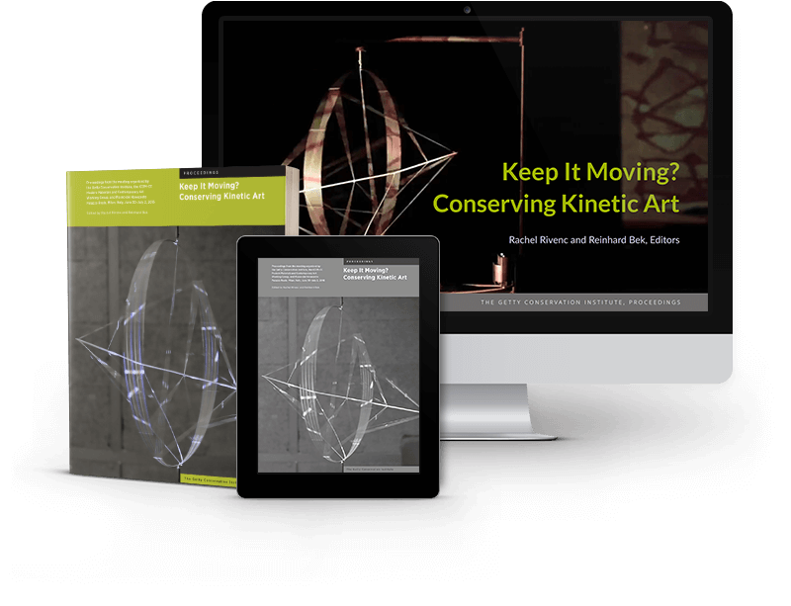
Quire
Quire is an open source software project developed by Getty for authoring rich exhibition-centric digital outputs which are easy to write, build, deploy and maintain, including by smaller institutions and individuals.
Quire projects are written as text (Markdown), images, and metadata (YAML)
The Quire tool turns these into simple standalone websites, PDFs, and/or ebooks
https://quire.getty.edu/ Quire Community Showcase: https://quire.getty.edu/community/community-showcase/

Slide 6
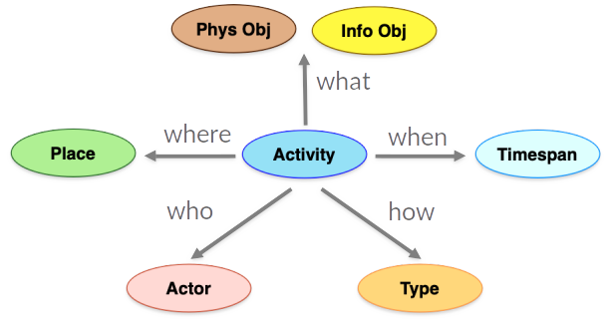
2. Linked Art
Linked Art is a usable, standards-based way to describe cultural heritage, providing museums with a shared data model:
an activity-centric metadata profile based on the CIDOC CRM
informed by lessons from past Linked Open Data initiatives
an API with recurrent principles, providing as JSON-LD
easily understood by developers - Linked Open Usable Data
https://linked.art/

Slide 7
3. Quire + Linked Art
Enriching Exhibition Stories adds capabilities to Quire so that it will work with Linked Art and through it enable new forms of digital stories.
This week we will show you a preview of our extended version of the Quire software, and help you learn how to use it.
Please install and use the preview version of Quire (instructions circulated)!
https://linked.art/community/projects/ees2/

Slide 8
What can Quire produce? Into the Labyrinth exemplar

Slide 9
How to use Quire and Linked Art (video)
https://www.youtube.com/watch?v=y0z8u-r9UCY

Slide 10
Installation
Installation instructions have been circulated via email, are available on Canvas, and were given out as hard copies at registration
If you are unable to get Quire installed, do not worry
You will be in groups for the second session
Help with installation will be offered before the second session

Slide 11
Links
Resource links are available on our webpage at https://linked.art/community/projects/ees2/docs/training

Slide 12
Before the second session…
Finish installing Quire and the extension
A team member will be available before the second session to help with installation issues
Find three objects on the Yale LUX platform
LUX home page: https://lux.collections.yale.edu/
You will use your three chosen objects when working through the exercise sheet
If you will be using a recommended text or code editor, have it installed
Getty recommends Visual Studio Code, Brackets, or Sublime Text for Quire
Recommended editor is not required
You can use your default text editor if you want. Your choice of editor will not significantly impact your experience doing the exercises

Slide 13
Thank you
Funded by the UK Arts and Humanities Research Council (AH/Y006011/1)

