Slide 1
Agile Principles and Practices
Agile Development Processes
Eric Knauss

Slide 2
Announcements
Some students have joined late. Please register for group work:
https://www.surveymonkey.com/r/EDA_397_2017
Any Roadblocks?

Slide 3
Overview (might take 2 lectures)
Principles
Artefacts and Tools
Practices
XP
Scrum
Kanban (you did watch the video, right?)
Later: Lean software development

Slide 4
Course Objectives
Knowledge and understanding | Skills and ability | Judgement and approach
Compare agile and traditional softw. dev, | Forming a team organically | Explain: people/commun. centric dev.
Relate lean and agile development | Collaborate in small software dev. teams | Apply fact: people drive project success
Contrast different agile methodologies | Interact and show progress continuously | Describe: No single methodology fits all
Use the agile manifest and its accompanying principles | Develop SW using small and frequent iterations | Discuss: methodology needs to adopt to culture
Discuss what is different when leading an agile team | Use test-driven dev. and automated tests
 | Refactor a program/design
 | Be member of agile team
 | Incremental planning using user stories
Sprint 3
Sprint 1
Sprint 2

Slide 5
User story
Widely accepted template: As a <role> I want to <feature> so that <customer value>
Promise to discuss this user goal further
Keep track of what the team is doing
A lot of value in physical artifact
Usually good idea to add: ID, Story Points, List of sub-tasks, Indication of customer value, notes on the backside

Slide 6
Agile Principles – Revised list (according to [Mey2014])
Organizational
Put the customer at the center.
Let the team self-organize.
Work at a sustainable pace.
Develop minimal software:
Produce minimal functionality.
Produce only the product requested.
Develop only code and tests.
Accept Change
Technical
Develop iteratively:
Produce frequent working iterations.
Freeze requirements during iterations.
Treat tests as a key resource:
Do not start any new development until all tests pass.
Test first.
Express requirements through scenarios.
6. Reflect regularly and improve continuously!
Notes:
Discuss with your neighbour: Name 2 that are easy and 2 that are difficult to adhere to in your project.

Slide 7
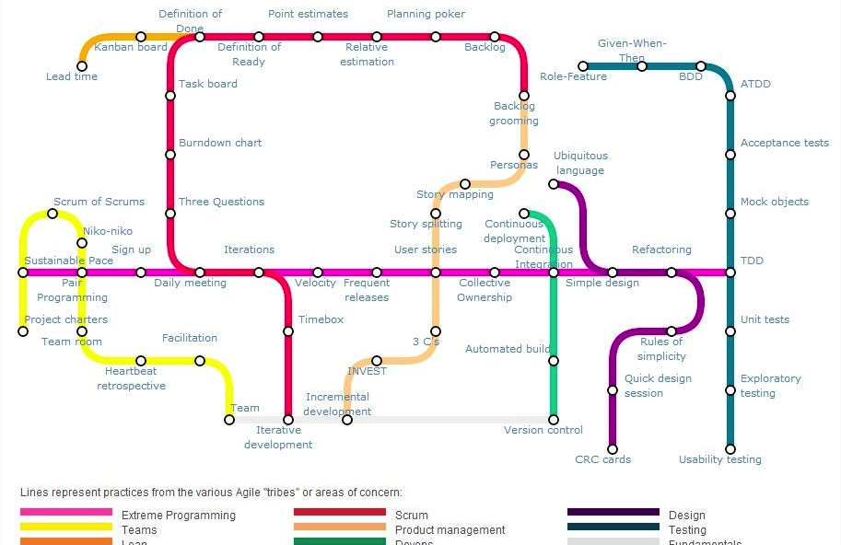
Agile Practices
https://techblog.betclicgroup.com/wp-content/uploads/2013/12/agileSubwayMap2.jpg
Also check: http://guide.agilealliance.org

Slide 8
XP Principles
Core
Less central
Rapid feedback
Assume simplicity
Incremental change
Embracing change
Quality work
Teach learning
Small initial investment
Play to win
Concrete requirements
Open, honest communication
Work with people’s instincts, not against them
Accepted responsibility
Local adaptation
Travel light
Hones measurement

Slide 9
XP Practices
Planning game
Small releases
Metaphor
Simple design
Testing (dedicated lecture)
Refactoring
Pair programming
Collective ownership
Continuous integration (dedicated lecture)
40h week
On-site customer
Coding standards

Slide 10
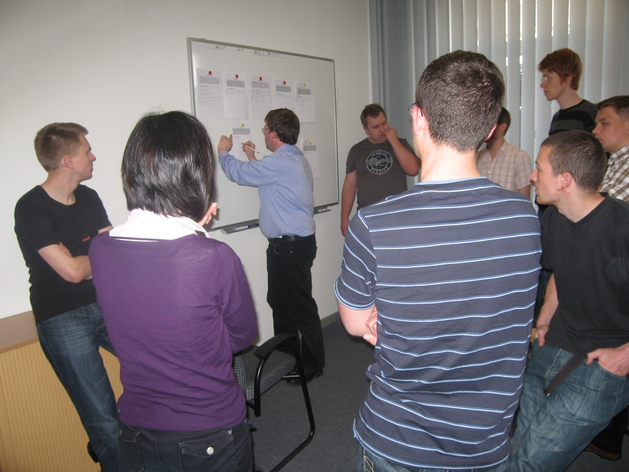
Planning Game
Basic idea
Create a rough iteration plan
Plan next iteration in detail
Players
Onsite Customer
Team
(Coach)
Moves
Write User stories (OC + Team)
[do some filtering]
OC ranks US by business value [assign Fibonacci numbers]
Team assigns story points [Planning poker]
OC put story cards in strictly prioritized order
Team selects the top n stories to match their velocity

Slide 11
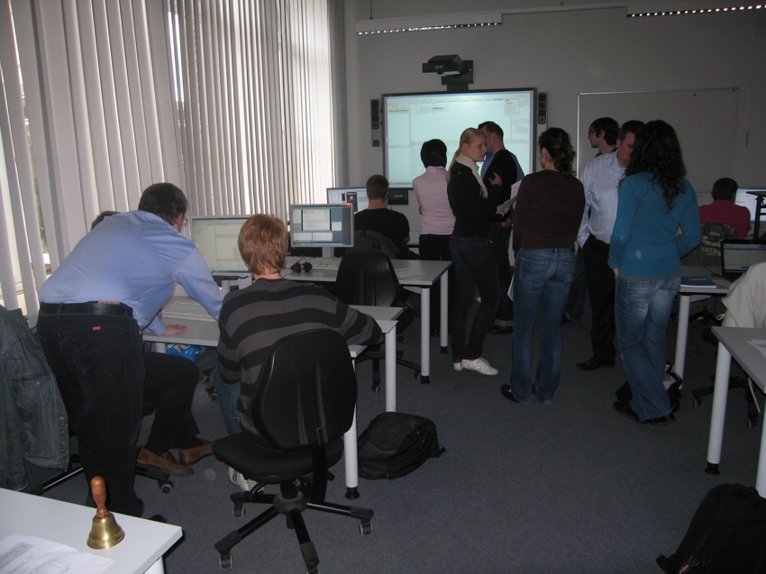
Pair Programming
Basic idea
Two people on one computer
Take one user story with them
Review each other
Share knowledge
Related concepts
User story as vertical increment
Truck factor
Sentiment in research
Studies with contradictory results, clearly leaning towards rejecting the idea of using pair programming in general
But Long term aspects of knowledge management not/insufficiently covered
Good results for specific use cases (exploration, difficult task, knowledge sharing, …)

Slide 12
Scrum Principles
Reflection
Stop and review product & process
Self-correction
Based on reflection
Visibility
Everything is visible (=known) for all stakeholders, e.g. plans, schedules, issues, …

Slide 13
Scrum practices
Product backlog vs. Sprint backlog
Sprint planning
Planning poker: estimate cost
ROI (Return on Investment): cost vs. benefit
Retrospective
Fixed sprint length
Burn-down charts
Daily scrum: no longer than 15min

Slide 14
Kanban principles
Start with what you do now
Agree to pursue incremental, evolutionary change
Respect the current process, roles, responsibilities and titles
Leadership at all levels
The following is based on [KS2009]

Slide 15
Kanban core practices
Visualize
Visualization of workflow allows to understand and improve it
Limit Work-in-Progress
Limit the amount of workitems for each step
Introduce a pull-system
Manage flow
Measure how workitems flow through the process and understand, if a change improves the situation
Make policies explicit
Implement feedback loops
Understand (as a team) how good the process is working
Improve collaboratively, evolve experimentally
Whole team needs to share a theory on why (small) change helps

Slide 16
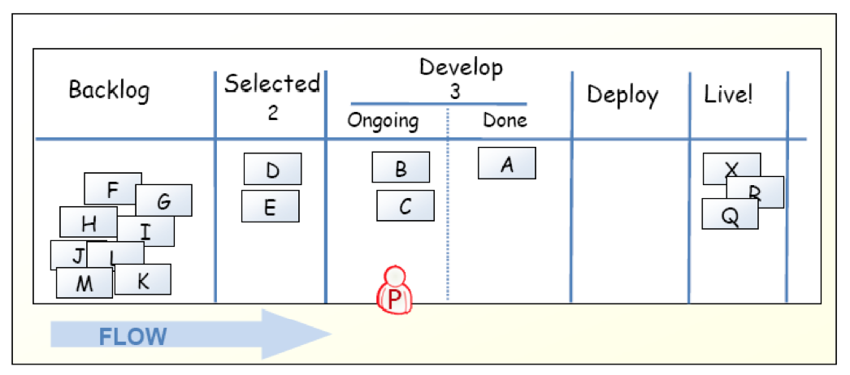
Kanban-Board
[KS2009]

Slide 17
Limit work in progress
Prevent context switching
Reduce multi-tasking
performing tasks sequentially yields results sooner
Maximize throughput
Enhance teamwork
working together to make things done
increase cross-functionality

Slide 18
WIP Strategy
Start with some initial value
Small constant (1-3)
number of developers
number of testers
Measure the cycle time
average time of one piece full cycle flow
Change limit to decrease cycle time

Slide 19
Idle Members
Can you help progress an existing kanban? – Work on that.
Don’t have the right skills? – Find the bottleneck and work to release it.
Don’t have the right skills? – Pull in work from the queue.
Can’t start anything in the queue? – Check if there is any lower priority to start investigating.
There is nothing lower priority? – Find other interesting work (refactoring, tool automation, innovation).

Slide 20
Metrics
Stories in progress (SIP)
When story enters stories queue set entry date (ED)
When story enters first process step set start processing date (SPD)
When story is done set finish date (FD)
Cycle time (CT) = FD – SPD
Waiting time (WT) = SPD – ED
Throughput (T) = SIP / CT

Slide 21
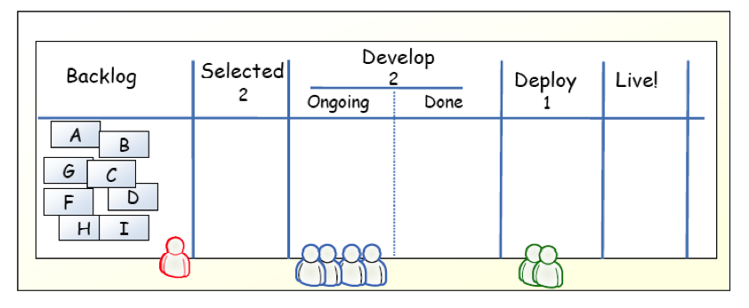
Example
[KS2009]

Slide 22
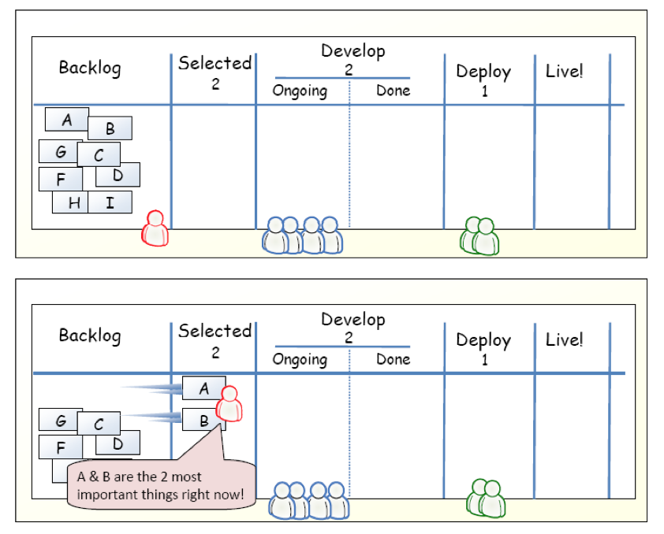
Example
[KS2009]

Slide 23
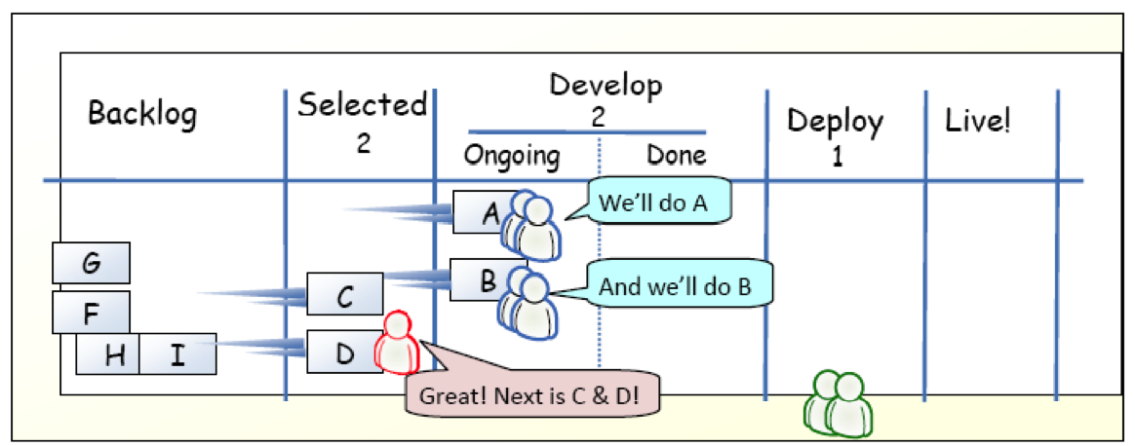
Example
[KS2009]

Slide 24
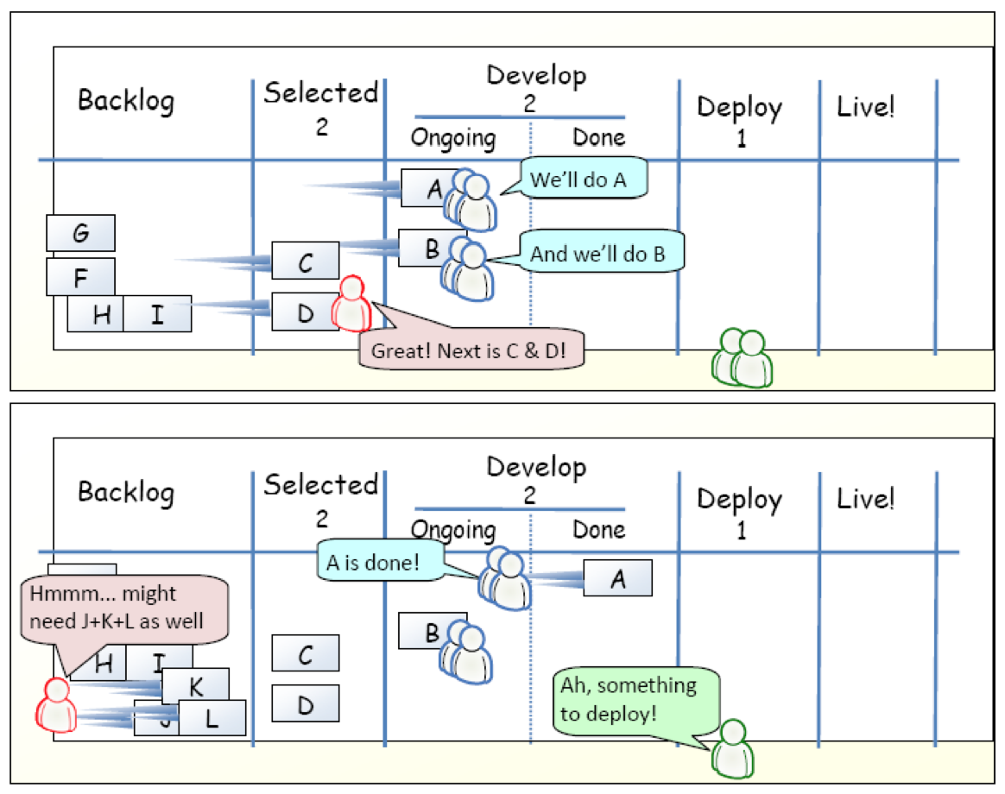
Example
[KS2009]

Slide 25
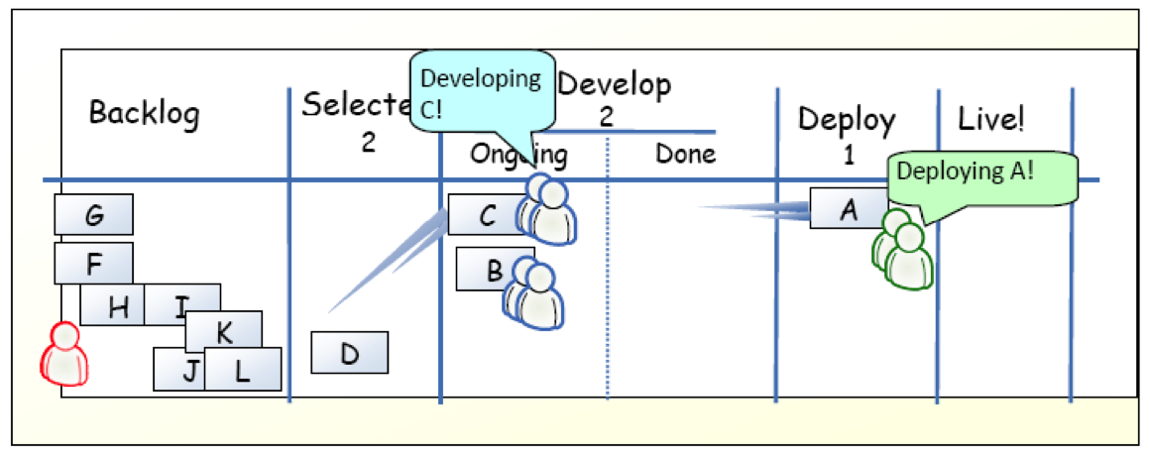
Example
[KS2009]

Slide 26
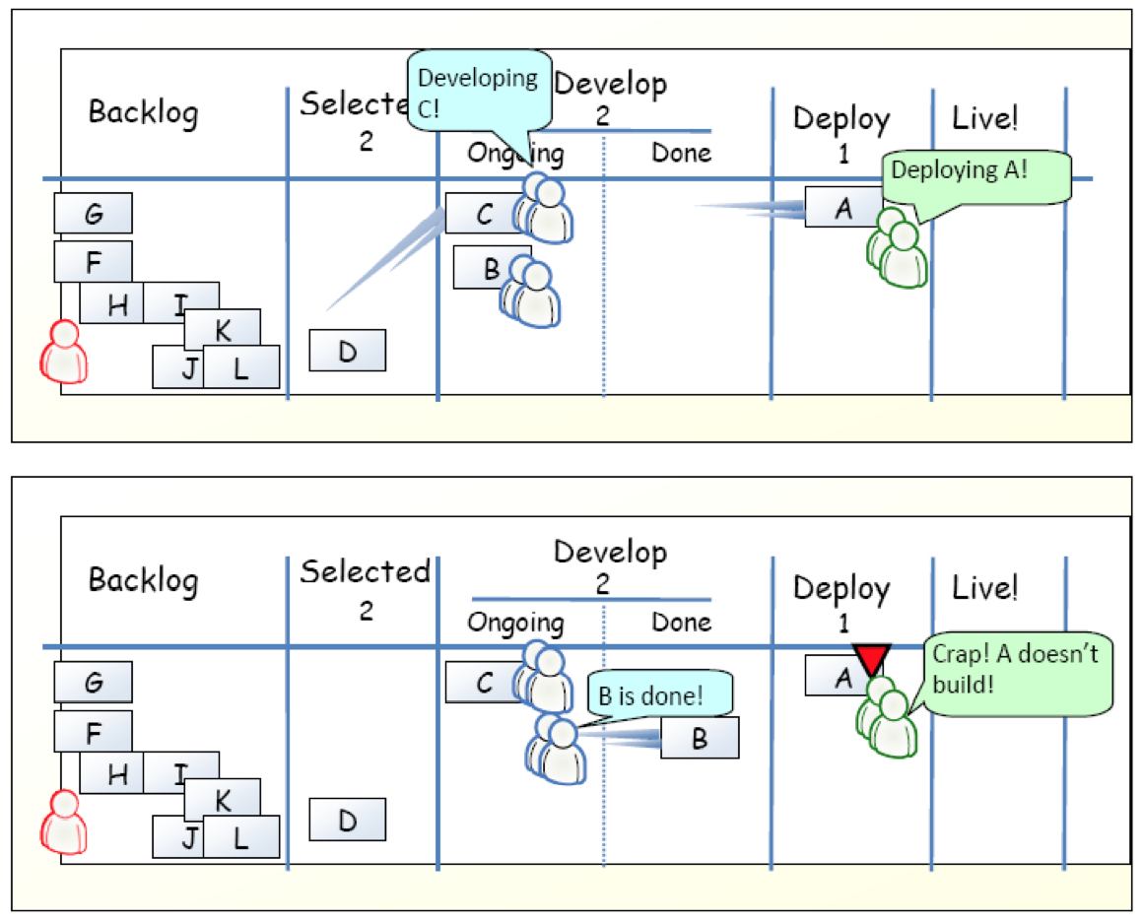
Example
[KS2009]

Slide 27
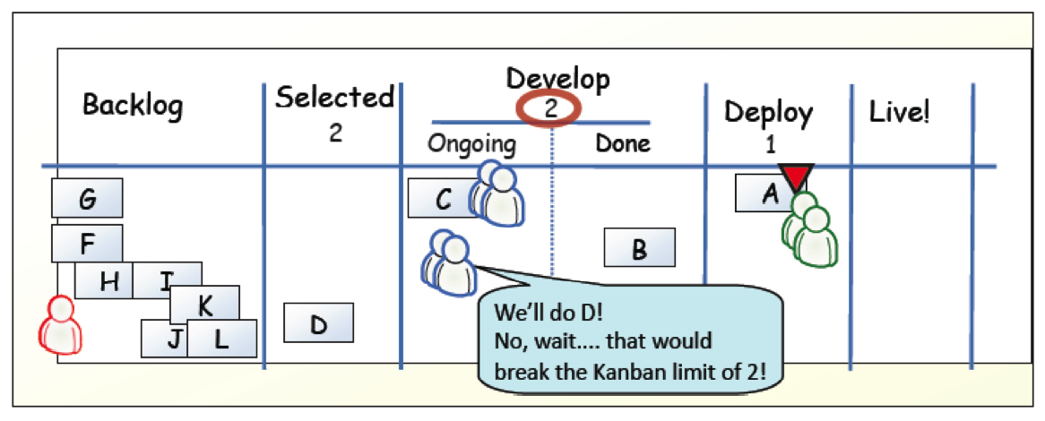
Example
[KS2009]

Slide 28
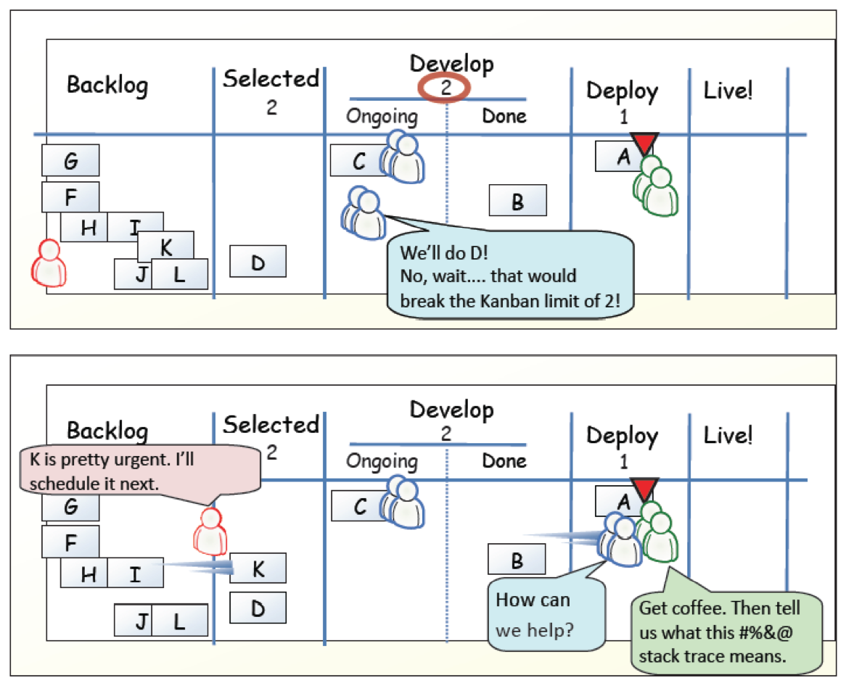
Example
[KS2009]

Slide 29
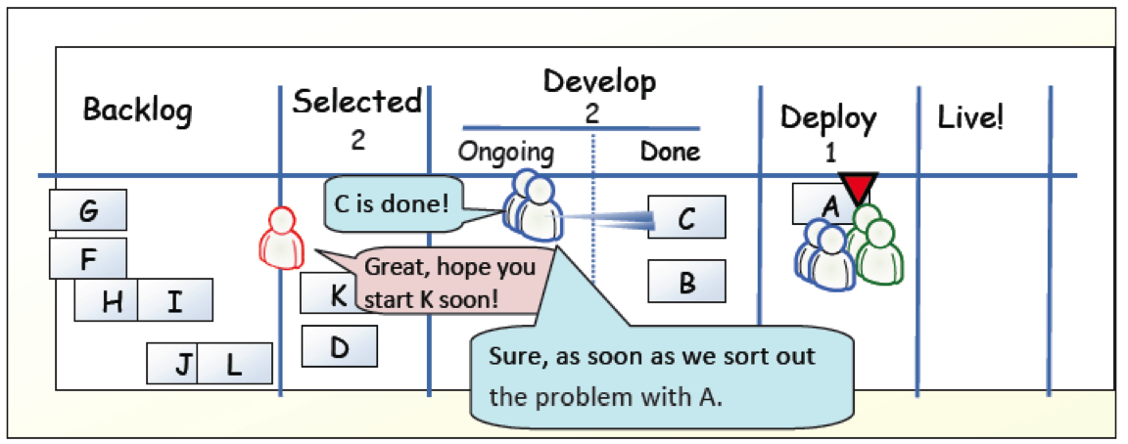
Example
[KS2009]

Slide 30
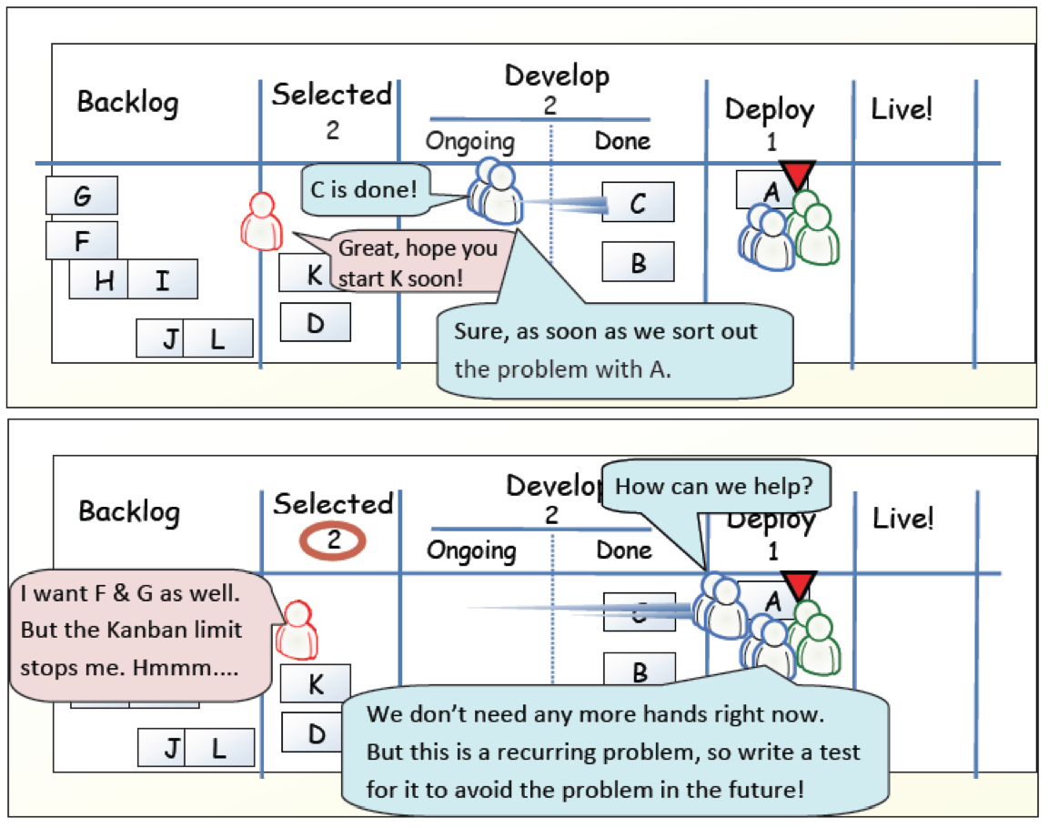
Example
[KS2009]

Slide 31
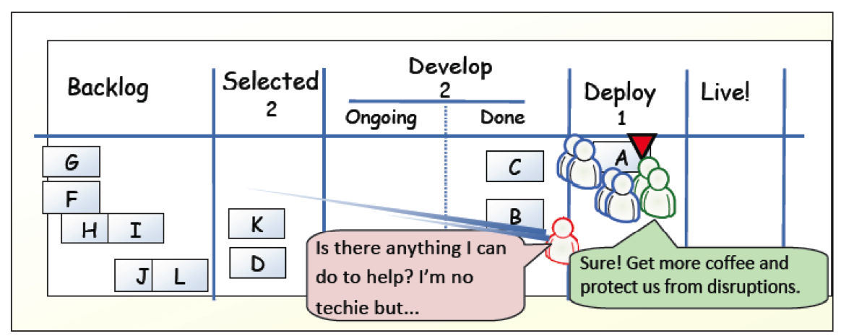
Example
[KS2009]

Slide 32
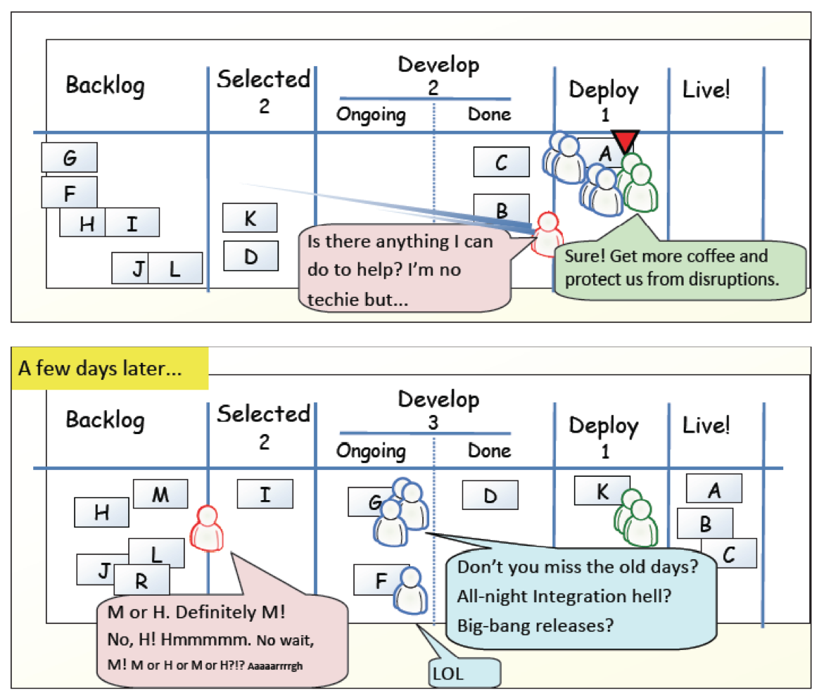
Example
[KS2009]

Slide 33
?
Compare Kanban with your favorite agile method.
What is similar?
What is different?
Is Kanban agile?

Slide 34
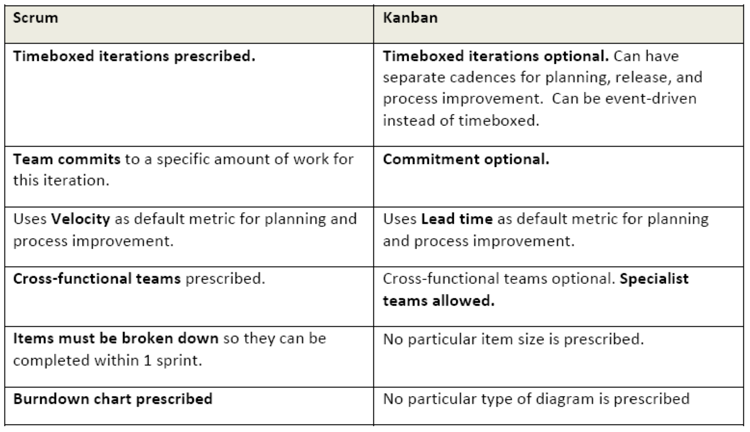
Scrum vs. Kanban
[KS2009]

Slide 35
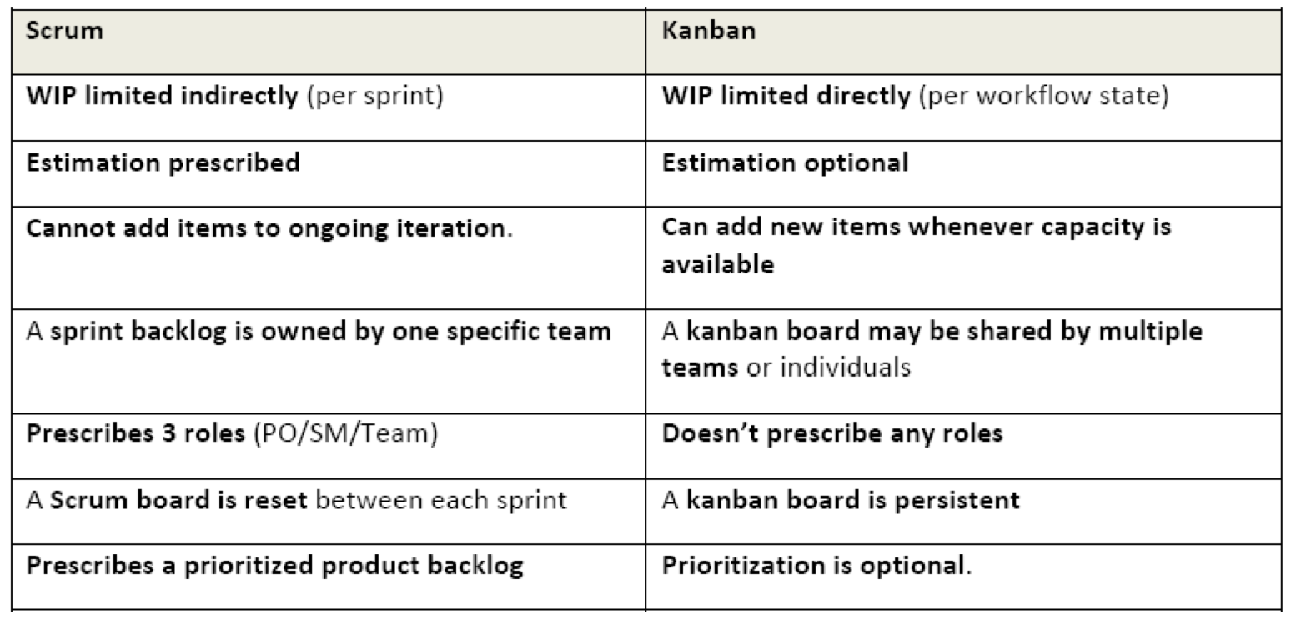
Scrum vs. Kanban
[KS2009]

Slide 36
Agile Principles
Early and continuous delivery of valuable software
Welcome changing requirements, even late
Deliver working software frequently
Business people and developers must work together
Build projects around motivated individuals
Face-to-face communication is most effective and efficient
Working software is the primary measure of progress
Sustainable development
Continuous attention to technical excellence and good design
Simplicity is essential
Self-organizing teams
Regular reflection
Notes:
Task: For each of the principles, compare XP, Scrum, and Kanban and discuss differences
NOW: Pick two – the others might be a good exercise for exam and report.

Slide 37
Agile Principles – Revised list (according to [Mey2014])
Task: For each of the principles, compare XP, Scrum, and Kanban and discuss differences NOW: Pick two – the others might be a good exercise for exam and report.
Organizational
Put the customer at the center.
Let the team self-organize.
Work at a sustainable pace.
Develop minimal software:
Produce minimal functionality.
Produce only the product requested.
Develop only code and tests.
Accept Change
Technical
Develop iteratively:
Produce frequent working iterations.
Freeze requirements during iterations.
Treat tests as a key resource:
Do not start any new development until all tests pass.
Test first.
Express requirements through scenarios.
6. Reflect regularly and improve continuously!

Slide 38
References
[KS2009] Henrik Kniberg and Mattias Skarin: Kanban and Scrum – Making the Most of Both. InfoQ (2009) Available online:http://infoq.com/minibooks/kanban-scrum-minibook

