Slide 1

Agile Information Flows
Agile Development Processes
Eric Knauss
http://3badbullies.files.wordpress.com/2013/10/tin-can-telephone.jpg

Slide 2
Feedback in XP
Release Plan
Month
Iteration Plan
Weeks
Stand Up Meeting
Pair Negotiation
One day
Unit Test
Hours
Pair Programming
Minutes
Seconds
Agile Software Dev. | Eric Knauss
2

Slide 3
How to make this project more agile?
Consider a project wiith problems
Large specification
Frequent changes – best designers manage those
Quotes
“It‘s just too many documents. […] Sure we need both user requts spec. and system reqts spec. But often, I change code and then go back to adjust the requirements.“
“Why is the customer not working on the user reqts spec? Are they confused by the many changes themselves?“
“System requirements specification? I know it is supposed to be useful. But currently I just try to keep it in sync with the unit tests we are writing.“
“We probably should adjust the design document. It is outdated, but so far we seem to be all on the same page. It would be such a pain to bring it up to date!“
Agile Software Dev. | Eric Knauss
3
Notes:
Anecdote for task: Consider a project with some problems: There is a large specification and during the last weeks we received a couple of change requests. First, there was resistance, but the changes are really crucial for the customer and it is possible that it is our fault that we got that stuff wrong. But once we accepted the first changes, more appeared. Now we lost our overview. Our best designers spend most of there time to understand the status of changes and to adjust specification and software design. If we continue like this, the project will fail and neither we nor the customer want that to happen.
Kurt‘s Text: Oft beginnt ein Projekt „klassisch“ und möchte dann unterwegs agiler werden. Dies ist oft der Fall, wenn man mit einer sehr umfangreichen Spezifikation Schwierigkeiten hat und feststellt, dass man mit dem Ändern gar nicht mehr nachkommt.
Druck wird reduziert, damit für die folgenden Schritte Luft bleibt.
Text for a handout:
As above, then a few developer quotes.
„It is just too many documents. Don‘t get me wrong, I think we need both for example user requirements specification and system requirements specification. But for many changes, I start changing the code and then go back to adjust the requirements.“
„The user requirements specification is really helpful, I ony wish the users would edit it once in a while. They seem to be confused by the many changes themselves.“
„System requirements specification? I know it is supposed to be useful. But currently I just try to keep it in sync with the unit tests we are writing.“
„We probably should adjust the design document. It is really outated. But so far, we seem to be all on the same page. And it would be such a pain to bring it up to date!“

Slide 4
Task (10min): How to make this project more agile?
Remove pressure through lightweight approachs
Discard unnecessary documents
Minimize process-requirements and templates
Provide for vague requirements and changes
Quickly to the core system, then incremental evolution
Better feedback
Organizational and technical change
Closer collaboration with customer
Agile Software Dev. | Eric Knauss
4
Notes:
Anecdote for task: Consider a project with some problems: There is a large specification and during the last weeks we received a couple of change requests. First, there was resistance, but the changes are really crucial for the customer and it is possible that it is our fault that we got that stuff wrong. But once we accepted the first changes, more appeared. Now we lost our overview. Our best designers spend most of there time to understand the status of changes and to adjust specification and software design. If we continue like this, the project will fail and neither we nor the customer want that to happen.
Kurt‘s Text: Oft beginnt ein Projekt „klassisch“ und möchte dann unterwegs agiler werden. Dies ist oft der Fall, wenn man mit einer sehr umfangreichen Spezifikation Schwierigkeiten hat und feststellt, dass man mit dem Ändern gar nicht mehr nachkommt.
Druck wird reduziert, damit für die folgenden Schritte Luft bleibt.
Text for a handout:
As above, then a few developer quotes.
„It is just too many documents. Don‘t get me wrong, I think we need both for example user requirements specification and system requirements specification. But for many changes, I start changing the code and then go back to adjust the requirements.“
„The user requirements specification is really helpful, I ony wish the users would edit it once in a while. They seem to be confused by the many changes themselves.“
„System requirements specification? I know it is supposed to be useful. But currently I just try to keep it in sync with the unit tests we are writing.“
„We probably should adjust the design document. It is really outated. But so far, we seem to be all on the same page. And it would be such a pain to bring it up to date!“

Slide 5
Thought experiment Ideal transfer of information: not via Documents!
Starting point: face-to-face
Spatial proximity: Gestures, expressions etc.
“Osmotic communication”
Remove co-location: Video-Conference
Synchronous seeing and hearing
Remove visual channel: Telephone
Synchronous listening, questions, and feedback
Remove audio channel: email
Questions and feedback possible, but written and with delay
Remove questions and feedback
- Read documents (e.g. on paper): So much is missing here!
Agile Software Dev. | Eric Knauss
5
Notes:
Man nimmt immer etwas weg - und landet ganz am Schluss bei Papierdokumentation. Das soll zeigen, dass diese Art der Dokumentation die Kanäle doch deutlich verengt. Das muss sich dann schon auf andere Weise lohnen.

Slide 6
Lifecycle of an XP project
Customer
Create value
Define value
Learn
Programmer
Programmer
Choose value
Estimate costs
Customer
Ron Jeffries et.al. XP installed
What do project members learn from each other?
Agile Software Dev. | Eric Knauss
6

Slide 7
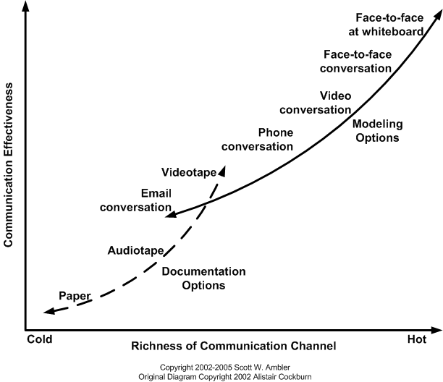
Modes of Communication
http://www.agilemodeling.com/essays/communication.htm
Agile Software Dev. | Eric Knauss
7
Notes:
Hier das ganze noch einmal als Kurve dargestellt.
Papier ist weder „hot“, es tut sich also nicht viel.
Noch ist die Effizienz (Erfolg/Aufwand) groß. Man braucht es doch manchmal, weil es ein viel effektiverer Speicher ist als die anderen Mittel.

Slide 8
Task (15min)
In small groups: Choose either XP or Scrum
Assume you are agile coaches for a team of 8 developers
BUT: 5 work here, 2 in Helsinki, 1 in New York
How do you make this work?
Which reoccurring, scheduled information flows are needed?
Which ad hoc information flows are needed?
Which continuous information flows are needed?
What communication technology do you use? When?
Agile Software Dev. | Eric Knauss
8

Slide 9
FLOW Mapping
One approach to the previous task
Kai Stapel et al.: FLOW Mapping: Planning and Managing Communication in Distributed Teams. In Proceedings of 6th IEEE International Conference on Global Software Engineering (ICGSE ’11), pages 190–199, Helsinki, Finland, 2011.

Slide 10
Problem and Proposed Solution
Communication in a distributed setting is more difficult
Unfamiliarity with each other
Limited communication media
Informal communication does not happen as naturally
FLOW Mapping, a systematic approach for planning and managing communication in distributed projects
2 phase process
Support for process steps
Stapel et al. (2011): Flow Mapping
Agile Software Dev. | Eric Knauss
10
Notes:
Insgesamt:
Story erzählen, auf das Paper neugierig machen.
Was ist unsere Contribution?
Welche Daten findet man im Paper?

Slide 11
FLOW Mapping Process
A. Planning Communication
1. Establish team
2. Create communication strategy
B. Managing Communication
1. Conformance analysis
2. Update FLOW Map
3. Create FLOW Map
3. Coordinate communication
Stapel et al. (2011): Flow Mapping
Agile Software Dev. | Eric Knauss
11

Slide 12
FLOW
FLOW Mapping is based on FLOW
Information flow perspective on software development
Informal communication incorporated
Metaphor of state of information
Solid information is
Long term accessible
Repeatable accessible
Understandable by third parties
Fluid information is not solid, i. e. one of the above criteria is not met
Notation to visualize information flows
FLOW Notation
Storage
Flow
Doc
Person
Stapel et al. (2011): Flow Mapping
Agile Software Dev. | Eric Knauss
12
Notes:
FLOW provides a special view on software development.
From the FLOW perspective the thing that matters when developing software are information flows.
No matter how the software is being developed, whether it is plan driven or agile, the information has to flow from the customer through the various SE activities, either using documents or more direct means of communication, to the final product.

Slide 13
FLOW Map – Example
LUH
TUC
Administrative
Coach &
Coordinator
Coordinator
XP, Android
XP, Android
Pair 2
Administrative
Reqs.
Pair 4
Reqs.
Customer
Reqs., Design, Code
Pair 1
Pair 3
Reqs., Design, Code
Trac, SVN
Areas for each site
Fluid storages for developers
Fluid storages for other stakeholders
Solid storages for essential documents
Fluid flows for planned communication
Flows for planned documentation
Other planned flows
Stapel et al. (2011): Flow Mapping
Agile Software Dev. | Eric Knauss
13

Slide 14
FLOW Map – Example
LUH
TUC
Administrative
Coach &
Coordinator
Coordinator
XP, Android
XP, Android
Pair 2
Administrative
Reqs.
Pair 4
Reqs.
Customer
Reqs., Design, Code
Pair 1
Pair 3
Reqs., Design, Code
Trac, SVN
Stapel et al. (2011): Flow Mapping
Agile Software Dev. | Eric Knauss
14

Slide 15










******** *********
Customer
Skype: **************
******** *********
Coach
Skype: ****.*******
******** *********
Coordinator
Skype: ******.********
Links
WebConf: http://webconf.*******/********/
Trac: https://trac.se.uni-hannover.de/********/
LUH
TUC
Administrative
Coach &
Coordinator
Coordinator
XP, Android
XP, Android
Pair 2
Reqs.
Administrative
Pair 4
Customer
Reqs.
Reqs., Design, Code
Pair 1
Reqs., Design, Code
Pair 3
Trac, SVN
Skype ID: pair1-H
Skype ID: pair2-H
Skype ID: pair3-C
Skype ID: pair4-C
Story Card #B9
Naming conventions
Estimate: -
Story Card #T3
Adjust fonts
Estimate: 1
Story Card #32
Core questions
Estimate: 3
Story Card #T2
Data persistece
Estimate: 2
******** *********
Developer (H)
MySQL
******** *********
Developer (H)
Android, GWT
******** *********
Developer (C)
GUI, SWT
******** *********
Developer (C)
Trac, Bugzilla
******** *********
Developer (H)
GUI, Swing
******** *********
Developer (H)
UML, Patterns
******** *********
Developer (C)
Hibernate
******** *********
Developer (C)
Eclipse, GWT
Stapel et al. (2011): Flow Mapping
Agile Software Dev. | Eric Knauss
15

Slide 16
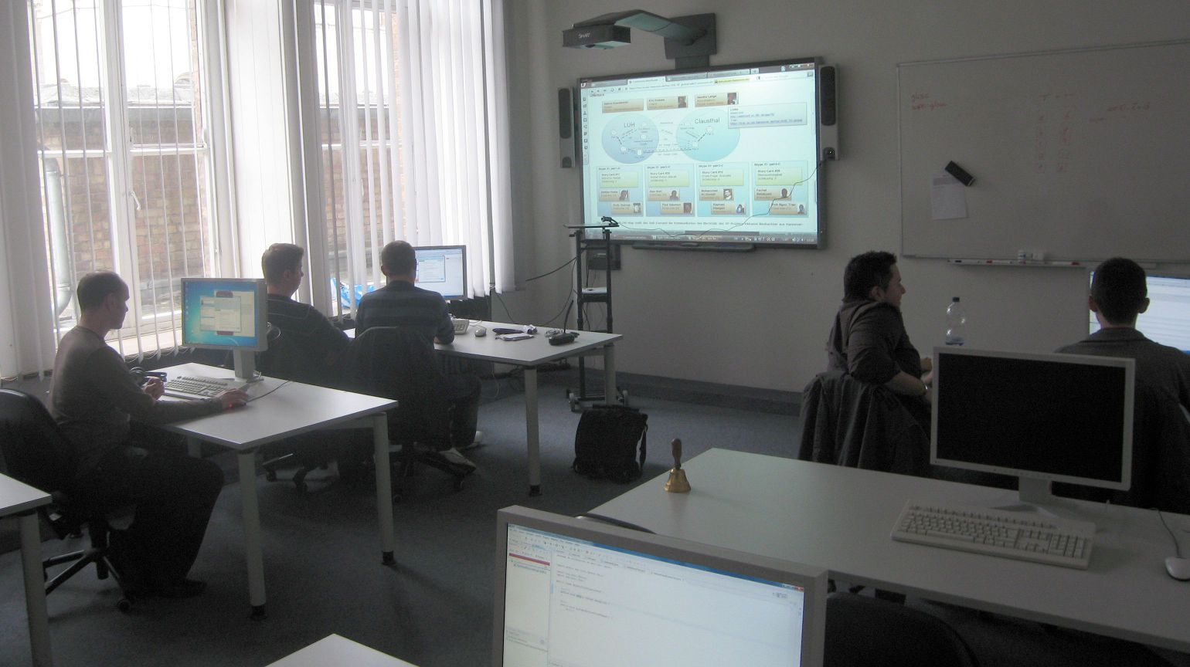
FLOW Map in Action
Stapel et al. (2011): Flow Mapping
Agile Software Dev. | Eric Knauss
16

Slide 17
Plan Communication – Establish Team
A. Planning Communication
1. Establish team
2. Create communication strategy
3. Create FLOW Map
LUH
TUC
Administrative
Coach &
Coordinator
Coordinator
XP, Android
XP, Android
Pair 2
Reqs.
Administrative
Pair 4
Customer
Reqs.
Reqs., Design, Code
Pair 1
Reqs., Design, Code
Pair 3
Trac, SVN
******** *********
Developer (H)
MySQL
******** *********
Developer (H)
Android, GWT
******** *********
Developer (C)
GUI, SWT
******** *********
Developer (C)
Trac, Bugzilla
******** *********
Developer (H)
GUI, Swing
******** *********
Developer (H)
UML, Patterns
******** *********
Developer (C)
Hibernate
******** *********
Developer (C)
Eclipse, GWT
Stapel et al. (2011): Flow Mapping
Agile Software Dev. | Eric Knauss
17

Slide 18
Plan Communication – Communication Strategy
A. Planning Communication
1. Establish team
2. Create communication strategy
3. Create FLOW Map
Communication activity | Schedule / event | Communication media
Stand-upª / Wrap-upª | Every morning / evening | HQ video conference
Planning gameª | Start of iteration (~ every 2. day) | HQ video conference with shared mind map
Acceptance test of iteration | Iteration completed | HQ video conference with shared desktop
Acceptance test of user storiesª | User story completed | Skype call with shared desktop
Informal collaboration | Ad-hoc | Skype call/chat and desktop sharing
Informal coordination | Ad-hoc | Skype call / chat
Status updateª | Status change | Skype status
prepare
conformance
analysis
Stapel et al. (2011): Flow Mapping
Agile Software Dev. | Eric Knauss
18

Slide 19
Plan Communication – Communication Strategy
Status update conformance template
Communication Activity | Status update
Goal | Increase awareness on who is working with whom on what task
Definition | Developers should use Skype status messages to broadcast who is working with whom on which User Story in a timely manner. The status message should contain User Story ID and the names of the pair programmers.
Collected Data | Skype status log for each workstation containing: timestamp and status message and status change events (pair switches, assignment of new User Stories)
Violations | Temporal: (1) Status message not updated for more than one hour (2) Status message suggests that a developer is working in two pairs concurrently Qualitative: (1) Incomplete information, e.g. User Story ID missing.
Stapel et al. (2011): Flow Mapping
Agile Software Dev. | Eric Knauss
19

Slide 20
Plan Communication – Communication Strategy
Status update conformance template
Communication Activity | Status update
Goal | Increase awareness on who is working with whom on what task
Definition | Developers should use Skype status messages to broadcast who is working with whom on which User Story in a timely manner. The status message should contain User Story ID and the names of the pair programmers.
Collected Data | Skype status log for each workstation containing: timestamp and status message and status change events (pair switches, assignment of new User Stories)
Violations | Temporal: (1) Status message not updated for more than one hour (2) Status message suggests that a developer is working in two pairs concurrently Qualitative: (1) Incomplete information, e.g. User Story ID missing.
Stapel et al. (2011): Flow Mapping
Agile Software Dev. | Eric Knauss
20

Slide 21
Case Study – Communication Overview
Stapel et al. (2011): Flow Mapping
Agile Software Dev. | Eric Knauss
21

Slide 22
Day 1
Day 2
Day 3
Day 4
Weekend
Day 5
Tue
Wed
Thu
Fri
Sat & Sun
Mon
9:00
Stand-up
Stand-up
Stand-up
Stand-up
Pair Prog.
Pair Prog.
Pair Prog.
Pair Prog.
Pair Prog.
10:00
11:00
12:00
Lunch
Lunch
Lunch
Dist. lunch
Dist. lunch
13:00
Planning Game
Pair Prog.
Pair Prog.
Pair Prog.
Pair Prog.
14:00
Pair Prog.
15:00
Planning Game
16:00
Pair Prog.
Wrap-up
17:00
Wrap-up
Wrap-up
Wrap-up
Stapel et al. (2011): Flow Mapping
Agile Software Dev. | Eric Knauss
22

Slide 23
Discussion
Impact
FLOW Map perceived to be useful
Especially at project start (team grows together)
Problem with manual update process → tool support
Stapel et al. (2011): Flow Mapping
Agile Software Dev. | Eric Knauss
23

Slide 24
Discussion
Impact
Cost
Plan: 1d strategy + 0.5d conformance + 2d prepare data collection
Execute: observer + 1h/activity for conformance analysis + 10 min./change to update FLOW Map
Management feasibility
Violations can be detected during project
Monitoring electronic media helps (see costs)
Planning feasibility
Communication was planned
Strategy was followed (79% - 88%)
Stapel et al. (2011): Flow Mapping
Agile Software Dev. | Eric Knauss
24

Slide 25
Distributed vs. Not distributed
Some personal experience
Agile Software Dev. | Eric Knauss
25

Slide 26
Business goal
User goal
Subgoal
Business goal
User goal
Subgoal
Agile Software Dev. | Eric Knauss
26

Slide 27
Via doc.
Via f2f
Via doc.
Via f2f
Agile Software Dev. | Eric Knauss
27

Slide 28
# documented
# not documented
# documented
# not documented
Agile Software Dev. | Eric Knauss
28

Slide 29
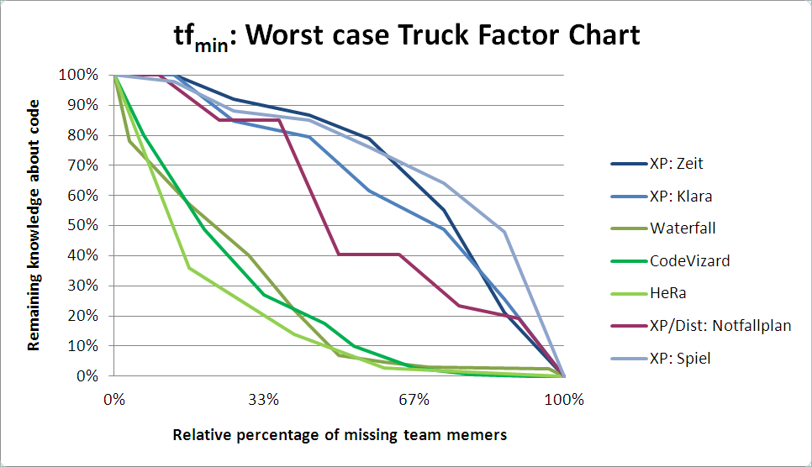
Truck Factor
Nico Zazworka, Kai Stapel, Eric Knauss, Forrest Shull, Victor R. Basili, Kurt Schneider. Are developers complying with the process: an XP study. In Proc. of the 4th Int. Symp. on Empirical Software Engineering and Measurement (ESEM ’10), Bolzano-Bozen, Italy, 2010.
Agile Software Dev. | Eric Knauss
29

Slide 30
Summary
We did our best to make distributed agile work
Not a surprise:
Truck factor analysis shows that we are not as agile in the distributed project as in the co-located one
Interesting:
Distributed team discussed requirements in less detail
Surprise:
Distributed team documented less
Why? Because it was @#%!$ difficult!
Agile Software Dev. | Eric Knauss
30

Slide 31
Course Objectives
Knowledge and understanding | Skills and ability | Judgement and approach
Compare agile and traditional softw. dev, | Forming a team organically | Explain: people/commun. centric dev.
Relate lean and agile development | Collaborate in small software dev. teams | Apply fact: people drive project success
Contrast different agile methodologies | Interact and show progress continuously | Describe: No single methodology fits all
Use the agile manifest and its accompanying principles | Develop SW using small and frequent iterations | Discuss: methodology needs to adopt to culture
Discuss what is different when leading an agile team | Use test-driven dev. and automated tests
 | Refactor a program/design
 | Be member of agile team
 | Incremental planning using user stories
Sprint 3
Sprint 1
Sprint 2

