Slide 1
Agile Principles and Practices
Agile Development Processes
Eric Knauss

Slide 2
Announcements
Challenge lab
Optional workshop on Git / Github / Android on Thursday, 2016-04-21?
Please indicate interest (now, email, or via course representatives)
Any Roadblocks?

Slide 3
Overview (might take 2 lectures)
Principles
Artefacts and Tools (to be added)
Practices
XP
Scrum
Kanban (you did watch the video, right?)
Later: Lean software development

Slide 4
Agile Principles – Revised list (according to [Mey2014])
Organizational
Put the customer at the center.
Let the team self-organize.
Work at a sustainable pace.
Develop minimal software:
Produce minimal functionality.
Produce only the product requested.
Develop only code and tests.
Accept Change
Technical
Develop iteratively:
Produce frequent working iterations.
Freeze requirements during iterations.
Treat tests as a key resource:
Do not start any new development until all tests pass.
Test first.
Express requirements through scenarios.
6. Reflect regularly and improve continuously!

Slide 5
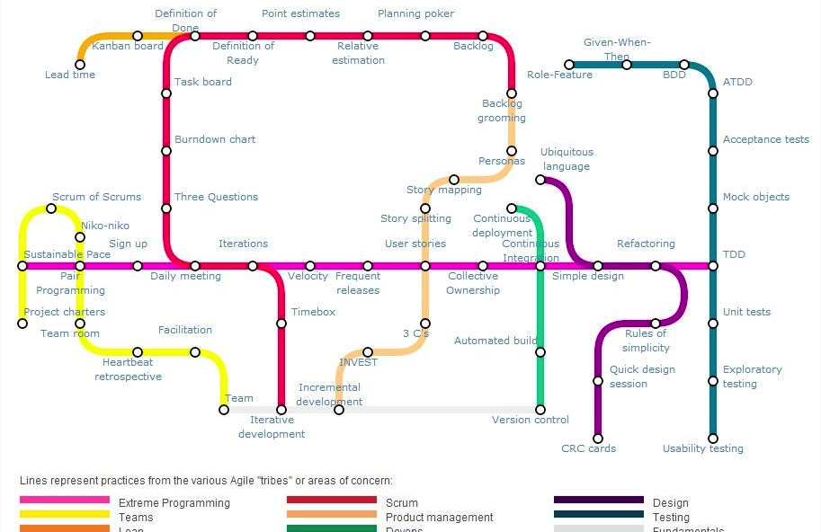
Agile Practices
https://techblog.betclicgroup.com/wp-content/uploads/2013/12/agileSubwayMap2.jpg
Also check: http://guide.agilealliance.org

Slide 6
XP Principles
Core
Less central
Rapid feedback
Assume simplicity
Incremental change
Embracing change
Quality work
Teach learning
Small initial investment
Play to win
Concrete requirements
Open, honest communication
Work with people’s instincts, not against them
Accepted responsibility
Local adaptation
Travel light
Hones measurement

Slide 7
XP Practices
Planning game
Small releases
Metaphor
Simple design
Testing (dedicated lecture)
Refactoring
Pair programming
Collective ownership
Continuous integration (dedicated lecture)
40h week
On-site customer
Coding standards

Slide 8
Planning Game
Basic idea
Create a rough iteration plan
Plan next iteration in detail
Players
Onsite Customer
Team
(Coach)
Moves
Write User stories (OC + Team)
[do some filtering]
OC ranks US by business value [assign Fibonacci numbers]
Team assigns story points [Planning poker]
OC put story cards in strictly prioritized order
Team selects the top n stories to match their velocity

Slide 9
Pair Programming
Two people on one computer

Slide 10
Scrum Principles
Reflection
Stop and review product & process
Self-correction
Based on reflection
Visibility
Everything is visible (=known) for all stakeholders, e.g. plans, schedules, issues, …

Slide 11
Scrum practices
Product backlog vs. Sprint backlog
Sprint planning
Planning poker: estimate cost
ROI (Return on Investment): cost vs. benefit
Retrospective
Fixed sprint length
Burn-down charts
Daily scrum: no longer than 15min

Slide 12
Kanban principles
Start with what you do now
Agree to pursue incremental, evolutionary change
Respect the current process, roles, responsibilities and titles
Leadership at all levels
The following is based on [KS2009]

Slide 13
Kanban core practices
Visualize
Visualization of workflow allows to understand and improve it
Limit Work-in-Progress
Limit the amount of workitems for each step
Introduce a pull-system
Manage flow
Measure how workitems flow through the process and understand, if a change improves the situation
Make policies explicit
Implement feedback loops
Understand (as a team) how good the process is working
Improve collaboratively, evolve experimentally
Whole team needs to share a theory on why (small) change helps

Slide 14
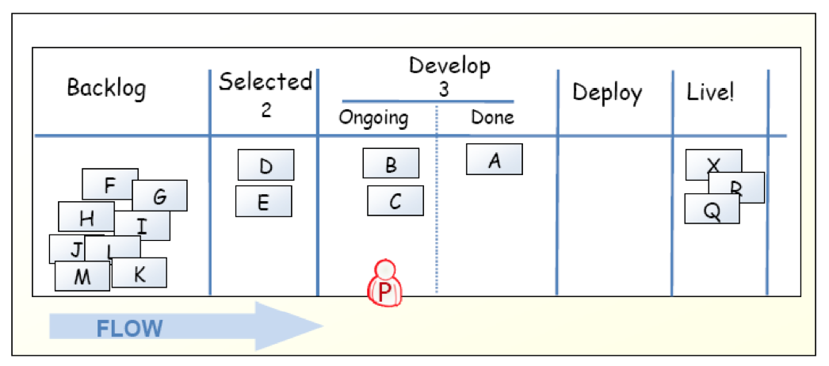
Kanban-Board
[KS2009]

Slide 15
Limit work in progress
Prevent context switching
Reduce multi-tasking
performing tasks sequentially yields results sooner
Maximize throughput
Enhance teamwork
working together to make things done
increase cross-functionality

Slide 16
WIP Strategy
Start with some initial value
Small constant (1-3)
number of developers
number of testers
Measure the cycle time
average time of one piece full cycle flow
Change limit to decrease cycle time

Slide 17
Idle Members
Can you help progress an existing kanban? – Work on that.
Don’t have the right skills? – Find the bottleneck and work to release it.
Don’t have the right skills? – Pull in work from the queue.
Can’t start anything in the queue? – Check if there is any lower priority to start investigating.
There is nothing lower priority? – Find other interesting work (refactoring, tool automation, innovation).

Slide 18
Metrics
Stories in progress (SIP)
When story enters stories queue set entry date (ED)
When story enters first process step set start processing date (SPD)
When story is done set finish date (FD)
Cycle time (CT) = FD – SPD
Waiting time (WT) = SPD – ED
Throughput (T) = SIP / CT

Slide 19
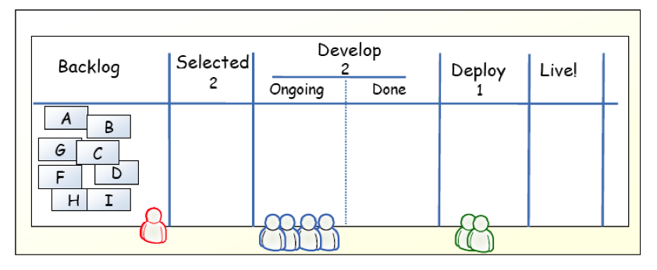
Example
[KS2009]

Slide 20
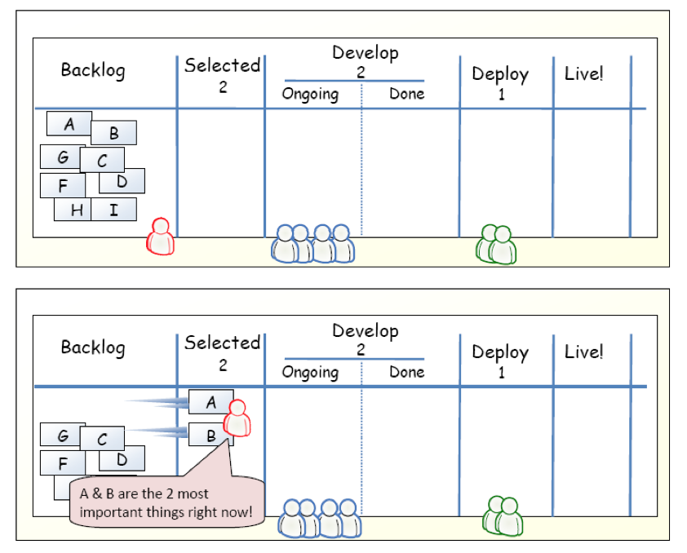
Example
[KS2009]

Slide 21
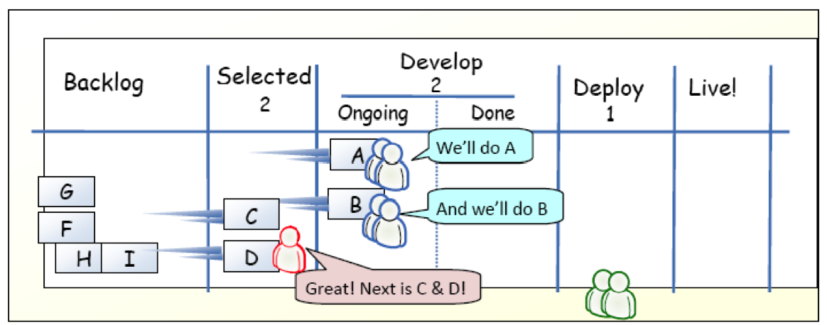
Example
[KS2009]

Slide 22
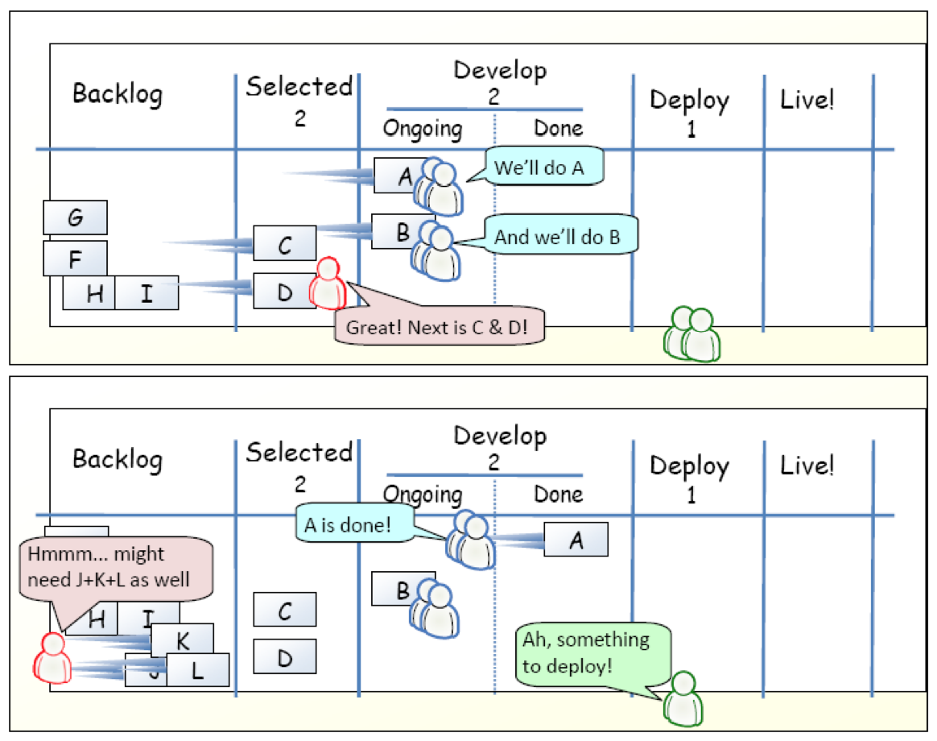
Example
[KS2009]

Slide 23
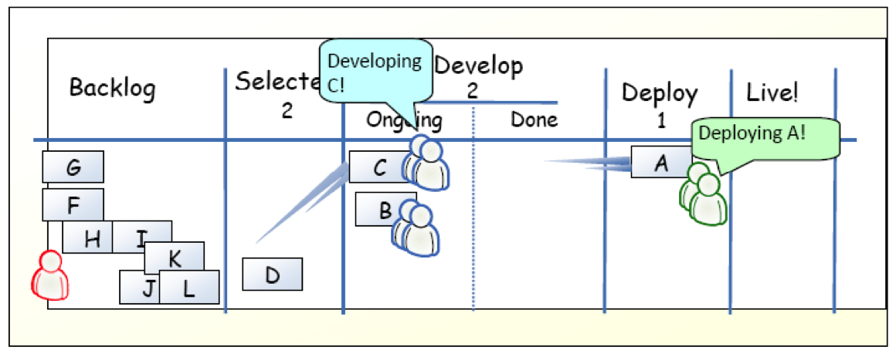
Example
[KS2009]

Slide 24
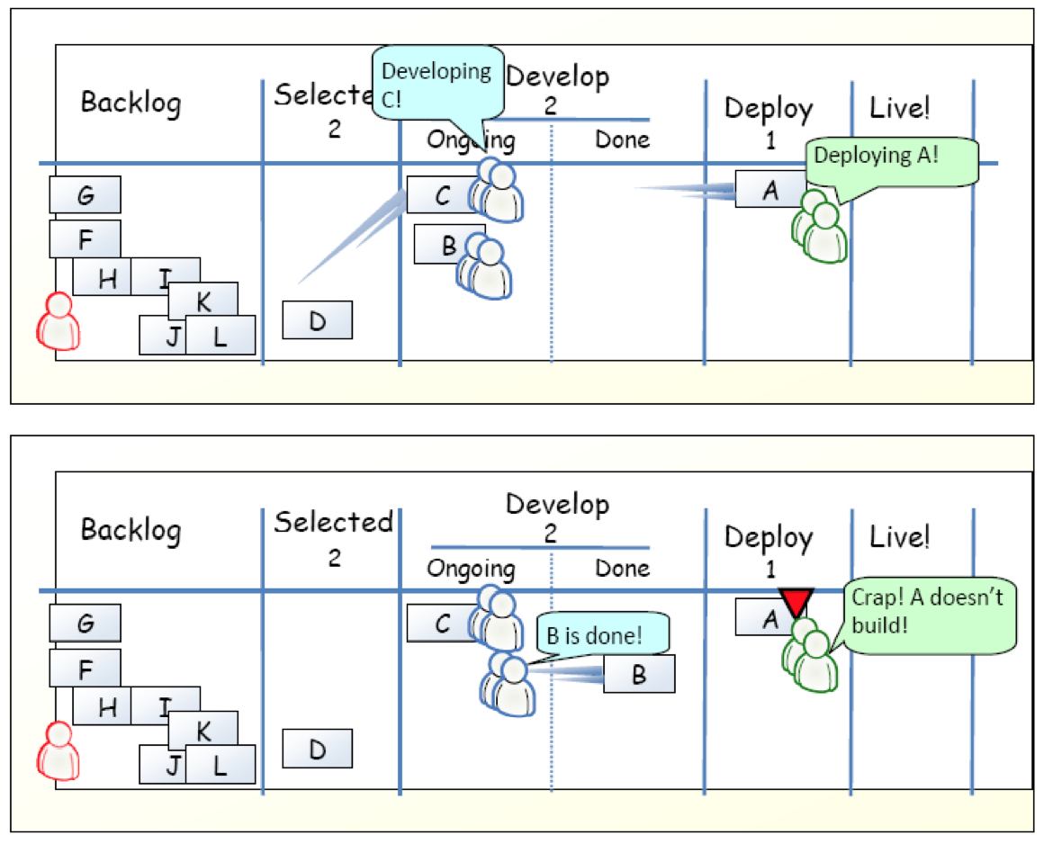
Example
[KS2009]

Slide 25
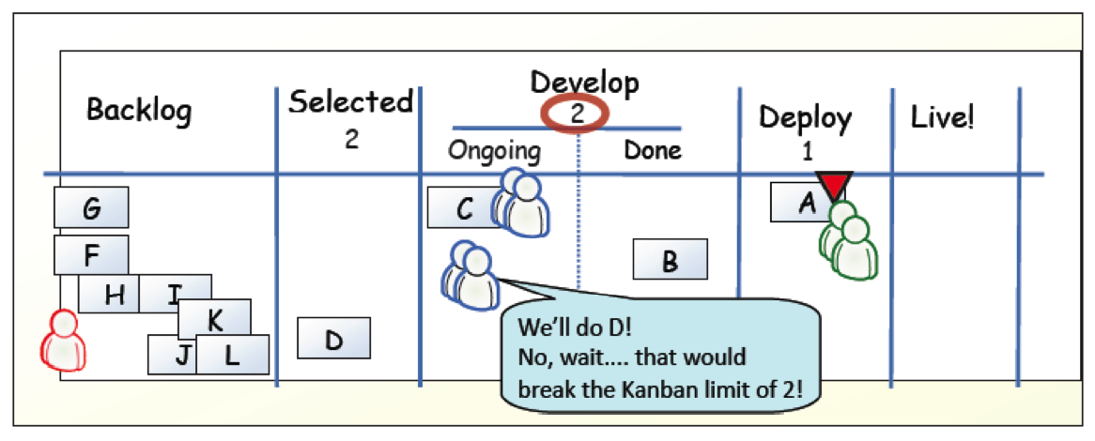
Example
[KS2009]

Slide 26
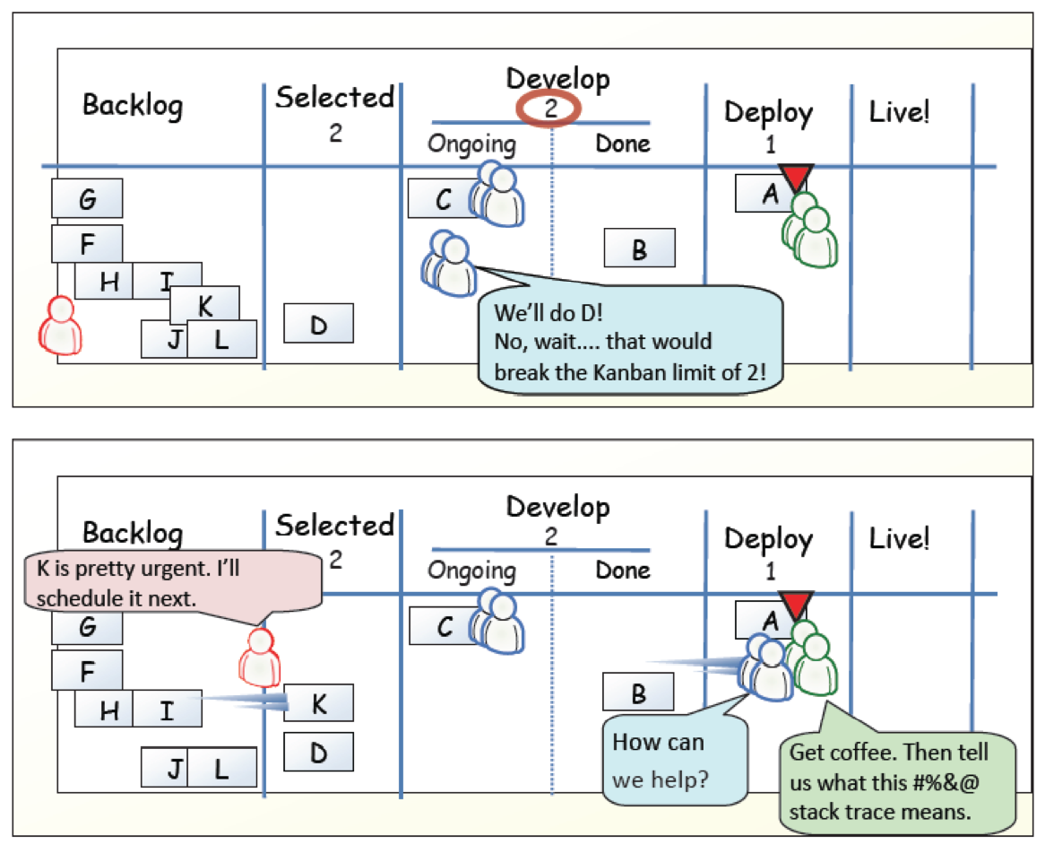
Example
[KS2009]

Slide 27
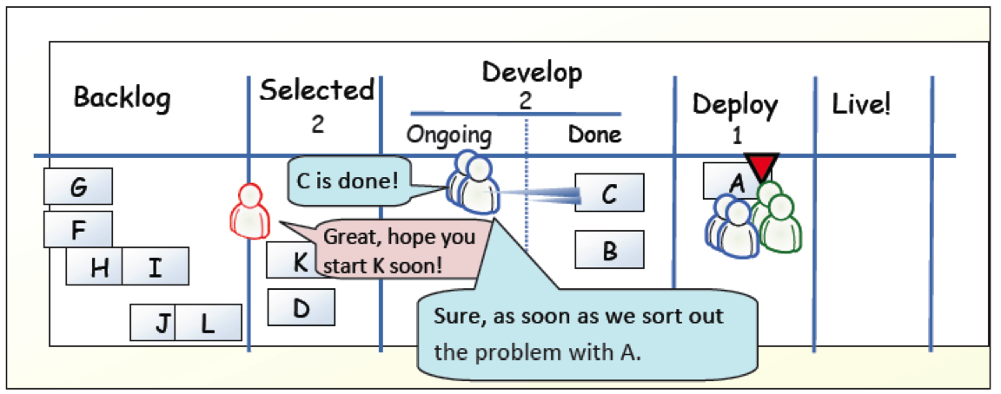
Example
[KS2009]

Slide 28
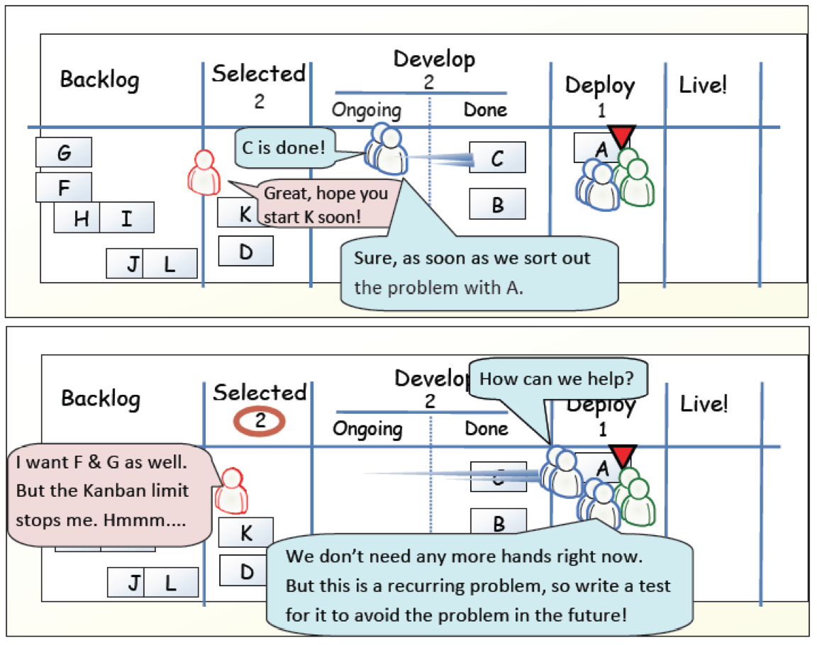
Example
[KS2009]

Slide 29
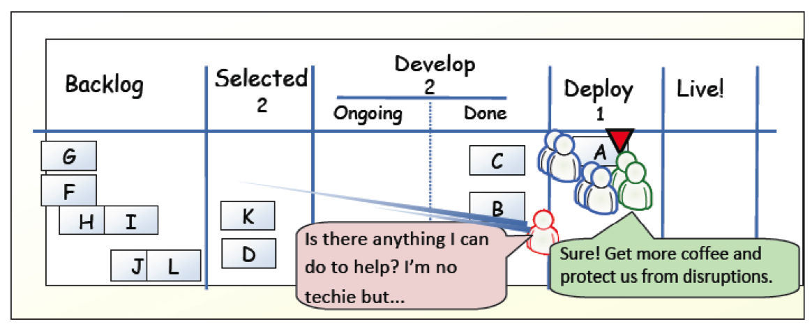
Example
[KS2009]

Slide 30
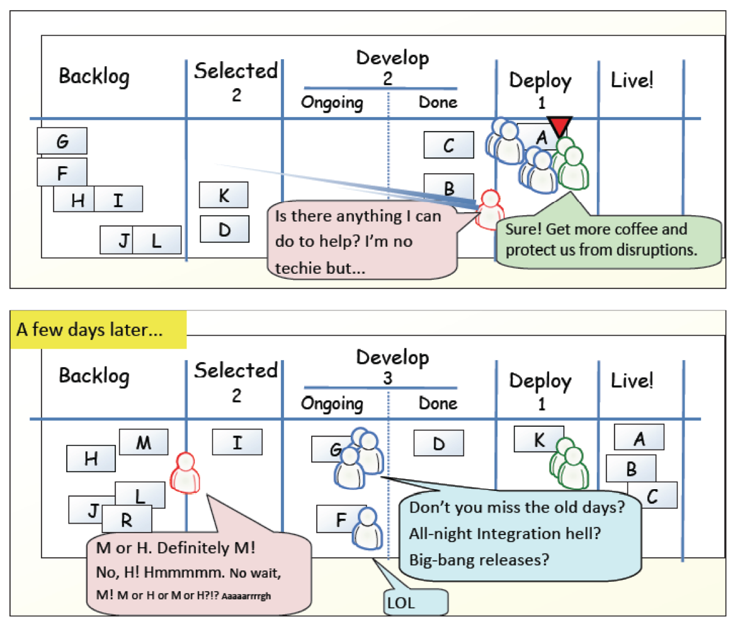
Example
[KS2009]

Slide 31
?
Compare Kanban with your favorite agile method.
What is similar?
What is different?
Is Kanban agile?

Slide 32
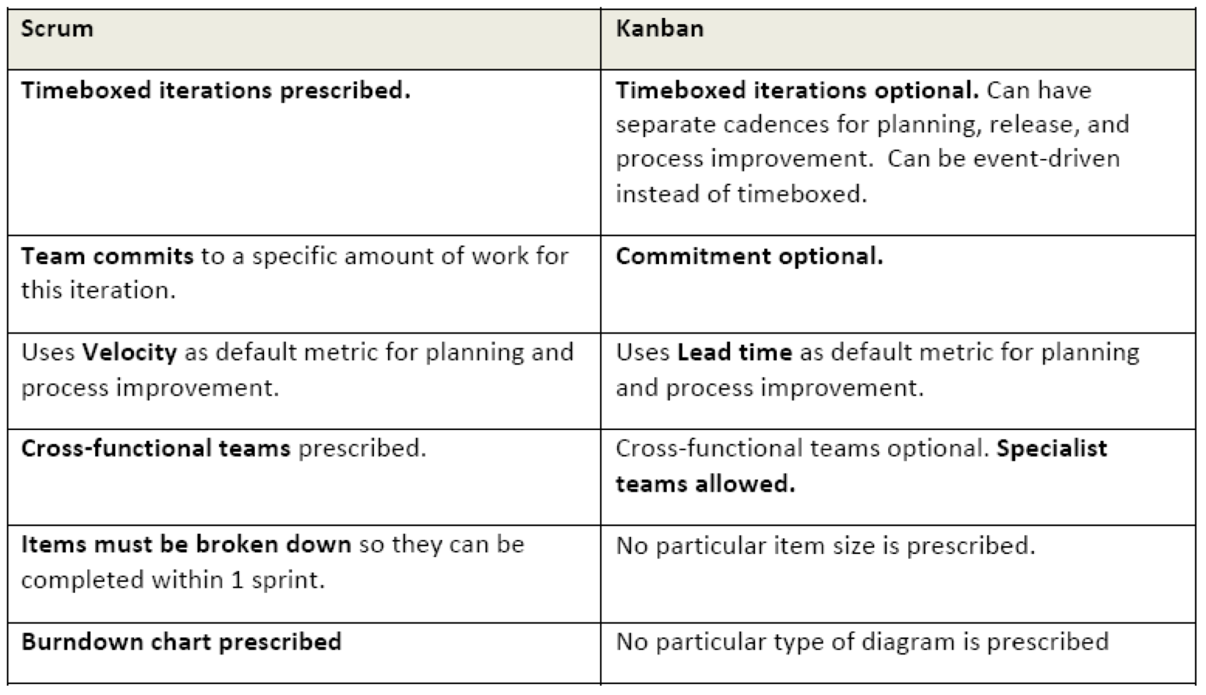
Scrum vs. Kanban
[KS2009]

Slide 33
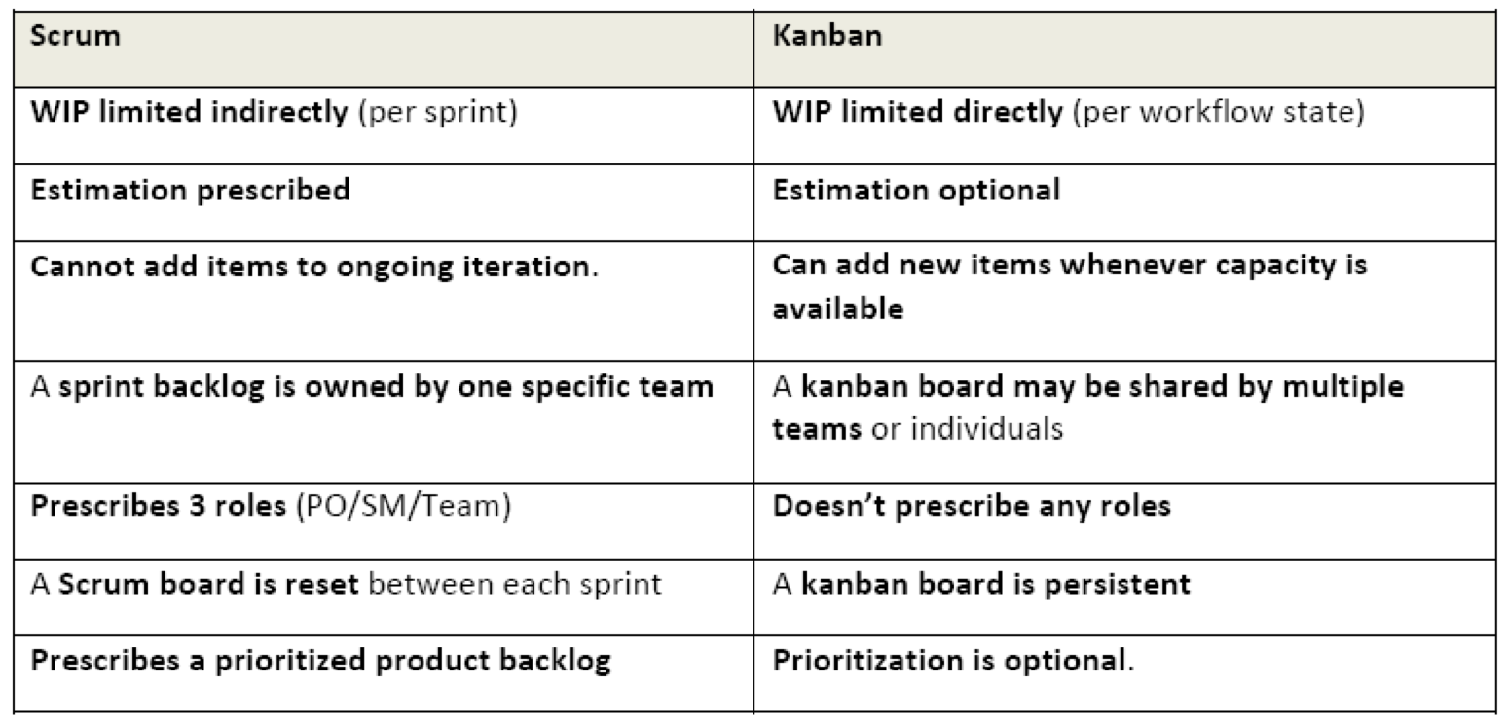
Scrum vs. Kanban
[KS2009]

Slide 34
Agile Principles
Early and continuous delivery of valuable software
Welcome changing requirements, even late
Deliver working software frequently
Business people and developers must work together
Build projects around motivated individuals
Face-to-face communication is most effective and efficient
Working software is the primary measure of progress
Sustainable development
Continuous attention to technical excellence and good design
Simplicity is essential
Self-organizing teams
Regular reflection
Task: For each of the principles, compare XP, Scrum, and Kanban and discuss differences
NOW: Pick two – the others might be a good exercise for exam and report.
Notes:
Task: For each of the principles, compare XP, Scrum, and Kanban and discuss differences
NOW: Pick two – the others might be a good exercise for exam and report.

Slide 35
References
[KS2009] Henrik Kniberg and Mattias Skarin: Kanban and Scrum – Making the Most of Both. InfoQ (2009) Available online:http://infoq.com/minibooks/kanban-scrum-minibook

