Slide 1
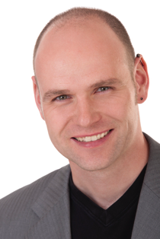


Agile Software Development (DIT191 / EDA397)
Spring 2017
Eric Knauss
eric.knauss@cse.gu.se
https://github.com/oerich/EDA397

Slide 2


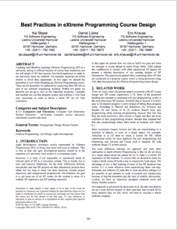
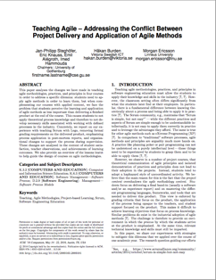
Course setup
Teaching Assistants
Terese Besker <besker@chalmers.se>
Magnus Ågren <magnus.agren@chalmers.se>
Course representatives
In parallel:
PhD course
Course Material
http://oerich.github.io/EDA397/
Meyer, B., (2014) Agile! The Good, the Hype and the Ugly
Papers

Slide 3
Course setup (Practical details)
Schedule
0-3 lectures per week
0-2 workshops per week
=3 scheduled activities per week
Even if there is no lecture, we will be available and you can (should!) use the rooms/time to work!
Examination
Project (teams)
Final product
Artifacts
Experience / Post-Mortem report
Written exam

Slide 4
Examination
Written exam, individual, 3.0 credits
60 points, 24 required to pass
Grades
Chalmers:
X < 24 → Fail,
24 ≤ X < 36 → 3,
36 ≤ X < 48 → 4,
48 ≤ X → 5
GU
X < 24 → Fail,
24 ≤ X < 48 → G,
48 ≤ X → VG
Project, 4.5 credits
Grades: Fail/Pass based on project participation and group report

Slide 5
Project
Develop software for a customer
Work in predetermined teams
https://github.com/oerich/EDA397/wiki/Groupings-of-Teams
You will be assigned teams
Focus on agile practices and methodology
You meet with the customer this Thursday
and get all the details!
We strive to create a realistic scenario/ environment
We rely on a number of real-world services and tools, e.g.
Android (SDK), GitHub, Trello, (perhaps Jenkins, Gerrit, SonarCube…)

Slide 6
Course setup
Three sprints
Sprint 1: Getting started
Sprint 2: Getting work done
Sprint 3: Theory and advanced concepts

Slide 7
Course Objectives
Knowledge and understanding | Skills and ability | Judgement and approach
Compare agile and traditional softw. dev, | Forming a team organically | Explain: people/commun. centric dev.
Relate lean and agile development | Collaborate in small software dev. teams | Apply fact: people drive project success
Contrast different agile methodologies | Interact and show progress continuously | Describe: No single methodology fits all
Use the agile manifest and its accompanying principles | Develop SW using small and frequent iterations | Discuss: methodology needs to adopt to culture
Discuss what is different when leading an agile team | Use test-driven dev. and automated tests
 | Refactor a program/design
 | Be member of agile team
 | Incremental planning using user stories
Sprint 3
Sprint 1
Sprint 2

Slide 8
Changes since last year
More choice in project part
Different course book
More hands-on, more critical
Updated slides (ongoing)
Updated reading list (ongoing)
Nothing will be added!
We will indicate which of the papers will not be on the exam
Much better timeline
First iteration done before Easter break!

Slide 9
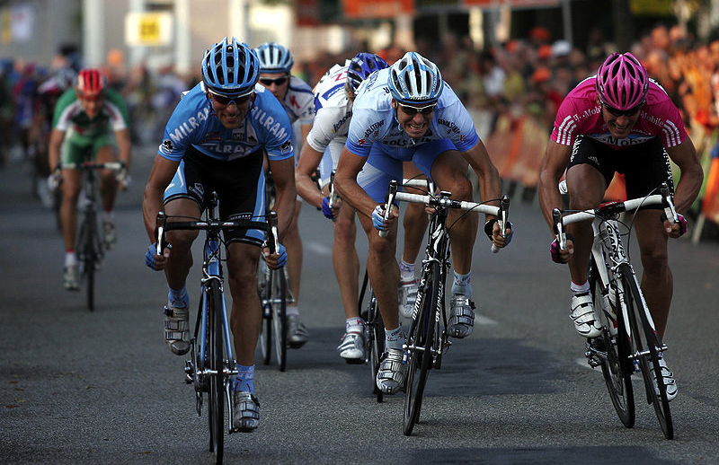
Sprint 1: Getting started
http://commons.wikimedia.org/wiki/File:Sprint_01.jpg

Slide 10

What is agility in Software Development?
Agile: An Overview
http://mediagallery.usatoday.com/New+Flame

Slide 11
Motivation
What is the “Software crisis”?
Software development inefficient
Software does not meet requirements
Projects over time/budget
Projects were unmanageable and software unmaintainable
What can be done about it?
Software Engineering
Application of engineering to Software
Systematic, disciplined, quantifiable approach to the development, operation, and maintenance of software
Assure quality of process and product

Slide 12
?
Do you know examples of
Systematic, disciplined, quantifiable approaches to the development, operation, and maintenance of software?
Applying engineering to software?

Slide 13

Where are we coming from?
Requirements
Design
Programming
Test
http://commons.wikimedia.org/wiki/File:Waterfall_katoomba.JPG

Slide 14
Systematic sequential development
Requirements
Design
Programming
Test
Advantages
Simple
Controllable
Cost efficient
Problems
Time-to-market
What about change?

Slide 15
Towards concurrent development
Requirements
Design
Programming
Test
What can we do if time to market and robustness against late changes are more important than cost-efficiency?
Requirements
Design
Programming
Test
Time-to-market
Time-to-market

Slide 16
?
What is the consequence of concurrent development?
(hint: why are concurrent tasks depicted longer than sequential tasks?)
What has this to do with agile?
What do you know about agile?

Slide 17
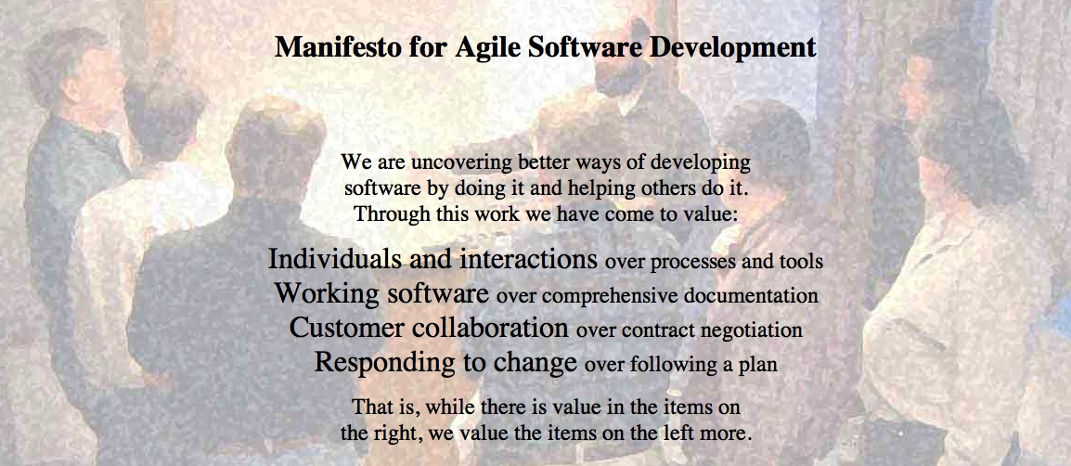
Agile Manifesto
http://agilemanifesto.org
Began as a provocation: Plan-driven development did not safe the Software world…
Now a very serious movement, well adapted in industry.
There are a couple of established agile methods: How to integrate these values in everyday software development

Slide 18
What is agile? What is not?
Agile – a compendium of ideas
Applied by number of methods (incl. XP, Scrum, Kanban, Lean Software Development)
Core characteristics defined through
Values: General assumptions framing the agile view of the world
Principles: Core agile rules, organizational and technical
Roles: responsibilities and privileges of the various actors in an agile process
Practices: specific activities practiced by agile teams
Artifacts: tools, both virtual and material, that support the practices
[Mey2014]

Slide 19
Agile Values
Redefined roles for developers, managers, and customers
No ”Big Upfront” steps
Iterative development
Limited, negotiated functionality
Focus on quality, understood as achieved through testing
[Mey2014]

Slide 20
Can the following projects be agile?
App development
Online shop
Mission controller for Airplane
Controller for nuclear plant
What is a “principle”?
Abstract
Falsifiable
Prescriptive
Discuss the following agile principles.
Do they help to define what is agile and what not?
Any problems in the list?
?

Slide 21
Agile Principles
# | Agile Principle | Comment
1 | Our highest priority is to satisfy the customer through early and continuous delivery of valuable software.
2 | Welcome changing requirements, even late in development. Agile processes harness change for the customer's competitive advantage.
3 | Deliver working software frequently, from a couple of weeks to a couple of months, with a preference to the shorter timescale.
4 | Business people and developers must work together daily throughout the project.
5 | Build projects around motivated individuals. Give them the environment and support they need, and trust them to get the job done.
6 | The most efficient and effective method of conveying information to and within a development team is face-to-face conversation.
7 | Working software is the primary measure of progress.
8 | Agile processes promote sustainable development. The sponsors, developers, and users should be able to maintain a constant pace indefinitely.
9 | Continuous attention to technical excellence and good design enhances agility.
10 | Simplicity--the art of maximizing the amount of work not done--is essential.
11 | The best architectures, requirements, and designs emerge from self-organizing teams.
12 | At regular intervals, the team reflects on how to become more effective, then tunes and adjusts its behavior accordingly.
[Mey2014]

Slide 22
Agile Principles
# | Agile Principle | Comment
1 | Our highest priority is to satisfy the customer through early and continuous delivery of valuable software.
2 | Welcome changing requirements, even late in development. Agile processes harness change for the customer's competitive advantage.
3 | Deliver working software frequently, from a couple of weeks to a couple of months, with a preference to the shorter timescale.
4 | Business people and developers must work together daily throughout the project.
5 | Build projects around motivated individuals. Give them the environment and support they need, and trust them to get the job done.
6 | The most efficient and effective method of conveying information to and within a development team is face-to-face conversation. | Practice
7 | Working software is the primary measure of progress.
8 | Agile processes promote sustainable development. The sponsors, developers, and users should be able to maintain a constant pace indefinitely.
9 | Continuous attention to technical excellence and good design enhances agility.
10 | Simplicity--the art of maximizing the amount of work not done--is essential.
11 | The best architectures, requirements, and designs emerge from self-organizing teams.
12 | At regular intervals, the team reflects on how to become more effective, then tunes and adjusts its behavior accordingly. | Practice
[Mey2014]

Slide 23
Agile Principles
# | Agile Principle | Comment
1 | Our highest priority is to satisfy the customer through early and continuous delivery of valuable software.
2 | Welcome changing requirements, even late in development. Agile processes harness change for the customer's competitive advantage.
3 | Deliver working software frequently, from a couple of weeks to a couple of months, with a preference to the shorter timescale.
4 | Business people and developers must work together daily throughout the project.
5 | Build projects around motivated individuals. Give them the environment and support they need, and trust them to get the job done. | Platitude
6 | The most efficient and effective method of conveying information to and within a development team is face-to-face conversation. | Practice
7 | Working software is the primary measure of progress.
8 | Agile processes promote sustainable development. The sponsors, developers, and users should be able to maintain a constant pace indefinitely.
9 | Continuous attention to technical excellence and good design enhances agility. | Platitude
10 | Simplicity--the art of maximizing the amount of work not done--is essential.
11 | The best architectures, requirements, and designs emerge from self-organizing teams.
12 | At regular intervals, the team reflects on how to become more effective, then tunes and adjusts its behavior accordingly. | Practice
[Mey2014]

Slide 24
Agile Principles
# | Agile Principle | Comment
1 | Our highest priority is to satisfy the customer through early and continuous delivery of valuable software.
2 | Welcome changing requirements, even late in development. Agile processes harness change for the customer's competitive advantage.
3 | Deliver working software frequently, from a couple of weeks to a couple of months, with a preference to the shorter timescale.
4 | Business people and developers must work together daily throughout the project.
5 | Build projects around motivated individuals. Give them the environment and support they need, and trust them to get the job done. | Platitude
6 | The most efficient and effective method of conveying information to and within a development team is face-to-face conversation. | Practice
7 | Working software is the primary measure of progress. | Assertion
8 | Agile processes promote sustainable development. The sponsors, developers, and users should be able to maintain a constant pace indefinitely.
9 | Continuous attention to technical excellence and good design enhances agility. | Platitude
10 | Simplicity--the art of maximizing the amount of work not done--is essential. | Assertion
11 | The best architectures, requirements, and designs emerge from self-organizing teams.
12 | At regular intervals, the team reflects on how to become more effective, then tunes and adjusts its behavior accordingly. | Practice
“Use working software as the primary measure of progress.”
“Seeking simplicity” = ok; “Maximizing work not done” = ok; but two principles
[Mey2014]

Slide 25
Agile Principles
# | Agile Principle | Comment
1 | Our highest priority is to satisfy the customer through early and continuous delivery of valuable software. | Duplicate (3)
2 | Welcome changing requirements, even late in development. Agile processes harness change for the customer's competitive advantage.
3 | Deliver working software frequently, from a couple of weeks to a couple of months, with a preference to the shorter timescale. | Duplicate (3,7)
4 | Business people and developers must work together daily throughout the project.
5 | Build projects around motivated individuals. Give them the environment and support they need, and trust them to get the job done. | Platitude
6 | The most efficient and effective method of conveying information to and within a development team is face-to-face conversation. | Practice
7 | Working software is the primary measure of progress. | Assertion Dupl. (3)
8 | Agile processes promote sustainable development. The sponsors, developers, and users should be able to maintain a constant pace indefinitely.
9 | Continuous attention to technical excellence and good design enhances agility. | Platitude
10 | Simplicity--the art of maximizing the amount of work not done--is essential. | Assertion
11 | The best architectures, requirements, and designs emerge from self-organizing teams.
12 | At regular intervals, the team reflects on how to become more effective, then tunes and adjusts its behavior accordingly. | Practice
“Use working software as the primary measure of progress.”
“Seeking simplicity” = ok; “Maximizing work not done” = ok; but two principles
Missing: Testing
[Mey2014]

Slide 26
Agile Principles – Revised list (according to [Mey2014])
Organizational
Put the customer at the center.
Let the team self-organize.
Work at a sustainable pace.
Develop minimal software:
Produce minimal functionality.
Produce only the product requested.
Develop only code and tests.
Accept Change
Technical
Develop iteratively:
Produce frequent working iterations.
Freeze requirements during iterations.
Treat tests as a key resource:
Do not start any new development until all tests pass.
Test first.
Express requirements through scenarios.

Slide 27
Agile Roles
Role | Description
Manager | A supporting role (“A guru, not a nanny!”)
Product Owner | Define and maintain the product backlog: The list of features. Before dev.: Explain them. After dev.: Accept/reject them
Team | Takes over manager responsibilities (incl: deciding what tasks to implement)
Self-organized | Optimize intense collaborations within and across organizational boundaries to meet challenges as they arise.
Cross-functional | Team includes all necessary skills to deliver a feature, independently of other teams.
Members vs. Observers | Members should dominate discussions, observers should offer opinions when asked (c.f. Chicken and Pigs)
Customer | Central. Constant interaction prescribed in XP, replaced through indirection (Product Owner) in Scrum.
Coach, Scrum-Master | Help sticking to agile values, principles, practices. Main question: dedicated role or not.
[Mey2014]

Slide 28

One Agile Method: Extreme Programming
Resonates well with our course
Focus on developer
1st and 2nd Edition differ quite significantly
We stick to the first
Today:
Most important practices for this week
Homework:
Pick two of the practices, read up on them, prepare to explain them in 1-2min

Slide 29
Agile Methods: eXtreme Programming (XP)
Extreme programming:
An approach based on the development and delivery of very small increments of functionality
No fine grained process description, but 12 practices arranged around short development circles (4-6 weeks)
“Turn-to-ten” metaphor (refers to volume setting of older amplifiers):
Reviewing is good? → Review continuously: Pair Programming
Early Tests are good? → Write tests before code: Test-First
Customer interaction is good? → Have Onsite-Customer
…

Slide 30
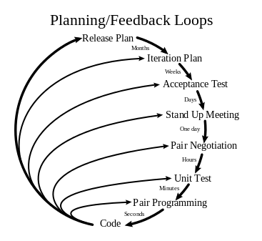
XP:
http://en.wikipedia.org/wiki/File:Extreme_Programming.svg

Slide 31
XP Practices
Feedback
Pair Programming
Continuous process
Onsite-Customer
Small releases
Test-first
Continuous integration
Planning game
Refactoring
Shared understanding
Programmer welfare
Coding standards
Sustainable pace
Collective Code Ownership
System metaphor
Simple design

Slide 32
Agile Principles and Practices
Goal: Try them out in your project!
 | Mandatory | Optional | Comment
Planning Game | 1 | 0 | Make the most out of it. Get Emil's Priorities based on your effort estimation. Employ customer proxy
Small Releases | 1 | 0
Metaphor | 0 | 1 | Try it out! But we will not check whether it works.
Simple Design | 1 | 0
Test-First | 1 | 0 | But only where it makes sense. Have a good rationale!
Refactoring | 1 | 0
Pair Programming | 0,5 | 0,5 | Try it out. Don't necessarily do it all the time.
Collective Codeownership | 2 | 0 | Everybody should know about the code. Some parts more than others
Continuous Integration | 1 | 0
Sustainable Pace | 1 | 0 | But also not too slow!
Onsite Customer | 0,5 | 0,5 | Have a customer proxy
Coding standards | 1 | 0 | Decide on them and try to have tool support

Slide 33
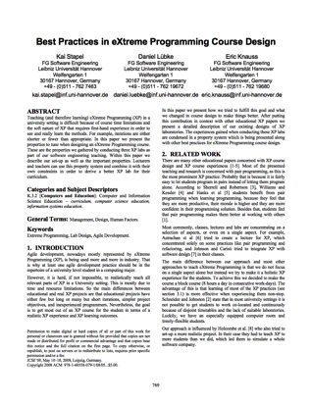
On-Site Customer
Real customer in the room
Answers all questions now (…and can revise answer later)
Customer proxy
Answer now more important than answer correct
“Students have to interact with a designated On-Site Customer who is available full-time to answer questions.”
(+) Block course, customer interest

Slide 34
Planning Game
Business people need to decide
Scope, Priority, Composition of release, dates of release
Technical people need to decide
Estimates, Consequences, Process, Detailed scheduling
[Bec1999]
“Students learn how to divide requirements into User Stories and how to prioritize and estimate the costs of these stories. While such tasks seem to be easy in theory, dealing with dependencies in the planning game is normally a challenge for inexperienced developers like students.”
(+) More iterations, small teams, customer interested, technical support, progress feedback
(-) Longer iterations
[SLK2008]

Slide 35
Continuous Integration
Integrate and test code every few hours (1 day at the most)
Dedicated machine helps
If Machine is free: pair sits down, integrates their changes, tests, and does not leave before 100% of tests run
“To counter conflicting updates to the code base, students learn to integrate and build the software frequently. ”
(+) Block course, longer iterations, more iterations, small team size
(discovered later: technical feedback)

Slide 36
Simple Design
The right design at any given time
Runs all the tests
Has no duplicated logic
States every intention important to the programmers
Has the fewest possible classes and methods
“Students learn the benefits of simple software design which improves their ability to change the system quickly and accommodate it to changing requirements.”
(+) More iterations, technical support

Slide 37
Small releases
Every release
… should be as small as possible
… should contain the most valuable business requirements
… has to make sense as a whole
… should be delivered every 4-8 weeks (rather than 6-12 month)
“Students learn the benefits of small releases that already offer value to the customer and how to technically put a system into production including packaging.”
(+) More iterations, progress feedback

Slide 38
Metaphor
Examples
Naïve: “Contract management system deals with contracts, customers, and endorsements”
“Computer should appear as a desktop”
“Pension calculation is a spreadsheet”
Align team thinking
“Students learn how to develop a metaphor that helps every team member to better understand how the whole system works.”
(+) Technical support, technical feedback

Slide 39
Testing
Any feature without automated test does not exist
Don’t write a test for every method
Write a test for every productive method that could possibly break
“Program becomes more and more confident over time”
“Students learn how to use unit test frameworks and the test-first approach to build high quality software and to recognize the advantages of well-tested code when making changes.”
(+) More iterations, technical support, technical feedback

Slide 40
Refactoring
Is there a way of changing the program to make it easier to add a new feature?
After adding the feature: Can we simplify the design?
Important investment!!!
“Students learn to refactor the software to remove duplication, improve communication and simplify the code base. Especially refactoring large systems can be troublesome and is a worthy experience that can only be made in long lasting projects.”
(+) More iterations, customer interest, technical support

Slide 41
Pair Programming
Driver: Has the keyboard, writes the code
Navigator: Thinking strategically
Will this work? Which test cases might not work? Can we simplify?
“Students learn and experience the principles of pair programming, the advantages of writing software with a partner and the social challenges that are associated.”
(+) Block course, small team size, technical support
(-) Long iterations

Slide 42
Collective Code Ownership
“Anybody who sees an opportunity to add value to any portion of the code is required to do so at any time.”
No code ownership → Chaos
Individual code ownership → Stable but slow
“Students get to know the advantages of collective code ownership and the challenges that arise with parallel updates and changes to their own code by other team members. ”
(+) Block course, small team size

Slide 43
Sustainable pace (aka 40h week)
Be fresh every morning, tired every night
One week of overtime must not be followed by another one
“In contrast to normal life in university, students experience to work continuously for 40-hours per week in a designated team room.”
(+) Block course

Slide 44
Coding Standards
Swapping partners, changing concurrently all parts of the code…
Your code should better look consistently!
Once and only once rule
Emphasize communication
Adopted by whole team
“Students experience the importance of uniform coding conventions throughout the team especially when combined with collective code ownership. ”

Slide 45
References
[Bec1999]
Kent Beck, Extreme Programming Explained, Addison-Wesley, 2ed, 2000
[SLK2008]
Kai Stapel, Daniel Lübke, Eric Knauss: Best Practices in eXtreme Programming Course Design. In: Proceedings of the 30th International Conference on Software Engineering (ICSE '08), Leibzig, Germany, pg. 769-776, 2008

