Slide 1
Agile Principles / Miniature (DIT191 / EDA397)
Eric Knauss
<eric.knauss@cse.gu.se>
Notes:
Thinks to remember:
- Use of cameras in round 3 seems to be unfair.
- The task scales nicely, but with too many students there is not enough space behind the screen.
- I think it was a good point to honor early submissions in round three and make a remark on the importance of quick time-to-market

Slide 2
Organizational
Thursday
Customer meeting
Exam date
Jun-2nd, 2pm

Slide 3
Agile workshop – Acceptance Test No 1. Apr-14 13:15-17:00
Welcome to the first Acceptance Test for the Android App project.
Each group will have 30 minutes to show current status and features of their project and also to discuss the use of an Agile development approach.
Please note the time restriction of 30 minutes, meaning “Be on time!”
The group will meet their group supervisor (Terese or Magnus) in a booked room.
Each group should bring a laptop where the App should be demonstrated and the development environment (i.e. Trello, Github) should also be accessible.

Slide 4
Acceptance Test - Schedule Group 1-5
Room: Aquarium, 4th Floor in house Jupiter (Close to evaluator)
Supervisor: Terese Besker
Time (30 min/each) | Group | Spokesperson
13.15 – 13.45 | 1 | Pedram Shirinbolaghi
13.45 – 14.15 | 2 | Dominik Muth
14.15– 14.45 | 3 | Sebastian Blomberg
14.45 – 15.15 | 4 | Sofia Edström
15.15 – 15.45 | 5 | Wissam Alfreijat

Slide 5
Acceptance Test - Schedule Group 6-9
Room: Room 322, 3th Floor in house Jupiter
Supervisor: Magnus Ågren
Time (30 min/each) | Group | Spokesperson
13.15 – 13.45 | 6 | Fredrik Holmdahl
13.45 – 14.15 | 7 | Johan Eriksson
14.15– 14.45 | 8 | Mustafa Hussein
14.45 – 15.15 | 9 | Linus Hagvall

Slide 6
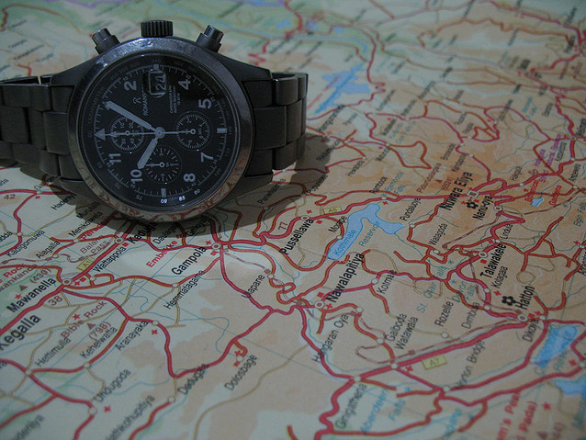
Agenda today
Course overview
Miniature
Agile Principles revisited

Slide 7
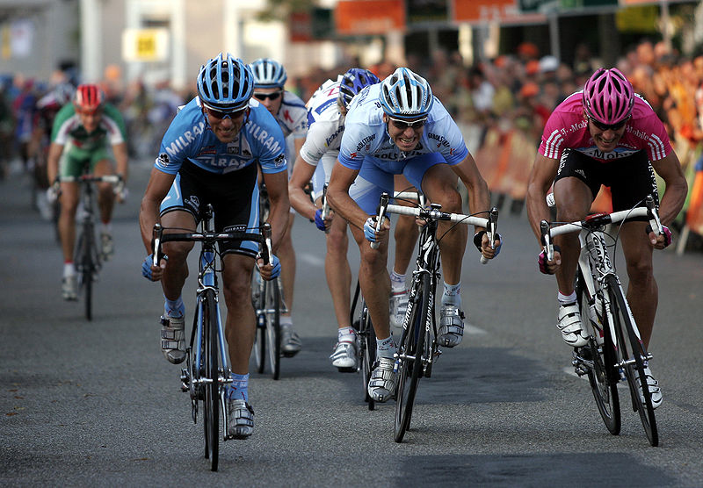
Sprint 1: Getting started
http://commons.wikimedia.org/wiki/File:Sprint_01.jpg

Slide 8
My idea of this course…
2 Streams
Lectures – Learn Agile
Project work – Experience Agile
3 Sprints
First sprint – Getting started
Second sprint – Focus on Project work
Third sprint – Advanced Concepts

Slide 9
Course Objectives
Knowledge and understanding | Skills and ability | Judgement and approach
Compare agile and traditional softw. dev, | Forming a team organically | Explain: people/commun. centric dev.
Relate lean and agile development | Collaborate in small software dev. teams | Apply fact: people drive project success
Contrast different agile methodologies | Interact and show progress continuously | Describe: No single methodology fits all
Use the agile manifest and its accompanying principles | Develop SW using small and frequent iterations | Discuss: methodology needs to adopt to culture
Discuss what is different when leading an agile team | Use test-driven dev. and automated tests
 | Refactor a program/design
 | Be member of agile team
 | Incremental planning using user stories
Sprint 3
Sprint 1
Sprint 2

Slide 10
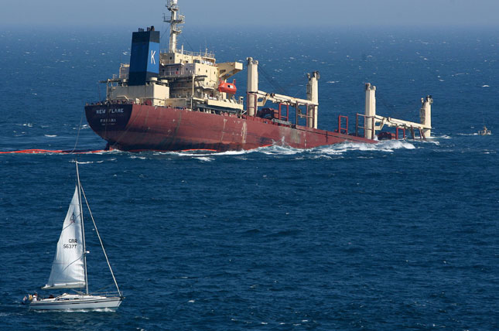
What is agility in Software Development?
Agile Development: A Miniature
http://mediagallery.usatoday.com/New+Flame

Slide 11
Miniatures
Good to get started in the project
Shared ideas / concepts
http://c2.com/xp/ExtremeHour.html
http://www.massey.ac.nz/~dpparson/agilehour.htm
Idea: Simulate an agile project within a limited time
Agile / Extreme Hour do not scale
Lego-Scrum does not scale
Thus, falling back to a simulation first presented by Chris Rupp, Sophist

Slide 12
Round 1
Create teams of 4 to 6 persons
Assign roles in each team: same number of customers and developers
Customers and developers sit as far apart as possible
Customers write instructions for developers
One of the customers
brings written instructions to developers
can answer (written) questions with (written) answers
Talking and drawings between customers and developers are not permitted
Time for this round: 5 minutes

Slide 13
Retrospective of Applied Strategy
What did work well?
What should we change?
…
Time management
Task management
Incremental work
Iterative work
Define/control language
Use coordinate-system
Specify from abstract descriptions to specifics
Communicate “big picture”
Use metaphors
What did not work well?
Not enough time/suddenly over
Customers wrote too long → no time for developers
Communication not fast enough
Descriptions confusing, full of contradictions

Slide 14
Round 2
Same rules as in Round 1, except …
Shorter Iterations:
Developers can send Shape/Picture back
Customers can write change request for a Shape or continue with next Shape
Time for this round: 5 minutes

Slide 15
Retrospective of Applied Strategy
What did work well?
What should we change?
Task management (increments)
Iterations
Metaphors
Common language
Time management
Introduce Integration Management
More and faster feedback
What did not work well?
Integration of Increments and Iterations to whole picture
Ambiguity of metaphors

Slide 16
Round 3
Only one customer per team! All others are developers
Customer is allowed to see drawing and memorize it
Customers explains the drawing using words only
No hands!
Time for this round: 5 minutes

Slide 17
Retrospective of Applied Strategy
What did work well?
What should we change?
Task management
Direct feedback of customer
Verbal communication
What did not work well?
Integration is challenging
Customer cannot keep all developers busy
Strategy not applicable
Common language not applicable

Slide 18


Conclusion
What did we learn?
Spatial distance hinders communication
Multimodal communication helps
Communication has limitations
Feedback is important: On Product and on Process level
Process Improvement is crucial
Feedback minimizes Ambiguities
Interrupting and Reflecting on the process helps to improve it!

Slide 19
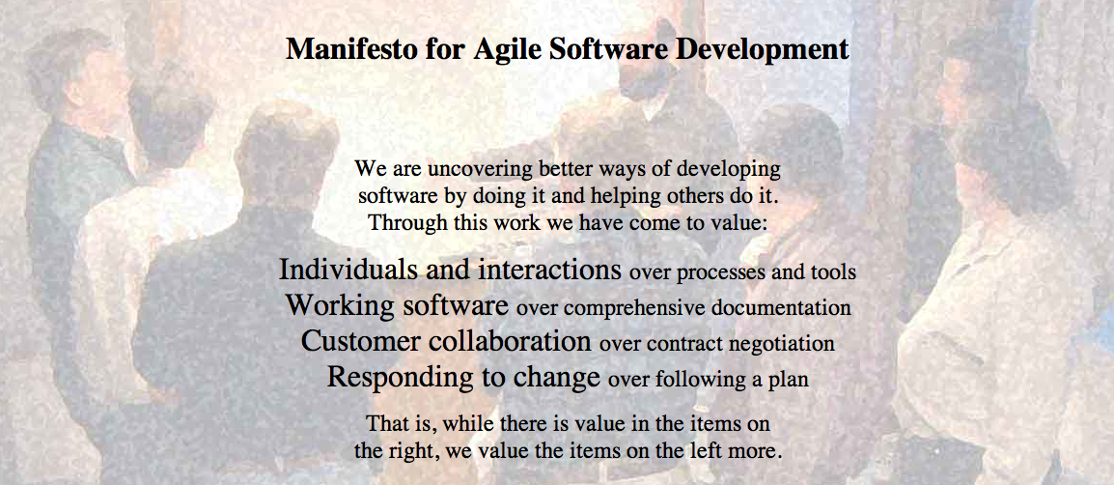
Agile Manifesto
http://agilemanifesto.org
Began as a provocation: Plan-driven development did not safe the Software world…
Now a very serious movement, well adapted in industry.
There are a couple of established agile methods: How to integrate these values in everyday software development

Slide 20
Agile Principles
Early and continuous delivery of valuable software
Welcome changing requirements, even late
Deliver working software frequently
Business people and developers must work together
Build projects around motivated individuals
Face-to-face communication is most effective and efficient
Working software is the primary measure of progress
Sustainable development
Continuous attention to technical excellence and good design
Simplicity is essential
Self-organizing teams
Regular reflection
Notes:
Take two minutes to discuss with your neighbour: Which are easy, which are hard to follow in your project?

