Slide 2
Fig. 1: Nonaka and Takeuchi
to
tacit
explicit
Socialization
Sympathized knowledge
Externalization
Conceptual knowledge
tacit
from
Internalization
Operational knowledge
Combination
Systemic knowledge
explicit

Slide 3
Fig. 1: From Propositions to Framework
Business drivers
Long-term
System quality
Main Conversion: Externalization
Key question | What quality levels guarantee competitive edge?
Source | Analyze existing artifacts
Target | Explicit documentation
Main Conversion: Combination
Key question | Does the system has sufficient quality?
Source | Existing engineering artifacts
Target | Explicit documentation
Competitive quality goals
Tracing
Customer / User Value
System knowledge
Main Conversion: Socialization
Key question | Which task should be done next?
Source | User data, Onsite-customer, prototype
Target | Spread Face-to-face in team
Main Conversion: Internalization
Key question | How to fulfill user requirement in this system?
Source | Existing engineering artifacts
Target | Operational knowledge of teams
Opportunity analysis
Change Impact analysis
Stakeholder need
Stakeholder wish
Tech. constraint
Just-in-time

Slide 4
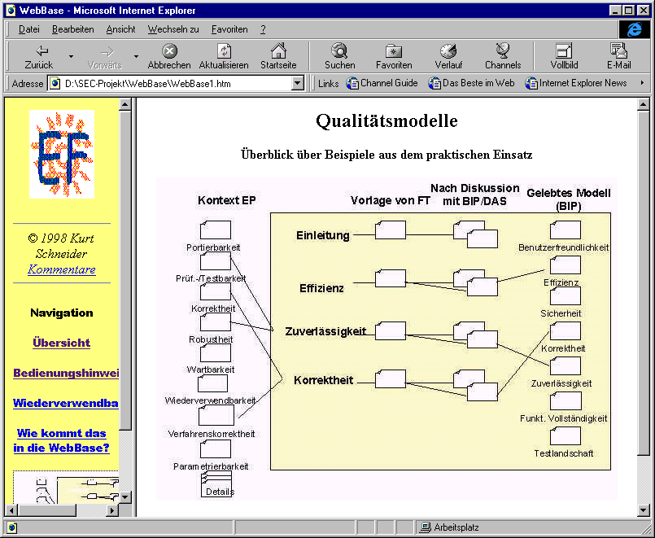
Collect
Activate
Experience
Engineering
Active
Dissemination
Fig. nnnUnten: Life-cycle of experiences, iterating around experience base

Slide 5
Activate implicit and explicit knowl.
Apply engineered knowledge (combination)
Disseminate and internalize new knowledge
Iteration and learning
(improve frames)
Requirements
Knowl.
Customer
SecVolution
semi-automated
application of
frames to detect suspicious patterns
Short list of
suspicious
requirements
Attack
knowledge
Attacker
Long list of
Reqs.
Security Expert
Developer
Specification (natural lang.)
Fig. nnnOben: Three essential activities in managing knowledge on software quality attributes

