Slide 1

GIT
2018. Február
Notes:
This is the June 2016 version of Aegon’s corporate template and standard corporate presentation.
This version reflects the updated strategy, the plans going forward for the company as presented during the Analyst & Investor Conference in London in January 2016, the full year 2015 and Q1 2016 results, and updates from the 2016 Review.
This slide deck provides an introduction to Aegon worldwide, its strategy, international presence, and focus on life insurance, pensions and asset management.
In the appendix you will find some additional slides with factual information. The appendix is followed by a Guide with guidelines for the use of this template and of the colors and photo’s included.

Slide 2
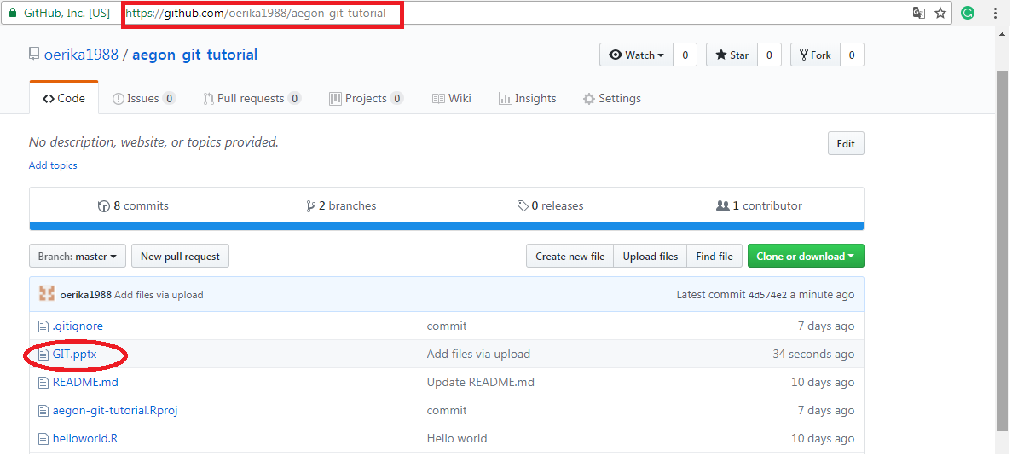
A ppt elérhető a GitHubon https://github.com/oerika1988/aegon-git-tutorial
Notes:
We have a clear purpose: helping people achieve a lifetime of financial security.
That’s our priority. To be there for our 30 million customers. And to be there for the growing number of people that place their trust in Aegon.
This purpose touches everything we do and it means that we are committed to building long-term relationships with our customers based on trust and transparency.
This means helping our customers to make those important decisions that will enable them to meet their obligations and ambitions at every stage of their life. This is our promise to our customers.
As all of us travel through life – through a first job, marriage, raising a family, retirement and old age – our needs change. As our needs change, so do the solutions we require of a company like Aegon.
Supporting these needs of our customers across their life is what all of the people in our company aim to achieve.

Slide 3
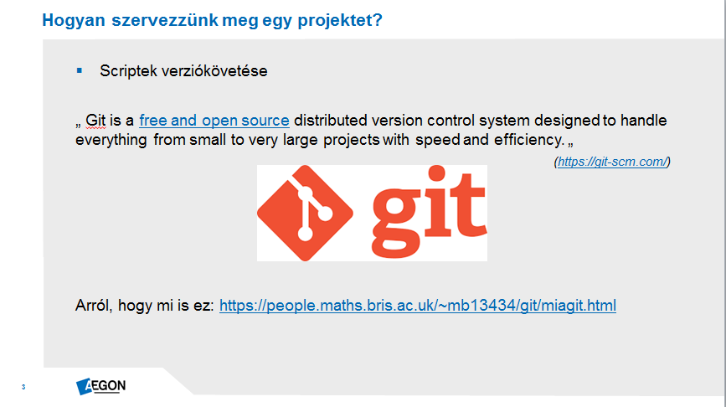

Mi is a git?
Józsi hollandiai beszámolójában már mesélt nekünk róla
R-Ladies előadás
Notes:
We have a clear purpose: helping people achieve a lifetime of financial security.
That’s our priority. To be there for our 30 million customers. And to be there for the growing number of people that place their trust in Aegon.
This purpose touches everything we do and it means that we are committed to building long-term relationships with our customers based on trust and transparency.
This means helping our customers to make those important decisions that will enable them to meet their obligations and ambitions at every stage of their life. This is our promise to our customers.
As all of us travel through life – through a first job, marriage, raising a family, retirement and old age – our needs change. As our needs change, so do the solutions we require of a company like Aegon.
Supporting these needs of our customers across their life is what all of the people in our company aim to achieve.

Slide 4
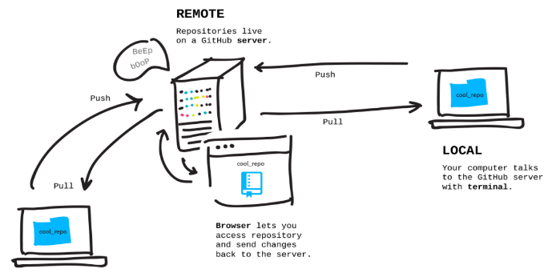
Mi is a git?
Linus Torvalds – Linux
Verziókezelő szoftver
Nyílt forráskódú
Git segítségével több ember egyszerre tud dolgozni ugyanazon a kódbázison, majd könnyedén tudják szinkronizálni a munkájukat
Git segítségével a saját munkádról készíthetsz biztonsági mentést
Bármelyik régi kódverzióra visszaállhatsz és dolgozhatsz a projekten
Notes:
We have a clear purpose: helping people achieve a lifetime of financial security.
That’s our priority. To be there for our 30 million customers. And to be there for the growing number of people that place their trust in Aegon.
This purpose touches everything we do and it means that we are committed to building long-term relationships with our customers based on trust and transparency.
This means helping our customers to make those important decisions that will enable them to meet their obligations and ambitions at every stage of their life. This is our promise to our customers.
As all of us travel through life – through a first job, marriage, raising a family, retirement and old age – our needs change. As our needs change, so do the solutions we require of a company like Aegon.
Supporting these needs of our customers across their life is what all of the people in our company aim to achieve.

Slide 5
Fontos kifejezések
Repository (repo) File‑ok, könyvtárak gyűjteménye, amit gittel verziózol. A repository tartalmazza a projekt minden valaha történt változtatását
Commit Mentési lépés. Ez a mentés csak lokálisan, a te gépeden fog létezni mindaddig, amig nem ”pusholod” a változtatást.
Push Szinkronizálja a commit‑jaidat a távoli, közös repository‑val. Egyszerre több commit is pusholható.
Pull Távoli repository‑ból az új változtatások másolása a lokális repoba.
Notes:
We have a clear purpose: helping people achieve a lifetime of financial security.
That’s our priority. To be there for our 30 million customers. And to be there for the growing number of people that place their trust in Aegon.
This purpose touches everything we do and it means that we are committed to building long-term relationships with our customers based on trust and transparency.
This means helping our customers to make those important decisions that will enable them to meet their obligations and ambitions at every stage of their life. This is our promise to our customers.
As all of us travel through life – through a first job, marriage, raising a family, retirement and old age – our needs change. As our needs change, so do the solutions we require of a company like Aegon.
Supporting these needs of our customers across their life is what all of the people in our company aim to achieve.

Slide 6
Fontos kifejezések
Clone: A távoli, közös repository‑t lemásolása a lokális gépedre (ha még nem volt ott előtte).
Branch: A git repo olyan, mint egy fa. A fő ága a master branch, de erről leágazhatnak egyéb branch‑ek. Ekkor a history‑juk közös, de az branch‑eken különböző, egymástől független változtatások megjelenhetnek. Használata: új feature fejlesztése
Merge: Két branch egyesítése, a commitok összefésülése. Például a te branch‑ed merge‑lése a master branch‑be.
Notes:
We have a clear purpose: helping people achieve a lifetime of financial security.
That’s our priority. To be there for our 30 million customers. And to be there for the growing number of people that place their trust in Aegon.
This purpose touches everything we do and it means that we are committed to building long-term relationships with our customers based on trust and transparency.
This means helping our customers to make those important decisions that will enable them to meet their obligations and ambitions at every stage of their life. This is our promise to our customers.
As all of us travel through life – through a first job, marriage, raising a family, retirement and old age – our needs change. As our needs change, so do the solutions we require of a company like Aegon.
Supporting these needs of our customers across their life is what all of the people in our company aim to achieve.

Slide 7
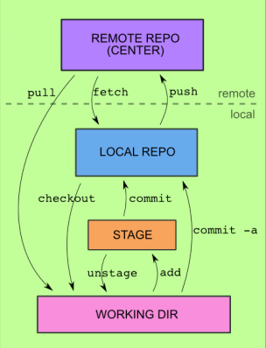
Fontos kifejezések
git push
git pull
git clone
git add
git commit
mkir – make directory
cd – change direktory
git status
Notes:
We have a clear purpose: helping people achieve a lifetime of financial security.
That’s our priority. To be there for our 30 million customers. And to be there for the growing number of people that place their trust in Aegon.
This purpose touches everything we do and it means that we are committed to building long-term relationships with our customers based on trust and transparency.
This means helping our customers to make those important decisions that will enable them to meet their obligations and ambitions at every stage of their life. This is our promise to our customers.
As all of us travel through life – through a first job, marriage, raising a family, retirement and old age – our needs change. As our needs change, so do the solutions we require of a company like Aegon.
Supporting these needs of our customers across their life is what all of the people in our company aim to achieve.

Slide 8

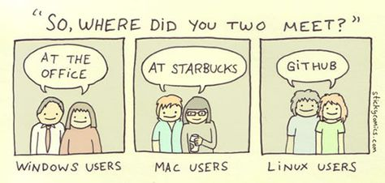
GitHub
A legnépszerűbb git repo hosztoló szolgáltatás. Kezelhetsz jogosultságokat, értesítéseket, sőt akár webfelületen is editálhatsz kódot.
GitHubon minden nyílt forráskódú projekt megtalálható, ami a világban képződött.
Olyan nagy projektekbe is bele lehet nézni, mint az Android kódja.
Az új LinkedIn / a kóderek Facebookja
Notes:
We have a clear purpose: helping people achieve a lifetime of financial security.
That’s our priority. To be there for our 30 million customers. And to be there for the growing number of people that place their trust in Aegon.
This purpose touches everything we do and it means that we are committed to building long-term relationships with our customers based on trust and transparency.
This means helping our customers to make those important decisions that will enable them to meet their obligations and ambitions at every stage of their life. This is our promise to our customers.
As all of us travel through life – through a first job, marriage, raising a family, retirement and old age – our needs change. As our needs change, so do the solutions we require of a company like Aegon.
Supporting these needs of our customers across their life is what all of the people in our company aim to achieve.

Slide 9
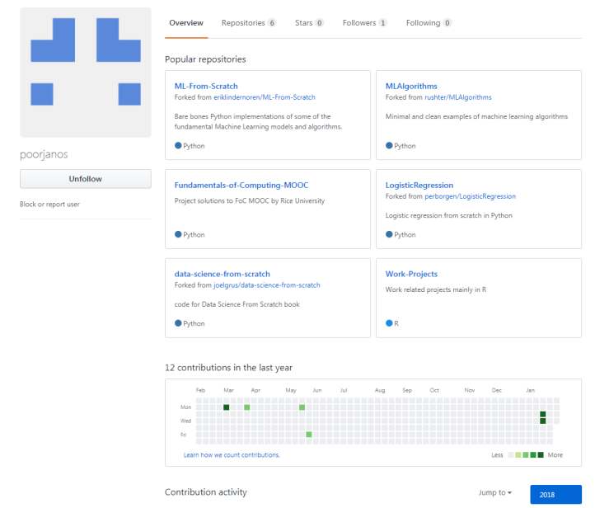
GitHub
Notes:
We have a clear purpose: helping people achieve a lifetime of financial security.
That’s our priority. To be there for our 30 million customers. And to be there for the growing number of people that place their trust in Aegon.
This purpose touches everything we do and it means that we are committed to building long-term relationships with our customers based on trust and transparency.
This means helping our customers to make those important decisions that will enable them to meet their obligations and ambitions at every stage of their life. This is our promise to our customers.
As all of us travel through life – through a first job, marriage, raising a family, retirement and old age – our needs change. As our needs change, so do the solutions we require of a company like Aegon.
Supporting these needs of our customers across their life is what all of the people in our company aim to achieve.

Slide 10
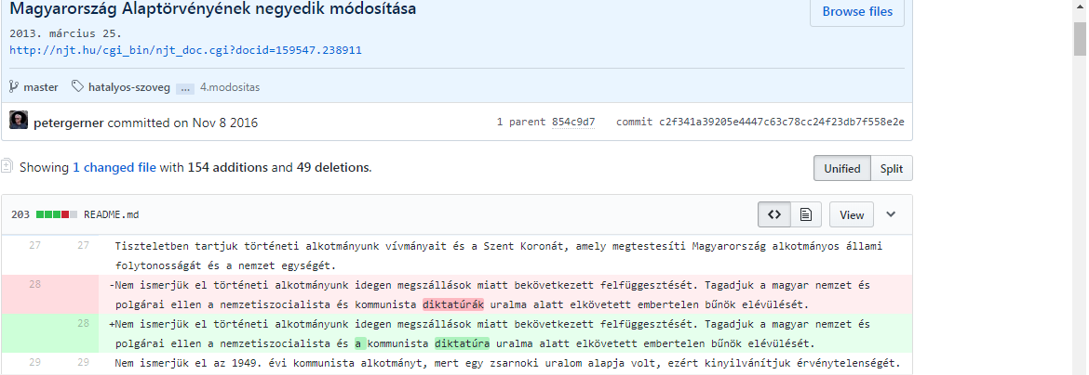
GitHub
Notes:
We have a clear purpose: helping people achieve a lifetime of financial security.
That’s our priority. To be there for our 30 million customers. And to be there for the growing number of people that place their trust in Aegon.
This purpose touches everything we do and it means that we are committed to building long-term relationships with our customers based on trust and transparency.
This means helping our customers to make those important decisions that will enable them to meet their obligations and ambitions at every stage of their life. This is our promise to our customers.
As all of us travel through life – through a first job, marriage, raising a family, retirement and old age – our needs change. As our needs change, so do the solutions we require of a company like Aegon.
Supporting these needs of our customers across their life is what all of the people in our company aim to achieve.

Slide 11
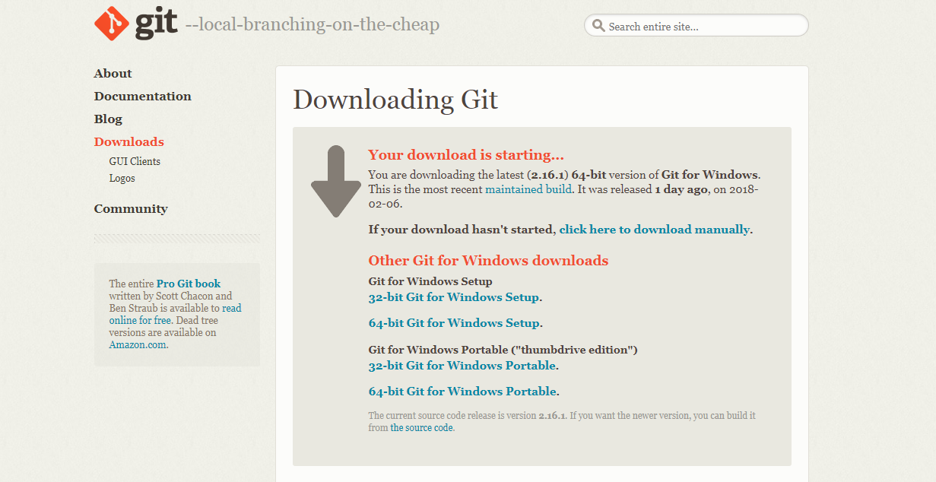
Próbáljuk ki!
Installer letölthető innen: https://gitforwindows.org/
Notes:
We have a clear purpose: helping people achieve a lifetime of financial security.
That’s our priority. To be there for our 30 million customers. And to be there for the growing number of people that place their trust in Aegon.
This purpose touches everything we do and it means that we are committed to building long-term relationships with our customers based on trust and transparency.
This means helping our customers to make those important decisions that will enable them to meet their obligations and ambitions at every stage of their life. This is our promise to our customers.
As all of us travel through life – through a first job, marriage, raising a family, retirement and old age – our needs change. As our needs change, so do the solutions we require of a company like Aegon.
Supporting these needs of our customers across their life is what all of the people in our company aim to achieve.

Slide 12
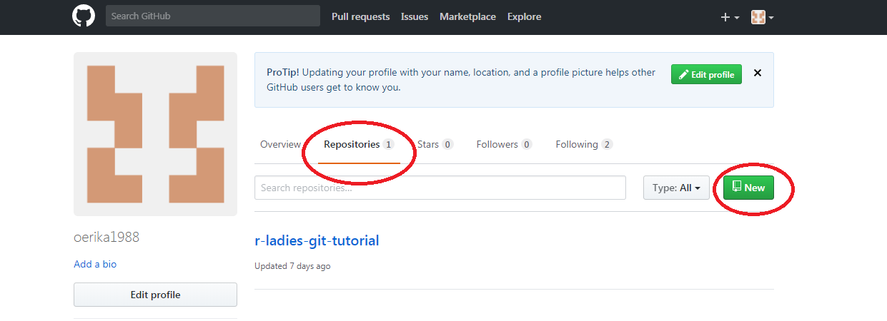
Próbáljuk ki!
Menj https://github.com/ -ra és hozz létre egy accountot
Hozz létre egy új repo‑t (initialize with README – a klónozhatóság miatt)
Repo neve: aegon-git-tutorial
Notes:
We have a clear purpose: helping people achieve a lifetime of financial security.
That’s our priority. To be there for our 30 million customers. And to be there for the growing number of people that place their trust in Aegon.
This purpose touches everything we do and it means that we are committed to building long-term relationships with our customers based on trust and transparency.
This means helping our customers to make those important decisions that will enable them to meet their obligations and ambitions at every stage of their life. This is our promise to our customers.
As all of us travel through life – through a first job, marriage, raising a family, retirement and old age – our needs change. As our needs change, so do the solutions we require of a company like Aegon.
Supporting these needs of our customers across their life is what all of the people in our company aim to achieve.

Slide 13

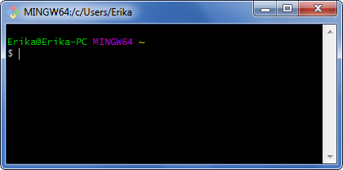
Próbáljuk ki!
Nyiss meg egy terminált!
mkdir aegon\gitrepos – make directory
cd aegon\gitrepos – change directory
git clone https://github.com/YOUR_ACCOUNT/aegon-git-tutorial.git
cd aegon-git-tutorial
git status
Notes:
We have a clear purpose: helping people achieve a lifetime of financial security.
That’s our priority. To be there for our 30 million customers. And to be there for the growing number of people that place their trust in Aegon.
This purpose touches everything we do and it means that we are committed to building long-term relationships with our customers based on trust and transparency.
This means helping our customers to make those important decisions that will enable them to meet their obligations and ambitions at every stage of their life. This is our promise to our customers.
As all of us travel through life – through a first job, marriage, raising a family, retirement and old age – our needs change. As our needs change, so do the solutions we require of a company like Aegon.
Supporting these needs of our customers across their life is what all of the people in our company aim to achieve.

Slide 14
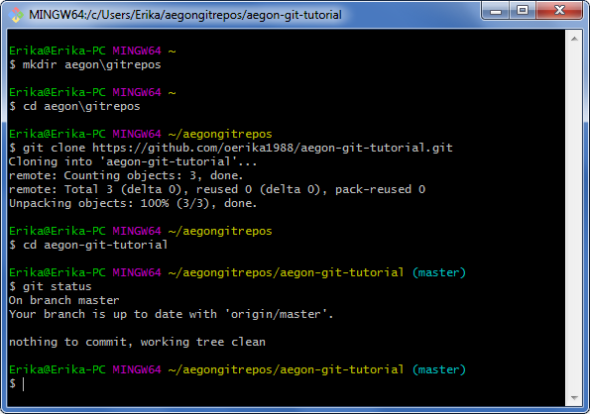
Próbáljuk ki!
Notes:
We have a clear purpose: helping people achieve a lifetime of financial security.
That’s our priority. To be there for our 30 million customers. And to be there for the growing number of people that place their trust in Aegon.
This purpose touches everything we do and it means that we are committed to building long-term relationships with our customers based on trust and transparency.
This means helping our customers to make those important decisions that will enable them to meet their obligations and ambitions at every stage of their life. This is our promise to our customers.
As all of us travel through life – through a first job, marriage, raising a family, retirement and old age – our needs change. As our needs change, so do the solutions we require of a company like Aegon.
Supporting these needs of our customers across their life is what all of the people in our company aim to achieve.

Slide 15
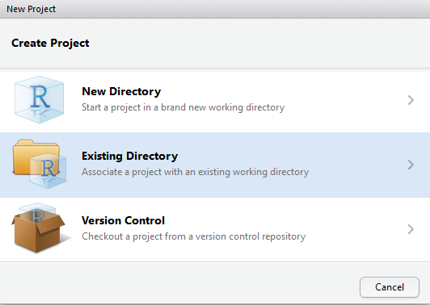
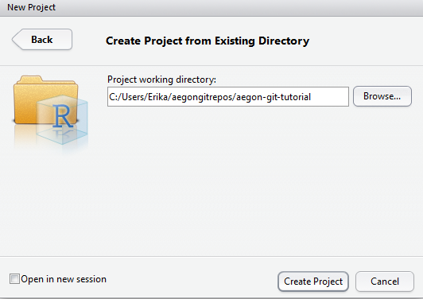
Próbáljuk ki!
Nyisd meg az Rstudio‑t! -> új projekt létező forrásból
Notes:
We have a clear purpose: helping people achieve a lifetime of financial security.
That’s our priority. To be there for our 30 million customers. And to be there for the growing number of people that place their trust in Aegon.
This purpose touches everything we do and it means that we are committed to building long-term relationships with our customers based on trust and transparency.
This means helping our customers to make those important decisions that will enable them to meet their obligations and ambitions at every stage of their life. This is our promise to our customers.
As all of us travel through life – through a first job, marriage, raising a family, retirement and old age – our needs change. As our needs change, so do the solutions we require of a company like Aegon.
Supporting these needs of our customers across their life is what all of the people in our company aim to achieve.

Slide 16
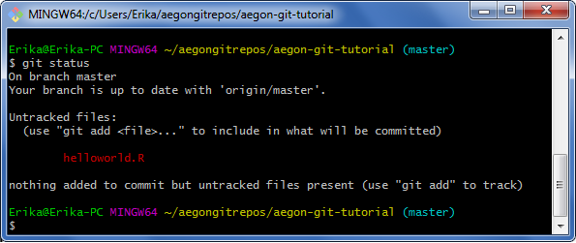
Próbáljuk ki!
Hozz létre egy új R file‑t ( helloworld.R ) az alábbi tartalommal:
# My first program in R Programming myString <- "Hello, World!" print ( myString)
Menj vissza a terminálba!
git status
Notes:
We have a clear purpose: helping people achieve a lifetime of financial security.
That’s our priority. To be there for our 30 million customers. And to be there for the growing number of people that place their trust in Aegon.
This purpose touches everything we do and it means that we are committed to building long-term relationships with our customers based on trust and transparency.
This means helping our customers to make those important decisions that will enable them to meet their obligations and ambitions at every stage of their life. This is our promise to our customers.
As all of us travel through life – through a first job, marriage, raising a family, retirement and old age – our needs change. As our needs change, so do the solutions we require of a company like Aegon.
Supporting these needs of our customers across their life is what all of the people in our company aim to achieve.

Slide 17
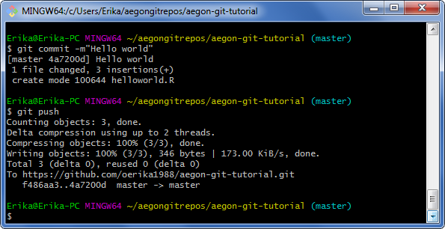
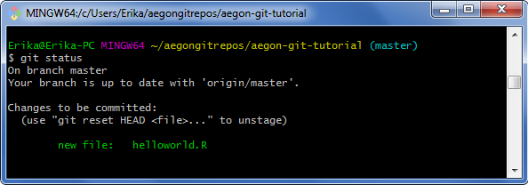
Próbáljuk ki!
git add helloworld.R (vagy git add . -> erre mindent hozzáad )
git commit –m”Hello world”
git push
Notes:
We have a clear purpose: helping people achieve a lifetime of financial security.
That’s our priority. To be there for our 30 million customers. And to be there for the growing number of people that place their trust in Aegon.
This purpose touches everything we do and it means that we are committed to building long-term relationships with our customers based on trust and transparency.
This means helping our customers to make those important decisions that will enable them to meet their obligations and ambitions at every stage of their life. This is our promise to our customers.
As all of us travel through life – through a first job, marriage, raising a family, retirement and old age – our needs change. As our needs change, so do the solutions we require of a company like Aegon.
Supporting these needs of our customers across their life is what all of the people in our company aim to achieve.

Slide 18
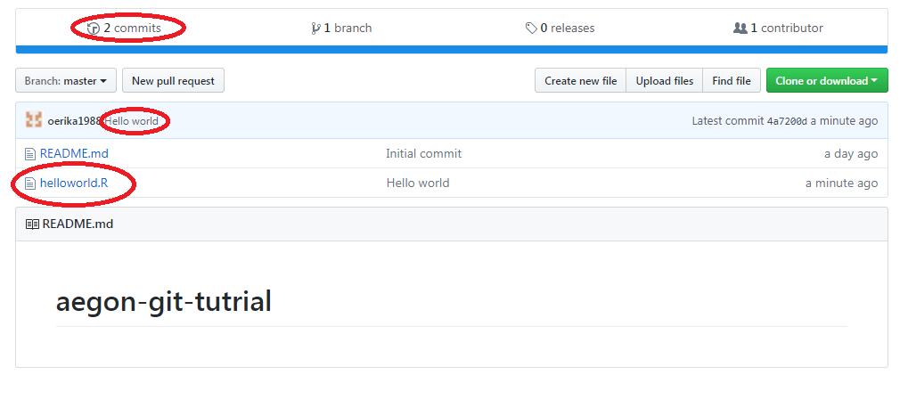
Próbáljuk ki!
Notes:
We have a clear purpose: helping people achieve a lifetime of financial security.
That’s our priority. To be there for our 30 million customers. And to be there for the growing number of people that place their trust in Aegon.
This purpose touches everything we do and it means that we are committed to building long-term relationships with our customers based on trust and transparency.
This means helping our customers to make those important decisions that will enable them to meet their obligations and ambitions at every stage of their life. This is our promise to our customers.
As all of us travel through life – through a first job, marriage, raising a family, retirement and old age – our needs change. As our needs change, so do the solutions we require of a company like Aegon.
Supporting these needs of our customers across their life is what all of the people in our company aim to achieve.

Slide 19
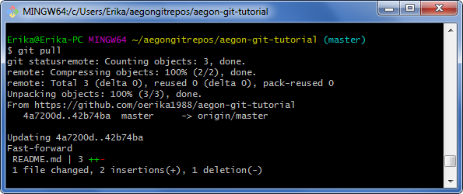
Próbáljuk ki!
Editáld itt a README‑t a webes felületen
Menj vissza a terminálba!
git status
git pull
git status
Notes:
We have a clear purpose: helping people achieve a lifetime of financial security.
That’s our priority. To be there for our 30 million customers. And to be there for the growing number of people that place their trust in Aegon.
This purpose touches everything we do and it means that we are committed to building long-term relationships with our customers based on trust and transparency.
This means helping our customers to make those important decisions that will enable them to meet their obligations and ambitions at every stage of their life. This is our promise to our customers.
As all of us travel through life – through a first job, marriage, raising a family, retirement and old age – our needs change. As our needs change, so do the solutions we require of a company like Aegon.
Supporting these needs of our customers across their life is what all of the people in our company aim to achieve.

Slide 20
Próbáljuk ki!
Készíts egy új R file‑t ( simple_plot.R ): # Define 2 vectors cars <- c(1, 3, 6, 4, 9) trucks <- c(2, 5, 4, 5, 12) # Graph cars using a y axis that ranges from 0 to 12 plot(cars, type="o", col="blue", ylim=c(0,12)) # Graph trucks with red dashed line and square points lines(trucks, type="o", pch=22, lty=2, col="red") # Create a title with a red, bold/italic font title(main="Autos", col.main="red", font.main=4) # Save image dev.copy(png,'beautiful_plot.jpg') dev.off()
Keresd meg a Tools > Version Control menüpontot, majd commitolj, pusholj innen!
Notes:
We have a clear purpose: helping people achieve a lifetime of financial security.
That’s our priority. To be there for our 30 million customers. And to be there for the growing number of people that place their trust in Aegon.
This purpose touches everything we do and it means that we are committed to building long-term relationships with our customers based on trust and transparency.
This means helping our customers to make those important decisions that will enable them to meet their obligations and ambitions at every stage of their life. This is our promise to our customers.
As all of us travel through life – through a first job, marriage, raising a family, retirement and old age – our needs change. As our needs change, so do the solutions we require of a company like Aegon.
Supporting these needs of our customers across their life is what all of the people in our company aim to achieve.

Slide 21
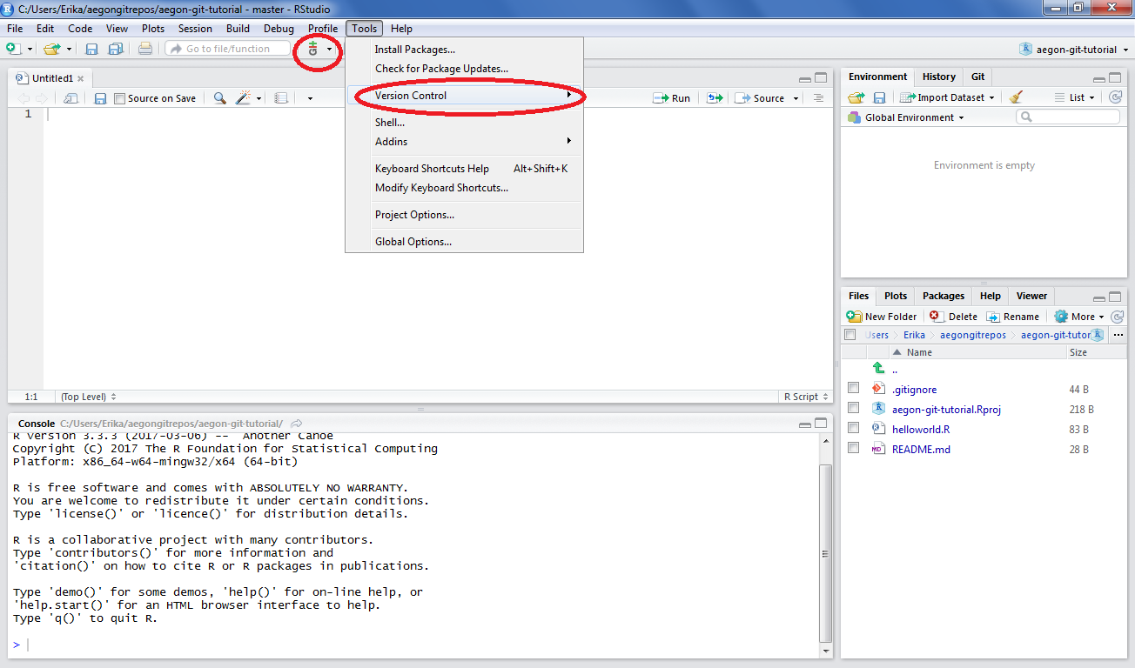
Próbáljuk ki!
Git <3 RStudio
Notes:
We have a clear purpose: helping people achieve a lifetime of financial security.
That’s our priority. To be there for our 30 million customers. And to be there for the growing number of people that place their trust in Aegon.
This purpose touches everything we do and it means that we are committed to building long-term relationships with our customers based on trust and transparency.
This means helping our customers to make those important decisions that will enable them to meet their obligations and ambitions at every stage of their life. This is our promise to our customers.
As all of us travel through life – through a first job, marriage, raising a family, retirement and old age – our needs change. As our needs change, so do the solutions we require of a company like Aegon.
Supporting these needs of our customers across their life is what all of the people in our company aim to achieve.

Slide 22
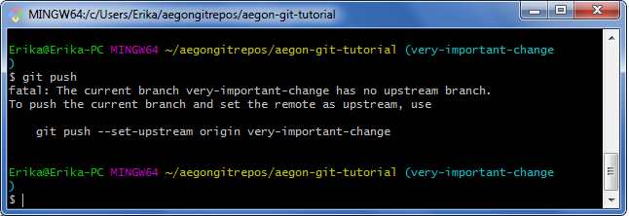
Próbáljuk ki!
[Terminál] git checkout -b very-important-change -new branch
[RStudio] Változtass valamit a simple_plot.R , pl. a red színt orange ‑ra. Futtasd le a scriptet!
[RStudio] A Tools > Version Control menüpontban commitolj! (Tudsz pusholni?)
[Terminál] git push . Figyeld meg, mit ír ki, és kövesd az utasítást!
[Github] Menj fel a repod oldalára, nézd meg a branchet, nyiss Merge Requestet!
Notes:
We have a clear purpose: helping people achieve a lifetime of financial security.
That’s our priority. To be there for our 30 million customers. And to be there for the growing number of people that place their trust in Aegon.
This purpose touches everything we do and it means that we are committed to building long-term relationships with our customers based on trust and transparency.
This means helping our customers to make those important decisions that will enable them to meet their obligations and ambitions at every stage of their life. This is our promise to our customers.
As all of us travel through life – through a first job, marriage, raising a family, retirement and old age – our needs change. As our needs change, so do the solutions we require of a company like Aegon.
Supporting these needs of our customers across their life is what all of the people in our company aim to achieve.

Slide 23
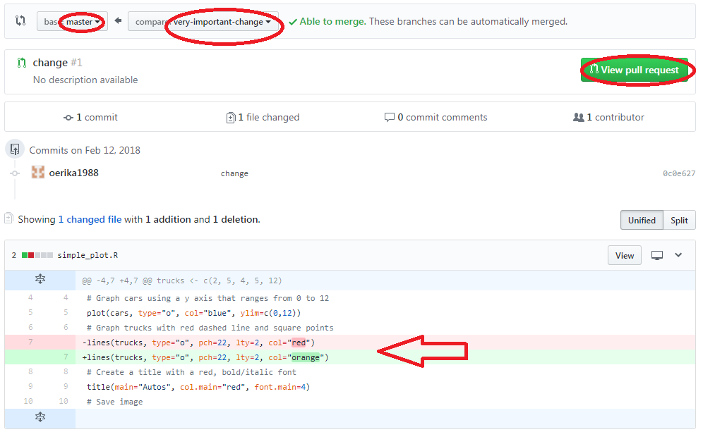
Próbáljuk ki!
Notes:
We have a clear purpose: helping people achieve a lifetime of financial security.
That’s our priority. To be there for our 30 million customers. And to be there for the growing number of people that place their trust in Aegon.
This purpose touches everything we do and it means that we are committed to building long-term relationships with our customers based on trust and transparency.
This means helping our customers to make those important decisions that will enable them to meet their obligations and ambitions at every stage of their life. This is our promise to our customers.
As all of us travel through life – through a first job, marriage, raising a family, retirement and old age – our needs change. As our needs change, so do the solutions we require of a company like Aegon.
Supporting these needs of our customers across their life is what all of the people in our company aim to achieve.

Slide 24
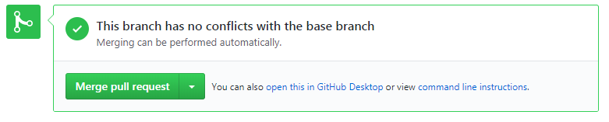
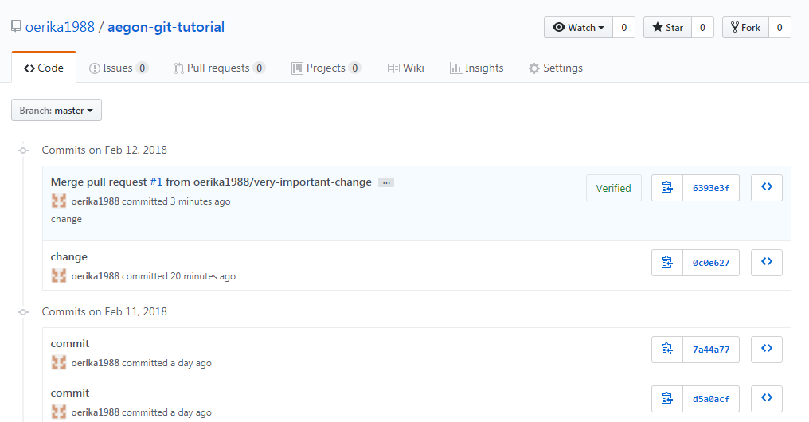
Próbáljuk ki!
Notes:
We have a clear purpose: helping people achieve a lifetime of financial security.
That’s our priority. To be there for our 30 million customers. And to be there for the growing number of people that place their trust in Aegon.
This purpose touches everything we do and it means that we are committed to building long-term relationships with our customers based on trust and transparency.
This means helping our customers to make those important decisions that will enable them to meet their obligations and ambitions at every stage of their life. This is our promise to our customers.
As all of us travel through life – through a first job, marriage, raising a family, retirement and old age – our needs change. As our needs change, so do the solutions we require of a company like Aegon.
Supporting these needs of our customers across their life is what all of the people in our company aim to achieve.

Slide 25
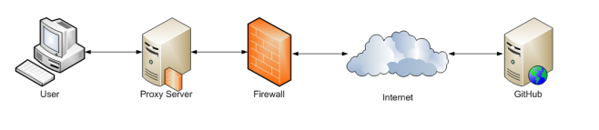
Néhány jótanács
A git a kódot, szöveges file‑okat kezeli hatékonyan, képeket kevésbé
Adatot legfeljebb akkor commitolj, ha kicsi és ha nyilvános adat.
Figyelj, hogy public vagy private a repod! Githubon ingyenesen csak public repod lehet. Ha private repora lenne szükséged, érdemes a Bitbucket‑et kipróbálni
Céges hálózatról külön beállítás kell a GitHub eléréséhez
Notes:
We have a clear purpose: helping people achieve a lifetime of financial security.
That’s our priority. To be there for our 30 million customers. And to be there for the growing number of people that place their trust in Aegon.
This purpose touches everything we do and it means that we are committed to building long-term relationships with our customers based on trust and transparency.
This means helping our customers to make those important decisions that will enable them to meet their obligations and ambitions at every stage of their life. This is our promise to our customers.
As all of us travel through life – through a first job, marriage, raising a family, retirement and old age – our needs change. As our needs change, so do the solutions we require of a company like Aegon.
Supporting these needs of our customers across their life is what all of the people in our company aim to achieve.

Slide 26


Néhány jótanács
A datacamp.com-on elérhető egy ingyenes Git kurzus
Forrás:https://github.com/gszjulcsi/git-for-rladies/blob/master/presentation.pdf
Notes:
We have a clear purpose: helping people achieve a lifetime of financial security.
That’s our priority. To be there for our 30 million customers. And to be there for the growing number of people that place their trust in Aegon.
This purpose touches everything we do and it means that we are committed to building long-term relationships with our customers based on trust and transparency.
This means helping our customers to make those important decisions that will enable them to meet their obligations and ambitions at every stage of their life. This is our promise to our customers.
As all of us travel through life – through a first job, marriage, raising a family, retirement and old age – our needs change. As our needs change, so do the solutions we require of a company like Aegon.
Supporting these needs of our customers across their life is what all of the people in our company aim to achieve.

Slide 27

Köszönöm a figyelmet!

