Slide 1

Welcome to Learning, Media, and Technology
DO NOW: Write down five things you are good at.
Put one thing per post-it note. Try to just write at the top.
Anything SFW is fair game:
(Writing bad first drafts quickly, top laning in League of Legends, teaching people to steer a canoe, interpreting quantitative education research for public audiences, etc.)
Image © illustration by Haley McDevitt; published by Jossey-Bass. All rights reserved. This content is excluded from our Creative Commons license. For more information, see https://ocw.mit.edu/help/faq-fair-use/

Slide 2
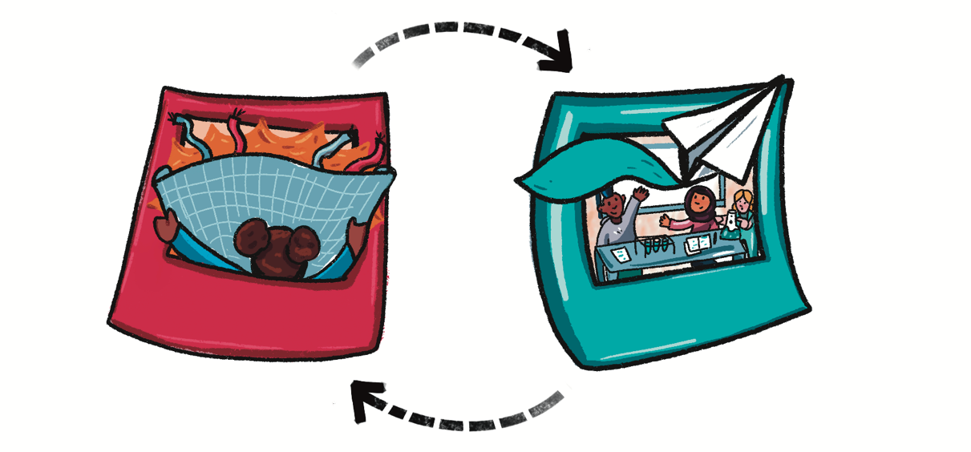
Learning Goals
look anew at your own educational history, and understand the ideas and practices that have shaped your own schooling and learning
develop familiarity with the skills and practices of social science and analysis of social-technical systems
peer into the marvelous complexity and richness of the education field..
seriously consider a career in the education field. It’s one of the most rewarding ways you can spend part of your life.
get a grounding in some foundational ideas in education, as well as exposure to new research and thinking about learning, media, and technology
Illustration © Haley McDevitt. All rights reserved. This content is excluded from our Creative Commons license. For more information, see https://ocw.mit.edu/help/faq-fair-use/

Slide 3

Attendance: (tl;dr- required)
The fundamental commitment that I’ll ask you to make is to attend every session and complete the assignments. This isn’t a class where there is a body of knowledge that I’m hoping you will master, however you manage to do that; rather, the participation of every student in the course is essential to a successful seminar.
Communication:
Early and often. When things come up, let me know and cc S3.
Illustration © Haley McDevitt. All rights reserved. This content is excluded from our Creative Commons license. For more information, see https://ocw.mit.edu/help/faq-fair-use/

Slide 4
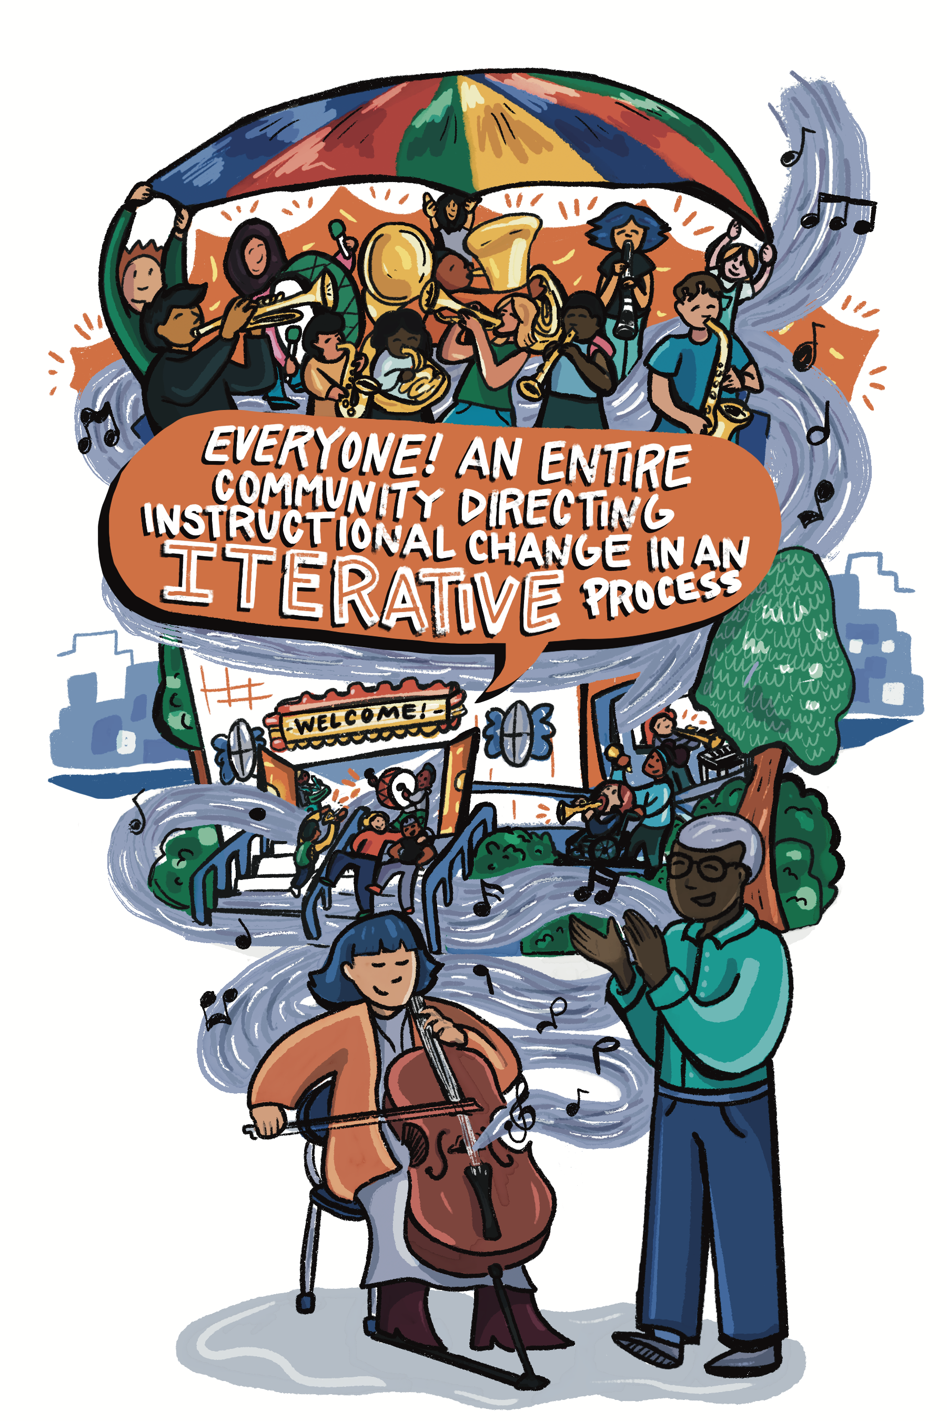
The Learning, Media, and Technology Thesis
Schools are socio-technical systems.
If you build tech for social systems, and you don’t understand those systems, the tech you build won’t work.
Illustration © Haley McDevitt. All rights reserved. This content is excluded from our Creative Commons license. For more information, see https://ocw.mit.edu/help/faq-fair-use/

Slide 5
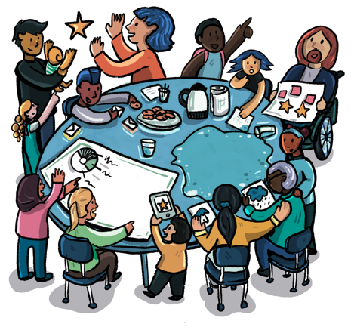
Structure of the Course
PART I: Foundations
  Assignment #1- EdTech From a Learning Science Perspective
PART II- Three Genres of Learning At Scale
  Assignment #2- Implementation Memo
PART III: Four As-Yet Intractable Dilemmas
  Assignment #3- Problem Finding (Final Project)
Illustration © Haley McDevitt. All rights reserved. This content is excluded from our Creative Commons license. For more information, see https://ocw.mit.edu/help/faq-fair-use/

Slide 6
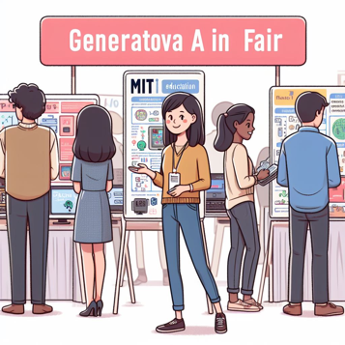

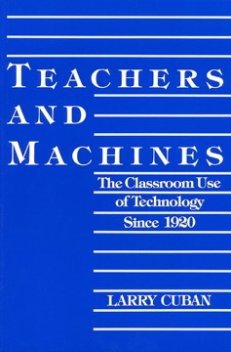

Part I: Foundations
Theories of Teaching and Learning:
Cognitive Load Theory (Mens)
Situated Learning (Manus)
EdTech and MIT
MIT Museum and Gen AI
CS and Equity in Mass.
Online Learning for Teachers
EdTech Before the Internet
Larry Cuban’s Teachers and Machines
Changing Practices in Schools
Justin Reich’s Iterate: The Secret to Innovation in Schools
MIT seal © MIT. Teachers and Machines © Teachers College Press. Iterate © Jossey-Bass.
All rights reserved. This content is excluded from our Creative Commons license. For more information, see https://ocw.mit.edu/help/faq-fair-use/

Slide 7
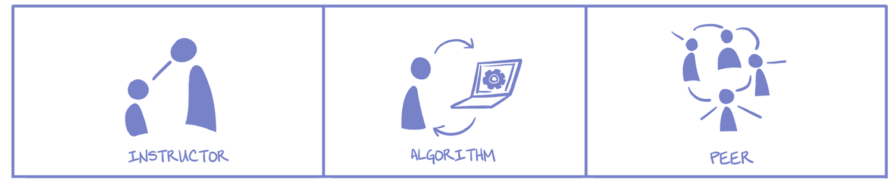
Part II: Three Genres of Learning@Scale
Who guides the sequence of learning activities?

Slide 8

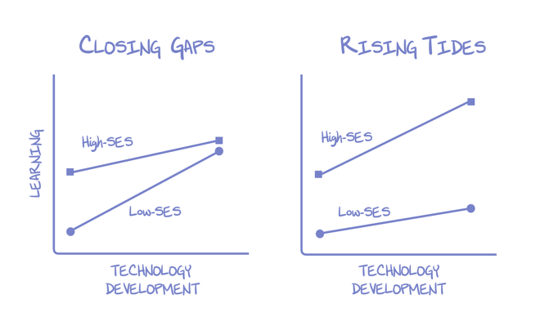
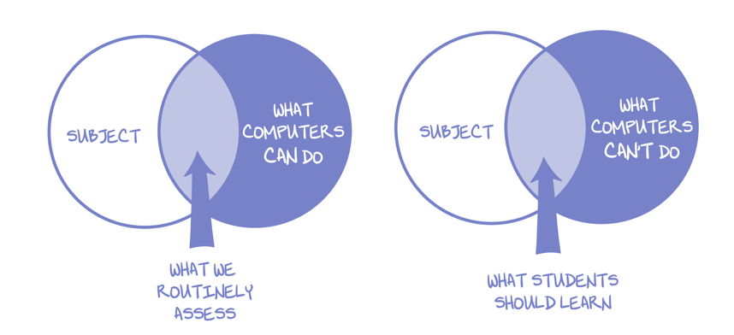
Part III: Four “As-Yet Intractable Dilemmas”
Curse of the Familiar
EdTech Matthew Effect
Trap of Routine Assessment
Toxic Power of Data and Experiments

Slide 9


Books!
Gotta buy it/get it. Used, ebook, or library. So good.
Two from me. I’ll get you copies.
Teachers and Machines © Teachers College Press. Iterate © Jossey-Bass. All rights reserved. This content is excluded from our Creative Commons license. For more information, see https://ocw.mit.edu/help/faq-fair-use/

Slide 10
Assignments
Assignment #1- EdTech From a Learning Science Perspective
  Evaluate an education technology and identify its pedagogical roots. Then, reimagine the technology from alternative pedagogical perspective.
Assignment #2- Implementation Memo
  Recommend (or reject) a new technology to be implemented in a particular context.
Assignment #3- Problem Finding (Final Project)
  Anything you want that addresses an interesting topic in Ed Tech.

Slide 11
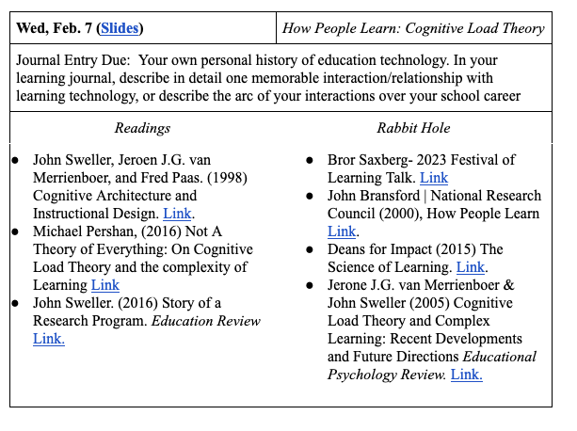
Syllabus
Do all the Readings.
More resources in the Rabbit Hole. Grad students please do one Rabbit Hole per week.
Learning Journal is a space for short writing/communicating assignments

Slide 12
Assignments and Grades
For every class period, there will be a set of core readings that we will all complete, and then an additional set of “Rabbit Hole” readings for your continued exploration. Graduate students will be required to do at least one of these additional readings.
Some weeks there will also be a short assignment, asking you to reflect on your own educational history, imagine a new future, or read something closely. These assignments will typically be a few hundred words or their multimedia equivalent in images, audio, video, code, etc. Short assignments will be completed in a semi-public learning journal, you can find the template here.

Slide 13
Special Syllabus Dates
Feb 14- Field Trip to MIT Museum
Feb 28- On Zoom, with ISTE’s Ed Prep Roundtable (https://iste.org/pledge-for-digital-equity-transformation)
    Note- we need to decide soon if you all are interested in joining the whole thing, or just my intro lecture
March 18/20 SIP week– maybe online, maybe something fun, maybe something else– (Most Flexible Dates for Non Class Related Travel/Interviews/etc.)
April 8- No class, Go see the Eclipse
May 13- Last class, mandatory

Slide 14
Education:
Filling Pails or Kindling Flames?
MIT seal © MIT. All rights reserved. This content is excluded from our Creative Commons license. For more information, see https://ocw.mit.edu/help/faq-fair-use/

Slide 15
For the mind does not require filling like a bottle, but rather, like wood, it only requires kindling to create in it an impulse to think independently and an ardent desire for truth. Plutarch (~50 AD), On Listening
Translation from 1927 Loeb Classic
Photo © Odysses at Wikimedia. All rights reserved. This content is excluded from our Creative Commons license. For more information, see https://ocw.mit.edu/help/faq-fair-use/
Notes:
https://upload.wikimedia.org/wikipedia/commons/6/62/Plutarch_head_only.jpg

Slide 16
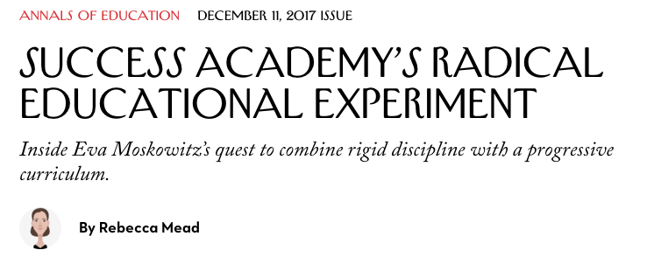
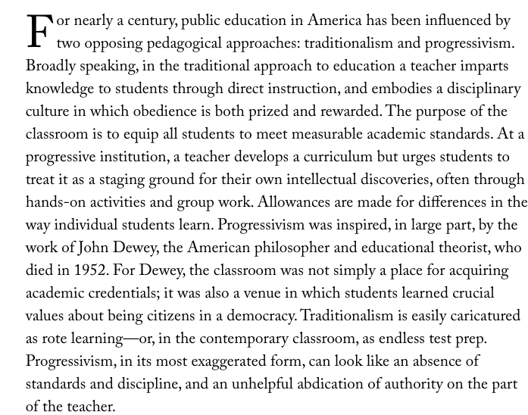
© Condé Nast. All rights reserved. This content is excluded from our Creative Commons license. For more information, see https://ocw.mit.edu/help/faq-fair-use/

Slide 17
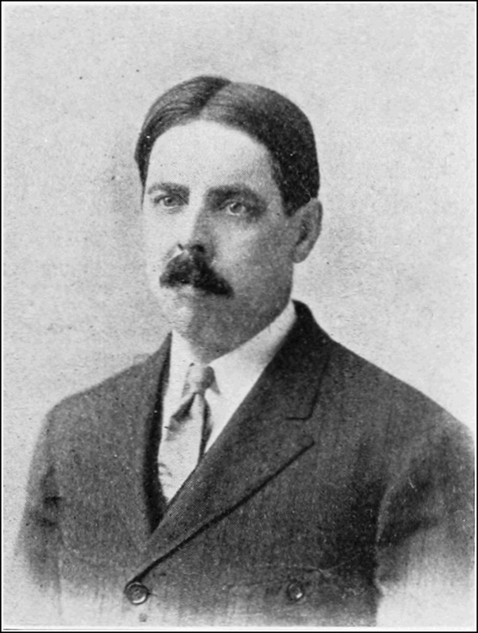
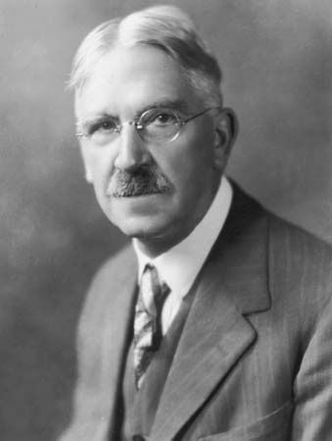
© Archive Photos/Hulton Archive/Getty Images. All rights reserved. This content is excluded from our Creative Commons license. For more information, see https://ocw.mit.edu/help/faq-fair-use/
Image is in the public domain.
Edward Thorndike
Education as Science of Delivery
John Dewey
Education as Life

Slide 18

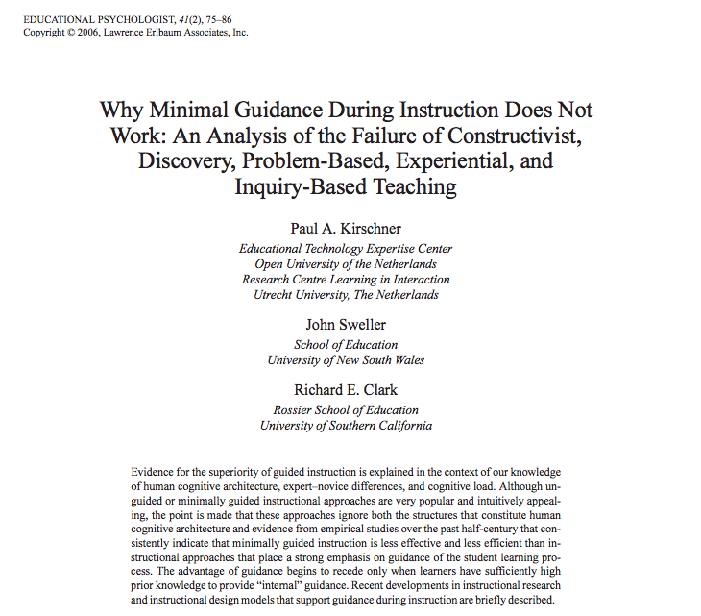
“One cannot understand the history of education in the United States during the 20th century unless one realizes that Edward L. Thorndike won and John Dewey lost.”
-Ellen Lagemann
Left © Lawrence Earlbaum Associates, Inc. Right © MIT Press. All rights reserved. This content is excluded from our Creative Commons license. For more information, see https://ocw.mit.edu/help/faq-fair-use/

Slide 19
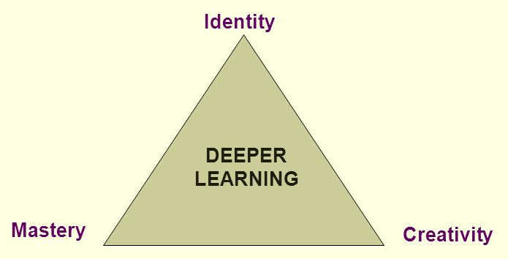
Slide from Jal Mehta and Sarah Fine, Harvard Graduate School of Education

Slide 20
Identity
Mastery
Creativity
© Lawrence Earlbaum Associates, Inc. All rights reserved. This content is excluded from our Creative Commons license. For more information, see https://ocw.mit.edu/help/faq-fair-use/

Slide 21

Identity
Mastery
Creativity
© MIT Press. All rights reserved. This content is excluded from our Creative Commons license. For more information, see https://ocw.mit.edu/help/faq-fair-use/

Slide 22
Identity
Mastery
Creativity
MIT seal © MIT. All rights reserved. This content is excluded from our Creative Commons license. For more information, see https://ocw.mit.edu/help/faq-fair-use/

Slide 23
MIT OpenCourseWare
https://ocw.mit.edu
CMS.595 Learning, Media, and Technology
Spring 2024
For information about citing these materials or our Terms of Use, visit: https://ocw.mit.edu/terms

