Slide 1

Innovation and Access in Online Learning
Courtesy of DML Research Hub. Used under CC BY.

Slide 2
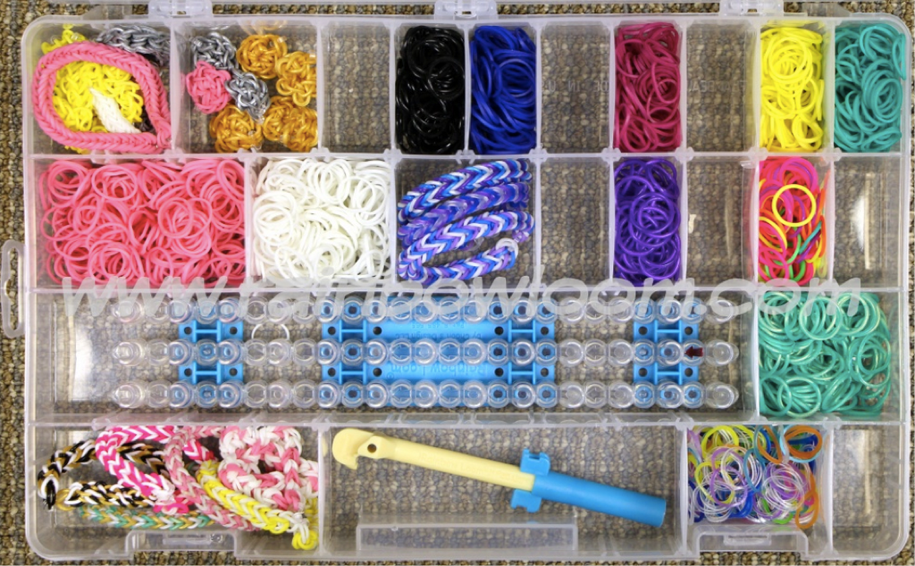
© Rainbow Loom USA. All rights reserved. This content is excluded from our Creative Commons license. For more information, see https://ocw.mit.edu/help/faq-fair-use/

Slide 3
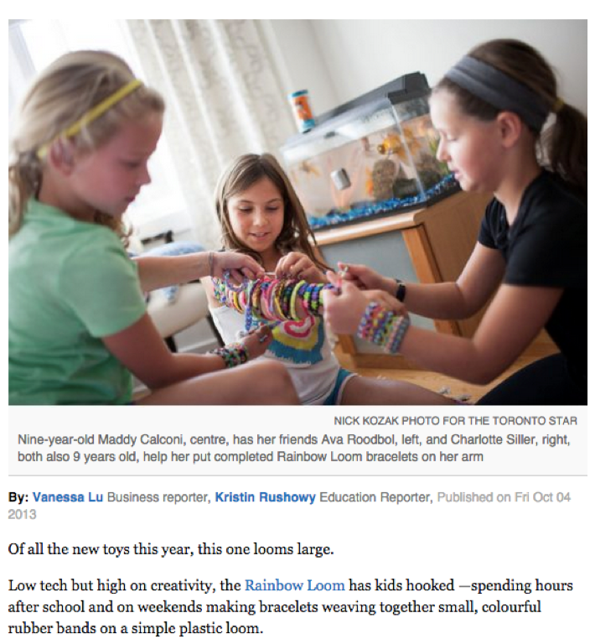
© Toronto Star Newspapers Limited. All rights reserved. This content is excluded from our Creative Commons license. For more information, see https://ocw.mit.edu/help/faq-fair-use/

Slide 4
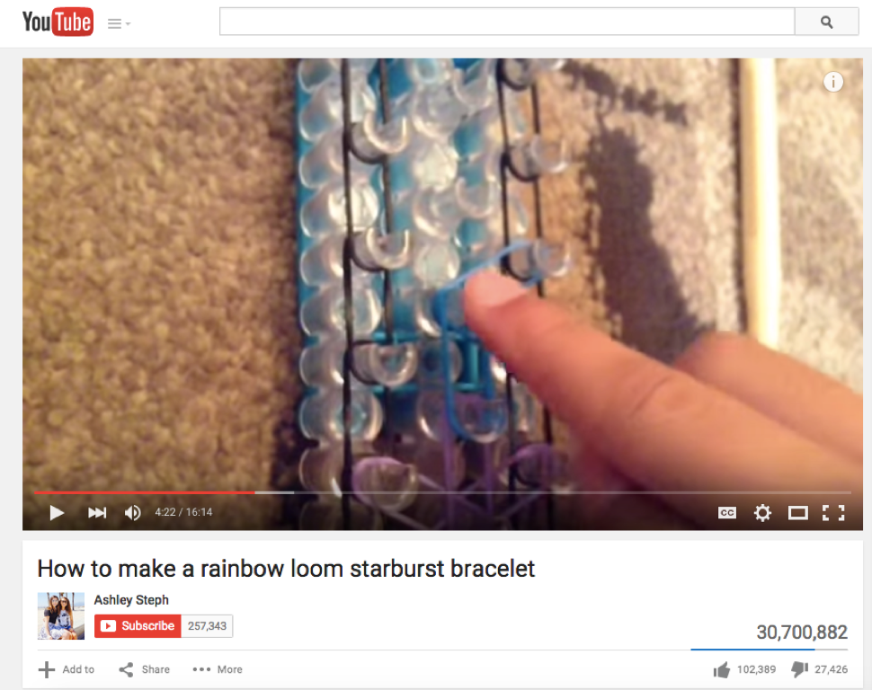
© @AshleyAndSteph7 on YouTube. All rights reserved. This content is excluded from our Creative Commons license. For more information, see https://ocw.mit.edu/help/faq-fair-use/

Slide 5
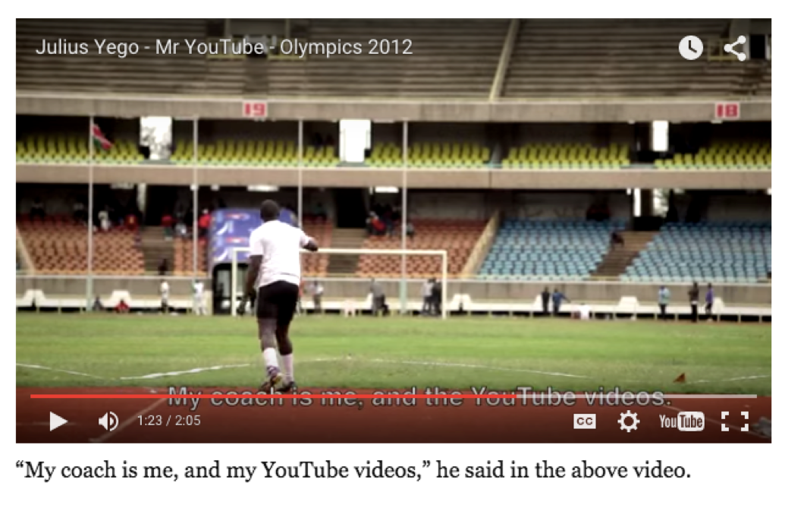
© EMEASports on YouTube. All rights reserved. This content is excluded from our Creative Commons license. For more information, see https://ocw.mit.edu/help/faq-fair-use/

Slide 6
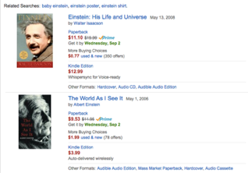
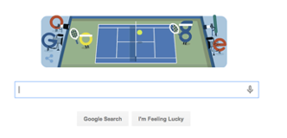

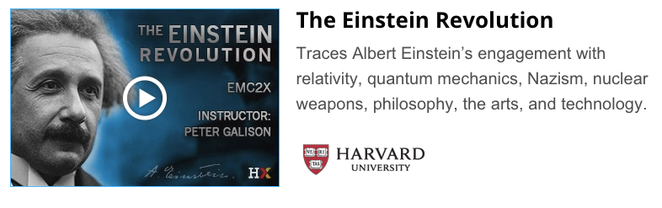
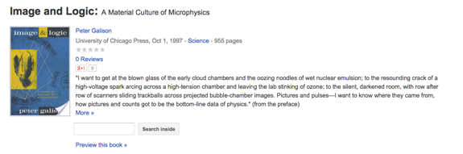

© Google, Amazon, Wikipedia, Harvard, Meta. All rights reserved. This content is excluded from our Creative Commons license. For more information, see https://ocw.mit.edu/help/faq-fair-use/

Slide 7
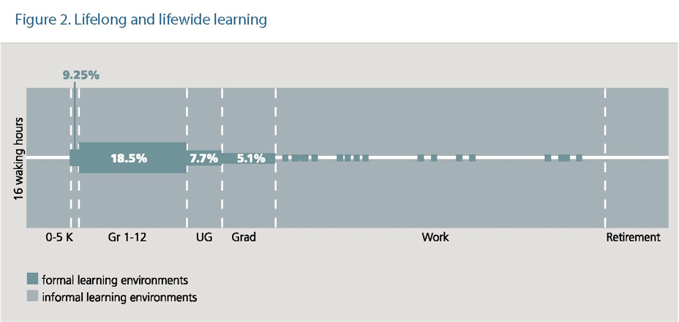
Lifelong and Lifewide Learning
© The LIFE Center and the Center for Multicultural Education, University of Washington. All rights reserved. This content is excluded from our Creative Commons license. For more information, see https://ocw.mit.edu/help/faq-fair-use/

Slide 8
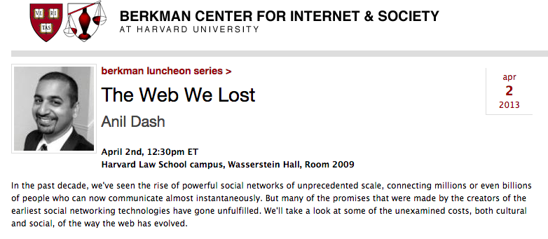
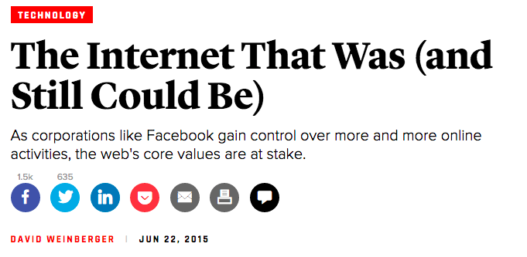
Courtesy of Harvard University. Used under CC BY.
© The Atlantic Monthly Group. All rights reserved. This content is excluded from our Creative Commons license. For more information, see
https://ocw.mit.edu/help/faq-fair-use/

Slide 9
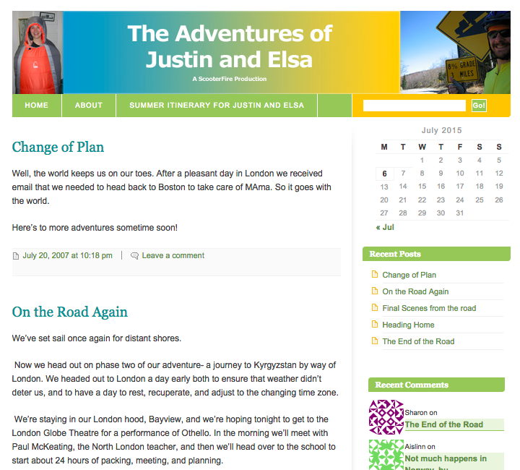


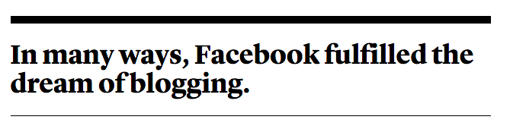
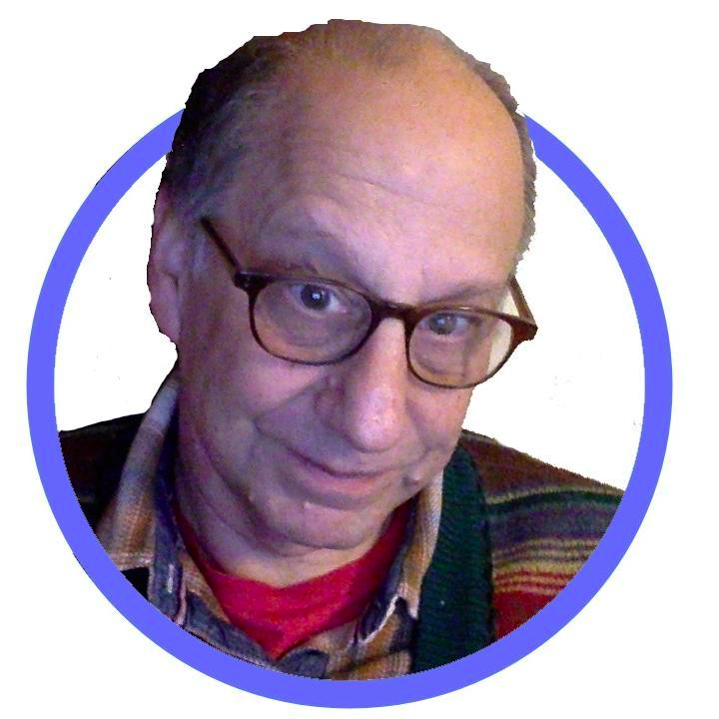
“Not exactly what I meant”
The blogosphere did not scale. I believe that problem could have been solved. But then Facebook happened.
© Meta, LiveJournal, source unknown., The Atlantic Monthly Group All rights reserved. This content is excluded from our Creative Commons license. For more information, see https://ocw.mit.edu/help/faq-fair-use/

Slide 10
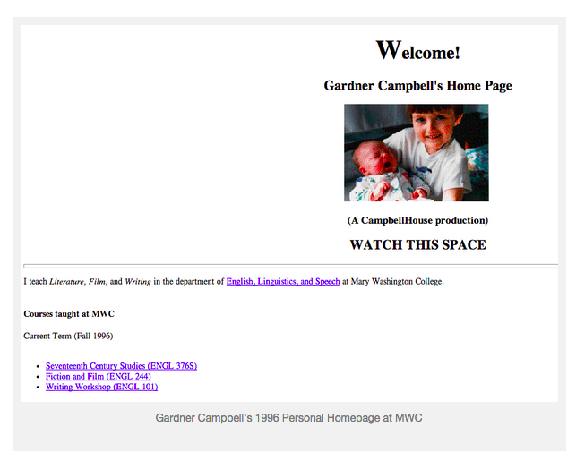
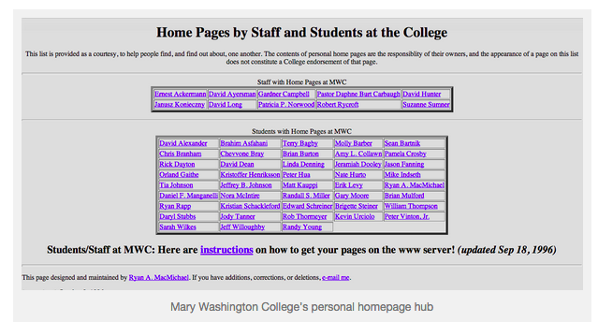
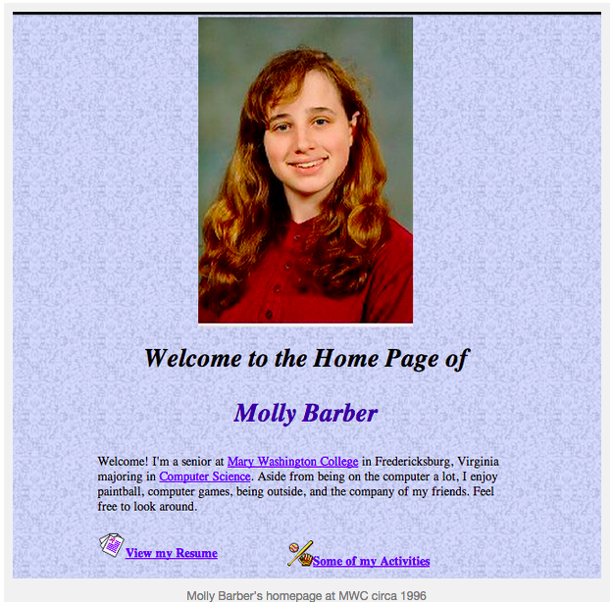
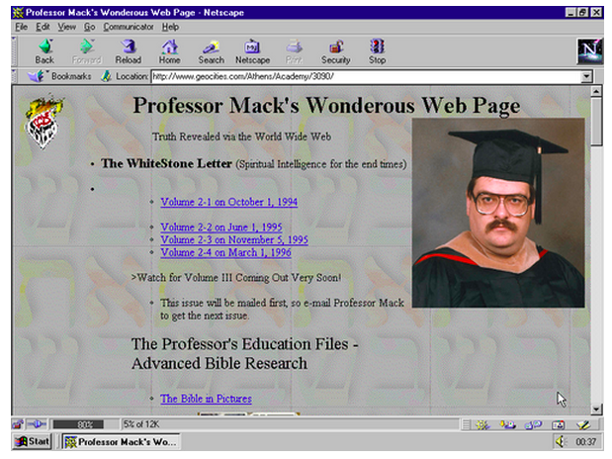
© babatuesdays.com. All rights reserved. This content is excluded from our Creative Commons license. For more information, see https://ocw.mit.edu/help/faq-fair-use/
Tilde Spaces
Jim Groom on Tilde Spaces http://bavatuesdays.com/how-the-web-was-ghettoized-for-teaching-and-learning-in-higher-ed/

Slide 11



Tilde spaces did not scale. I believe that problem could have been solved. But then Blackboard happened.
© bavatuesdays.com, Anthology Inc and TMs owned by Anthology Inc. All rights reserved. This content is excluded from our Creative Commons license. For more information, see https://ocw.mit.edu/help/faq-fair-use/

Slide 12
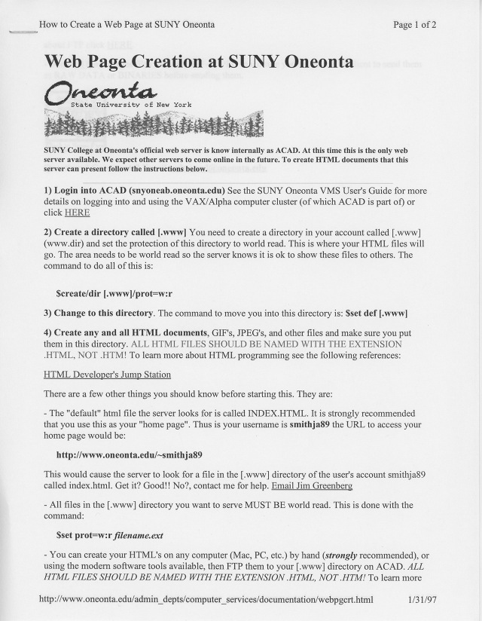
© bavatuesdays.com. All rights reserved. This content is excluded from our Creative Commons license. For more information, see https://ocw.mit.edu/help/faq-fair-use/

Slide 13

© source unknown. All rights reserved. This content is excluded from our Creative Commons license. For more information, see https://ocw.mit.edu/help/faq-fair-use/

Slide 14
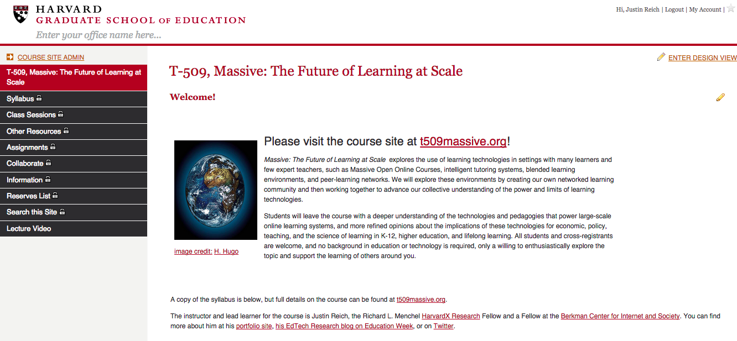
© Harvard University. All rights reserved. This content is excluded from our Creative Commons license. For more information, see https://ocw.mit.edu/help/faq-fair-use/

Slide 15
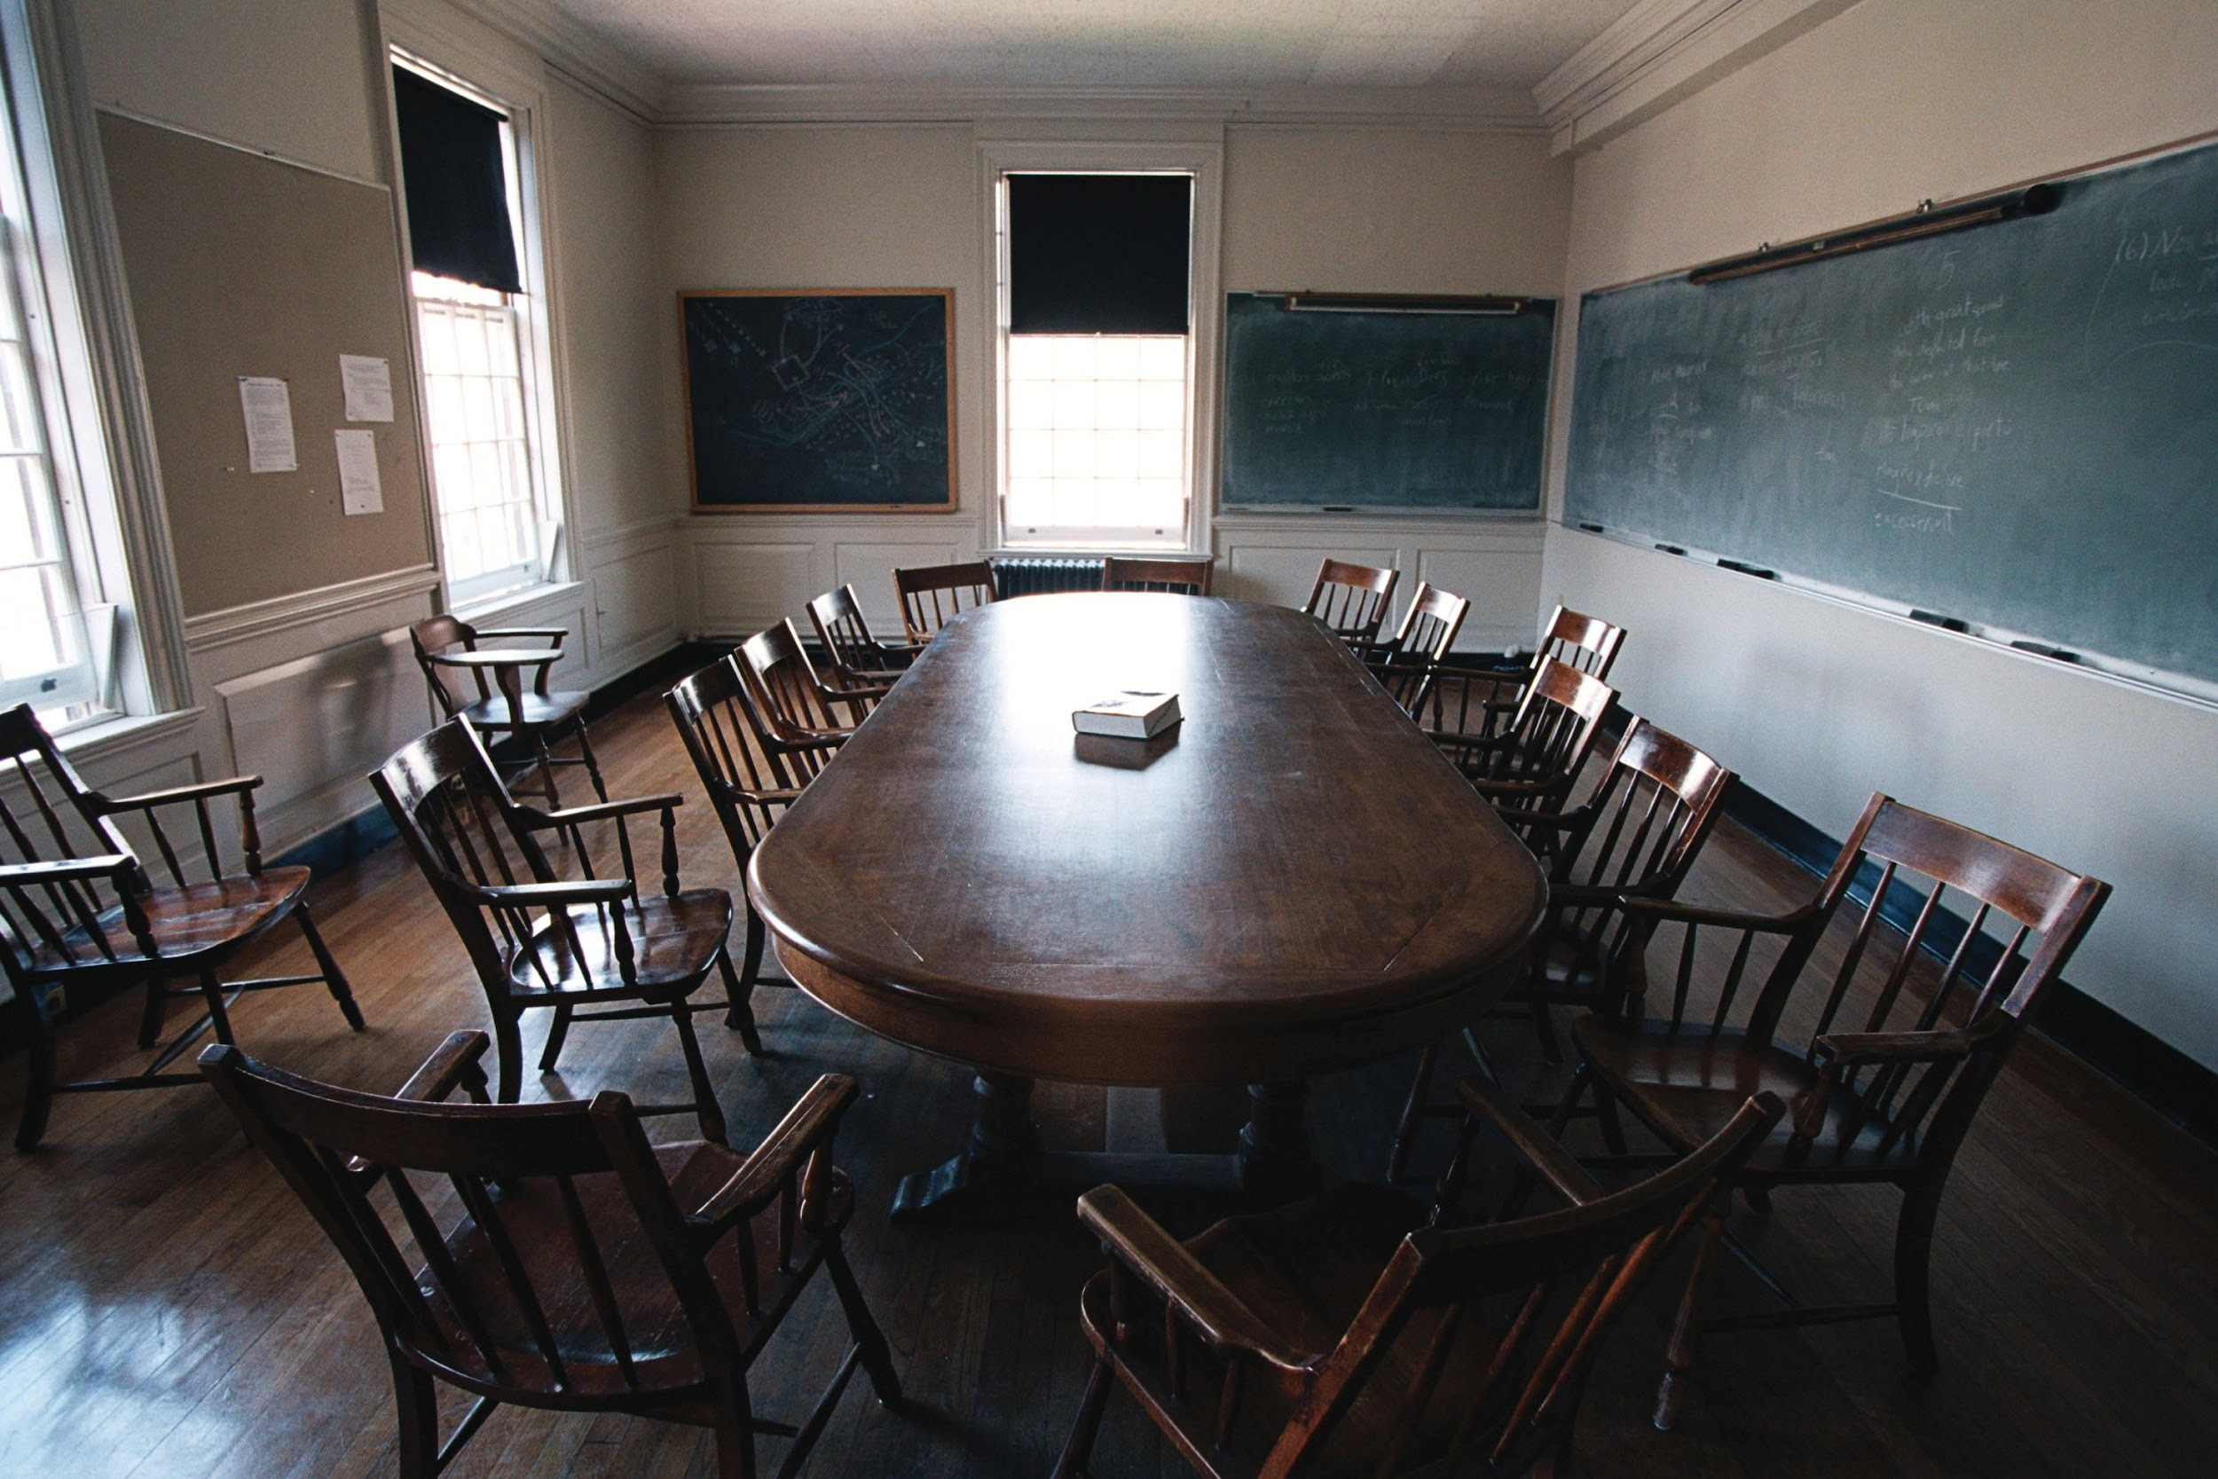
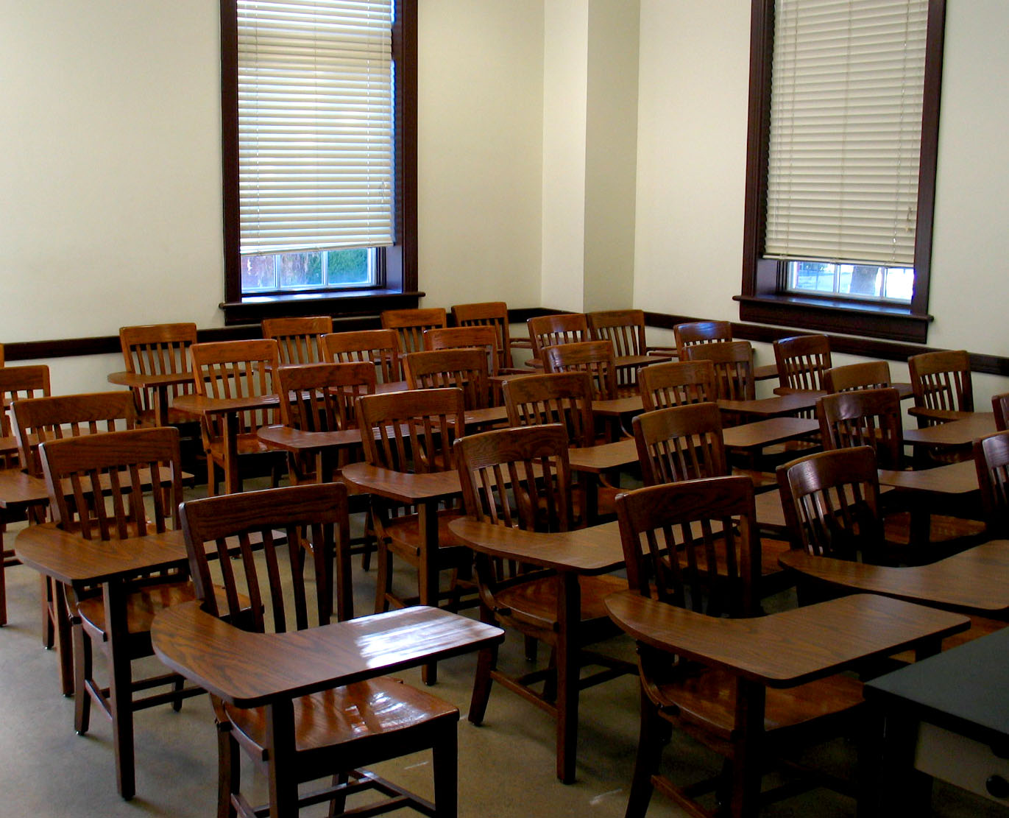
© Phillips Exeter Class of 1997 on Facebook. All rights reserved. This content is excluded from our Creative Commons license. For more information, see https://ocw.mit.edu/help/faq-fair-use/

Slide 16
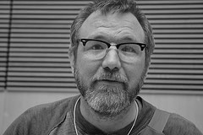
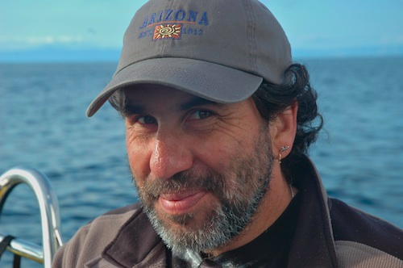
“Reverend” Jim Groom
Alan “Cogdog” Levine
Bavatuesdays.com
Reclaimhosting.com
Reclaiming Innovation, EDUCAUSE
http://www.educause.edu/visuals/shared/er/extras/2014/ReclaimingInnovation/default.html
http://cogdogblog.com/
Building Connected Courses
http://cogdogblog.com/2014/07/14/feed-wordpress-101/
Images © source unknown. All rights reserved. This content is excluded from our Creative Commons license. For more information, see https://ocw.mit.edu/help/faq-fair-use/

Slide 17
Stamped | Controlled | Destroyed
© Harvard University. All rights reserved. This content is excluded from our Creative Commons license. For more information, see https://ocw.mit.edu/help/faq-fair-use/
Coordination

Slide 18

Official Tweet of
This Talk

Slide 19

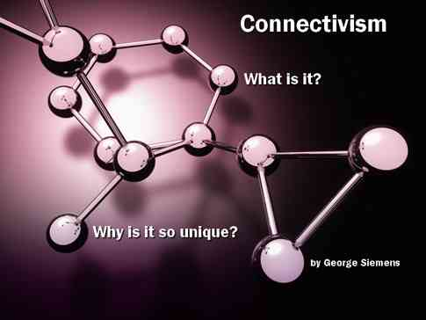
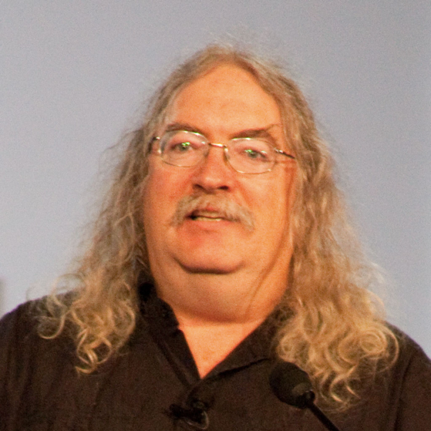
George Siemens
© source unknown. All rights reserved. This content is excluded from our Creative Commons license. For more information, see https://ocw.mit.edu/help/faq-fair-use/
Stephen Downes

Slide 20
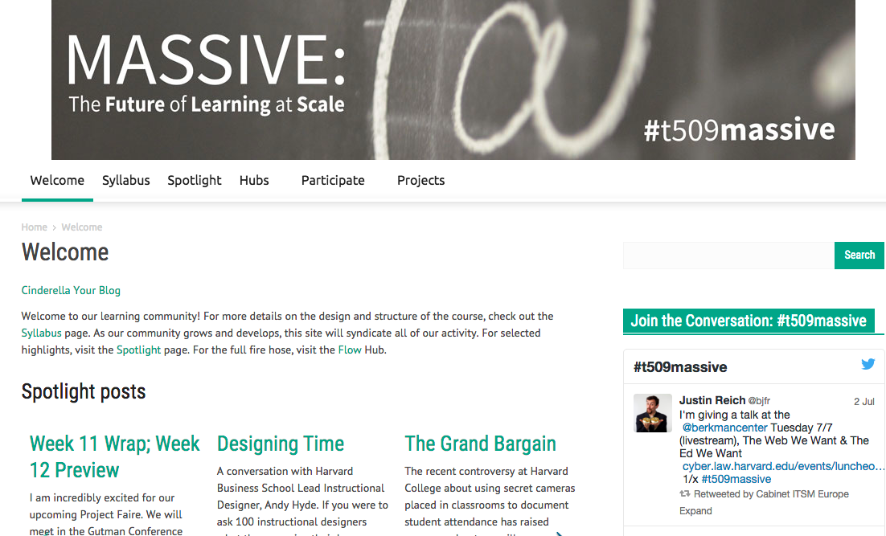
T509massive.org | mitmassive.org

Slide 21

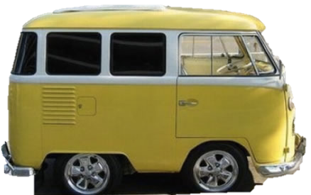



RSS
SYNDICATION BUS
© Wordpress, X Corp, Tumblr, others unknown. All rights reserved. This content is excluded from our Creative Commons license. For more information, see https://ocw.mit.edu/help/faq-fair-use/

Slide 22
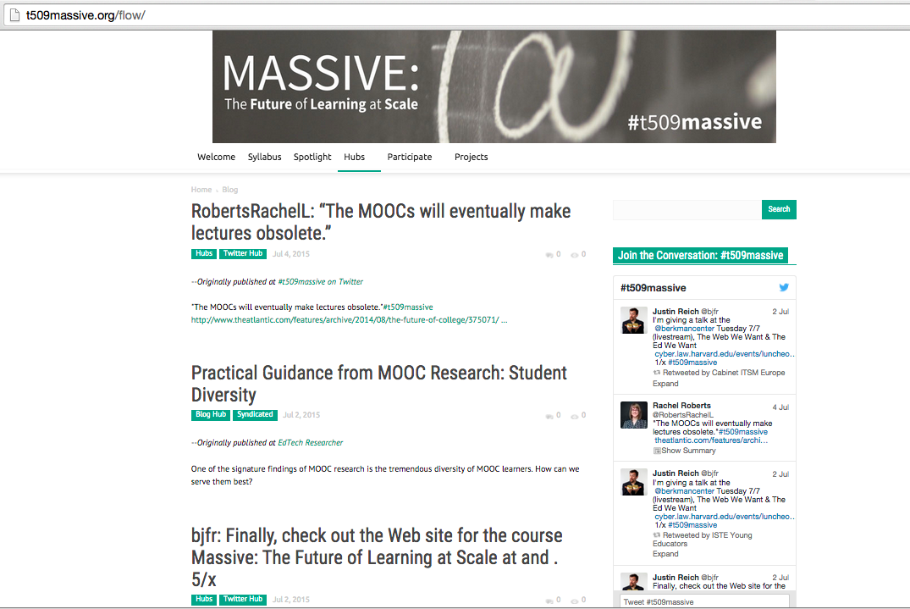

Slide 24
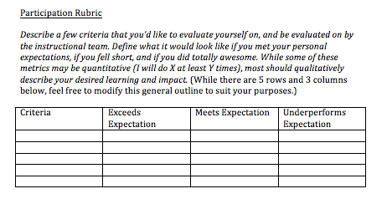

Slide 25
T509massive.org http://bit.ly/t561cce

Slide 26
Courtesy of DML Research Hub. Used under CC BY.

Slide 27
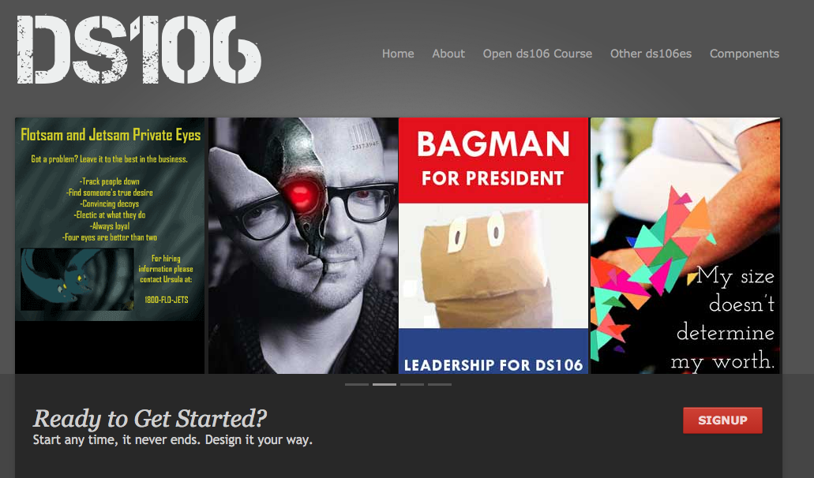
© https://ds106.us/. All rights reserved. This content is excluded from our Creative Commons license. For more information, see https://ocw.mit.edu/help/faq-fair-use/

Slide 28
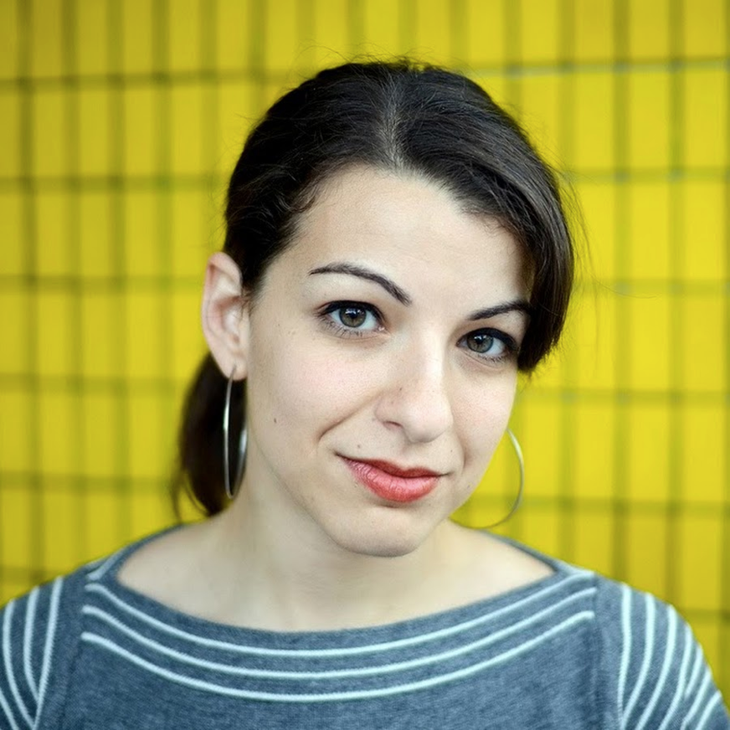
Curse of the Familiar
Inequitable Vulnerability
© source unknown. All rights reserved. This content is excluded from our Creative Commons license. For more information, see https://ocw.mit.edu/help/faq-fair-use/

Slide 29
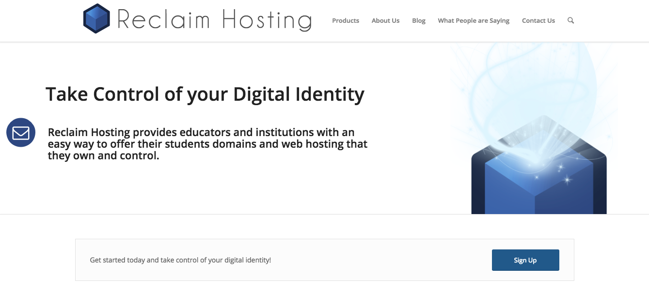

Above © Reclaim Hosting, LLC. Below © Known, Inc. All rights reserved. This content is excluded from our Creative Commons license. For more information, see https://ocw.mit.edu/help/faq-fair-use/

Slide 30
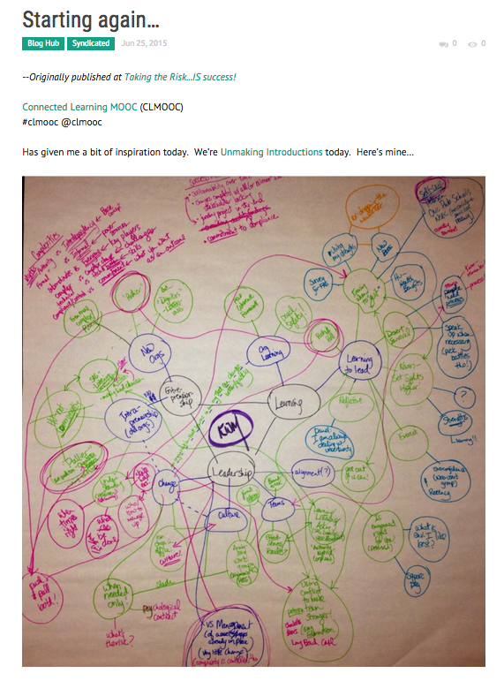
© CLMOOC. All rights reserved. This content is excluded from our Creative Commons license. For more information, see https://ocw.mit.edu/help/faq-fair-use/

Slide 31
MIT OpenCourseWare
https://ocw.mit.edu
CMS.595 Learning, Media, and Technology
Spring 2024
For information about citing these materials or our Terms of Use, visit: https://ocw.mit.edu/terms

