Slide 1

Learning Games:
Testing the Three Genres
Justin Reich
Massachusetts Institute of Technology
tsl.mit.edu

Slide 2
 |  | Technology | Pedagogy
Driven by | Instructor | LMS + Autograders | Thorndike
 | Algorithm | IRT + Autograders
 | Peer | Web + Aggregators | Dewey
Corresponding
games
Games in Ch. 5
Sequence of chapters
Math Blaster
(Luminosity?)
Zoombinis
Ch 1 -- MOOCs
Ch 2 – Intelligent Tutors
Math Blaster
Vanished
Duolingo
Duolingo
Ch 3 -- cMOOCs
Luminosity
Vanished
(Minecraft?)
Minecraft

Slide 3
Links to Explore:
https://playclassic.games/games/educational-dos-games-online/play-math-blaster-plus-online/play/
https://playclassic.games/games/educational-windows-games-online/logical-journey-of-the-zoombinis/play/
https://education.minecraft.net/
duolingo.com

Slide 4
 | Who controls/drives the pace and pathway of learning? | What are the core technologies? | What pedagogies inspired the design? | What can I predict will happen in my educational system given as a consequence of this design?
Math Blaster | Instructor | Auto-grader | Thorndike | just worksheet problems, not reconfiguring learning
Duolingo | Algorithm | IRT/auto-grader | Thorndike (or maybe not!) | Does gamification address challenges of self-paced learning? What are upper bounds of language learning outside a foreign country?
Vanished | Peer | Open web, aggregators | Dewey | This is cool, doesn’t fit into schools
Zoombinis | Instructor | Auto-grader | Dewey | Cost per combinatorics lesson?
Minecraft | Peer | Open web, aggregators | Dewey | Doesn’t fit well with how time is organized,

Slide 5
Transfer—the application of learning from one domain to another—is much less likely to happen than teachers or learners hope
(Alas, for historians reading on the internet, for softball players reading soccer passages, or computer programmers writing essays…)
Near transfer is more likely than far transfer, and the bounds of “near” are much smaller than we would hope

Slide 6
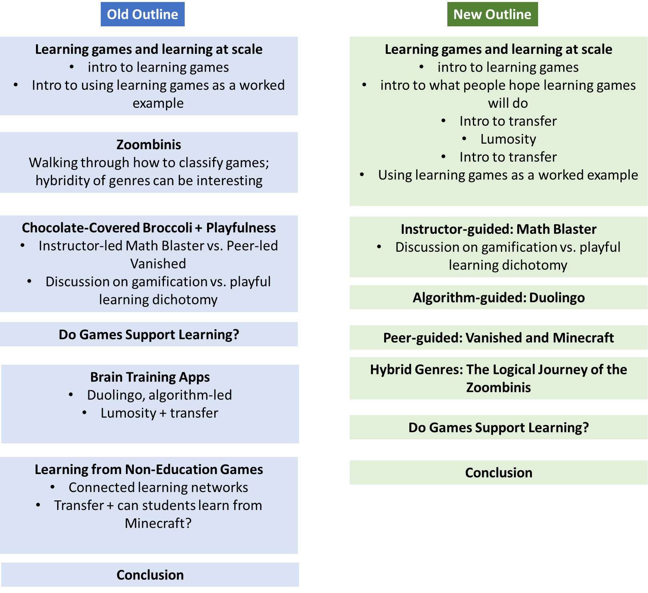

Slide 7
Using the L@S Genres
Who controls the pace and pathway of learning?
What are the core technologies?
What pedagogies inspired the design?
Math Blaster
(Lumosity?)
Duolingo
Vanished
(Minecraft?)

Slide 8
MIT OpenCourseWare
https://ocw.mit.edu
CMS.595 Learning, Media, and Technology
Spring 2024
For information about citing these materials or our Terms of Use, visit: https://ocw.mit.edu/terms

