Slide 1

Failure to Disrupt:
Why Technology Alone Can’t Transform Education
failuretodisrupt.com
Free online book club
teachlabpodcast.com
Justin Reich
Mitsui Career Development Professor
Massachusetts Institute of Technology
Director, MIT Teaching Systems Lab
tsl.mit.edu

Slide 2
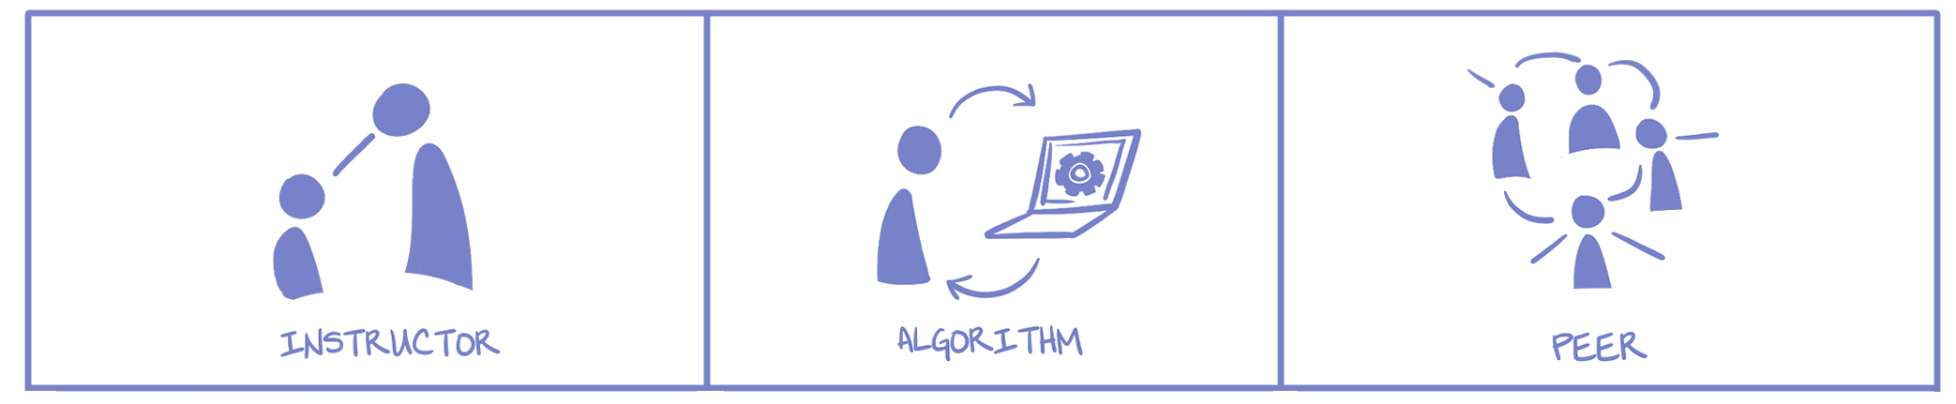
Three Genres
Who guides the sequence of learning activities?

Slide 3
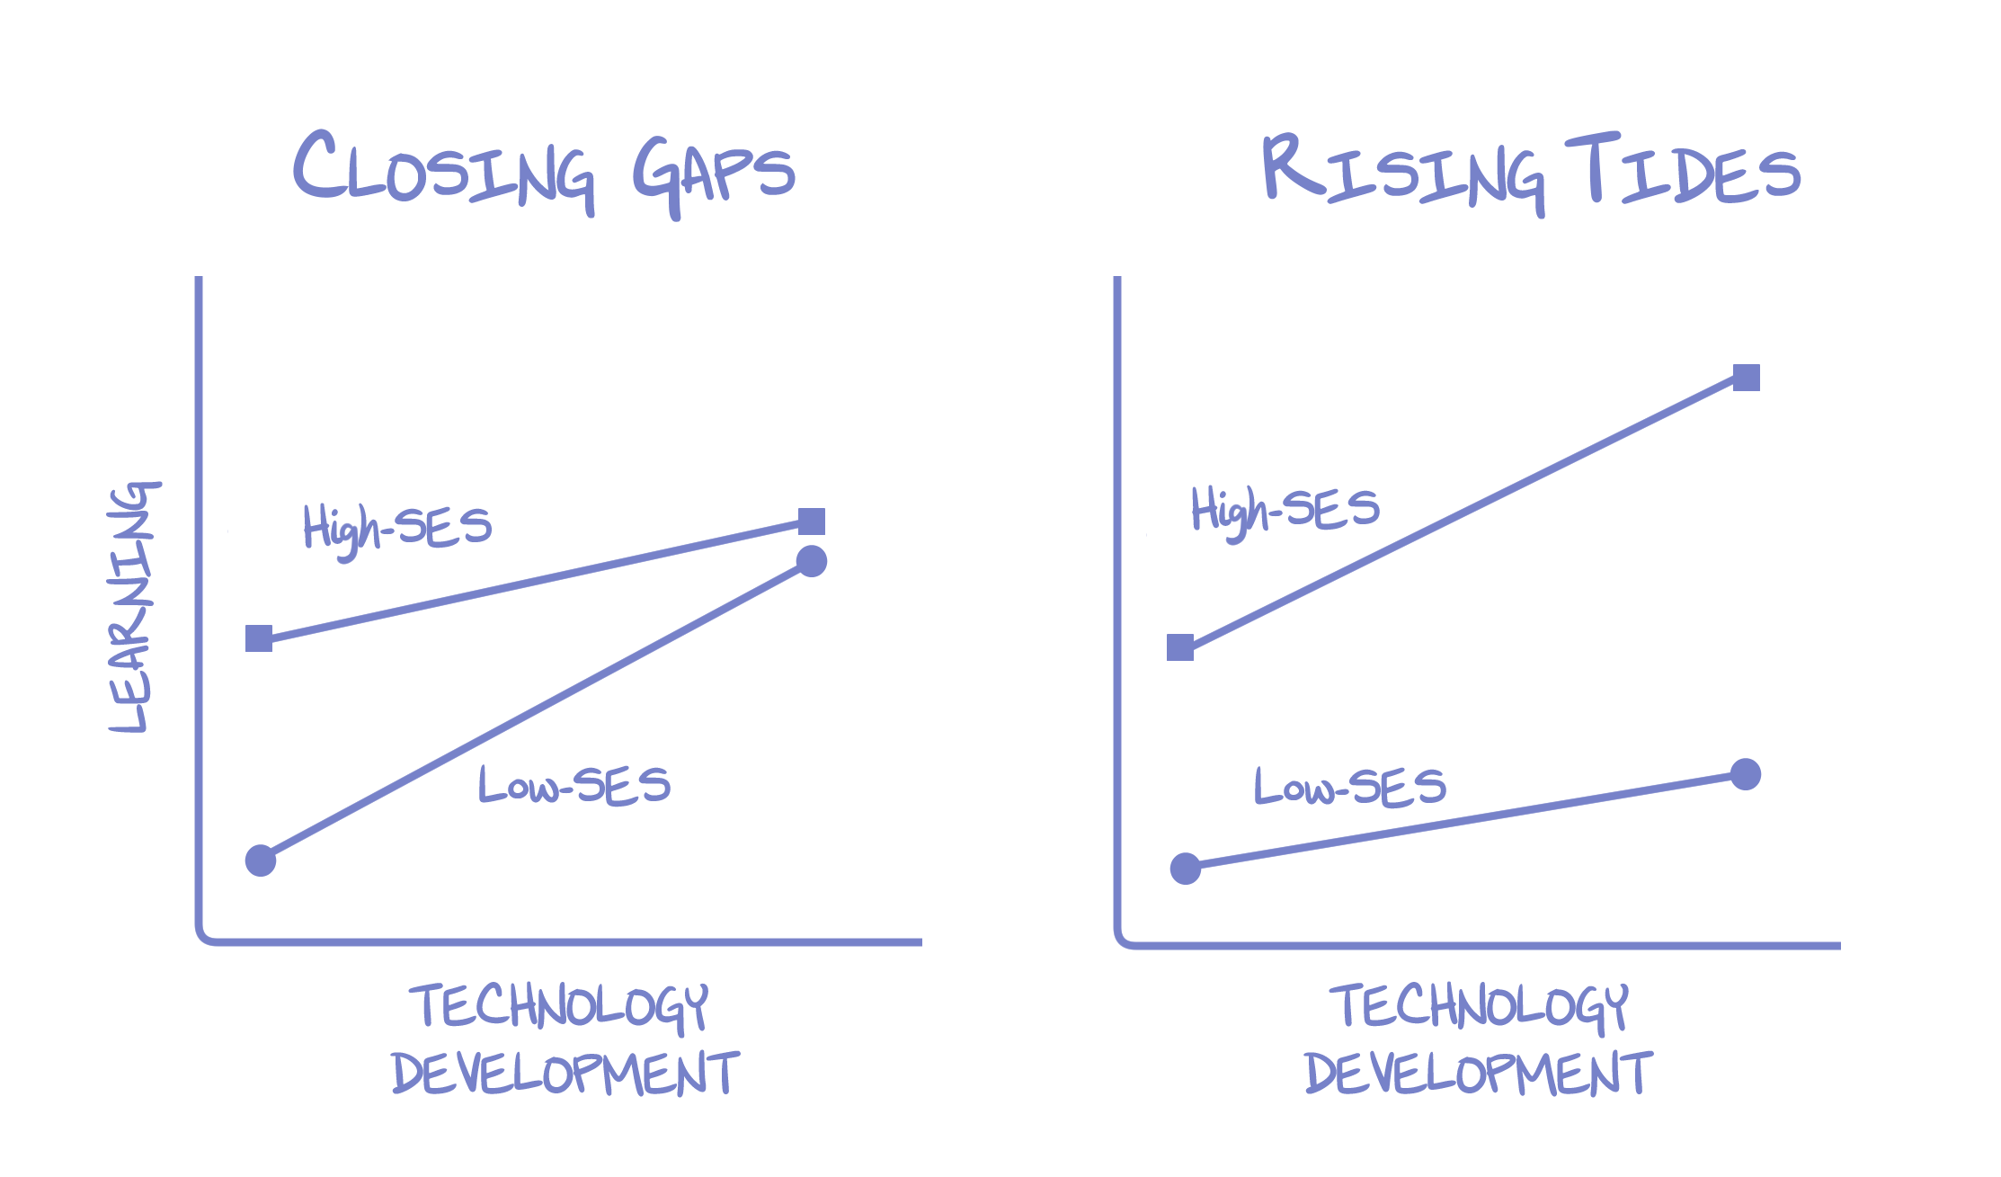
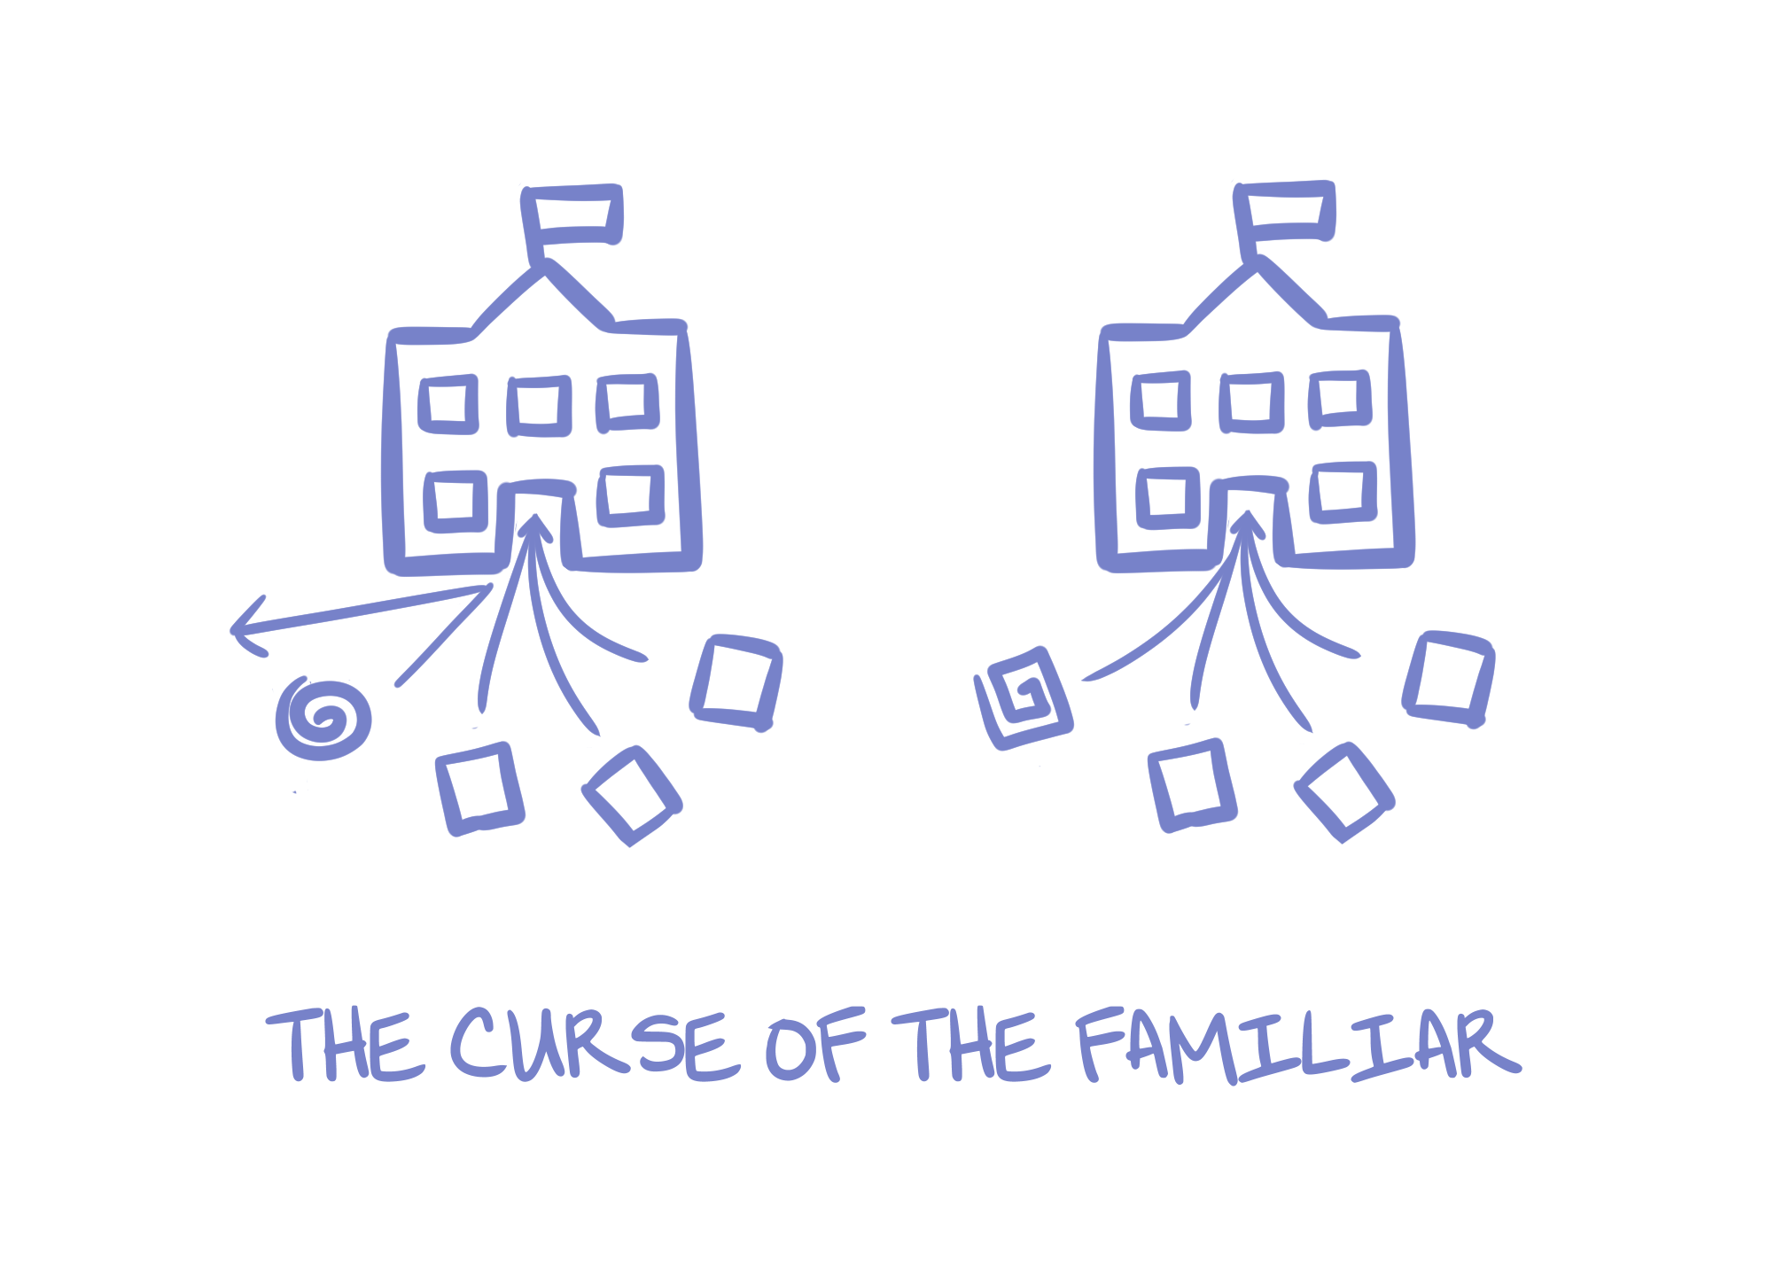
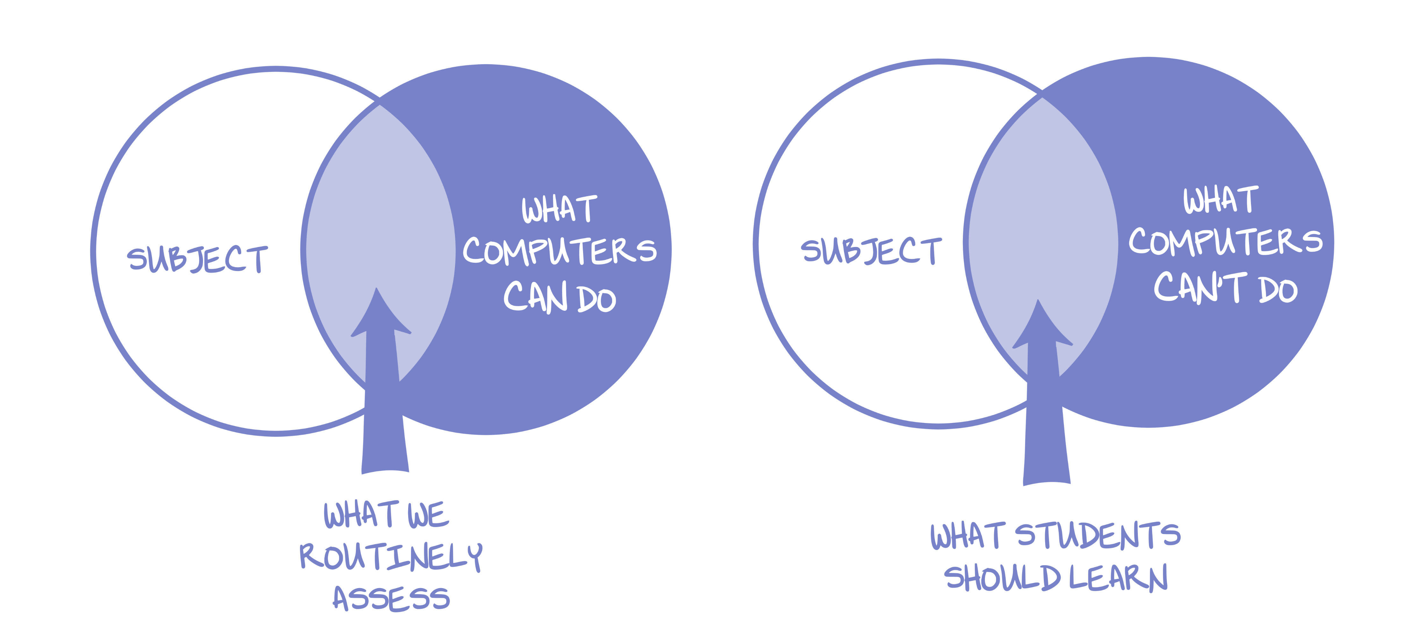
Four “As-Yet Intractable Dilemmas”
Curse of the Familiar
EdTech Matthew Effect
Trap of Routine Assessment
Toxic Power of Data and Experiments

Slide 4
Curse of the Familiar

Slide 5
Curse of the Familiar
Digitizing
Existing
Routines

Slide 6
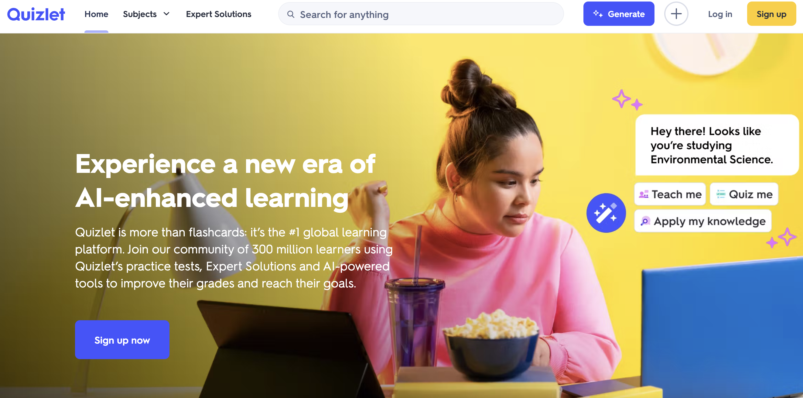
© Quizlet, Inc. All rights reserved. This content is excluded from our Creative Commons license. For more information, see https://ocw.mit.edu/help/faq-fair-use/

Slide 7
Curse of the Familiar
Rejecting
Novel
Approaches

Slide 8
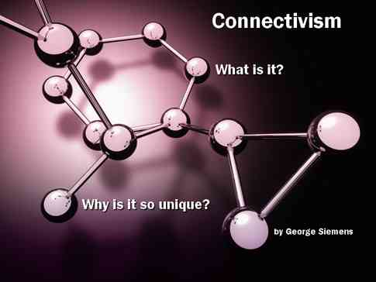
George Siemens
© source unknown. All rights reserved. This content is excluded from our Creative Commons license. For more information, see https://ocw.mit.edu/help/faq-fair-use/
Stephen Downes

Slide 9
Start with the familiar then go new places
Cultivate professional
communities

Slide 10
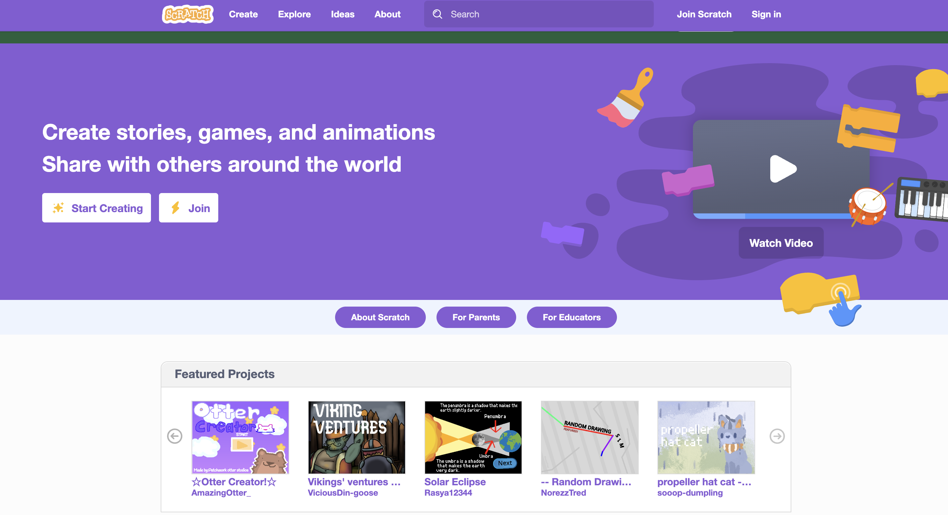
© Scratch Team at MIT. All rights reserved. This content is excluded from our Creative Commons license. For more information, see https://ocw.mit.edu/help/faq-fair-use/

Slide 11
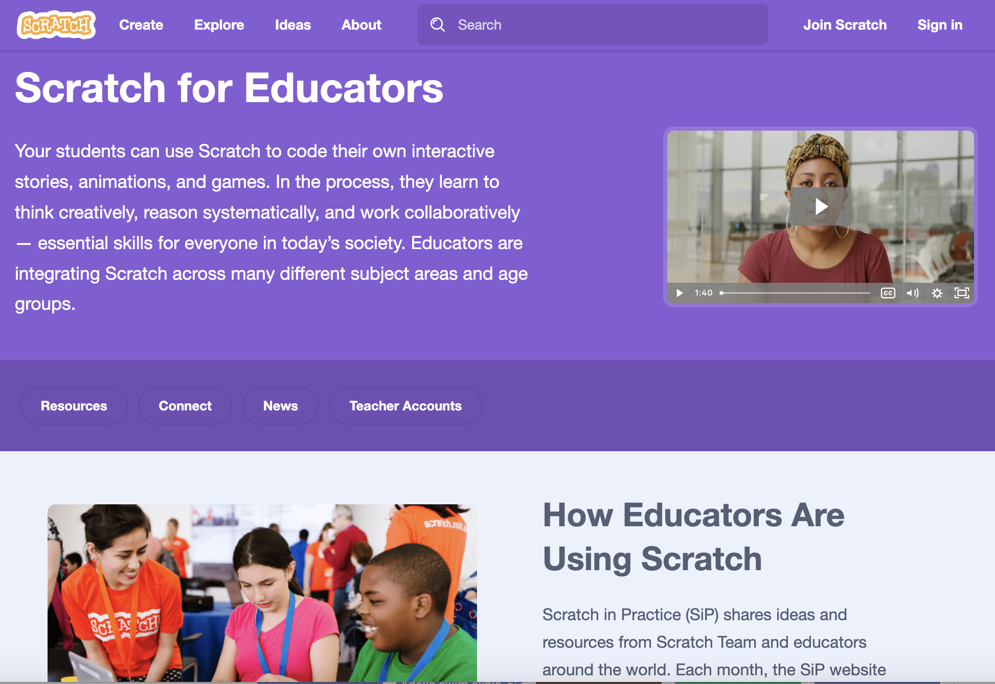
© Scratch Team at MIT. All rights reserved. This content is excluded from our Creative Commons license. For more information, see https://ocw.mit.edu/help/faq-fair-use/

Slide 12
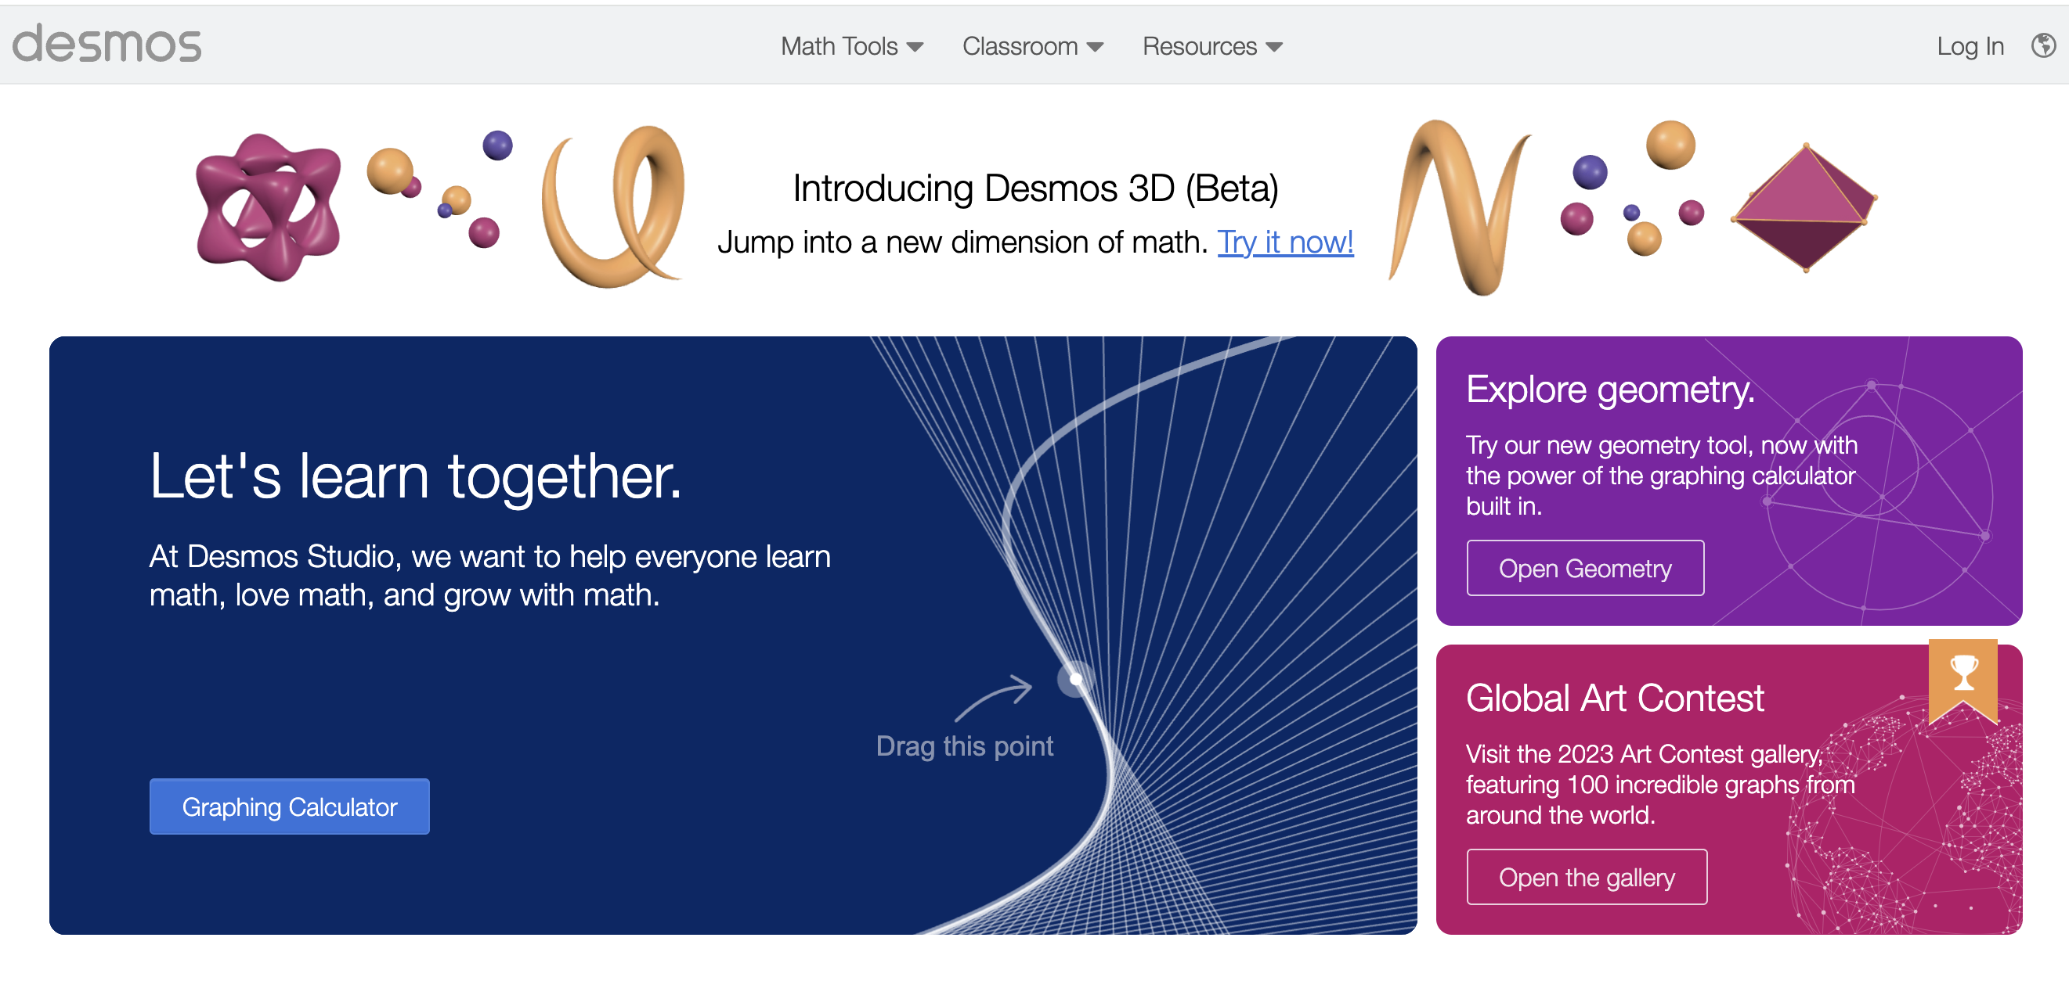
© Desmos Studio, PBC. All rights reserved. This content is excluded from our Creative Commons license. For more information, see https://ocw.mit.edu/help/faq-fair-use/

Slide 13
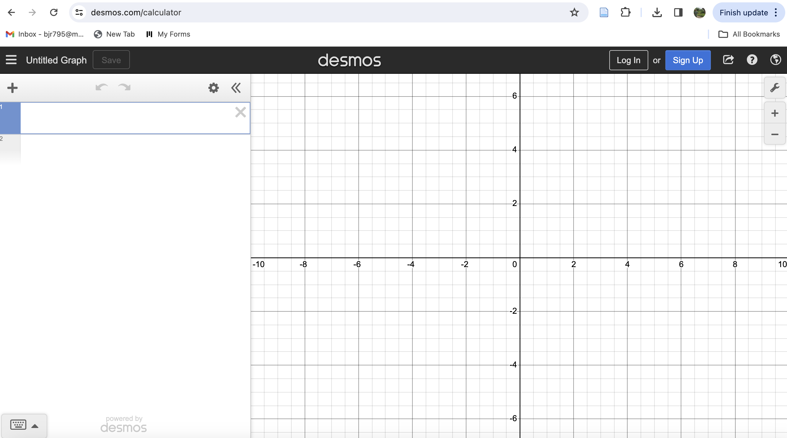
© Desmos Studio, PBC. All rights reserved. This content is excluded from our Creative Commons license. For more information, see https://ocw.mit.edu/help/faq-fair-use/

Slide 14
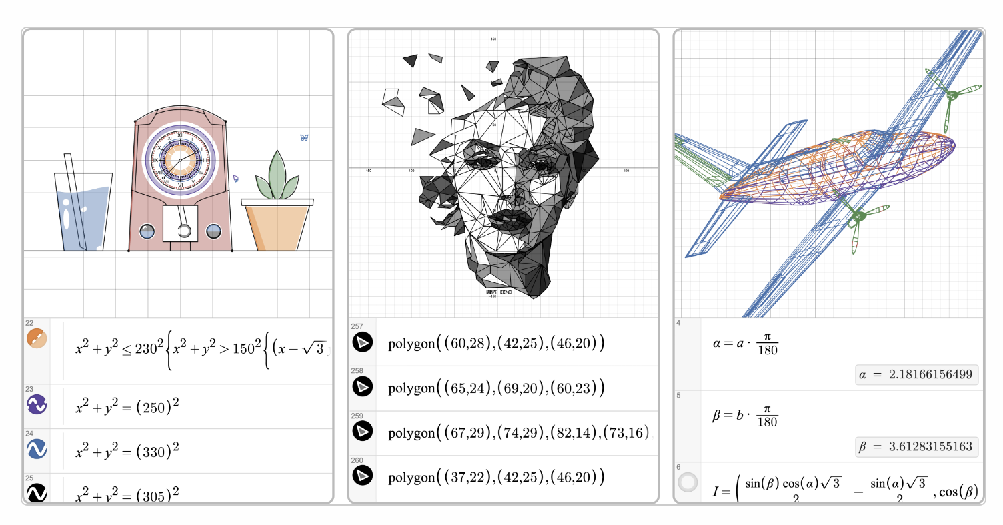

Slide 15
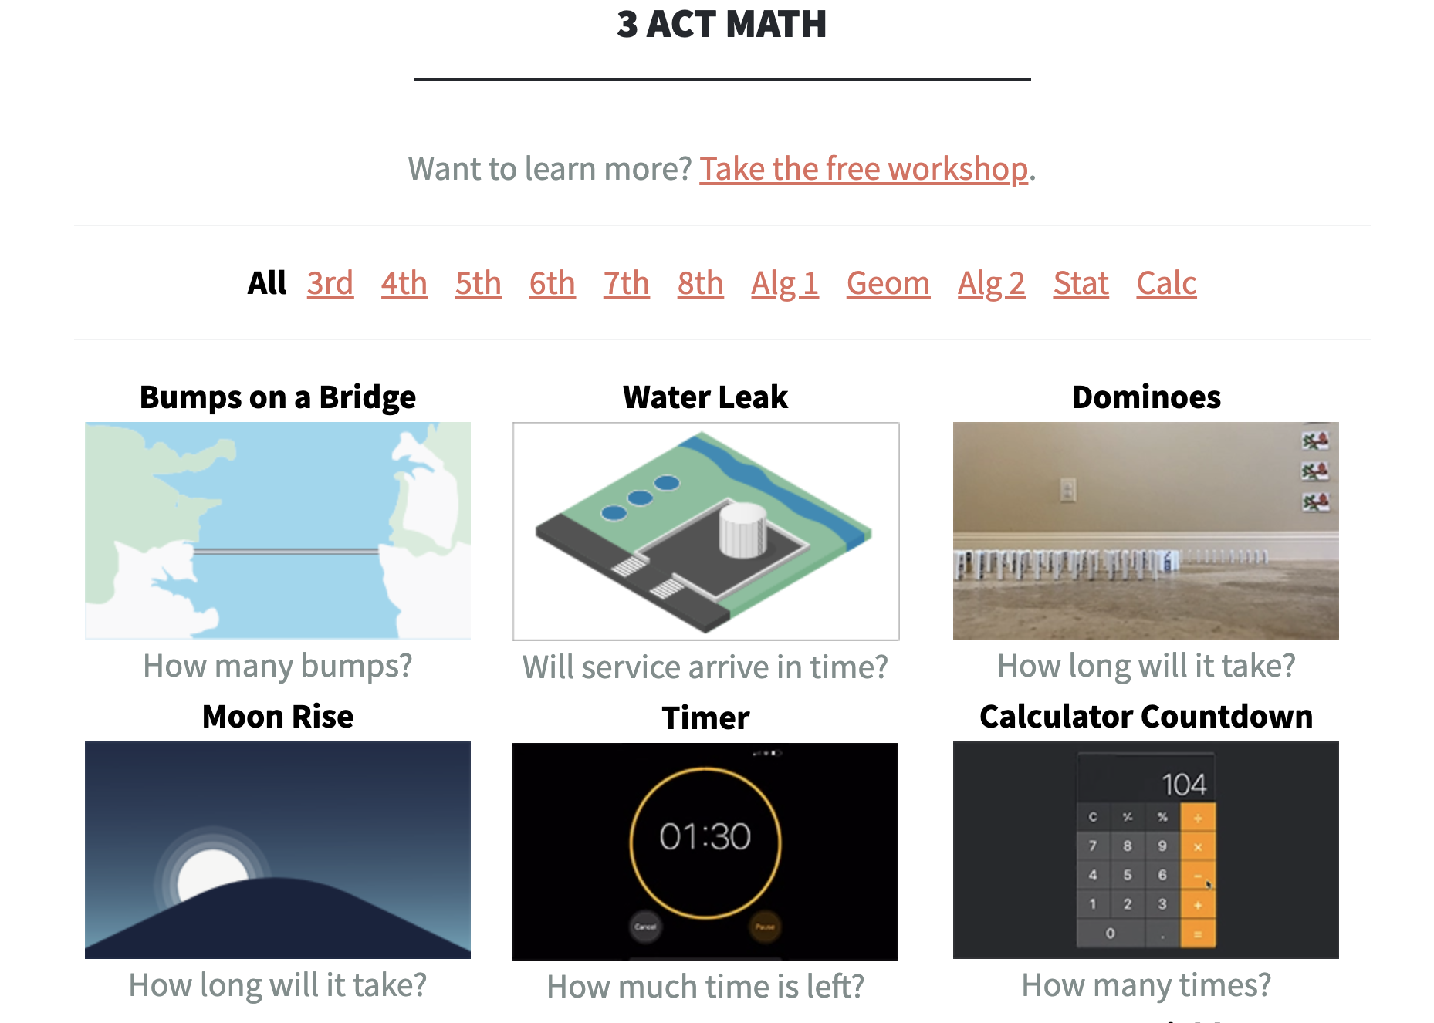
© Dane Ehlert. All rights reserved. This content is excluded from our Creative Commons license. For more information, see https://ocw.mit.edu/help/faq-fair-use/

Slide 16
Start with the familiar then go new places
Cultivate professional
communities

Slide 17
MIT OpenCourseWare
https://ocw.mit.edu
CMS.595 Learning, Media, and Technology
Spring 2024
For information about citing these materials or our Terms of Use, visit: https://ocw.mit.edu/terms

