Slide 1

Welcome to Learning, Media, and Technology
DO NOW: Get in groups of 2-3. Discuss your personal edtech history. Are your experiences similar or different? What stands out as really great or terrible in your history with edtech?
Image © illustration by Haley McDevitt; published by Jossey-Bass. All rights reserved. This content is excluded from our Creative Commons license. For more information, see https://ocw.mit.edu/help/faq-fair-use/

Slide 2
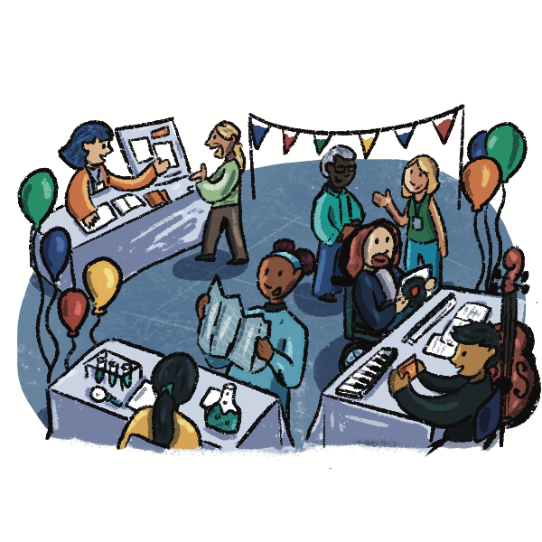
Agenda (1-2:30pm Eastern)
Getting Started (1:05-1:30)
Your edtech history
Assignment #1
Starting with learning theory
Cognitive Load Theory: (1:30-2:25)
Drawing models of cognitive architecture
From models of cognitive architecture to instructional principles
© Haley McDevitt. All rights reserved. This content is excluded from our Creative Commons license. For more information, see
https://ocw.mit.edu/help/faq-fair-use/

Slide 3
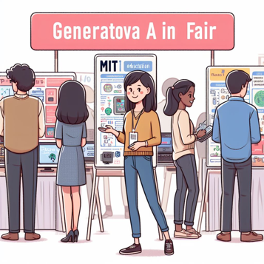

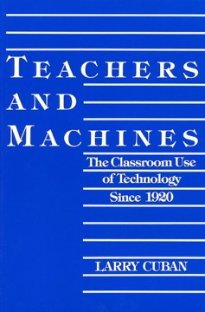
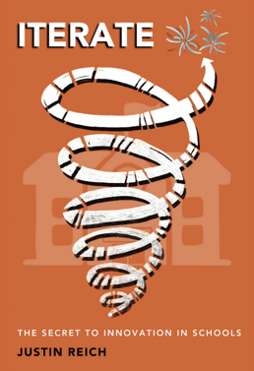
Part I: Foundations
Image by Justin Reich generated in DallE.
Theories of Teaching and Learning:
Cognitive Load Theory (Mens)
Situated Learning (Manus)
EdTech and MIT
MIT Museum and Gen AI
CS and Equity in Mass.
Online Learning for Teachers
EdTech Before the Internet
Larry Cuban’s Teachers and Machines
Changing Practices in Schools
Justin Reich’s Iterate: The Secret to Innovation in Schools
MIT seal © MIT. Teachers and Machines © Teachers College Press. Iterate © Jossey-Bass.
All rights reserved. This content is excluded from our Creative Commons license. For more information, see https://ocw.mit.edu/help/faq-fair-use/

Slide 4
Assignments
Assignment #1- EdTech From a Learning Science Perspective
  Evaluate an education technology and identify its pedagogical roots. Then, reimagine the technology from alternative pedagogical perspective.
  Example: Scratch is a community-centered platform for learning creative computing. It’s inspired by constructivism.
    Connect specific features of Scratch with specific principals of constructivism
    Redesign Scratch through instructionism

Slide 5
Education:
Filling Pails or Kindling Flames?
MIT seal © MIT. All rights reserved. This content is excluded from our Creative Commons license. For more information, see https://ocw.mit.edu/help/faq-fair-use/

Slide 6
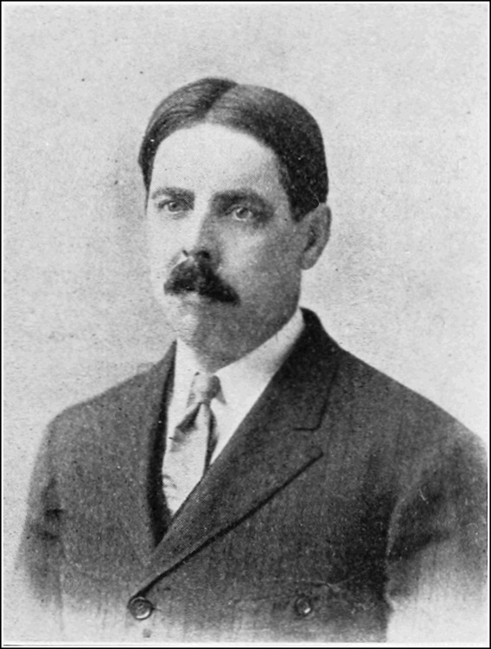
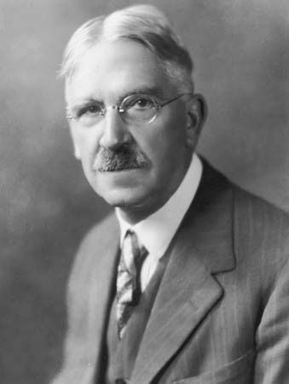
© Archive Photos/Hulton Archive/Getty Images. All rights reserved. This content is excluded from our Creative Commons license. For more information, see https://ocw.mit.edu/help/faq-fair-use/
Image is in the public domain.
Edward Thorndike
Education as Science of Delivery
John Dewey
Education as Life

Slide 7

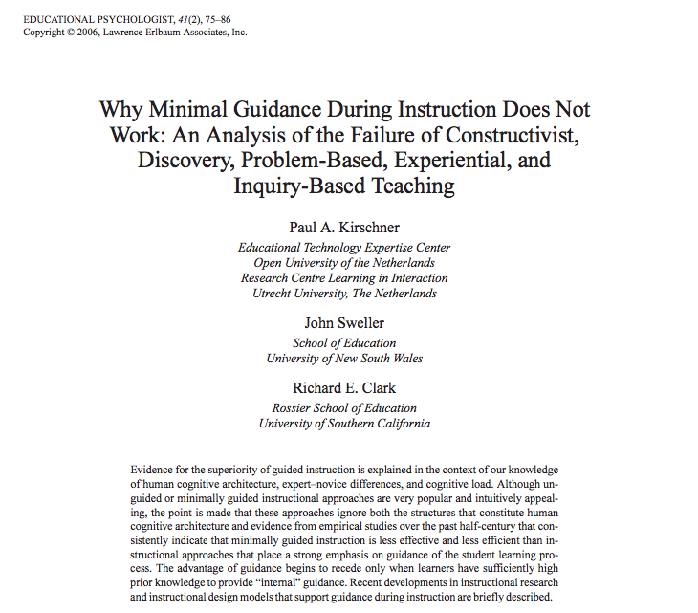
“One cannot understand the history of education in the United States during the 20th century unless one realizes that Edward L. Thorndike won and John Dewey lost.”
-Ellen Lagemann
Left © Lawrence Earlbaum Associates, Inc. Right © MIT Press. All rights reserved. This content is excluded from our Creative Commons license. For more information, see https://ocw.mit.edu/help/faq-fair-use/

Slide 8
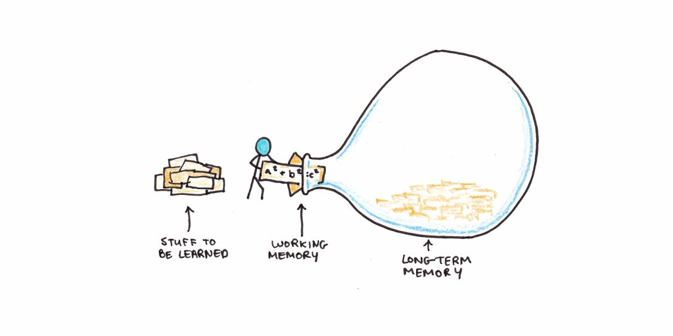
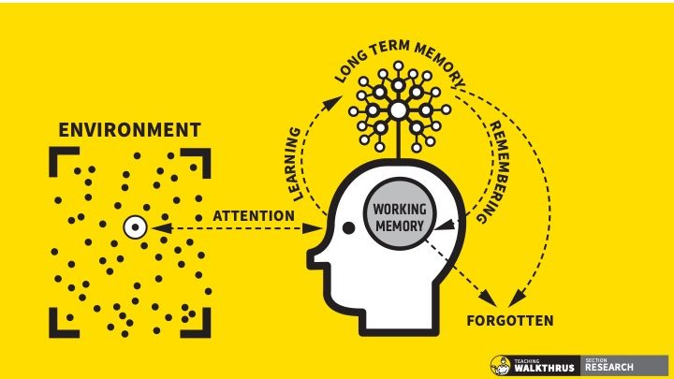
Models of Human Cognitive Architecture
https://www.scotthyoung.com/blog/2022/01/04/cognitive-load-theory/
https://teacherhead.com/2021/06/22/the-genius-of-dt-willingham-and-wdsls/
Left © ScottHYoung.com Services Ltd. Right © Oliver Caviglioli. All rights reserved. This content is excluded from our Creative Commons license. For more information, see https://ocw.mit.edu/help/faq-fair-use/

Slide 9

© ReSanskrit. All rights reserved. This content is excluded from our Creative Commons license. For more information, see
https://ocw.mit.edu/help/faq-fair-use/

Slide 11
© ReSanskrit. All rights reserved. This content is excluded from our Creative Commons license. For more information, see
https://ocw.mit.edu/help/faq-fair-use/

Slide 12
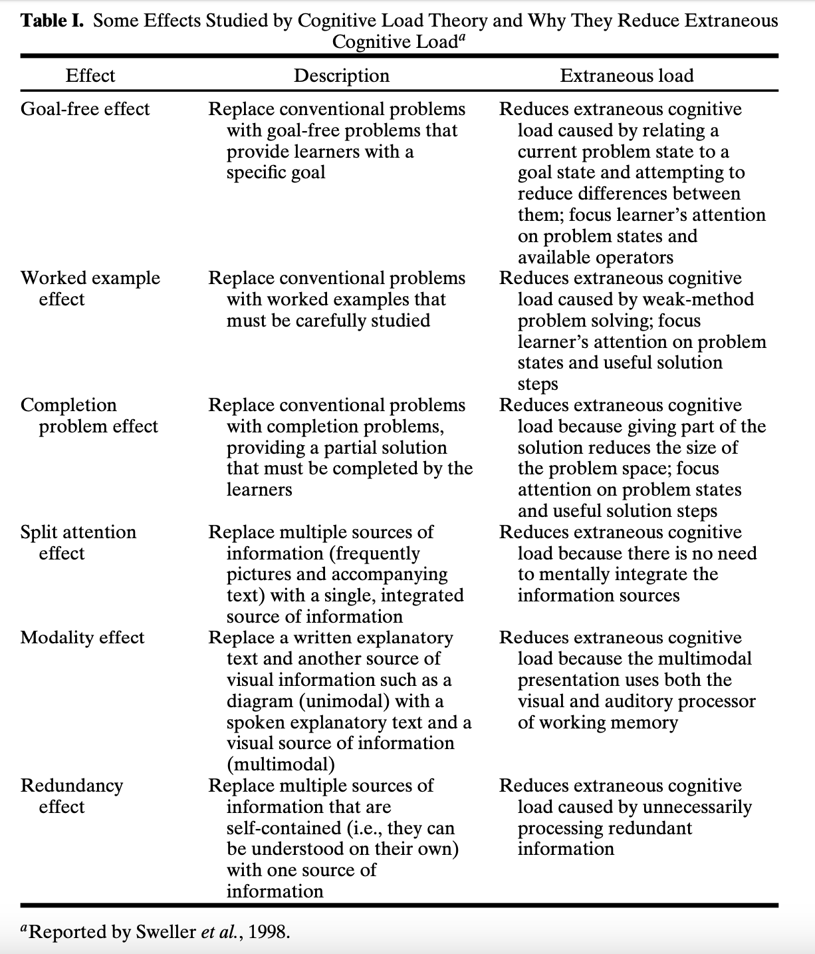
Instructional guidance follows from a particular view of cognitive architecture
Table © Springer Science+Business Media, Inc. All rights reserved. This content is excluded from our Creative Commons license. For more information, see https://ocw.mit.edu/help/faq-fair-use/

Slide 13
Understanding Questions:
According to CLT, what is the main bottleneck in the learning process?
What are the goals of CLT-based instruction? What would end-state proficiency look like in a domain?
What methods do CLT researchers use to evaluate instructional techniques?

Slide 14
Insights from readings:
Pershan, Not a Theory of Everything
Sweller, Story of a Research Program

Slide 15
MIT OpenCourseWare
https://ocw.mit.edu
CMS.595 Learning, Media, and Technology
Spring 2024
For information about citing these materials or our Terms of Use, visit: https://ocw.mit.edu/terms

