Slide 1

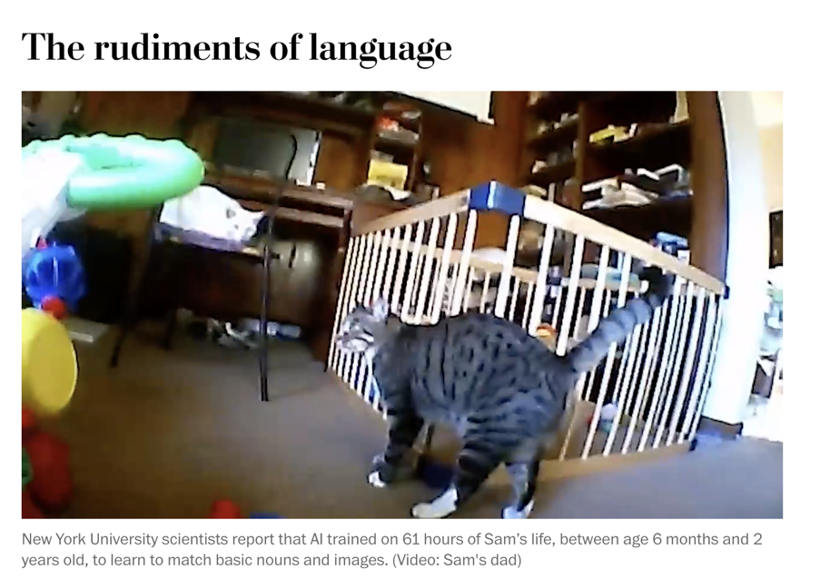
Situated Learning
DO NOW: Turn to a partner. Why would babies be a big problem for cognitive load theorists.
https://www.washingtonpost.com/science/2024/02/02/how-humans-learn-language-ai-child/
Background © illustration by Haley McDevitt; published by Jossey-Bass. Cat © Sam's dad / The Washington Post. All rights reserved. This content is excluded from our Creative Commons license. For more information, see https://ocw.mit.edu/help/faq-fair-use/

Slide 2
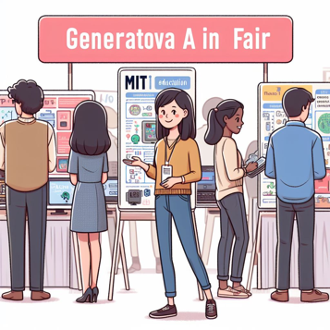

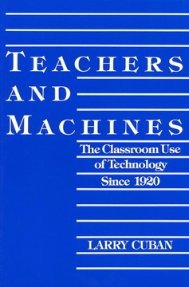

Part I: Foundations
Image by Justin Reich generated in DallE.
Theories of Teaching and Learning:
Cognitive Load Theory (Mens)
Situated Learning (Manus)
EdTech and MIT
MIT Museum and Gen AI
CS and Equity in Mass.
Online Learning for Teachers
EdTech Before the Internet
Larry Cuban’s Teachers and Machines
Changing Practices in Schools
Justin Reich’s Iterate: The Secret to Innovation in Schools
MIT seal © MIT. Teachers and Machines © Teachers College Press. Iterate © Jossey-Bass.
All rights reserved. This content is excluded from our Creative Commons license. For more information, see https://ocw.mit.edu/help/faq-fair-use/

Slide 3
Education:
Filling Pails or Kindling Flames?
MIT seal © MIT. All rights reserved. This content is excluded from our Creative Commons license. For more information, see https://ocw.mit.edu/help/faq-fair-use/

Slide 4
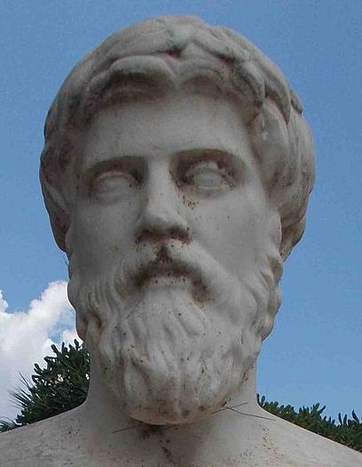
For the mind does not require filling like a bottle, but rather, like wood, it only requires kindling to create in it an impulse to think independently and an ardent desire for truth. Plutarch (~50 AD), On Listening
Translation from 1927 Loeb Classic
Photo © Odysses at Wikimedia. All rights reserved. This content is excluded from our Creative Commons license. For more information, see https://ocw.mit.edu/help/faq-fair-use/
Notes:
https://upload.wikimedia.org/wikipedia/commons/6/62/Plutarch_head_only.jpg

Slide 5
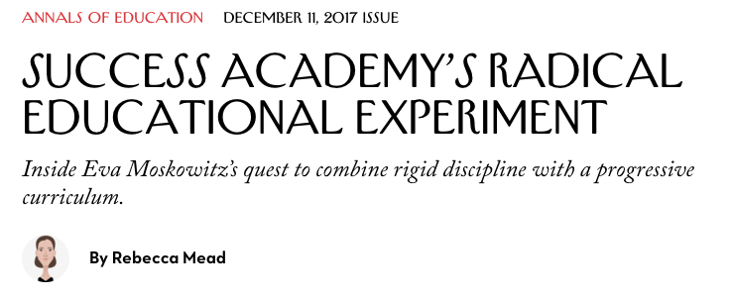
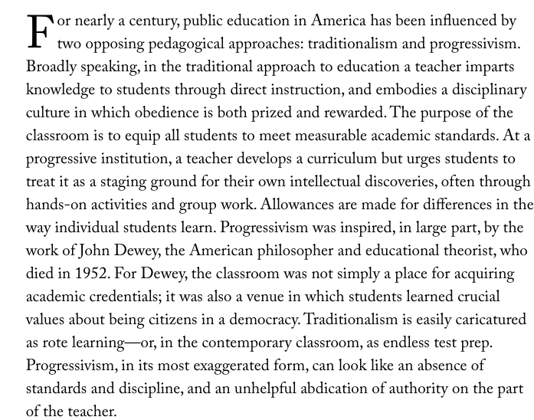
© Condé Nast. All rights reserved. This content is excluded from our Creative Commons license. For more information, see https://ocw.mit.edu/help/faq-fair-use/

Slide 6
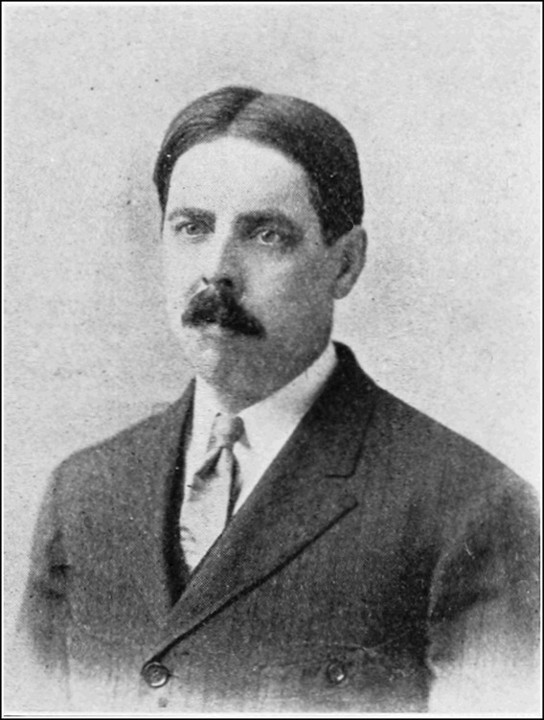
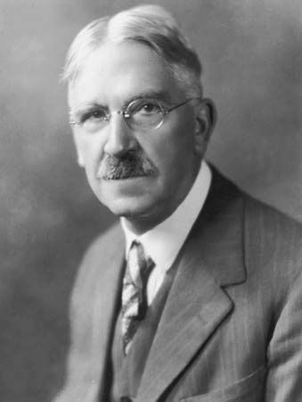
© Archive Photos/Hulton Archive/Getty Images. All rights reserved. This content is excluded from our Creative Commons license. For more information, see https://ocw.mit.edu/help/faq-fair-use/
Image is in the public domain.
Edward Thorndike
Education as Science of Delivery
John Dewey
Education as Life

Slide 7
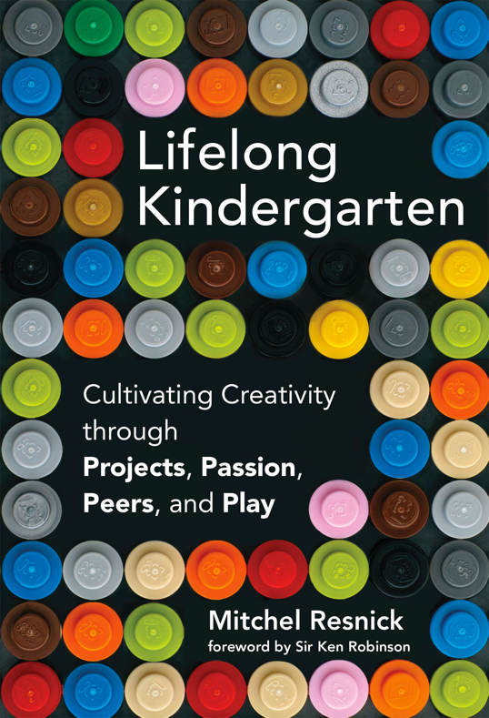
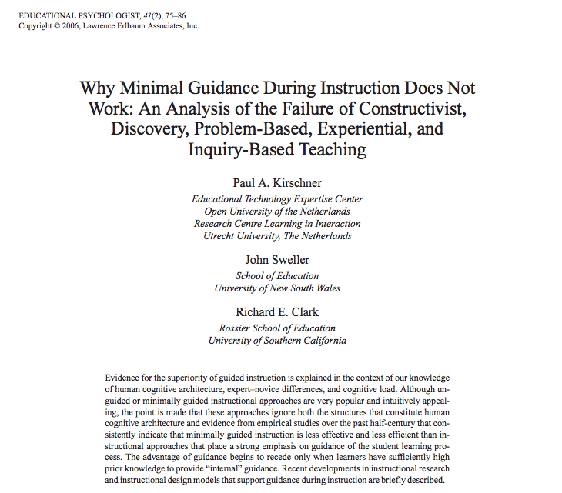
“One cannot understand the history of education in the United States during the 20th century unless one realizes that Edward L. Thorndike won and John Dewey lost.”
-Ellen Lagemann
Left © Lawrence Earlbaum Associates, Inc. Right © MIT Press. All rights reserved. This content is excluded from our Creative Commons license. For more information, see https://ocw.mit.edu/help/faq-fair-use/

Slide 8
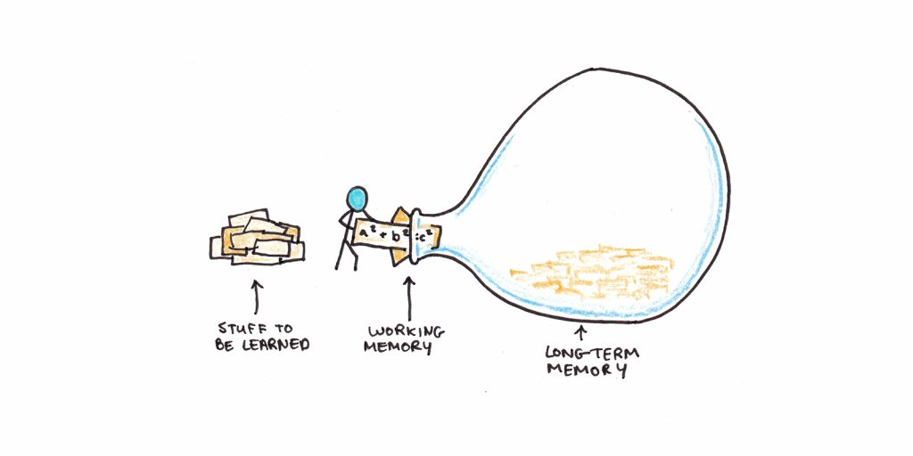
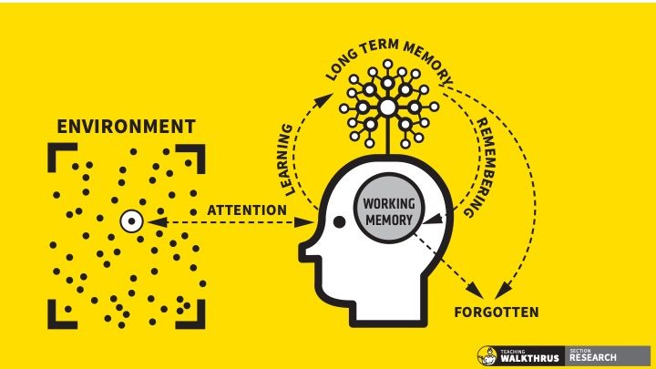
Models of Human Cognitive Architecture
https://www.scotthyoung.com/blog/2022/01/04/cognitive-load-theory/
https://teacherhead.com/2021/06/22/the-genius-of-dt-willingham-and-wdsls/
Left © ScottHYoung.com Services Ltd. Right © Oliver Caviglioli. All rights reserved. This content is excluded from our Creative Commons license. For more information, see https://ocw.mit.edu/help/faq-fair-use/

Slide 9
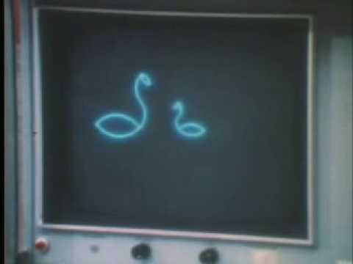
© Unknown. Obtained from Seth Morabito's page at https://www.youtube.com/watch?v=xMzojQFyMo0. All rights reserved. This content is excluded from our Creative Commons license. For more information, see https://ocw.mit.edu/help/faq-fair-use/.

Slide 10
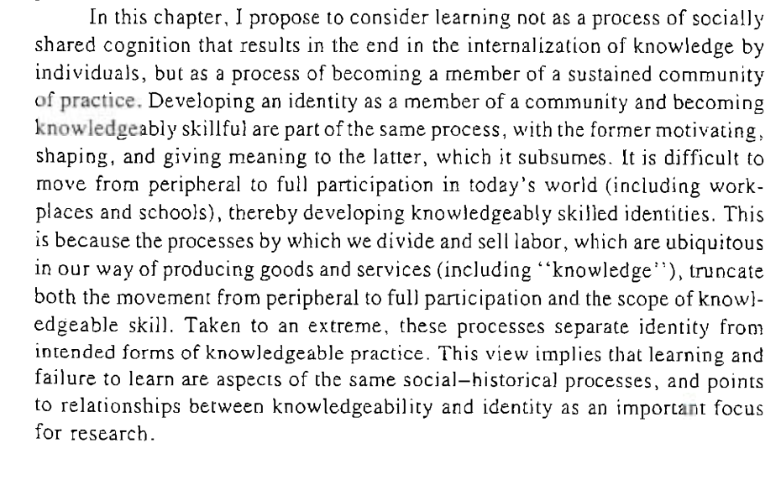
© Jean Lave / American Psychological Association. All rights reserved. This content is excluded from our Creative Commons license. For more information, see https://ocw.mit.edu/help/faq-fair-use/

Slide 11
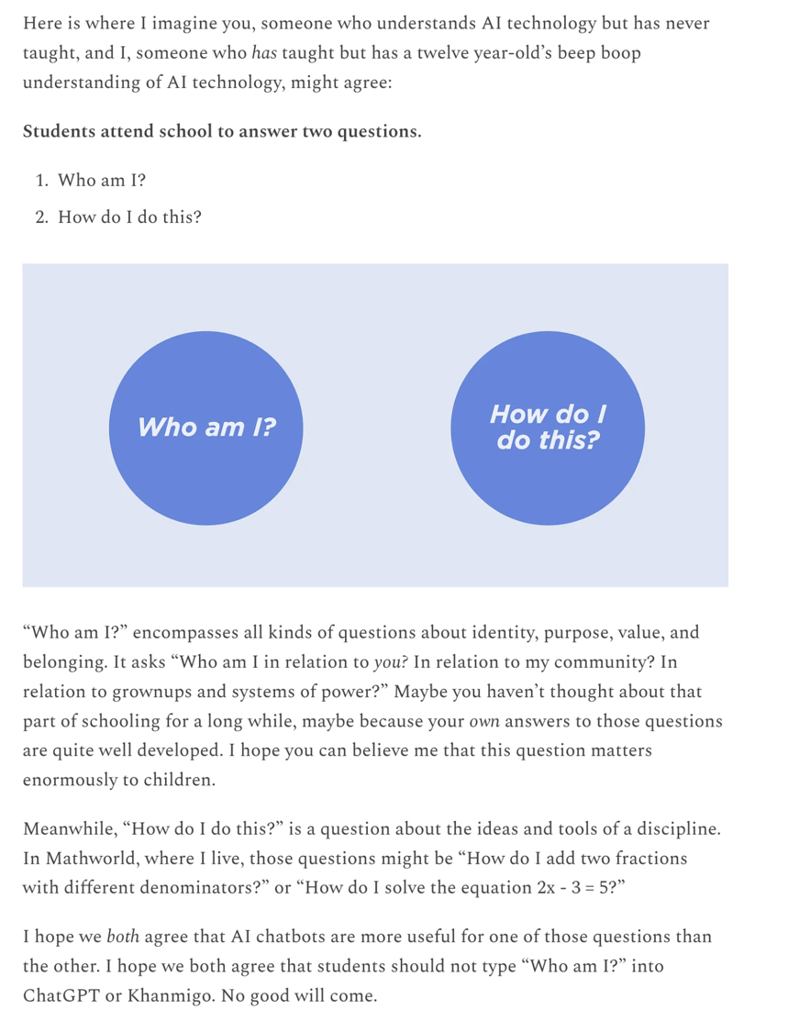
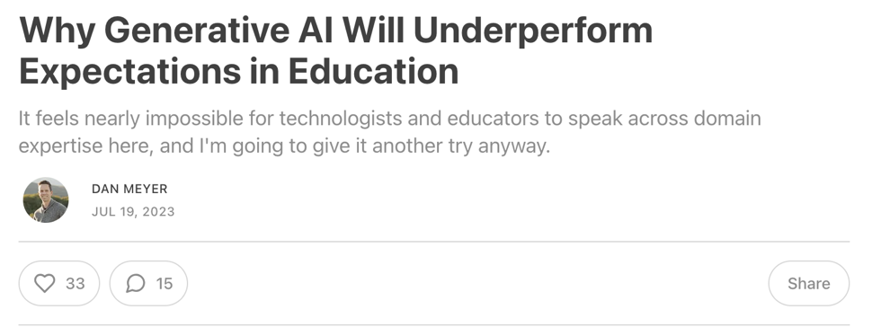
© Dan Meyer. All rights reserved. This content is excluded from our Creative Commons license. For more information, see https://ocw.mit.edu/help/faq-fair-use/

Slide 12
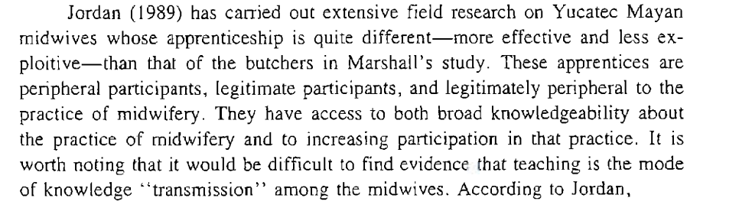
© Jean Lave / American Psychological Association. All rights reserved. This content is excluded from our Creative Commons license. For more information, see https://ocw.mit.edu/help/faq-fair-use/

Slide 13
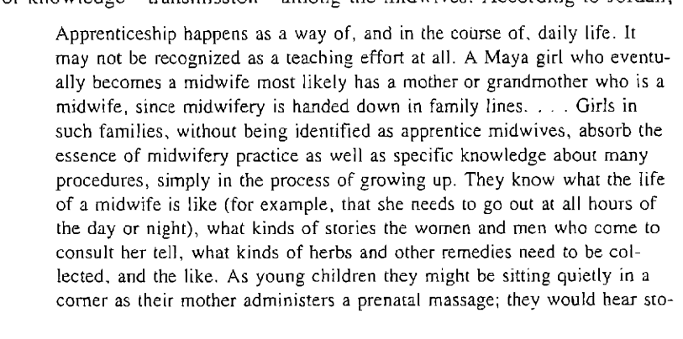
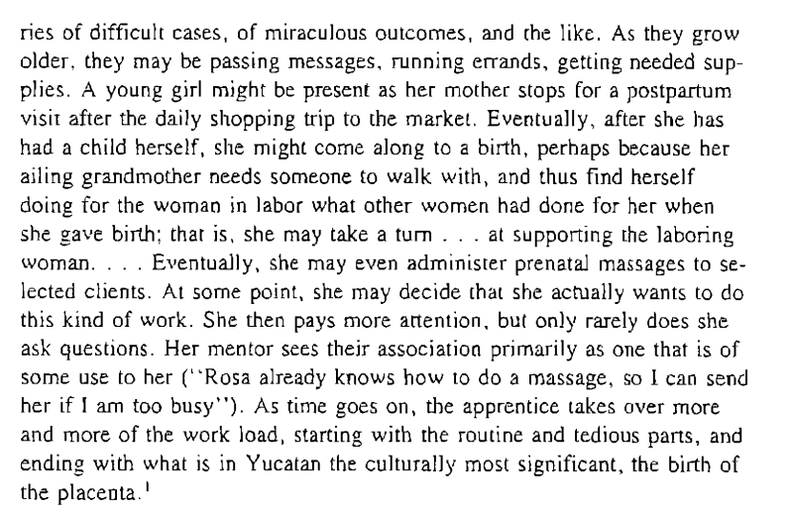
© Jean Lave / American Psychological Association. All rights reserved. This content is excluded from our Creative Commons license. For more information, see https://ocw.mit.edu/help/faq-fair-use/

Slide 14
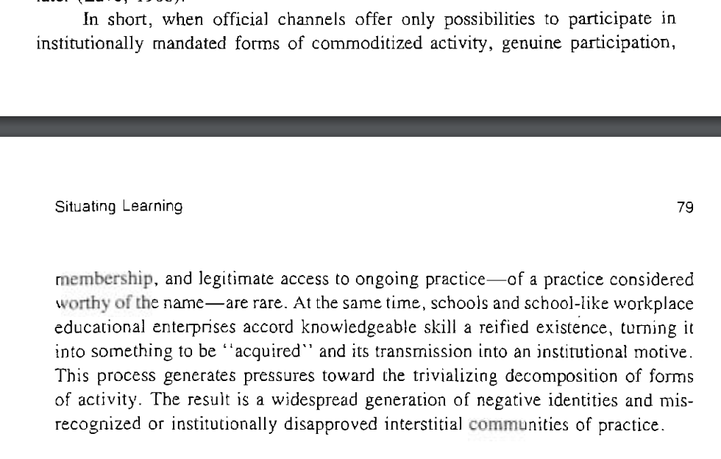
© Jean Lave / American Psychological Association. All rights reserved. This content is excluded from our Creative Commons license. For more information, see https://ocw.mit.edu/help/faq-fair-use/

Slide 15
Understanding Questions:
Does situated learning define an equivalent to the “human cognitive architecture” in CLT? What is it?
What does Resnick propose as a pedagogy that follows from the core insights of situated learning?

Slide 16
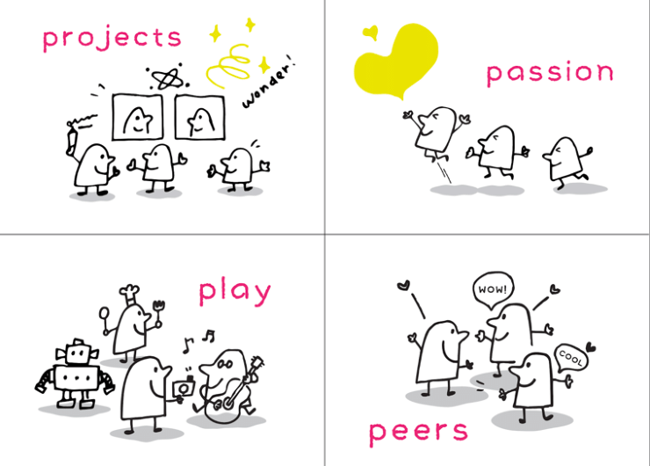
© Mitchel Resnick. All rights reserved. This content is excluded from our Creative Commons license. For more information, see https://ocw.mit.edu/help/faq-fair-use/

Slide 17

Courtesy of Brendan C on Flickr. Used under CC BY.

Slide 18
DO NOW: Draw a Venn Diagram of overlap and differences between
instructionists/traditionalist//Cognitive Load Theory/pail fillers
and
constructionist/progressive/situated learning/flame kindlers
Image © illustration by Haley McDevitt; published by Jossey-Bass. All rights reserved. This content is excluded from our Creative Commons license. For more information, see https://ocw.mit.edu/help/faq-fair-use/

Slide 19
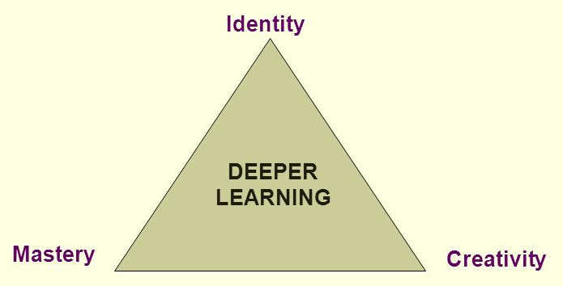
Slide from Jal Mehta and Sarah Fine, Harvard Graduate School of Education

Slide 20
Identity
Mastery
Creativity
© Lawrence Earlbaum Associates, Inc. All rights reserved. This content is excluded from our Creative Commons license. For more information, see https://ocw.mit.edu/help/faq-fair-use/

Slide 21

Identity
Mastery
Creativity
© MIT Press. All rights reserved. This content is excluded from our Creative Commons license. For more information, see https://ocw.mit.edu/help/faq-fair-use/

Slide 22

Identity
Mastery
Creativity
MIT seal © MIT. All rights reserved. This content is excluded from our Creative Commons license. For more information, see https://ocw.mit.edu/help/faq-fair-use/

Slide 23
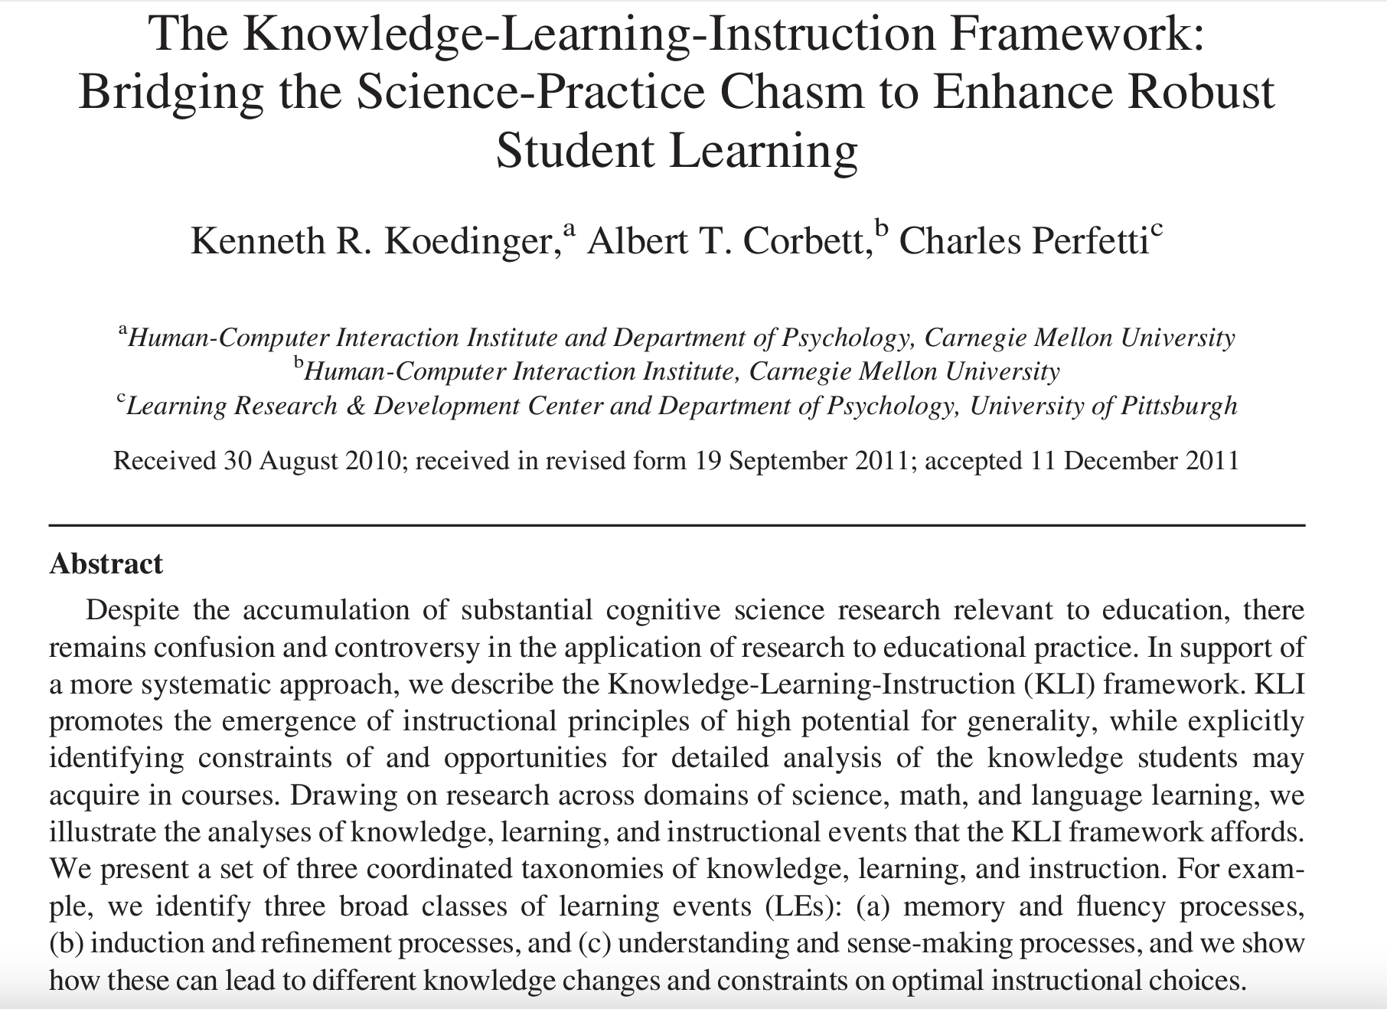
Koedinger’s Knowledge-Learning-Instruction Framework
© Cognitive Science Society, Inc. All rights reserved. This content is excluded from our Creative Commons license. For more information, see https://ocw.mit.edu/help/faq-fair-use/

Slide 24
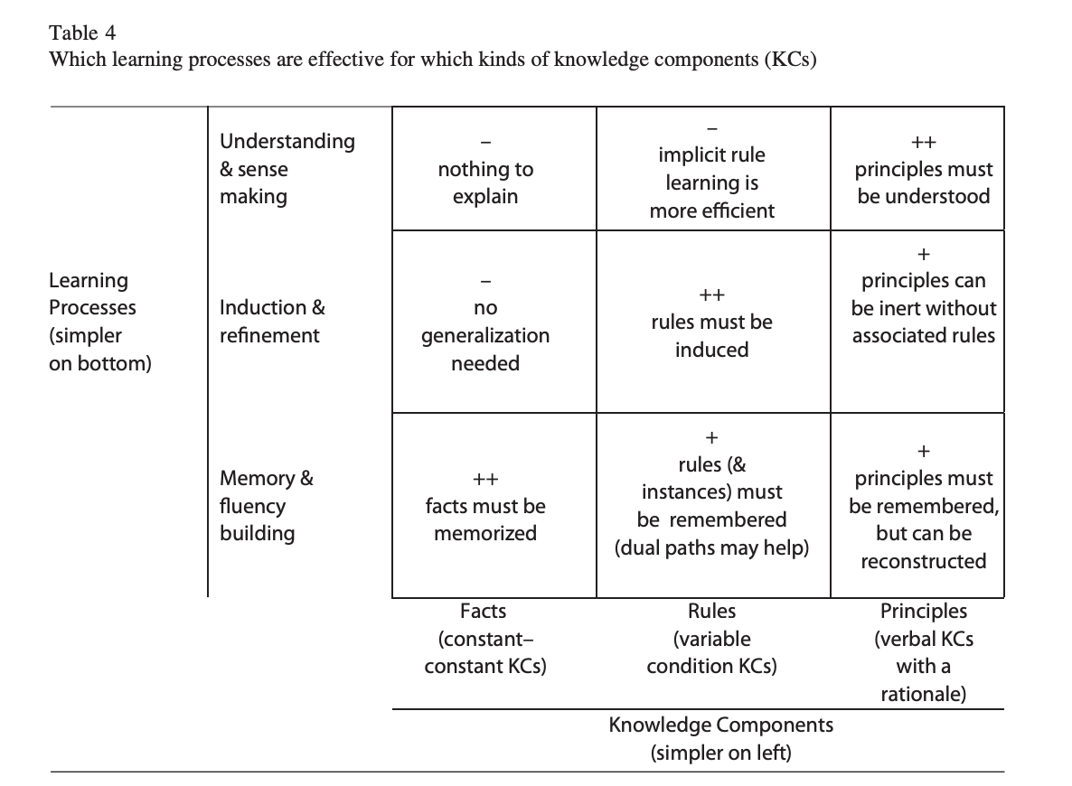
© Cognitive Science Society, Inc. All rights reserved. This content is excluded from our Creative Commons license. For more information, see https://ocw.mit.edu/help/faq-fair-use/

Slide 25
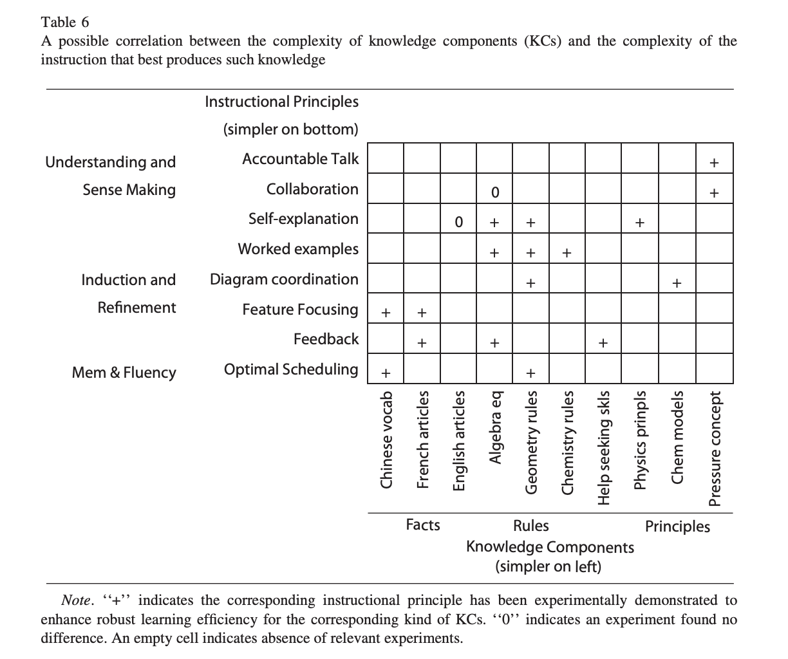
© Cognitive Science Society, Inc. All rights reserved. This content is excluded from our Creative Commons license. For more information, see https://ocw.mit.edu/help/faq-fair-use/

Slide 26
Assignments
Assignment #1- EdTech From a Learning Science Perspective
  Evaluate an education technology and identify its pedagogical roots. Then, reimagine the technology from alternative pedagogical perspective.
  Example: Scratch is a community-centered platform for learning creative computing. It’s inspired by constructivism.
    Connect specific features of Scratch with specific principals of constructivism
    Redesign Scratch through instructionism

Slide 27
MIT OpenCourseWare
https://ocw.mit.edu
CMS.595 Learning, Media, and Technology
Spring 2024
For information about citing these materials or our Terms of Use, visit: https://ocw.mit.edu/terms

