Slide 1
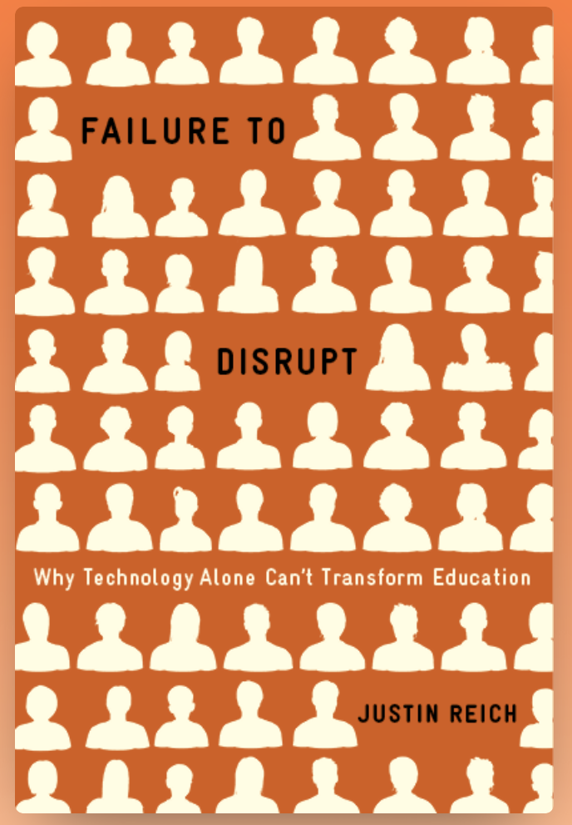
Justin Reich
Mitsui Career Development Professor
Massachusetts Institute of Technology
tsl.mit.edu

Slide 2
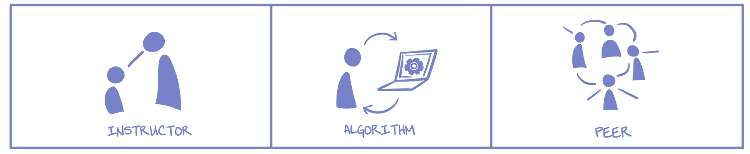
Three Genres
Who guides the sequence of learning activities?

Slide 3
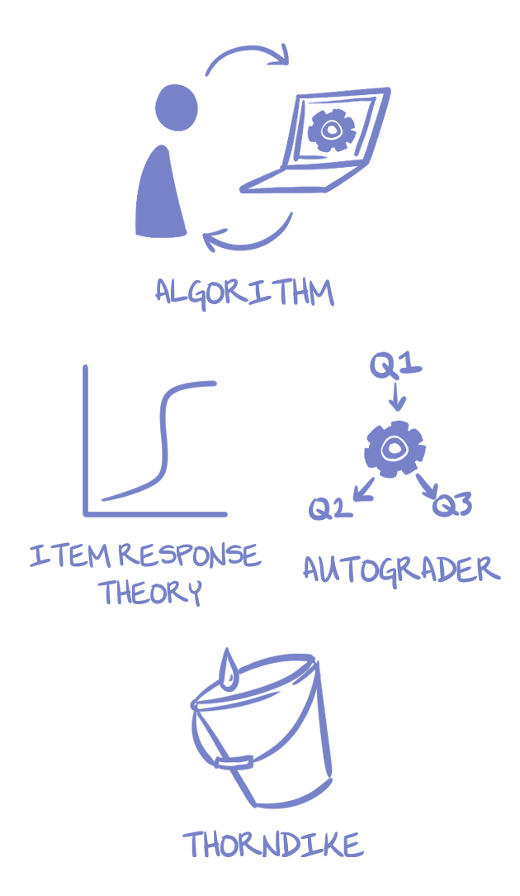
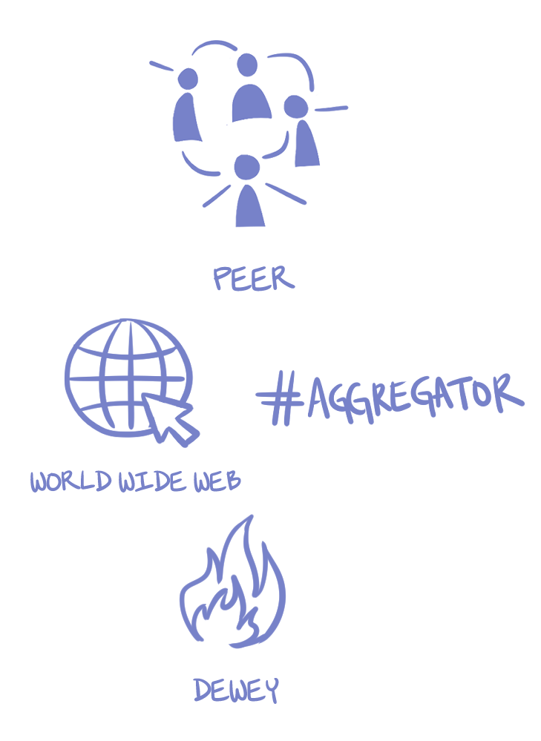
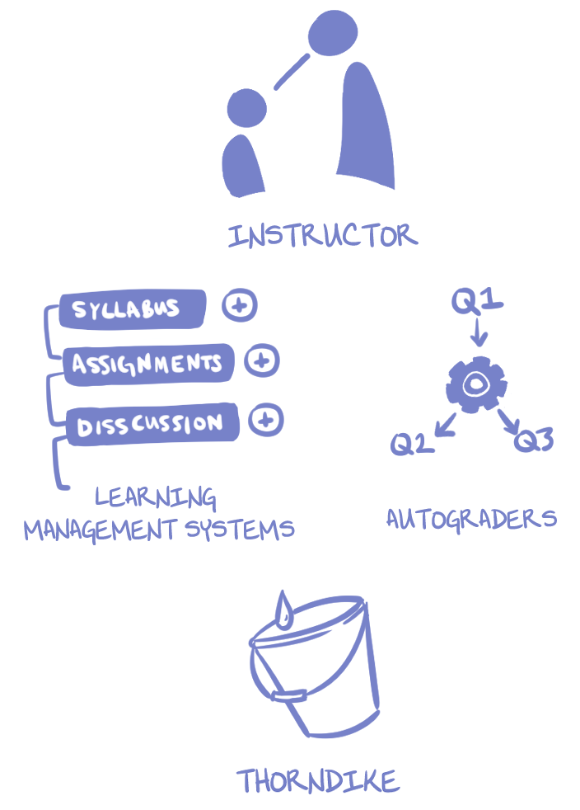

Slide 4
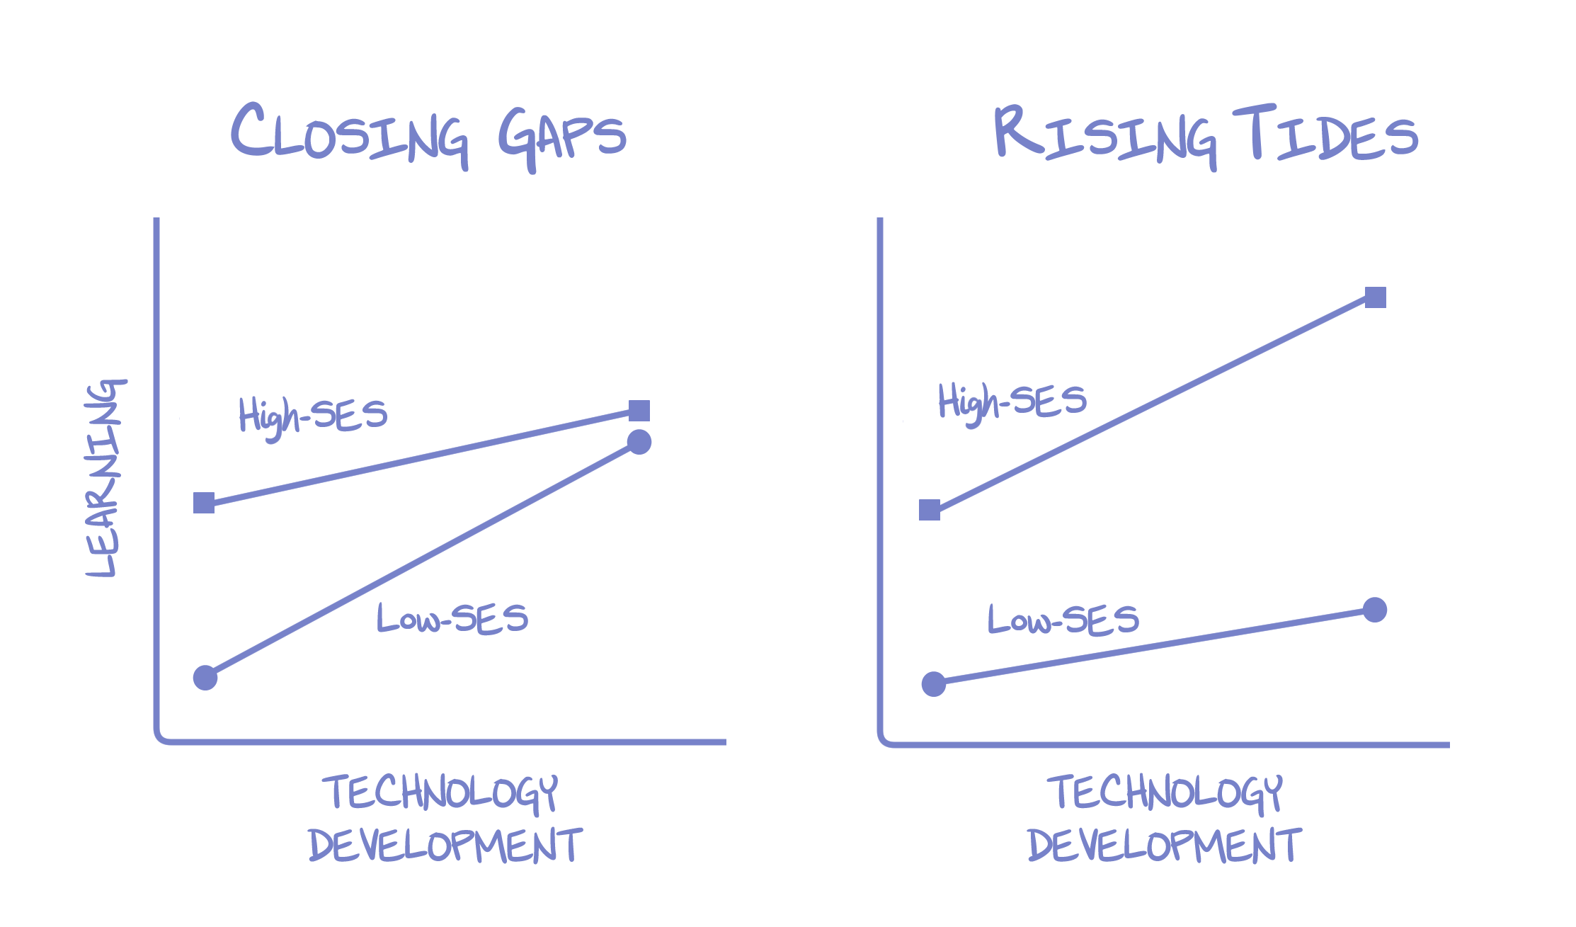
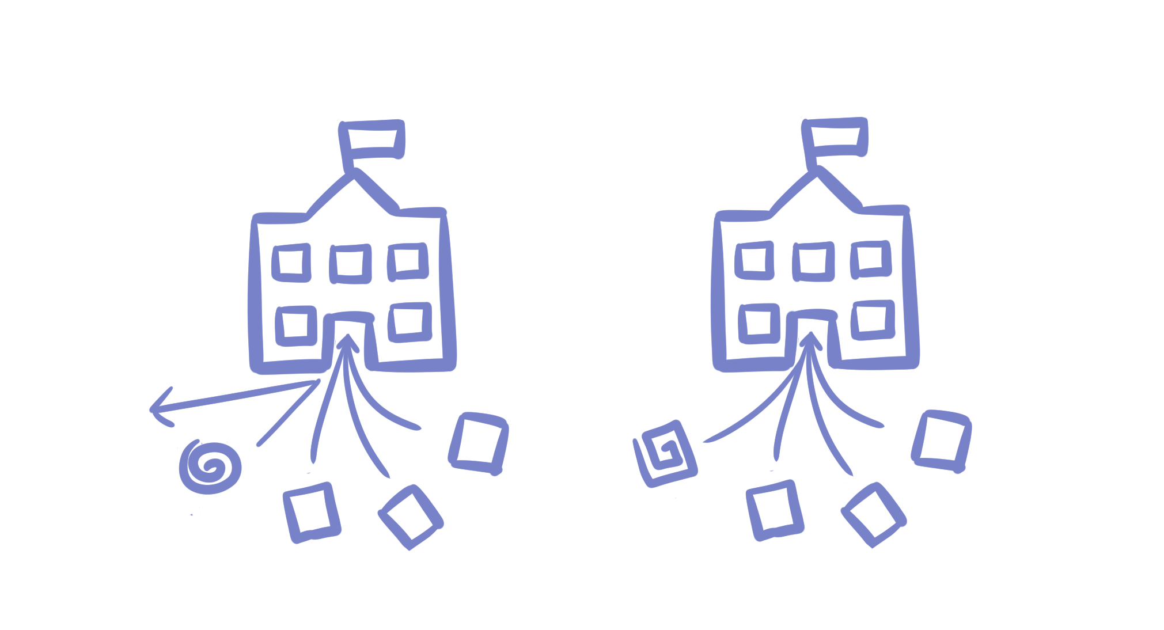
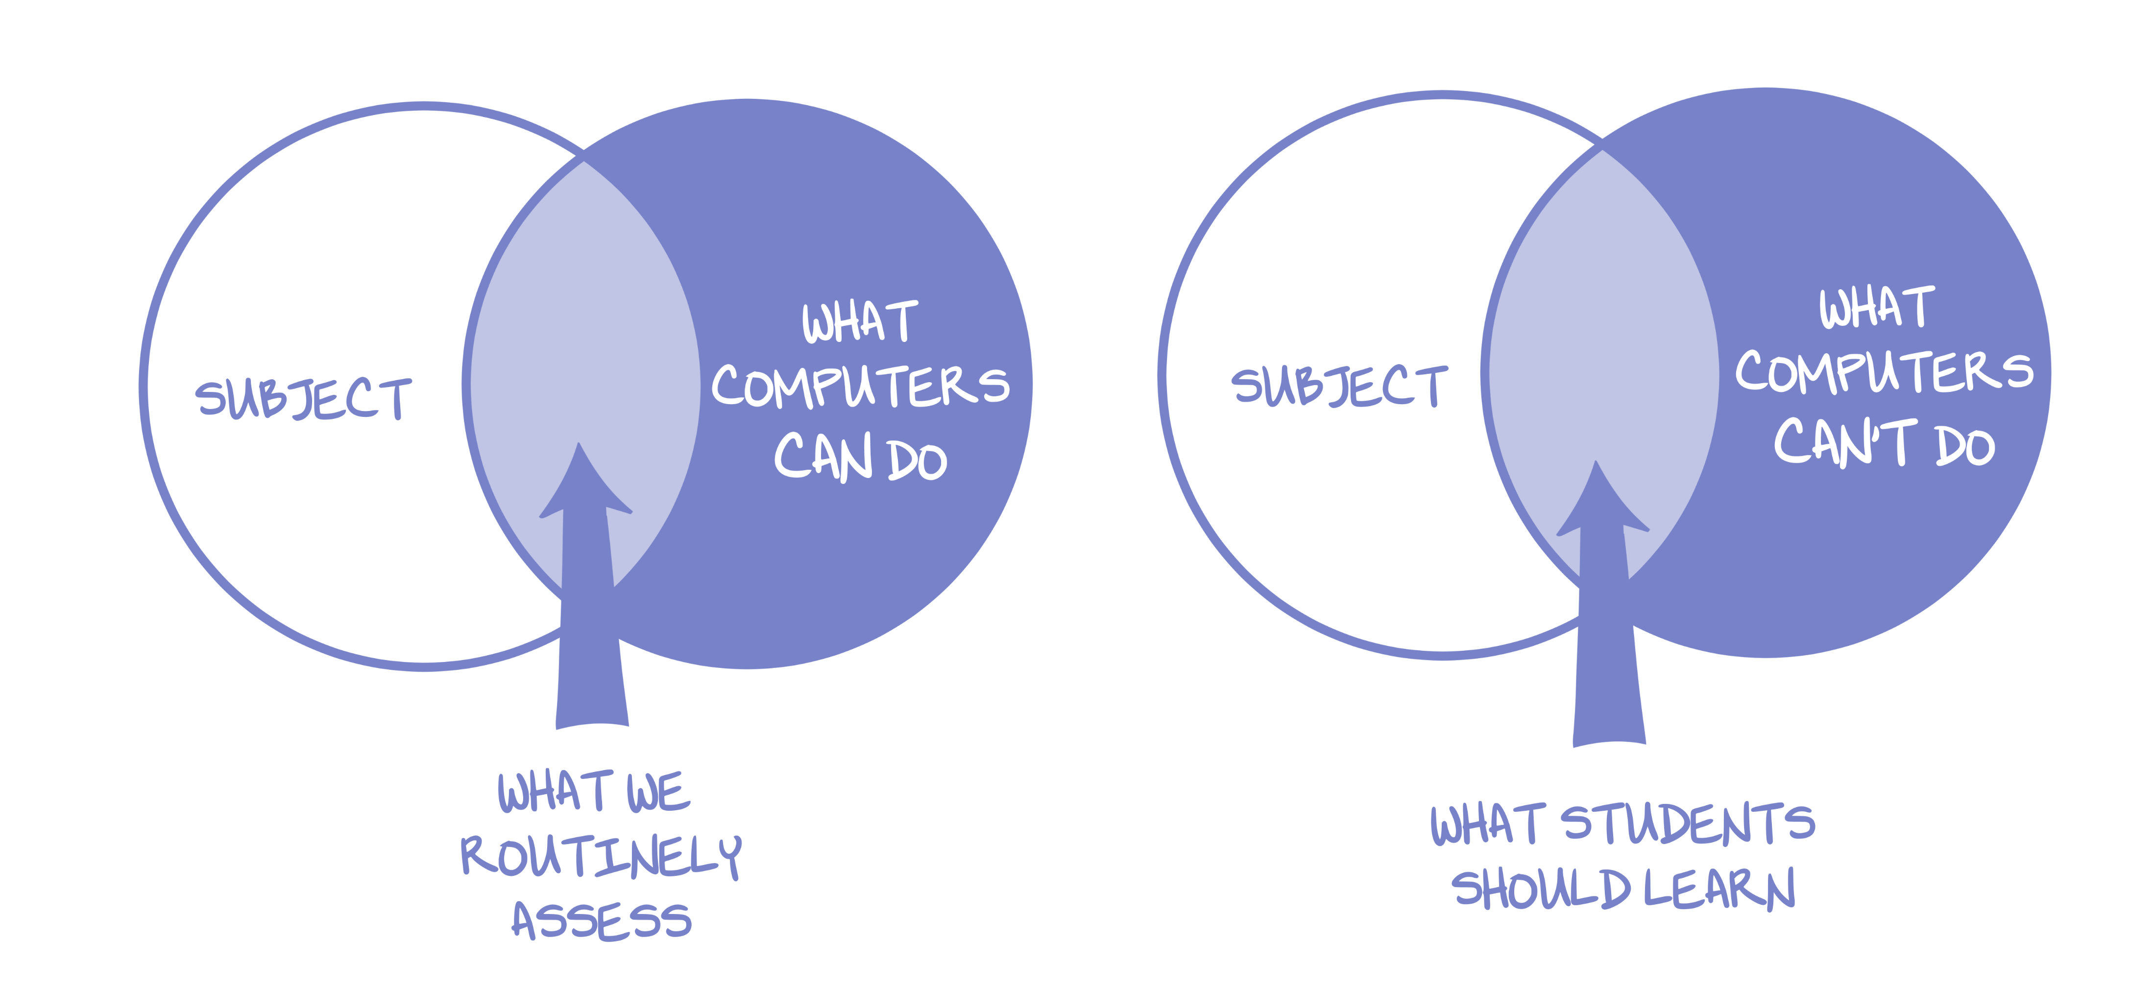
Four “As-Yet Intractable Dilemmas”
Curse of the Familiar
EdTech Matthew Effect
Trap of Routine Assessment
Toxic Power of Data and Experiments

Slide 5
Curse of the Familiar

Slide 6
EdTech Matthew Effect

Slide 7
Trap of Routine Assessment

Slide 8
Toxic Power of Data and Experiments

Slide 9
Four “As-Yet Intractable Dilemmas”
Curse of the Familiar
EdTech Matthew Effect
Trap of Routine Assessment
Toxic Power of Data and Experiments

Slide 10
Three Big Bets of MOOCs
Provide new pathways into higher education for people with limited access
Reorganize (disrupt, unbundle, etc.) higher education
Create a new data-driven science of learning

Slide 11
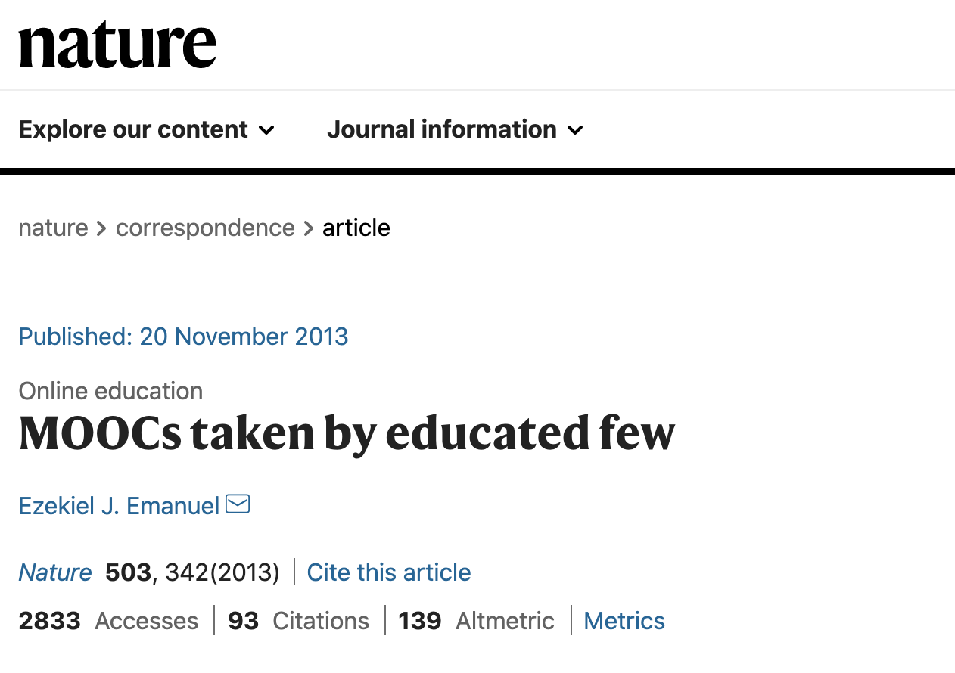
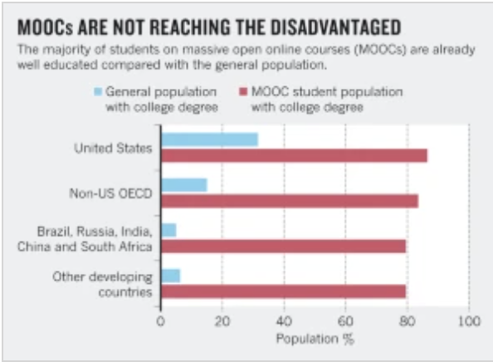
t
New Pathways?
Article © Springer Nature Limited. All rights reserved. This content is excluded from our Creative Commons license. For more information, see https://ocw.mit.edu/help/faq-fair-use/

Slide 12
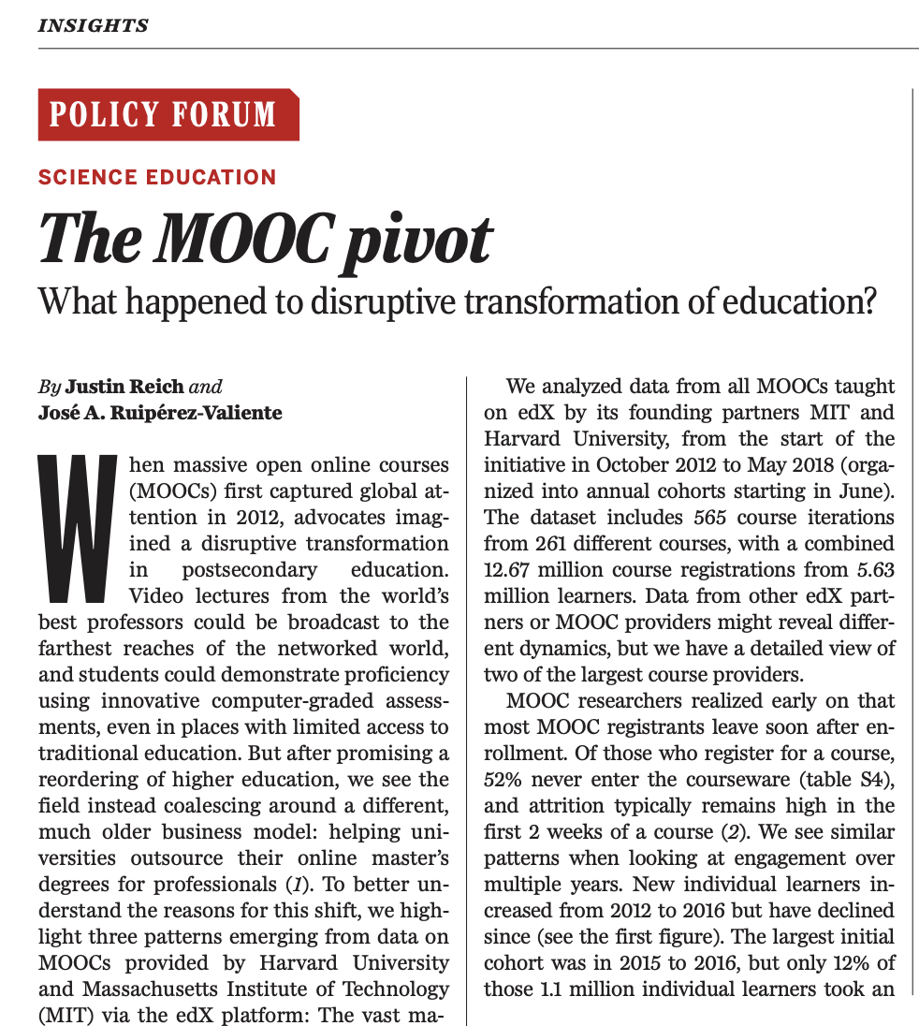
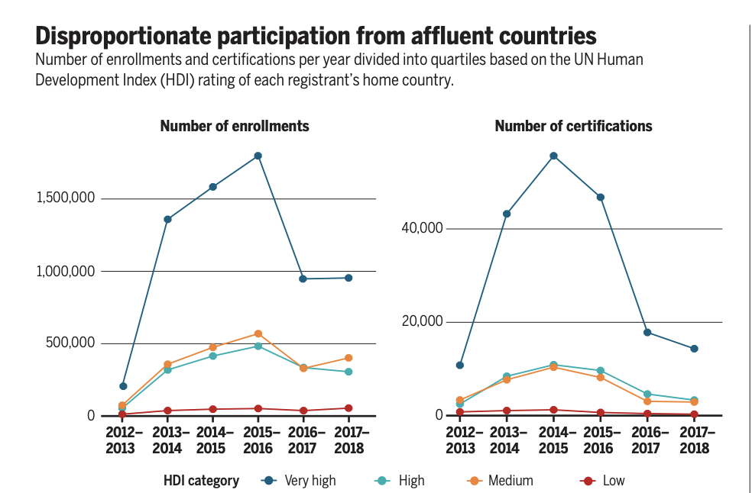
New Pathways?
Article © American Association for the Advancement of Science. All rights reserved. This content is excluded from our Creative Commons license. For more information, see https://ocw.mit.edu/help/faq-fair-use/

Slide 13
New Pathways?
MOOCs reduce costs by digitizing faculty labor
No faculty + many peers = minimal human contact
Individual, self-paced learning, requires high self-regulated learning
4) Most people are not good at self-regulated learning
5) The best preparation for independent, self-regulated learning is an apprenticeship in formal education systems

Slide 14

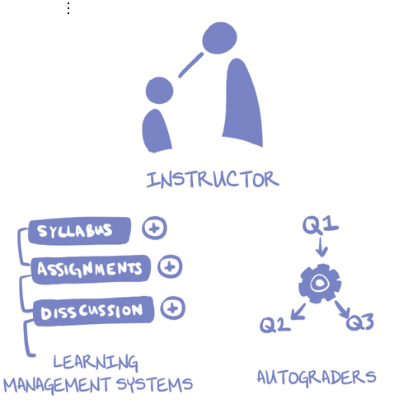


Disrupt Higher Ed?
Student © source unknown. All rights reserved. This content is excluded from our Creative Commons license. For more information, see https://ocw.mit.edu/help/faq-fair-use/
Storefront courtesy of Eucalyp and University courtesy Massupa Kaewgahya from the Noun Project. Used under CC BY.

Slide 15
Disrupt Higher Ed?
People tried out storefronts, but paying customers wanted legitimacy
Traditional registrar arrangements confer legitimacy
MOOC providers move towards the space occupied by Online Program Managers
Rather than disrupting higher education, MOOCs have been domesticated by existing systems

Slide 16
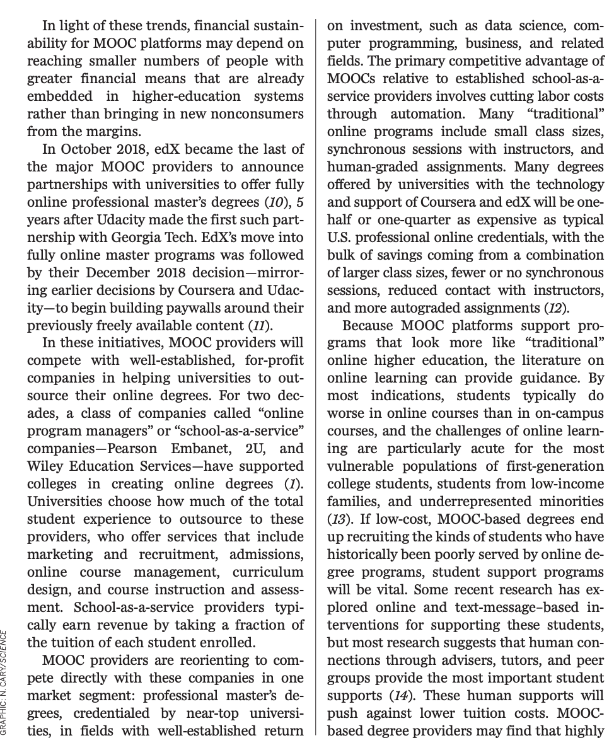
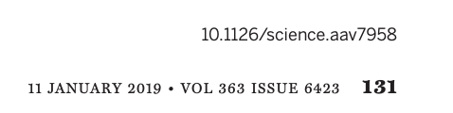
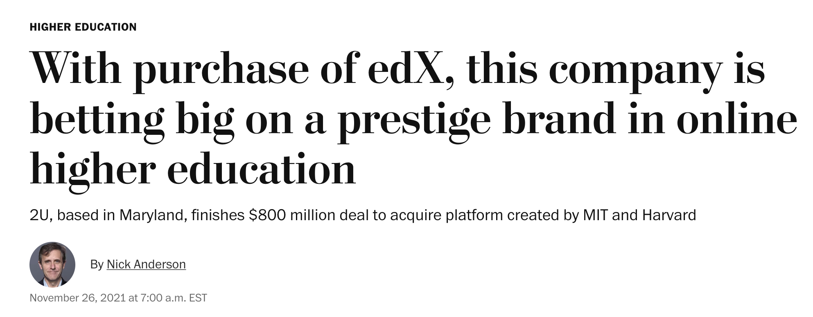
January 19– jeez, these MOOC things are sure looking like OPMs
Nov 2021, 2U, largest OPM, buys non-profit edX
© The Washington Post. All rights reserved. This content is excluded from our Creative Commons license. For more information, see https://ocw.mit.edu/help/faq-fair-use/

Slide 17
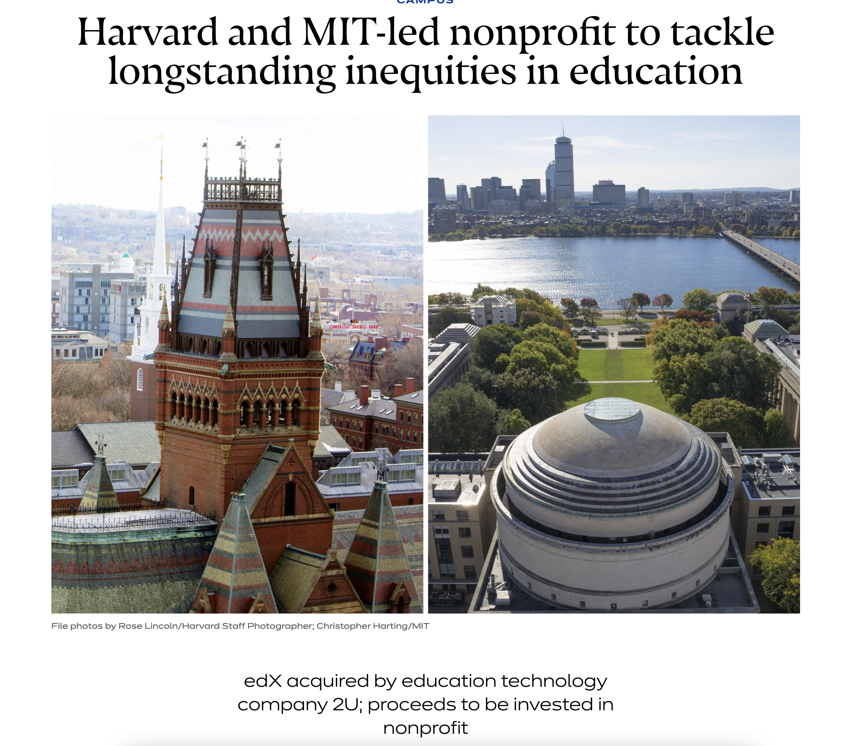
© Harvard / photos by Rose Lincoln/Harvard Staff Photographer; Christopher Harting/MIT . All rights reserved. This content is excluded from our Creative Commons license. For more information, see https://ocw.mit.edu/help/faq-fair-use/

Slide 18
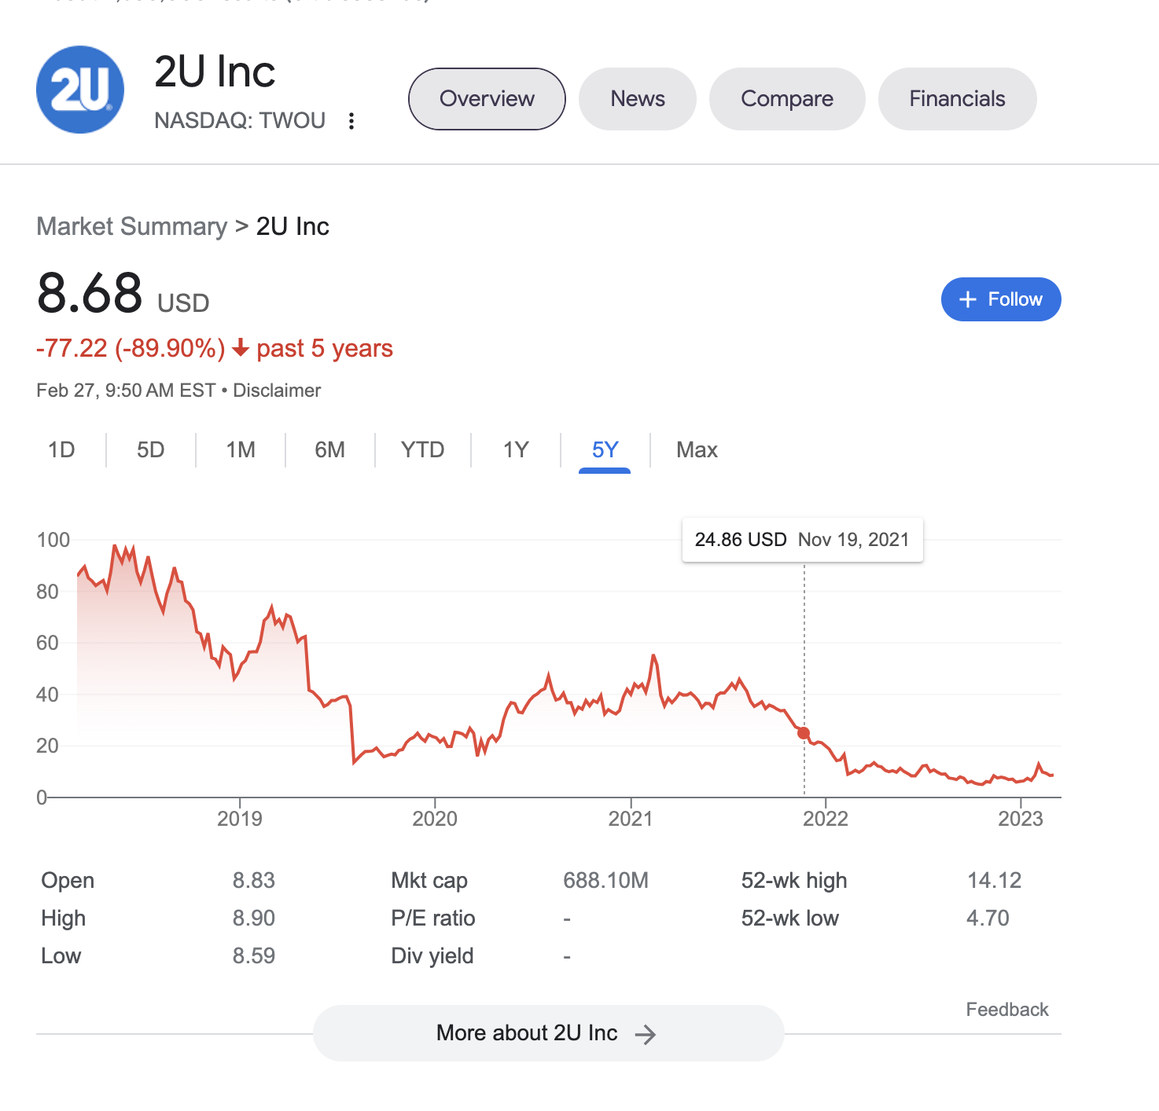
© source unknown. All rights reserved. This content is excluded from our Creative Commons license. For more information, see https://ocw.mit.edu/help/faq-fair-use/

Slide 19
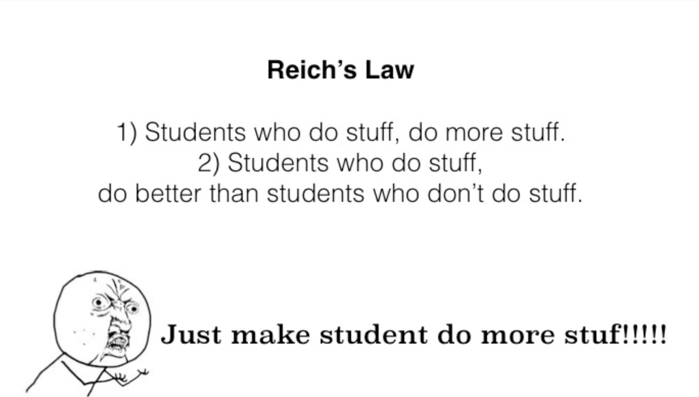
New Science of Learning?
© source unknown. All rights reserved. This content is excluded from our Creative Commons license. For more information, see https://ocw.mit.edu/help/faq-fair-use/

Slide 20
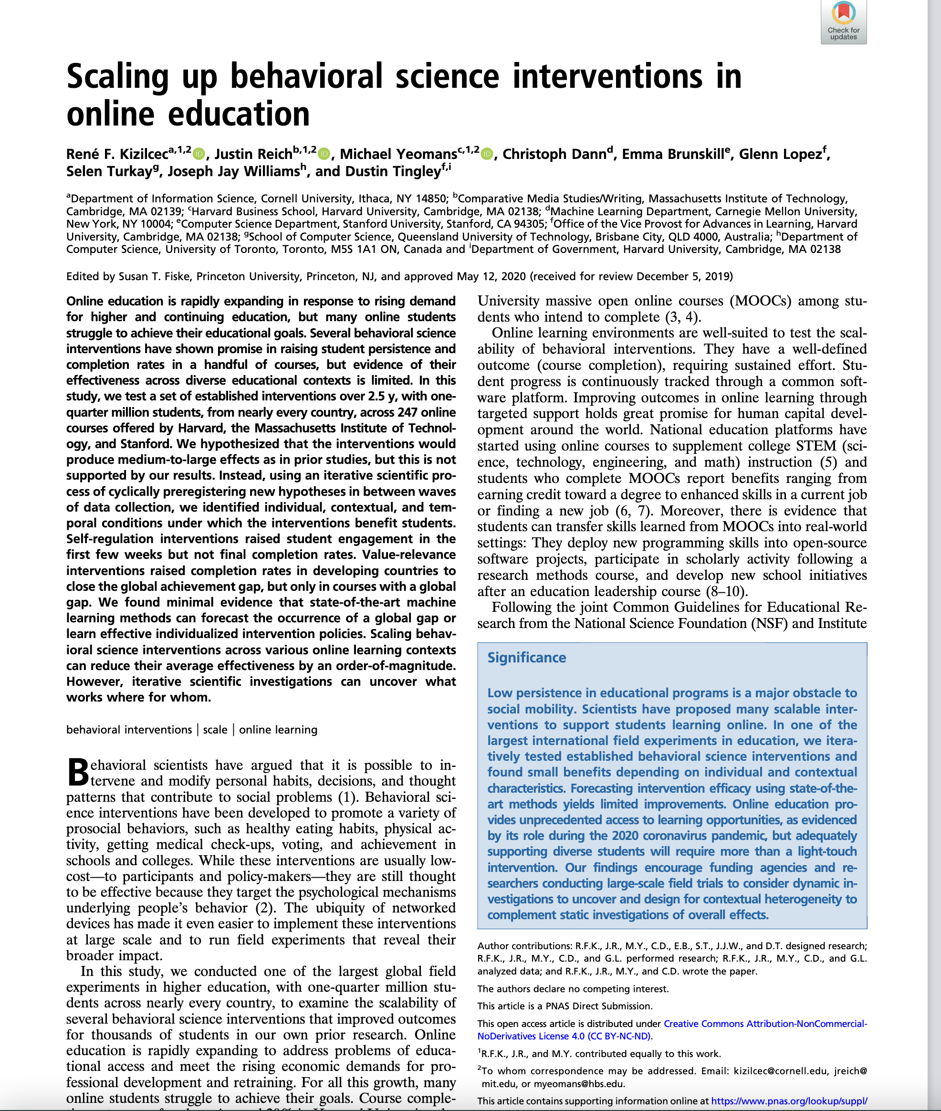
© Kizilcec, et al. All rights reserved. This content is excluded from our Creative Commons license. For more information, see https://ocw.mit.edu/help/faq-fair-use/

Slide 21
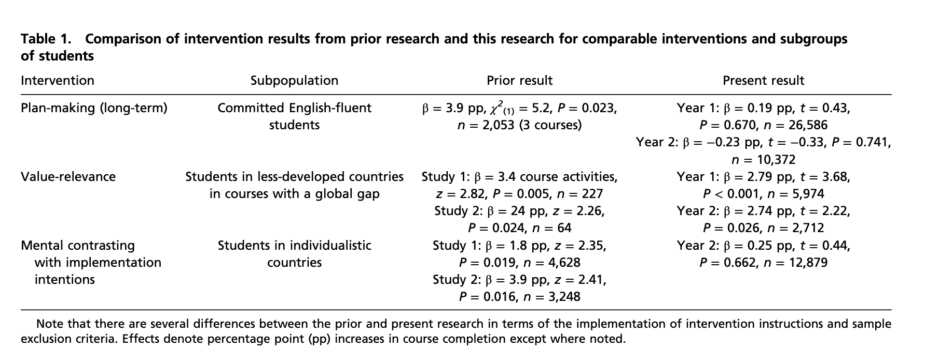
© Kizilcec, et al. All rights reserved. This content is excluded from our Creative Commons license. For more information, see https://ocw.mit.edu/help/faq-fair-use/

Slide 22
New Science of Learning
The hypothesis was that vast new sources of data would create a new science of learning
This data captured many forms of behavior, but not so much about learning
Designing online learning to generate new insights about effective instruction or effective learning is much harder and more expensive than just designing new courses

Slide 23
Three Big Bets of MOOCs
Provide new pathways into higher education for people with limited access
Reorganize (disrupt, unbundle, etc.) higher education
Create a new data-driven science of learning

Slide 24
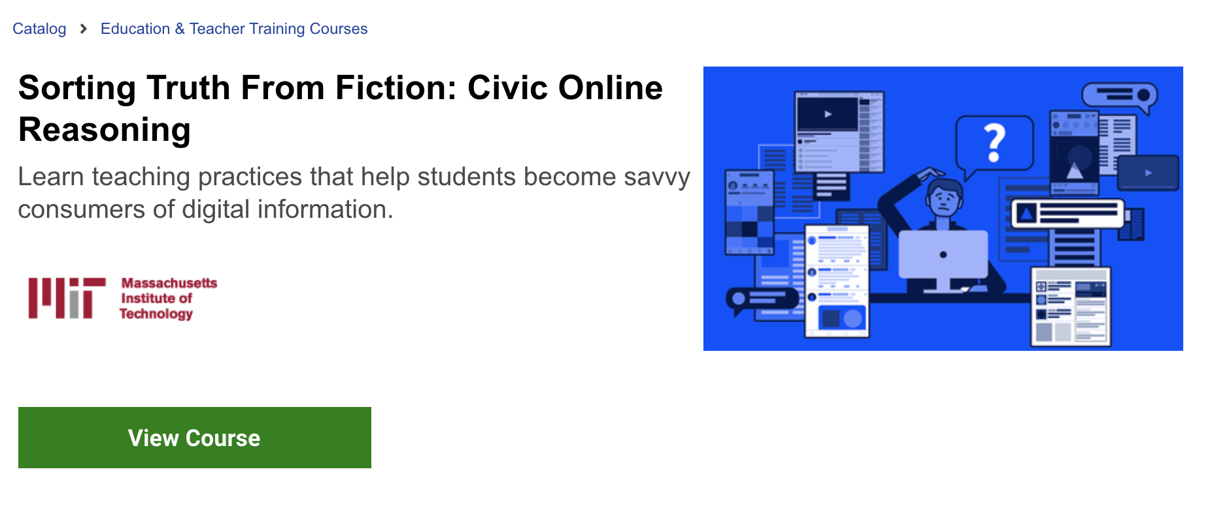
Little Bets of MOOCs?
Courtesy of Justin Reich and Sam Wineburg. Used under CC BY.

Slide 25
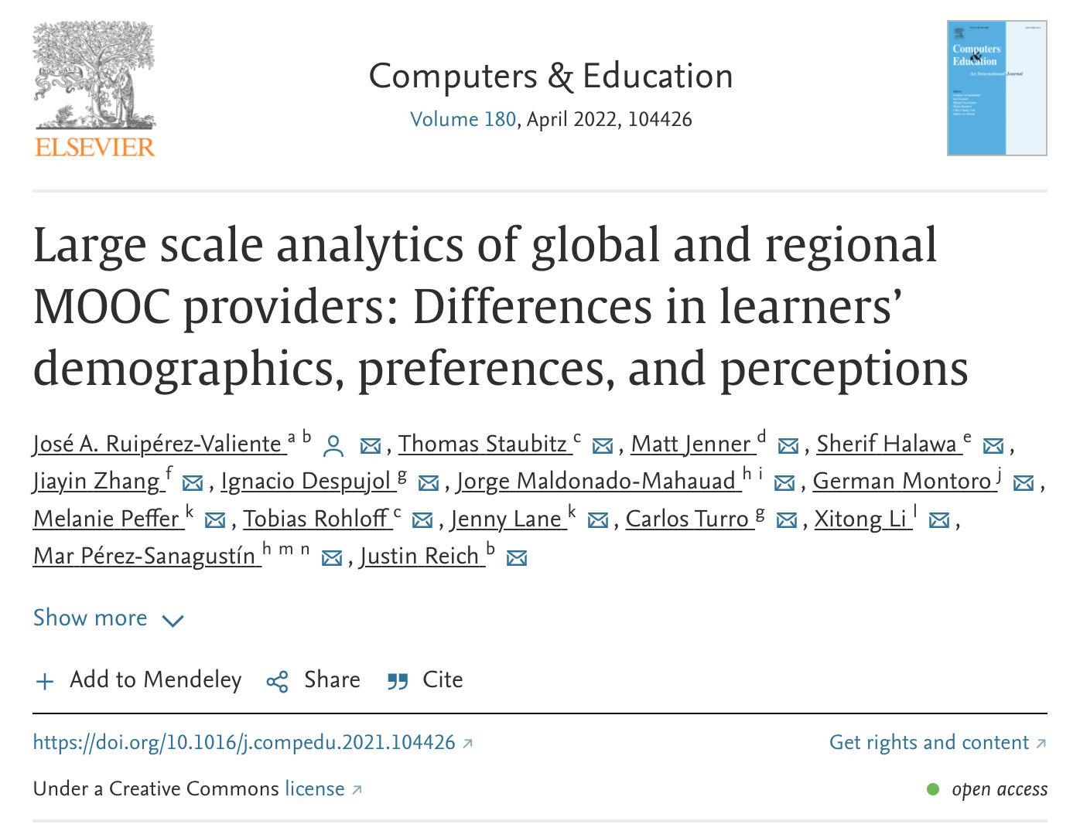
© Ruipérez-Valiente, et al. All rights reserved. This content is excluded from our Creative Commons license. For more information, see https://ocw.mit.edu/help/faq-fair-use/

Slide 26
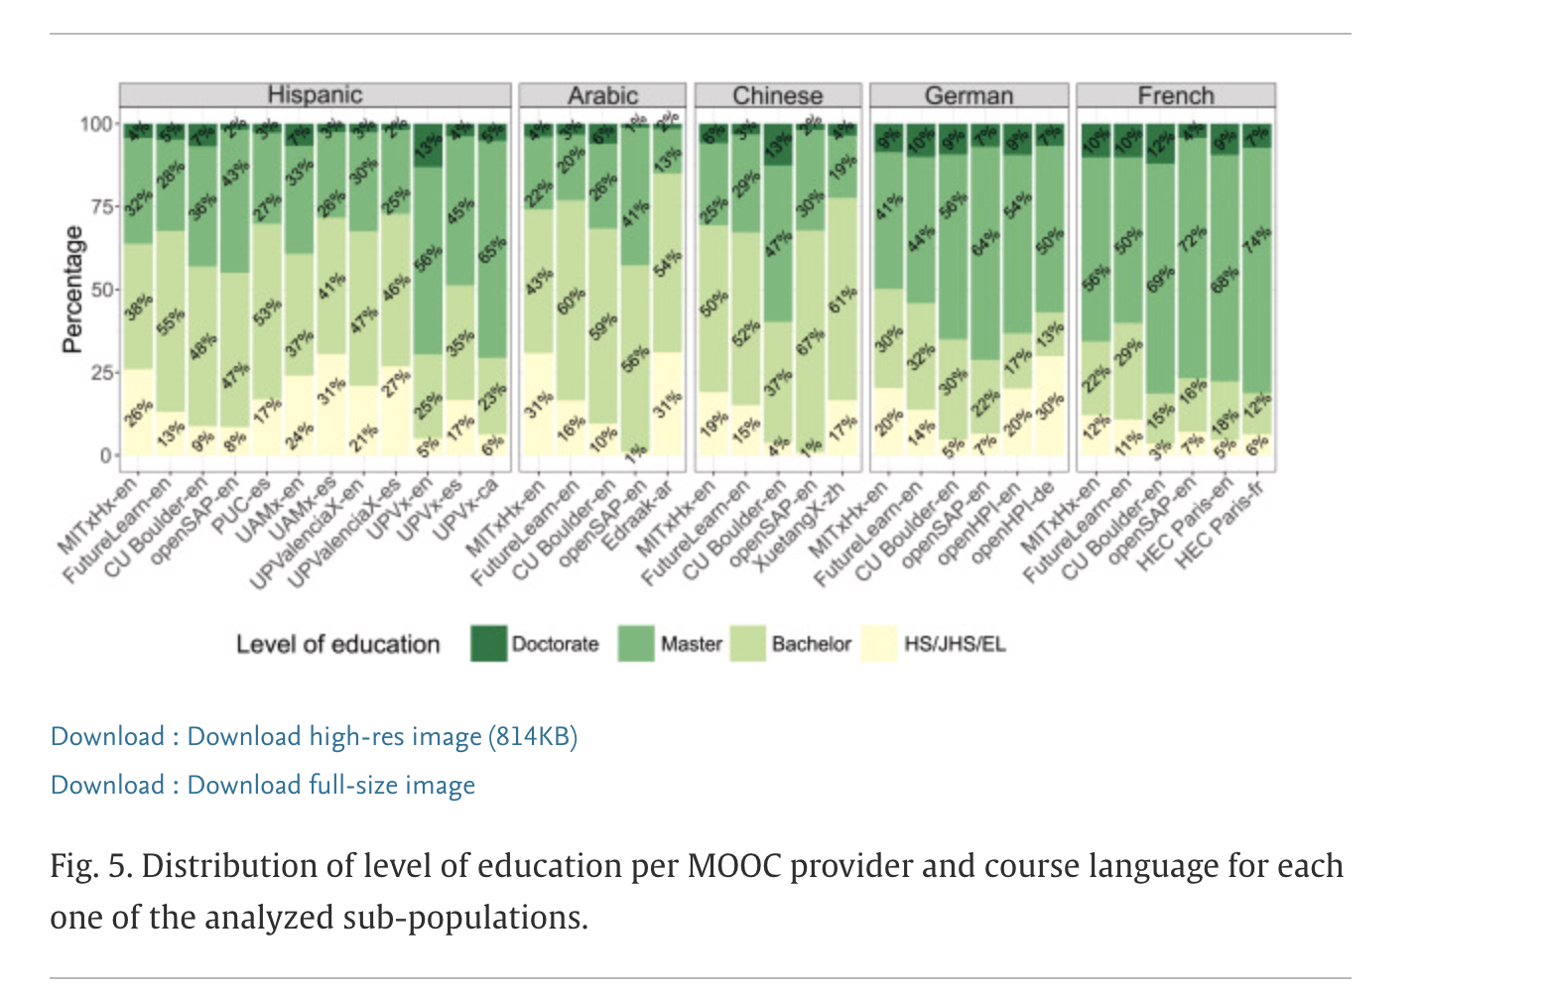
© Ruipérez-Valiente, et al. All rights reserved. This content is excluded from our Creative Commons license. For more information, see https://ocw.mit.edu/help/faq-fair-use/

Slide 27
New Bets for MOOCs?

Slide 28
MIT OpenCourseWare
https://ocw.mit.edu
CMS.595 Learning, Media, and Technology
Spring 2024
For information about citing these materials or our Terms of Use, visit: https://ocw.mit.edu/terms

