Slide 1

Trend Researcher
Lars Langfeldt, Arne Seufert, Arne Wiese, Carolina Horlbeck

Slide 2




Progress Week 3
Recap
progress
next steps

Slide 3


recap
STOCK MARKET
Are certain stocks or sectors correlated in their performance?
How does stock market performance relate to broader economic indicators like GDP growth, unemployment rates, or interest rates?
How do stock market movements in one country correlate with movements in another?
Does public sentiment measured by news articles and tweets about a company have any predictive power for stock prices?
How do different sectors (e.g., technology, healthcare, energy) perform relative to each other and the broader market?
How do specific events (like elections, major geopolitical events, product launches, earnings reports) impact stock prices?
Is there a sector that indicates the movement of other sectors?
https://tse1.mm.bing.net/th?id=OIP.X8af1kwXfDIHNigIwsuULgHaEK&pid=Api
Notes:
Datenquelle gefunden
Erste Datensätze für Forschungsfragen
Erste Visualisierungen

Slide 4
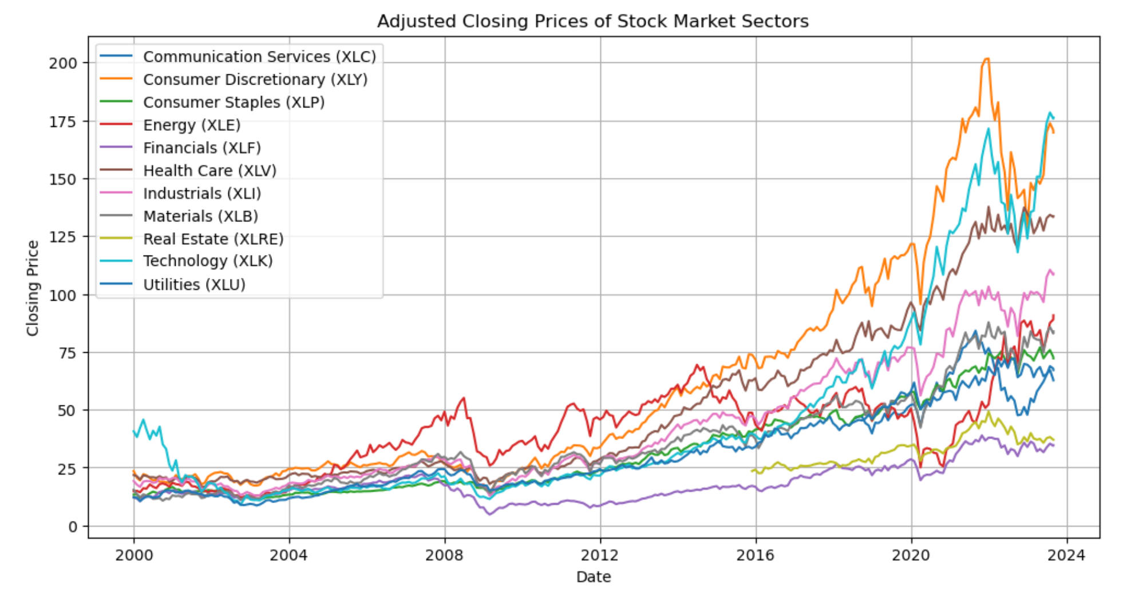
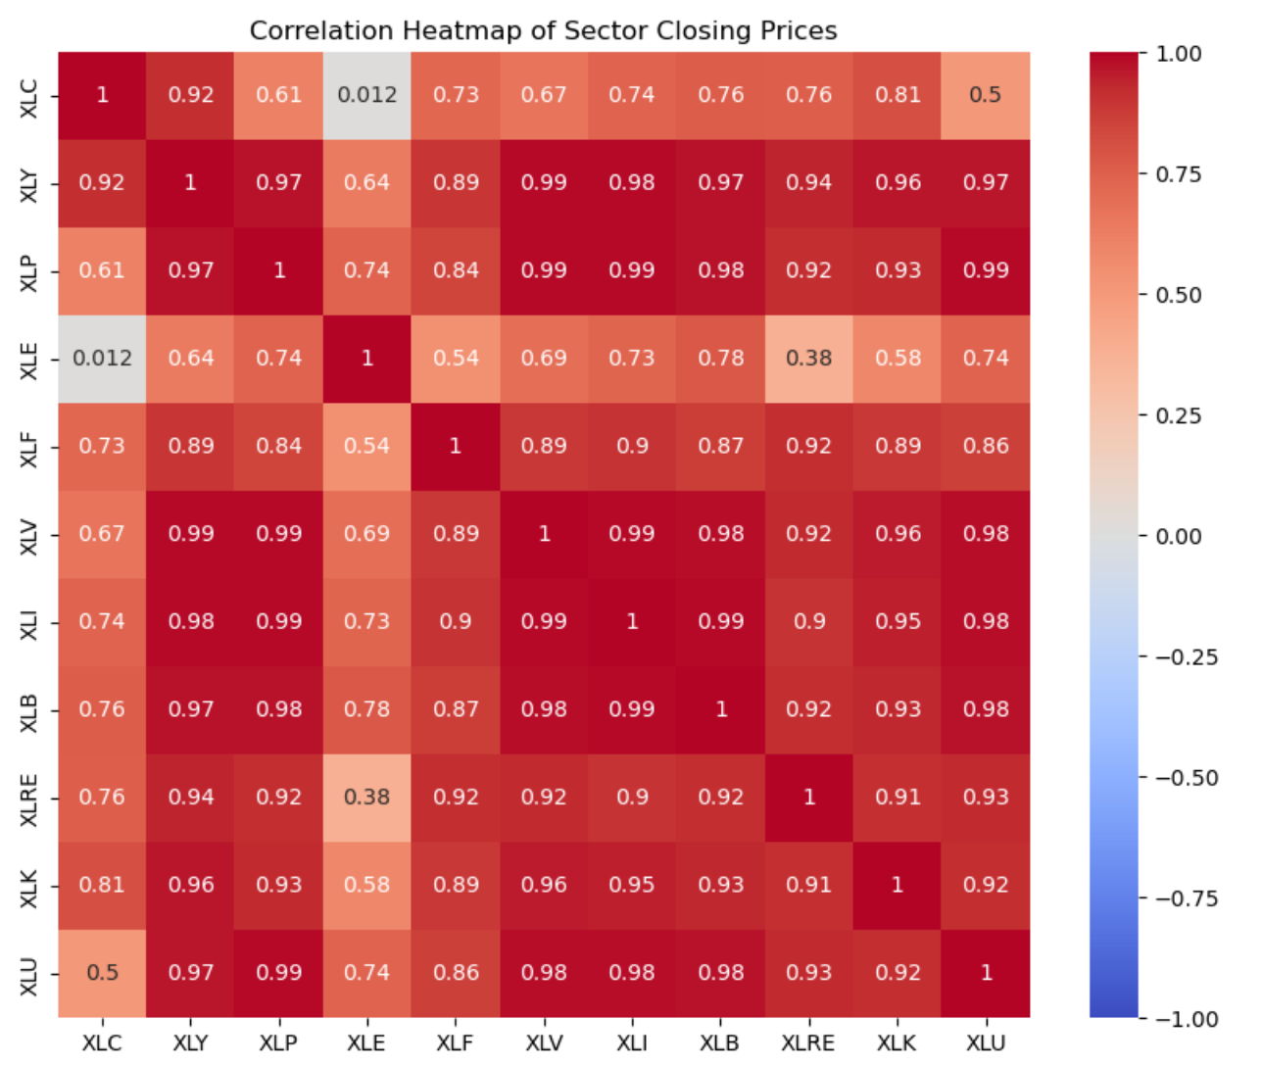
Progress
Notes:
Erste Daten zu Forschungsfragen

Slide 5
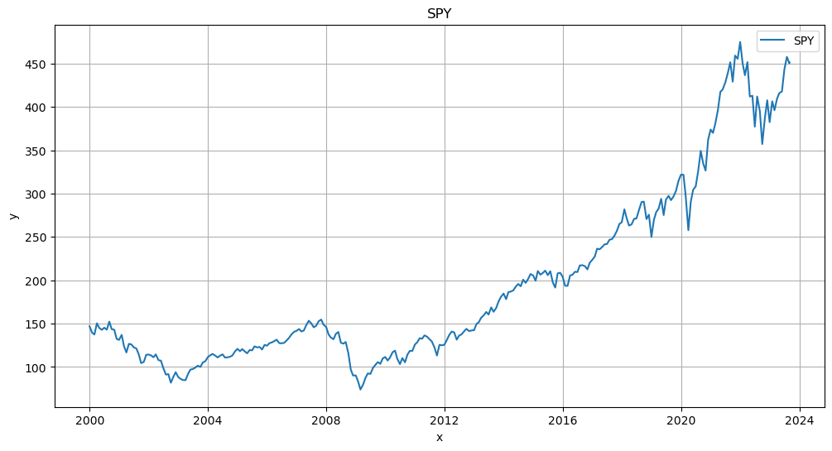
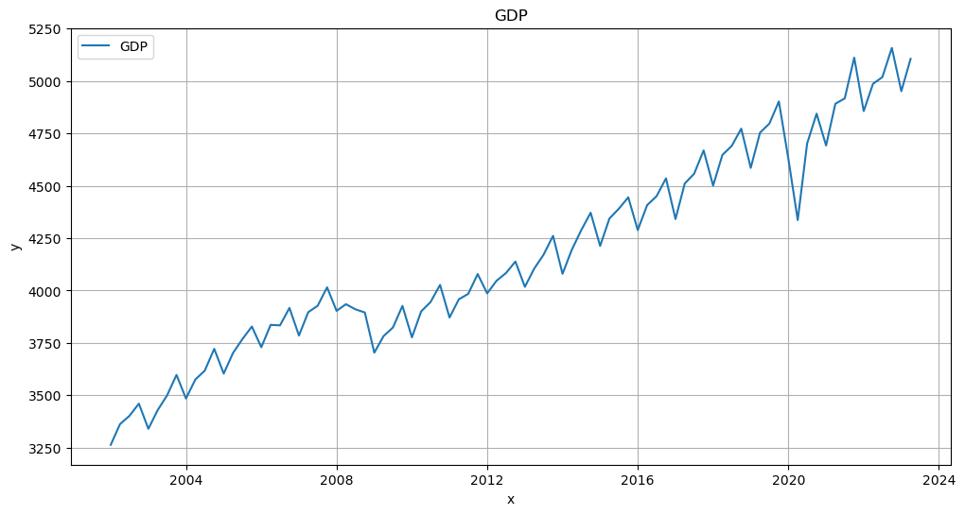
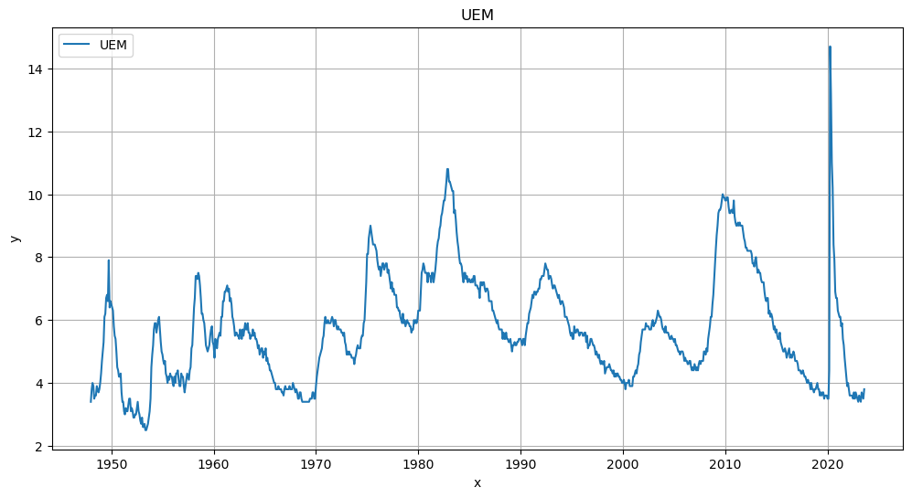
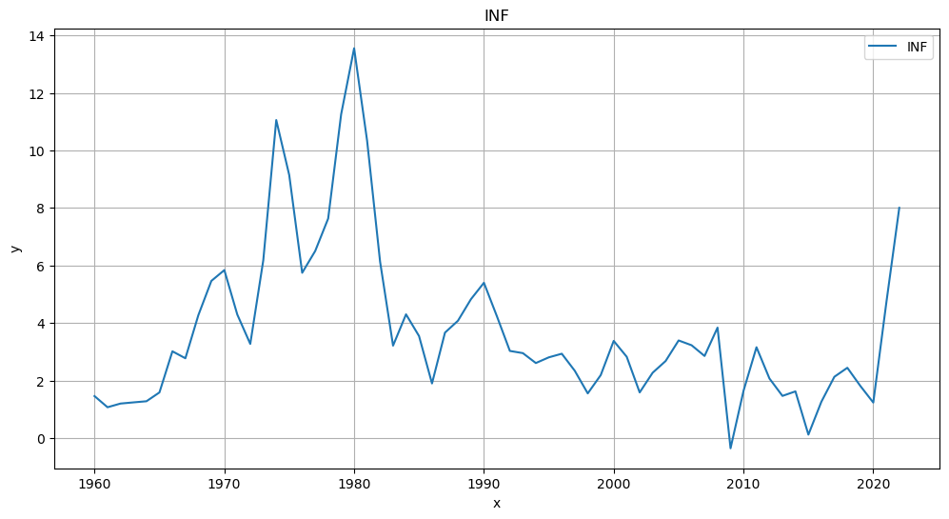
Progress
Notes:
Erste Daten zu Forschungsfragen

Slide 6
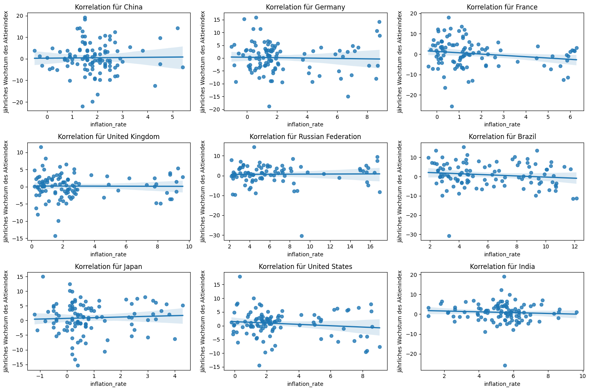
Progress
Notes:
Erste Daten zu Forschungsfragen

Slide 7
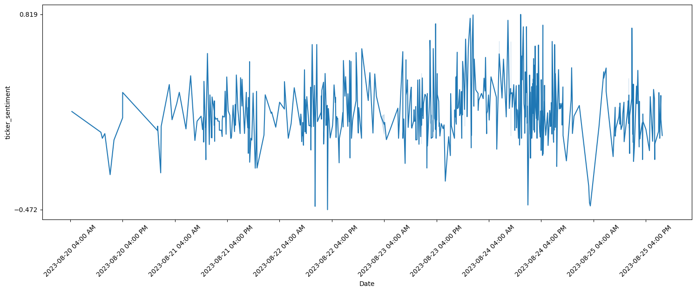
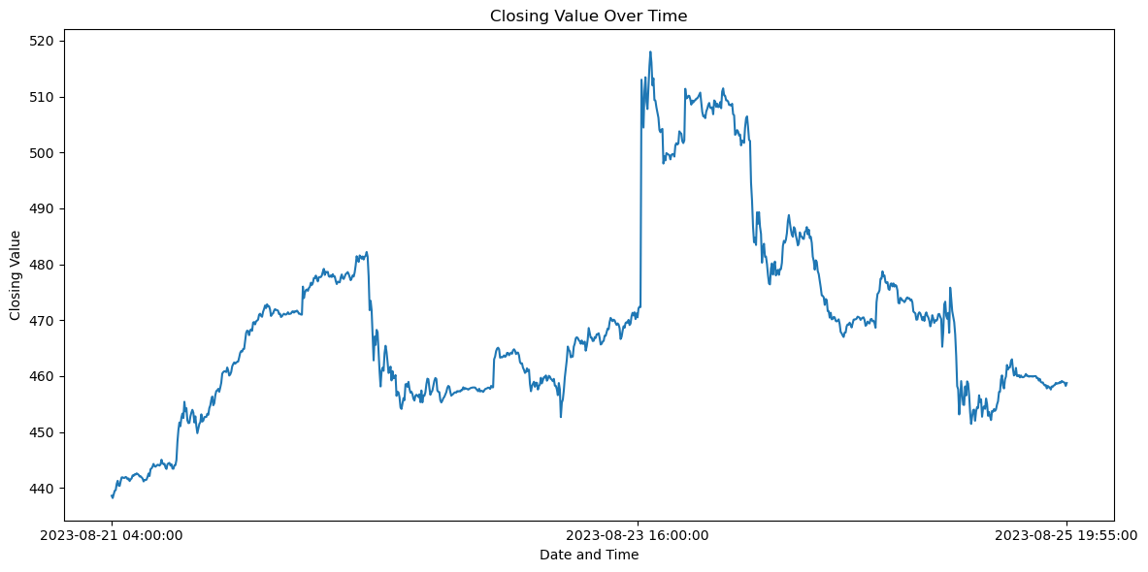
Progress
Notes:
Erste Daten zu Forschungsfragen

Slide 8
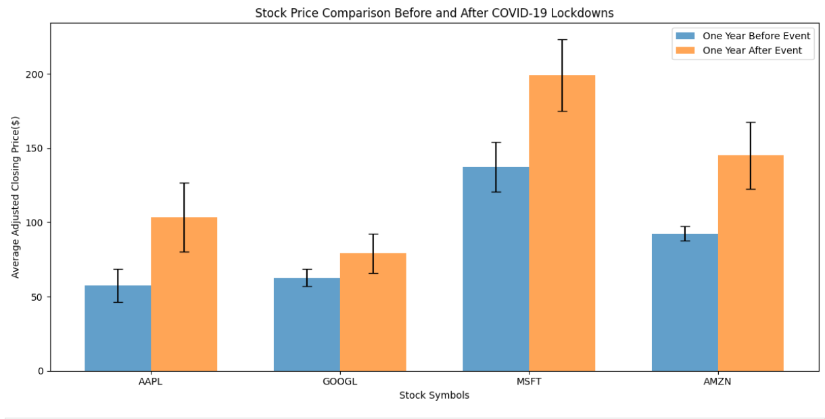
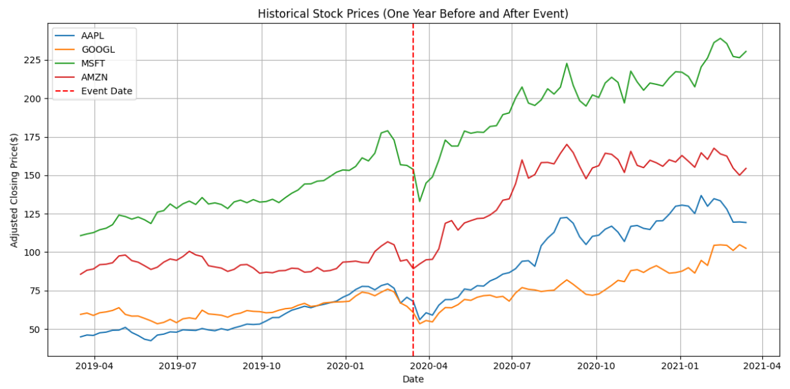
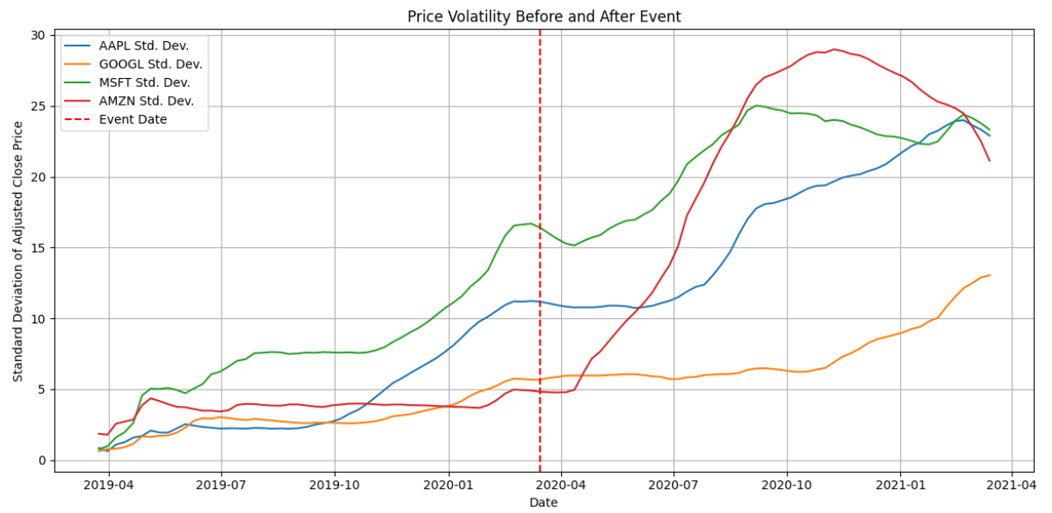
Progress
Notes:
Erste Daten zu Forschungsfragen

Slide 9
Next steps
Work on remaining questions
Optimize Visualizations
Answer research questions
Built website

Slide 10

Thanks
Any questions?

