Slide 1


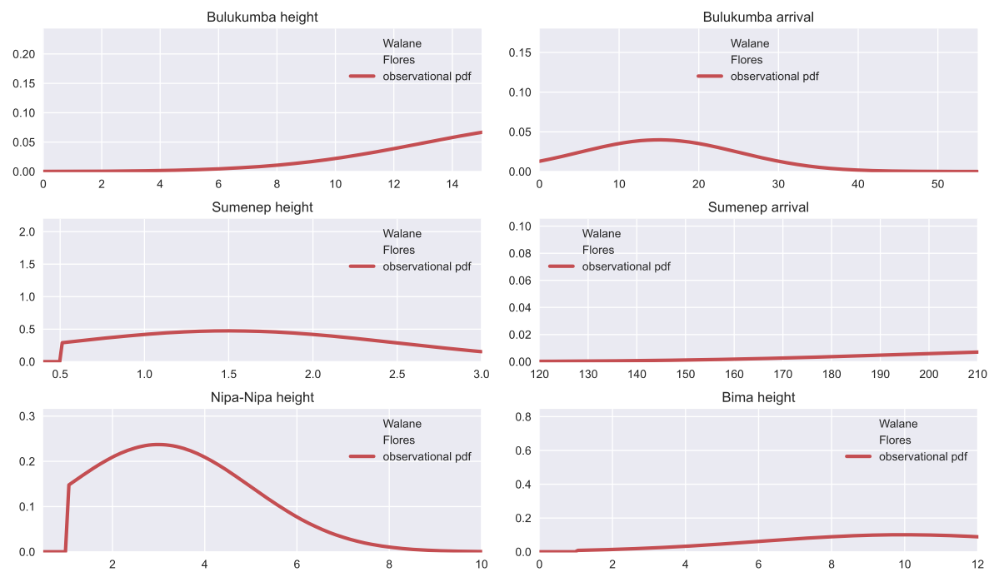
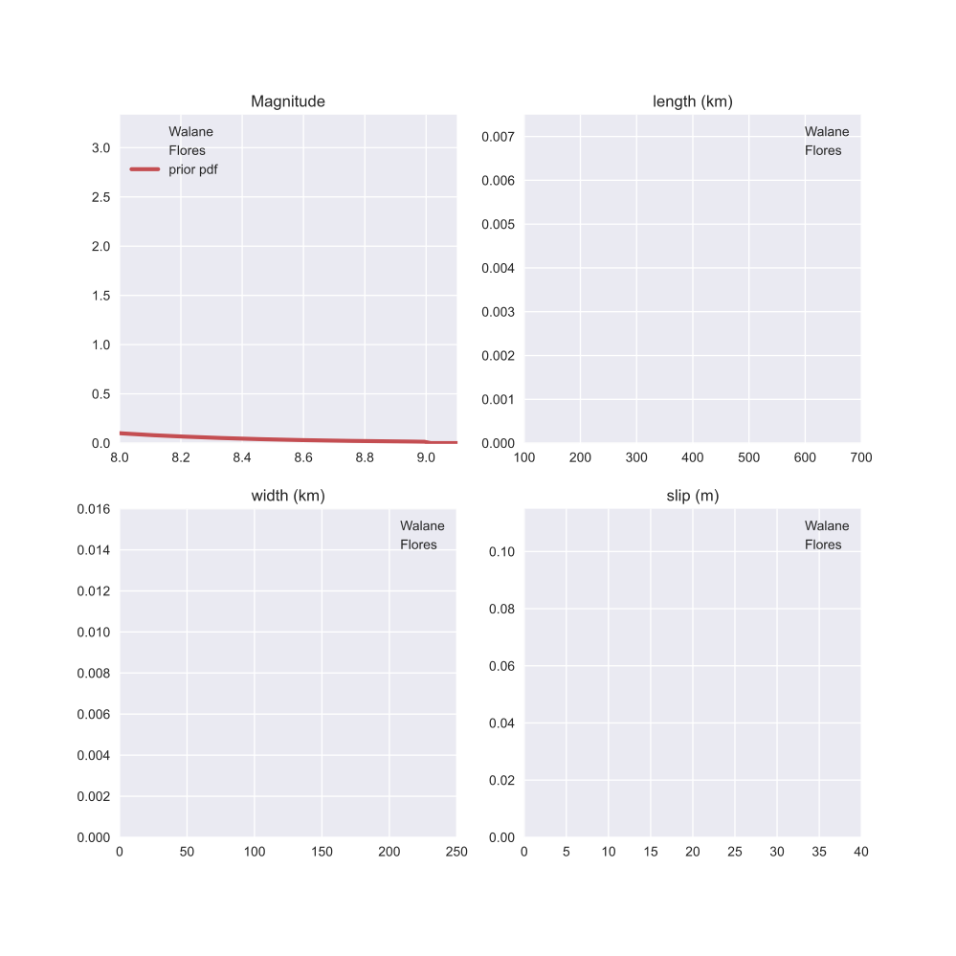
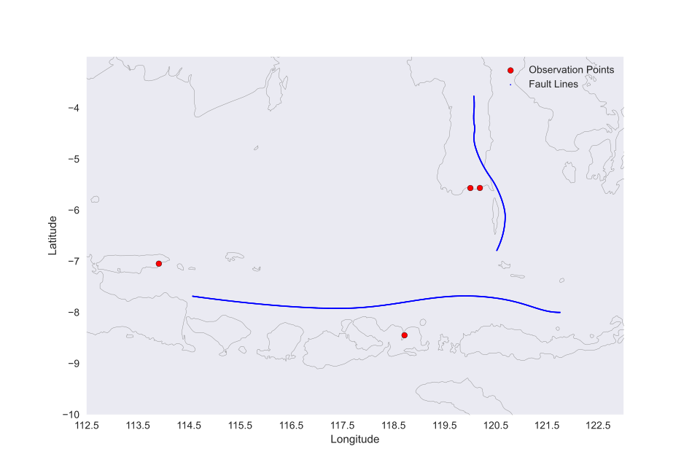
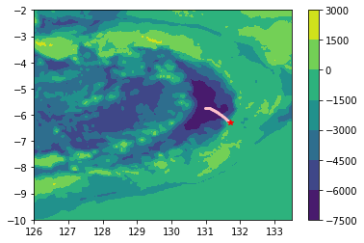
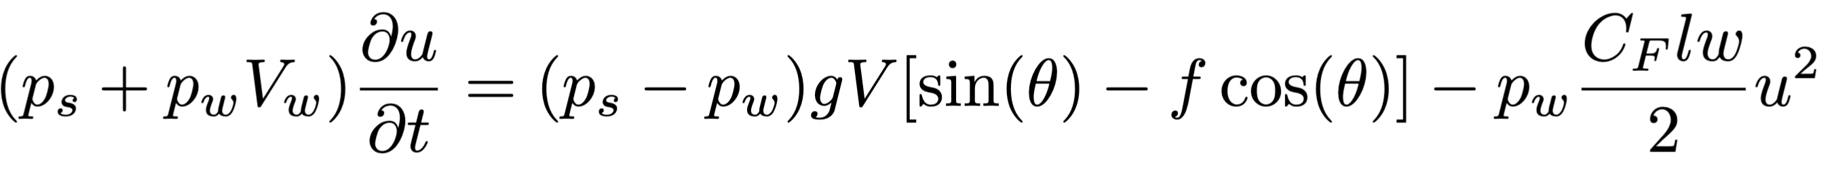
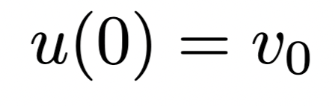
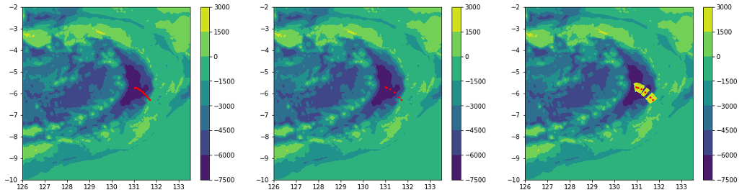
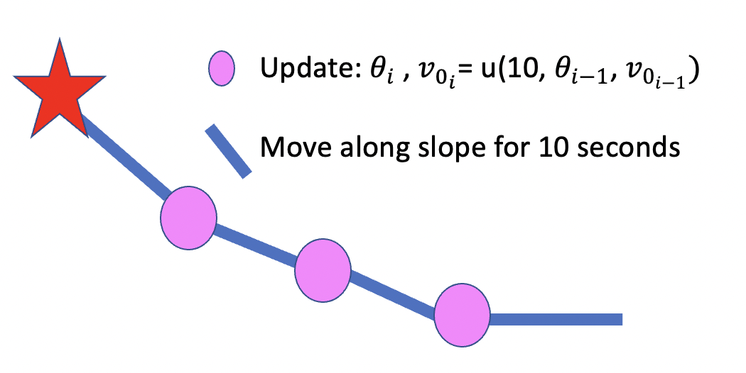
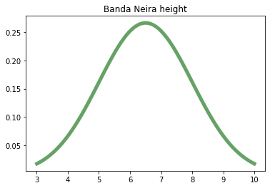
A catchy, very cool title
Names of all the important people who contributed, i.e. everyone in the group. The QR code can be used to link to a GitHub repo, animation, pdf copy of details etc..
Overview This is where you can put an abstract/brief description of the project
Keep in mind that you want the font size to be relatively large to make readability a maximum.
Describe what progress you made
What did you manage to do? You are allowed to report on mistakes and/or steps you took that did not pan out as well as on those that worked out well.
Optimal control theory is a powerful framework used in engineering, economics, and various other fields to design control strategies that optimize the performance of a system while adhering to specified constraints. At its core, optimal control seeks to find the control inputs that minimize or maximize an objective function, often representing a cost or utility associated with the system's behavior over time.
In engineering applications, optimal control plays a crucial role in designing efficient and robust control systems for complex dynamical systems. Whether it's guiding a spacecraft to its destination with minimal fuel consumption, stabilizing an aircraft during flight, or regulating the operation of industrial processes, optimal control techniques provide a systematic approach to achieving desired performance objectives while accounting for constraints such as energy limitations, safety requirements, and environmental considerations.
Figure 3: The layout here is just a suggestion. You can modify the figure placement, adjust the spacing etc.. The important thing is really to use a lot of figures.
In engineering applications, optimal control plays a crucial role in designing efficient and robust control systems for complex dynamical systems. Whether it's guiding a spacecraft to its destination with minimal fuel consumption, stabilizing an aircraft during flight, or regulating the operation of industrial processes, optimal control techniques provide a systematic approach to achieving desired performance objectives while accounting for constraints such as energy limitations, safety requirements, and environmental considerations.
In economics, optimal control is employed to study decision-making processes in dynamic systems, such as resource allocation, investment strategies, and policy design. By formulating mathematical models that represent the dynamics of economic systems and the objectives of decision-makers, economists can use optimal control theory to identify optimal policies that maximize social welfare, economic growth, or other desirable outcomes, taking into account factors like resource constraints, uncertainty, and competing objectives.
Overall, optimal control theory provides a rigorous framework for addressing a wide range of optimization problems in dynamic systems, offering insights and methodologies that are indispensable for tackling real-world challenges in diverse domains.
The problem
Describe the problem that you are considering
As the sun dipped below the horizon, casting hues of orange and pink across the sky, the quaint village came to life with the soft chatter of its inhabitants. Children chased each other through narrow cobblestone streets, their laughter echoing against the ancient stone walls. The scent of freshly baked bread wafted from the local bakery, enticing passersby with its warm embrace. In the distance, the sound of church bells rang out, signaling the end of another peaceful day in this idyllic countryside retreat.
As the sun dipped below the horizon, casting hues of orange and pink across the sky, the quaint village came to life with the soft chatter of its inhabitants. Children chased each other through narrow cobblestone streets, their laughter echoing against the ancient stone walls. The scent of freshly baked bread wafted from the local bakery, enticing passersby with its warm embrace. In the distance, the sound of church bells rang out, signaling the end of another peaceful day in this idyllic countryside retreat.
As the sun dipped below the horizon, casting hues of orange and pink across the sky, the quaint village came to life with the soft chatter of its inhabitants. Children chased each other through narrow cobblestone streets, their laughter echoing against the ancient stone walls. The scent of freshly baked bread wafted from the local bakery, enticing passersby with its warm embrace. In the distance, the sound of church bells rang out, signaling the end of another peaceful day in this idyllic countryside retreat.
As the sun dipped below the horizon, casting hues of orange and pink across the sky, the quaint village came to life with the soft chatter of its inhabitants. Children chased each other through narrow cobblestone streets, their laughter echoing against the ancient stone walls. The scent of freshly baked bread wafted from the local bakery, enticing passersby with its warm embrace. In the distance, the sound of church bells rang out, signaling the end of another peaceful day in this idyllic countryside retreat.
Figure 4: Very fascinating figure that catches your attention right away.
Figure 2: Lots of figures (high quality ones) is a good idea.
Conclusions and next steps
In the wake of unprecedented global challenges, the urgency for collective action has never been more apparent. Climate change continues to threaten ecosystems, exacerbating natural disasters and disrupting livelihoods. Socioeconomic inequalities persist, amplifying disparities in access to healthcare, education, and economic opportunities. Political tensions simmer, fueling conflicts and undermining international cooperation. In this complex landscape, fostering empathy, understanding, and resilience becomes paramount. It requires bold leadership, innovative solutions, and a shared commitment to address systemic issues at their root. The path forward demands courage, compassion, and collaboration, as we navigate the intricate tapestry of our interconnected world, striving to build a more just and sustainable future for generations to come.
Optimal control theory is a powerful framework used in engineering, economics, and various other fields to design control strategies that optimize the performance of a system while adhering to specified constraints. At its core, optimal control seeks to find the control inputs that minimize or maximize an objective function, often representing a cost or utility associated with the system's behavior over time.
In engineering applications, optimal control plays a crucial role in designing efficient and robust control systems for complex dynamical systems. Whether it's guiding a spacecraft to its destination with minimal fuel consumption, stabilizing an aircraft during flight, or regulating the operation of industrial processes, optimal control techniques provide a systematic approach to achieving desired performance objectives while accounting for constraints such as energy limitations, safety requirements, and environmental considerations.
In economics, optimal control is employed to study decision-making processes in dynamic systems, such as resource allocation, investment strategies, and policy design. By formulating mathematical models that represent the dynamics of economic systems and the objectives of decision-makers, economists can use optimal control theory to identify optimal policies that maximize social welfare, economic growth, or other desirable outcomes, taking into account factors like resource constraints, uncertainty, and competing objectives.
Overall, optimal control theory provides a rigorous framework for addressing a wide range of optimization problems in dynamic systems, offering insights and methodologies that are indispensable for tackling real-world challenges in diverse domains.
Figure 6:
Figure 5:
Equations can be added either directly or as snapshots from a Latex file
Figure 7: Make sure you label each figure and provide a descriptive caption
The approach
Describe what you are going to try and accomplish
Figure 1:
You want to use as many figures as you can in a poster
References
[1] Pelinovsky E, Poplavsky A. 1996 Simplified model of tsunami generation by submarine landslides. Phys. Chem. Earth 21, 13–17. (doi:10.1016/S0079-1946(97)00003-7)
You can either have a traditional list of references like this, or just a handful of QR codes that link to the DOI of the relevant articles.
[3] Hayden Ringer, et al. Methodological reconstruction of historical seismic events from anecdotal accounts of destructive tsunamis: a case study for the great 1852 banda arc mega-thrust earthquake and tsunami, 2021.
[4] Ron Harris and Jonathan Major. Waves of destruction in the East Indies: theWichmann catalogue of earthquakes and tsunami in the Indonesian region from 1538 to 1877. Geological Society, London, Special Publications, 441:SP441–2, 2016.

