Slide 1
Extopus
The Monitoring Aggregator
Tobias Oetiker <tobi@oetiker.ch>
OETIKER+PARTNER AG
www.oetiker.ch

Slide 2
MRTG won't die!

Slide 3
„A singe frontend capable of integrating the data of multiple monitoring systems“

Slide 4
Customer: “We need traffic charts in the portal”

Slide 5
Wide Selection of OSS Monitoring Tools

Slide 6
Web Interfaces from last century

Slide 7
Web 2.0

Slide 8
JavaScript

Slide 9
JavaScript ?

Slide 10
JavaScript !

Slide 11


Slide 12
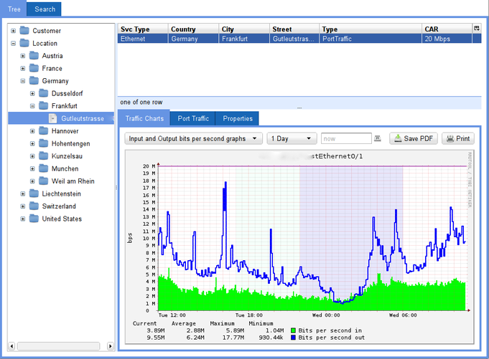

Slide 13
Tobi's OSS Secrets: Plugability and Visibility

Slide 14
demo: Extopus

Slide 15
JavaScript Qooxdoo Application running in the Browser
Perl Mojo Service
running on the Server
Visualizer Plugins
Visualizer Plugins
Inventory Plugins
Inventory Cache
BROWSER
SERVER

Slide 16
Name: Tobi
Location: Olten
ID: 39445
Type: Person
a “no-sql” problem
Port: en2
Service: Ethernet
Device: Cisco 871
Speed: 5Mb/s
Type: Port
Link: Olten-Zurich
Service: ICMP Ping
Device: Acer 334
Info: OS Status
Location: Bern
Year: 1993

Slide 17
Name: Tobi
Location: Olten
ID: 39445
Type: Person
With an SQLite solution
Port: en2
Service: Ethernet
Device: Cisco 871
Speed: 5Mb/s
Type: Port
Link: Olten-Zurich
Service: ICMP Ping
Device: Acer 334
Info: OS Status
Location: Bern
Year: 1993

Slide 18
Name: Tobi
Location: Olten
ID: 39445
Type: Person
Full text Search
JSON Encoding
Port: en2
Service: Ethernet
Device: Cisco 871
Speed: 5Mb/s
Type: Port
Link: Olten-Zurich
Service: ICMP Ping
Device: Acer 334
Info: OS Status
Location: Bern
Year: 1993

Slide 19
about tree building
Level0: “Location”
Level1: Country
Level2: Town
Level3: Street
Level0: “Type”
Level1: Brand
Level2: Model

Slide 20
Location
  Zurich
    Zollstrasse
    Universitätsstrasse
  Bern
    Bundesplatz
Type
  Cisco
    871
    875
  Juniper
    T320
    T640

Slide 21
Status
Today:
in production @ upc-cablecom
Now:
SIAM inventory
channeling torrus
Future:
porting SmokePing
integrating remOcular
connecting collectd, nagios

Slide 22
Tobi Oetiker <tobi@oetiker.ch>
www.remocular.org
www.oetiker.ch

