Slide 1


Slide 2
„A generic but cool web interface to UNIX command line tools“

Slide 3
Smokeping OSS Project

Slide 4
Customer wish: Traceroute for Call Center Engineers

Slide 5
Command Line = Raw Power

Slide 6
Web 2.0

Slide 7
JavaScript

Slide 8
JavaScript ?

Slide 9
JavaScript !

Slide 10


Slide 11
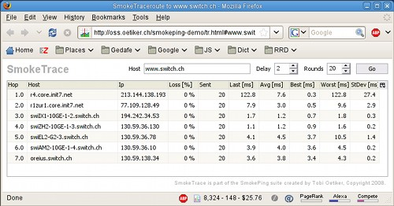

Slide 12
Tobi's OSS Secrets: Plugability and Visibility

Slide 13
demo: remOcular

Slide 14
JavaScript Qooxdoo Application running in the Browser
Perl Mojo Service
running on the Server
trace
route
top
iostat
vmstat

Slide 15
Plug-in architecture for OSS success

Slide 16
All brains in the Plug-In

Slide 17
Plug-In Object Methods
get_config
check_params
start_instance

Slide 18
Tobi Oetiker <tobi@oetiker.ch>
www.remocular.org
www.oetiker.ch

