Slide 1

Tobias Oetiker <tobi@oetiker.ch>
OETIKER+PARTNER AG
www.oetiker.ch

Slide 2
„A generic but cool web interface to UNIX command line tools“

Slide 3
Origin: Smokeping OSS Project

Slide 4
Customer: Give me Traceroute in the Browser
for Call Center Engineers

Slide 5
Command Line = Raw Power

Slide 6
Web 2.0

Slide 7
JavaScript

Slide 8
JavaScript ?

Slide 9
JavaScript !

Slide 10


Slide 11
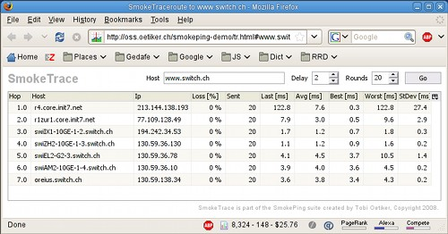

Slide 12
remOcular

Slide 13
demo

Slide 14
JavaScript Qooxdoo Application running in the Browser
Perl Mojo Service
running on the Server
trace
route
top
iostat
vmstat

Slide 15
Plug-in architecture for OSS success

Slide 16
All brains in the Plug-Ins

Slide 17
Plug-In Object Methods
get_config
check_params
start_instance

Slide 18
Tobi Oetiker <tobi@oetiker.ch>
www.remocular.org
www.oetiker.ch

