Slide 1


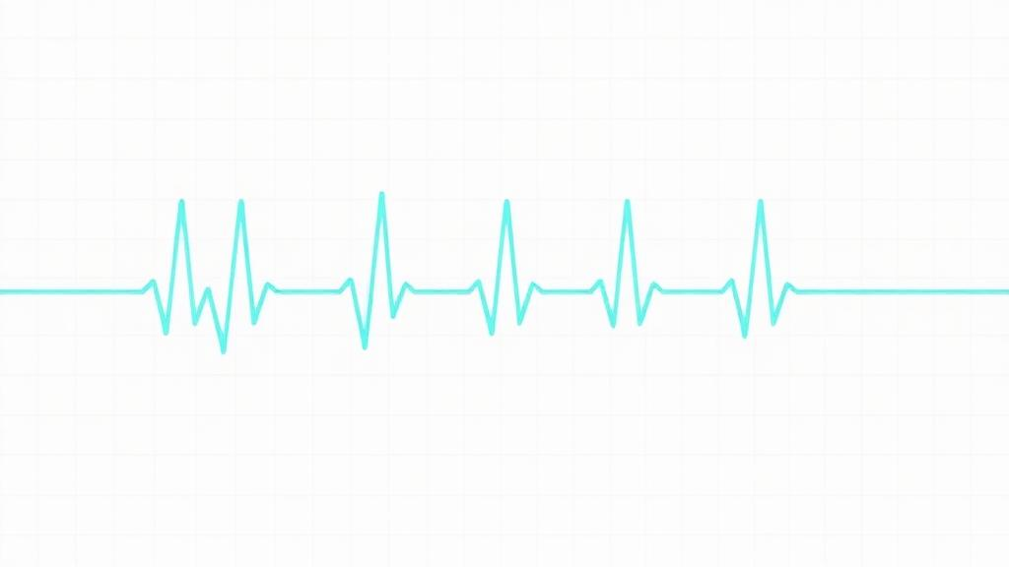

Automated ECG Heartbeat Categorization & Arrhythmia Detection
Utilizing Deep Learning Architectures (CNN vs. Bidirectional LSTM)
Technical Overview
Team
Dataset: MIT-BIH Arrhythmia Database (Kaggle via PhysioNet)
Hardware Acceleration: Google Colab NVIDIA T4 GPU Environment
Target Frameworks: TensorFlow 2.x / Keras / Scikit-Learn
Presented By:
Khalid Hussien Ahmed
Ehdaa Mohamed Hilal
Ahd Ali Mahmoud
Amr Ashraf Mohamed
Omar Ewis Ibrahim
July 2026
ECG Arrhythmia Detection — DEPI Final Project
1

Slide 2
Project Concept & Problem Statement
The Clinical Challenge
The Deep Learning Solution
The Problem: Cardiovascular diseases (CVDs) remain the leading cause of global mortality. Arrhythmias are often asymptomatic or transient, necessitating continuous monitoring.
The Bottleneck: Manual ECG interpretation is time-consuming, expensive, prone to human fatigue, and requires on-site cardiologists — 24/7 ICU monitoring is logistically unsustainable.
Automated Pipeline: End-to-end DL framework ingests raw single-lead ECG windows, segments them into beats, and classifies each heartbeat within milliseconds.
Real-Time Capabilities: The trained model operates as a continuous listener on streaming interfaces (e.g., serial connection), delivering instant telemetry.
Unique Value Proposition (UVP) Multi-Tiered Imbalance Strategy — standard models collapse on rare cardiac anomalies due to heavy data skewness. This project resolves severe class imbalance by simultaneously integrating Minority Oversampling, Class-Weighted Objective Functions, and custom Per-Class Threshold Tuning.
July 2026
ECG Arrhythmia Detection — DEPI Final Project
2

Slide 3
Project Architecture & Wireframe
End-to-End Data Pipeline
Automated User Journey
Streaming ECG Device / CSV Data Source
Sensor Ingestion: Patient electrodes capture electrical cardiac activity; data streams automatically to a localized or cloud-based server.
Instant Inference: The model evaluates each individual 187-point time-step array in real time.
Autonomous Alerting: If an anomaly (e.g., Ventricular Escape Beat) crosses the tuned decision threshold, the system triggers an instant alert for clinical staff.
Raw Time-Series: 187 Time Steps
Data Preprocessing
StandardScaler • Resampling • One-Hot Labels • Reshape (Samples,187,1)
1D-CNN Network
(4 Conv Blocks)
438,181 Params
vs
Bidirectional LSTM
(2 stacked layers)
80,261 Params
Custom Per-Class Threshold Sweep
Inference & Automated Alerting → Normal vs. Arrhythmia
July 2026
ECG Arrhythmia Detection — DEPI Final Project
3

Slide 4
End-User Personas & Key Features
Market & Clinical Stakeholders
Key System Features
Cardiologists & Physicians
5-Category Diagnostic
1
AI-powered diagnostic assistant for rapid pre-screening, flagging highly suspicious waveforms and reducing workload.
Robust classification across distinct medical heartbeat groups (N, S, V, F, Q).
Intensive Care Units (ICUs)
High-Fidelity Benchmarks
2
Tireless 24/7 background monitor for hospitalized patients, minimizing false negatives.
Achieved 96.05% Test Accuracy using the 1D-CNN architecture.
Wearable Health Technology
Optimized Medical Sensitivity
3
Embeddable engine for remote edge-devices (Holter monitors) to log ambulatory arrhythmia trends over 24–48 hours.
Fusion class precision boosted from 36.80% → 54.81% via specialized post-processing.
July 2026
ECG Arrhythmia Detection — DEPI Final Project
4

Slide 5
Data Structure & Imbalance Management
Dataset Specification
Class Distribution (Severe Skewness)
Source: MIT-BIH Arrhythmia Dataset (mitbih_train.csv & mitbih_test.csv)
Dimensions: Train — 87,554 | Test — 21,892 records
Feature Layout: 188 cols • Cols 0–186 = ECG amplitude (187 steps) • Col 187 = label (0–4)
ID | Clinical Category | Count | %
0 | N — Normal / Sinus | 72,471 | 82.77%
1 | S — Supraventricular | 2,223 | 2.54%
2 | V — Ventricular (PVC) | 5,788 | 6.61%
3 | F — Fusion | 641 | 0.73%
4 | Q — Unclassifiable / Paced | 6,431 | 7.35%
Critical Skew Ratio: Normal outnumbers the rare Fusion class by 113 : 1. Unmitigated training forces the model into a majority-class bias.
Imbalance Mitigation Framework
Data Resampling: sklearn.utils.resample synthetically augments minority sample counts before optimization loops.
Algorithmic Weighting: compute_class_weight dynamically penalizes minority misclassifications more harshly in cross-entropy loss.
Optimal Threshold Tuning: Multi-variate search — Normal 0.35 | Supraventricular 0.90 | Fusion 0.90.
Result: Pushed the overall Macro F1-Score to 88.80%.
July 2026
ECG Arrhythmia Detection — DEPI Final Project
5

Slide 6
Technology Stack & Deep Learning Architectures
Software Ecosystem
Language
Python 3.x
1D-CNN Blueprint (CNN_ECG_Fixed)
Total Params: 438,181 (Trainable)
Design: 4 sequential Conv1D blocks + BatchNorm, MaxPooling1D, Dropout (0.2).
Aggregation: GlobalAveragePooling1D → 5-way Softmax Dense.
Optimization: Adam (α = 1e-3) with EarlyStopping & ReduceLROnPlateau.
DL Platform
TensorFlow 2.x • Keras API
Scientific
NumPy • Pandas • Scikit-Learn
Visualization
Matplotlib • Seaborn
Bidirectional LSTM Blueprint (LSTM_ECG_Model)
Total Params: 80,261
Design: Dual-stacked Bidirectional LSTM (64 units each) capturing forward and backward temporal dependencies across 187 time-steps.
July 2026
ECG Arrhythmia Detection — DEPI Final Project
6

Slide 7
Evaluation Metrics & Live Test Performance
The 1D-CNN outperformed the Bidirectional LSTM across all primary metrics due to its capacity to extract translation-invariant spatial patterns from fixed ECG shapes.
Model | Accuracy | Precision (W) | Recall (W) | F1 (W)
1D-CNN (Base) | 96.05% | 97.52% | 96.05% | 96.56%
Bidirectional LSTM | 83.44% | 92.55% | 83.44% | 86.46%
Un-Tuned CNN Per-Class Performance
Class | Prec. | Recall | F1 | Support
0 — Normal | 99.58% | 96.14% | 97.83% | 18,118
1 — Supraventricular | 53.97% | 89.21% | 67.25% | 556
2 — Ventricular | 95.92% | 94.06% | 94.98% | 1,448
3 — Fusion | 36.80% | 93.83% | 52.87% | 162
4 — Unknown | 97.02% | 99.38% | 98.19% | 1,608
Post-Threshold Optimization Enhancements (CNN)
Supraventricular Precision: rose sharply to 80.69%
Fusion (rarest) Precision: climbed to 54.81%
Overall Optimized Macro F1-Score: stable at 88.80%
July 2026
ECG Arrhythmia Detection — DEPI Final Project
7

Slide 8
Strategic Threshold Optimization
METHODOLOGY
OPTIMAL THRESHOLD VECTOR
Beyond Default Argmax
Standard Softmax picks the highest raw probability — biasing toward the majority Normal class and missing rare arrhythmias.
Normal (N)
0.35
Supraventricular (S)
0.90
Custom Decision Boundaries
A multivariate grid-search sweep across 288+ combinations calibrates distinct cutoffs for the minority classes S and F.
Ventricular (V)
0.45
Fusion (F)
0.90
MATHEMATICAL CALIBRATION
Adjusted P = Raw Probabilities ÷ Threshold Vector
Unknown / Paced (Q)
0.45
c
ECG Arrhythmia Detection — DEPI Final Project
8

Slide 9
CNN Test Performance Matrix
FINAL PERFORMANCE · FOCAL LOSS + SMOTE + TUNING
Medical Class
Precision
Recall
F1
Support
97.52%
Test Accuracy
0.8355
Macro F1
0.9768
Weighted F1
Normal (N)
0.9948
0.9793
0.9870
18,118
Supraventricular (S)
July 2026
0.6640
0.8885
0.7600
556
Ventricular (V)
0.9539
0.9434
0.9486
1,448
Diagnostic Gains
Fusion (F)
0.5814
0.9259
0.7143
162
● Precision boost: S → 66.40%, F → 58.14% after tuning.
● High-sensitivity safeguard: Recall 88.85% (S) & 92.59% (F) — eliminating false negatives.
Unknown / Paced (Q)
0.9834
0.9925
0.9879
1,608
July 2026
ECG Arrhythmia Detection — DEPI Final Project
9

Slide 10
System Deliverables & Project Artifacts
Production-Ready Deliverables
Project Execution Roadmap
Source Code
Milestone 1
Exploratory Data Analysis & Class-Skew Inspection
1
Fully verified Jupyter Notebook, structured into clean reproducible milestones.
Serialized Model
Milestone 2
Pipeline Dev, Z-score Normalization & Resampling
2
Trained network exported as cnn_ecg_final.keras (native Keras format).
Parameter Weights
Milestone 3
Parallel Prototyping of 1D-CNN & Bi-LSTM
3
Portable structural file cnn_weights.weights.h5 for distributed deployment.
Analytical Artifacts
Milestone 4
Validation, Confusion Matrix & Threshold Tuning
4
Training history curves (loss/accuracy) and multi-class confusion matrices.
July 2026
ECG Arrhythmia Detection — DEPI Final Project
10

Slide 11
Team Roles & Collaborative Workflow
Cross-Functional Team Assignments
Data & Preprocessing Engineer
ML Engineer — CNN Lead
1
2
Managed Kaggle API ingest, dataset segregation, scaling, and resampling strategies.
Designed CNN_ECG_Fixed, tuned regularization, and built the multi-variate threshold sweep.
ML Engineer — RNN Lead
Data Analyst & Reporter
3
4
Constructed the Bidirectional LSTM prototype and led comparative model evaluations.
Compiled visualization metrics, tracked loss behaviors, and prepared documentation.
Collaborative Development Framework
Environment: Synchronized runtime via Google Colab T4 GPU instances.
Version Control: Managed source code tracking and pipeline merges.
Methodology: Iterative sprints — each milestone a self-contained deliverable with verifiable metrics before final serialization.
July 2026
ECG Arrhythmia Detection — DEPI Final Project
11

Slide 12
Conclusion & Open Discussion
Summary of Achievement
Developed a high-reliability, automated deep learning pipeline capable of parsing continuous raw ECG streams into distinct clinical diagnostics with 96.05% Accuracy, successfully engineering around massive class imbalances to preserve minority-class detection integrity.
Open Questions & Technical Inquiries
We welcome any technical evaluation or feedback from the committee.
Thank You
July 2026
ECG Arrhythmia Detection — DEPI Final Project
12

